Slide 1
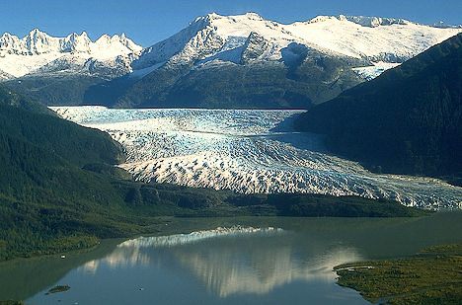


S-TEK Subcommittee Meeting
March 16, 2016
We will start at 10:00 Pacific/9:00 Alaska Time
Scheduled for approx. 1.5 hrs.
Phone #: 866-628-1318
Passcode: 6959549
  nplcc.org

Slide 2

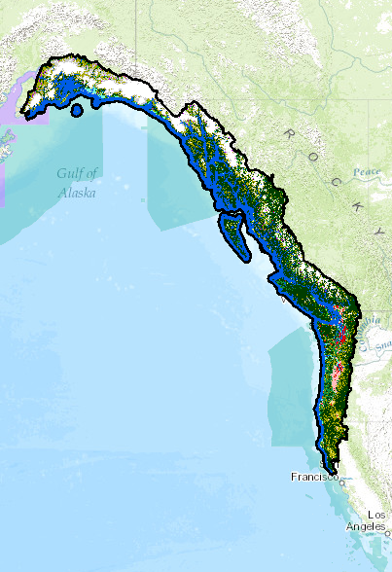
Draft Agenda
General Updates
CPA V.2
Fire Regime/Climate Change/Tribes
RFP/Other potential projects
2017-2021 S/TK Strategy - Initial Framing Questions
Group Sharing
  nplcc.org

Slide 3
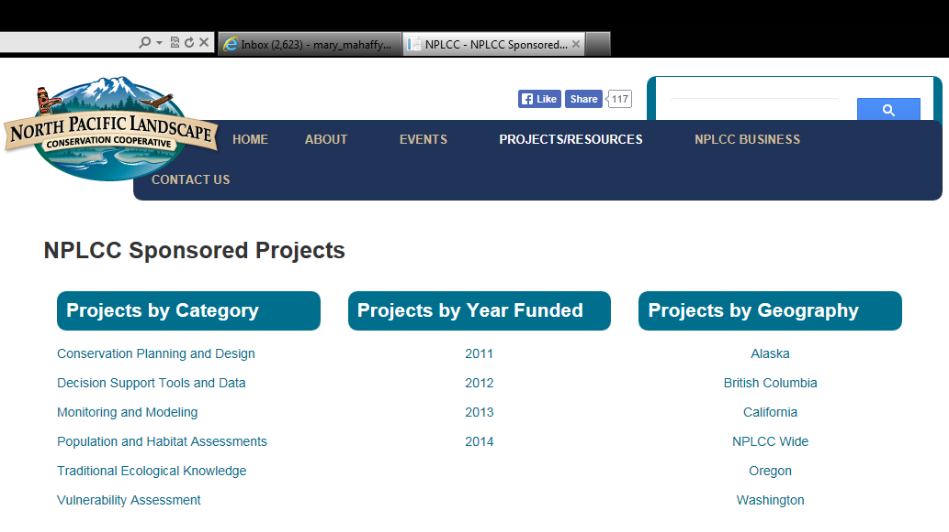
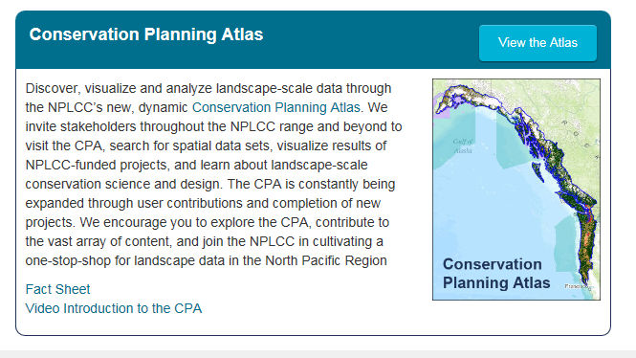
CPA: Proposed Version 2 - Tom Miewald

Slide 4
Draft Agenda
General Updates
CPA V.2
Fire Regime/Climate Change/Tribes
RFP/Other potential projects
2017-2021 S/TK Strategy - Initial Framing Questions
Group Sharing
  nplcc.org

Slide 5
Original NPLCC Mission:
The North Pacific Landscape Conservation Cooperative promotes development, coordination and dissemination of science to inform landscape level conservation and sustainable resource management in the face of a changing climate and related stressors.
Proposed New NPLCC Mission
In the face of a changing climate and other landscape-scale stressors, the North Pacific Landscape Conservation Cooperative supports development and application of useful science; we coordinate and disseminate that science; and we serve as a convener to further collaborative efforts to inform and advance landscape-scale conservation and sustainable resource management.

Slide 6
Proposed New NPLCC Goals:
Maximize the ability of natural and cultural resource managers to make informed landscape-level conservation/sustainable resource management decisions by understanding their conservation challenges and providing practical and useable information and solutions (Informing Management Decisions)
Identify trans-boundary landscape-level natural and cultural resource opportunities for (and barriers to) landscape-level conservation/sustainable resource management that the LCC is uniquely qualified to address. (Unique role of LCC)
Promote identification, open-access, use, and sharing of science, traditional knowledge and other relevant information to determine priorities for applied science. (Use/Access of information)
Promote awareness and understanding of the work of the NPLCC (partnerships and products); and the effects of climate change on ecosystems, resources, cultures, and economies. (Outreach)

Slide 7
Next S-TEK Meeting
April 28, 2016
Seattle (at EPA)
9:00 a.m. – 3:30 p.m.
  nplcc.org

