Slide 1
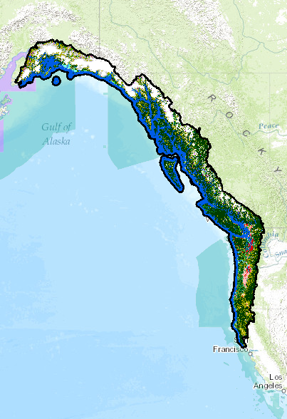


S-TEK Subcommittee
Meeting
January 26, 2016
Mary Mahaffy – Science Coordinator
  nplcc.org

Slide 2
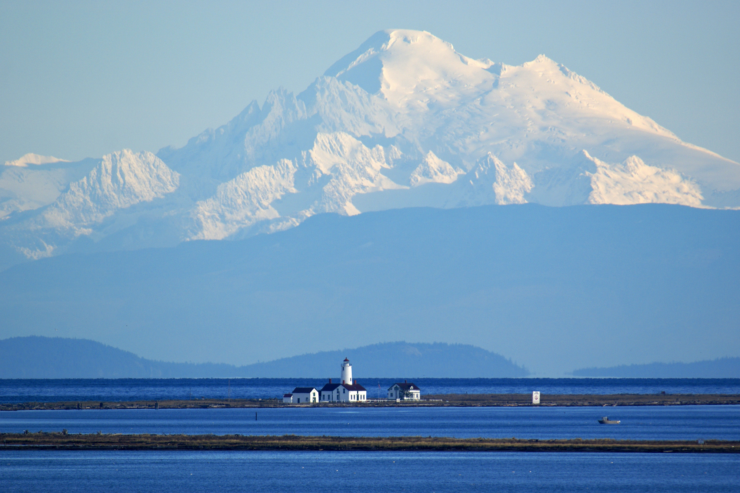
Draft Agenda
National Updates - National Academy of Science review
Request for Pre-proposals
Steering Committee updates (Juneau, Dec. 3-5)
Update other NPLCC activities
Discussion 2017-2022 Science/Traditional Knowledges Strategy
Round Robin
Schedule next 2 meetings
  nplcc.org

Slide 3
National Academy of Science Review
Overall positive review – Nation needs to take a landscape approach to conservation and addressing this need with LCCs is justified.
Unique
Improved coordination with Joint Ventures and LCCs
LCC and CSC programs need to be more clearly delineated
LCCs should improve its evaluation process; establishment of metrics should be a high priority
Important to recognize accomplishments made in last 5 yrs.
  nplcc.org
Notes:
Unique – no other program designed to address landscape conservation needs at a national scale for all natural and cultural resources; a way that bridges research and management efforts
Joint Ventures & LCCs – limited state capacity
LCCs and CSCs – explicitly stat how their research efforts differ and how they complement each other. ID and build on existing examples of coordination across the network
Improve evaluation process to better capture the contributions made by all partner agencies or groups toward common objectives. In particular to demonstrate the effectiveness of individual LCCs and the LCC Network.

Slide 4
Request for Pre-Proposals
Pre-Proposals due March 18
Posted on NPLCC Website (http://northpacificlcc.org/Resources/Funding)
“Develop/improve information on how climate change and associated adaptation actions will affect linkages between ecological and human resources (including tribal and First Nations subsistence activities and cultural resources)”
Full proposals due May 18th
Reviewers needed for Pre-proposals (please email me)
  nplcc.org

Slide 5
December Steering Committee Meeting
5-year Strategy – broader mission, fewer goals
Partner Needs – Small group highlights
  Increase profile of NPLCC in B.C.
  Tribal participants noted that structural issues still important to address
  Range-wide analysis of yellow cedar; Multi-dimensional look; Convene diverse group across NPLCC to discuss yellow cedar decline
  Potentially have a focus on fire for S-TEK ecological consideration; Social science
  nplcc.org
Notes:
BC and Canada are paying more attention to LCCs now so NPLCC is in a good position to gain momentum; incorporate more Canadian agencies
Tribal – convening parties and getting them to agree on their goals can be difficult. Strength is the NPLCC’s broad approach. Voluntary aspect can make it difficult to meet goals and interferes with LCC’s ability to capitalize on their strength
Recommendation to work with Alaska Coastal Rainforest Center on creating a forum session for yellow cedar (possibly other cedar species as well)
Changing fire patterns mean that traditional burning patterns are impacted. Question about what N{PLCC could do regarding social science ,particularily in terms of connecting NPLCC products with public and understand where general public stands on these issues.

Slide 6
2016 S-TEK Implementation Plan
New Activities/ Projects | Timing & Funding Mechanism
1. Data and information synthesis and sharing. Identify, compile, collate, and integrate existing data and information concerning climate impact data and modeling, monitoring networks, TEK etc. | 2015 and 2016 Contracts/ Agreements/ Salary
2. Support the use of vulnerability assessments and resilience studies in adaptation planning and implementation | 2015 and 2016 Contracts/ Agreements
3. Conduct, support, or facilitate landscape-scale conservation exercise(s) in a particular geography or region | 2015 and 2016 Contracts/ Agreements/ Salary
4. Develop / improve information on how climate change and associated adaptation actions will affect linkages between ecological and human resources (including tribal and First Nations subsistence activities and cultural resources) | 2016 Agreements RFP Pre-proposals

Slide 7

Metrics Adopted by Steering Committee:
Objective A: Identify decision-relevant information needs associated with understanding how changes in [stressor] will affect [resource]
Do we have a list of information needs (and when was the list last received or updated?
Number of unique stakeholders participating in list development (and percent of NPLCC geography covered by those participants)
Percent of identified needs on the list that are “well characterized” in terms of what the info will be used for (and the detailed characteristics of each information need)

Slide 8
Metrics Adopted by Steering Committee:
Objective B: Where appropriate, develop, support, and/or provide that information (metrics 4-7) to decision makers in a manner that can be used for promoting and informing decisions (metrics 8-9)
Number of items on the list that have been addressed with projects?
Diversity of projects funded (counts by entity type, project, type, geography, etc.)
Number/percent of projects that met their deliverable requirements (if not, why not)
Counts of project deliverables by type (publications, webinars, participants, etc.)

Slide 9
Metrics Adopted by Steering Committee:
Objective B: Where appropriate, develop, support, and/or provide that information (metrics 4-7) to decision makers in a manner that can be used for promoting and informing decisions (metrics 8-9).
Number of projects that included direct interaction with intended end-users of information prior to project finalization (and details and results of those interactions)
For each project, success or impact stories (or perspective on why results were not used) 6 months to 1 year after project completion

Slide 10
Metrics Adopted by Steering Committee:
Goal: Inform policy, management decisions, and actions of resource managers to support ecosystem functions and provide for conservation and sustainable cultural, subsistence, recreational, and commercial use of [priority resource] in light of projected changes [due to stressor].
Citation counts for references to NPLCC-produced work in key partner planning documents

Slide 11
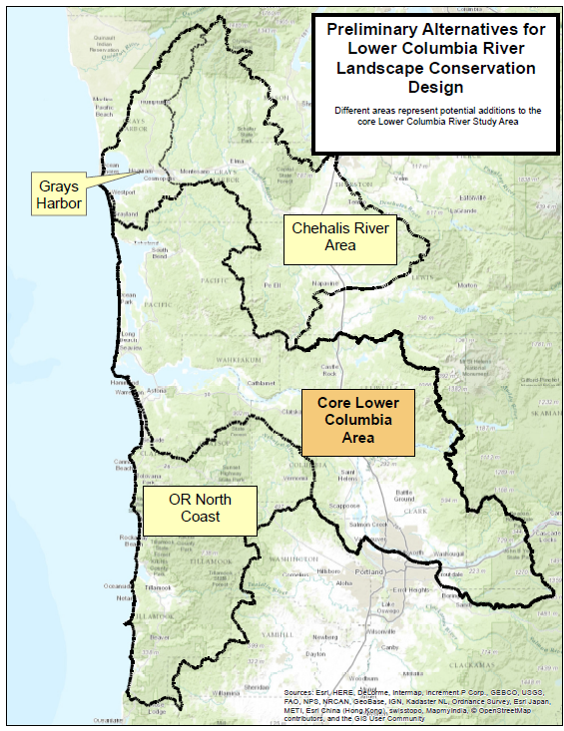
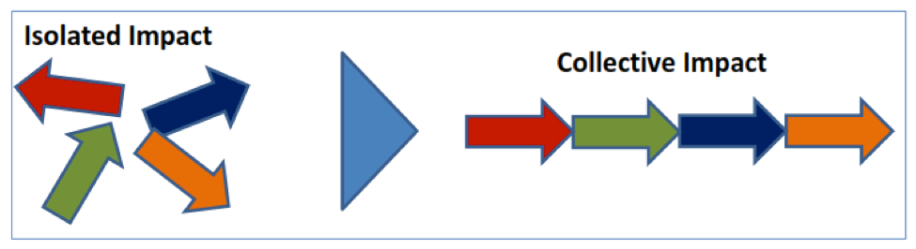
Lower Columbia/Coastal WA/OR Landscape Conservation Blueprint
Phase I
  Convene Partners/Stakeholders
  Identify Core Team & Technical Advisors
  Clarify common interests/goals
Phase II
  Assess the Landscape
  Prioritize Places and Actions
Isolated Actions
Collective Actions
https://sites.google.com/site/lowercolumbiariverlcd/home
Notes:
First Core Team Meeting was Jan. 20th
FY 15 extra funds to Pacific Birds Joint Venture start assessment work
Non-regulatory
Holistic look at landscape
Collaborative, Partner-Driven
Build from Existing Planning and Science
Focus on needs for collaborative conservation
Synthesis of landscape science and planning efforts.
Assessment landscape scale stressors, including climate change
Shared Data and Information
Spatial Prioritization
Shared Strategies

Slide 12
Other NPLCC Projects:
Kenai Conservation Blueprint
  Working with Kenai NWR and Kenai Watershed Forum
  Initiate meetings in Winter/Spring
Southeast Alaska Workshop
  Climate Change in SE Alaska – Informing Sustainable Management of Water Resources and Anadromous Fisheries
  April 12 – 15; Juneau

Slide 13
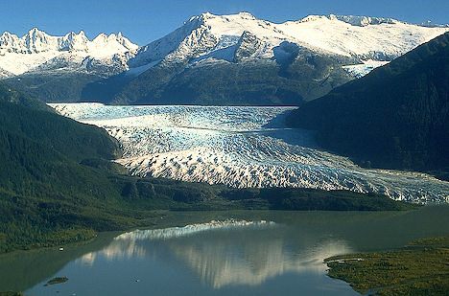
S-TK Strategy 2017 - 2021
  nplcc.org

Slide 14
Original NPLCC Mission:
The North Pacific Landscape Conservation Cooperative promotes development, coordination and dissemination of science to inform landscape level conservation and sustainable resource management in the face of a changing climate and related stressors.
NPLCC 5-Year Strategic Plan: 2016-2021
In the face of a changing climate and other landscape-scale stressors, the North Pacific Landscape Conservation Cooperative supports development and application of useful science; we coordinate and disseminate that science; and we serve as a convener to further collaborative efforts to inform and advance landscape-scale conservation and sustainable resource management.

Slide 15
Original NPLCC Goals (Total 7):
Maximize the ability of partners to make informed decisions with respect to conservation and sustainable resource management of priority natural and cultural resources subject to climate change and related large-scale stressors in the NPLCC region. (Conservation and restoration)
Identify and address trans-boundary landscape-level natural and cultural resource information needs that the LCC is uniquely qualified to address -- including the identification of opportunities for (and barriers to) landscape-level conservation/sustainable resource management. (Unique role of LCC)
Identify priorities for applied science and other information for conservation/sustainable resource management. Coordinate efforts with the relevant Climate Science Centers and other research entities to help inform research priorities. (Information priorities)
Promote identification, use, and sharing of science, traditional knowledge and other relevant information to support conservation/sustainable resource management, and adaptive management decisions. (Use of information)

Slide 16
Original NPLCC Goals ( Total 7):
Maximize the availability and accessibility of data and information about large-scale stressors and their impacts on natural and cultural resources, and about conservation/sustainable resource management approaches and effectiveness. (Availability of information)
Promote coordination and efficiency of efforts among resource managers and science entities that are addressing science, traditional knowledge and other relevant information to achieve landscape level conservation/sustainable resource management. (Coordination)
Promote awareness and understanding of NPLCC and its products for landscape-level conservation and the effects of climate change on ecosystems, resources, cultures, and economies. (Outreach)

Slide 17
New 5-year Strategy Goals (Total 4):
Maximize the ability of natural and cultural resource managers to make informed landscape-level conservation/sustainable resource management decisions by understanding their conservation challenges and providing practical and useable information and solutions (Informing Management Decisions)
Identify trans-boundary landscape-level natural and cultural resource opportunities for (and barriers to) landscape-level conservation/sustainable resource management that the LCC is uniquely qualified to address. (Unique role of LCC)
Promote identification, open-access, use, and sharing of science, traditional knowledge and other relevant information to determine priorities for applied science.. (Use/Access of information)
Promote awareness and understanding of the work of the NPLCC (partnerships and products); and the effects of climate change on ecosystems, resources, cultures, and economies. (Outreach)

Slide 18

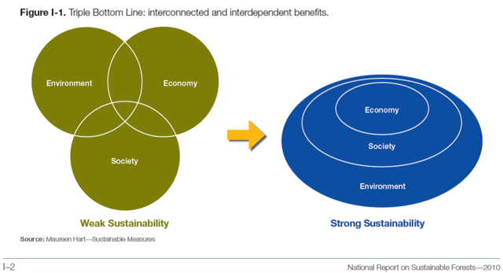
Social-Ecological Systems
Notes:
18

Slide 19
2013-2016 Science/TEK Strategy
Guiding Principles | Priority Topics
In annual implementation planning, and in the activities it supports, the NPLCC will: Focus on helping managers understand the availability and effectiveness of adaptation and mitigation response actions Focus on facilitating coordination, collaboration, and capacity building, and on developing or assisting with tools to assist decision-makers Identify and promote opportunities to use TEK to inform partner and stakeholder decisions Promote and facilitate consideration of the connections and interactions between ecosystems | Effects of hydrologic regime shifts on rivers, streams, and riparian corridors Effects of change in air temperature and precipitation on Forests Effects of changes in sea levels and storms on marine shorelines, the nearshore and estuaries Effects of the changes in the hydrologic regime on anadromous fish Invasive species, diseases, pests and their effects on biological communities

Slide 20
Round Robin
  nplcc.org

Slide 21
Likely Steering Committee Meetings
April: Call
June: In-person (Portland area; possible w/ GNLCC)
Fall (Oct./Nov.): In-person (B.C.)
S-TEK Meetings
March (15 & 16 best days; in-person or hubs?)
  FY 16 spending priorities; new 5-year S-TK Strategy
April (in-person or hubs?; Haven’t checked dates yet)
  FY 16 spending priorities; new 5-year S-TK Strategy
May (4, 5, 19 best days, check later dates?; in-person or hubs?)
  Draft 5-year S-TK Strategy
  nplcc.org

