Slide 1







NPLCC FY14 Projects
and
Project Management/ Accountability & Relevance
S-TEK Committee Mtg.
March 13, 2014

Slide 2
From 2014 Implementation Plan Table 2 (part) | Priority Topics | Likely Funding Mechanism
1. Augment, integrate, and share existing S-TEK data and information |  | Salary/Agreement/ Contract
1.1 Conservation Planning Atlas – spatial data | All
2. Align and coordinate the delivery of Science and TEK with decision-maker needs |  | RFP
2.5 Synthesize information existing work | B, C or E
3. Identify S-TEK information necessary support large-scale planning and management efforts |  | Agreement/ Contract
4. Incorporate climate information into line management activities |  | RFP
4.2 Habitat conservation and restoration planning | B or E
4.4 Planning and adaptation actions | Any
5. Joint support for partner-initiated projects (TBD)

Slide 3
2014 Request for Pre-Proposals Actions
All Actions – Work with Decision-makers
Action 2.5
Synthesize information existing work related to species, ecosystem or ecosystem service/characteristic in different geographic locations to inform common factors affecting that resource across a broader geography and issues that may be unique to that one geography. (Priority Topics: B, C or E)
Action 4.2
Assist with incorporating climate change info into habitat restoration, adaptation or enhancement (Priority Topics: B or E)
Action 4.4
Assist with incorporating climate change information into natural resource management through linking actions to key climate impacts, vulnerabilities or adaptation options. (Priority Topics: Any)

Slide 4

FY 2014 Pre-Proposals
Action | 2.5 | 4.2 | 4.4 | Total
# Pre-proposals | 19 | 19 | 22 | 60
Distribution
NPLCC | 4 | 1 | 1 | 6
AK | 3 | 1 | 3 | 7
BC | 4 | 5 | 9 | 18
WA | 6 | 6 | 8 | 20
OR | 7 | 9 | 5 | 21
CA | 6 | 4 | 1 | 11
Tribes/First Nations | 1 | 4 | 9 | 14
Priority Topics
A - Streams |  |  | 7 | 7
B - Forests | 11 | 10 | 7 | 28
C - SLR / Storms | 3 | 9 | 5 | 17
D - Anadromous fish |  |  | 7 | 7
E - Invas, pests, disease | 9 | 2 | 2 | 13
Across Topics |  |  | 4 | 4
Notes:
4.4 – 9 out of 22 proposed by First Nations or Tribe
4.4 – 1 pre-proposal was 3 pages, limit 2 pages so only read first 2 pages – OK not score well based on what you have read

Slide 5
Full Proposals Requested (From 2014 RFP)
Pre-proposal | Geographic Area | Priority Topics | Title | Amount Requested ($)
Action 2.5
2.5-13_BCMFLNRO_Floyd | BC & AK | B | Floyd (Snow-cover, soil drainage and yellow cedar decline in BC and SE Alaska) | 50,000
Action 4.2
4.2-16_PSU_Pincus | OR | B | Incorporating climate change into compliance based Riparian restoration initiative investment planning | 15,508
4.2-12_DU Canada _Harrison | BC | C | Modeling the effects of sea level rise to prioritize BC estuaries for conservation | 50,000
4.2-11_Cascadia Geosciences_Leroy | CA | C | Effects of relative sea level changes and storms on the Humboldt Bay Estuary | 40,000
Action 4.4
4.2-10_WDFW_Quinn | WA | D | Applied Case Study to integrate climate change science into culvert design for WDFW& Partners | 45,000
4.2-11_USFS_Peterson | OR | B | Implementing Climate-smart resource management across multiple ownerships in SW OR | 50,000
4.4-13_CDAECP_Arcese | BC, WA & OR | B; E | Cross Boundary planning for resilience and restoration of Endangered Oak savanna and Coastal Douglas-fir Forest Ecosystems | 50,000
4.4-09_Nooksack_Grah | WA | A; D | Climate Change Impacts on Nooksack River Hydrology | 50,000
 |  |  | Total Requested: Approx. $350,000
Notes:
Review open to everyone on S-TEK or their designees - 15 reviewers
5-8 reviewers each pre-proposals
Coastal Douglas-fir and Associated Ecosystems Conservation Partnership )co-chaired by The Nature Conservancy of Canada

Slide 6
Next Steps:
Full Proposal Review (9 total – up to 6 pages each):
  April 1 – April 15 review
  Need minimum 3 reviewers for each proposal, 5 criteria
  S-TEK members (review 3 or more proposals – please contact Mary with your best fit)
  Min. 1 specialized technical reviewer each proposal (you may fit the role for some of the proposals)
Notes:
4.4 – 9 out of 22 proposed by First Nations or Tribe
4.4 – 1 pre-proposal was 3 pages, limit 2 pages so only read first 2 pages – OK not score well based on what you have read

Slide 7
Next Steps:
Hopefully we will have budget by beginning April
Discuss other project priorities:
  CPA enhancement
  Interactive Map (started by Patricia Tillman)
  FY13 prior project commitments
  Potential additions to past projects to improve management use of products
  Potential other FY 14 full proposals developed (likely not; however, depends on available funding)
Present recommendations to Steering Committee at April 22-24 meeting
Notes:
4.4 – 9 out of 22 proposed by First Nations or Tribe
4.4 – 1 pre-proposal was 3 pages, limit 2 pages so only read first 2 pages – OK not score well based on what you have read

Slide 8
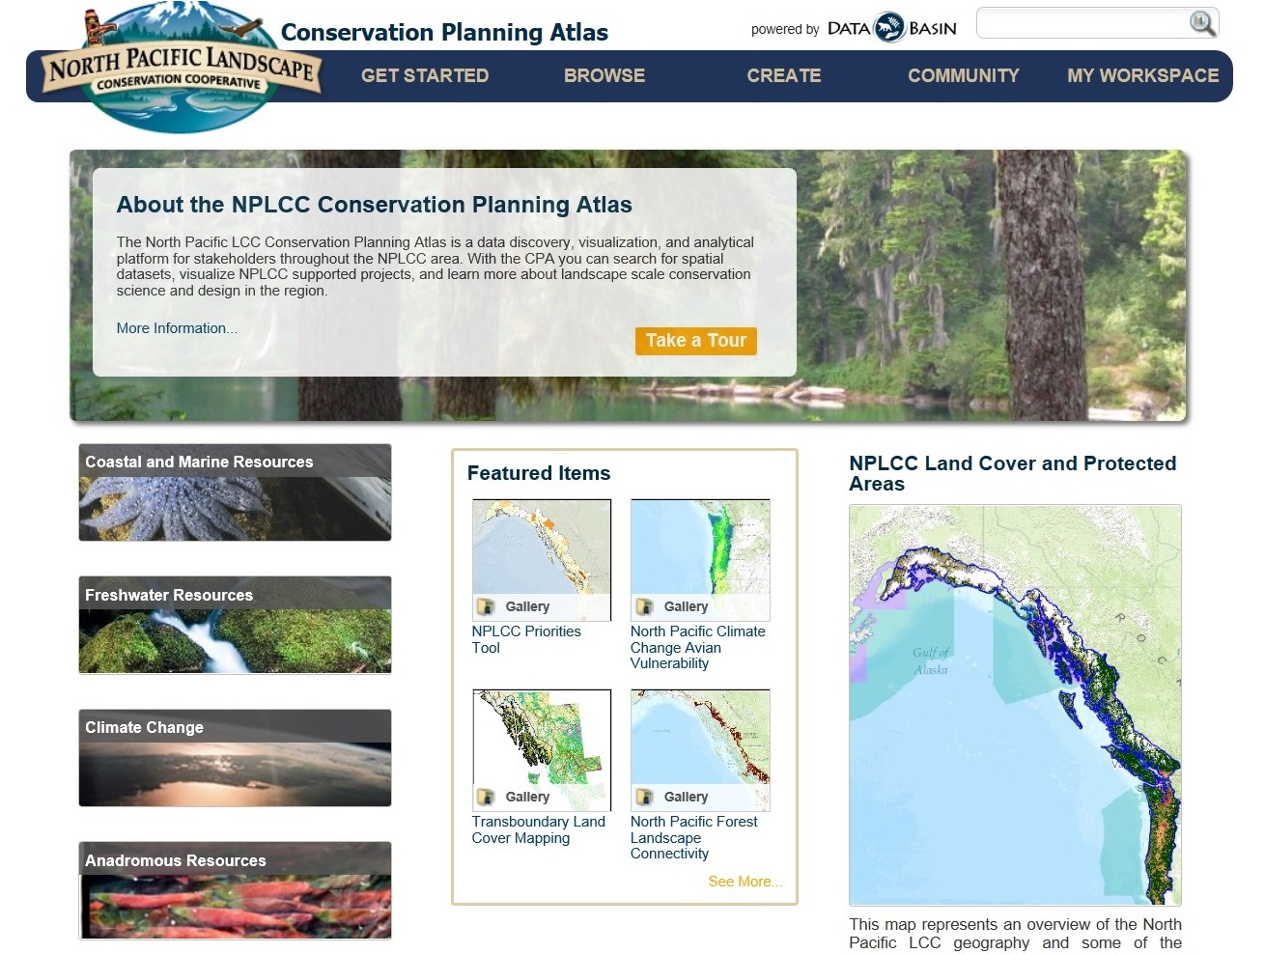
Conservation Planning Atlas
2013 Funded Project
Spatial data
NPLCC funded projects
Other
Convene Review Teams:
April 9
April 10
Link available on Website Resources Page:
http://nplcc.databasin.org/
April - Announcement

Slide 9
Continued Discussion:
Project Relevance
Management/Accountability Document
Notes:
4.4 – 9 out of 22 proposed by First Nations or Tribe
4.4 – 1 pre-proposal was 3 pages, limit 2 pages so only read first 2 pages – OK not score well based on what you have read

Slide 10
Theme: Project Relevance
Goal – Encourage and measure project relevance that accounts for end-user application of findings
Ask: does the project advance climate adaptation and landscape conservation on the ground
Assure full proposal discussion of how agency needs will be met, or results used
End users should be involved throughout most projects, except perhaps for projects testing very novel approaches, models, or frameworks
Ask PIs to identify metrics of “success” and “relevance” both for who should review, and who will be the end users of the information
Ask for target audience review of deliverables based on metrics in proposal review

Slide 11
Theme: Continued Learning
Goal – Better develop a framework for continual adaptive learning– both individual projects and program-scale response
Learn as we go (e.g. learn from our own metrics); use adaptive management approach for “relevance” and “success” of projects
Identify an explicit learning component in the project management, to continually improve project quality, incorporating all steps in project management
ID program-level hypotheses to test as inherent in an ongoing institutional learn process
Don’t mix up individual project accountability and relevance with NPLCC learning overall; how do the projects altogether improve our knowledge and performance
Review post-project lessons learned across all LCCs

Slide 12
Theme: Communication and Implementation
Goal – Build capability for project support, communication of findings, and enhanced end-user implementation of NPLCC project outcomes
Project support appears to be missing: hired or volunteer
Develop an RFP project next year to support evaluation of project success
Require outreach and longer term follow-up for project outcomes
Project support is important and different from project evaluation; fund expert consultation for outreach and linkage of project findings to management decisions
Fund a position or contract to assess and support use of project findings
The NPLCC communications plan should seek to support project relevance, or it will be low

Slide 13
NPLCC Project Management and Accountability Practices
Draft complete and is on NPLCC Website – See Business Page, S-TEK meetings, 3-13-14 folder
Includes your input and general requirements
Goal: S-TEK 2- week review prior to forwarding to Steering Committee (please send feedback/comments to Frank and Mary by 3/27)

Slide 14
NPLCC Project Management and Accountability Practices
Determine project area priorities (Section 1)
NPLCC Strategy and NPLCC S-TEK Strategy set overall Priorities
All activities within this step are conducted by the NPLCC Steering Committee, S-TEK subcommittee or designees, and NPLCC Staff
Solicit and select projects
(Section 2)
Prepare and distribute RFP(s) (NPLCC Staff)
-- May include directed funding and may include a pre-proposal step
Review proposals and make recommendations (S-TEK subcommittee)
Conduct projects (Sections 3 )
Investigators / contractors carry out projects according to their Proposals
Annual Implementation Plan identifies Priority Activities that individual Projects should support
Prepare and submit project proposals (Investigators / contractors)
Select projects for funding (Steering Committee, considering S-TEK recommendations)
S-TEK Oversight and review
-- At least one mid-project review
-- Data management plan
-- Peer review of deliverables
Contracting (NPLCC staff, Section 3.x)
Project Outcome Delivery

Slide 15
NPLCC Project Management and Accountability Practices
Proposal (and pre-proposal) review process
NPLCC Science Coordinator:
Proposal Reviewers:
S-TEK subcommittee and NPLCC Steering Committee
Review proposal for compliance with RFP requirements
Compile, summarize, and distribute meta-data on proposals
Recruit / invite reviewers
Review and complete conflict of interest policy
Score proposals using an agreed-upon set of criteria and a review template (each proposal reviewed by at least 3 reviewers)
Participate in discussion of proposals and make recommendations:
S-TEK makes project funding recommendations based on reviewer input
Steering Committee determines project funding after considering:
S-TEK input
Project portfolio balance
for funding (if reviewing full proposals)
For full proposals (if reviewing pre-proposals)
Issue RFP (with guidance assistance from the S-TEK subcommittee)

