Slide 1
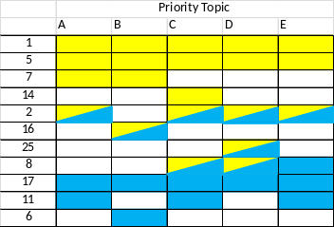
FY15-16 Implementation Plan Status
Task 1. Identify potential activities
Task 2. Evaluate and rank activities
Task 3. Select Areas of focus for 2013-2016
Task 4. Develop Focused Activities for NPLCC support in FY13-FY14
Activity
Need
Description
Specific actions
$$
Guiding Principles | Priority Topics
… … … … | A B C D
Activity
Need
Description
Specific actions
$$
Activity
Need
Description
Specific actions
$$
Importance for NPLCC action
…
Tasks 1 – 3 have been completed
List of ~50 “Focused Activities” has been developed
Steering Committee discussion planned for July
  Review / modify the focused activity list
  How use NPLCC to do something they can’t do on their own
  Discuss potential joint funding opportunities
  Initial selection of focused activities
Notes:
Karen

Slide 2
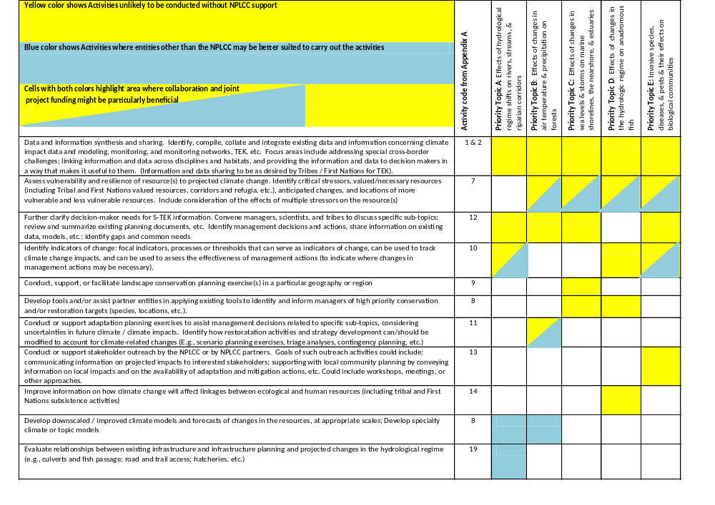
Table 1: Areas of Focus for FY15-16
Notes:
Mary and Frank –
For this part of the discussion I will use the summary distributed with the agenda – my goal is to get head nods for Table 1 and for the Activity description modifications, and to use the identification of focused actions that has already been completed to kick off the discussion of current and future actions for the remaining topics.
I’ll “lead” that discussion from the excel file and keep track as we go.

Slide 3
Examples: Potential Focused Activities for FY15
3-X Potential “Activities” have been identified by the S-TEK for each of the areas of focus indicted in Table 1
  List has been distributed to the S-TEK prevoiusly
Goal is for each of these activities to be sufficiently well described that a scope of work and/or an RFP could be written to solicit specific projects
For example:
  For data and information synthesis and sharing
    Document and highlight roadblocks for data sharing and integration (and identify ways to overcome those roadblocks)
    Add one or more priority datasets (as identified by the GIS technical team) to the NPLCC data management system
  For develop tools and/or assist partner entities in applying existing tools to identify and inform managers of high priority conservation and/or restoration targets
    Support development of a specific decision-support system or tool that was identified by multiple stakeholders in the NWF focus groups as being of interest or as a need
  For conduct or support adaptation planning exercises
    Support several case studies using different approaches to address the same/similar questions; compare strengths and weaknesses of the approaches.
Next step: Steering Committee discussion and initial selection of FY15 activities

Slide 4
Plan for SC discussion of FY15-16 Implementation Plan
Prior to meeting, Steering Committee will receive:
  Draft text of Implementation Plan (through Table 1)
  List of potential Focused Activities for each item in Table 1
At the meeting:
  We will ask for discussion / endorsement of the Plan through Table 1
  Committee members will be asked if they want to add to the list of potential activities
  Prioritization exercises and SC discussion to identify where they want to focus funding
    First at the level of Table 1 – of the “yellow blocks,” where do they think NPLCC funding will be most beneficial? (to their own entities / to the NPLCC as a whole)
    For those high priority areas, additional discussion of the list of potential Activities

Slide 5
S-TEK next steps
We will include you on distribution of the documents and questions to the Steering Committee
If you have additional input or thoughts that you want to be part of the Steering Committee discussion about FY15 activities, please provide them:
  To the Steering Committee member(s) that you know or work with
  To Frank, Mary, and Karen
Notes:
Frank and Mary – I’m just “seeding” the pro/con tables with a few of the things we have talked about to try to kick off the discussion

Slide 6
What’s next / what else?
From the NPLCC Charter:
To date, the S-TEK has focused on the first three items
  Those tasks are moving into “maintenance” mode
  The QA task will require the most time and attention moving forward
In the January meeting, there was significant discussion about how the S-TEK could “support” projects during implementation to ensure their usefulness, and coordination with the Communication and Outreach Committee
The Science and Traditional Ecological Knowledge Subcommittee (Science/TEK) is charged with:
  Developing and recommending a 5-year NPLCC science strategy for consideration by the Steering Committee
  Developing and recommending a ranking of science needs
  Reviewing and recommending projects for LCC support
  Science quality assurance (e.g., peer review of LCC-supported projects)

Slide 7
Discussion questions
Are there other issues you think the S-TEK should be addressing?
In each of the past several years, we have conducted S-TEK business through a single in-person meeting (focused on setting priorities) and numerous phone calls.
  How has this worked for you?
  Ideas or suggestions for how we work together going forward?
    In light of the future focus of S-TEK activities

