Slide 1
The NPLCC Conservation Planning Atlas:
Towards Version 2.0
Tom Miewald, NPLCC
Katie O’Connor, Conservation Biology Institute

Slide 2
Overview
Background
Current Activity
Proposed direction

Slide 3
Background
Improving access and use of landscape scale data an articulated goal of the NPLCC.
Scoping and identification of high initial priorities
Implementation of the CPA

Slide 4
Highest Initial Priorities
Strategic positioning within the expanding world of on-line portals
Supporting the Practitioner Community
Finding and accessing information
Landscape-scale Information
Meta-Data System

Slide 5
2 Years Later: Who’s Using it and What For?
Publishing Data (Lamprey, TNC resilience data)
Data that can’t be accessed elsewhere
  NPLCC-funded data
  A few other data sets (estuaries, salmon data)
Collaborative Groups

Slide 6
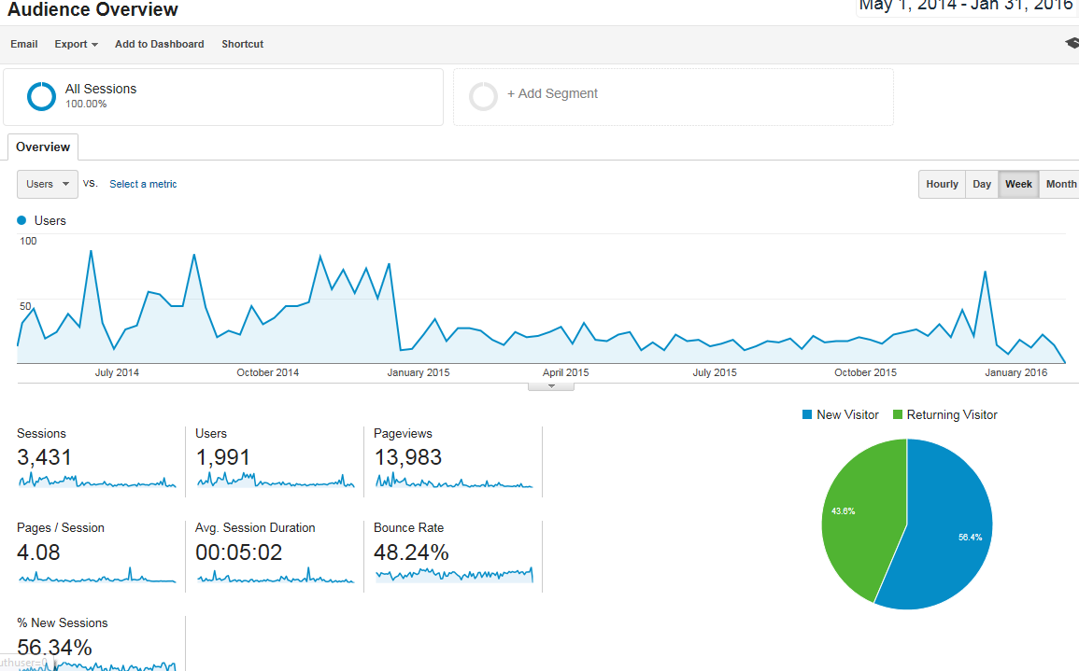

Slide 7
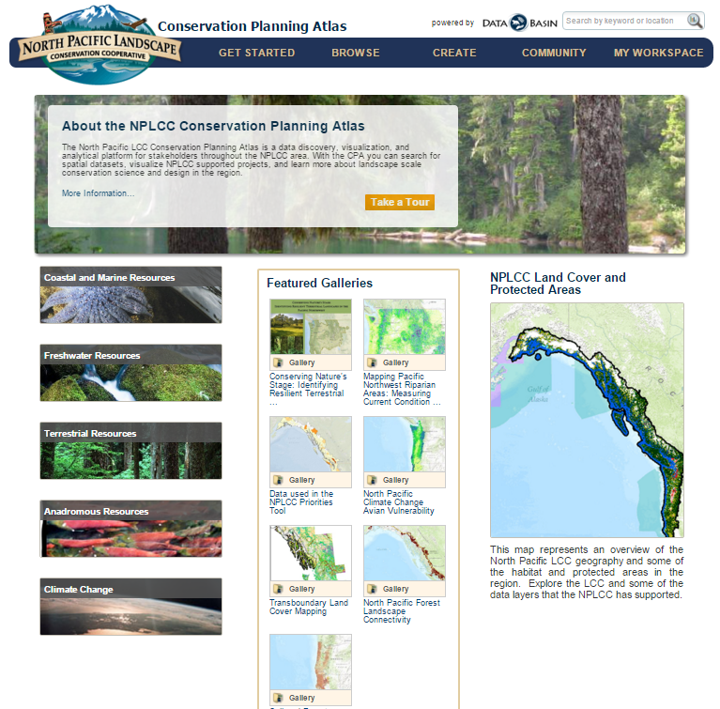

Slide 8
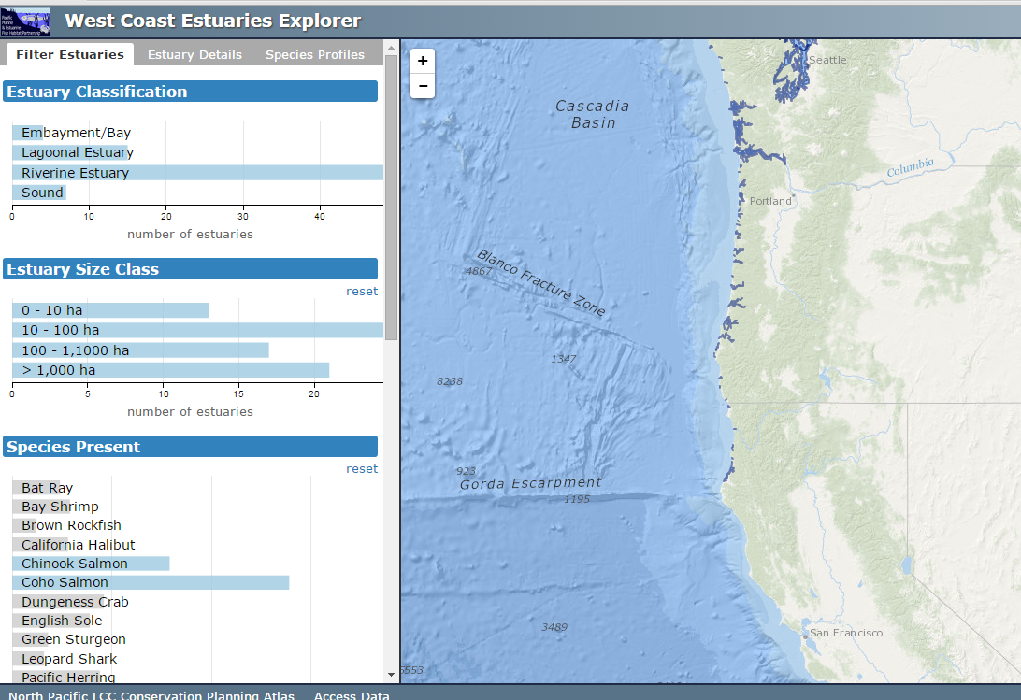
CPA Component in Progress #1: PMEP

Slide 9
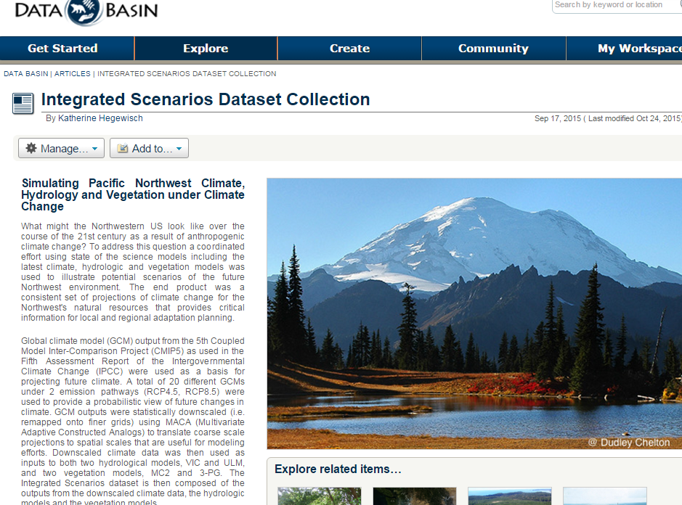
CPA Component in Progress #2: I.S.

Slide 10
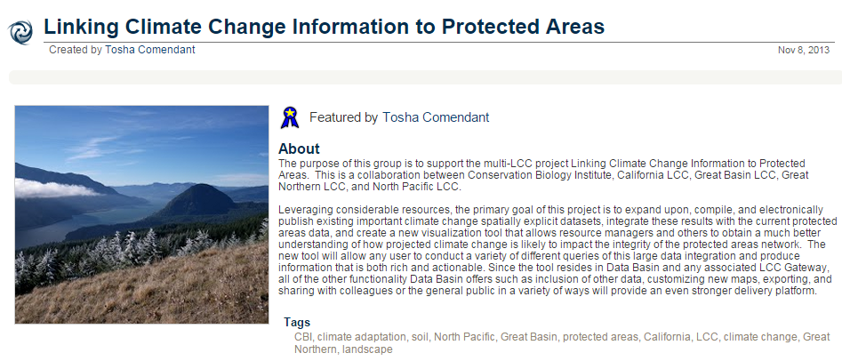
CPA Component in Progress : Climate Change and Protected Areas Viewer
TBD, anyone know of latest?

Slide 11
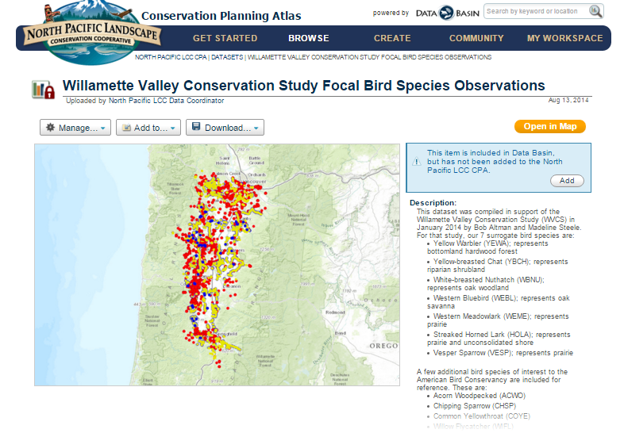
CPA Component in Progress : Willamette Valley
???

Slide 12
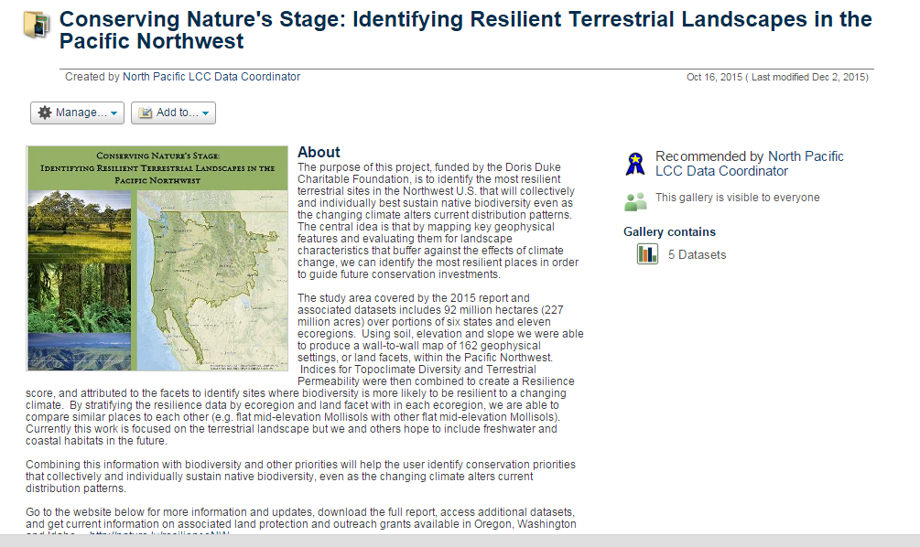

CPA Component in Progress : Resilience
Sponsored By

Slide 13
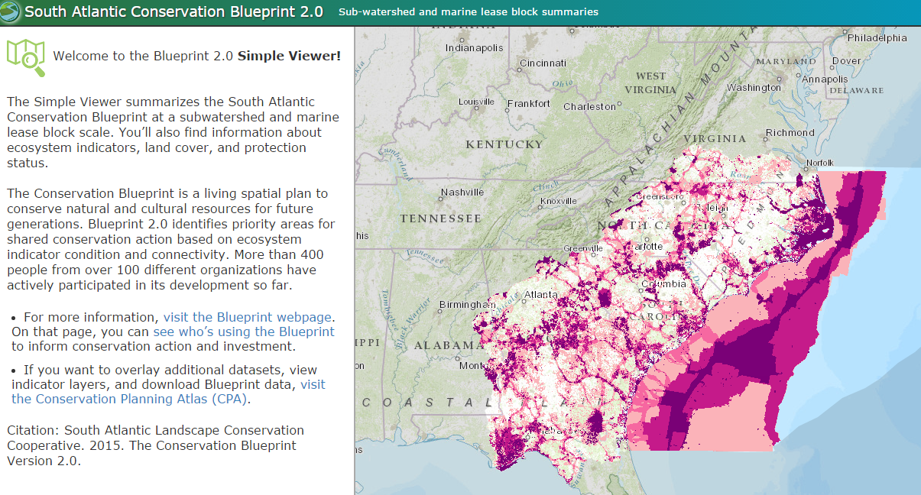

Slide 14
Challenges
How to differentiate the CPA from the other web-based portals?
What is the strength of the NPLCC
How do we make this more useful/have a broader impact?
Unique transboundary south-north geography

Slide 15
Major Proposed Changes
Focus on shared priority areas for conservation (conservation design) and large-scale stressors, particularly climate change.
Shift towards ecoregions as topical areas.
Development of viewers
Organization
Synthesis of priority areas

Slide 16

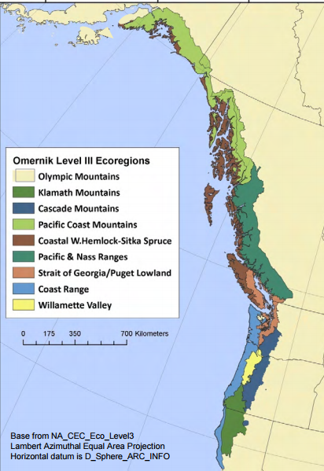
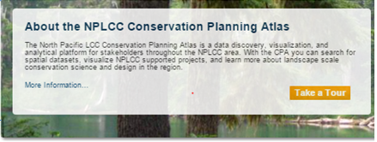
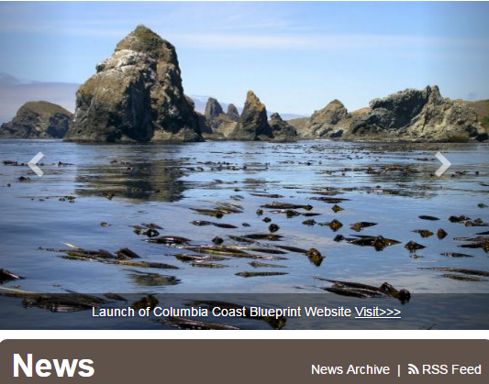
Climate Change Analysis Resources
Conservation Priority Areas

Slide 17

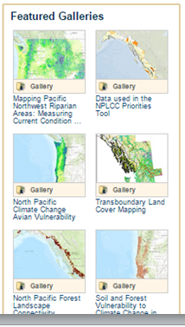
In this section will be a link to a map with different conservation priorities in the region. (IBAs, strongholds, etc).
Climate Change Analysis Resources
Conservation Priority Areas

Slide 18
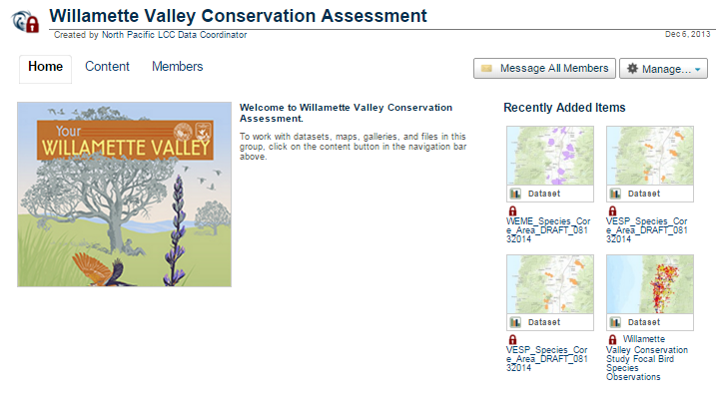
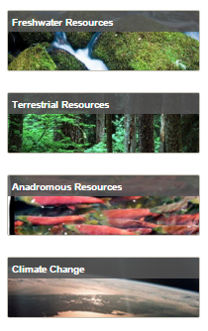
View the Willamette Valley “Blueprint”

Slide 19
Climate Change Analysis Toolkit
Climate Change and Protected Areas Viewer
Resiliency of the PNW (TNC)
Integrated Scenarios
Other Climate Change Resources

Slide 20
Core Functionality/Components
Synthesis of Priority Areas in the NPLCC
Ecoregional/LCD Footprint sub-geographies
Climate Change Components

