Slide 1
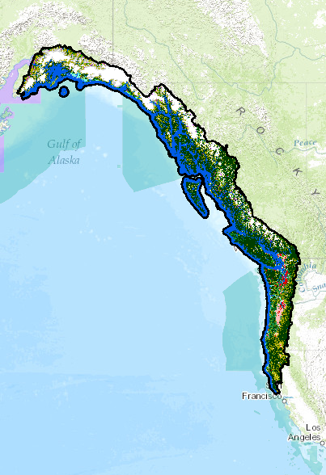


S-TEK Subcommittee
Meeting
November 10, 2015
11:00 – 12:00 PST/
10:00 – 11:00 AKST
or
1:30 - 2:30 PST/
12:30 – 1:30 AKST
(which ever time fits your schedule – same information will be covered on both calls)
Revised Boundary:
Expanded East to
Crest of Cascades in WA
  nplcc.org

Slide 2
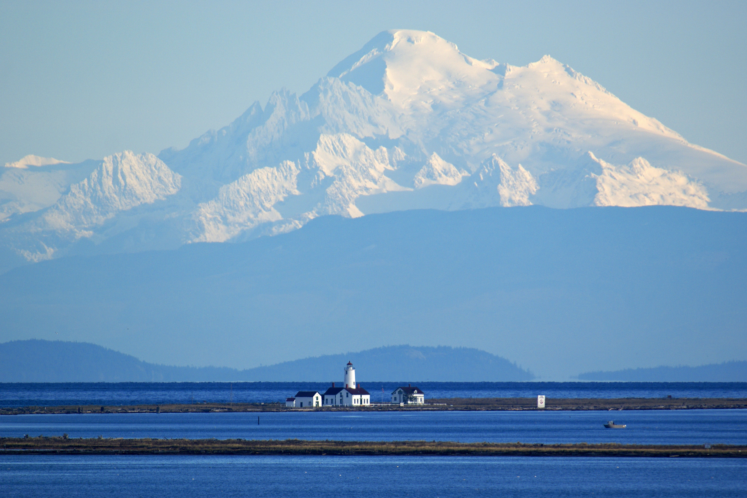
Draft Agenda
National LCCs
NPLCC Updates:
  2015 funded projects
  Communications
  Dec. Steering Committee mtg.
S-TEK in 2016
  RFP (pre-proposals)
  New Science Strategy (2017-2021)
Sharing information by all relevant for S-TEK
  nplcc.org

Slide 3
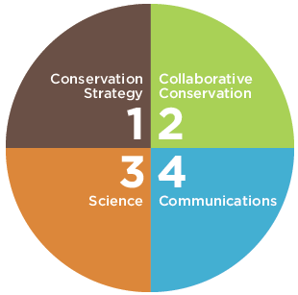

Network Strategic Plan
(Oct. 2014)
lccnetwork.org
Science Plan Themes
1) Landscape Conservation Planning
2) Landscape Conservation Design
3) Climate Adaptation
4) Data Management, Integration, & Sharing
5) Socioeconomic & Cultural Values
6) Science Communication and Delivery
7) Monitoring
  nplcc.org

Slide 4
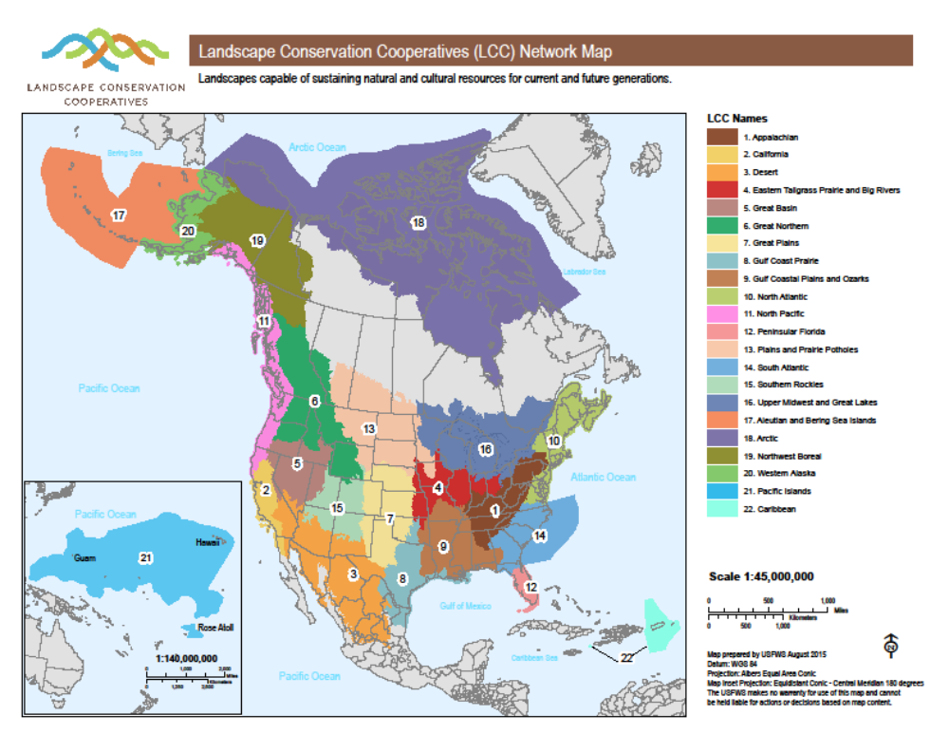
National Updates:
LCC Council
NAS Review
2016 Funding
  nplcc.org

Slide 5
NPLCC Projects Funded in 2015
Total # Projects: 10
Total Funding: $255K NPLCC; $30K National LCC
Data and information synthesis and sharing. Identify, compile, collate, and integrate existing data and information concerning climate impact data and modeling, monitoring networks, TEK etc. (4 Projects)
  University of Oregon ($7K): Tribal Climate Change Guide - online searchable climate-science connections database
  Conservation Biology Institute ($35K): Support for the Conservation Planning Atlas (includes PMEP, Integrated Scenarios Project – NKN, Willamette Valley)
  Pacific Salmon Foundation, BC ($38K, GNLCC -$38K): Develop interagency stream temperature database and high-resolution temperature model (like NorWeST)
  Univ. AK Fairbanks ($30K National LCC, $2.5 NPLCC): Synthesis coastal change research Cook Inlet and SE AK – builds on similar project WA LCC.
  nplcc.org

Slide 6
Projects Funded in 2015 (Continued)
Support the use of vulnerability assessments and resilience studies in adaptation planning and implementation (3 Projects)
  WDFW ($37K): Incorporating climate change in Washington State Wildlife Action Plan.
  USFS/SEAK FHP ($33K): Climate change in the Tongass NF/ SE Alaska – prepare an action plan and host a workshop in April 2015.
  Coastal Ecosystems Institute of Northern California ($24.5K): Planning and implementing adaptation measures for sea level rise in Humboldt Bay, CA.
  nplcc.org

Slide 7
Projects Funded in 2015 (Continued)
Conduct, support, or facilitate landscape-scale conservation exercise(s) in a particular geography or region (3 Projects)
  Contracts ($45K): Initial planning and assessments for Lower Columbia/Coastal WA/OR Landscape Conservation Design
  Conservation Northwest ($18K): Build adaptive capacity in the Cascadia Partner Forum geography; identify and inventory existing spatial priority landscapes and identify conservation priorities.
  Kenai Watershed Forum/USFWS: Kenai Peninsula, AK ($15K): Develop a “Conservation Blueprint” to describe places and actions needed to meet conservation objectives.
  nplcc.org

Slide 8
Communication Updates
Audience Growth:
nplcc.org: 5,153 visits (since May), 84% US/6% CA, Top page is Projects page – 600 visits,
Listserve – 6,067 subscribers, Twitter – 362 followers, Facebook – 137 likes, YouTube – 19 subscribers/576 views since May
Highlights:
Website updates: New Resources Library, updated partner resources page, in progress updates to Tribes/First Nations Resources
2 full webinars (150+ registered) – Dan Isaak & Nature Conservancy
Beaver Restoration Guidebook (2,400opens) & Northwest Climate Magazine (8,600opens)
GLACIER Conference
Lower Columbia River Basin LCD project outreach – new collaborative website, outreach and webinars
  nplcc.org

Slide 9
Communication Updates (Continued)
Upcoming:
2015 performance measures
2016 Implementation Plan
Website partner linkages
Improvements to website projects page
  nplcc.org

Slide 10
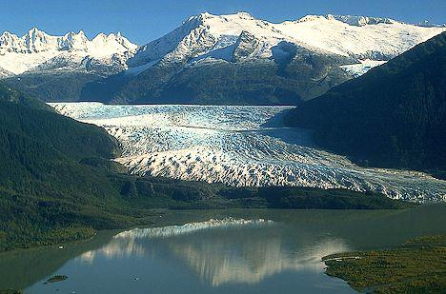
Steering Committee Meeting
December 2-4, Juneau
Joint with Northwest Boreal LCC
Present metrics developed by S-TEK for adoption
  nplcc.org

Slide 11
2016 S-TEK Implementation Plan
New Activities/ Projects | Timing & Funding Mechanism
1. Data and information synthesis and sharing. Identify, compile, collate, and integrate existing data and information concerning climate impact data and modeling, monitoring networks, TEK etc. | 2015 and 2016 Contracts/ Agreements/ Salary
2. Support the use of vulnerability assessments and resilience studies in adaptation planning and implementation | 2015 and 2016 Contracts/ Agreements
3. Conduct, support, or facilitate landscape-scale conservation exercise(s) in a particular geography or region | 2015 and 2016 Contracts/ Agreements/ Salary
4. Develop / improve information on how climate change and associated adaptation actions will affect linkages between ecological and human resources (including tribal and First Nations subsistence activities and cultural resources) | 2016 Agreements RFP Pre-proposals
  nplcc.org

Slide 12
2016 S-TEK Implementation Plan
New Activities/ Projects
Adaptive learning
  Evaluation framework (metrics)
  Investment in projects generated through past projects (follow-up from 2014 Hydrologic Regime Workshop as part of RFP? – I will send out the USGS report for your consideration if we should include it )
  nplcc.org

Slide 13
Science/TEK Strategy 2013-2016
Guiding Principles | Priority Topics
In annual implementation planning, and in the activities it supports, the NPLCC will: Focus on helping managers understand the availability and effectiveness of adaptation and mitigation response actions Focus on facilitating coordination, collaboration, and capacity building, and on developing or assisting with tools to assist decision-makers Identify and promote opportunities to use TEK to inform partner and stakeholder decisions Promote and facilitate consideration of the connections and interactions between ecosystems | Effects of hydrologic regime shifts on rivers, streams, and riparian corridors Effects of change in air temperature and precipitation on Forests Effects of changes in sea levels and storms on marine shorelines, the nearshore and estuaries Effects of the changes in the hydrologic regime on anadromous fish Invasive species, diseases, pests and their effects on biological communities
  nplcc.org

Slide 14
S-TEK Activities / Timeline
Develop RFP (subgroup) – Release early January
  Pre-proposals
  Grants.gov posting 60 days
  Review Pre-proposals late March (subgroup)
  Review invited full proposals end May (subgroup)
Science/TEK Strategy 2017-2021 (5 year)
  Start development winter (Subcommittee)
  Include conservation targets and metrics
  Present to Steering Committee summer
Schedule S-TEK Meetings – Jan, March, May, July…
  nplcc.org

Slide 15
Sharing of Information - All
Thank you for your participation in today’s meeting!
  nplcc.org

