Slide 1



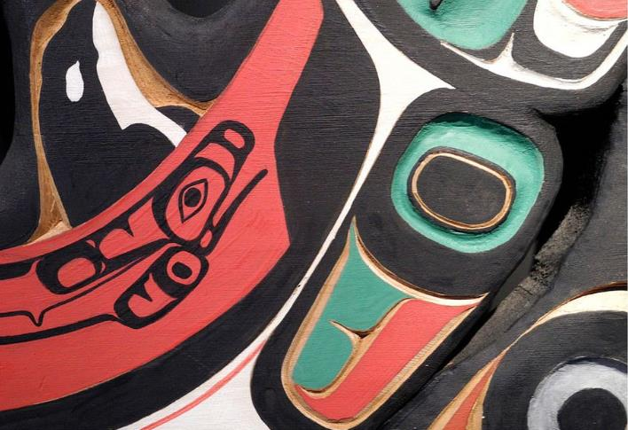
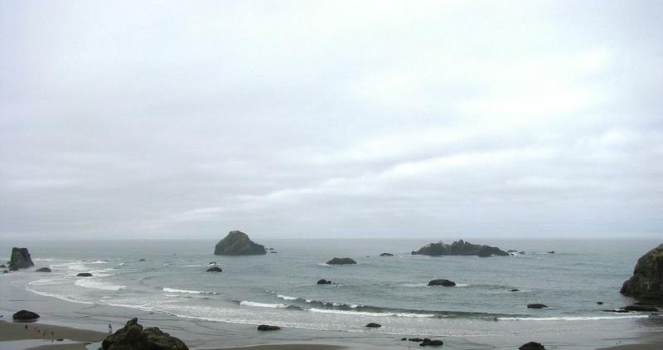
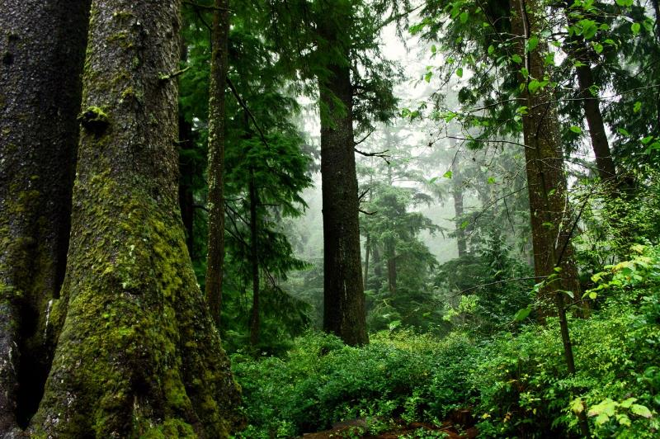

NPLCC S-TEK
Subcommittee
Meeting
October 1, 2014
9:00 a.m. – 11:00 a.m. Alaska
10:00 a.m. – 12:00 p.m. Pacific
Phone #: 866-628-1318
Passcode: 6959549
Frank Shipley – Chair

Slide 2
Draft Agenda
General Updates – Frank & Mary
Project Tracking and Accountability – Jill
Discussion FY15-16 Implementation Plan – Karen & All
Future S-TEK Work – Frank, Mary, Tom, Meghan, All
Discussion about in-person meeting in January – All
Round Robin – relevant topics for S-TEK - All
Wrap-up – Frank & Mary
Notes:
Interest and obligation in making sure some of the service’s objectives and goals are met
For example talked last week how SLR work we advocate for or fund can meet info needs of Mig birds
Want same conversations with other Service programs.
Want to see where can do work that meets both of our needs.

Slide 3
  Updates
  Steering Committee Meeting
    July 7-9
    In-Person at Nisqually NWR, WA
  Tribes/First Nations Committee Meeting
    Sept. 4
    Portland, OR
Notes:
Interest and obligation in making sure some of the service’s objectives and goals are met
For example talked last week how SLR work we advocate for or fund can meet info needs of Mig birds
Want same conversations with other Service programs.
Want to see where can do work that meets both of our needs.

Slide 4
  Agenda Item #4: Future S-TEK Work
  Conservation Goals and Objectives
  Project products, tracking and accountability reviews
    Data management Plan
    Role S-TEK members in process
  Strategies learning from and communicating results
  Other topics for S-TEK?
Notes:
Interest and obligation in making sure some of the service’s objectives and goals are met
For example talked last week how SLR work we advocate for or fund can meet info needs of Mig birds
Want same conversations with other Service programs.
Want to see where can do work that meets both of our needs.

Slide 5
  Communicating Results Updates
Website Updates – New project format & new news format
Conservation in Action Project Spotlights
Misc. Publications (NFWP Strategy)
Northwest Climate Science Conference
Regular Science Management Webinars
Notes:
Interest and obligation in making sure some of the service’s objectives and goals are met
For example talked last week how SLR work we advocate for or fund can meet info needs of Mig birds
Want same conversations with other Service programs.
Want to see where can do work that meets both of our needs.

Slide 6
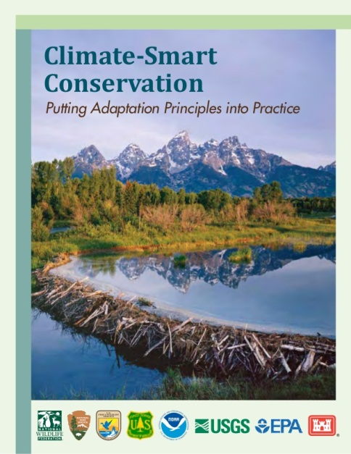
Climate-Smart Conservation Class for NPLCC Partners
  Spaces available at no cost to participants
  Olympia, WA; October 26-28, 2014
  Register on-line: USFWS – National
  Conservation Training Center
  Course ALC3195

