Slide 1

Discussion:
2015-16 S-TEK Implementation Plan
S-TEK Subcommittee Discussion – October 1, 2014

Slide 2
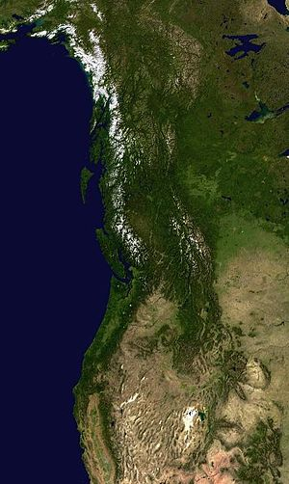
Outline
Review
  Relationship of the Implementation Plan to other NPLCC documents / processes
  Where we are: process so far
  “Table 1” – Areas of Focus for FY15-16
Discussion
  Feedback from Steering Committee discussions in July
  “Table 2” – Activities to be pursued in FY15
  Next steps/schedule for completion

Slide 3


NPLCC Charter
S-TEK Strategy
Mission
5 Priority Topics
Annual S-TEK Implementation Plans (Determines Areas of focus and NPLCC funding priorities)
Four Guiding Principles
NPLCC funded projects
NPLCC-relevant work by Partners
7 NPLCC Objectives
Communication and Outreach Strategy
Partner Engagement Strategy

Slide 4
LCC-Specific Conservation Goals
Achieve national performance benchmark, linked to funding
Provides method to refine S/TEK Strategy and what we work on within our 5 Priority Topics
Provides metrics and opportunities for performance tracking, demonstrating our success/value to partners
Helps better define “why” NPLCC exists, what it does, how it helps, where it is adding value.

Slide 5
NPLCC Charter
Mission
S-TEK Strategy
5 Priority Topics
Conservation Goals and Objectives
Annual S-TEK Implementation Plans (Determines Areas of focus and NPLCC funding priorities)
7 NPLCC Objectives
Four Guiding Principles
NPLCC funded projects
NPLCC-relevant work by Partners
Notes:
Adding Conservation Goals and Objectives to the mix – where do they fit?
Clearly within the boundaries of the Charter & must support the mission and NPLCC goals and objectives.
NPLCC staff defined them within the context of the S-TEK Strategy -- as you have seen (or will see shortly), a set of goals and objectives is proposed for ach of the 5 Priority Topics Identified in the Strategy
So the 5 Priority Topics define WHAT the NPLCC S-TEK work will focus on; the Conservation Goals and Objectives are intended to state WHAT WE WANT TO ACCOMPLISH with respect to each of those topics (the “Why”?), and the Annual Implementation Plan Plan describes how we are are going to (move towards) accomplishing those goals

Slide 6
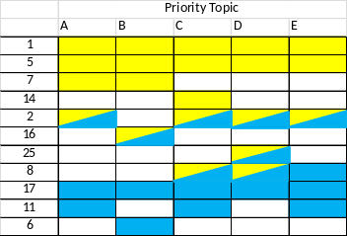
Closing Questions – Sense of the SC
2015-16 Implementation Planning Process
Task 1. Identify potential activities
Task 2. Evaluate and rank activities
Task 3. Select Areas of focus for 2015-2016
Task 4. Develop Activities for NPLCC support in 2015 (& 2016)
Activity
Need
Description
Specific actions
$$
Guiding Principles | Priority Topics
… … … … | A B C D
Activity
Need
Description
Specific actions
$$
Activity
Need
Description
Specific actions
$$
Importance for NPLCC action
…
Tasks 1 – 3 have been completed
List of ~50 candidate activities within the 9 areas of focus has been developed
Steering Committee discussion identified a short(er) list of activities that are of high(er) priority for NPLCC support in the near-term

Slide 7
Elements of the Implementation Plan
Areas of focus specify the types of work associated with each Priority Topic that would be most useful to the partnership in the near-term
Activities are defined for each area of focus as a more specific way of carrying out the work of the NPLCC
  Activities identified in the annual implementation plan form the basis for direct support- or RFP-initiated projects
Notes:
Aiming for more clarity in terminology…

Slide 8
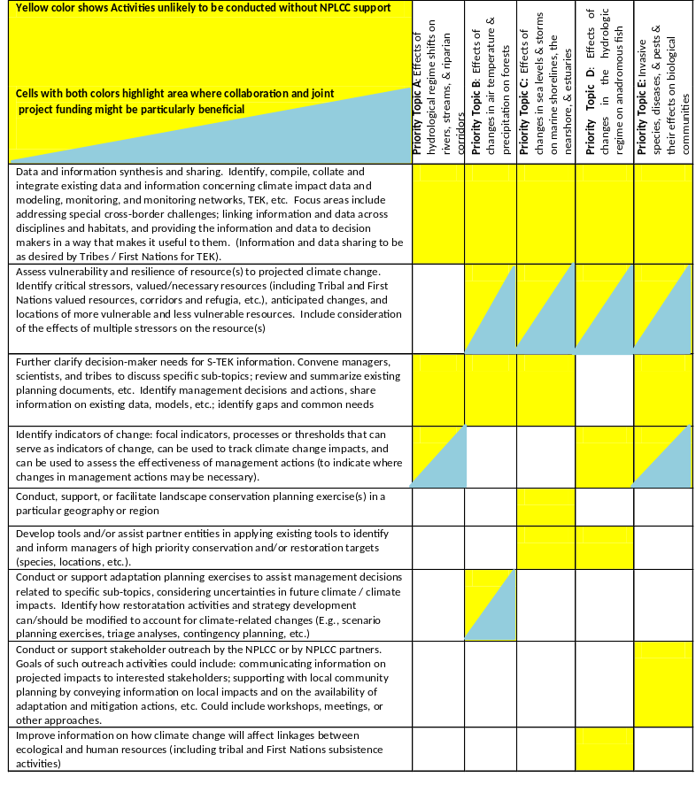
9 Areas of Focus for 2015-2016
See Table 1 distributed separately
The first three areas of focus were evaluated by the S-TEK as high priority for most Priority Topics
The remaining six were evaluated as high priority for a narrower set of Priority Topics
Two additional topic were identified as high priority but more appropriate for other entities to support
“High priority” =
  Likely to produce management and decision-relevant information or tools
  Useful for multiple/many NPLCC partners
  Particularly useful if started “now”

Slide 9
Discussion: FY15 Activities
Note: All NPLCC-funded activities should have management application and broader implications or lessons
Data and information sharing and synthesis (all Priority Topics)
  Includes (but not limited to) ongoing support for the data management platform
Assess vulnerability and resilience of resources to projected climate change; incorporate results in adaptation planning and implementation
  Priority Topics B, C, and D
Conduct, support, or facilitate landscape-scale conservation planning exercise(s) in a particular geography or region
  Sea level rise and estuaries (Priority Topic C) in the northern portion of the LCC
Improve information on how climate change will affect linkages between ecological and human resources
  Potentially focus on Priority Topics A and/or D
Notes:
Four (five?) activities identified base on
S-TEK work to-date
Steering Committee discussion of priorities
SAIS expectations (may affect future funding)

Slide 10
Discussion: Assuring/Increasing the management relevance of FY15 projects
What is the appropriate balance between
  Detailed descriptions in the implementation plan of the types of projects we want to see
  Reliance on the RFP process to generate the detailed projects for each activity?
How do we promote more management relevance in the proposals?
  Require that proposals state how results can be used?
  Ask for letters of support from natural resource managers?
    Targeted, with information on how the managers will use the results?
  Direct involvement / joint proposals from scientists and natural resource managers?
  Other?

Slide 11
Additional discussion on Activity #2
How do we increase the likelihood that projects related to this activity are useful to resource managers?
Assess vulnerability and resilience of the resource(s) to projected climate change: identify critical stressors, valued/necessary resources (including Tribal and First Nations valued resources, corridors and refugia, etc.), anticipated changes, and locations of more vulnerable and less vulnerable resources. Include consideration of the effects of multiple stressors on the resource(s) Identified as an area of focus for Priority Topics B, C, D, and E; Identified as fruitful area for collaboration / joint funding opportunities | Tool development/Needs identification Focus on how to understand and assess the cumulative effects/cumulative impacts of a variety of stressors (esp. relevant in BC?) Analysis/Sharing of “what works” Examination of the use/non-use of existing studies Note that there are quite a few methods used for "vulnerability assessments"; there is some research being done on what is used / not used and why; and inventory of existing/past VAs might be available from USGS Examine scale/scope of assessments and applicability to decisions at, potentially, different scales from the VA itself Add climate considerations Support (jointly with Partner?) specific/individual vulnerability assessment that includes consideration of multiple environments and stressors that can be used in adaptation planning

Slide 12
Additional discussion on Activity #1
Beyond / in addition to the data management platform
What other types of projects should be encouraged?
Data and information synthesis and sharing. Identify, compile, collate and integrate existing data and information concerning climate impact data and modeling, monitoring, and monitoring networks, TEK, etc. Focus areas include addressing special cross-border challenges; linking information and data across disciplines and habitats, and providing the information and data to decision makers in a way that makes it useful to them. (Information and data sharing to be as desired by Tribes / First Nations for TEK). Identified as an area of focus for all Priority Topics | Tool development/Needs identification Continue to develop/expand the data platform: Add one or more priority datasets (as identified by the GIS technical team) to the NPLCC data management system Additional support for hydrology data in SE Alaska Implement suggestions from EcoAdapt workshops and others on the data platform, data needs, and data presentation Increase awareness of data that is already available (through NPLCC, through Partners, or both) and actively promote/provide data/information to decision-makers Identify/track what information is being sought and / or used by decision-makers (e.g. network analyses on data use) use results identify what should be put into the data platform, and/or what people need to be made aware of (also proposed as a way to further clarify decision-makers needs for S-TEK information) Document and highlight roadblocks for data sharing and integration (and identify ways to overcome those roadblocks)

Slide 13
Additional discussion on Activity #4
How do we increase the likelihood that projects related to this activity are useful to resource managers?
Improve information on how climate change will affect linkages between ecological and human resources (including tribal and First Nations subsistence activities) Identified as an area of focus for Priority Topics A and D | Tool development/Needs identification Develop and pilot test a method / conceptual model for an integrated social and ecological vulnerability assessment Add climate considerations Analyze these interactions and linkages within any one of the Priority Topics (note that this was identified as high priority for Topic D only). Examples might include: Public health impacts related to climate change impacts within a Priority Topics (e.g., for Topics D & E, links between climate change and fish/shellfish disease – hatchery closures, fish advisories, etc. that affect consumption) Interactions between connectivity, species range shifts, and tribal and First Nations access to culturally important species Climate change effects on subsistence and/or recreational hunting and gathering, including economic, health, and quality of life impacts Add consideration of the human dimensions of climate change, including ways to improve communication of impacts, and to incorporate considerations related to the social/human impacts of change into the existing planning processes.
Notes:
Four (five?) activities identified base on
S-TEK work to-date
Steering Committee discussion of priorities
SAIS expectations (may affect future funding)

Slide 14
Next Steps – Implementation Plan
What | Who | When
Draft 2015-2016 Implementation Plan | NPLCC Staff, consultant | By 10/13
Review and approve 2015-2016 Implementation Plan | Steering Committee | 11/3 SC mtg
Draft RFP(s) for the four FY15 Activities | NPLCC Staff, with support from S-TEK | First call week of 11/10
Preproposal development | Researchers & Managers | 12/3 – 1/14
Preproposal review and selection | NPLCC Staff and S-TEK support; Steering Committee approval | 1/19 – 2/16 2/16 – 3/8
Full proposal development | Researchers & Managers | 3/8 – 4/6
Proposal review and selection | NPLCC Staff and S-TEK support; Steering Committee approval | 4/8 – 5/6 5/8 – 5/31
Agreements in place | NPLCC Staff | June, 2015

