Slide 1


Integrated Data Management Network presentation by Matt Heller and Deanne DiPetro
Presented by Jill Hardiman, NPLCC S-TEK Committee Meeting 10-1-2014

Slide 2
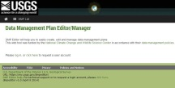

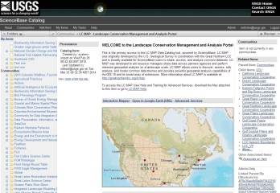
LCC Project Tracking Lifecycle
DEPTH
Helps PI Manage Project Records
Project-centric view
DMPEditor
Helps PI Build/Update DMP
ScienceBase
Data Repository for LCC Project Records (LCMAP) and CSCs and other research work. It has webservices capabilities. NPLCC uses this in conjunction with Data Basin to serve up the CPA
Project Tracking System
lccRFPManager
Manages RFP Process and Creates Initial Project Record in Science Base
  Proposal/SOI PDF
  Data Management Plan
  Budget Document
Project Pages Tool
Displays Project Records on LCC Web Sites (currently the NCCWSC website is linked to Science Base
LCC WebSites
National and individual LCCs

Slide 3

Statement of Need
LCCs have a critical need for information management processes that facilitate:
  science product (i.e., data, analysis and decision tools, documents) sharing;
  data storage, security, and dissemination; and
  project tracking, communication and collaboration tools
Effort must be interoperable with the USGS National Climate Change and Wildlife Science Center (NCCWSC) and other landscape‐level project management systems

Slide 4
Two kinds of project information
Project Tracking
Project Cataloging
Project Cataloging: basic, standardized information about LCC projects, with links to more detail on LCC websites
Project Tracking: detailed information about every aspect of a project needed to manage it from start to completion; typically expands on project cataloging with deliverables, contacts, deadlines, etc.
DD

Slide 5
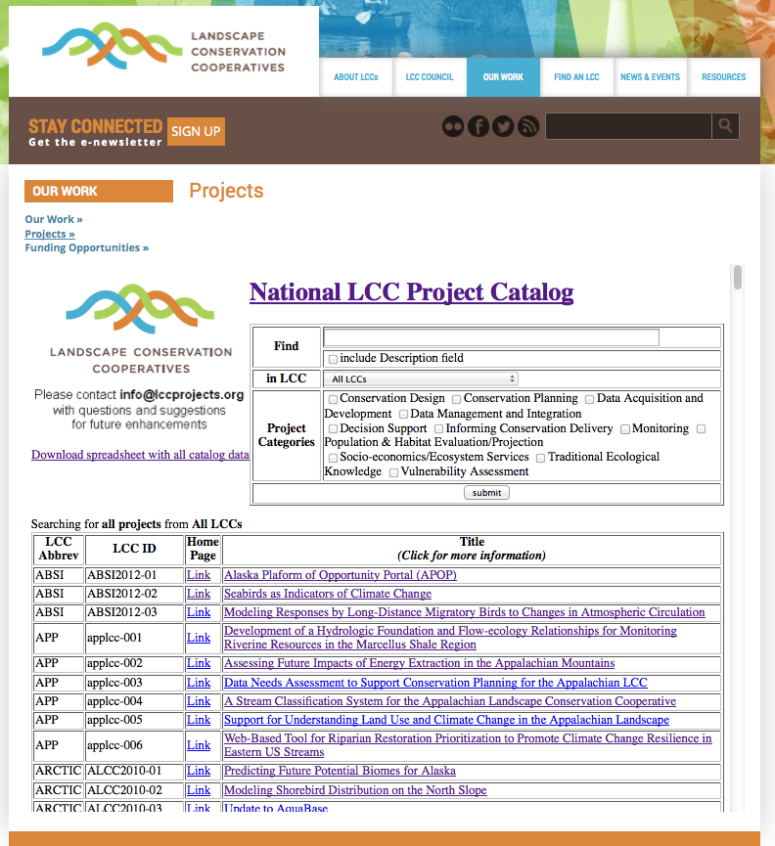
Previous work:
Simple National Project Catalog
Spring 2013
Gathered, standardized, and assembled project metadata from all 22 LCCs
Collaboratively developed a common standard for the data, got buy-in from all LCCs
Worked with each LCC to incorporate the standard with their current methods for managing this data
http://lccnetwork.org/
DD

Slide 6
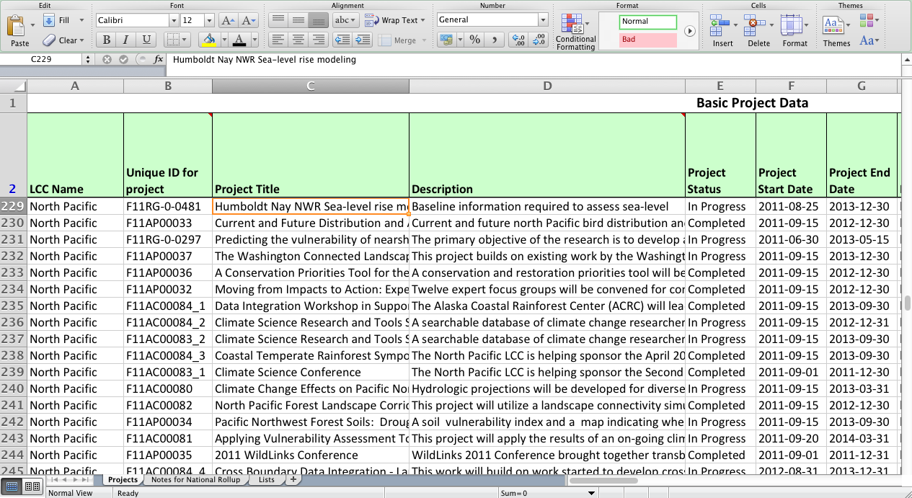
Previous work:
Simple National Project Catalog
The SNPC Spreadsheet tool. Each LCC data manager was provided their data back in standardized form.
DD

Slide 7
ScienceBase
Data catalog and collaborative data management platform with project cataloging capabilities
Central search and discovery application
Data Repository
Used by many different communities for many different purposes
Has a front end web application, DEPTH, to create project metadata that complies with the national LCC standard
Web services for facilitating other applications which provides added flexibility to display data
LW

Slide 8
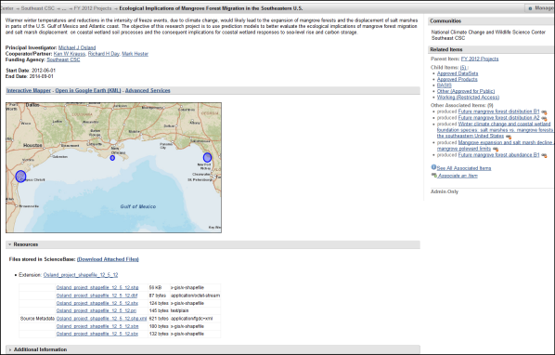
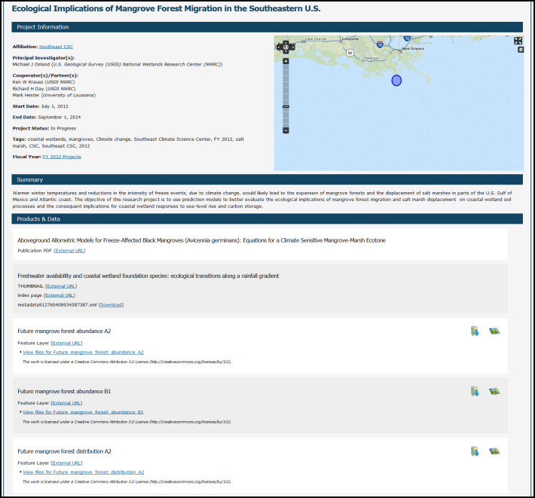
Case Study: NCCWSC
Project & products cataloged in ScienceBase/DEPTH
Using ScienceBase web services, the project metadata & products are displayed on the NCCWSC website
LW

Slide 9

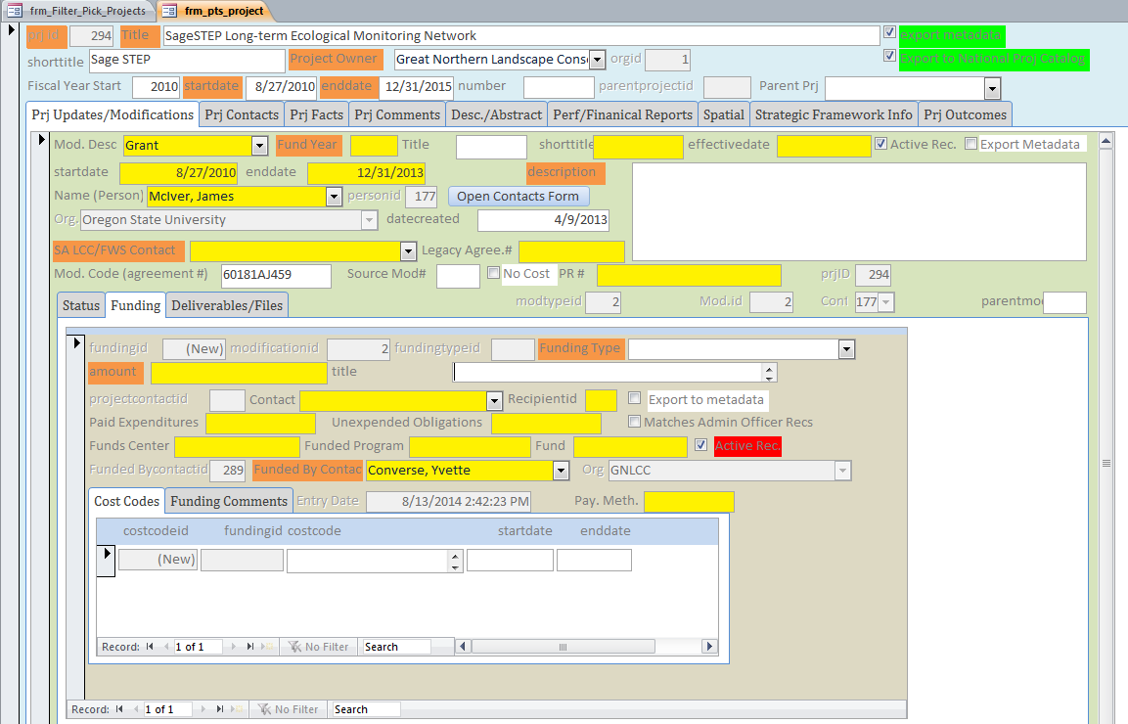
Great Northern Project Tracking System
(based on Arctic Project Tracker)
National LCC Project Catalog
Manual entry
OR
Standardized metadata in
.CSV
ingest Simple National Project Catalog spreadsheet
Microsoft Access
Low/moderate technical overhead
Project tracking features (i.e. lcc strategic elements)
You can customize it (entry forms, tables, reports, etc.)
Sciencebase linking/export options
Batch uploads of lccproject.org data
Webinar: http://greatnorthernlcc.org/event/462
MH

