Slide 1


S-TEK Project Relevance, Tracking and Communication
Jill Hardiman, Assistant Science Coordinator
Meghan Kearney, Communication Specialist
Mary Mahaffy, Science Coordinator
Steering Committee Meeting, July 9,2014

Slide 2
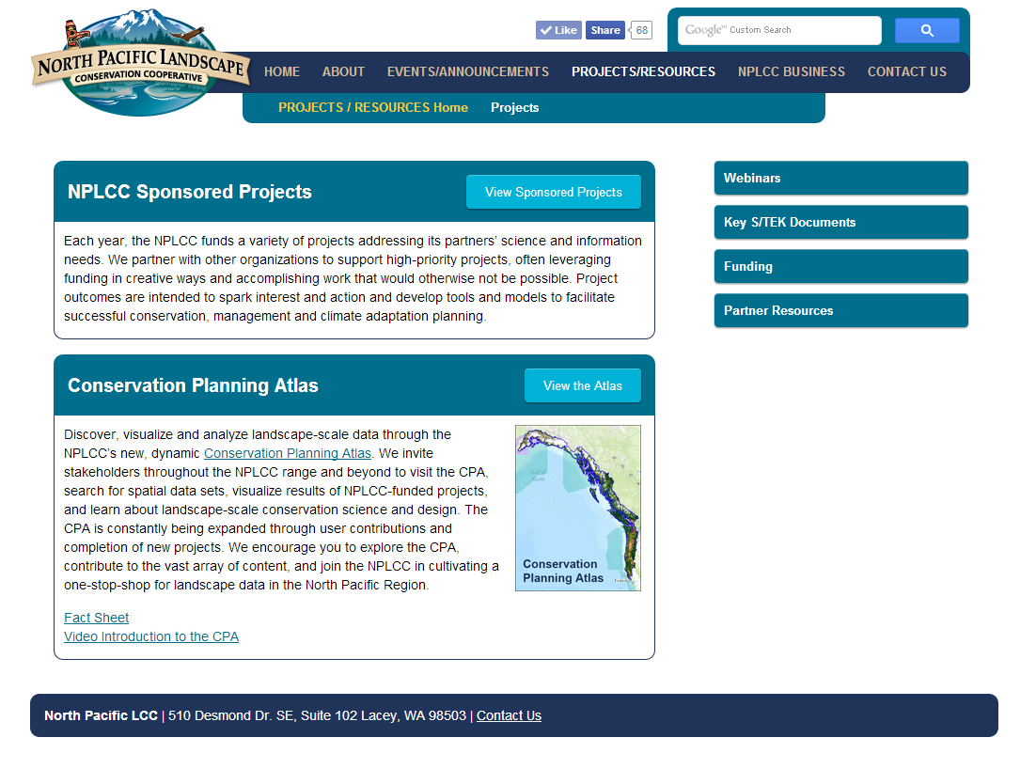

Slide 3
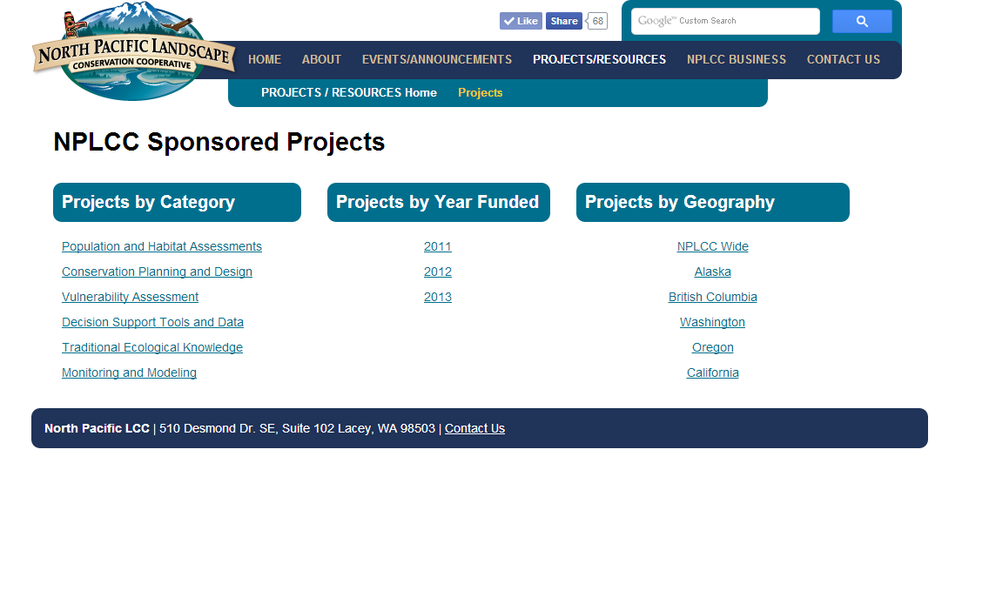

Slide 4
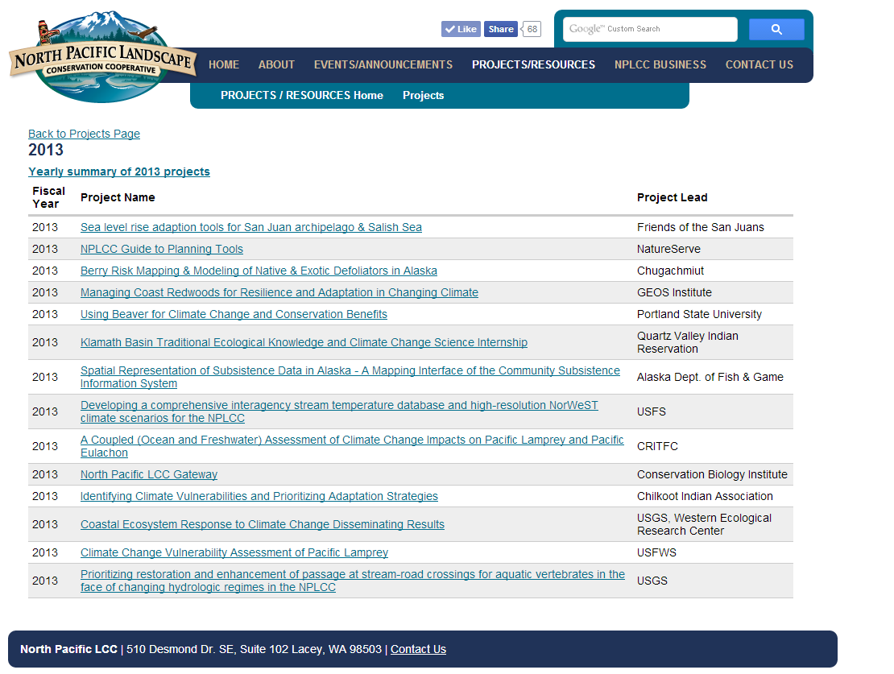

Slide 5
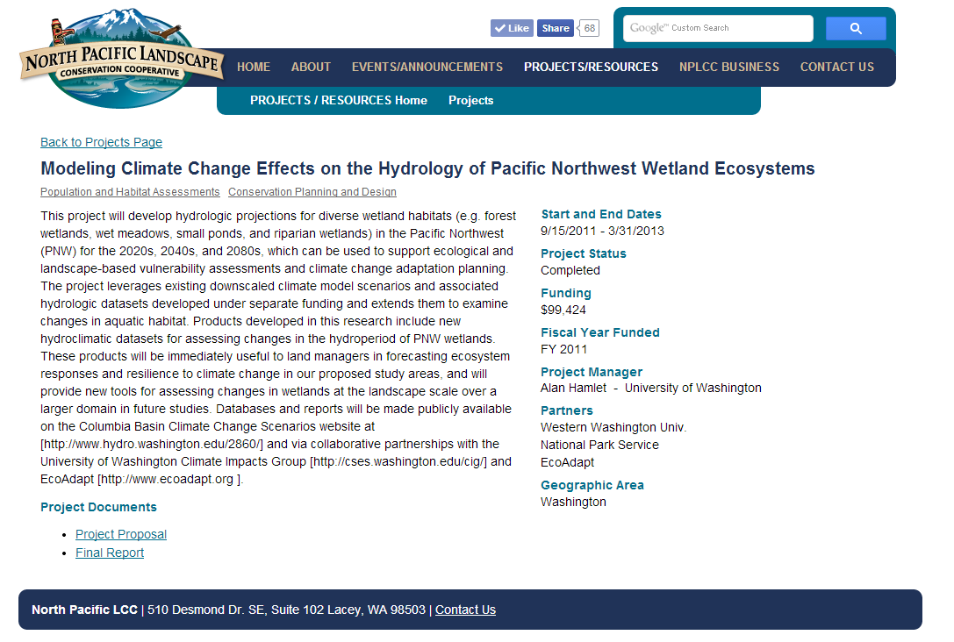

Slide 6
Project Tracking and Relevance
Project tracking data base provided by Matt Heller, GNLCC
Customizing for NPLCC
  Priority topics
  Goals
  Project category
  Deliverables

Slide 7
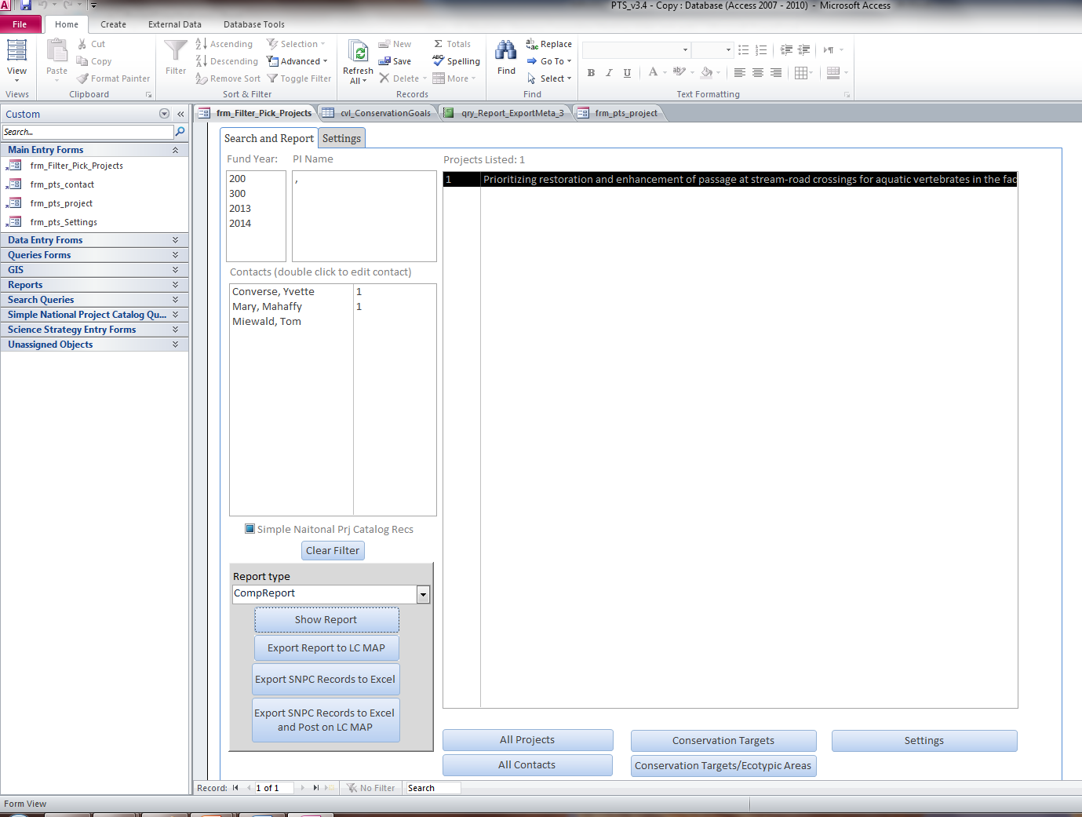
Project Tracking Database

Slide 8
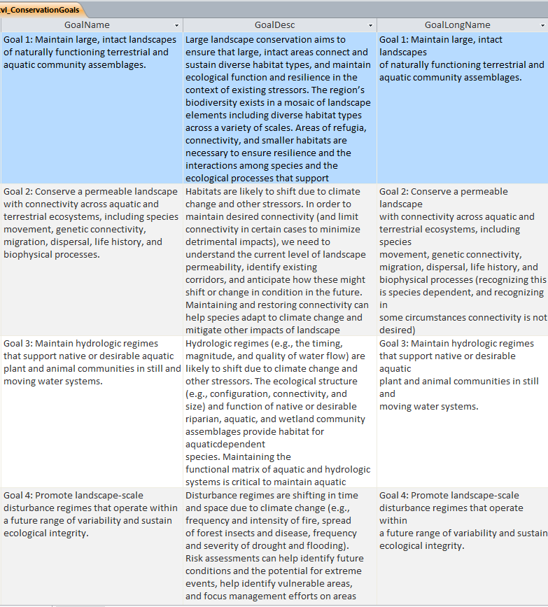
Conservation Goals

Slide 9
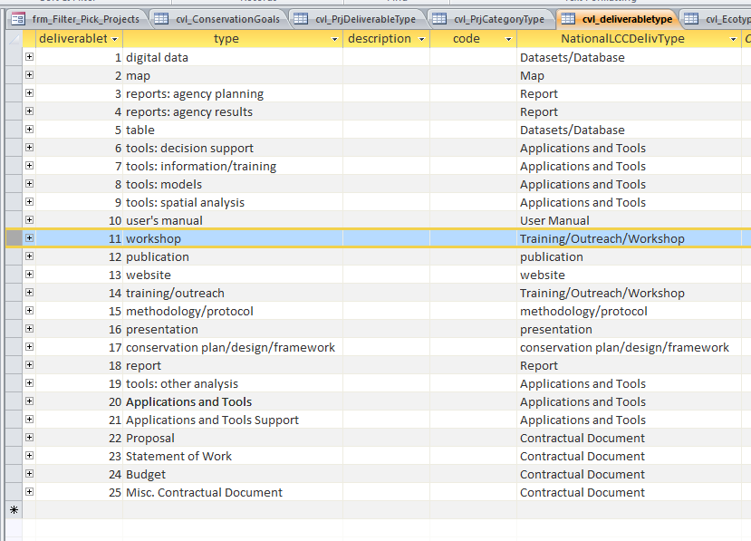
Project Deliverable Types

Slide 10
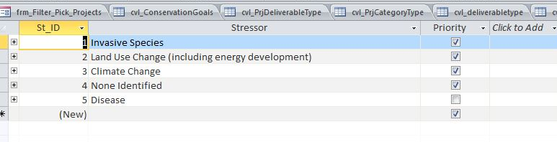
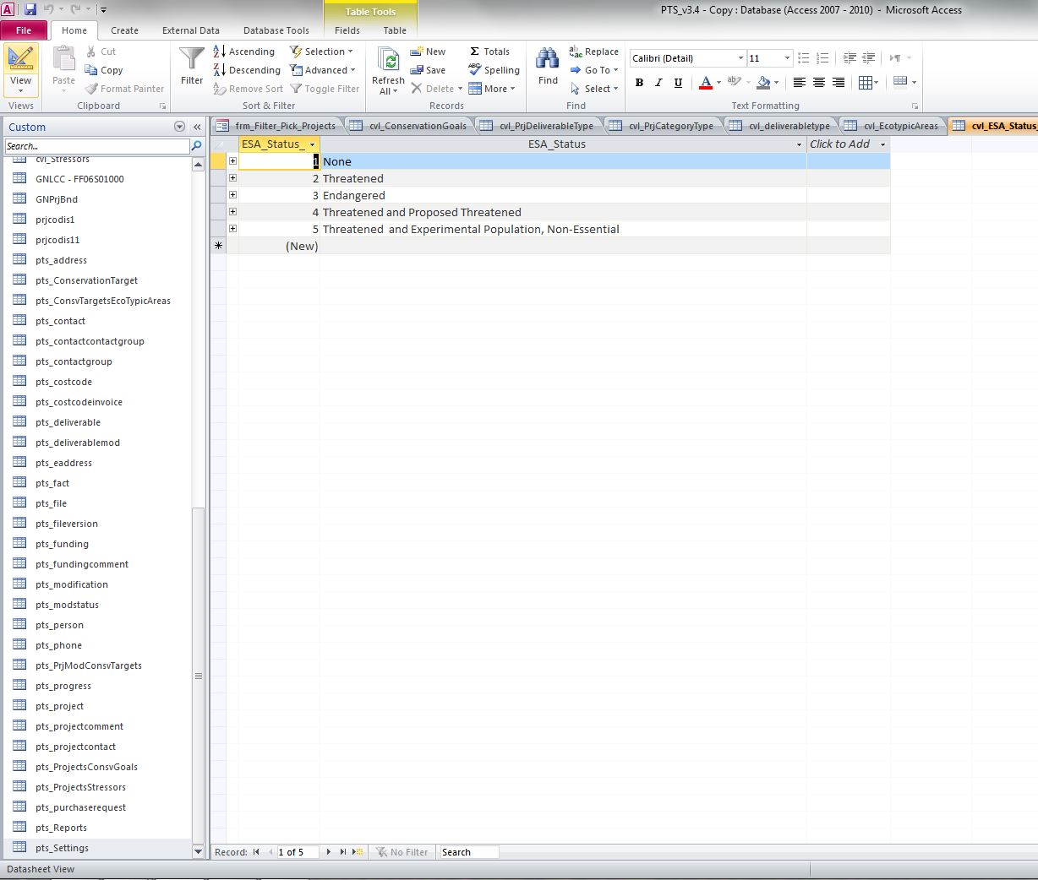
Project Themes and ESA Status

Slide 11
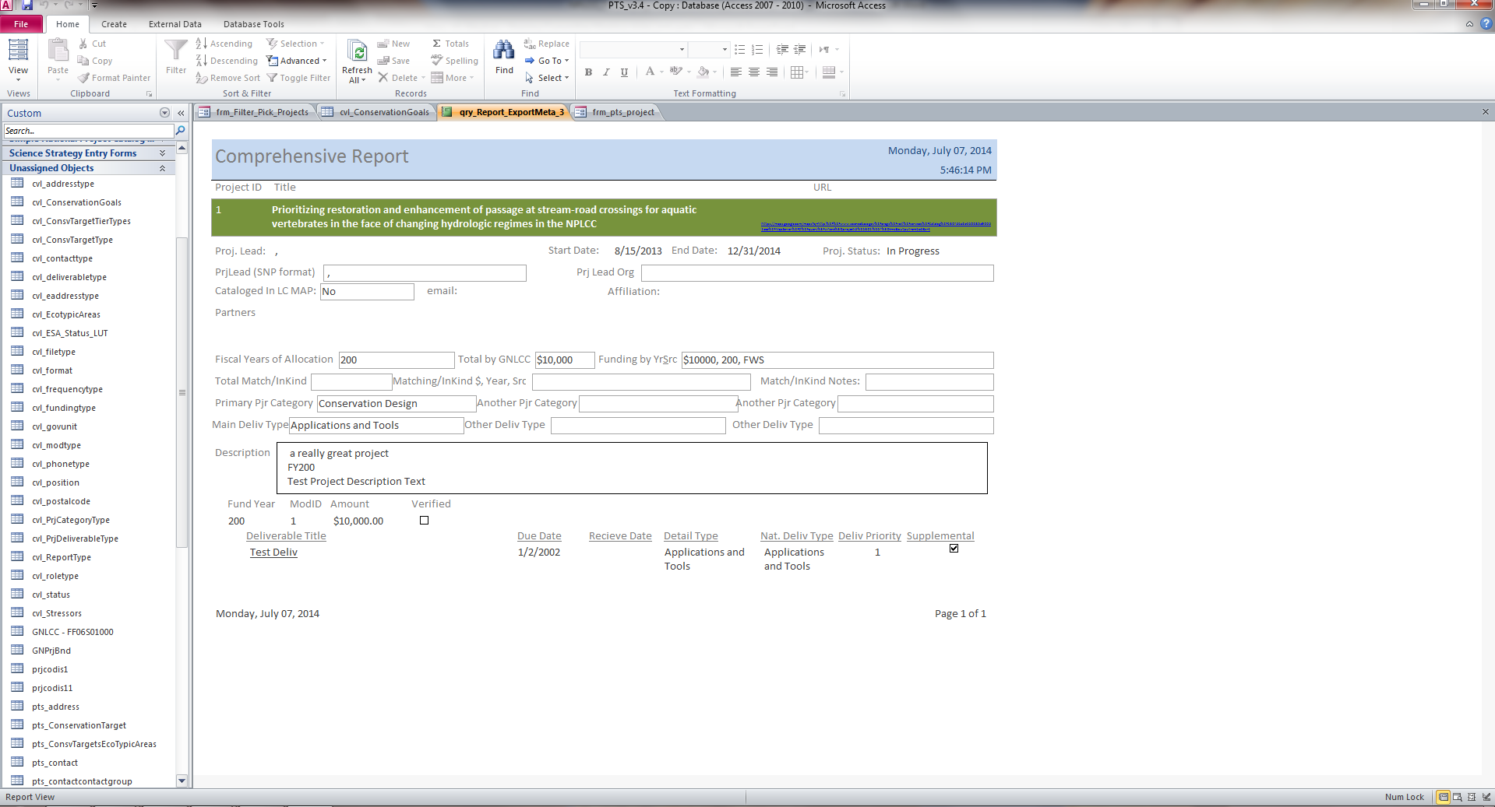
Project Reports

Slide 12
Implementing Communication & Outreach Strategy
Milestone Notifications
  Timely & appropriate COR pieces
  Awareness of COR opportunities (photo ops, invites)
Tracking Outreach Documents & Links
  Factsheets, webinars, news stories, etc.
  Keep track of who, when, where
  Stored/Organized within each Project’s record
  Any type of outreach we do can be tracked within

Slide 13
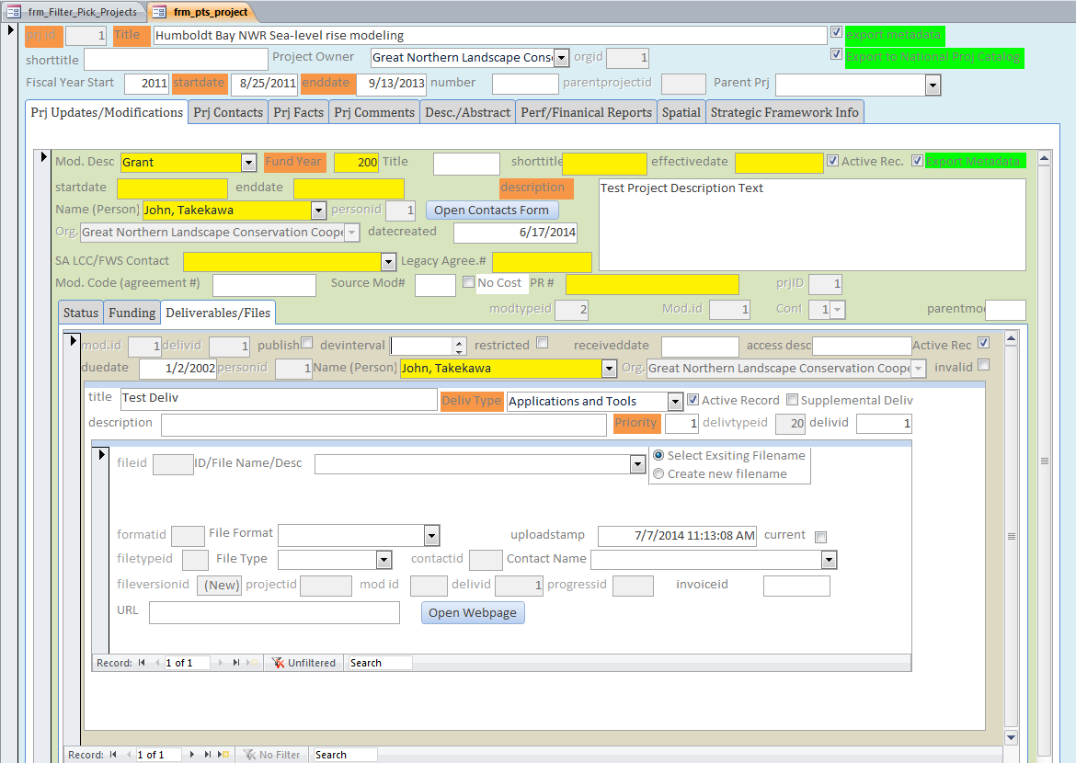
Storing COR Pieces - Deliverables

Slide 14
Questions for the Steering Committee
  How do you track use of your project products?
  Do you have good case examples to share?
  Are there key metrics you think the NPLCC should track?
  How can we increase use of NPLCC products in your organization?

