Slide 1



Project Management and Accountability
Practices
Frank Shipley, Chair, S-TEK Subcommittee
Mary Mahaffy, Science Coordinator
Tom Miewald, Data Management Specialist
Steering Committee Discussion – July 9, 2014

Slide 2

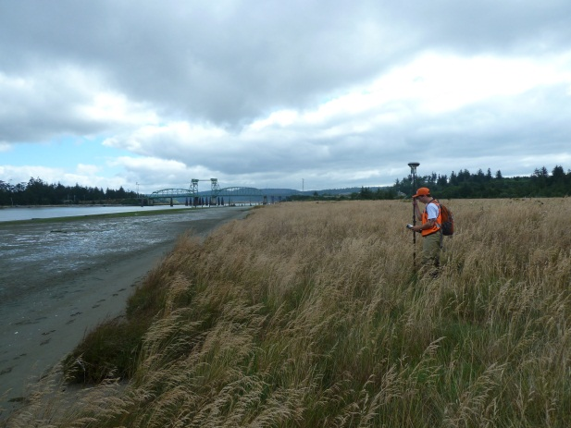
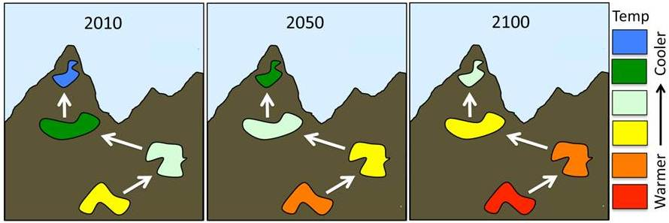
Awarding and managing project funding
Primary objectives
  Accountability of use of funds
  Relevance of project outcomes and products
Guidance for NPLCC-Sponsored Projects
  Initiation to close-out
  Consistency for project management
Nature Conservancy/UW Project
USGS- Humboldt Bay SLR Project
Notes:
Cooperatively manage data and information provided to the NPLCC to address shared natural resource challenges

Slide 3

Project Management and Accountability Elements
Identification of project priorities
  Tiered planning approach
Solicitation and award of projects
  Competed using RFP
  Directed
Project implementation
  Project management database
  Project tracking
  Peer review
  Delivery project outcomes
Chilkoot Indian Association Project, Photo: Brad Ryan

Slide 4
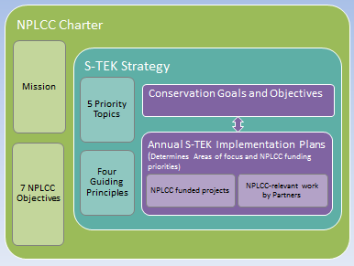
Determining Project Priorities

Slide 5
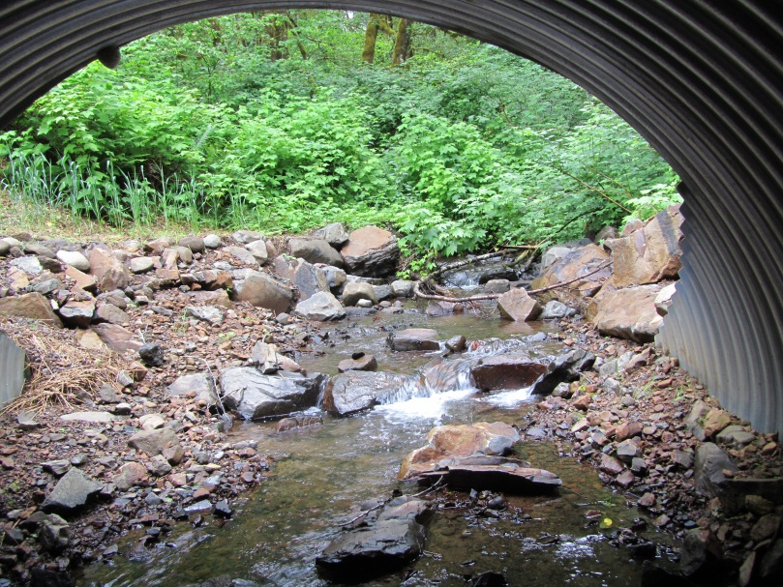
Solicitation and Award of Projects
Competed projects – RFP
  Pre-proposals / full proposals
    Proposal templates
    Review criteria
  RFP Announcements
    Grants.gov
    NPLCC website
    NPLCC newsletter
Directed projects
  Specific qualification
  Full proposal
USGS Culvert Project; Photo by R. Reagan
Notes:
Clear process established
Directed – meet requirements of the agency or other entity managing the agreements

Slide 6
Solicitation and Award of Projects
All Projects
  Review Process
    Reviewer conflict of interest and confidentiality statements
    Minimum 3 reviewers
    S-TEK members plus additional qualified peer reviewers
  Steering Committee Project Selection
    Recommendations Science/TEK Subcommittee
    Deliberation mix competed and directed projects
    Deliberation project portfolio balance – equally qualified projects
Notes:
Clear process established
S-TEK recommendations based on project rankings and other considerations brought up during proposal discussions (technical or other concerns)

Slide 7

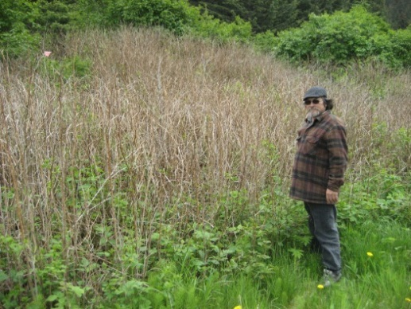

Solicitation and Award of Projects
All Projects
  Approval Process
    Steering Committee
    Delegated Ad Hoc Committee
      Steering Committee Co-Chairs
      Chair of Science/TEK Subcommittee (typo in document – missing “chair”)
USGS, Sea-level Rise Project
Chugachmiut Project
UW Project; Photo M. Ryan
Notes:
Clear process established
S-TEK recommendations based on project rankings and other considerations brought up during proposal discussions (technical or other concerns)

Slide 8
Solicitation and Award of Projects
Recommended addition
New paragraph “Awards” section (page 10)
  Give delegated Ad Hoc Committee authority for approval of small amounts of “year-end” funding (projects <$20,000 ?) without the requirement to involve the entire Steering Committee
  Projects and/or contracts for services that help implement the Science/TEK Strategy
  Include that we will seek approval from additional Steering Committee members if Ad Hoc Committee feels it is warranted

Slide 9
Project Implementation
Project management database (“master project table”)
  Available to all S-TEK Subcommittee and Steering Committee members and NPLCC Staff – used to track projects
  Portions available to the public
  Facilitate progress reporting by Science Coordinator to S-TEK Subcommittee and Steering Committee
Required reporting
  Interim progress reports (mid-year for 1 year projects and semi-annual or annual for multi-year reports
  Template developed for consistency
  Reports posted to NPLCC website

Slide 10

Project Implementation
Project review
  Data Management Plans due within 90 days project start
    Distinguish between technical and non-technical projects regarding what is required
    Tribes/First Nations not required enter data or information related proprietary or sensitive TEK or sacred sites.
  Deliverables review
    Compliance review
    “Peer” review

Slide 11
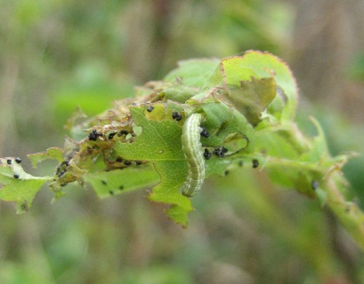
Project Implementation/ Close-out
Delivery of project outcomes
  Final Project Report
    90 days after end agreement
    Posted on website
  Data delivery
    Raw data, metadata, data products (unless proprietary)
    Stored on ScienceBase
Targeted Communications
  Partners, natural resource practitioners & public
  Possibly convene PIs, Steering Committee & additional management entities
Geometrid Moth,
Chugachmiut Project

Slide 12

Steering Committee Feedback
Ad Hoc Committee Authority to approve fiscal year-end projects (each <$20k)? (need to add new paragraph to document)
Feedback on document
Changes needed?
Ready to adopt with edits?

