Slide 1
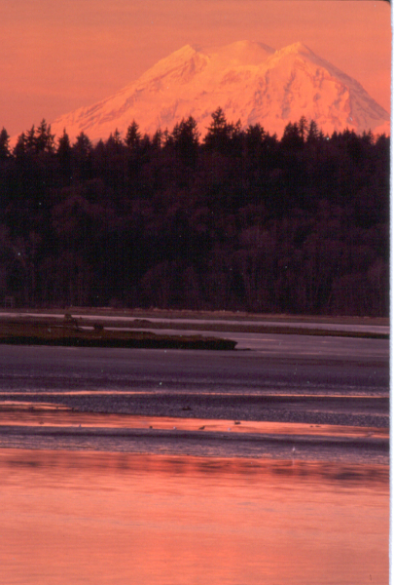

Nisqually National Wildlife Refuge Complex

Slide 2
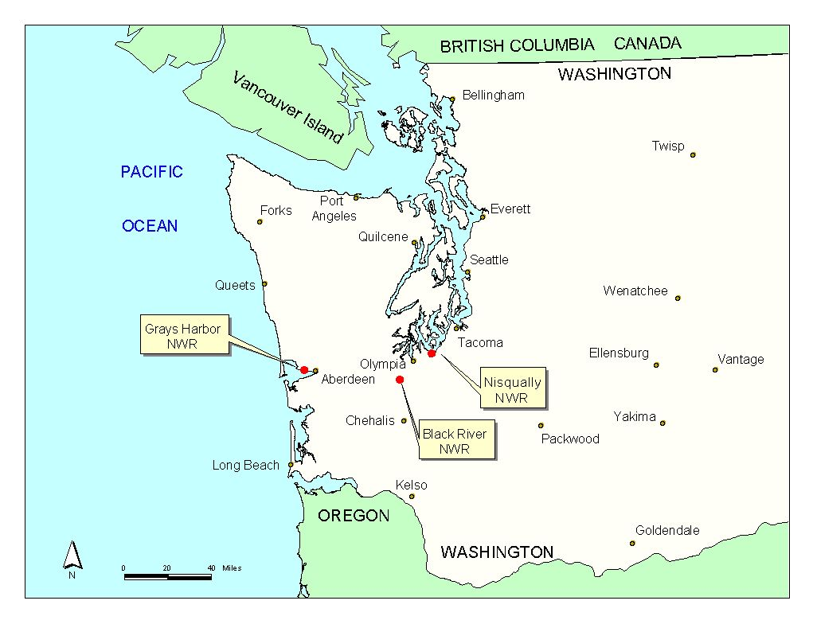

Slide 3
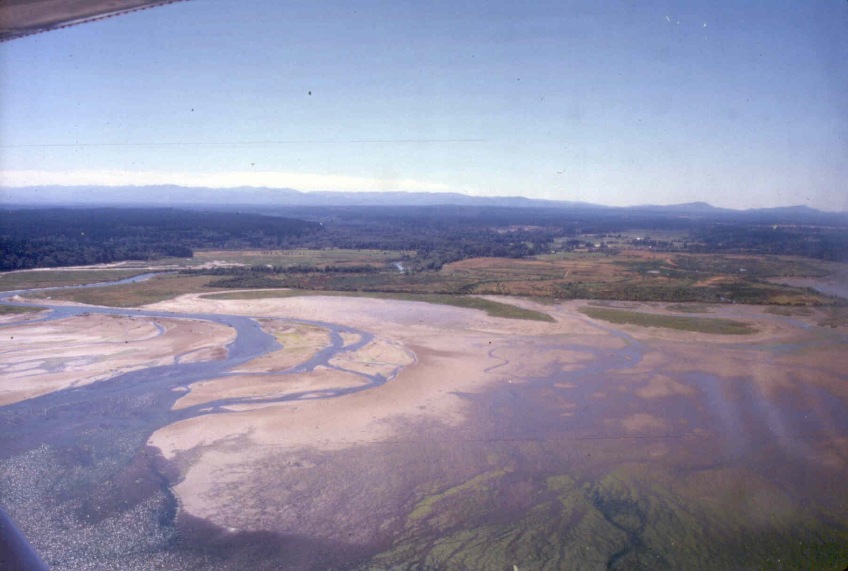
Nisqually National Wildlife Refuge

Slide 4
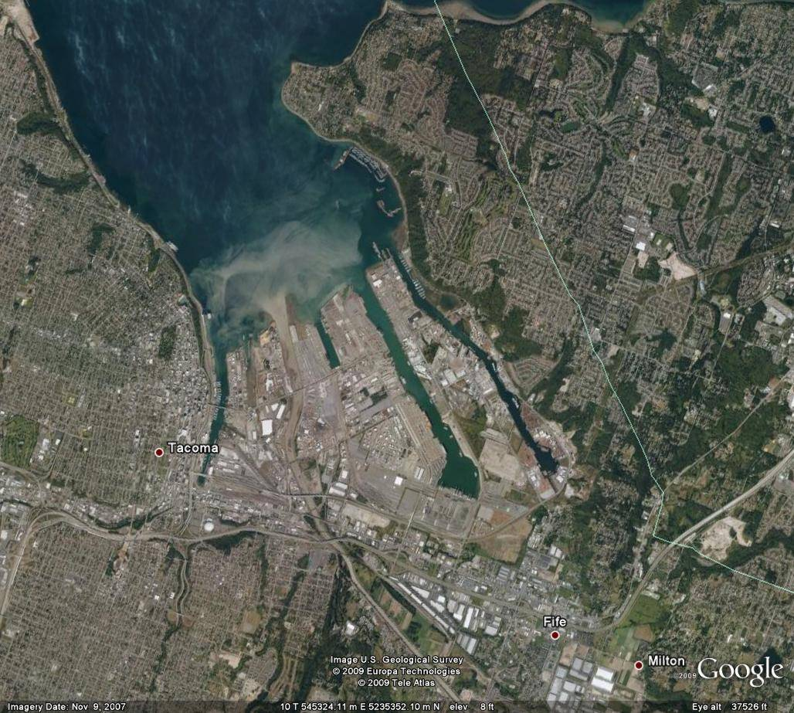
Another Puget Sound River Delta
Notes:
What the delta could have become compared to other estuaries in Puget Sound. Unique opportunity

Slide 5
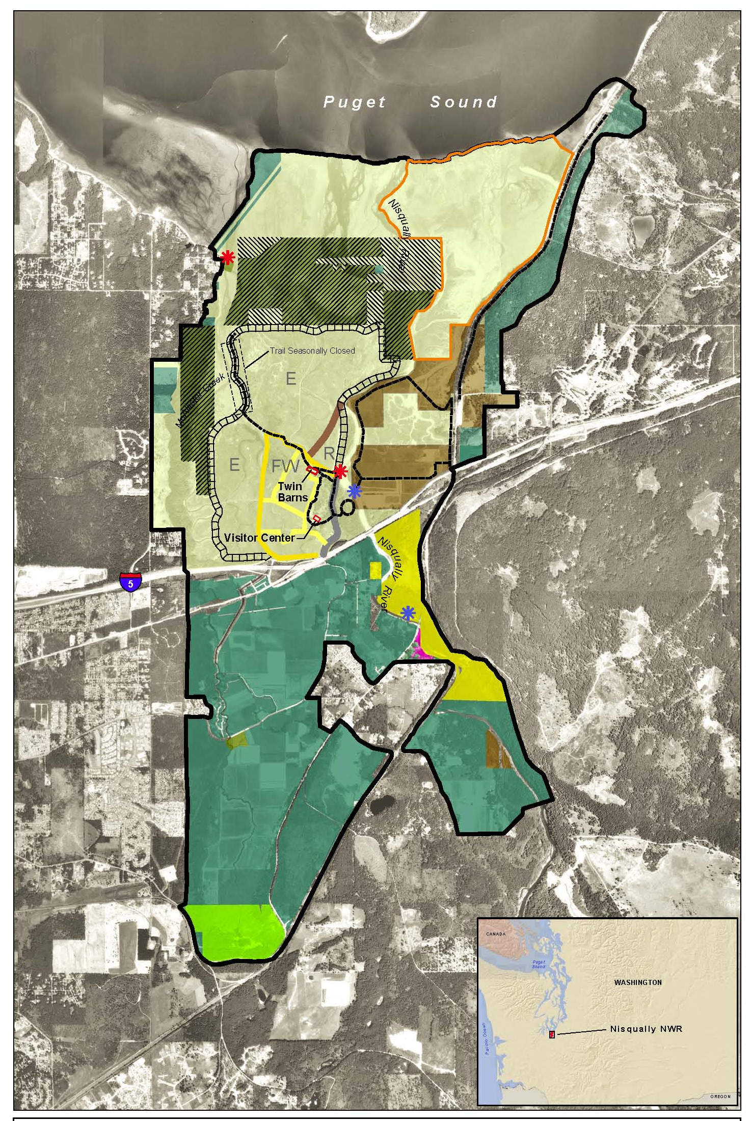

Slide 6
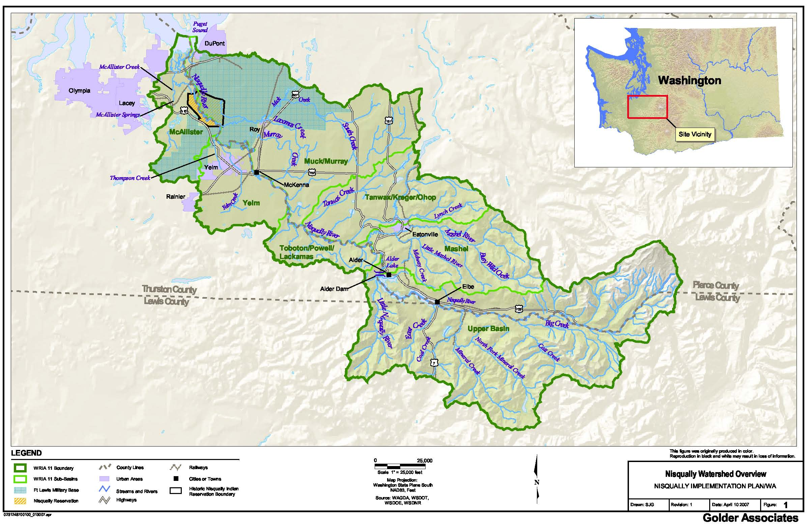
Source: Nisqually Indian Tribe. Nisqually Watershed Detailed Implementation Plan, February 2007. 25pp.

Slide 7
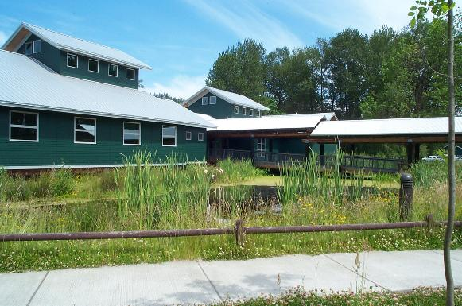
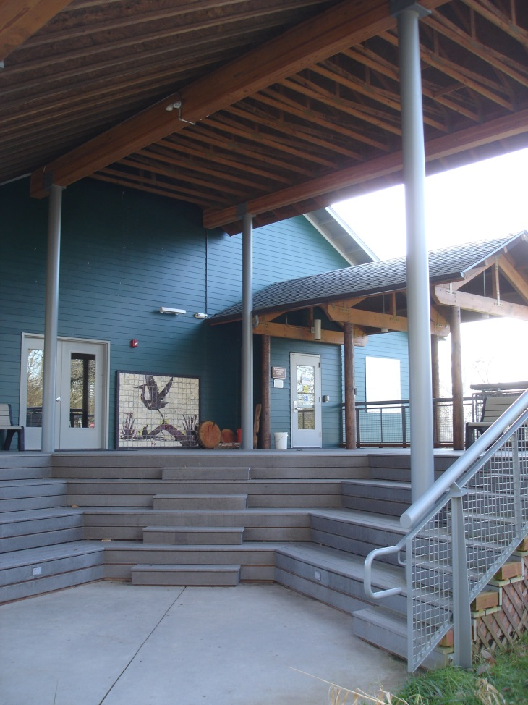
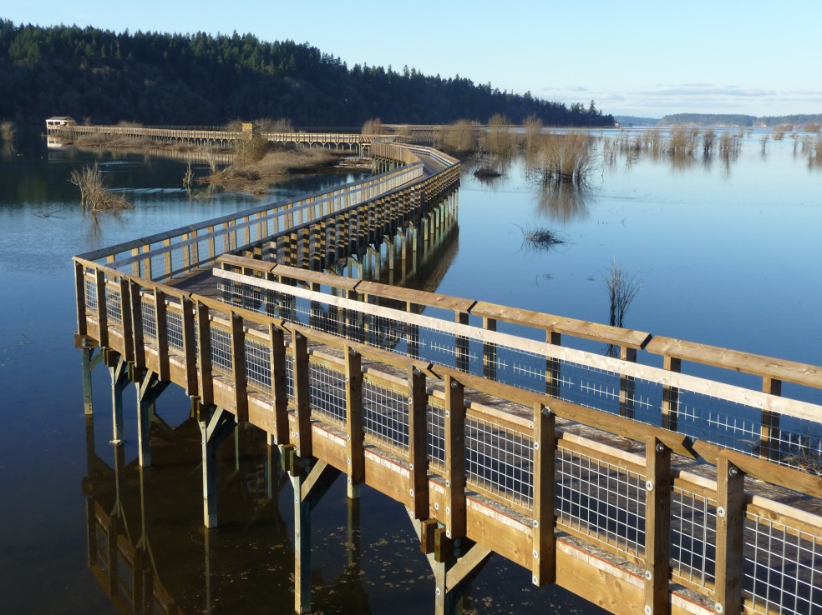
Norm Dicks Visitor Center & Administrative Building
Education Center
Nisqually Estuary Boardwalk

Slide 8
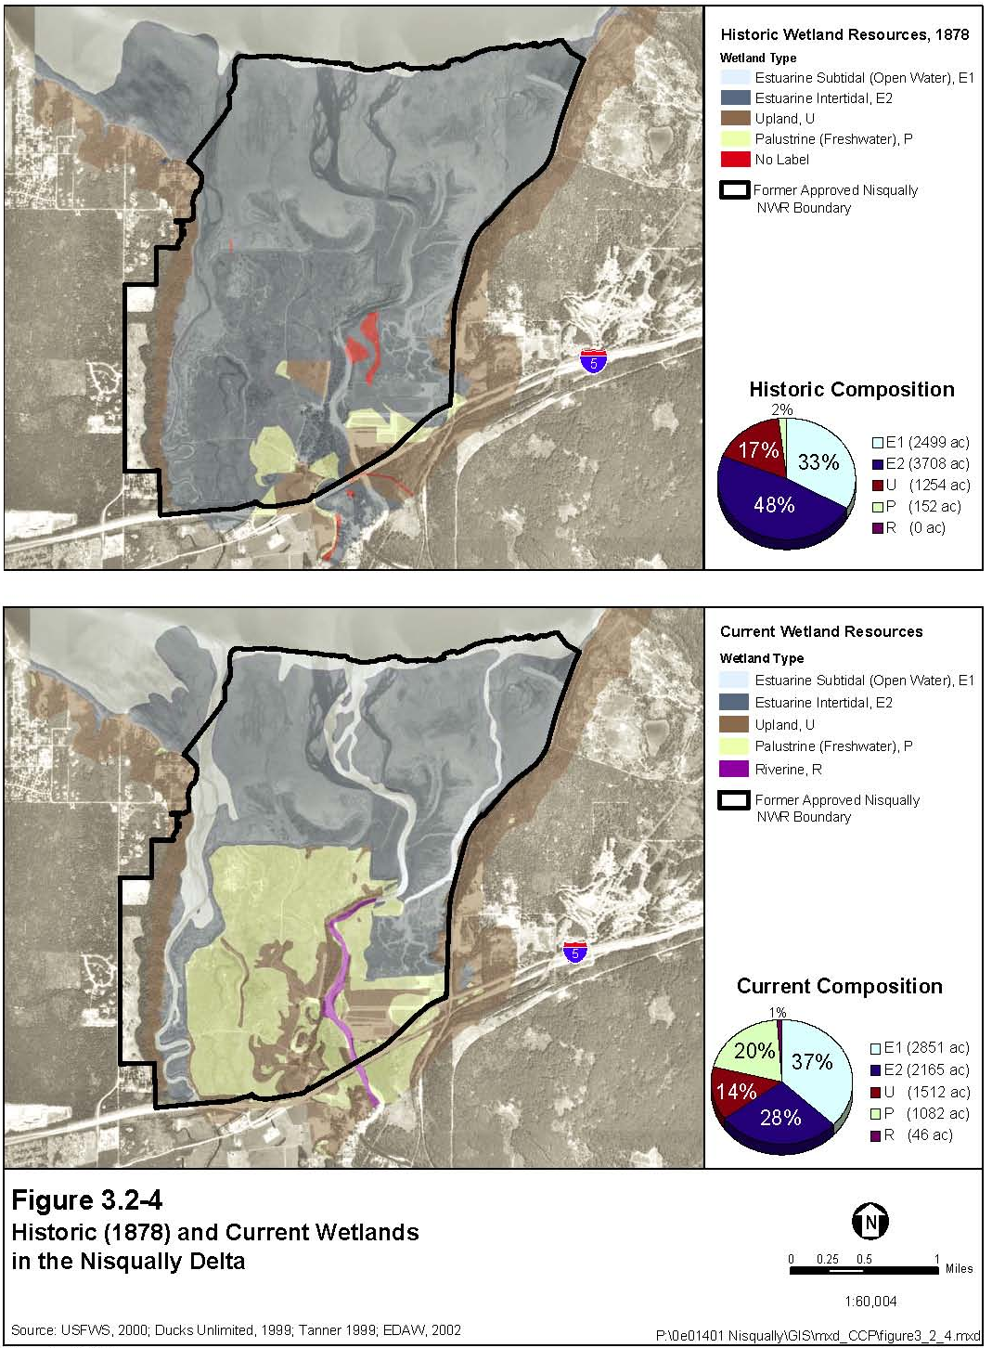

Slide 9
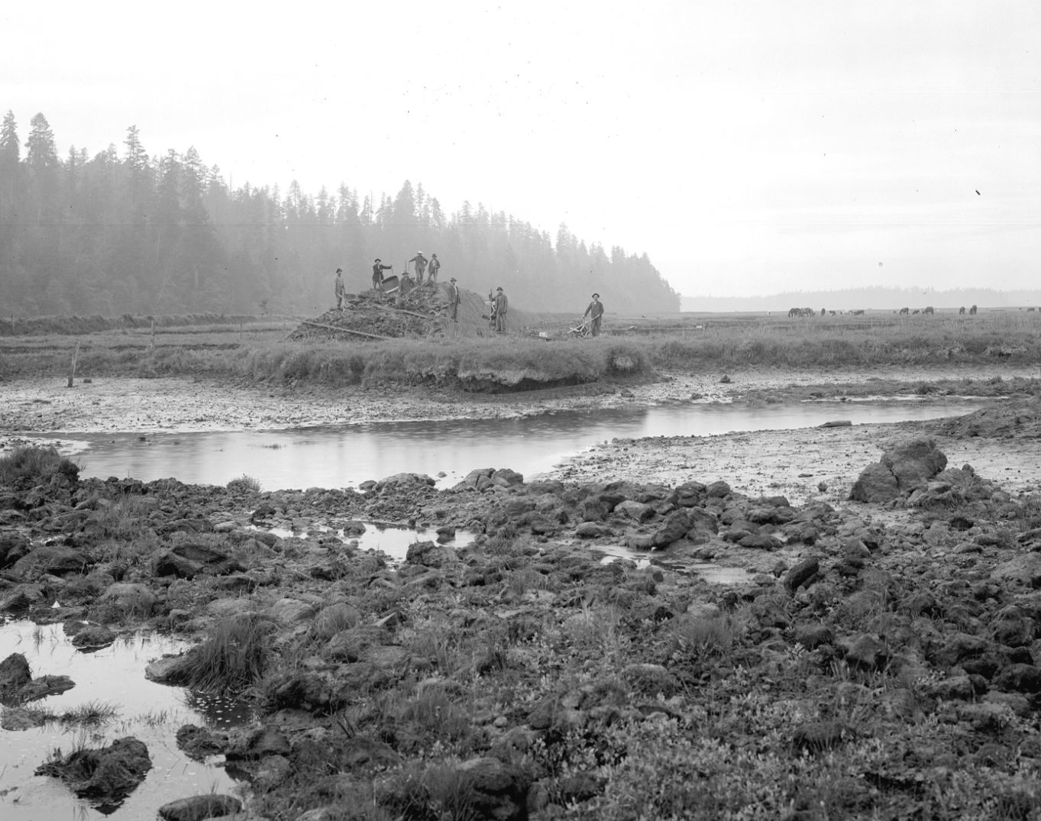
Dike Construction
(Agricultural Conversion)
1904 ~ 1910+
Photo: WA State Historical Society
Notes:
9
Allister Brown purchased over 2000 acres in 1904 building a 5 mile dike cutting of approximately 1000 acres from the tides of Puget Sound. Dike built from native materials out of borrow ditch along inside of dike. Crew of 30 with horse drawn scoop. Also significant dike costruction on the Braget Farm on the eastside of the river in the same era.
3+ yrs to Build the dike and 3 yrs to leach salts

Slide 10
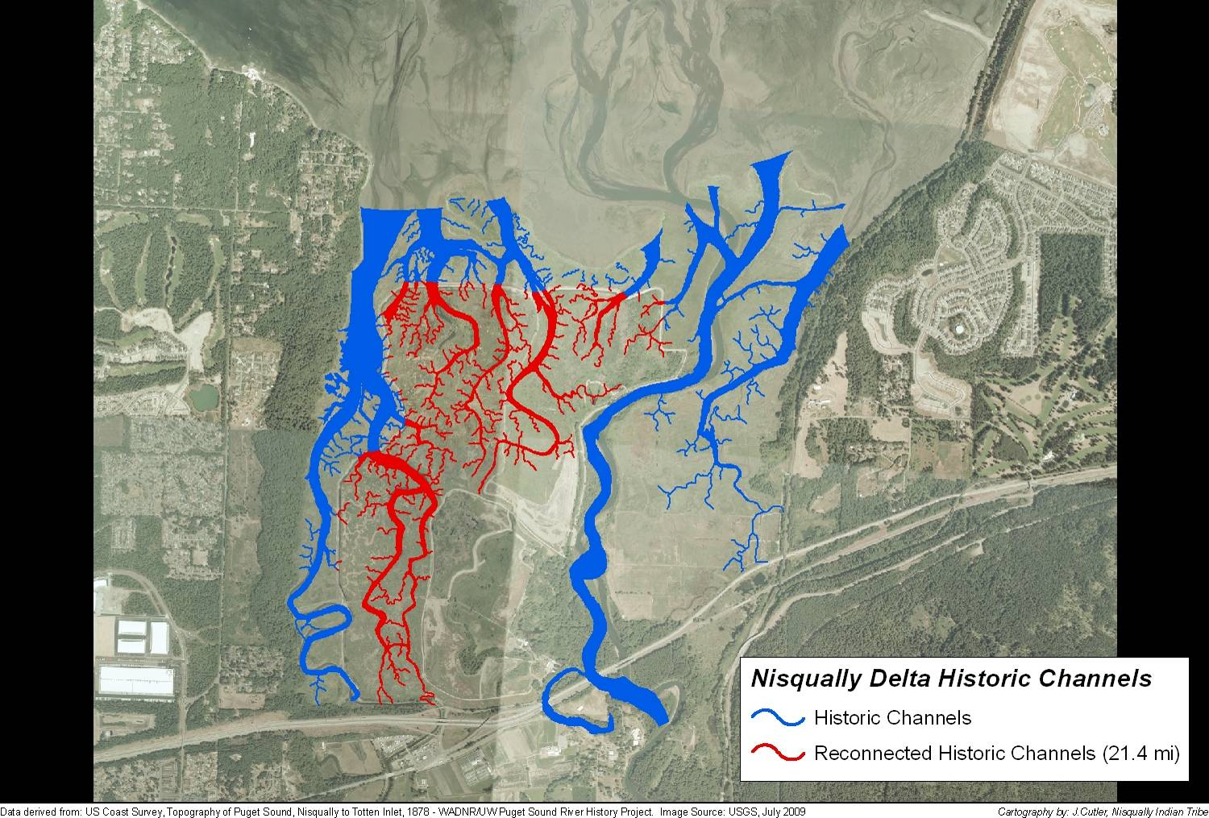
Lost Tidal Channel Habitat at the Refuge
Notes:
The building of the dike cut over 21 miles of tidal channels and slough from Puget Sound

Slide 11
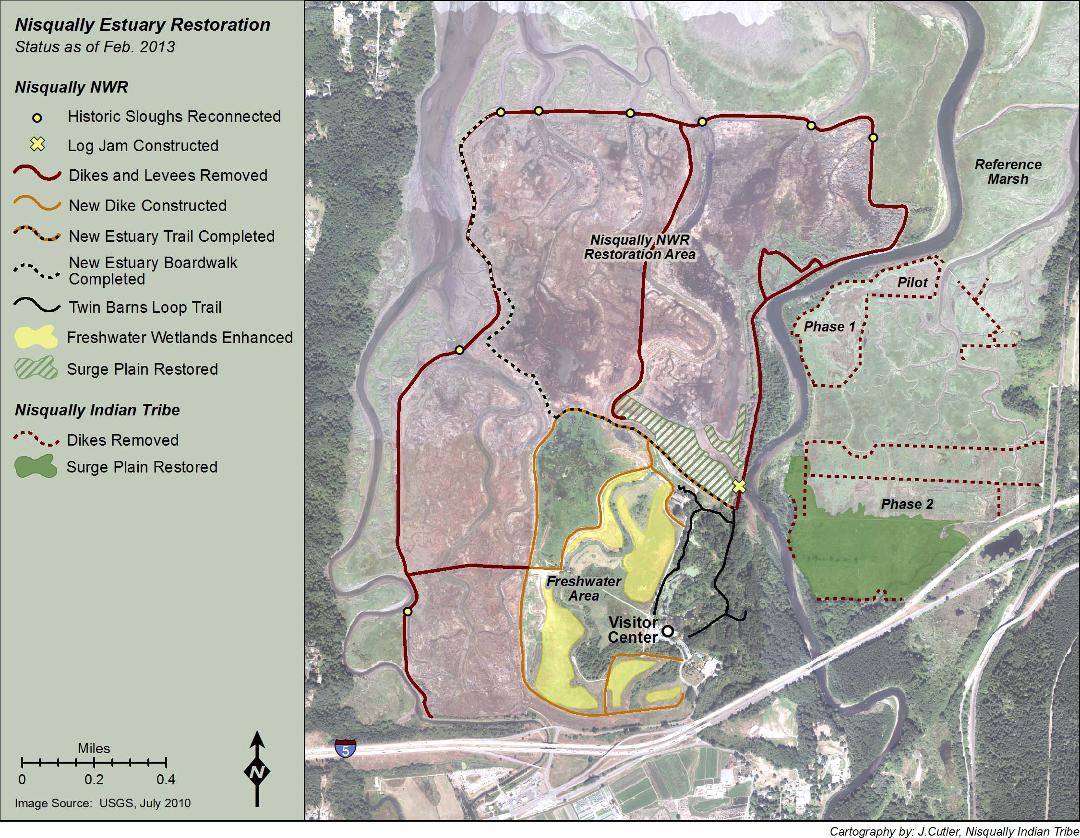
Actions Implemented 2008/2009
Notes:
Preferred alternative as implemented. 760 acres of estuary restored to tides. 250 acres of FW wetland habitat protected by setback levee, enhanced FW habitats with smaller levees/WCS and borrow areas. 25+ acres of new tidal riparian forest, reconnection of 8 significant tidal slough systems, ELJ to protect dike jct, Rock armor removal to allow river to migrate. Increased sanctuary areas. Improved FW wetlands in smaller area. New trail and boardwalk. Also NIT projects on E side of river – Pilot, Phase I, Phase II and Riparian Planting.

Slide 12
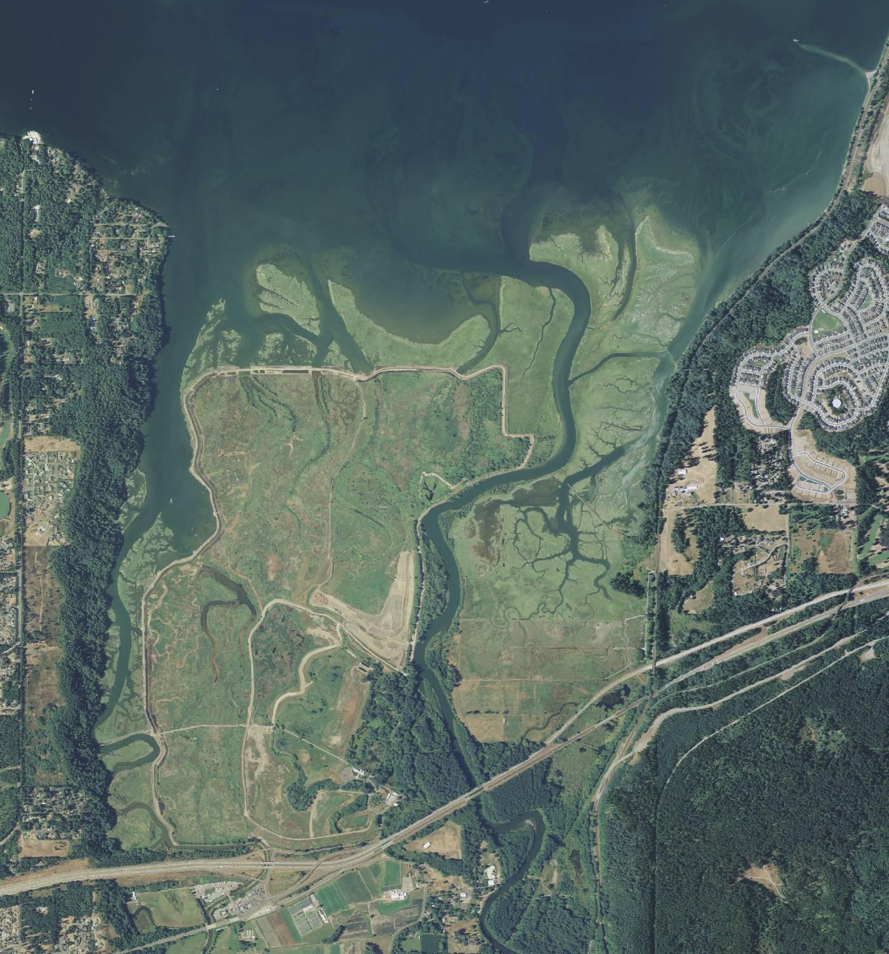
July 2009
Source:
USDA NAIP

Slide 13
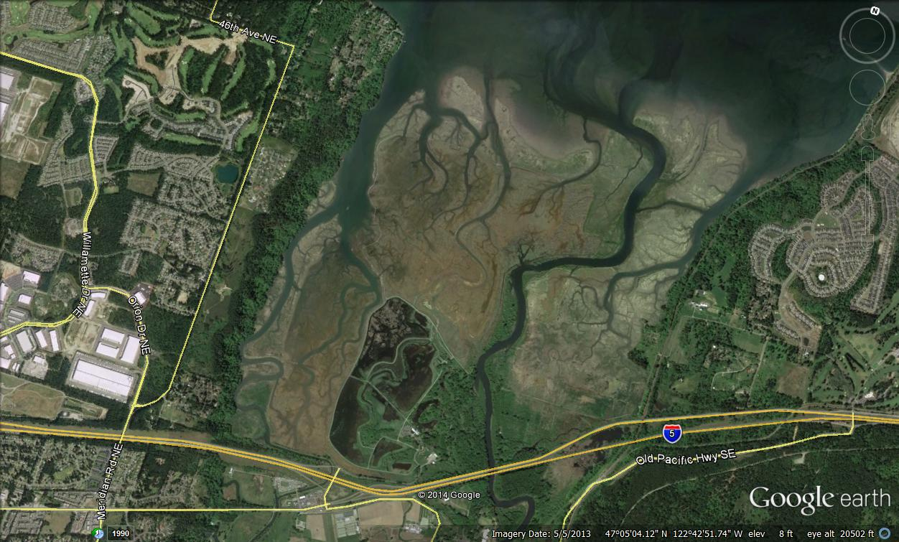
May 4, 2013

Slide 14
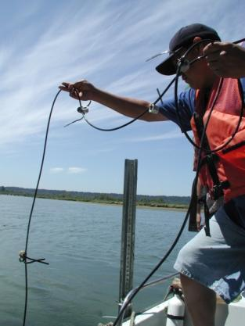
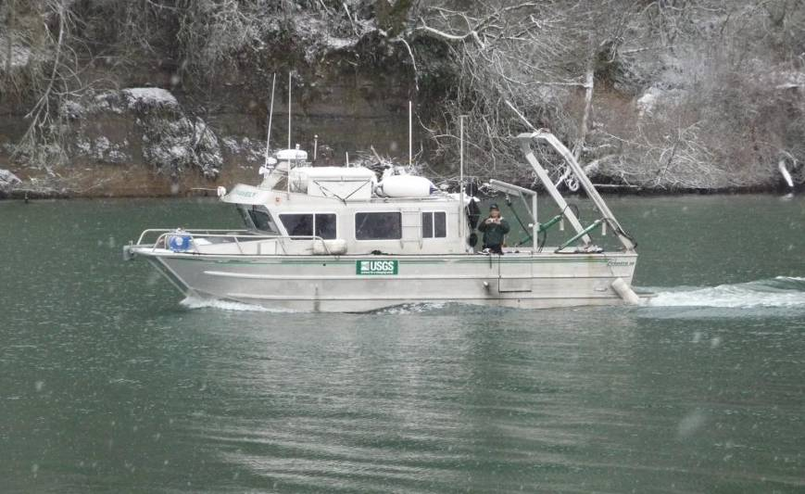

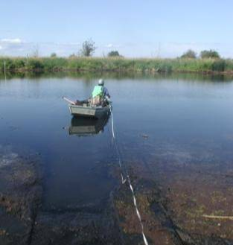
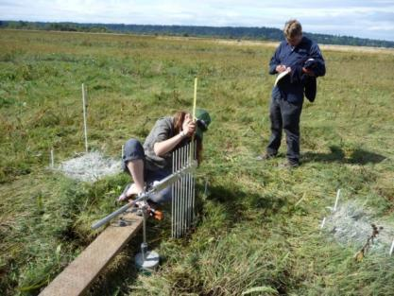
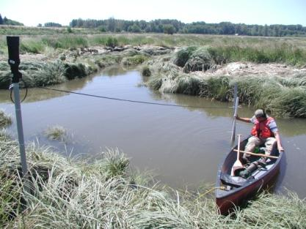
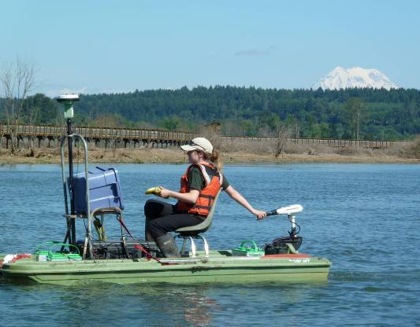
Restoration Monitoring Components abiotic factors
Aerial Photography and Remote Sensing
Photodocumentation
Hydrology
Water Quality
Geomorphology
Elevation
Sedimentation
Photos: USGS, USFWS
Notes:
14
MONITORING COMPONENTS – Now that I’ve given you a framework for our monitoring plan, I’d like to take you through our monitoring components and present some preliminary results based on this last year of data collection. This slide shows the abiotic factors we are studying. Lets first talk about aerial photographs.

Slide 15
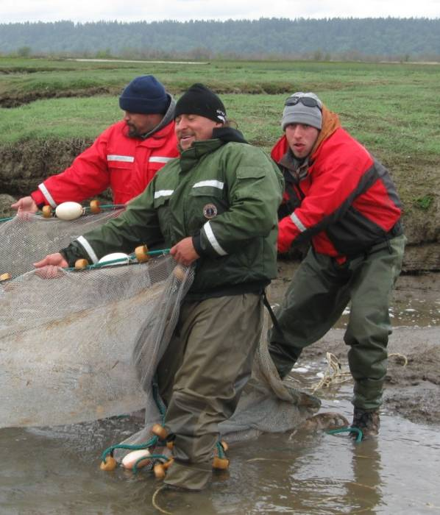
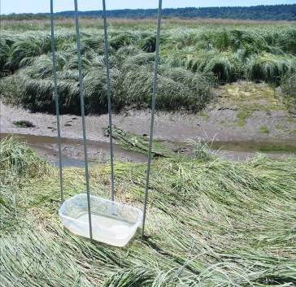

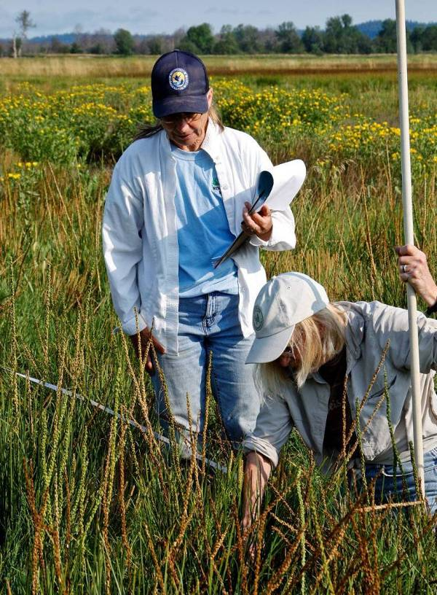
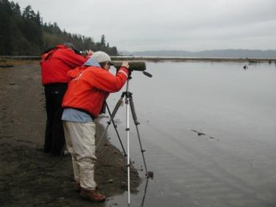
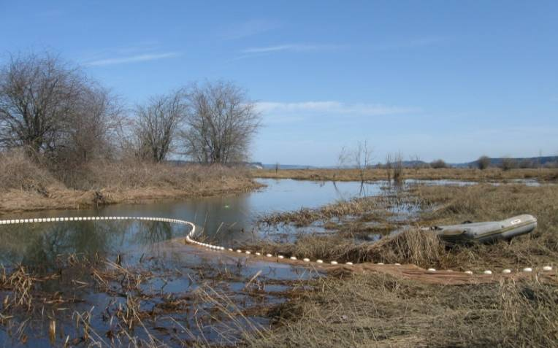
Restoration Monitoring Components biotic factors
Vegetation
Birds
Invertebrates
Fish
Photos: USGS, Nisqually Tribe
Notes:
15
BIOTIC FACTORS – Lets move on to our biotic monitoring components.

Slide 16
Let’s get outside !

