Slide 1



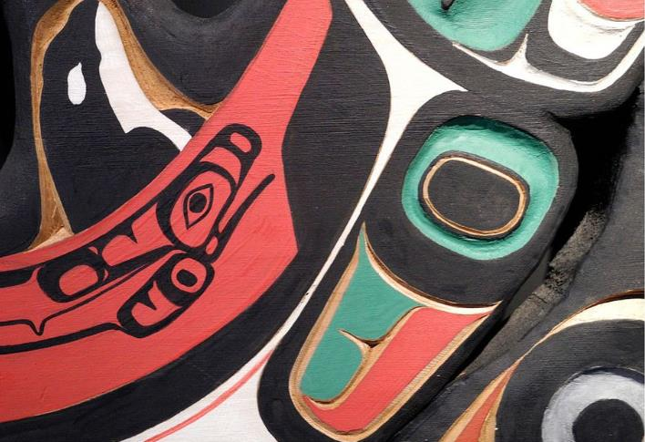
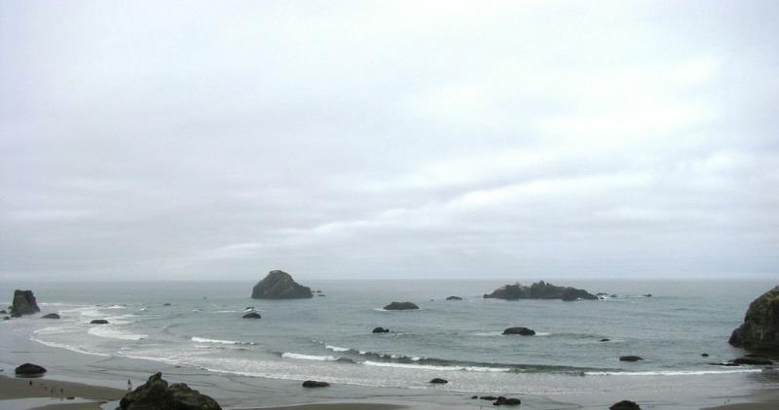
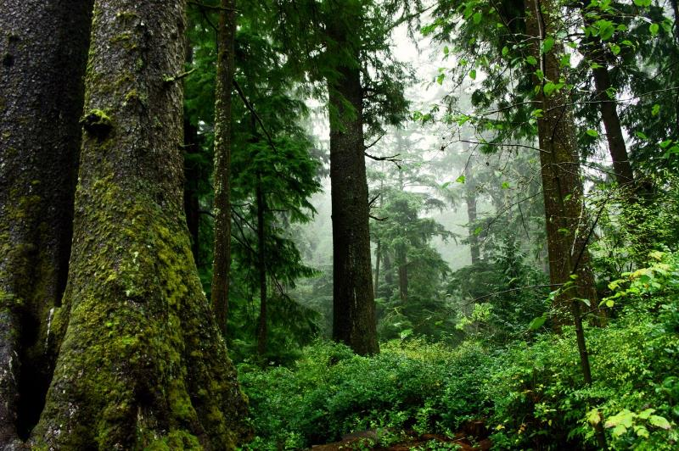

North Pacific LCC
An Overview
NPLCC Steering Committee
July 9, 2014
John Mankowski
NPLCC Coordinator

Slide 2

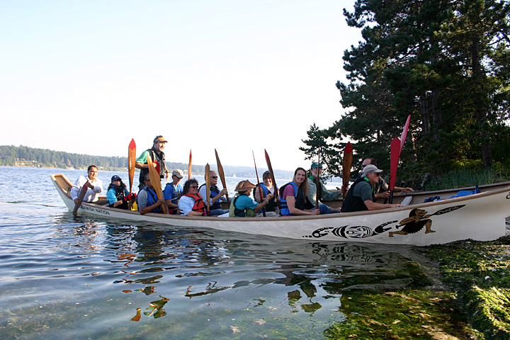
Who we are. Where we’ve been. Where we’re going.
Why Landscape Conservation Cooperatives?
North Pacific LCC
  The work we do
  How we’re organized

Slide 3

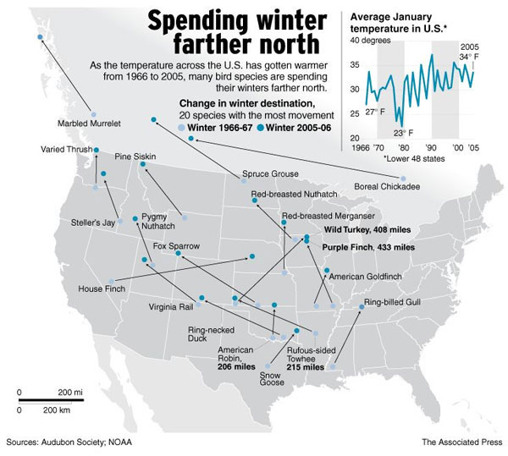
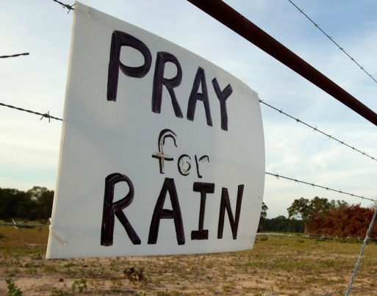

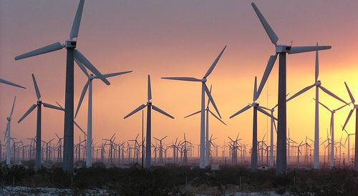
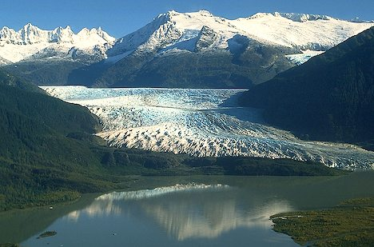
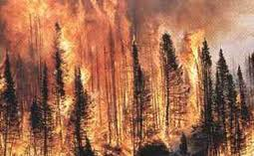
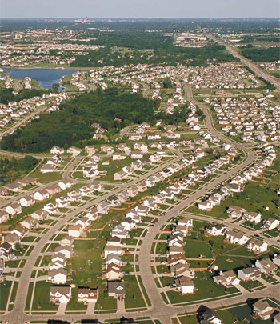
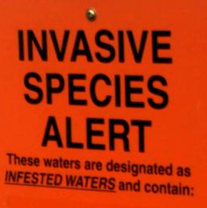
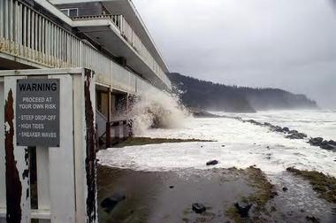
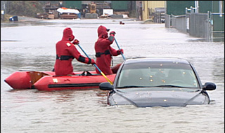
Why should we organize around LARGE SCALE Conservation?
CO2 Reaches 400 ppm: 1ST Time in 3 MILLION YEARS

Slide 4

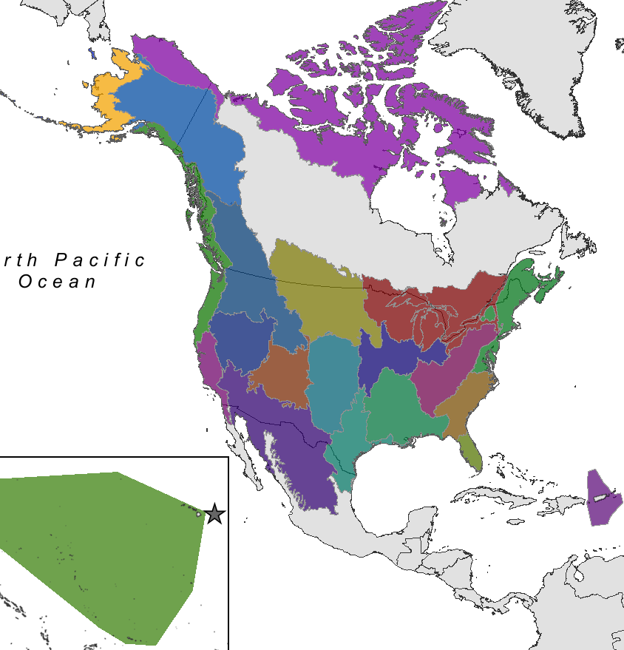
LCC Geographic Framework
Administration response to Climate Change
  Sec Order - 3289, 2009
  22 LCCs; (8 CSCs)
  Led by - FWS, BOR, USFS, BLM
Self-directed partnerships
Respond to regional threats; Natural & Cultural Resources
Leverage, develop goals/tools, link science-mgt., facilitate info exchange
Work with other federal CC programs, like CSCs, USFS Hubs, RISAs, etc.

Slide 5
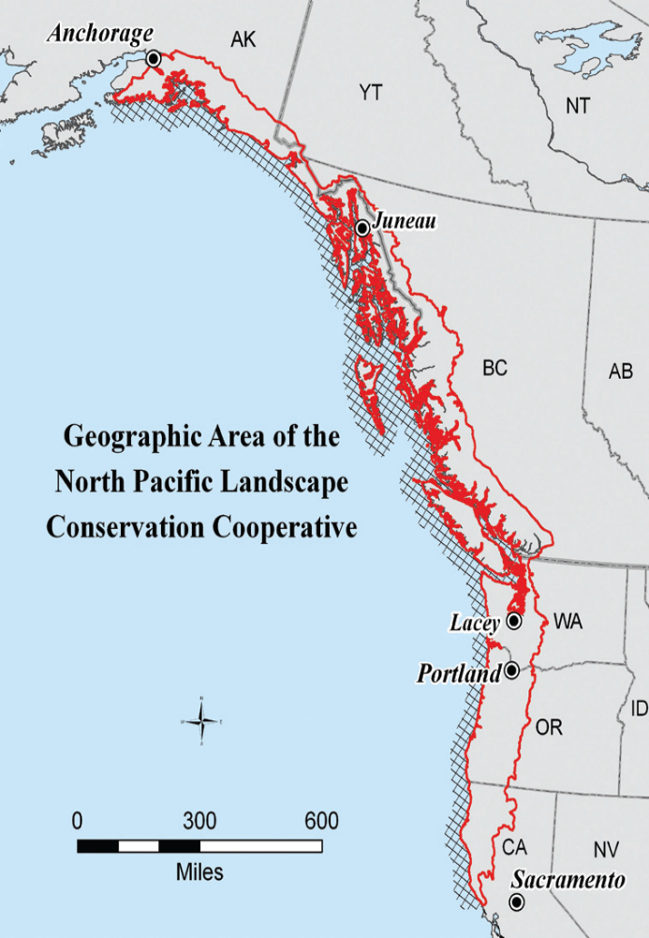
Who?
2 Countries
200+ Tribes and First Nations
4 States, 1 Province, 1 Territory
What?
Understand and respond to climate-related large-scale stressors
  Traditional Knowledge and western science
Build trans-boundary bridges (international, jurisdictional, geographic)
Provide broader context to conservation efforts
Share information, experiences, best practices
Where?
Entire range of Pacific Coastal Temperate Rainforest
Terrestrial & Freshwater Aquatic Ecosystems
Adjacent Marine Ecosystems (shorelines, estuaries, nearshore)
Why?
Face larger-scale challenges with shrinking fiscal resources
Natural & cultural resources know no boundaries,
Become a Community of Practice

Slide 6
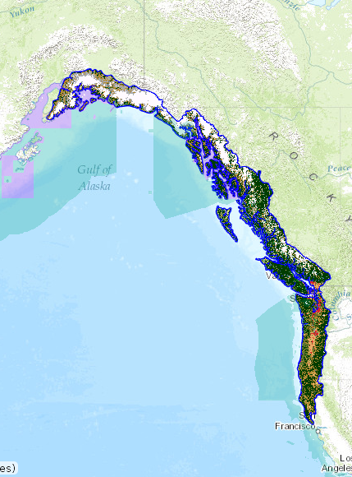
NPLCC Mission:
Promote development, coordination & dissemination of science
to inform landscape-level conservation & sustainable resource management
in the face of a changing climate and related stressors.
Notes:
If you need to leave out a slide – I recommend this one (or just briefly mention points here)
In FY 2012 – a focus was placed on funding TEK projects throughout the NPLCC. We hope to learn more about how and where TEK can be incorporated into NPLCC actions and management decisions. We may also need to update the Science/ TEK Strategy and the Implementation Plan based on lessons learned with these projects.
Currently on our website are draft reports that National Wildlife Federation prepared that compile literature and synthesize information about climate change effects and adaptation approaches for freshwater and for marine and coastal ecosystems in the entire range of the NPLCC. They are in the process of preparing a similar report for terrestrial habitats.
A cross –boundary data sharing workshop that will be held in Vancouver. B.C. was also supported. The Alaska Coastal Rainforest Center hosted the first two workshops and this third workshop will build on the past efforts.

Slide 7

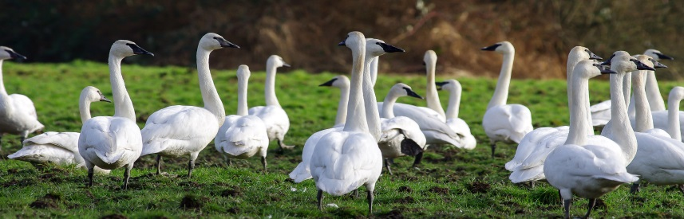
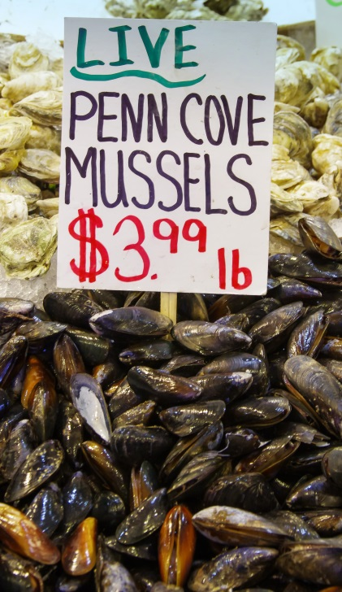
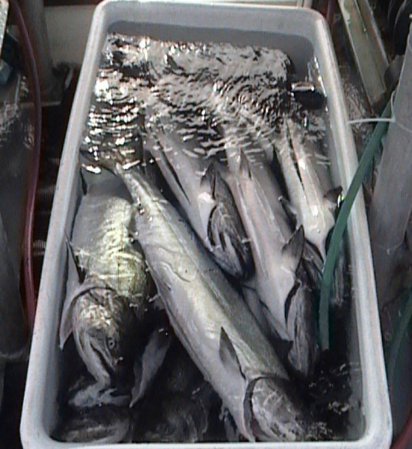
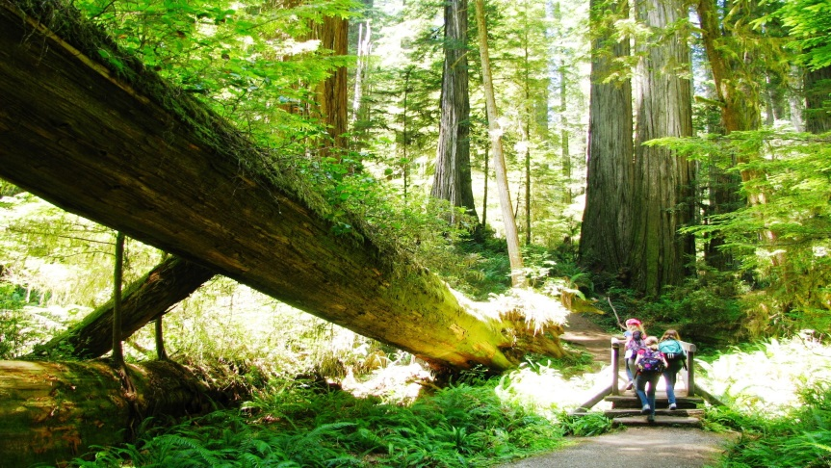
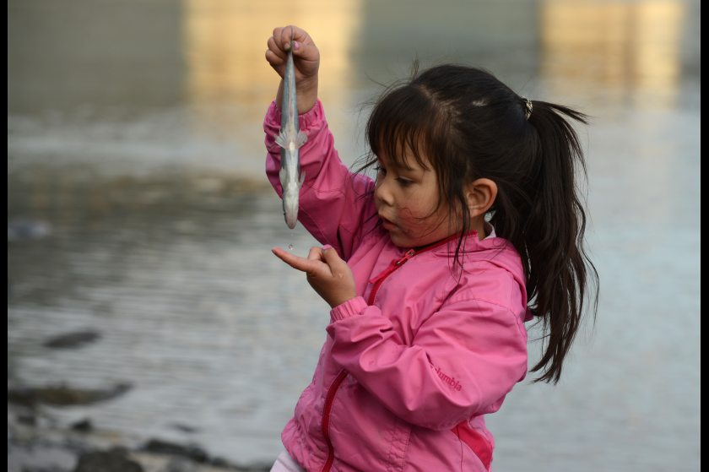
Seven Goals Guide our Work on:
Conservation & restoration
Unique role of NPLCC
Information Priorities, Use, Availability
Partnership Coordination and Efficiency
Outreach and education
Notes:
If you need to leave out a slide – I recommend this one (or just briefly mention points here)
In FY 2012 – a focus was placed on funding TEK projects throughout the NPLCC. We hope to learn more about how and where TEK can be incorporated into NPLCC actions and management decisions. We may also need to update the Science/ TEK Strategy and the Implementation Plan based on lessons learned with these projects.
Currently on our website are draft reports that National Wildlife Federation prepared that compile literature and synthesize information about climate change effects and adaptation approaches for freshwater and for marine and coastal ecosystems in the entire range of the NPLCC. They are in the process of preparing a similar report for terrestrial habitats.
A cross –boundary data sharing workshop that will be held in Vancouver. B.C. was also supported. The Alaska Coastal Rainforest Center hosted the first two workshops and this third workshop will build on the past efforts.

Slide 8

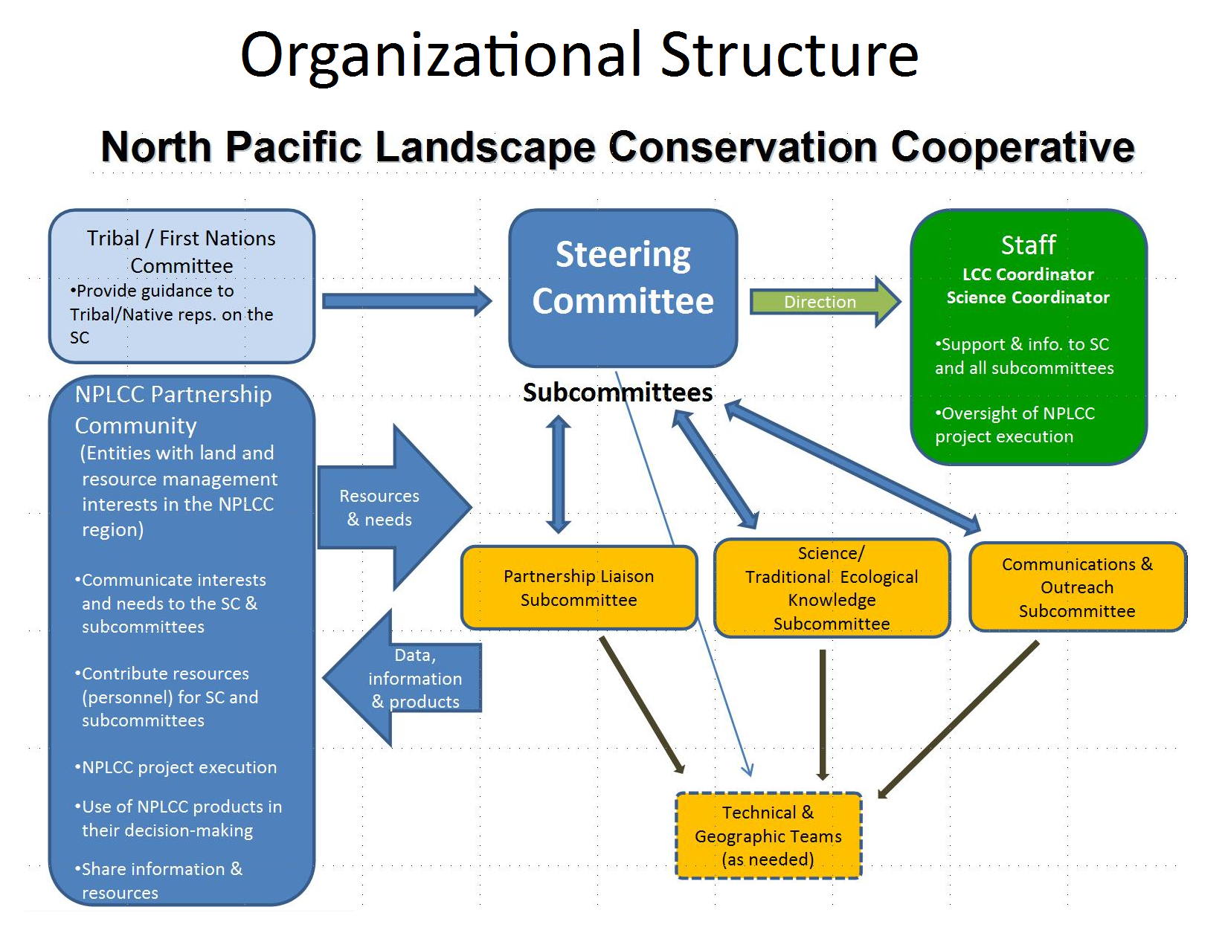
Convene Fund Build Share

Slide 9
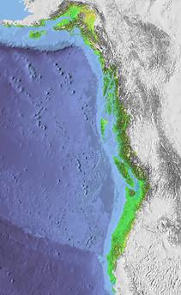
Steering Committee Entities
Federal
FWS, USFS, BLM, NOAA, NRCS, EPA, NPS, USGS, BIA
CWS, DFO
State/Provincial
4 States (AK, WA, OR, CA)
British Columbia
Partnerships:
Pacific Coast J.V.
Science Orgs:
CSC (AK, NW, SW)
NOAA RISAs
Pacific Inst. Climate Sol.
Pac. Climate Impacts Con.
5 Tribes & First Nations
AK, BC, WA, OR, CA
Notes:
If you need to leave out a slide – I recommend this one (or just briefly mention points here)
In FY 2012 – a focus was placed on funding TEK projects throughout the NPLCC. We hope to learn more about how and where TEK can be incorporated into NPLCC actions and management decisions. We may also need to update the Science/ TEK Strategy and the Implementation Plan based on lessons learned with these projects.
Currently on our website are draft reports that National Wildlife Federation prepared that compile literature and synthesize information about climate change effects and adaptation approaches for freshwater and for marine and coastal ecosystems in the entire range of the NPLCC. They are in the process of preparing a similar report for terrestrial habitats.
A cross –boundary data sharing workshop that will be held in Vancouver. B.C. was also supported. The Alaska Coastal Rainforest Center hosted the first two workshops and this third workshop will build on the past efforts.

Slide 10
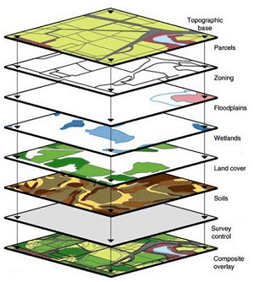
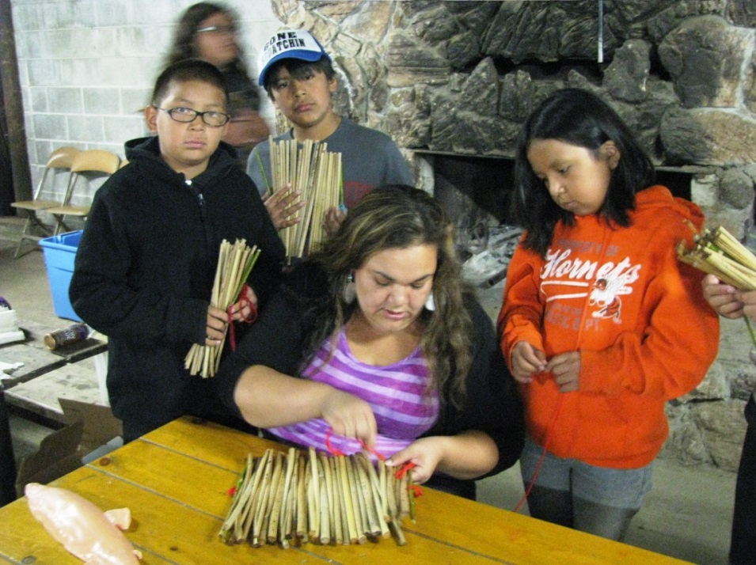
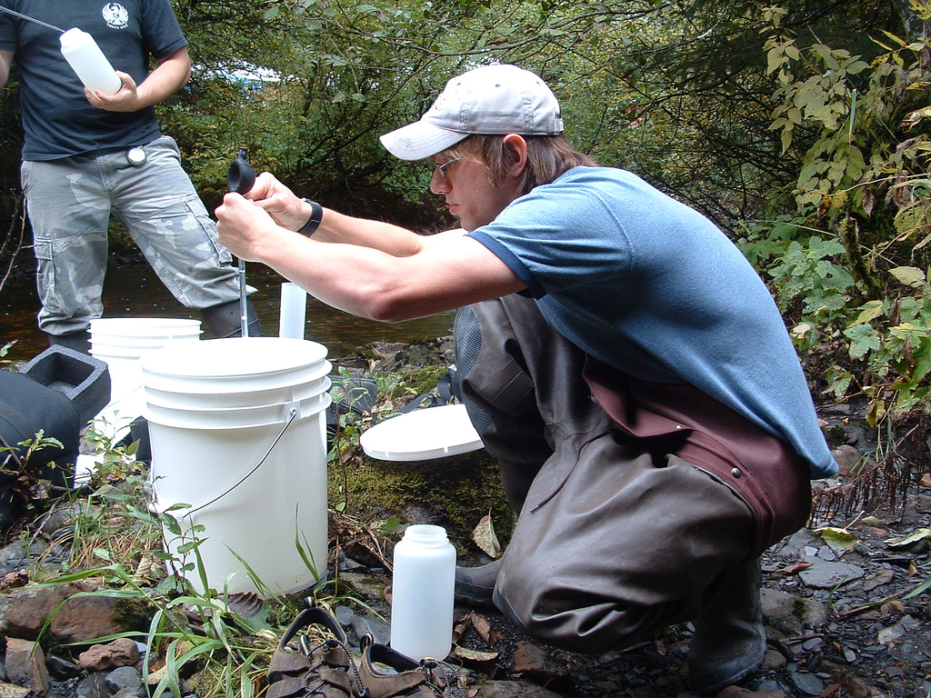
What we do:
Convene partners/leaders with common interests; Assess needs
Fund Strategic, High-priority Projects
Build Capacity
Share information & Communicate

Slide 11
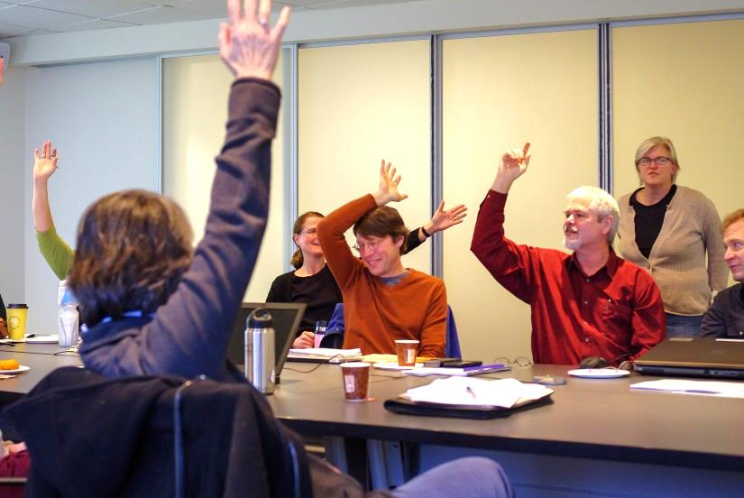
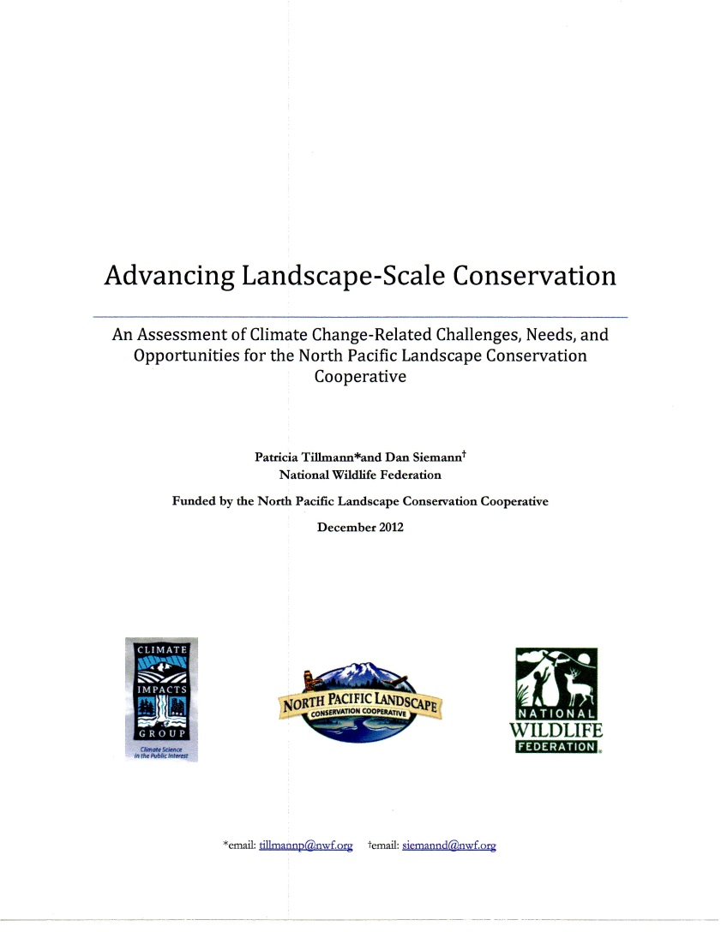
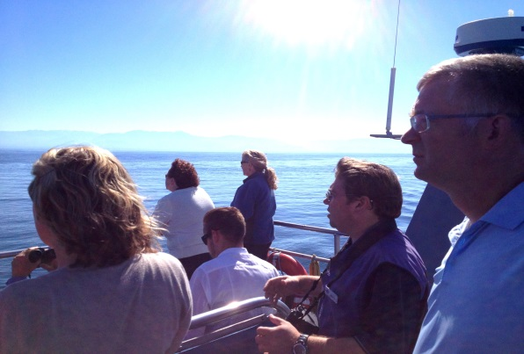
Convene Partners and Assess Needs
Committees & subcommittees
Structured needs assessments
In-person meetings
Collaborate and leverage with others
  CSCs, HUBs, RISAs, USGS, Tribes, state and federal agencies

Slide 12
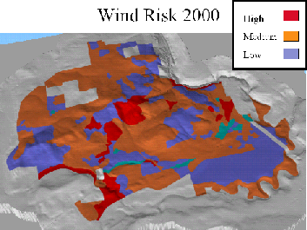
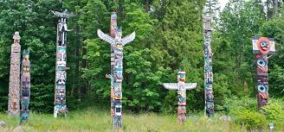
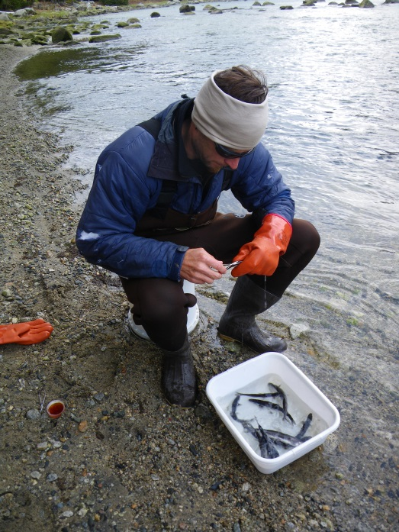
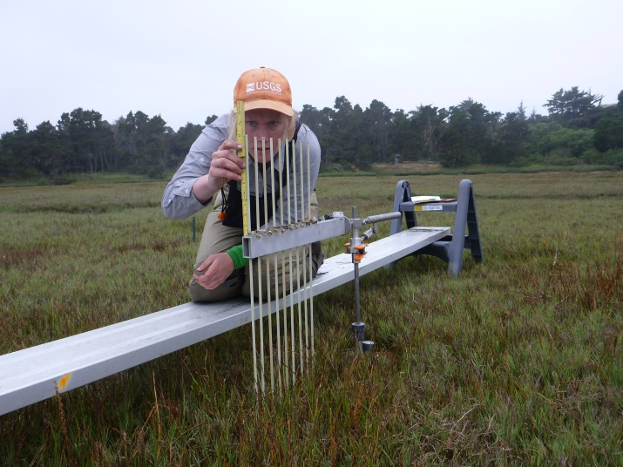

Fund Strategic Projects
Population & Habitat Assessments (3)
Conservation Planning & Design (23)
Vulnerability Assessments (16)
Decision Support Tools & Data (15)
Traditional ecological knowledge, cultural & subsistence resources (12)
Monitoring & Modeling (3)
NPLCC.org/resources

Slide 13
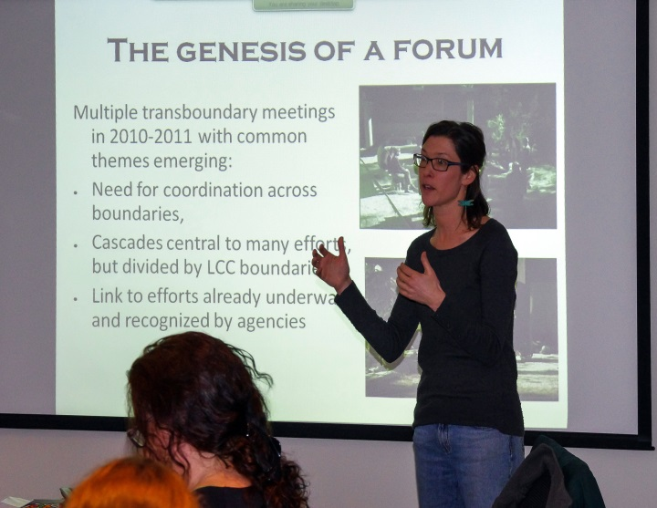
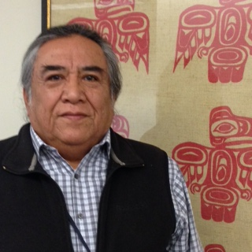

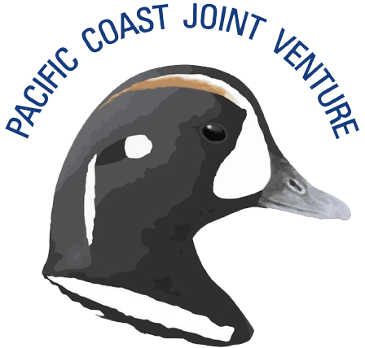


Build Capacity
Travel support for Tribes and state/province partners
Provide training/workshops
Support conservation planning efforts
  North Cascadia Partner Forum
  Willamette Basin
Seek/leverage resources with partners of common interests
  PCJV Pacific Flyway
  Adjacent LCC joint projects
  Co-fund projects with CSCs

Slide 14
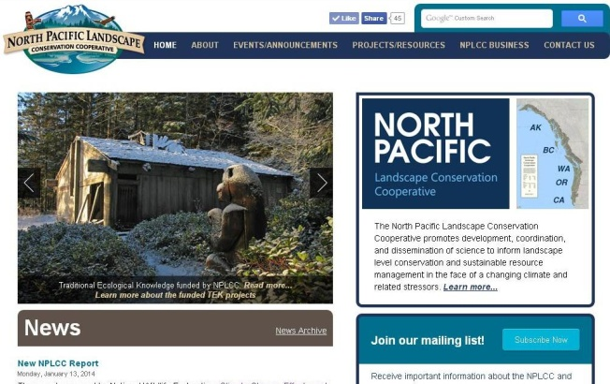

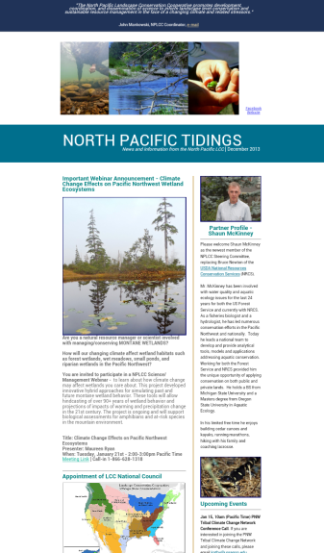



Communicate & Share Information
Conservation Planning Atlas
Website
Science/Management Webinars
Newsletters
  Climate Science Digest
  North Pacific Tidings
Social Media
  Facebook, Twitter, YouTube
Conferences/workshops
  NorthPacificLcc.org

Slide 15
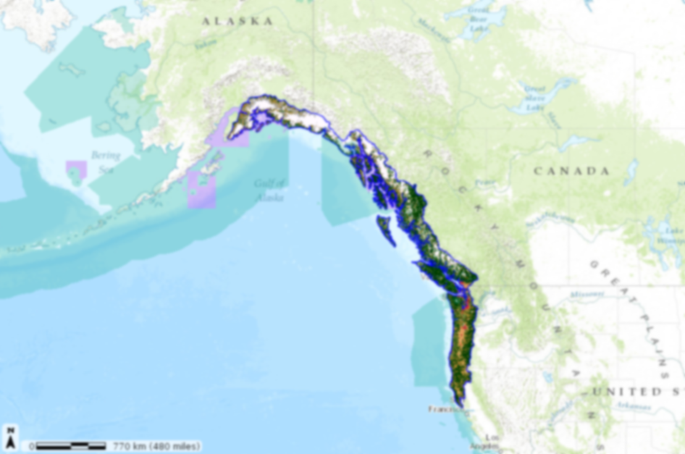
Leadership/staff/support
Rory Annett & Lyman Thorsteinson, SC Co-chairs
Frank Shipley, S/TEK Chair
Mike Tranel, Communications Subcommittee Chair
Eric Morrison, Tribe/First Nations Committee
  John Mankowski, Coordinator
  Mary Mahaffy, Science Coordinator
  Tom Miewald, Data Coordinator
  Meghan Kearney, Communications Specialist
  Jill Hardiman, Assistant Science Coordinator
  Erin Butts, GIS Technician – Student Intern
    Penny, Daniel, Patricia – EnviroIssues
    Karen - Insight Decision LLC

