Slide 1
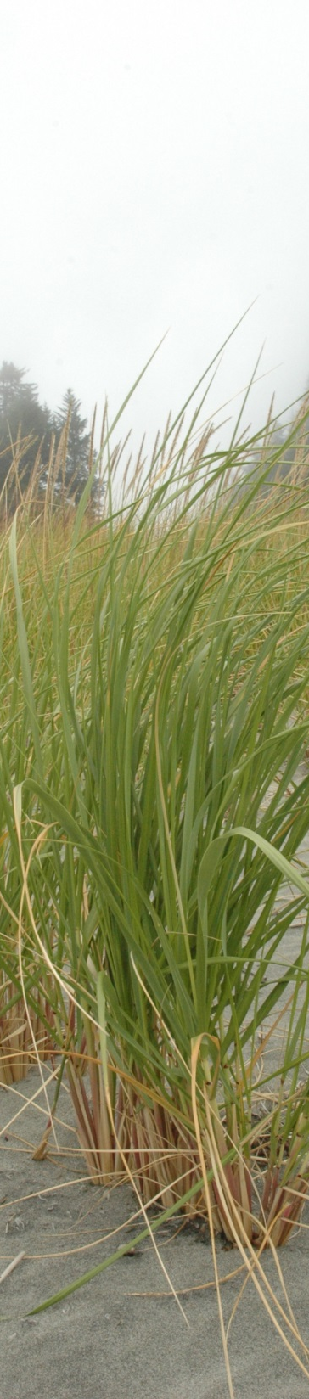


Climate Change Impacts on the Domain of the NPLCC
Lara Whitely Binder
UW Climate Impacts Group
North Pacific Landscape Cooperative Steering Committee
July 9, 2014
Climate Science in the Public Interest
Notes:
Image source: Climate Impacts Group

Slide 2



The UW Climate Impacts Group
Science for climate resilience
Linking science with public and private decision making
Conducting decision-relevant climate science
  Identifying emerging climate risks for the built and natural environment
  Illuminating response options
Supporting the interpretation and application of climate science
  Local climate change information
  Expert guidance on climate risk assessment & adaptation planning
  Synthesis & assessment of emerging climate science
Northwest Climate
Science Center
Notes:
The Climate Impacts Group is an interdisciplinary network of researchers and technical experts based at the University of Washington who study the impacts of climate variability and change on natural resources and human communities in the Pacific Northwest and other locations.
- We work to link… by producing scientific information that is both useful to and used by decision makers
- By conducting decision –relevant science…
- And providing technical expertise on the interpretation and application of climate science to issues that decision makers care about. This includes….

Slide 3
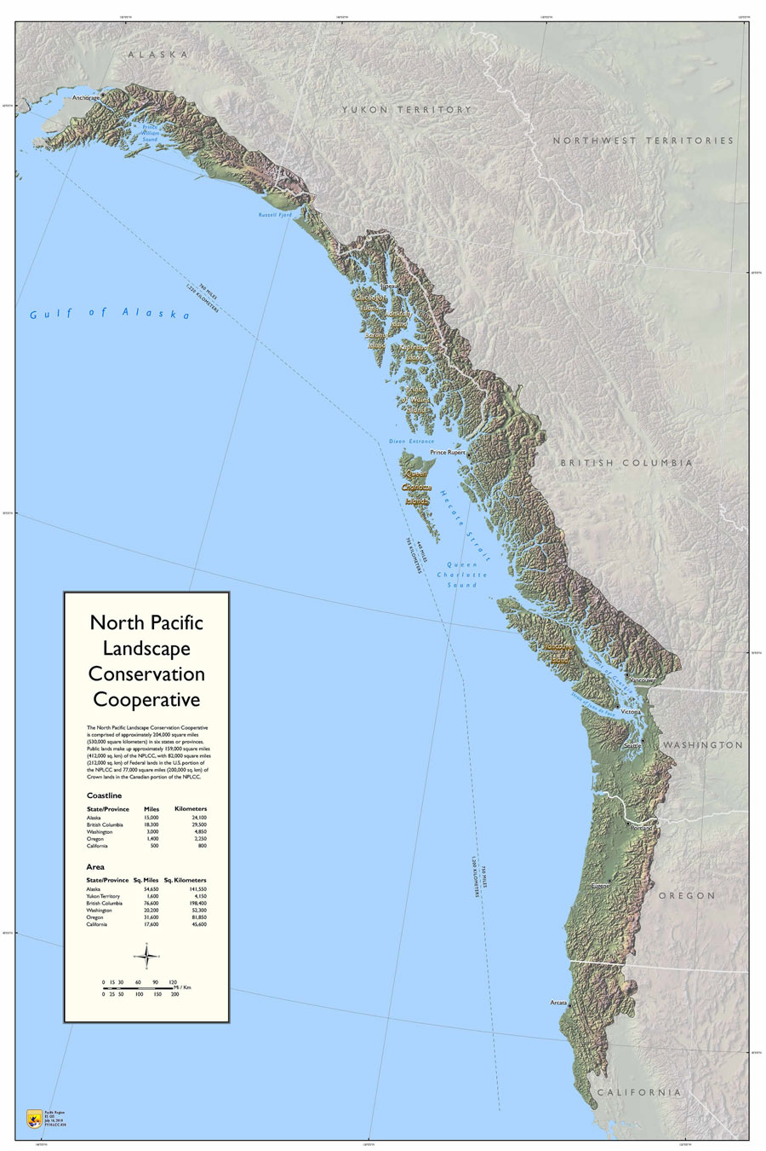
The task for today:
Summarize observed and projected climate change impacts for the domain of the NPLCC
The challenge:
Diversity of climates, habitats, elevations (!!)
Few climate change studies deal explicitly with the extensive but narrow domain of the NPLCC
Sources:
NWF NPLCC syntheses
National Assessment chapters and supporting reports for the SW, PNW, AK
Climate Impacts Group, BC Pacific Climate Impacts Consortium, Scenarios Network for Alaska & Arctic Planning (SNAP)
CalAdapt and related CA reports

Slide 4

Observed Trends: Climate
The NPLCC region has experienced long-term warming, a lengthening of the frost-free season, and variable changes precipitation.
Changes in annual average temperature:
  CA: +1.7°F, 1885-2011 (Moser et al 2012)
  PNW: +1.3°F, 1885-2011 (Kunkel et al. 2013, Mote et al. 2013)
  BC West Coast : +2.3°F, 1901-2009 (PCIC 2013)
  SE AK: +2.6°F, 1949-2011 (Table 1, Stewart et al 2013)
PNW frost-free season has lengthened 35 days (+6 days), 1885-2011
(Kunkel et al. 2013)
No discernible long-term trend in PNW, CA precipitation; slight increased in BC and AK precip, although some locations show a decrease (e.g. Annette, AK) (Kunkel et al. 2013, Moser et al. 2012, PCIC 2013, Stewart et al 2013)
Notes:
BC: The warming trend is greater over the 1951-2009 period, except in autumn.
SE AK: warming trend really kicked in with PDO switch in 1976-77. “Annual departures from the long-term mean show mostly negative (cool) anomalies from 1949 to 1976, then mostly positive (warm) anomalies for the last three decades.”
Sources:
Kunkel, K.E. et al., 2013. Part 6. Climate of the Northwest U.S., NOAA Technical Report NESDIS 142-6.
Mote, P.W. et al., 2013. Climate: Variability and Change in the Past and the Future. Chapter 2, 25-40, in M.M. Dalton, P.W. Mote, and A.K. Snover (eds.) Climate Change in the Northwest: Implications for Our Landscapes, Waters, and Communities, Washington D.C.: Island Press.
PCIC 2013: http://www.pacificclimate.org/sites/default/files/publications/Climate_Summary-West_Coast.pdf

Slide 5
Observed Trends: Hydrology
Long-term changes in snow, ice, and streamflows reflect the influence of warming.
Spring snowpack varies year-to-year but PNW snowpack declined ~25% from mid-20th century through 2006 (Stoelinga et al. 2009, Mote et al. 2008)
Most glaciers declined during the 20th century (Sisson et al. 2011; Sitts et al. 2010; Granshaw and Fountain, 2006)
Spring peak streamflow has generally shifted earlier by up to 20 days in snowmelt systems, depending on location (1948-2002) (Stewart 2005)
Notes:
For general reference:
Glacier decline stats and time period
North Cascades: −7% decline in glacier area (1958-1998) (Fountain et al. 2007)
Mt. Rainier: −14% decline in glacier volume (1970-2007)
Mt. Adams: −49% decline in glacier area (1904-2006)
Olympic Mountains: No published studies on long-term trends.
Sources:
Stoelinga, M.T. et al., 2009. A new look at snowpack trends in the Cascade Mountains. Journal of Climate. doi: 10.1175/2009JCLI2911.1
Mote, P.W. et al., 2008. Has snowpack declined in the Washington Cascades? Hydrology and Earth System Sciences. 12: 193–206.
Sisson, T.W. et al., 2011. Whole-edifice ice volume change AD 1970 to 2007/2008 at Mount Rainier, Washington, based on LiDAR surveying. Geology, 39(7): 639-642.
Sitts, D.J. et al., 2010. Twentieth century glacier change on Mount Adams, Washington, USA. Northwest Science 84(4): 378-385.
Granshaw, F. D., and A. G. Fountain. 2006. Glacier change (1958-1998) in the North Cascades National Park Complex, Washington, USA. Journal of Glaciology 52(177):251-256
Stewart, I. et al., 2005. Changes toward earlier streamflow timing across western North America. J. Climate, 18: 1136-1155.

Slide 6

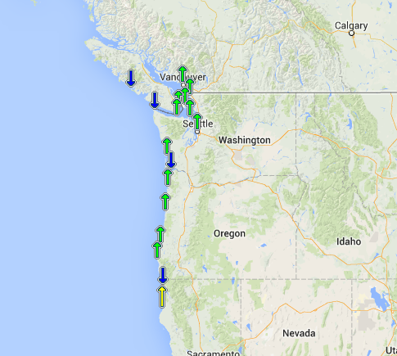
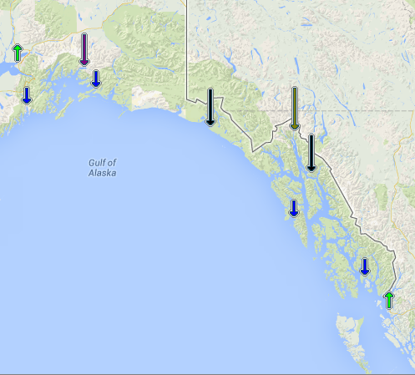
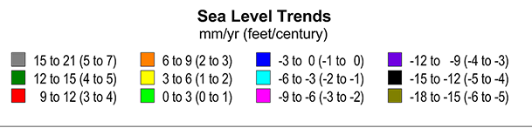
Observed Trends: Regional Sea Level
Sea level is rising along some parts of the NPLCC region and falling in others.
http://tidesandcurrents.noaa.gov/sltrends/

Slide 7
Observed Trends: Oceans
The coastal ocean is acidifying and some local inshore coastal waters are warming.
Ocean acidity in Washington’s marine waters has increased +10% to +40% since 1800
Long-term warming observed off the BC coast (0.52 to 1.7°F, 1915 to 2003); also in the Strait of Georgia and west of Vancouver Island (+1.4°F, 1970-2005).
No significant warming of coastal surface ocean temperatures offshore of North America, 1900-2008

Slide 8
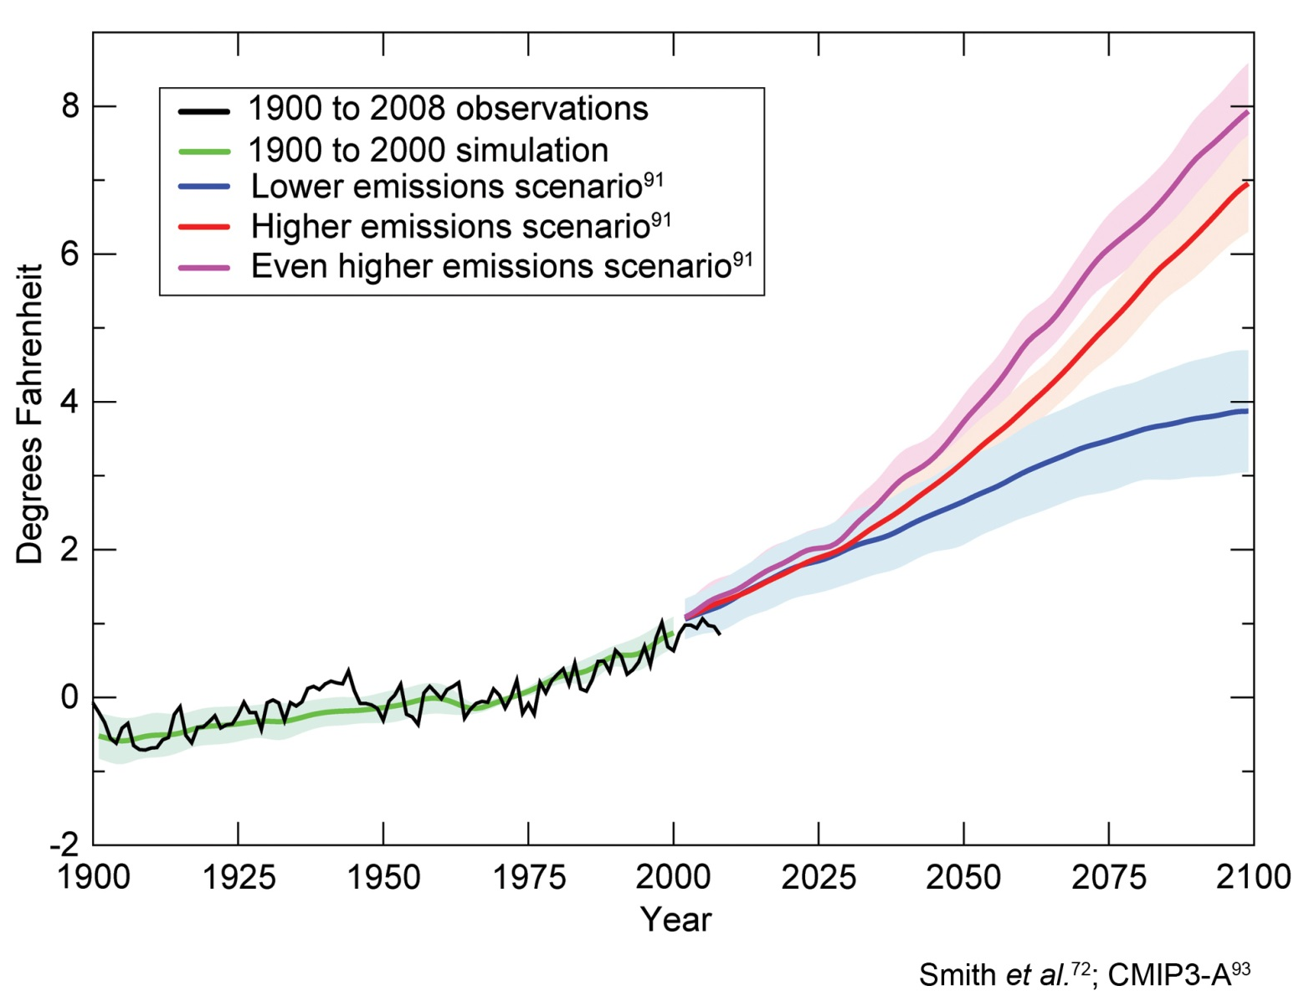

The question is no longer if climate changes but how fast and how much.
?
Figure source: Source: USGCRP 2009, available at http://nca2009.globalchange.gov/global-climate-change
Notes:
As we take stock of what has been observed and start looking forward in time, the question…
Figure caption: Observed and projected changes in global average temperature under three no-policy emissions scenarios. The shaded areas show the likely ranges while the lines show the central projections from a set of climate models. A wider range of model types shows outcomes from 2 to 11.5°F. Changes are relative to the 1960-1979 average.

Slide 9
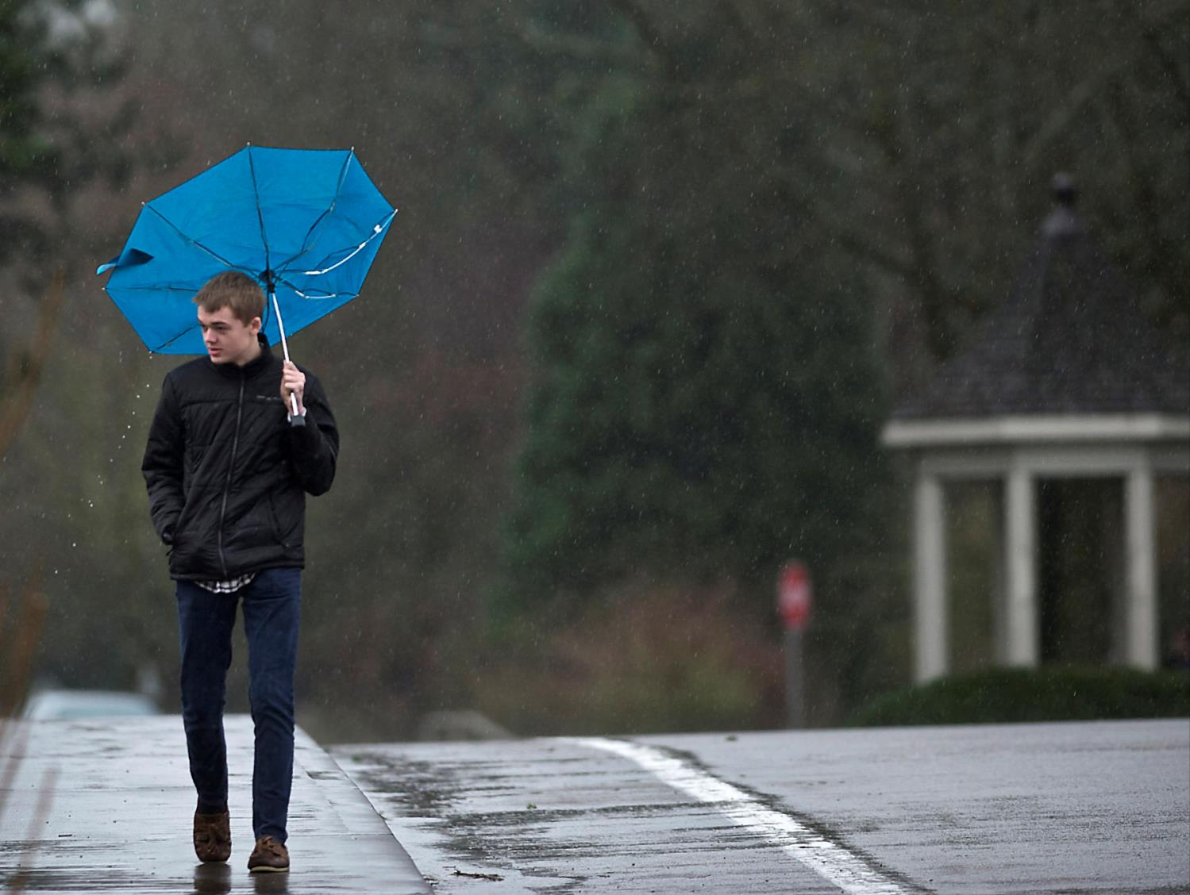
What is expected?
Key climate impact drivers for
NPLCC ecosystems
Photo source:
Zachary Kaufman/The Columbian
Notes:
So what is expected as a result?
Photo: Zachary Kaufman/The Columbian
http://www.columbian.com/news/2014/feb/18/string-of-storms-hits-state-snowpack-builds-to-80/

Slide 10

Broadly speaking, we can expect….
Habitat loss, degradation, and transition
Gains, losses, and shifts in biodiversity,
ranges, abundance, and community
composition
Increased competition from invasive species
Altered phenology
Changes in disturbance (insects, disease, fire)

Slide 11
…and we can also expect…
Exacerbation of many existing management
challenges (along with new challenges)
Changing policy, management, and fiscal priorities
Changing goals and objectives (or at least changes in how to interpret goals and objectives)
New species listings
Changes stakeholder needs and priorities
Changes in management approaches
In other words: More of the same! (in many ways…)

Slide 12

What’s Driving Those Changes?

Slide 13
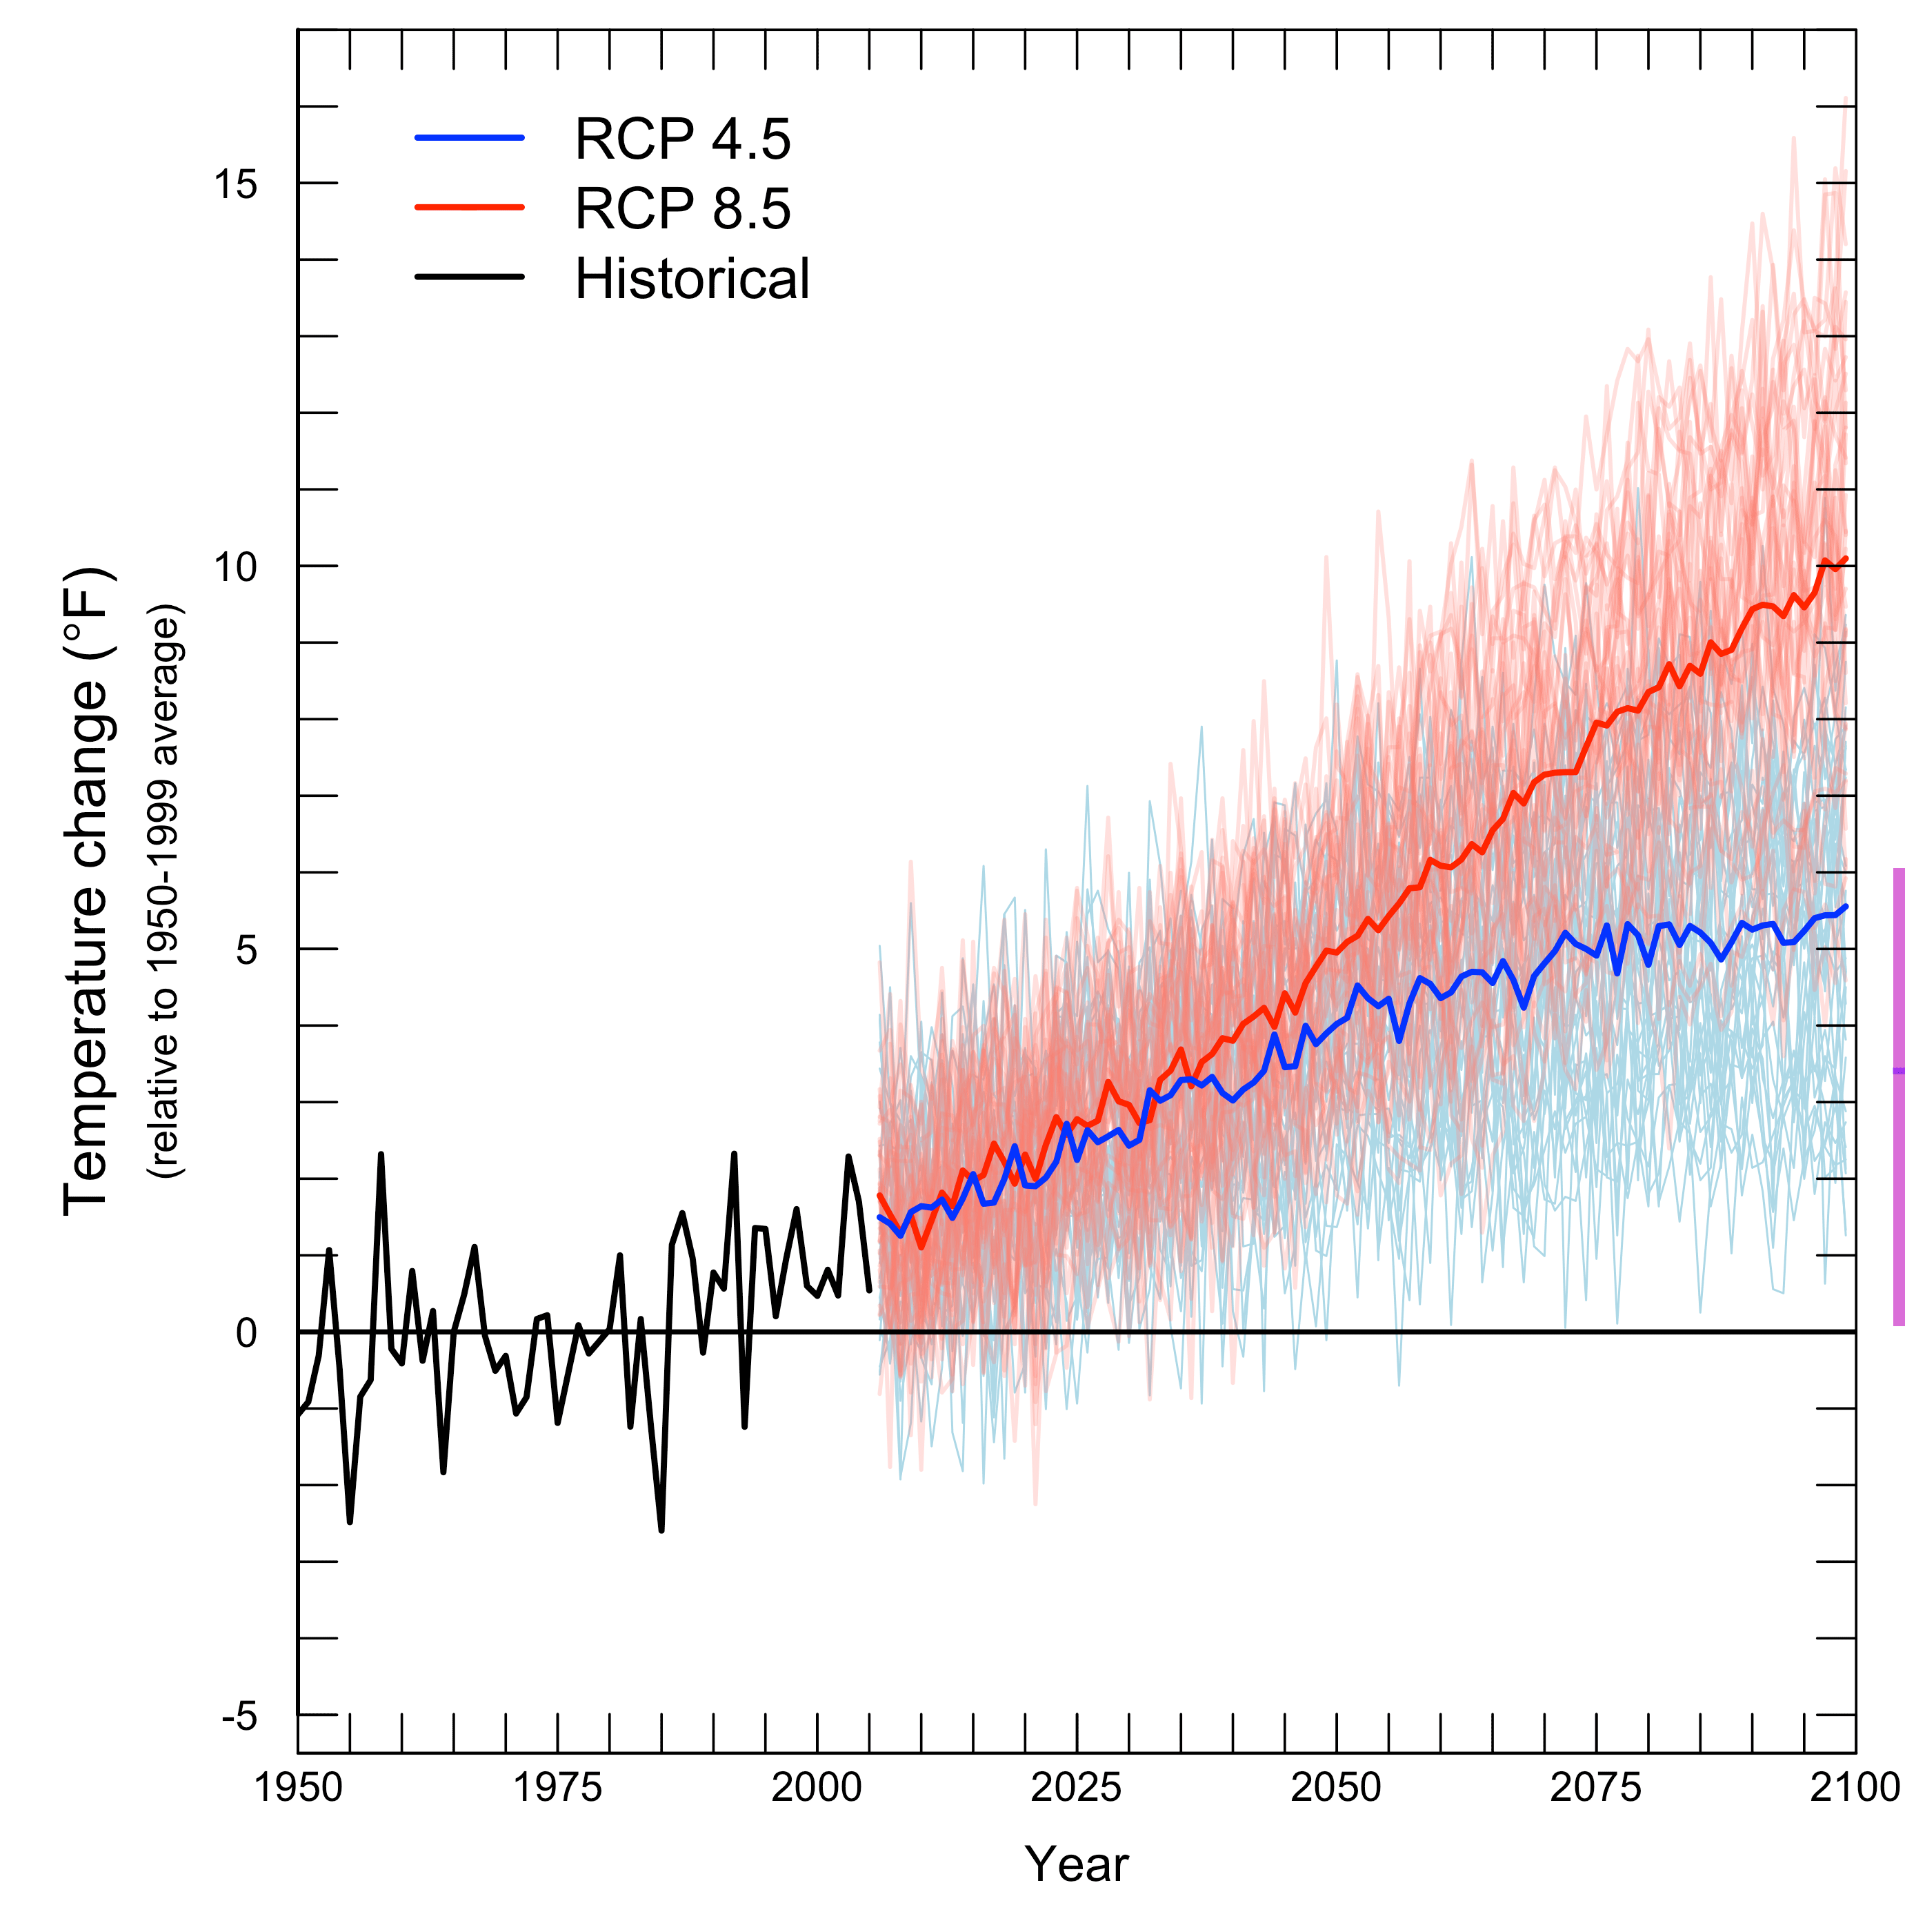
Rapid Warming Projected
Projected Change in Average Annual PNW Temperature
(relative to 1950-1999 average)
All scenarios indicate warming in the PNW in the 21st century
2050s (relative to 1950-1999)
Low emissions (RCP 4.5) | +4.3°F (2.0-6.7°F)
High emissions (RCP 8.5) | +5.8°F (3.1-8.5°F)
Figure source: Climate Impacts Group, based on projections used in IPCC 2013;
2050 projections from Mote et al. 2013
Notes:
PNW projections – would expect slightly lesser amounts closer to the coast (relative to the interior)
In general:
warming is projected through the 21st century in all scenarios (although not all scenarios are shown here)
warming is expected in all seasons.
Strong agreement among models that extreme heat events become more frequent
For 2050s:
Provides specifics to how much change is projected
This change is significant relative to annual average temperature observed in the 20th century
2050 projections source:
Mote, P. W. et al., 2013. Climate: Variability and Change in the Past and the Future. Chapter 2, 25-40, in M.M. Dalton, P.W. Mote, and A.K. Snover (eds.) Climate Change in the Northwest: Implications for Our Landscapes, Waters, and Communities, Washington D.C.: Island Press.

Slide 14
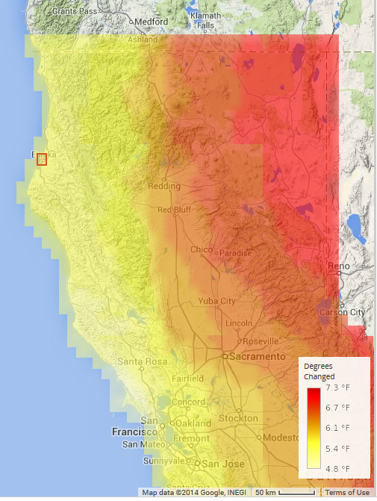
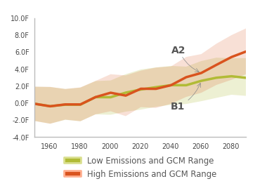

Projected change in average annual temperature for 2070-2099 (relative to 1961-1990) for a high (A2) emissions scenario (left)
As above, but for Eureka, CA
http://cal-adapt.org/temperature/century/
Notes:
These results from CA illustrate that point as well. (not – different emissions scenarios and slightly different time periods)

Slide 15
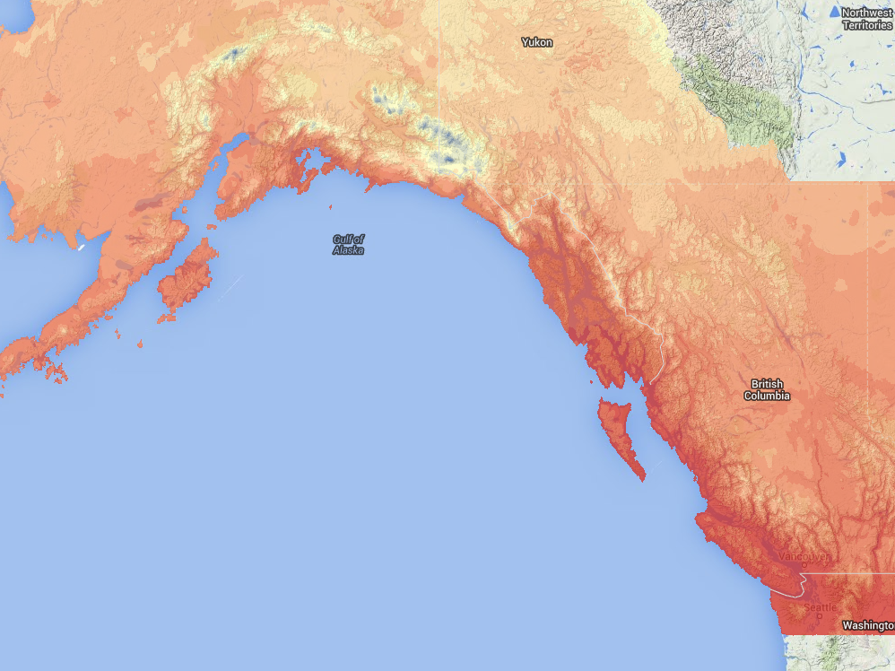
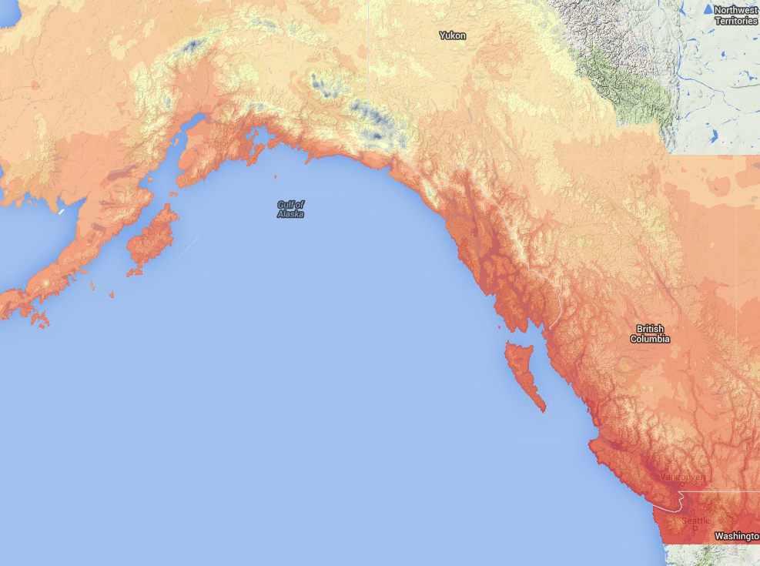
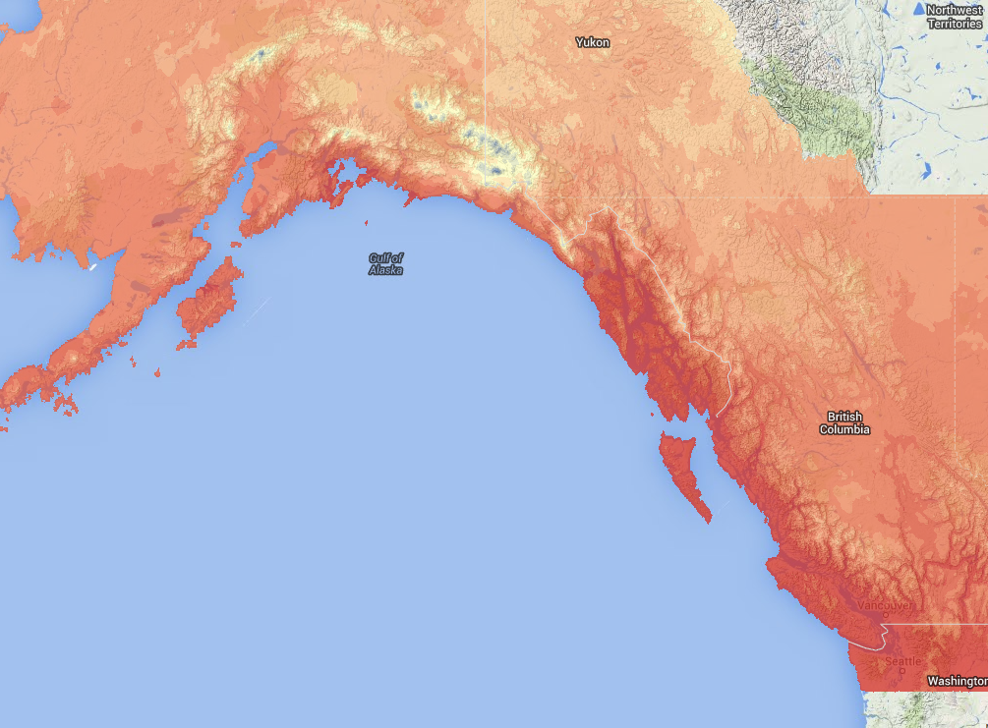

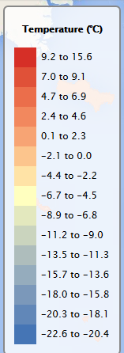
Projected GCM Average Temperature for 2050–2059 assuming mid–range emissions (A1B) from the 5-model average at 2km resolution
Projected GCM Average Temperature for 2010–2019 assuming mid–range emissions (A1B) from the 5-model average at 2km resolution
Projected GCM Average Temperature for 2090–2099 assuming mid–range emissions (A1B) from the 5-model average at 2km resolution
Notes:
AK and BC also show significant warming, although in this case more so by the coast (due to elevational differences?)

Slide 16
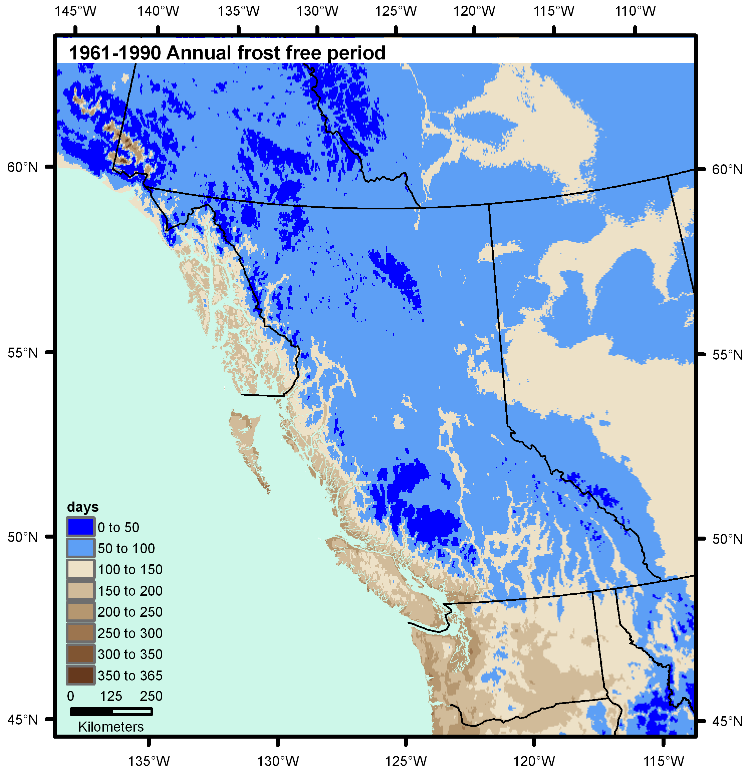
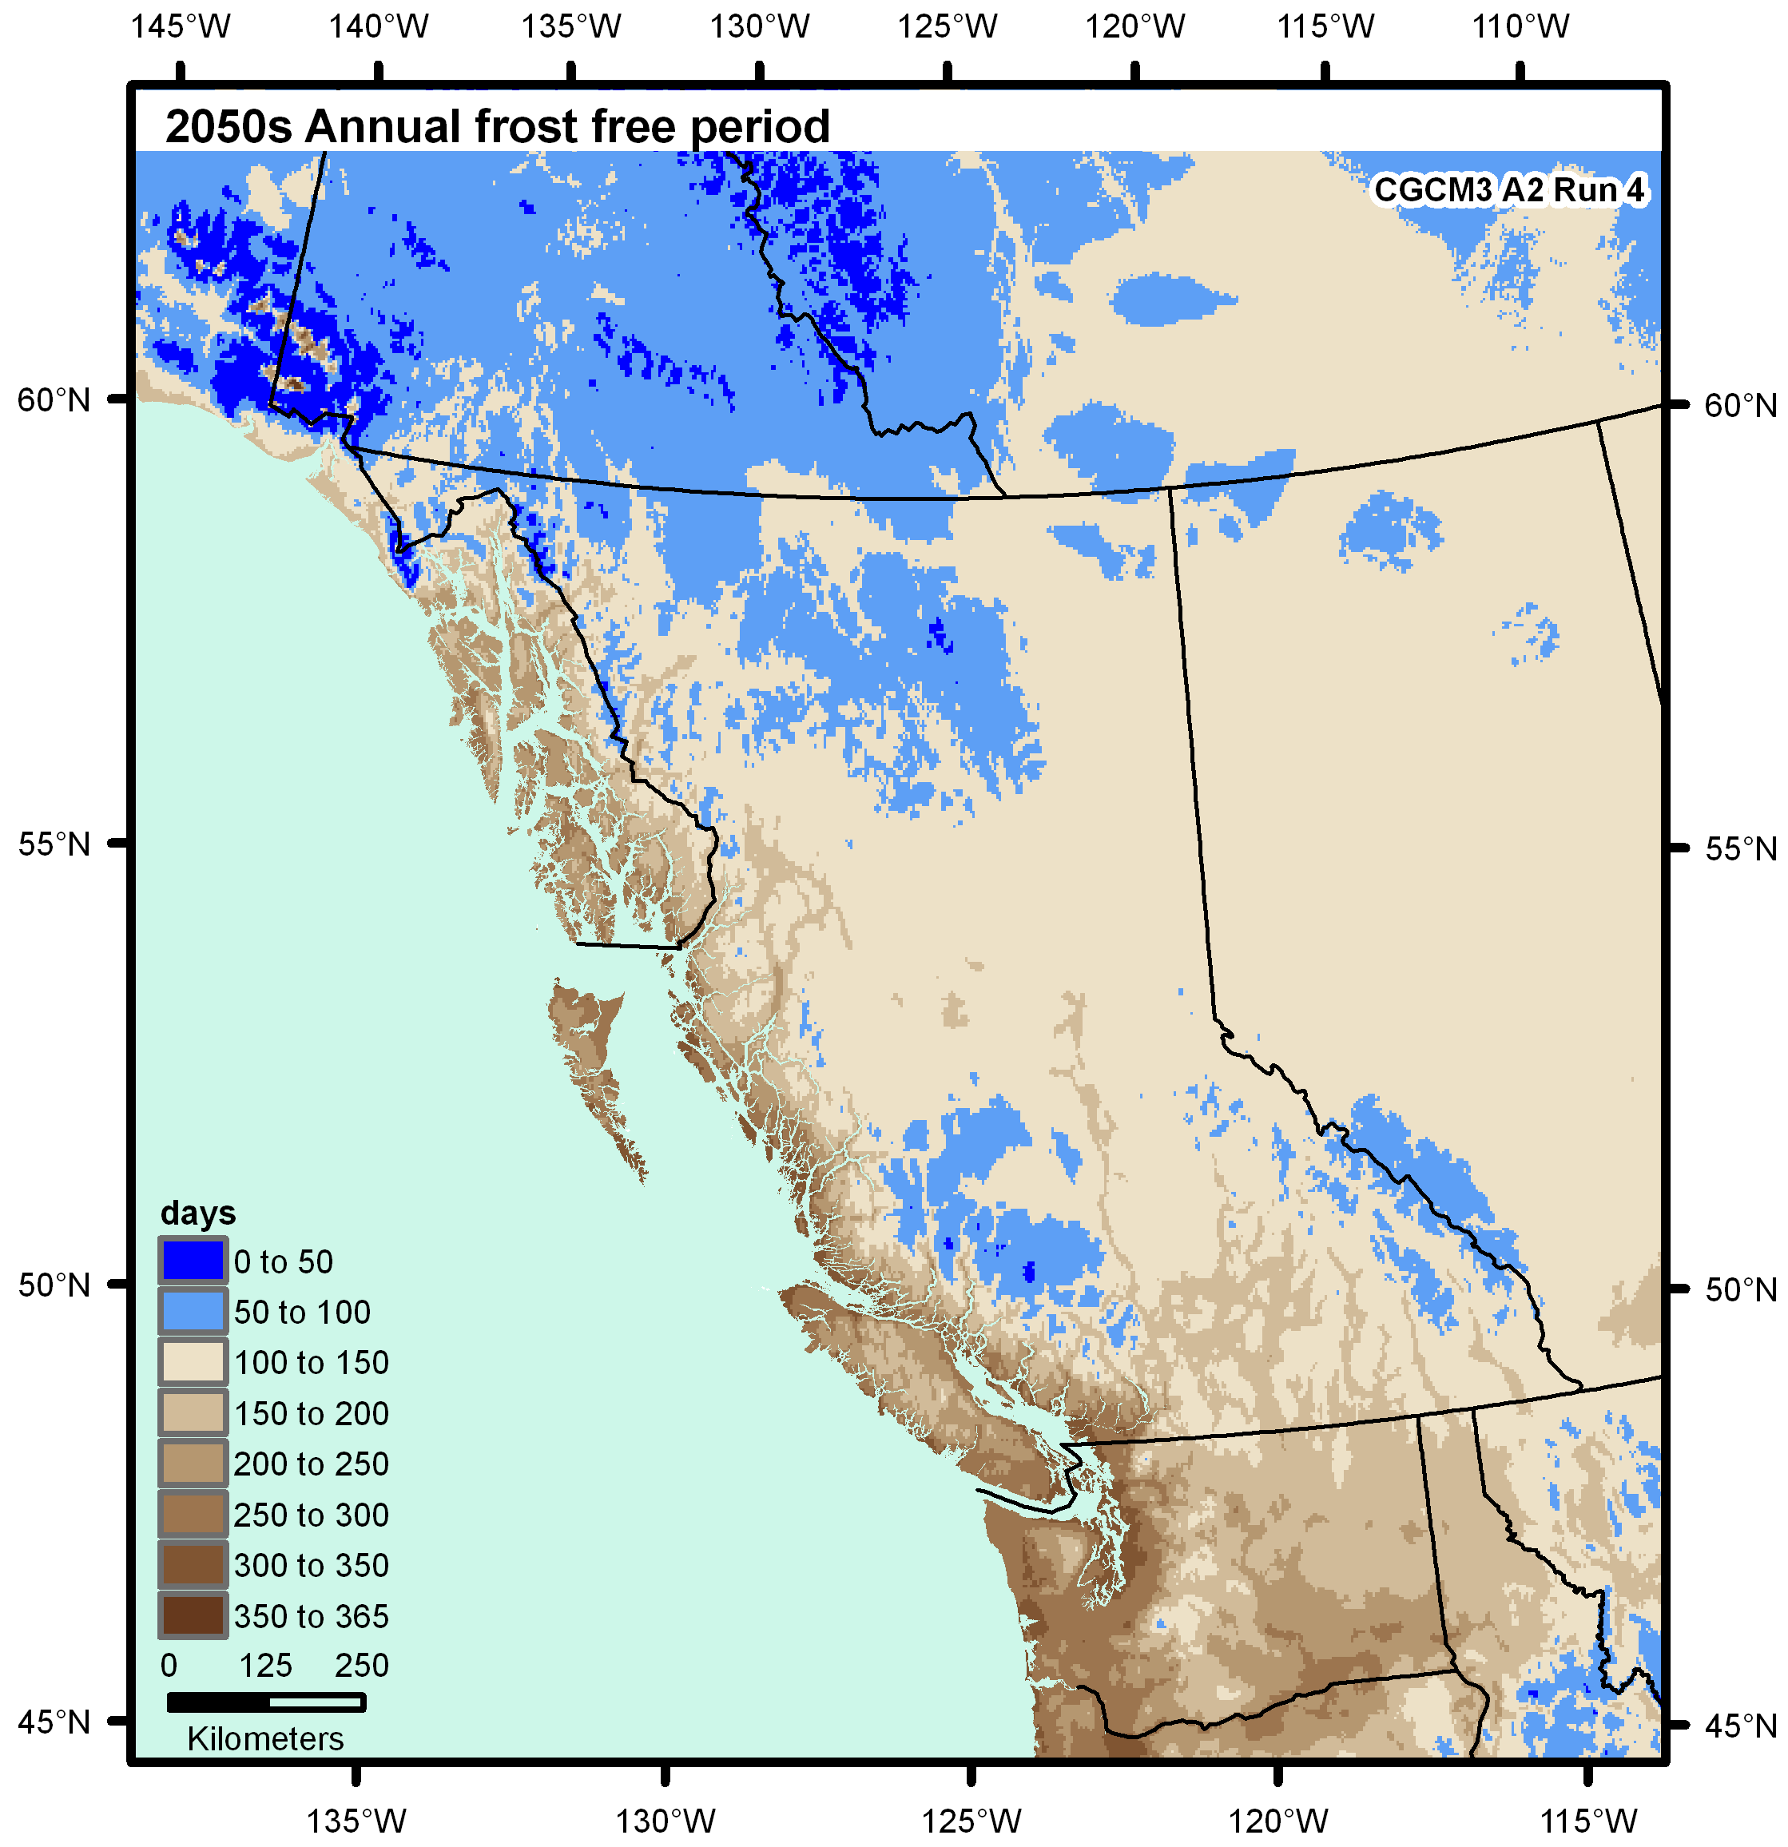
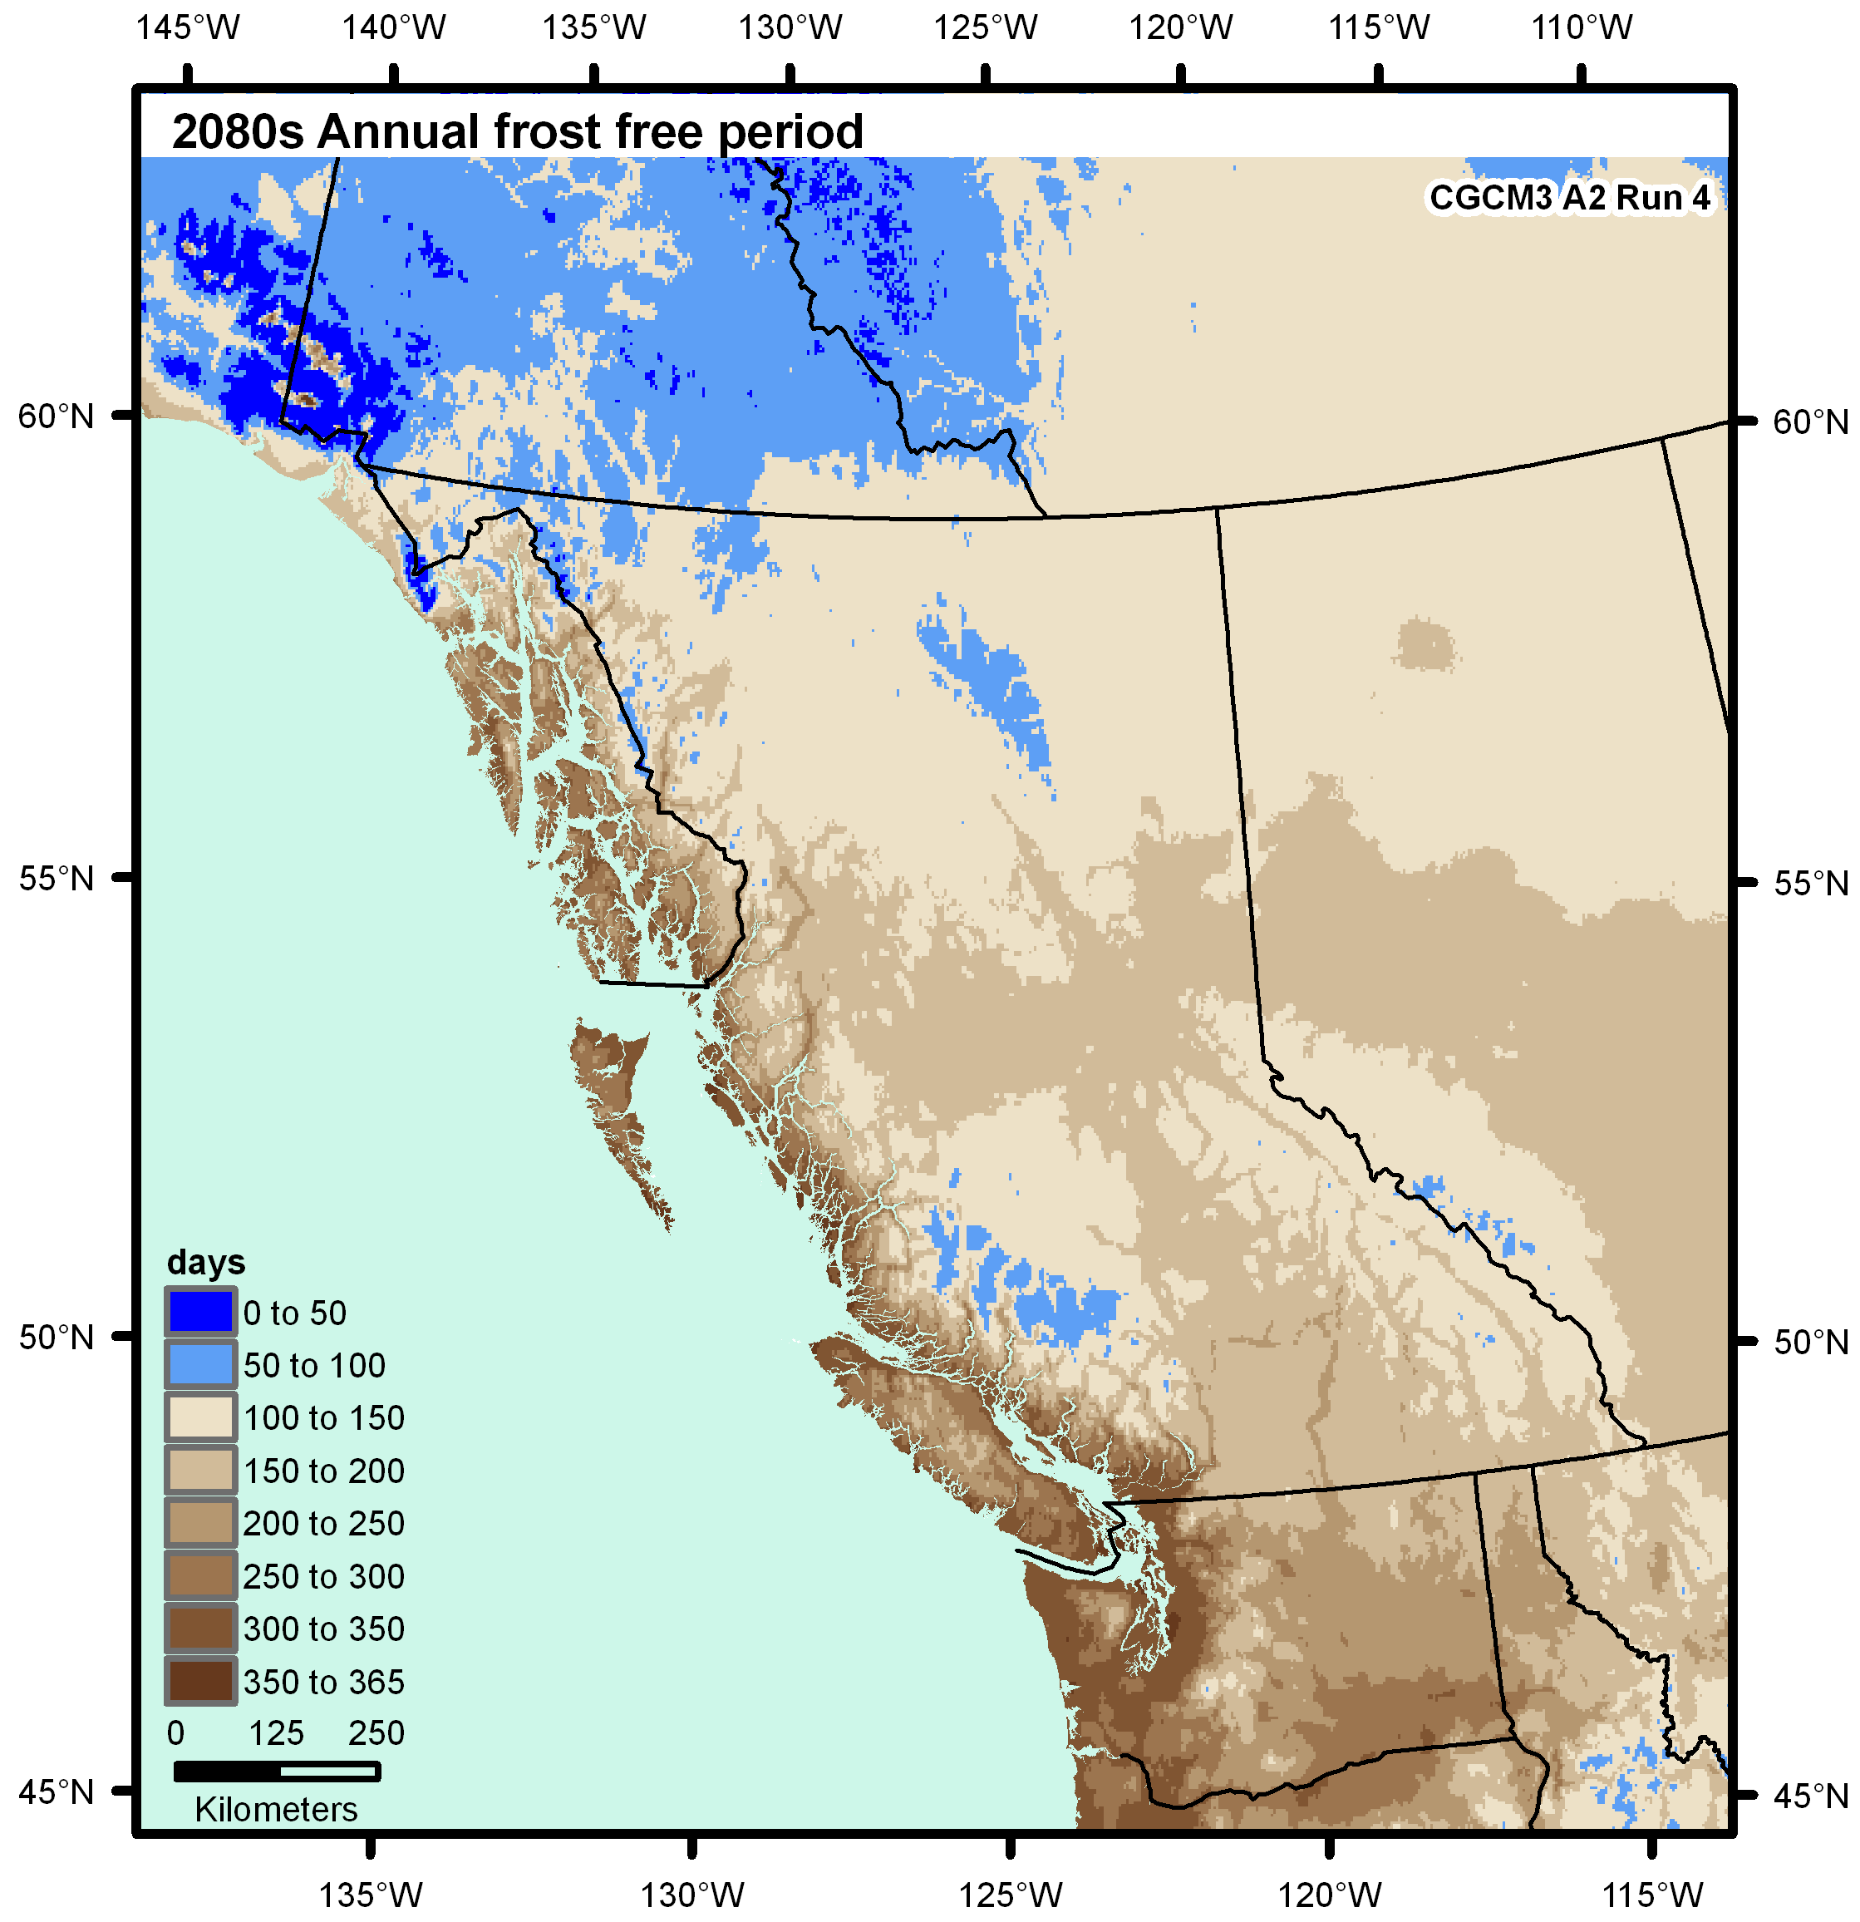
Shorter frost free period

Slide 17
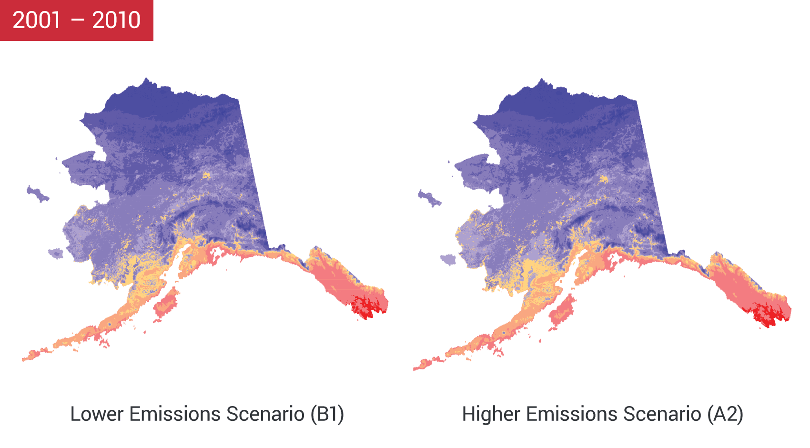
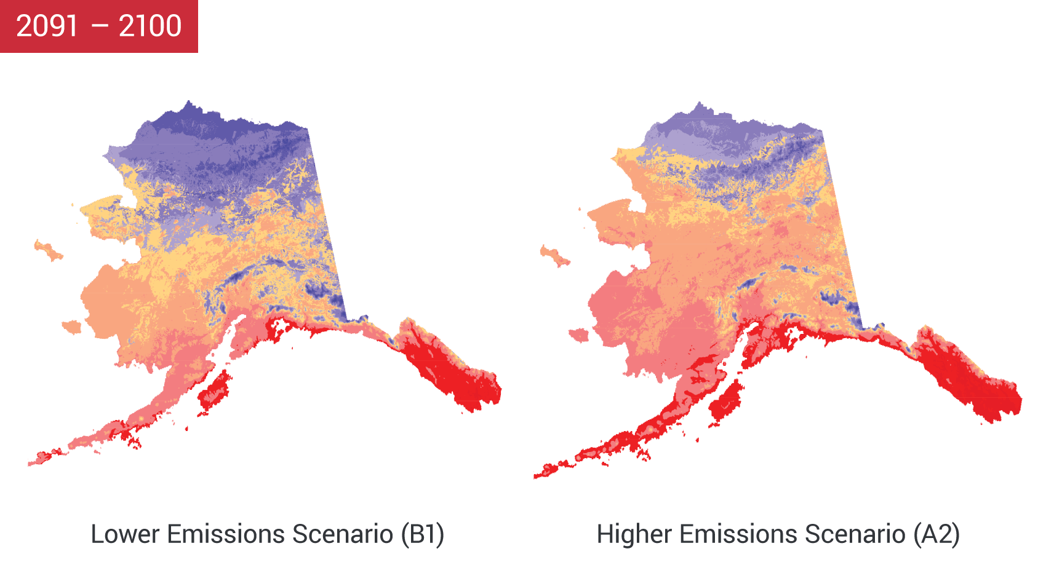
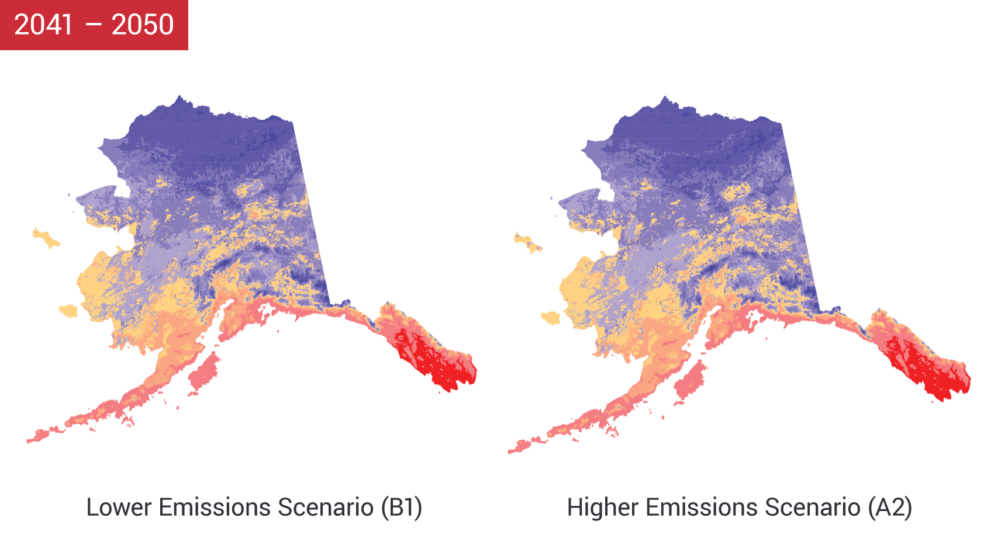
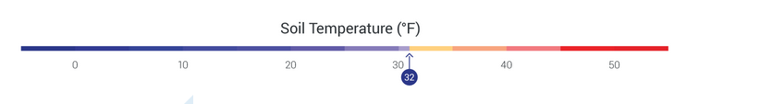
“The Big Thaw” - Projections for average annual ground temperature at a depth of 3.3 feet
Notes:
Figure 22.5: Projections for average annual ground temperature at a depth of 3.3 feet over time if emissions of heat-trapping gases continue to grow (higher emissions scenario, A2), and if they are substantially reduced (lower emissions scenario, B1). Blue shades represent areas below freezing at a depth of 3.3 feet, and yellow and red shades represent areas above freezing at that depth, based on the GIPL 1.0 model. (Figure source: Permafrost Lab, Geophysical Institute, University of Alaska Fairbanks).

Slide 18
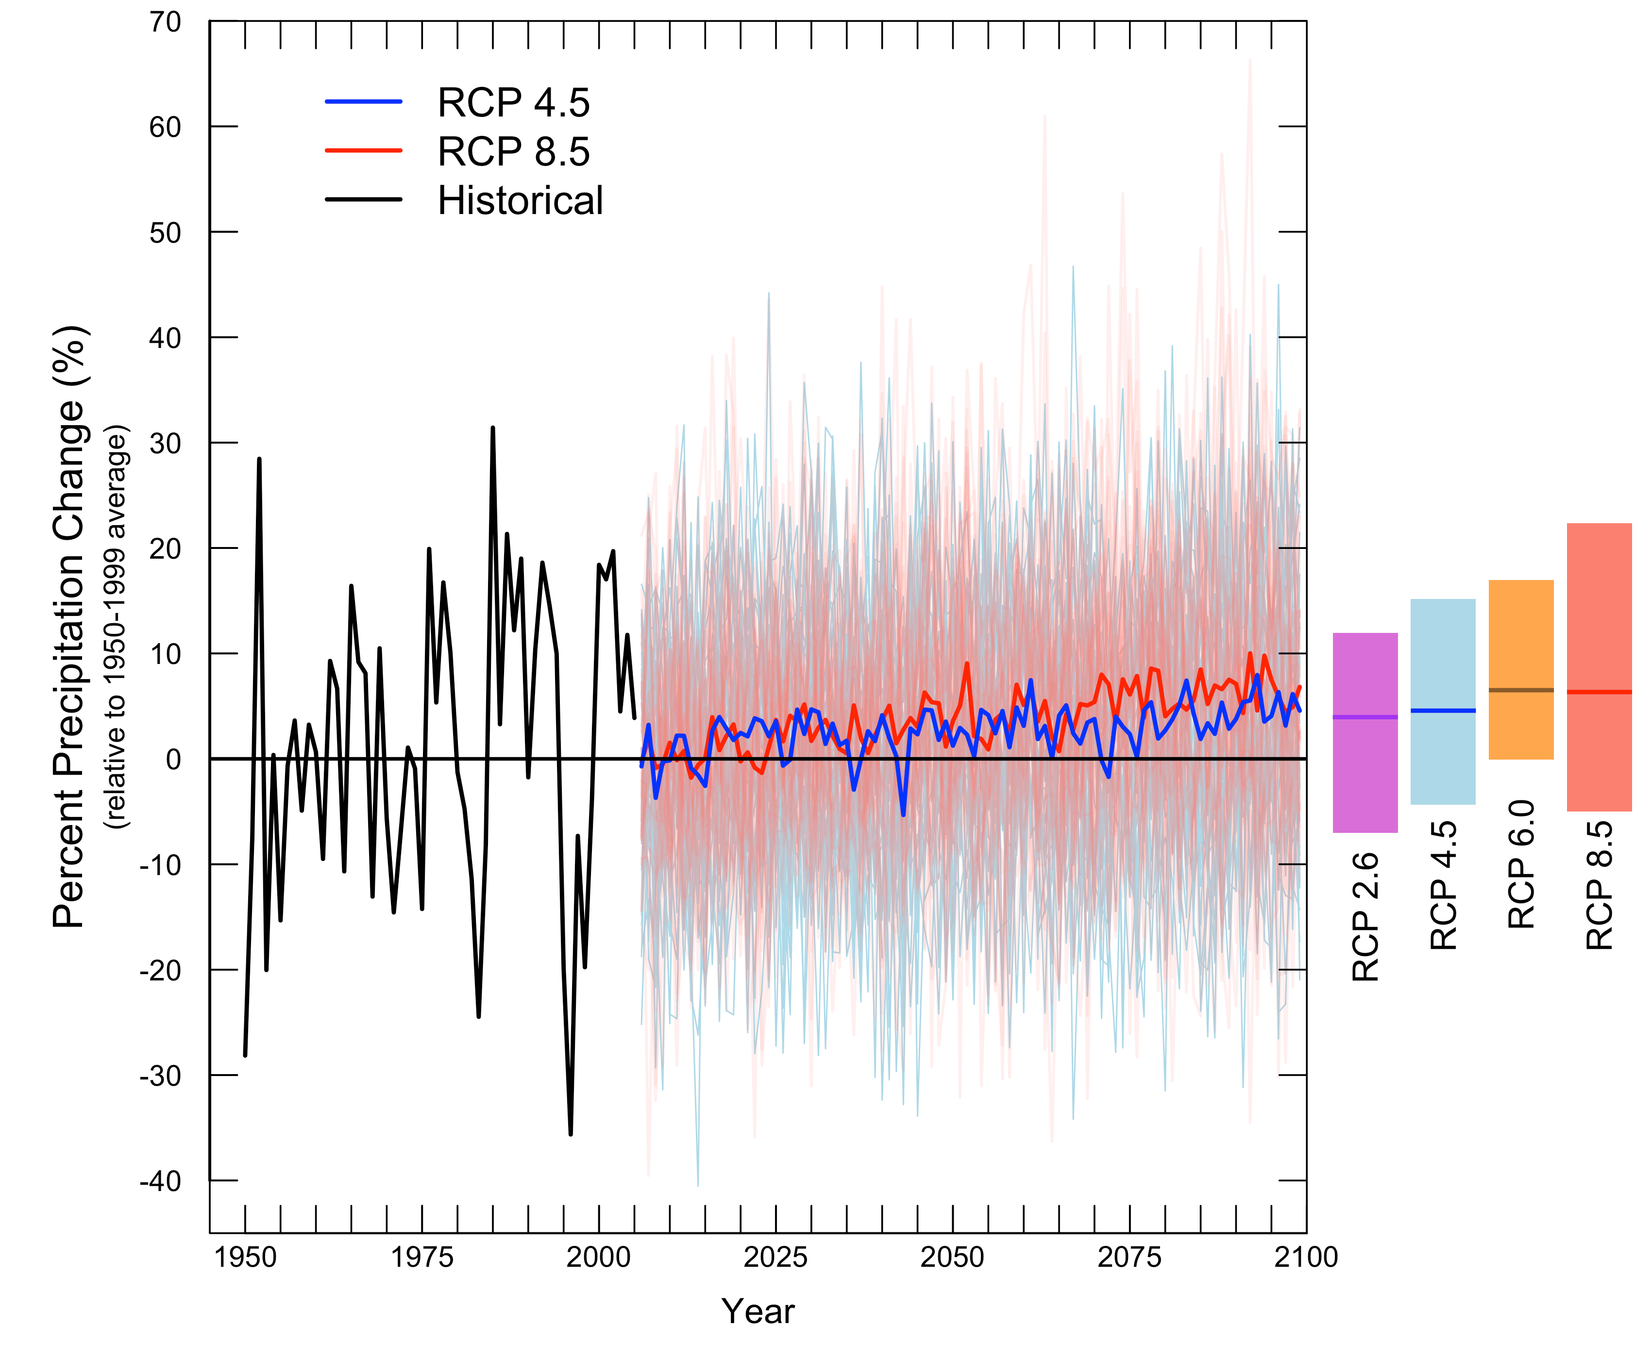
Continued Variability in Precipitation
Projected Change in Average Annual PNW Precipitation
(relative to 1950-1999 average)
Modest increases in average annual precipitation projected in most scenarios for PNW, BC, and AK.
In PNW, seasonal patterns reinforced. Wetter fall, winter, and spring; drier summers likely.
More frequent heavy rainfall events expected.
Figure source: Climate Impacts Group, based on projections used in IPCC 2013
Notes:
Seasonal patterns reinforced. Wetter fall, winter, and spring; drier summers likely.
More frequent heavy rainfall events expected.
2050 projections source:
Mote, P. W. et al., 2013. Climate: Variability and Change in the Past and the Future. Chapter 2, 25-40, in M.M. Dalton, P.W. Mote, and A.K. Snover (eds.) Climate Change in the Northwest: Implications for Our Landscapes, Waters, and Communities, Washington D.C.: Island Press.

Slide 19
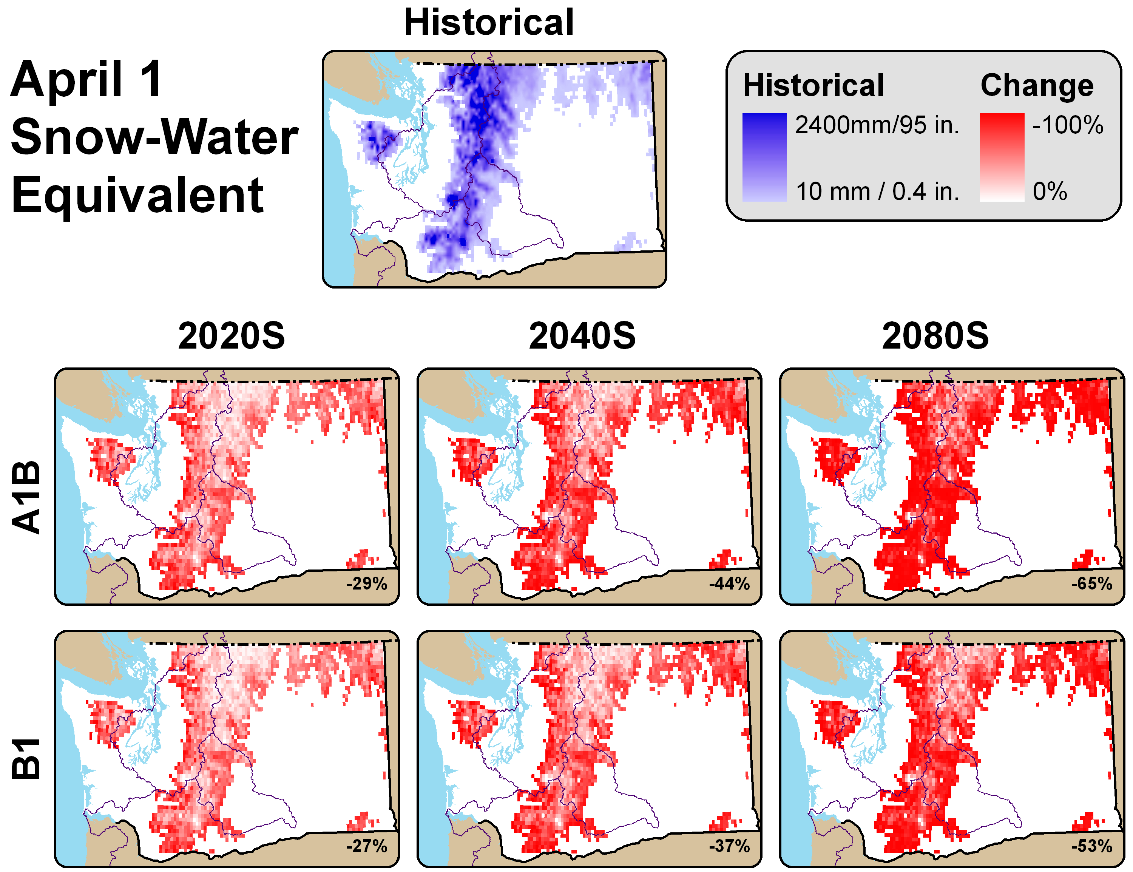
Changing Hydrology:
All Scenarios Indicate Less Snow
Apr. 1 Snow Water Equivalent
1916-2006
s
s
s
Medium Emissions
Scenario
-29%
-44%
-65%
Elsner et al. 2010
Why? Spring snowpack is projected to decline as more winter precipitation falls as rain rather than snow, especially in warmer mid-elevation basins. Also, snowpack will melt earlier with warmer spring temperatures.
Notes:
Elsner, M.M. et al. 2009: Implications of 21st Century climate change for the hydrology of Washington State (and Elsner et al. 2010 Climatic Change paper);
Shown above are the results of hydrologic model simulations under multi-model average future climate scenarios for A1B and B1 emissions (middle and bottom panels, respectively)

Slide 20
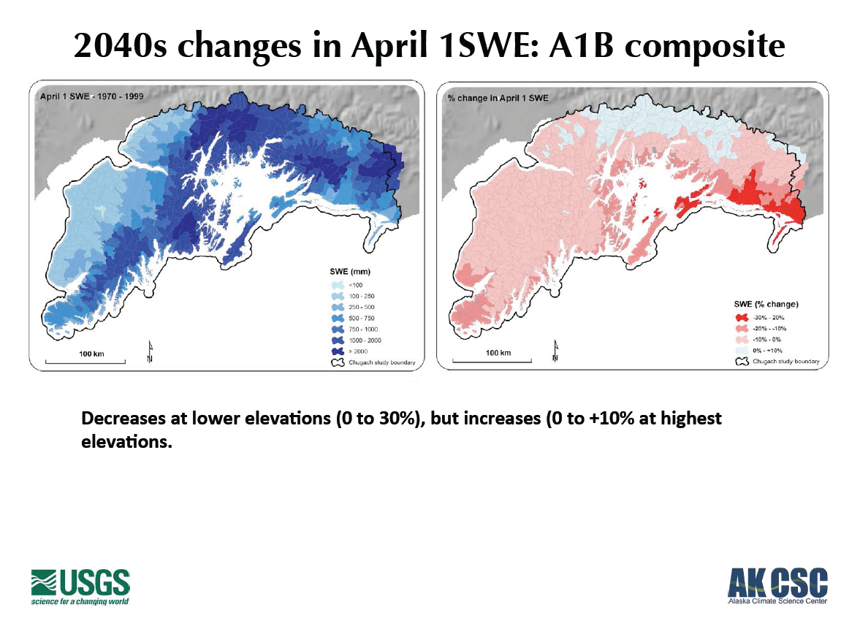
Chugach National Forest
Slide source: Jeremy Littell, USGS
Notes:
Similar findings are found in other parts of the NPLCC region, including this example from AK.
SWE is projected to decline most in the autumn (October and November) and at lower elevations (less than 1500m), an average of -26% for the 2030-2059 period compared to 1971-2000.
http://ecoadapt.org/data/documents/Littell_ChugachSnow_13Jan14.red.pdf
Five GCM composite

Slide 21
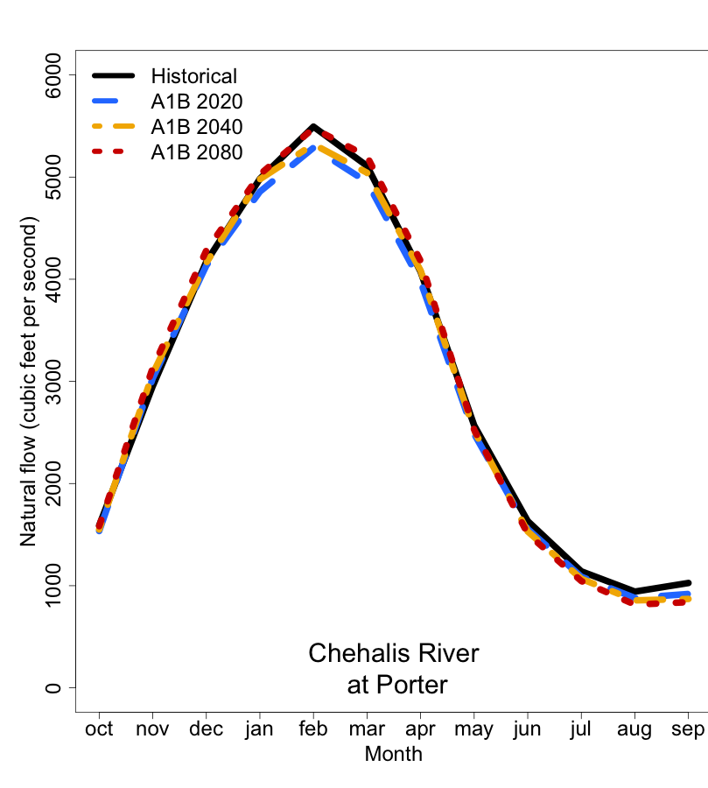
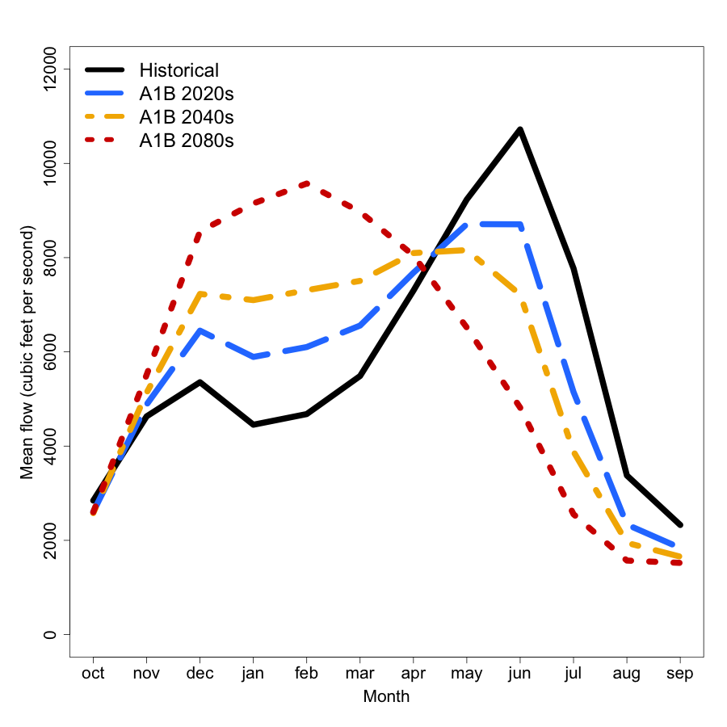
Hydrology
Shifting Streamflows
Rain Dominant Basin
Transient Basin
Oct. April Sept.
Naturalized flows (without the influence of dams); Elsner et al. 2010
Notes:
Presentation note for Amy:
You will want to talk through how the projected changes affect the likelihood of flooding, landslides, sediment transport in winter, etc. – I did not include the slides you have that shade out winter and summer flows and list implications.
Caption: Projected increased winter flows and decreased summer flows in many Northwest rivers will cause widespread impacts.
Mixed rain-snow watersheds, such as the Yakima River basin, an important agricultural area in eastern Washington, will see increased winter flows, earlier spring peak flows, and decreased summer flows in a warming climate.
Changes in average monthly stream flow from baseline (simulated 1916-2006 average, black) to the 2020s (blue), 2040s (yellow), and 2080s (red) indicate that the Yakima could change from a basin deriving most of its streamflow from snow melt to a rain-dominant basin by the 2080s under a scenario that assumes continued increases in emissions through mid century but declines thereafter (A1B).
Hydrologic response to climate change varies by type of watershed, with the largest responses in basins with significant snow accumulation, where warming increases winter flows and advances the timing of spring melt.
By 2050, snowmelt is projected to shift 3 to 4 weeks earlier than the 20th century average (Barnett et al. 2005; U.S. Bureau of Reclamation 2008), and summer flows are projected to be substantially lower.
Change in flood risk depends on many factors, but is projected to increase the most in mixed basins (those with both winter rainfall and summer snowmelt-related runoff peaks) and decrease in higher basins.

Slide 22
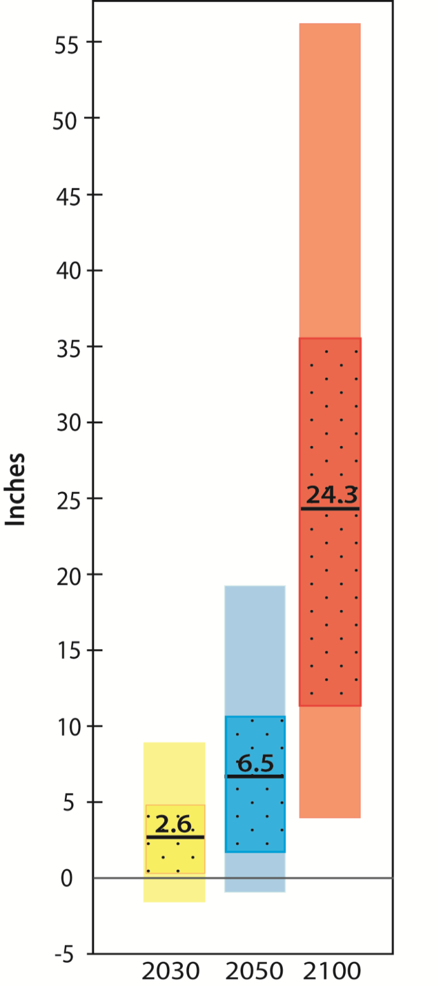
Projected SLR - Seattle
Sea Level Change
Sea level rise projected for CA, OR, WA
and BC by 2100
Projected Range, Seattle Relative to 2000 (NRC 2012)
2030 | -1.5 to +8.8 inches
2050 | - 1.0 to +18.8 inches
2100 | +3.9 to +56.3 inches
Sea level fall (-2.1 to -3.4 feet) projected in southeast AK by 2100 (as cited in Tillmann and Siemann 2011; no baseline provided)
Notes:
In Alaska, land level changes are, in general, more rapid than sea level changes.
Presentation notes :
- These are the resulting projections when you take into account the various global and local scale factors that affect sea level at any given location
Regarding the potential for sea level fall in the Olympic Peninsula. Under current scenarios, declining sea level is possible in the Northwest Olympic Peninsula if the rate of global sea level rise is very low and if the rate of uplift caused by plate tectonics continues to exceed the rate of global sea level rise. Although most current global projections would result in sea level rise for the northwest Olympic Peninsula, it is not yet possible to conclusively rule out a decline in sea level for that region.
About the figure/numbers
Projected range values are for the B1 scenarios to the A1FI scenarios (and including uncertainty in other factors as well – glaciers, ice caps, sea level fingerprint, vertical land motion)
Stippling is the range around the mean, based on the A1B scenario (and including uncertainty in other factors as well – glaciers, ice caps, sea level fingerprint, vertical land motion)
20th century highest observed tidal surge (storm surge?) 3.1 feet – Seattle (from King County report)

Slide 23

Ocean Acidification
Approximately 25% of the CO₂ generated by human activities since the mid-1700s has been absorbed by the oceans.
Ocean acidity has increased 30% since the start of the industrial age.
Ocean acidity is projected to increase 100-150% percent by 2100.
Current rate of acidification is nearly 10x faster than any period over the past 50 million years.
WA State Blue Ribbon Panel on Ocean Acidification, 2012
Notes:
Note for 1st bullet: the atmospheric concentration of CO₂ in the atmosphere has increased about 35% since the start of the industrial age (1750s). The current concentration in the atmosphere (~392 ppm) has not been seen for at least 800,000 years (based on ice core data).
Note for 2nd bullet point: a 30% increase in acidity corresponds to a decrease of 0.1 pH units. The pH scale is logarithmic (like the Richter scale), so a small change in pH corresponds to a large change in acidity. For example, pH 7 is 10 times as acidic as pH 8.
Note for 3rd bullet point: This projection is based on the current rate of global carbon dioxide emissions.
Note for 4th bullet point: This rapid rate of change gives marine organisms, ecosystems and humans less time to adapt, evolve or otherwise adjust to changing ocean chemistry. Scientists are concerned that many marine species will not be able to keep pace, and will go extinct.

Slide 24
Implications for Resource Management

Slide 25
Key Impacts Common
Across NPLCC Ecosystems
Habitat loss and transition
Due to….
Changes in climatic suitability
Changes in food availability
Changes in productivity/ reproductive success
Changes in hydrology & snowpack
Changes in soil moisture & evapotranspiration
Sea level rise
Increased erosion
Changes in disturbance (e.g., fires, flooding, insects, disease)
Human response to climate impacts
Notes:
Which factors will vary with species and location

Slide 26
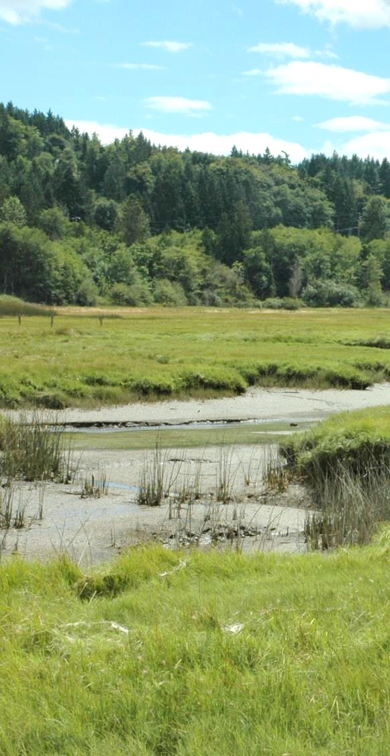

Coastal Habitat
Coastal/Marine
Modeled (SLAMM) results by 2100 with 27.3 inches of SLR (0.69 m) at the sites investigated:
66% loss of low tidal areas in Willapa Bay and Grays Harbor;
11 to 56% loss of freshwater tidal marsh in Grays Harbor, Puget Sound, and Willapa Bay;
Replacement of much of these habitats by transitional marsh.
In the Lower Columbia River:
Minimal losses to low tidal, saltmarsh, and freshwater tidal habitats (-2%, -19%, -11%, respectively)
Substantial gains in transitional areas (+160%).
Tillman and Siemann 2011

Slide 27
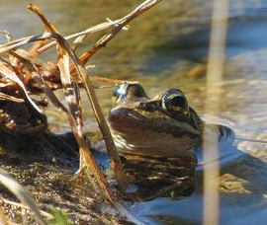
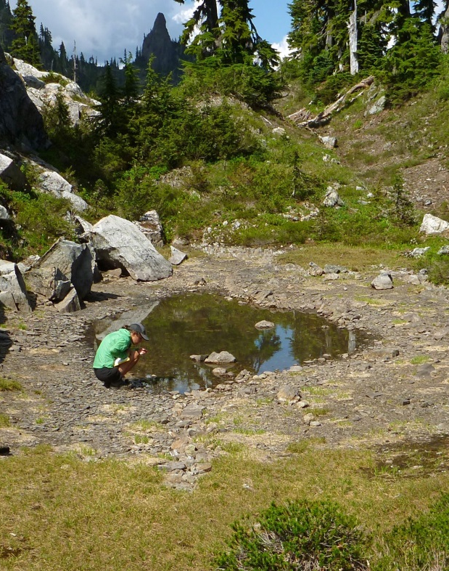
Freshwater Wetlands
Freshwater/Riparian
Cascades frog
Where precipitation < evapotranspiration (drying ) occurs…
reduction/loss of wetlands, particularly peat wetlands
reduction/loss of seasonal streams
Where precipitation > evapotranspiration (wetting) occurs….
Expansion of wetlands
Also…
Potential for more rapid transition of wetland types due to longer growing season (faster growth of forests, shrubs, mosses, grasses, sedges)
Increased stress for cold temperature-dependent flora in alpine wetlands
M Ryan/U of Washington
Notes:
Key determinant: the balance between changes in precipitation, evapotranspiration, snowpack
Top photo: Cascades frogs, found only at high elevations in three states, will face a hard future where trout dominate high mountain lakes and climate change dries up many of the shallower waterways such amphibians have been using.
Bottom photo: With climate change, there will be fewer seasonal ponds that have water during crucial times of the year when amphibians breed and their young, such as frogs in their tadpole stage, need to be in water.
In a drier climate, peat-based wetlands would be especially hard-hit as the highly organic soils undergo oxidation and subsidence, thus altering drainage patterns, topography, and exposure to fire

Slide 28

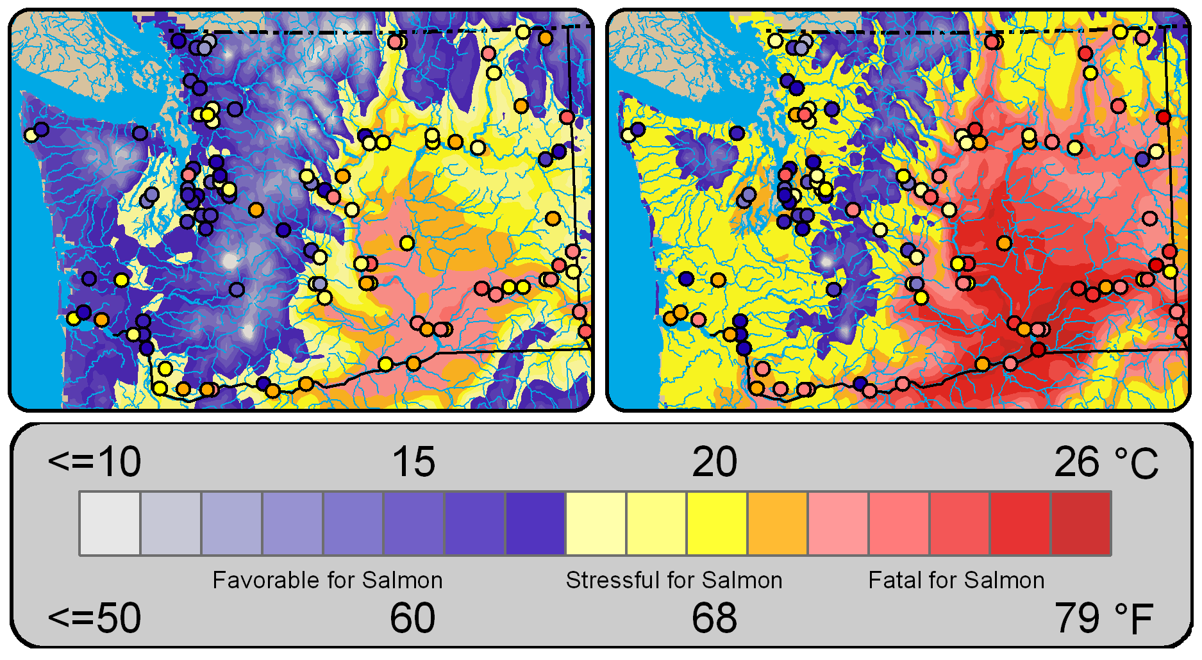
Salmon and Ecosystems
Freshwater/Riparian
August Mean Surface Air Temperature and Maximum Stream Temperature
Historical (1970-1999)
2040s medium (A1B)
* Projections are compared with 1970-1999 average
Mantua et al. 2010
Notes:
28
It is well known that there are temperature thresholds for coldwater fish, and that warming temperatures will increasingly stress coldwater fish in the warmest parts of the Pacific Northwest. A monthly average temperature of 68F has been used as an upper limit for resident cold water fish habitat, and is known to stress Pacific salmon during periods of freshwater migration, spawning, and rearing.
In Washington, the most significant temperature impacts are projected in the Columbia Basin. Because salmon move through these regions during parts of their lifecycle, this doesn’t necessarily mean that salmon will be eliminated from these regions. It does, however, suggest increased stress on populations that use these areas during summer, such as summer and fall chinook, summer steelhead, and sockeye salmon.
About the figure: August mean surface air temperature and maximum stream temperature for 1970-1999 (top left) and the 2040s (top right, emissions scenario A1B). The area of favorable thermal habitat for salmon declines by the 2040s in western Washington, and in eastern Washington many areas transition from stressful to fatal for salmon.
Source: Mantua, N.J., I. Tohver, and A.F. Hamlet. 2009. Impacts of climate change on key aspects of freshwater salmon habitat in Washington State. Chapter 6 in The Washington Climate Change Impacts Assessment: Evaluating Washington's Future in a Changing Climate, Climate Impacts Group, University of Washington, Seattle, Washington.

Slide 29
Key Impacts Common
Across NPLCC Ecosystems
Habitat loss and transition
Shifts in biodiversity,
ranges, abundance, and
community composition

Slide 30

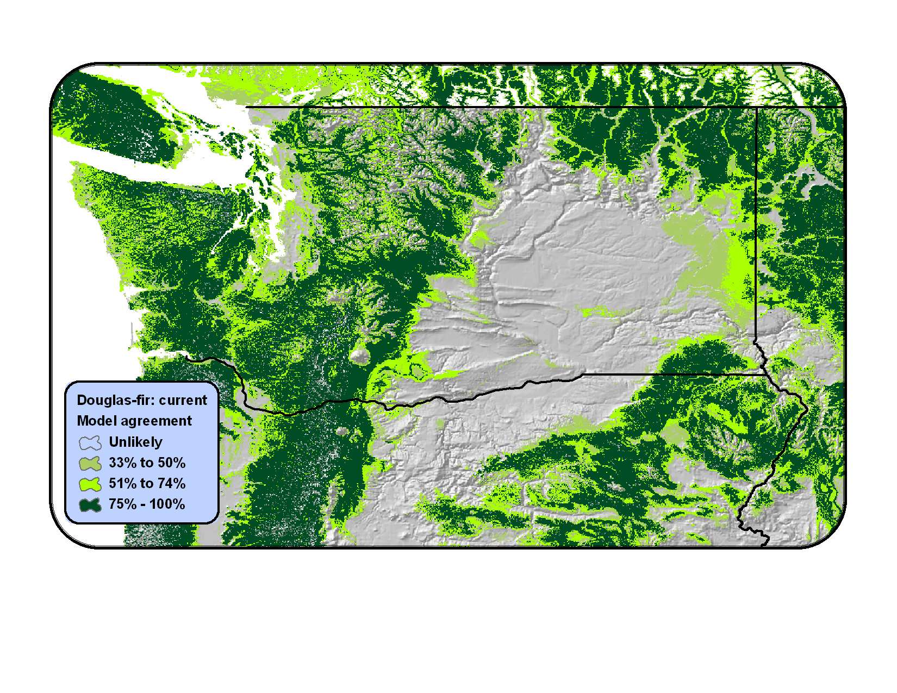
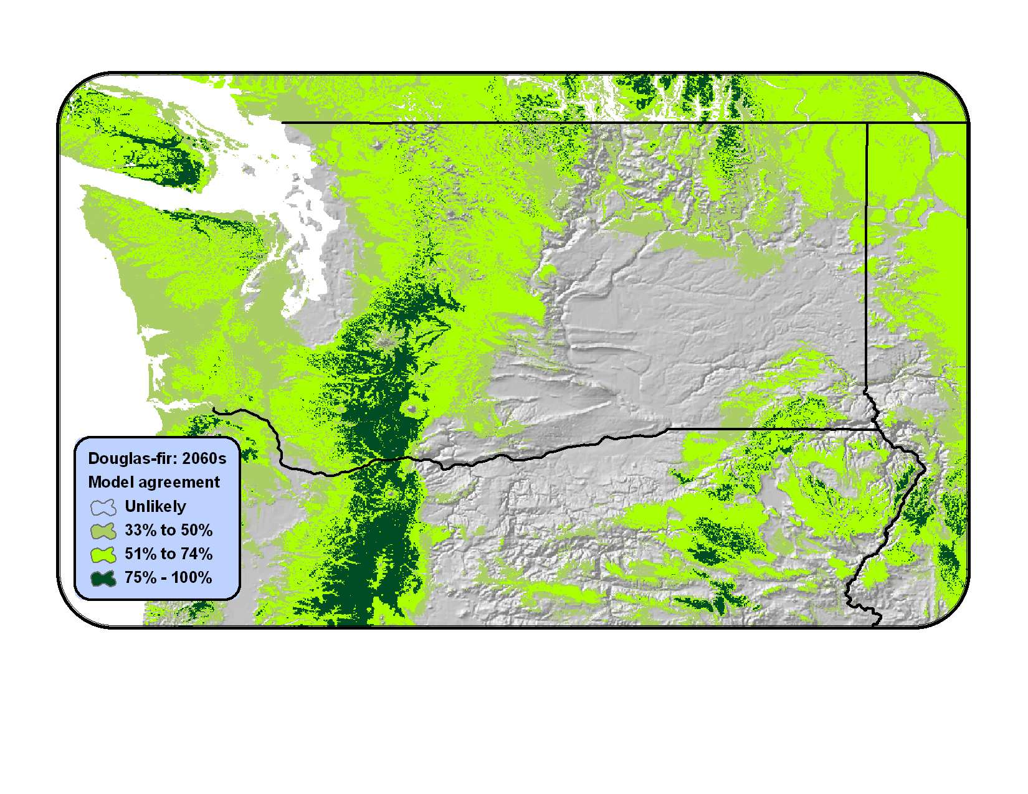
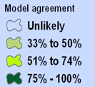
Reduced climatic suitability:
Douglas-fir
Current
2060s
Changes in the potential climatically suitable range of Douglas-fir
(Data: Rehfeldt et al. 2006, multiple IPCC scenarios).
Littell et al. 2009
Notes:
30
Range for Douglas-fir may be reduced due to changes in climatic suitability for Douglas-fir. This is particularly relevant to seedling establishment.

Slide 31
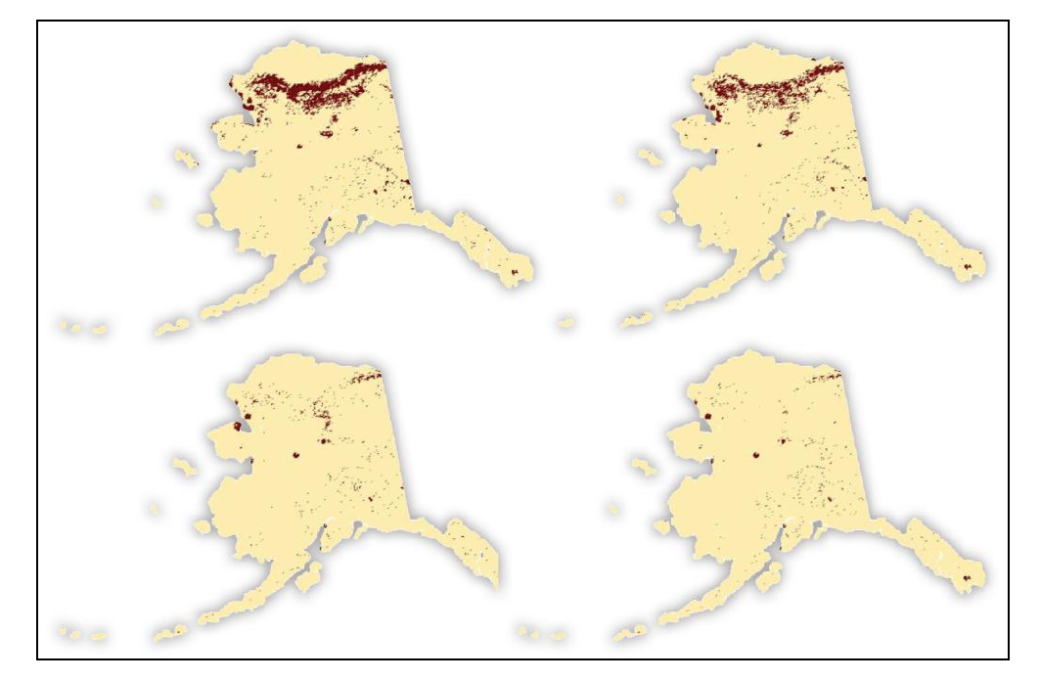
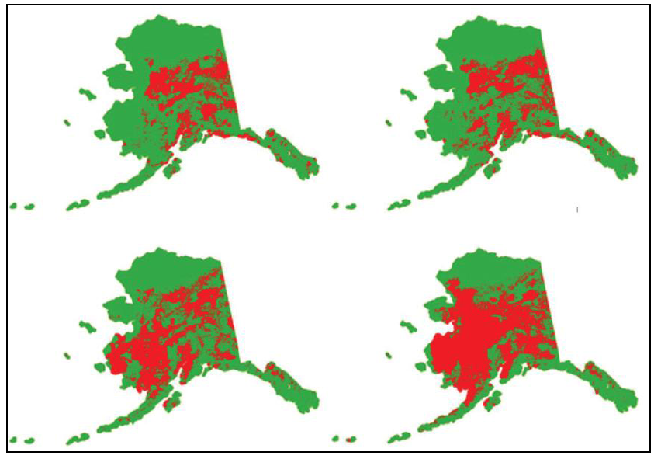
There will be losers….
Projected change in Alaska marmot distribution under the A1B scenario. Statewide, total range area shrank by 27% by 2039, 81% by 2069, and 87% by 2099, relative to the estimated range size for 2000-2099 (top left).
2039, -27%
2069, -81%
2099, -87%
…and winners
Potential expansion of trumpeter swan habitat. Trumpeter swans are predicted to shift their range northward and westward over the course of this century. Red indicates trumpeters present. Green indicates trumpeters absent
Source: Murphy et al. (August 2010, Fig. 20 and 21), as used in Tillman and Siemann 2011

Slide 32
Key Impacts Common
Across NPLCC Ecosystems
Habitat loss and transition
Shifts in biodiversity, ranges,
abundance, and community
composition
Increased competition from
invasive species

Slide 33
Climate change benefits invasive species when…
New species are now able to survive in new or existing locations,
Known invasive species expand their range into new territories, and
Species that currently are not considered invasive may become invasive and cause significant impacts
Tillman and Siemann 2011

Slide 34
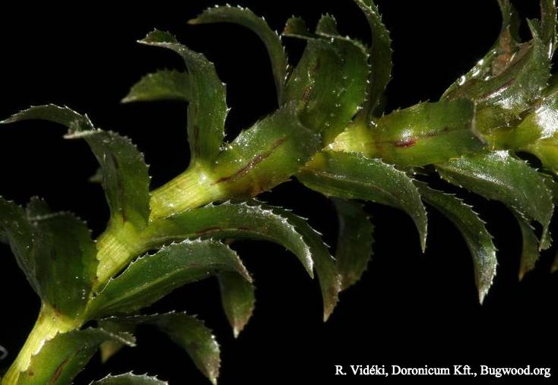
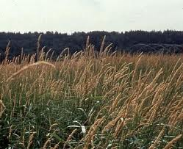
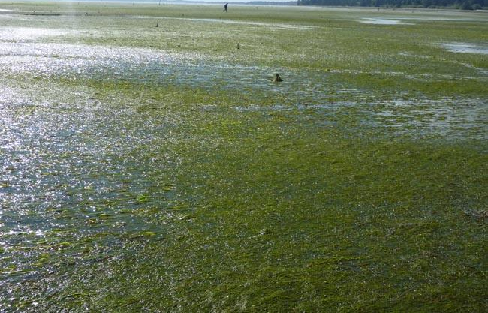
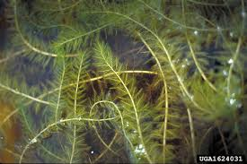
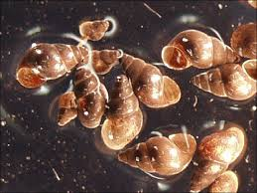
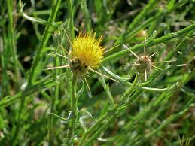
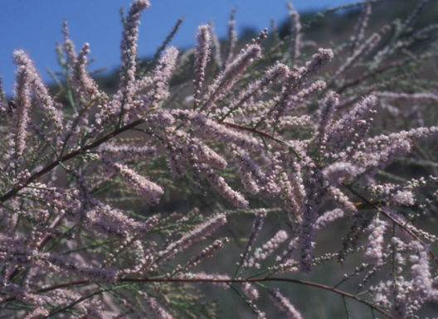
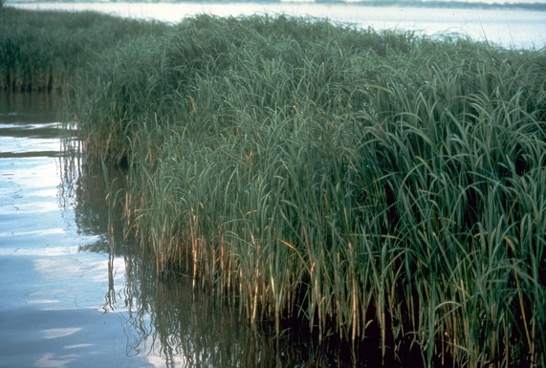
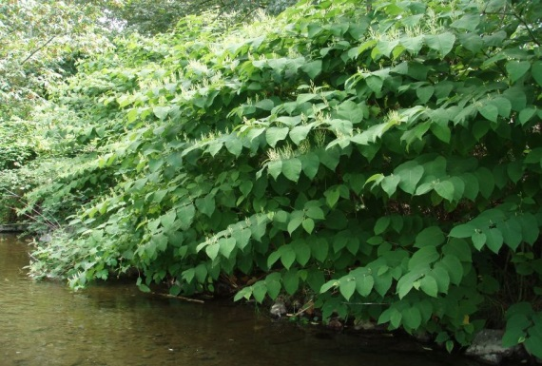
Invasives that appear to benefit from climate change
Hydrilla
Reed canarygrass
Japanese eelgrass
Eurasian watermilfoil
New Zealand mud snail
Yellowstar thistle
Tamarisk
Spartina
Knotweed
Notes:
In Washington, Oregon, and Idaho, a habitat suitability model projects 21% of the region could support suitable habitat for the invasive tamarisk by 2099 (a two- to ten-fold increase). Tamarisk currently occupies less than 1% of this area

Slide 35
Key Impacts Common
Across NPLCC Ecosystems
Habitat loss and transition
Shifts in biodiversity, ranges,
abundance, and community
composition
Increased competition from
invasive species
Altered phenology

Slide 36

Timing Matters…
Timing of juvenile salmon migration with peak runoff
Timing of coastal upwelling with arrival of species dependent on plankton
  e.g., 2005 recruitment failure of plankton-reliant rockfish species, low survival of coho and Chinook salmon, complete nesting failure by Cassin’s Auklet, and widespread deaths of other seabirds (due to delayed upwelling)
Timing of snowmelt/snow cover with reproduction, shelter, food needs
Timing of blooms with arrival of pollinators
(Tillman and Siemann 2011)

Slide 37
Key Impacts Common
Across NPLCC Ecosystems
Habitat loss and transition
Shifts in biodiversity, ranges,
abundance, and community
composition
Increased competition from
invasive species
Altered phenology
Changes in disturbance (insects, disease, fire)

Slide 38
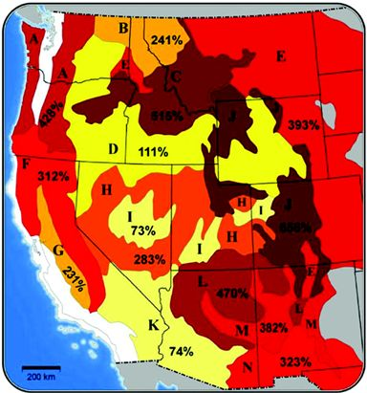

Projected increases in area burned from the regional temperature and precipitation changes associated with a 2.2°F global warming
NRC 2011
Notes:
Map indicates the increases in area burned that would result from the regional temperature and precipitation changes associated with a 2.2°F global warming100 across areas that share broad climatic and vegetation characteristics.101 Local impacts will vary greatly within these broad areas with sensitivity of fuels to climate.14
Although infrequent historically, wildfire risk increases in northern CA, western WA and OR, and southeast AK

Slide 39
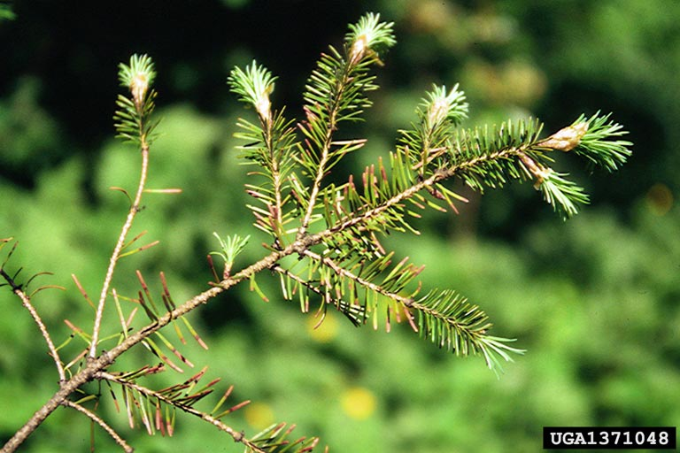
Increased risk of disease, insect outbreaks
For example:
Spruce bark beetle
Swiss needle cast
Yellow-cedar decline
Sudden oak death
Mountain pine beetle (increase then decrease)
Discovery Fire burns near volatile stands of
insect-damaged trees, DNR
Notes:
Changes in disease, insect outbreaks can vary by location and may depend on changes in precipitation. For example, warmer temperatures and drier conditions will increase host susceptibility to infection and growth of cytospora canker (alder). Wetter conditions may reduce the host moisture stress, slowing or stopping canker growth.
-----------------
Spruce bark beetle is the dominant disturbance agent in southcentral Alaska
Swiss needle cast: reduces growth and needle retention in Douglas-fir stands in wet, coastal, low-elevation forests in the southern NPLCC region. Swiss needle cast is expected to expand north from the central Oregon coast and inland as milder, wetter conditions become the norm, and to decrease from California to southern Oregon where June-July precipitation may remain below the limiting threshold of 3.94 inches (110 mm).
Yellow-cedar decline occurs in several thousand locations of concentrated mortality, totaling approximately 494,211 acres (200,000 hectares, ha) in southeast Alaska; also affects parts of BC.
The most detailed projections suggest the largest areas with increased risk of mountain pine beetle outbreak are outside the NPLCC region. However, future outbreaks in the region may stress whitebark pine, ponderosa pine, and lodgepole pine as outbreaks shift to high elevations in Oregon and Washington. Yet by 2100, outbreaks are expected to decline throughout most of the NPLCC region due to a temperature-driven mistiming in the emergence of adult beetles or a lack of suitable climate conditions for host tree species.

Slide 40
Table 34. Washington Important Bird Area (Figure 70) species potentially impacted by increased forest fire intensity and changes in temperature and precipitation driven by climate change.
Forest Fire Intensity
Beneficial | Low Risk | Moderate Risk | High Risk
Black-backed woodpecker Olive-sided flycatcher | Sooty grouse Williamson’s sapsucker | Northern goshawk Dusky grouse White-headed woodpecker Hermit warbler | Flammulated owl
Changes in temperature and precipitation
 | Black-crowned night-heron Cinnamon teal Common goldeneye Hooded merganser Osprey Lewis’s woodpecker | American bittern Canvasback Ring-necked duck Lesser scaup Ruddy duck Virginia rail Sora Sandhill crane Long-billed dowitcher Wilson’s snipe Wilson’s phalarope Forster’s tern Willow flycatcher | Western grebe Clark’s grebe Black-necked stilt American avocet Long-billed curlew Black tern
Source: Reproduced from Audobon Washington (2009, Tables shown on p. 7 and p. 10) by authors of this report.

Slide 41
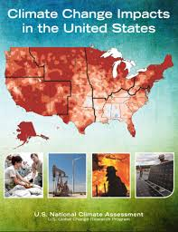
Implications for Tribes
Socioeconomic and health impacts from:
Reduced/lost access to traditional foods such as fish, game, and wild and cultivated crops
Loss of culturally significant places and traditions associated with traditional foods and places
Risky travel and hunting conditions, damage and loss to settlements, and food insecurity
Relocation of communities
Bennett et al 2014, Ch 12 in U.S. Third Nat. Assess.

Slide 42
Where Do We Go From Here?

Slide 43
Planning for Climate Change
Anticipate changes. Accept that the future climate will be substantially different than the past.
Use scenario based planning over long time scales to evaluate options rather than the historical record.
Expect surprises and plan for flexibility and robustness in the face of uncertain changes rather than counting on one approach.
Plan for the long haul. Where possible, make adaptive responses and agreements “self tending” to avoid repetitive costs of intervention as impacts increase over time.

Slide 44
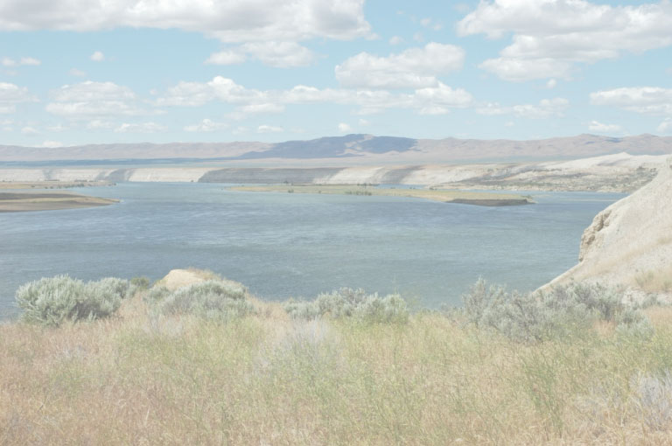

The Climate Impacts Group
www.cses.washington.edu/cig
CIG@uw.edu
Save the Date!
5th Annual Pacific Northwest
Climate Science Conference
September 9-10, 2014
http://pnwclimateconference.org/
Northwest Climate Science Center

Slide 45
Extra Slides

Slide 46
“Big Picture” Messages from the
Third National Climate Assessment (2014)
Climate change is here. Climate change is apparent across a wide range of observations.
Climate will continue to change at an accelerating rate. By end of century, average annual temperature in the U.S. is projected to increase 3°F to 5°F rise under a lower greenhouse gas emissions scenario (the “B1 scenario”) and 5°F to 10°F for a higher emissions scenario (the “A2 scenario”).
Climate change affects many components of the built and natural environment. Impacts related to climate change are already evident in many sectors and are expected to become increasingly disruptive across the nation throughout this century and beyond.
Planning for adaptation and mitigation is becoming more widespread, but current implementation efforts are insufficient to avoid increasingly negative social, environmental, and economic consequences.
Notes:
There are many, many key messages distributed in the various report chapters.

Slide 47
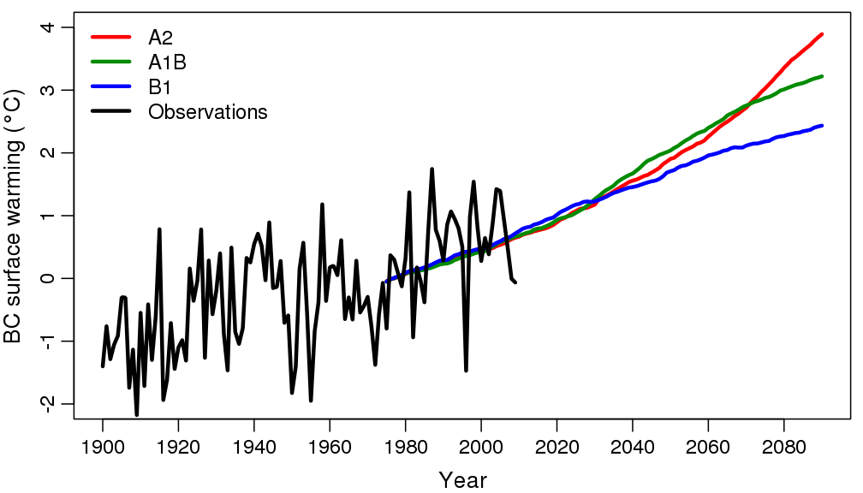


Projected BC warming
BC Mean Annual Temperature Anomalies (from 1961-1990 baseline)
UVic ESCM % reduction from 2006 levels by 2050
compared to mean of AR4 GCM projections for A2, B1, and A1B
(20 yr centered means)

Slide 48

Average and Extreme Precipitation Increases – Bella Coola, BC
Queen Charlotte Sound
Vancouver Island
Indicator | Past (‘71-2000) | Future (2041-’70) | Change
Annual Total | 673 mm | 744 mm | 11%
5-Day Precip. | 56 mm | 67 mm | 20%
10-year event | 36 mm | 47 mm | 31%
25-year event | 44 mm | 60 mm | 36%
Notes:
In terms of the indicator projections the picture is similar to Bear Pass. The annual total is projected to increases by 11% while the extreme events increase is larger, with 30-36 percent increases in the 10 and 25 year events. As well the persistence events in the 5-day totals are also expected to increase by 20% compared to the past.

Slide 49



Slide 50



Slide 51
Major climate-driven impacts on NPLCC coastal and marine environments
1. Ocean acidification
2. Increasing sea surface temperature
3. Altered hydrology
4. Altered ocean currents
5. Increased frequency and severity of storms
6. Sea level rise
7. Coastal upwelling
8. Coastal hypoxia and anoxia

Slide 52
Major climate change effects on NPLCC coastal and marine environments
1. Altered nutrient cycling
2. Altered ocean productivity
3. Altered food web dynamics
4. Multiple stressors and thresholds

Slide 53
Major climate change effects on NPLCC aquatic and riparian ecosystems
1. Altered nutrient cycling and productivity
2. Changes to stratification and eutrophication
3. Changes to water input, level, and area
4. Changes to the length and date of seasonal ice cover
5. Habitat loss, degradation, and conversion

Slide 54
Major climate change effects on NPLCC terrestrial ecosystems
1. Altered hydrology, fog regimes, and drought regimes
2. Altered growing season and freeze and thaw patterns
3. Altered fire regimes
4. Altered insect, pathogen, and disease regimes
5. Altered patterns of landslides, ice and wind storms, and avalanches

Slide 55
Table 1. Observed trends and future projections for summer and winter temperature in the NPLCC region. °F with °C in parentheses
Location | Summer |  | Winter |  | Time Periods
 | Observed Trends | Future Projections | Observed Trends | Future Projections
Near Juneau, Alaska | 2.2 (1.2) | N/A | 6.2 (3.4) | N/A | Trends: 1949-2009 Projections: N/A
Coastal British Columbia | 0.31 to 0.74 (0.17 to 0.41) | 2.7 to 9.0 (1.5 to 5.0) | 0.40 to 0.52 (0.22 to 0.29) | 0 to 6.3 (0 to 3.5) | Trends: 1950-2006 Projections: 2050 vs. 1961-1990
Pacific Northwest* | 1.93 (1.07) | 8.1 (4.5) | 3.3 (1.83) | 5.9 (3.3) | Trends: 1920-2000 Projections: 2080s vs. 1970-1999
Northwest California | N/A | >2.9 and <12 (>1.6 and <6.4) | N/A | >3.1 and <6.1 (>1.7 and <3.4) | Trends: N/A Projections: 2070-2099 vs.1961-1990
N/A: Specific data is unavailable. * The Pacific Northwest includes Washington, Idaho, Oregon, and southern British Columbia. Sources: Ainsworth & Fritsch (2011, personal communication); B.C. Ministry of Environment (2007); Cayan et al. (2008); Karl, Melillo & Peterson (2009); Mote (2003); Mote and Salathé, Jr. (2010)
Tillman and Glick 2013, Climate Change Effects and Adaptation Approaches for Terrestrial Ecosystems, Habitats, and Species

Slide 56

Vulnerable Sea and Shorebirds
Including…
Aleutian Tern
Kittlitz’s Murrelet
beach-nesting black oystercatchers
Cassin’s auklet
Key issues for coastal birds: loss of habitat and food sources
Reproductive failure among seabirds has been documented as a result of changes in marine productivity, often observed during El Niño years when sea surface temperatures are warmer than average.

