Slide 1



Conservation Goals & the NPLCC
John Mankowski, Coordinator
Mary Mahaffy, Science Coordinator
Karen Jenni, Insight Decisions - Facilitator
Steering Committee Discussion – July 9, 2014

Slide 2

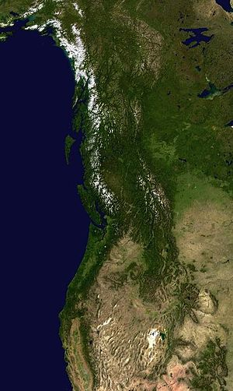
Outline
Review
  What are Conservation Goals in context of LCCs?
  Why articulate them?
  Origin of proposed goals
Discussion of proposed goals
  Overall Conservation Goal
  Topic-specific Conservation Goals
Steering Committee Decision on next steps

Slide 3
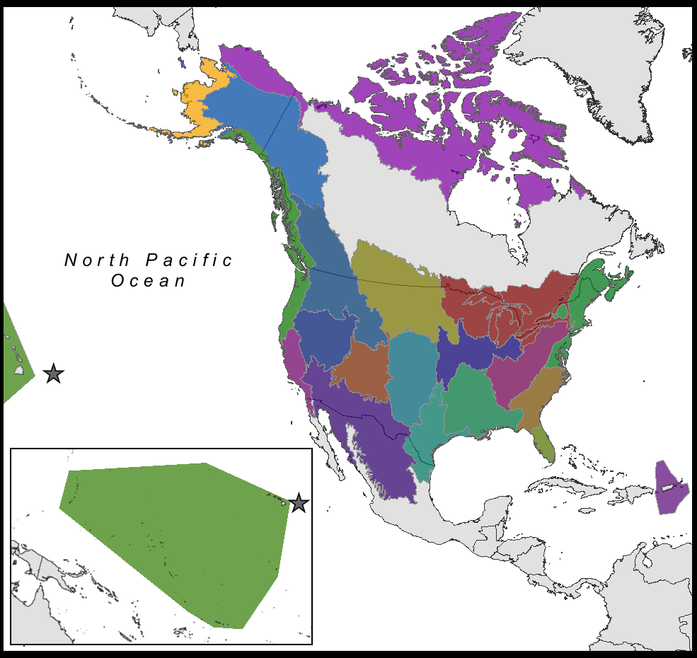
What are LCC Conservation Goals?
22 Partner-lead Collaboratives
Respond to Congressional direction to “establish clear goals, objectives, and measureable outcomes for LCCs”
DOI/FWS funding/performance expectations
SIAS – Science Investment & Accountability Schedule
  Includes 8 performance categories (sample)
  One of which is: Collating and Establishing Conservation Goals and Measurable Objectives for priority resources

Slide 4
Why Articulate LCC-Specific Conservation Goals
Achieve national performance benchmark, linked to funding
Provides method to refine S/TEK Strategy and what we work on within our 5 Priority Topics
Provides metrics and opportunities for performance tracking, demonstrating our success/value to partners
Helps better define “why” NPLCC exists, what it does, how it helps, where it is adding value.

Slide 5
NPLCC Charter
S-TEK Strategy
Mission
5 Priority Topics
Annual S-TEK Implementation Plans (Determines Areas of focus and NPLCC funding priorities)
Four Guiding Principles
NPLCC funded projects
NPLCC-relevant work by Partners
7 NPLCC Objectives
Communication and Outreach Strategy
Partner Engagement Strategy

Slide 6
NPLCC Charter
Mission
S-TEK Strategy
5 Priority Topics
Conservation Goals and Objectives
Annual S-TEK Implementation Plans (Determines Areas of focus and NPLCC funding priorities)
7 NPLCC Objectives
Four Guiding Principles
NPLCC funded projects
NPLCC-relevant work by Partners
Notes:
Adding Conservation Goals and Objectives to the mix – where do they fit?
Clearly within the boundaries of the Charter & must support the mission and NPLCC goals and objectives.
NPLCC staff defined them within the context of the S-TEK Strategy -- as you have seen (or will see shortly), a set of goals and objectives is proposed for ach of the 5 Priority Topics Identified in the Strategy
So the 5 Priority Topics define WHAT the NPLCC S-TEK work will focus on; the Conservation Goals and Objectives are intended to state WHAT WE WANT TO ACCOMPLISH with respect to each of those topics (the “Why”?), and the Annual Implementation Plan Plan describes how we are are going to (move towards) accomplishing those goals

Slide 7
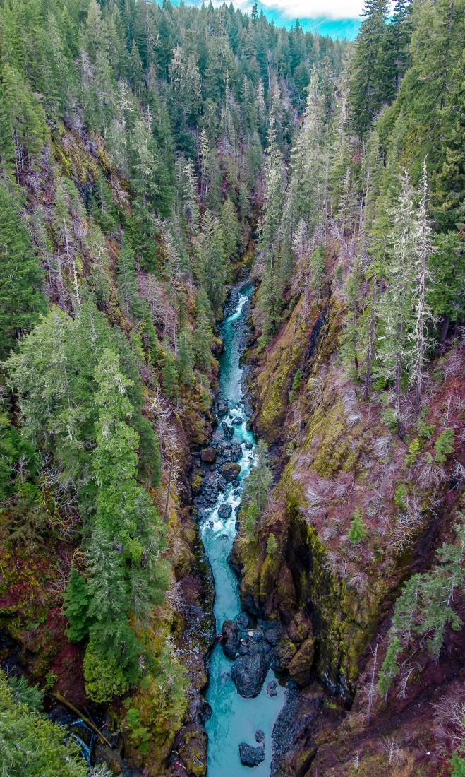
Proposed NPLCC Goals and Objectives
Approach –
  Pulled from S/TEK Strategy - 5 Priority Topics (Priority Resources + Significant Climate Stressors)
  Reviewed goals/objectives of many NPLCC partner climate-related initiatives (BC VA for working forests)
  Reviewed work of other LCCs (Arctic LCC)
  Ensured consistency with NPLCC charter, mission, and 7 overarching goals.
Notes:
Reminders – these didn’t come out of blue sky – they are grounded in the documents just discussed, and consistent with many of your own goals and objectives, and with work of related LCCs

Slide 8
Structure of proposed draft Goals
One overall Conservation Goal
  Defined to be consistent with overall goals of your agencies and organizations
One Goal and two supporting Objectives for each Priority Topic
  Goal is to inform policy, management decisions, and actions of resource management [with respect to each of the Priority Topics](NPLCC goals 1, 4, 5 and 6)
  Supporting objectives:
    Identify decision-relevant information needs (NPLCC goals 2 and 3)
    Support / develop / provide that information to interested decision-makers in a useful form (All four S-TEK guiding principles)
Notes:
I will use this structure to essentially “limit” our discussion to 4 issues (assuming if we can agree on the one Goal and two supporting objectives for each Priority Topic we don’t have to review all 15 of them…)

Slide 9
Proposed overall conservation goal
Increase the likelihood that the NPLCC region will continue to support it’s emblematic species, ecosystems, and the cultures and livelihoods that depend on them. We [NPLCC Partners] will accomplish this by managing in ways that anticipate climate change and related stressors thereby contributing to sustainable ecologically-connected landscapes.
Notes:
I would anticipate 10-15 minutes of discussion on this slide.
Desired outcome: Agreement in principle on the overall goal and volunteers for wordsmithing it into shape
Potential outcome: Agreement on the first half but not the second half
Acceptable but not desired outcome (?): We don’t need an overall goal and can focus on Topic-specific goals
----------------------------------
The NPLCC Staff developed this proposal by looking at what each of your agencies do and what you have as your own conservation and management goals and objectives. They think this reflects a broad view of your common objectives.
In an effort to stay out of wordsmithing-level comments, let me ask you two questions:
If the NPLCC could accomplish this goal, would it help you and your agency to accomplish YOUR goals? (show of hands – yes / no. If divergent views, pick one person from each side to articulate their perspective)
There are two parts to this goal: first is the outcome that is desired; second is a step towards accomplishing that goal
a) Comments on the first – the outcome
b) Comments on the second – what to do to accomplish the desired outcome.
-

Slide 10
Topic-specific conservation goals
Inform policy, management decisions, and the actions of resource managers to maintain ecosystem functions so as to provide sustainable cultural, subsistence, recreational, and commercial resource use [of the priority resource] in light of [the climate-related stressor]
Notes:
I would anticipate 10-15 minutes of discussion on this slide.
Desired outcome: Agreement in principle on the overall goal and volunteers for wordsmithing it into shape
Possible but not desired outcome (?): NPLCC staff to bring another rock… (if discussion is going this way I will save the last 15 minutes of the discussion period for brainstorming what the SC members think should be in a Topic-specific conservation goal statement)
----------------------------------
As discussed, each of the more detailed conservation goals are tied to the five Priority Topics in the S-TEK strategy – then all follow the same structure and focus at the primary “goal” level on informing those who are directly involved in conservation and sustainable resource management, and the climate related impacts on a particular resource.
Again, in an effort to stay out of wordsmithing-level comments, let me start this the same way:
If the NPLCC could accomplish this goal, would it help you and your agency to accomplish YOUR goals? To design conservation and management plans, to carry out your organizational missions? (show of hands – yes / no. If divergent views, pick one person from each side to articulate their perspective)

Slide 11
Supporting objectives
(a) Identify decision-relevant information needs associated with understanding how [climate-related stressor] will affect [priority resource]
(b) Where appropriate, support/develop/provide that information to decision-makers in a manner that will useful for promoting and informing decisions that (1) anticipate landscape-scale [climate-stressor-related] changes, and (2) reduce risk, increase adaptive capacity, increase resilience [of the priority resources]
Notes:
I would anticipate up to 30 minutes of discussion on this slide – possibly getting to the different wordings in the sub-bullets in the draft document; ideally getting to the idea of the measureability of each of these…
----------------------------------
Two supporting objectives are defined for the primary Topic-specific conservation goal. These are more detailed but still at a level that’s not yet measureable. Let’s take them one at a time and talk about
Whether it is an appropriate objective, and then – if so –
how your organizations measure achievement of similar objectives.
-

Slide 12
Closing Questions – Sense of the SC
Overall conservation goal
  Is it reflective of the goals of your organization?
Topic-specific conservation goals
  Level of support for the conservation goal for each Priority Topic?
  Level of support for the two supporting objectives for each Priority Topic?
Notes:
I took out the sub-bullets and will handle that verbally: I’ll ask:
Do you like them as written?
Do you think them conceptually but would like to see some rewriting?
Do you think they need to be reformulated entirely?

