Slide 1
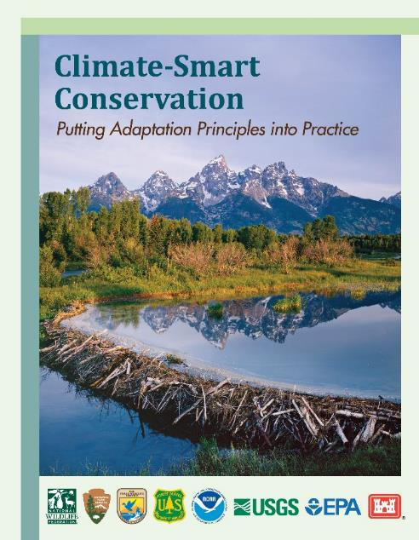
Climate-Smart Conservation:
Putting Adaptation Principles into Practice
Patty Glick
Senior Climate Change Specialist
National Wildlife Federation
North Pacific Landscape Conservation Cooperative Steering Committee Meeting
July 9, 2014

Slide 2
Guidance Development Approach
Expert workgroup convened to develop adaptation guidance
  Federal, state, and NGO participants
  Builds on previous guidance for vulnerability
Designed to demystify process
  Breaks down into manageable steps
Non-prescriptive
  Focus on understanding principles and use of a general framework
  Encourages innovation and context-specific application
Assumes use of existing best practices

Slide 3



Putting Adaptation
Principles into Practice
VS
Chopped – Adaptation Edition
“What’s in your basket?”

Slide 4
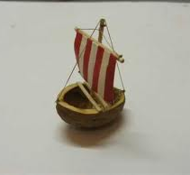
Climate-Smart Conservation
“Themes” in a Nutshell
Act with intentionality
Manage for change, not just persistence
Reconsider goals, not just strategies
Integrate adaptation into existing work

Slide 5



1. Act with Intentionality
Two key components
  Link actions to climate-related impacts
  Show your work!
Do you need to be doing something “different”?
  Actions may be novel or reflect current practice, as long as you meet the above
Shouldn’t all conservation be intentional?
  Yes, but we must avoid “repackaging” actions as “adaptation” if they are not

Slide 6
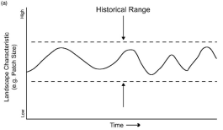
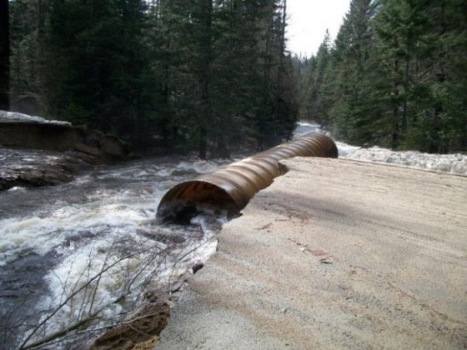
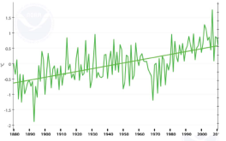
2. Manage for Change
Not Just Persistence
“Stationarity” is dead!
  Directional changes exceeding “historical range of variability”
Learn from the past, look to the future
  Paleo data, system response to disturbances
Adaptation will increasingly be about preparing for and managing change

Slide 7

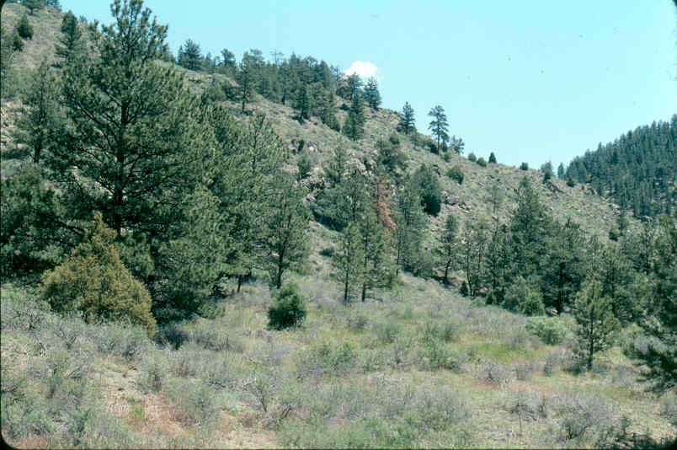
Continuum of Change
Persistence
  May still be relevant, especially in short term (e.g., buy time for valued species) or for particular places (e.g., refugia)
Transformation
  New “desired state”
Depends on Scale, Values

Slide 8



Approaches for Change Management
Resistance
  Focus on maintaining status quo
  May be appropriate for high-value assets
Resilience
  Current usage mostly focus on rebound to status quo conditions
Realignment
  Facilitate/manage for inevitable shifts to help achieve acceptable outcomes (or “let nature take its course”)

Slide 9
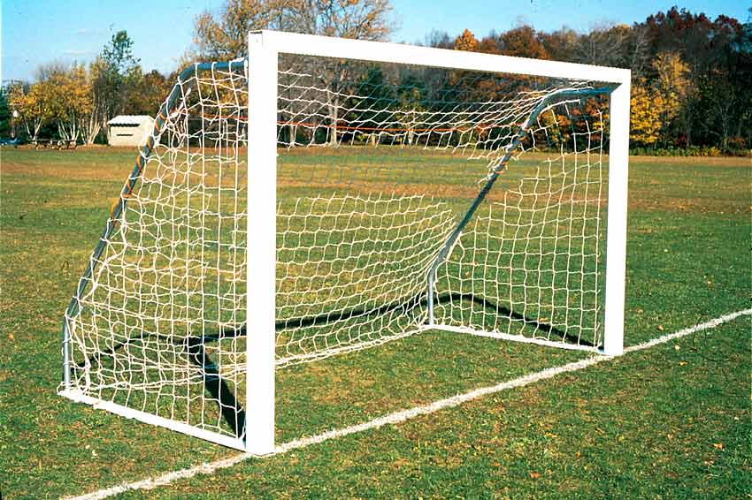



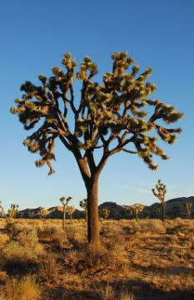
3. Reconsider Conservation Goals
Not just strategies
Goals are a reflection of human values
  Conservation goals evolve over time
Many current goals will no longer be feasible
  Need to embrace forward-looking rather than retrospective goals
May consider different targets, strategies (the means) in interim

Slide 10

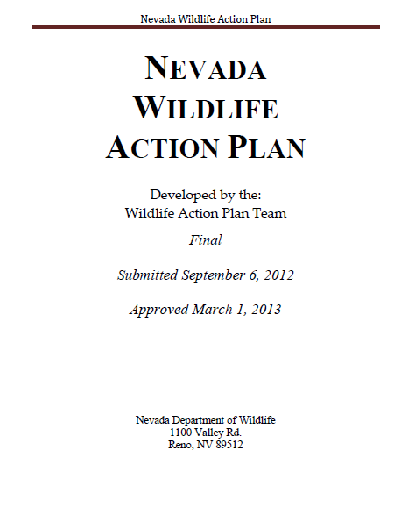
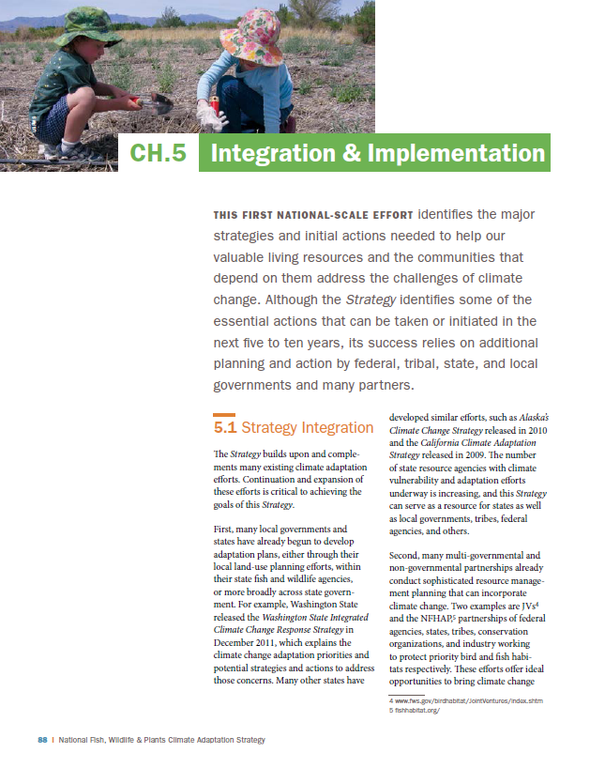
4. Integrate with Existing Work
Not Just Stand-Alone Adaptation
Stand-alone/dedicated adaptation planning
  State or national adaptation plans
Integrated adaptation planning
  SWAP revision, CCP updates
One may lead to the other
  Integrate adaptation recommendations

Slide 11
Structure of Guidance Document
Part 1 – Getting Started
  Introduction to climate-smart conservation
  Overview of adaptation planning and climate-smart cycle
Part 2 – Putting Principles into Practice
  Detailed exploration of steps in the adaptation cycle
  Separate chapter for each step of cycle
Part 3 – Making Adaptation Count
  Cross-cutting topics (e.g., uncertainty, communicating about adaptation, enabling policies, data sources)

Slide 12
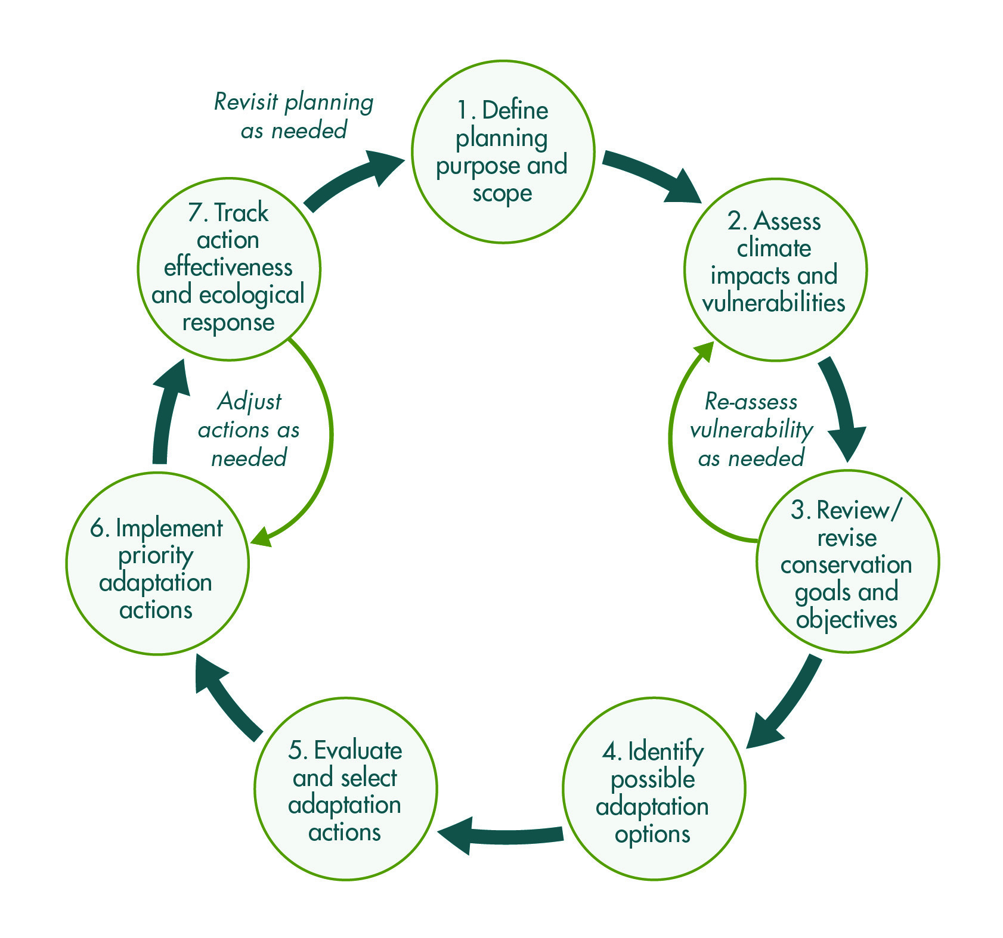
Climate-Smart Conservation Cycle
A Generalized Framework for Adaptation Planning and Implementation

Slide 13
Step 1
Define Planning Purpose and Scope
Inputs
Outputs
Determine purpose (users/needs)
Existing targets, goals, objectives
Problem(s) to be addressed
Existing plans/ decision processes
Clear purpose
Targets that will be focus of adaptation planning
Identified geographic/ temporal scales
Appropriately scaled planning approach
Define Planning Purpose and Scope

Slide 14
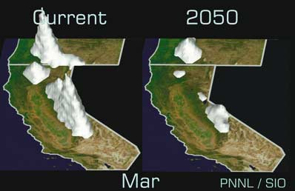
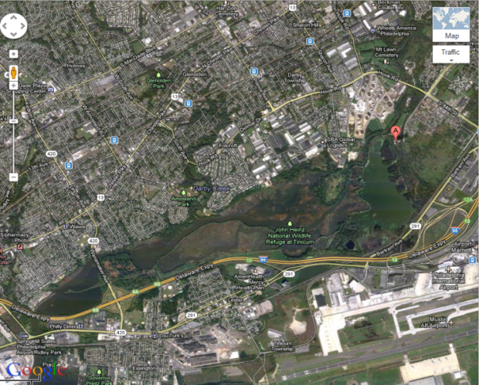
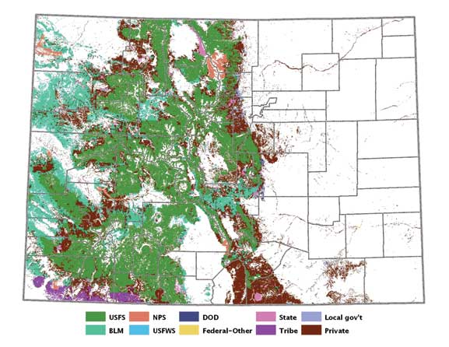

What Spatial Scale?
Local
  Physical boundaries
  Exogenous impacts
Regional
  Connectivity?
  Jurisdictional challenges
Broader “landscape”
  Hard to focus

Slide 15
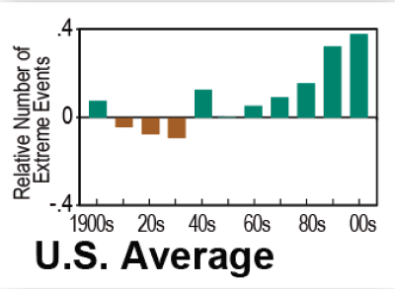
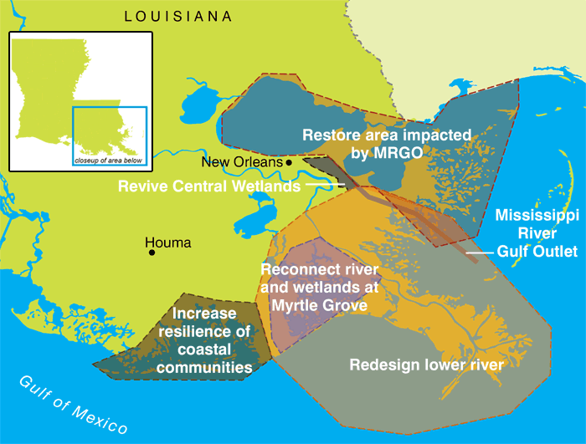
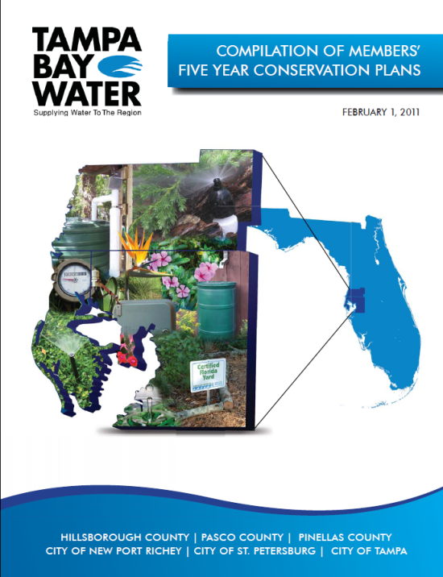
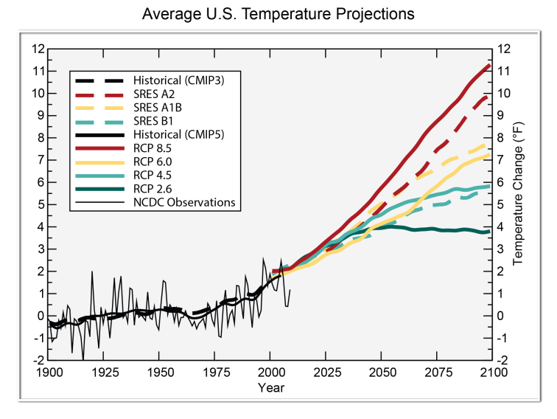
What Temporal Scale?
Near term
  Immediate impacts?
  Buy time?
Intermediate term
  “Official” planning timeframe
  Nearing tipping points?
Long-term
  What scenarios?
  “Who cares?”

Slide 16
Step 2
Assess Climate Impacts and Vulnerabilities
Inputs
Outputs
Clearly defined user needs/problem statement
Identified conservation targets/focus
Defined spatial and temporal scope and scale
Relative vulnerabilities of conservation targets
Understanding of factors contributing to vulnerability
“key vulnerabilities”
Assess Climate Impacts and Vulnerabilities

Slide 17
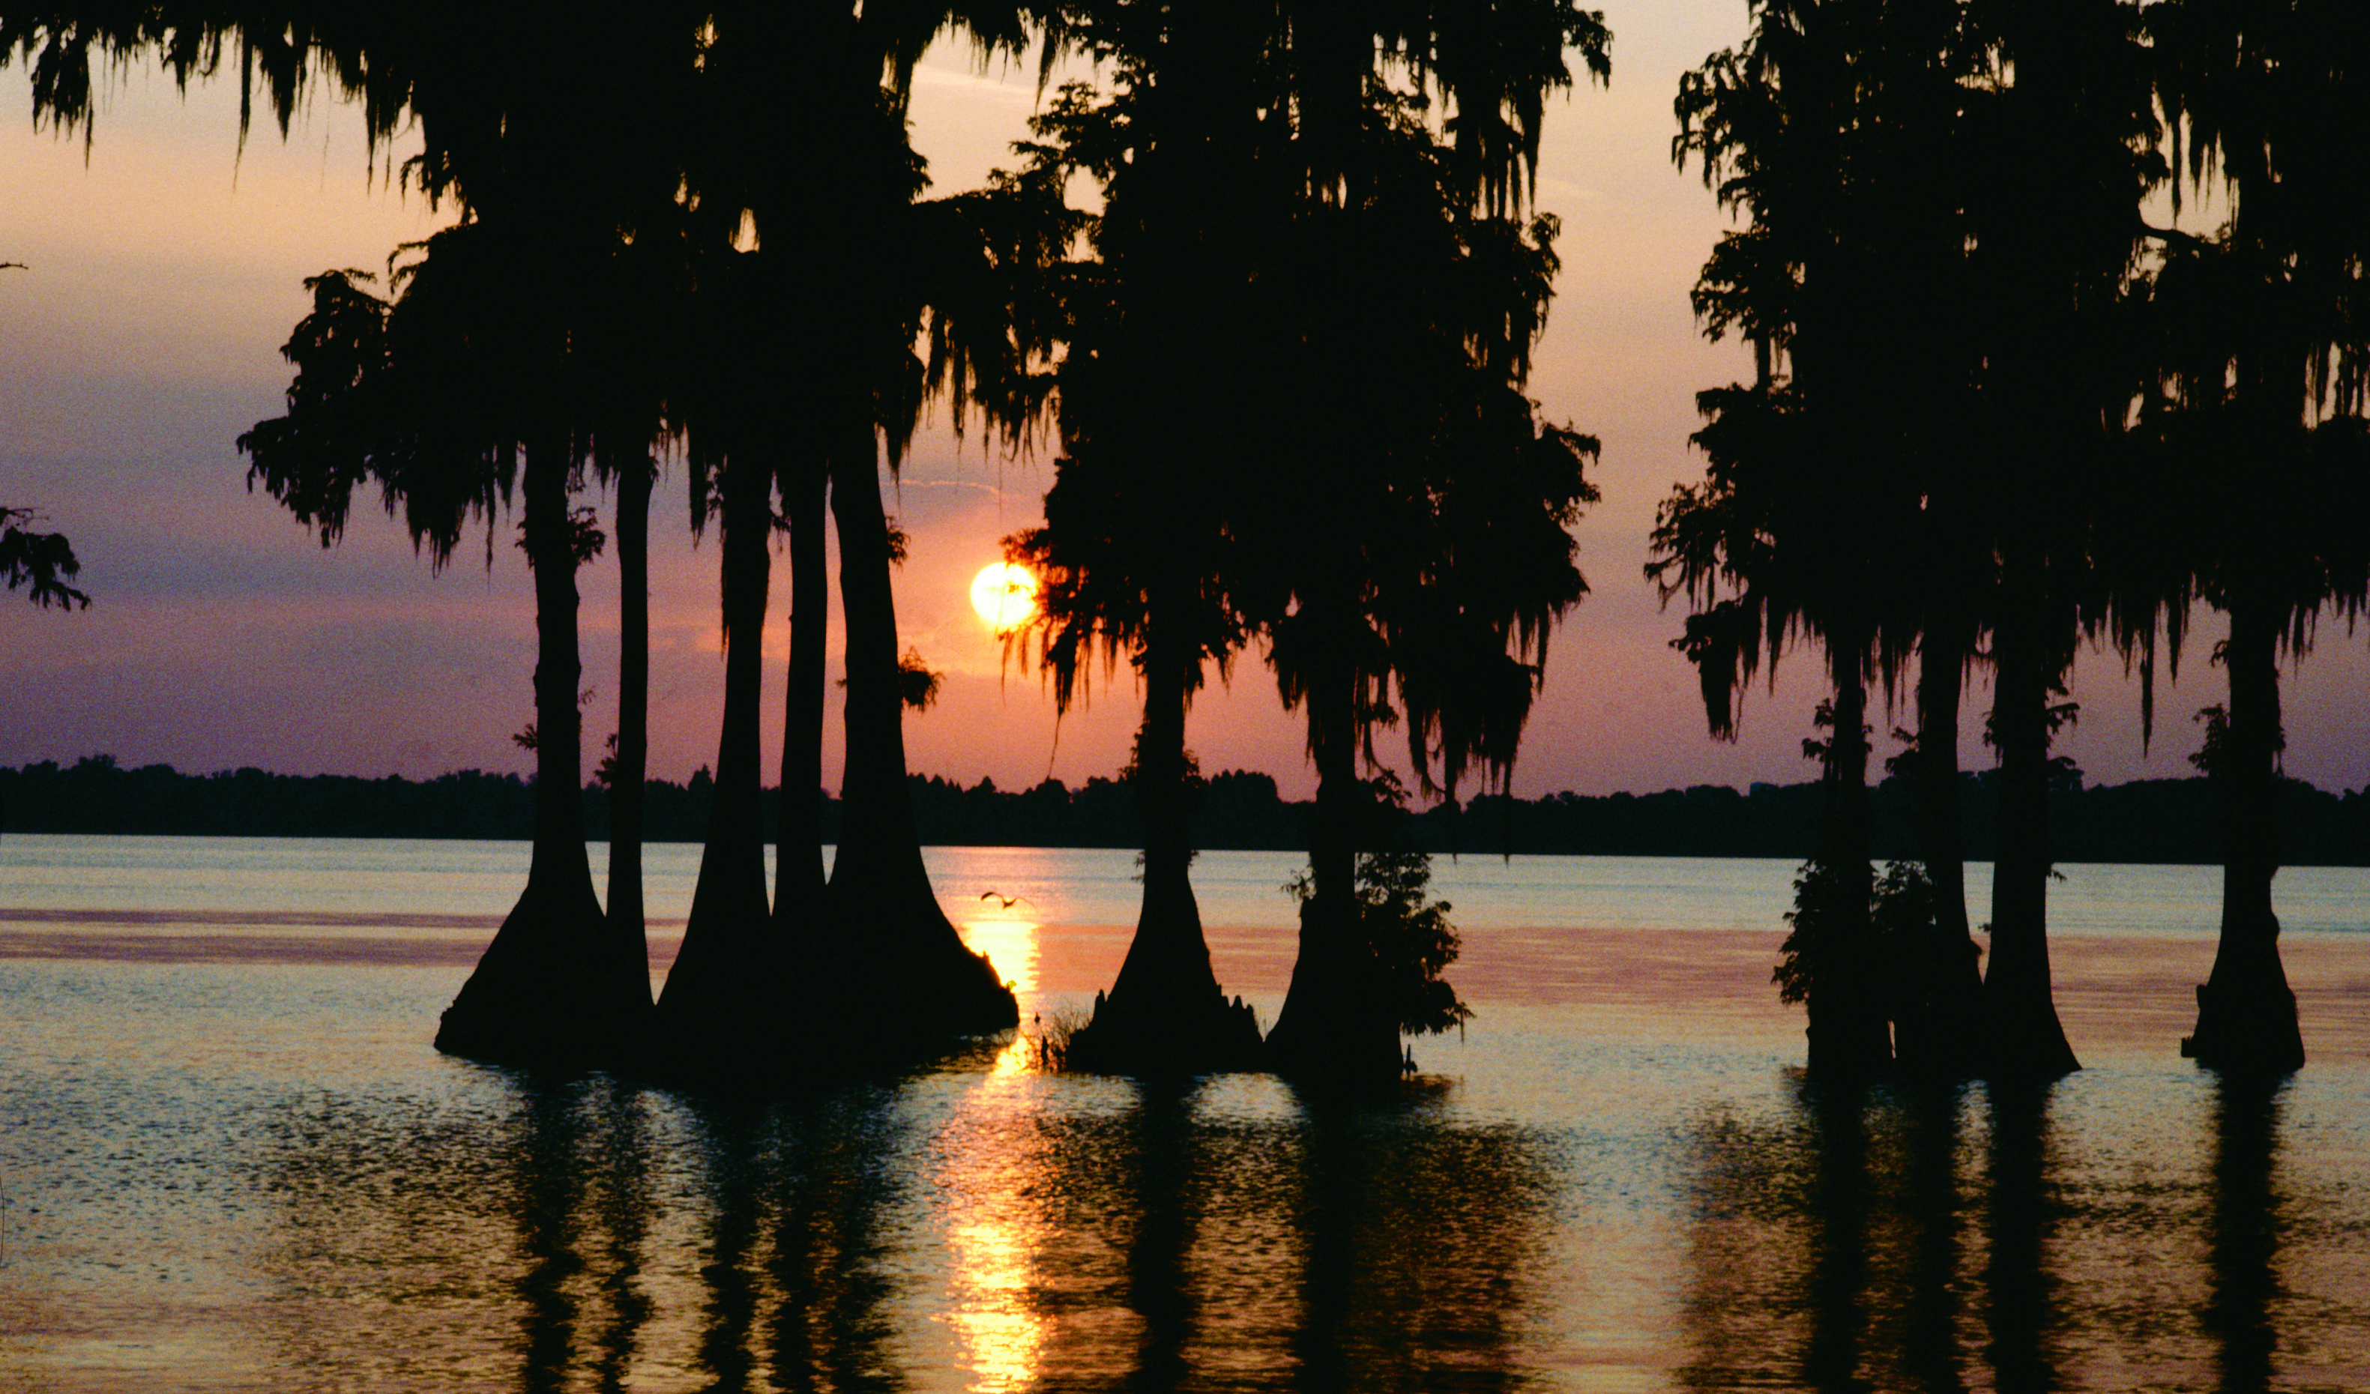
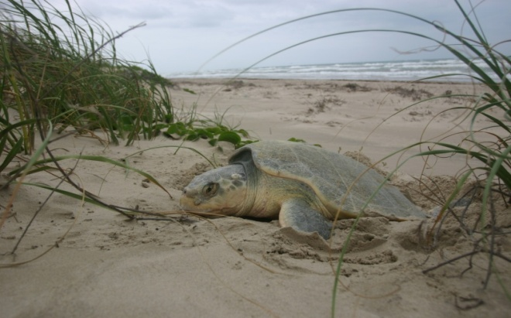
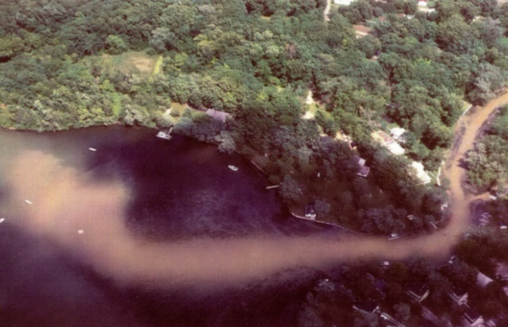
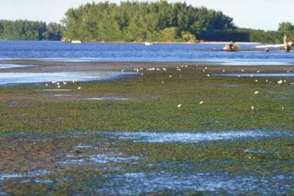
Defining Vulnerability
Climate change vulnerability refers to the extent to which a species, habitat, or ecosystem is susceptible to harm from climate change impacts
What things are most vulnerable
Why they are vulnerable

Slide 18
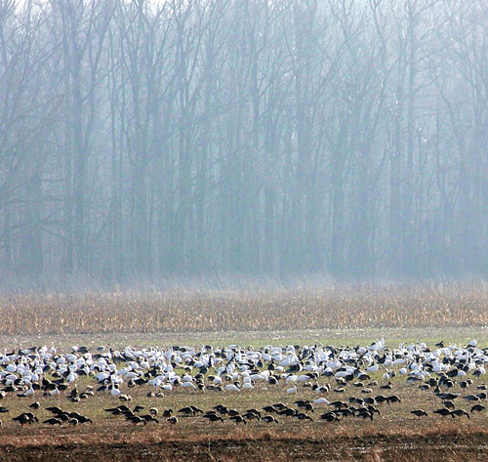
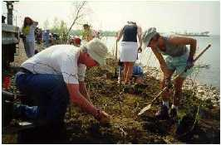
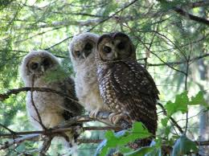
Why Assess Vulnerability?
Vulnerability assessments can help:
  Prioritize species and systems for management actions
  Develop management strategies to address climate change
What vulnerability assessments don’t do:
  The don’t make a conservation decision for you

Slide 19
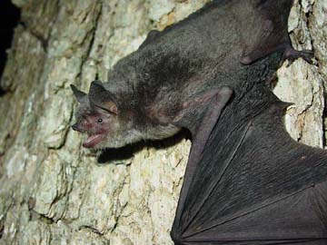
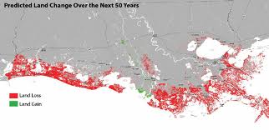
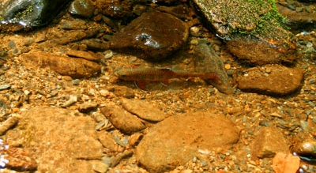
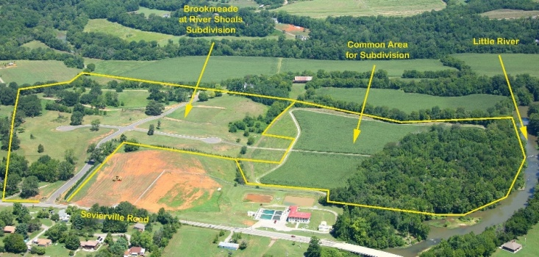
Select “Key Vulnerabilities”
Importance of the species/system at risk (or not)
  Keystone species, ecosystem service
Intensity/magnitude of impacts
  Impacts on many species, large area
Reversibility of impacts
  Potential for thresholds/tipping points?
Timing of impacts
  Near versus long term, opportunity costs

Slide 20
Step “3”
Review/Revise Conservation Goals
Inputs
Outputs
Existing targets, goals, management objectives
Understanding of system/target vulnerabilities
Agreed-upon set of climate-informed conservation targets, goals, management objectives
Review/ Revise Conservation Goals

Slide 21
Step 4
Identify Possible Adaptation Options
Inputs
Outputs
Key vulnerabilities
Factors contributing to those vulnerabilities
Specific actions capable of reducing key vulnerabilities
Explicit rationale or logic model for how identified actions link to climate-related impacts
Identify Possible Adaptation Options

Slide 22
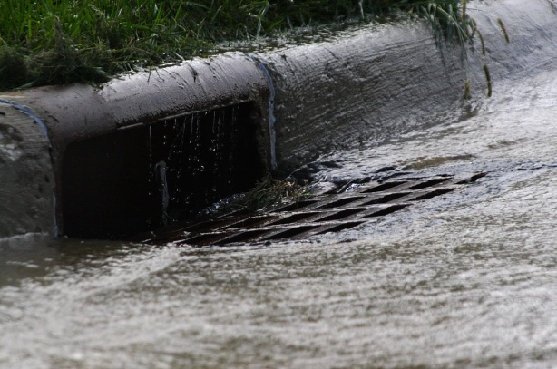
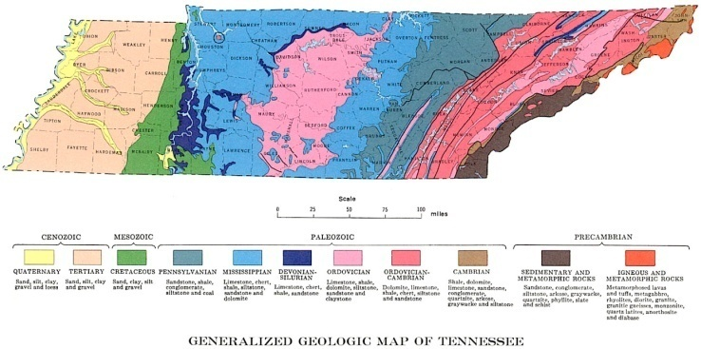
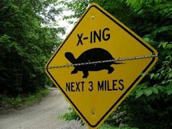
Adaptation Strategies and Options
Reduce non-climate stressors
  Identify those that exacerbate or are exacerbated by climate change (e.g., invasive species)
Protect key ecosystem features
  Identify characteristics that represent “underpinnings” of the system (e.g., geophysical stage)
Ensure connectivity
  Consider ability of species/habitats to move, connect the “right” habitats

Slide 23
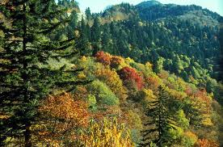
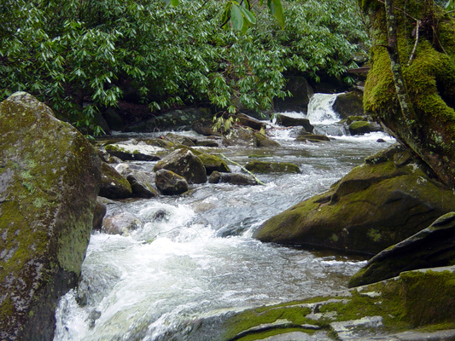
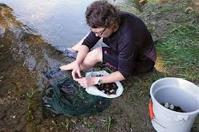
Adaptation Strategies and Options
Restore structure and function
  Identify characteristics that promote “resilience” (e.g., species diversity)
Support evolutionary potential
  Maintain/enhance genetic diversity
Protect refugia
  Identify current or future areas that are less affected by climate change
Relocate organisms
  Translocate to “favorable” habitat

Slide 24
Step 5
Evaluate and Select Adaptation Actions
Inputs
Outputs
Agreed-upon climate-informed goals
Set of possible adaptation actions
Set of adaptation actions most appropriate to implement
A coherent plan based on selected actions
Metrics for use in tracking action effectiveness
Evaluate and Select Adaptation Actions

Slide 25
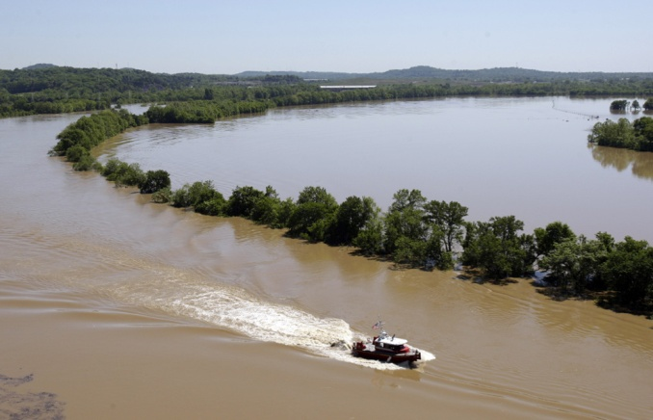
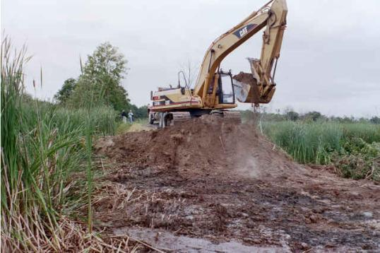
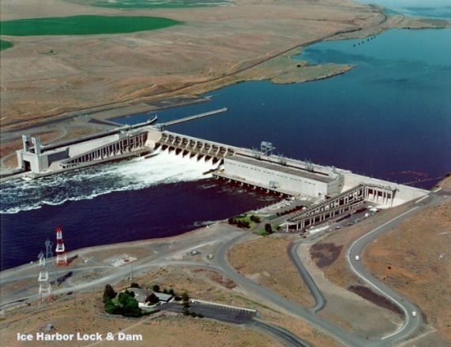
Examples of Criteria for Selection
Importance/urgency
  Impacts require immediate action
  Potential for irreversible harm
Benefits/performance
  Co-benefits (e.g., clean drinking water)
  “Proven” action
Costs/feasibility
  Cost of action versus inaction
  Technical/political feasibility

Slide 26
Step 6
Implement Priority Adaptation Actions
Inputs
Outputs
Priority actions for implementation
Implementation challenges identified during strategy and action evaluation and selection
Set of actions put into practice
Results of actions
Implement Priority Adaptation Actions

Slide 27
(Overcoming) Obstacles to Adaptation
Lack of knowledge of climate change
Research (new models), workshops, info-sharing
Uncertainty
Adaptive management, scenario planning
Psychological and institutional barriers
Reevaluation of goals, policies, procedures
Lack of resources
Dedicated funding, prioritization
Political will
Encourage leadership

Slide 28
Step 7
Track Action Effectiveness/Ecological Response
Inputs
Outputs
Adaptation actions selected for implementation
Possible evaluation metrics
Management-relevant changes in ecological resources documented
Climate change and ecological responses measured
Track Action Effectiveness and Ecological Response

Slide 29
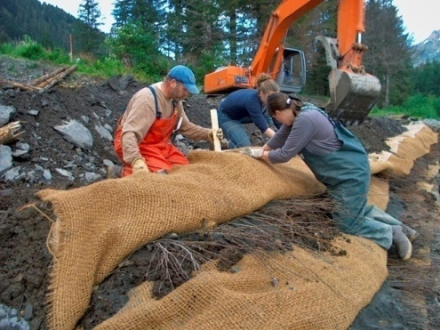
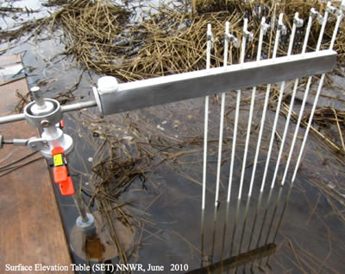
Monitoring and Evaluation
Evaluate effectiveness of management efforts
  “Forward-looking” baseline
  Long-term commitment
  Consider “process” metrics
Monitor impacts and incorporate new science
  Potential tipping points
Revisit one or more steps

Slide 30
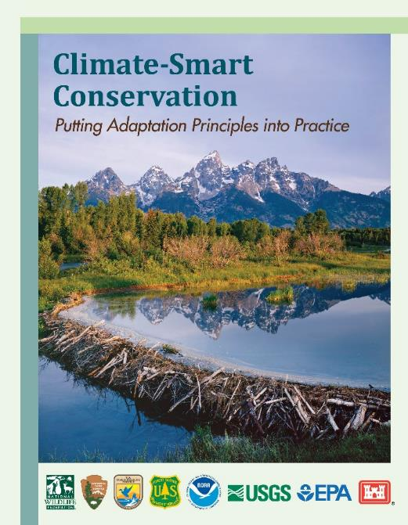
Guide available at: www.nwf.org/ClimateSmartGuide
Climate-Smart Conservation Training
Olympia, WA
October 28-30
http://training.fws.gov/courses/programs/climate-change/schedule.html

