Slide 1
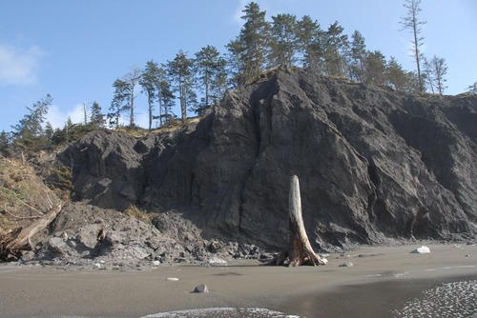
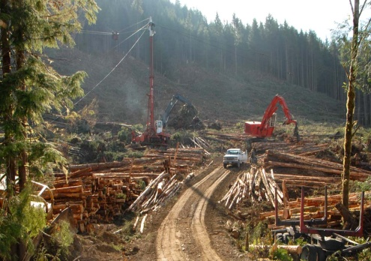
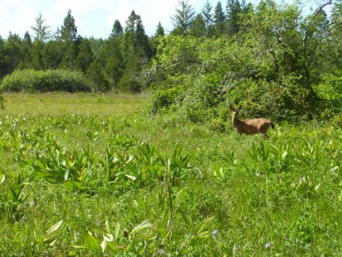
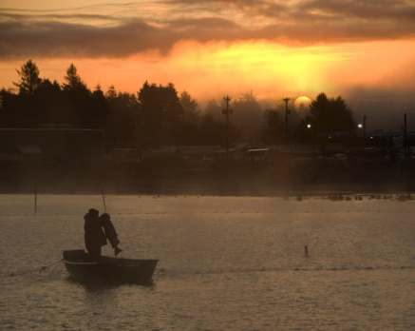
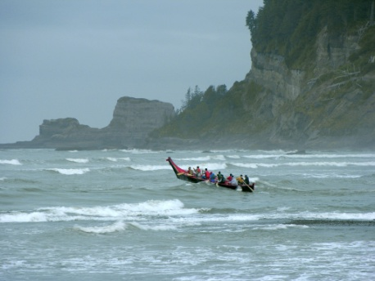

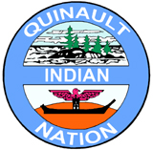
Climate Change and the Quinault Indian nation
Facing Climate Change:
Issues, Successes, Challenges, and Looking at the Future
Notes:
Opening remarks (time dependent): QIN = Natural Resource based tribe

Slide 2
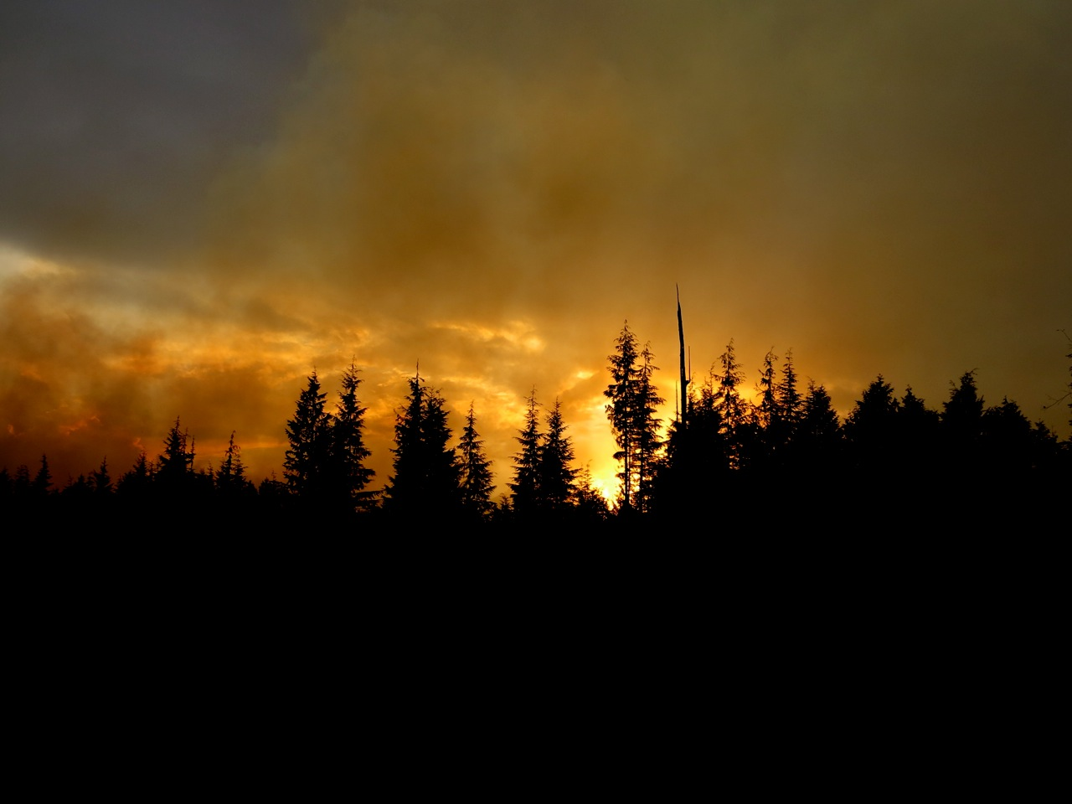
Tribes and Climate Change…
Climate change exacts disproportionate social, economic, and cultural impacts on tribes limited by scarce resources, mobility, and access to information. These inequities are amplified as rates of change accelerate (Bull Bennett and Maynard 2013).
Climate Change and Indian Forestry (Indian Forest Management Team)
Notes:
So many studies and reports are adding sections/chapters/etc. on indigenous communities and the effects they’re facing from climate change because they are in such a unique position.
Being place based, relying on the land, having cultural and traditional practices that go back thousands of years, etc. Every aspect of life will be affected by climate change to some degree.
Unfortunately even among those communities, some are being hit harder and sooner than others.

Slide 3
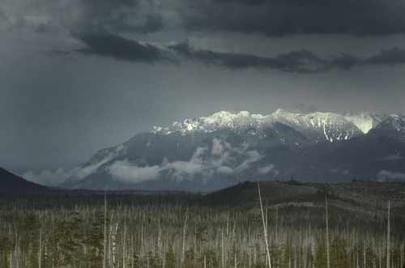
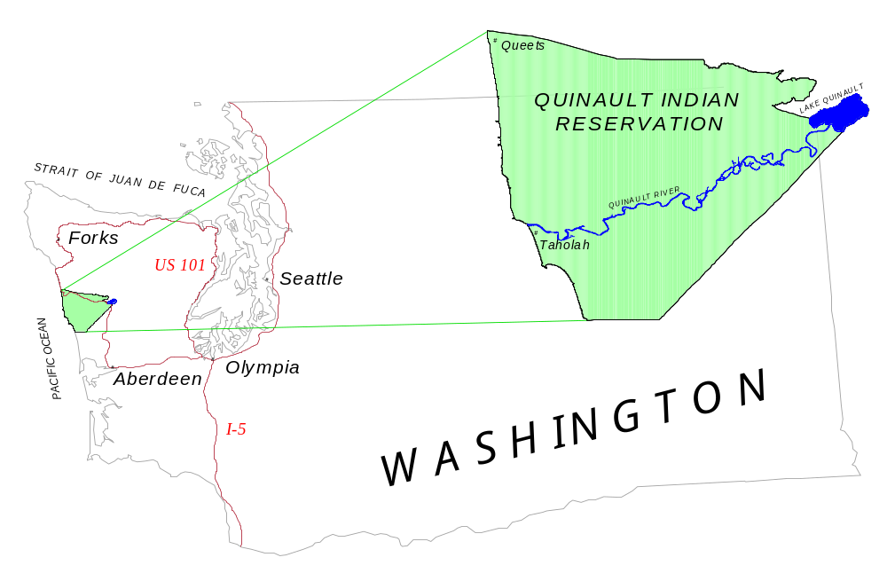
Quinault Homelands
Notes:
The Quinault Indian Reservation encompasses more than 210,000 acres with 25 miles of Pacific Ocean Coastal shoreline in the rural southwest corner of the Olympic Peninsula in Western Washington.
The reservation lies mostly within grays harbor county with the north west corner in Jefferson County spanning from the Pacific Ocean east across Lake Quinault to the foothills of the Olympic Mountain Range.

Slide 4
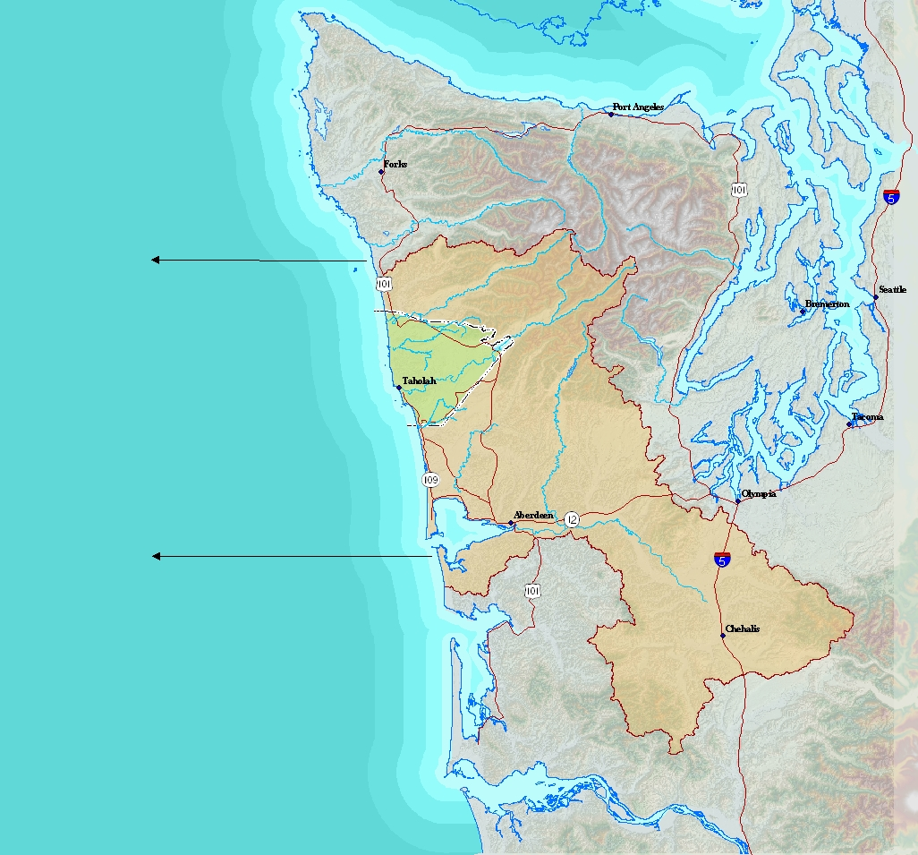
Quinault Homelands
Notes:
In addition to our reservation land base we’re also co-resource managers in the areas where we’ve retained the right to fish, hunt, and gather. These areas extend from SW Washington all the way up to the NW part of the Olympic Peninsula, including a large section of marine waters off our coastline.

Slide 5
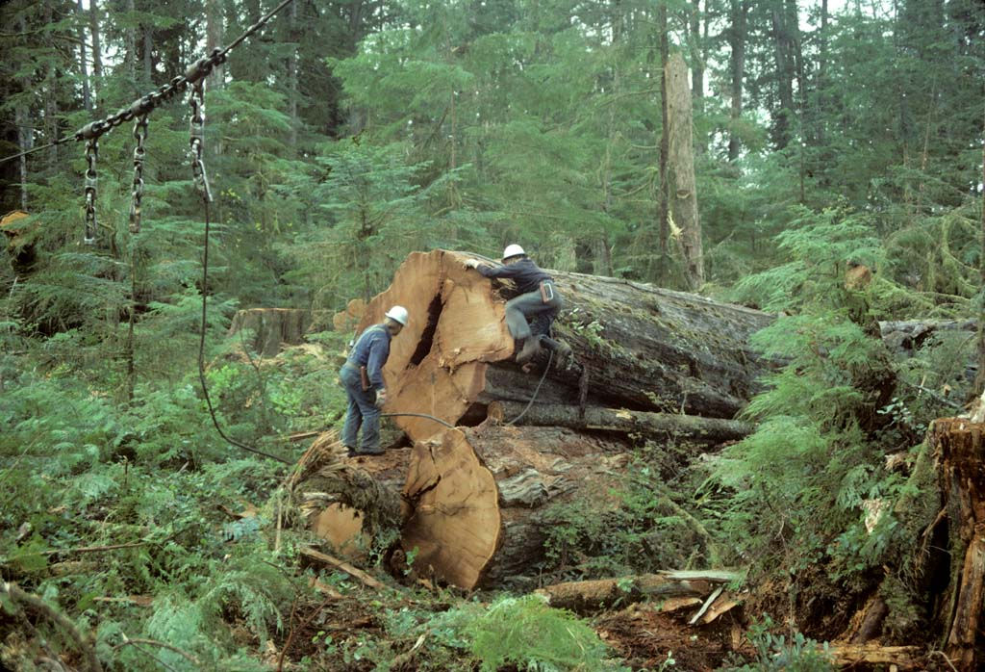
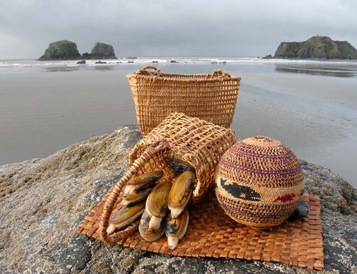
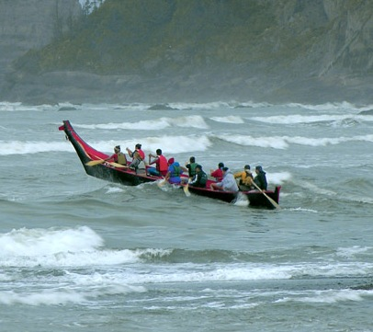

Natural Resource Dependency In Quinault Communities
Multifarious value of Natural Resources: i.e. Cultural, Economic, Tradition, etc…
…The many uses of Western Red Cedar…
Notes:
When we talk about Natural Resource dependency it’s important to note that it has a much broader definition in indigenous communities. Meaning a single resource can have varying units of value…it can be cultural, economic, traditional, for purposes like subsistence, and at times, even recreational.
This concept is very apparent when you look at the many uses of our Western Red Cedar tree…which has significant economic value and a wide variety of cultural uses, including materials for basket making, and of course the renown ocean canoes of the Pacific NW.

Slide 6
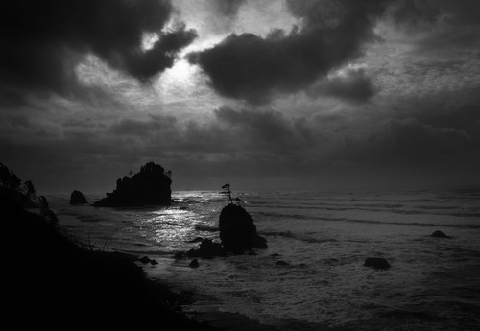
Why is Climate Change an Issue?
A “Nature-Culture Nexus”
Tribal worldview – we are a part of nature not apart from nature
“Reciprocity”…. a give and take relationship with Mother Earth
Notes:
First, let’s look at this from the tribal perspective.
Starting with, what has been referred to as, our “Nature-Culture Nexus”, the idea that the Natural Environments we live in and the resources we depend on, are deeply intertwined in every aspect of the culture.
There also exists a Tribal worldview – that, as tribal people, we are a part of nature as oppose to being apart from nature.
We’ve also strived through history to master the art “reciprocity”. This ideology of a give and take relationship with our mother earth is both spiritual in our ceremonies (like the first salmon ceremony of the Pac NW) and also tangible in our many historic and modern day stewardship and sustainability efforts.

Slide 7
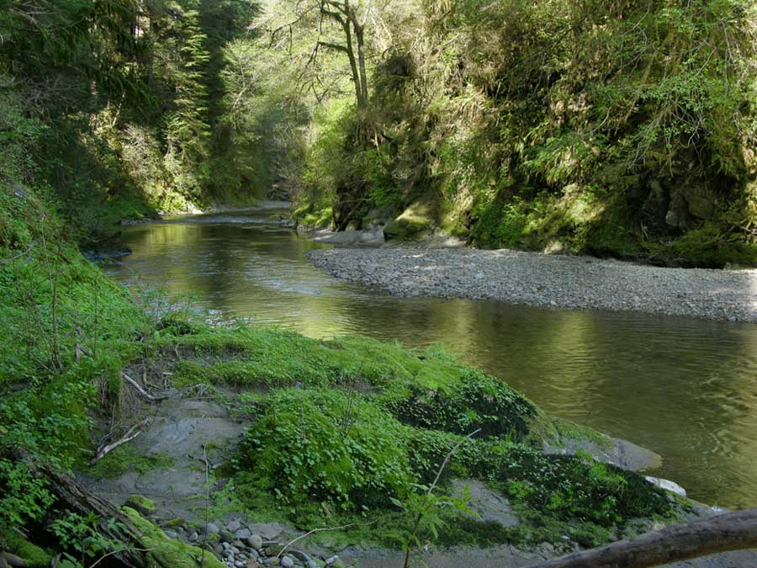
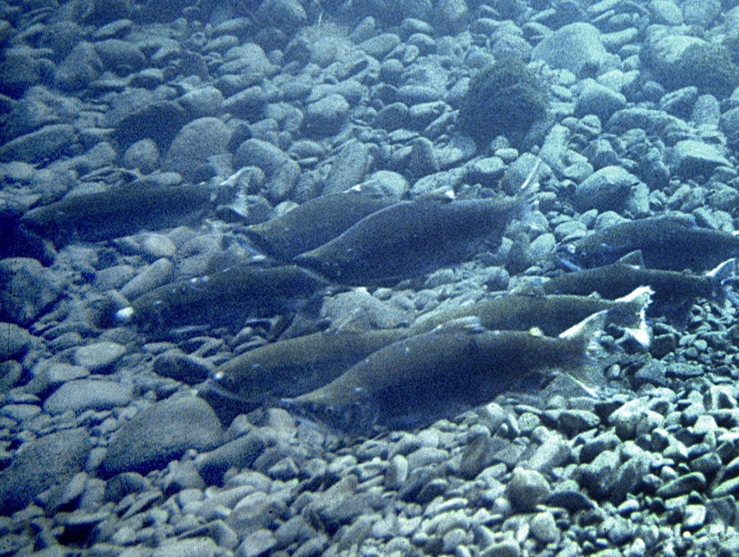
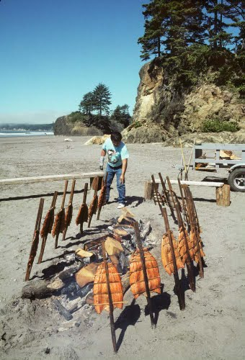
Natural Resource Dependency In Quinault Communities
  …The physical, mental, social, and spiritual health of Quinault people is directly and uniquely related to the health of the ecosystems of the lands they inhabit…
Healthy Ecosystems → Healthy Resources → Healthy People
Notes:
So in considering the intimate relationship we’ve developed with the natural environment through history and the wide variety of values we put on resources…
it should come as no surprise that…the physical mental, social, and spiritual health of the tribe is directly and uniquely related to the health of the ecosystems of the lands we inhabit.

Slide 8
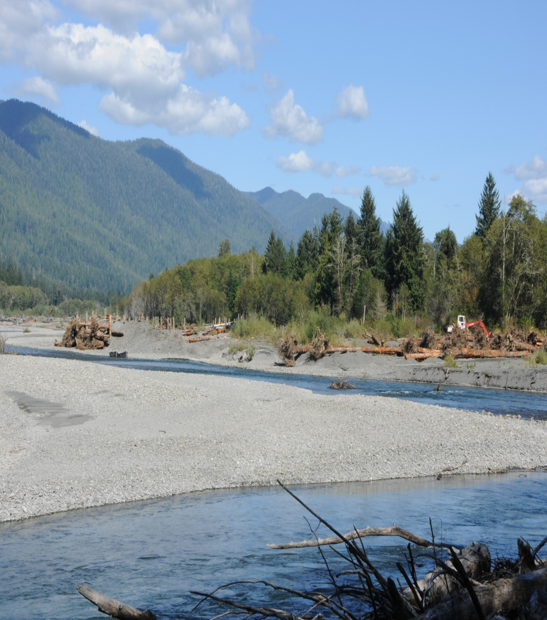
Threats to the Pacific Northwest
  Ocean Acidification
  Sea Level Rise
  Invasive species/disease
  Increased wildfire seasons
  Increased severity of storms
  Melting glaciers
  Severe drought
  Increased rainfall

Slide 9
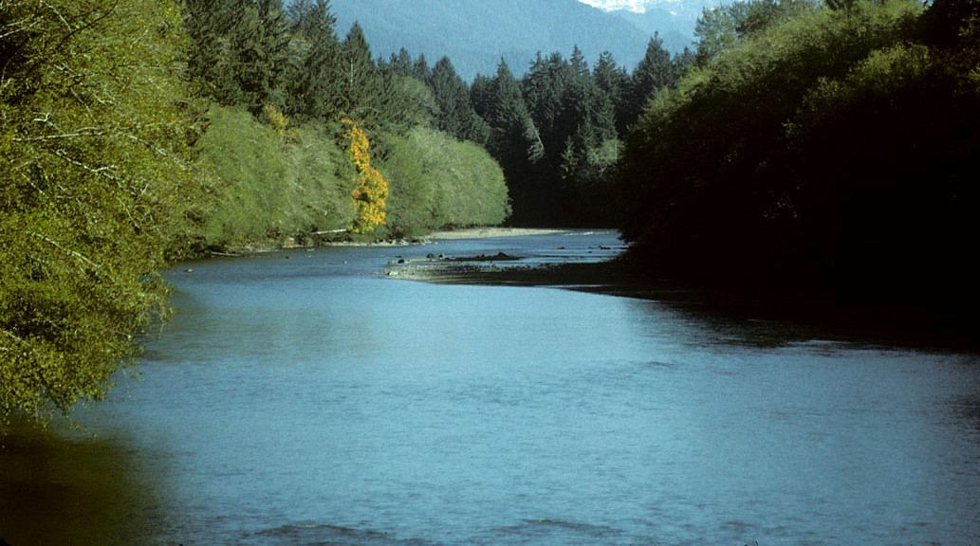
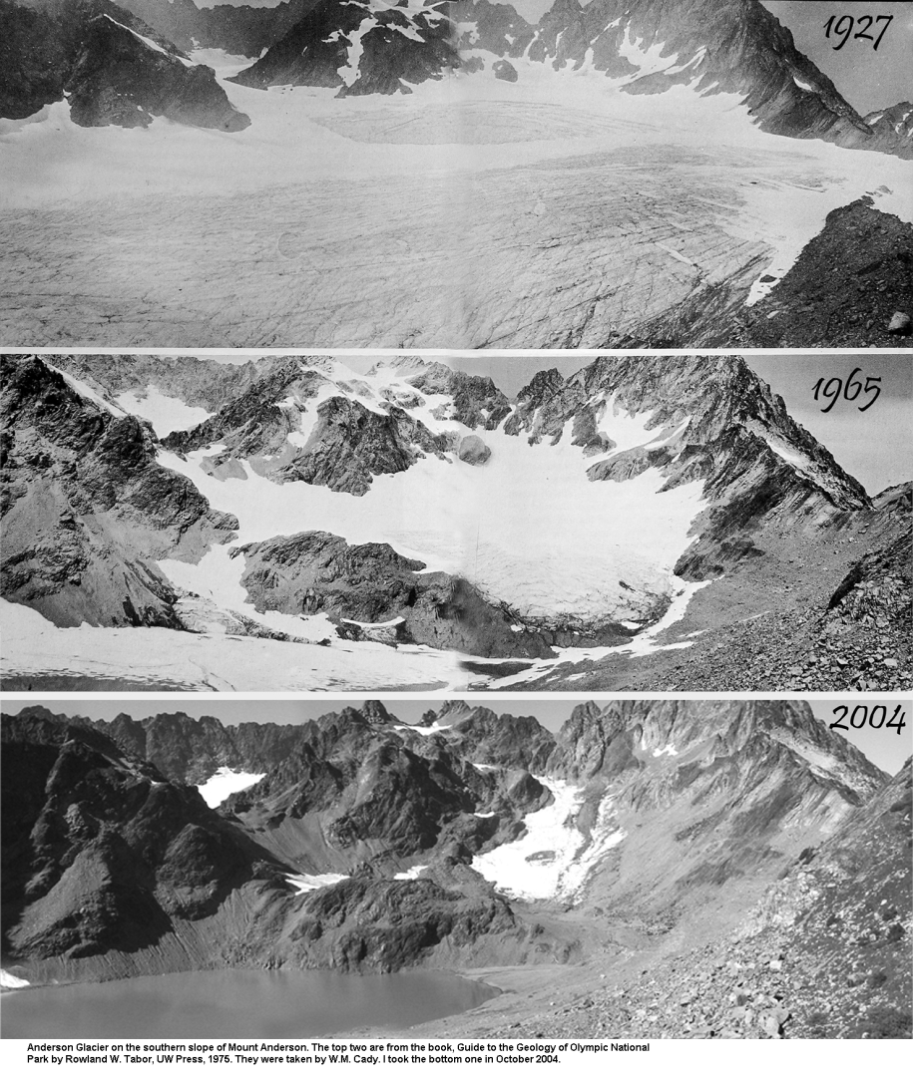
Loss of Olympic Glaciers
Anderson Glacier
Historically a source of cool, clean water during warm summer months
Benefits Salmon at all life stages…especially diminishing Spring Chinook
Compounded by anthropogenic ecosystem degradation in Quinault Watershed…
Notes:
The most obvious impacts to water temperature that are implicated with climate change is the shocking revelation that our Olympic Glaciers are disappearing…as you can see from this time elapsed photo series of Anderson glacier where we significant glacial retreat from the time period from 1927 – 2004.
Anderson glacier sits at the headwaters of the Quinault River and has historically contributed cool, clean water during our warmer summer months. This slow summer melting benefits many salmon species at their various life stages.
This occurrence is alarming for fisheries scientists, but even more so, if we look at the anthropogenic impacts to water quality from the various land uses in the upper Quinault watershed.

Slide 10
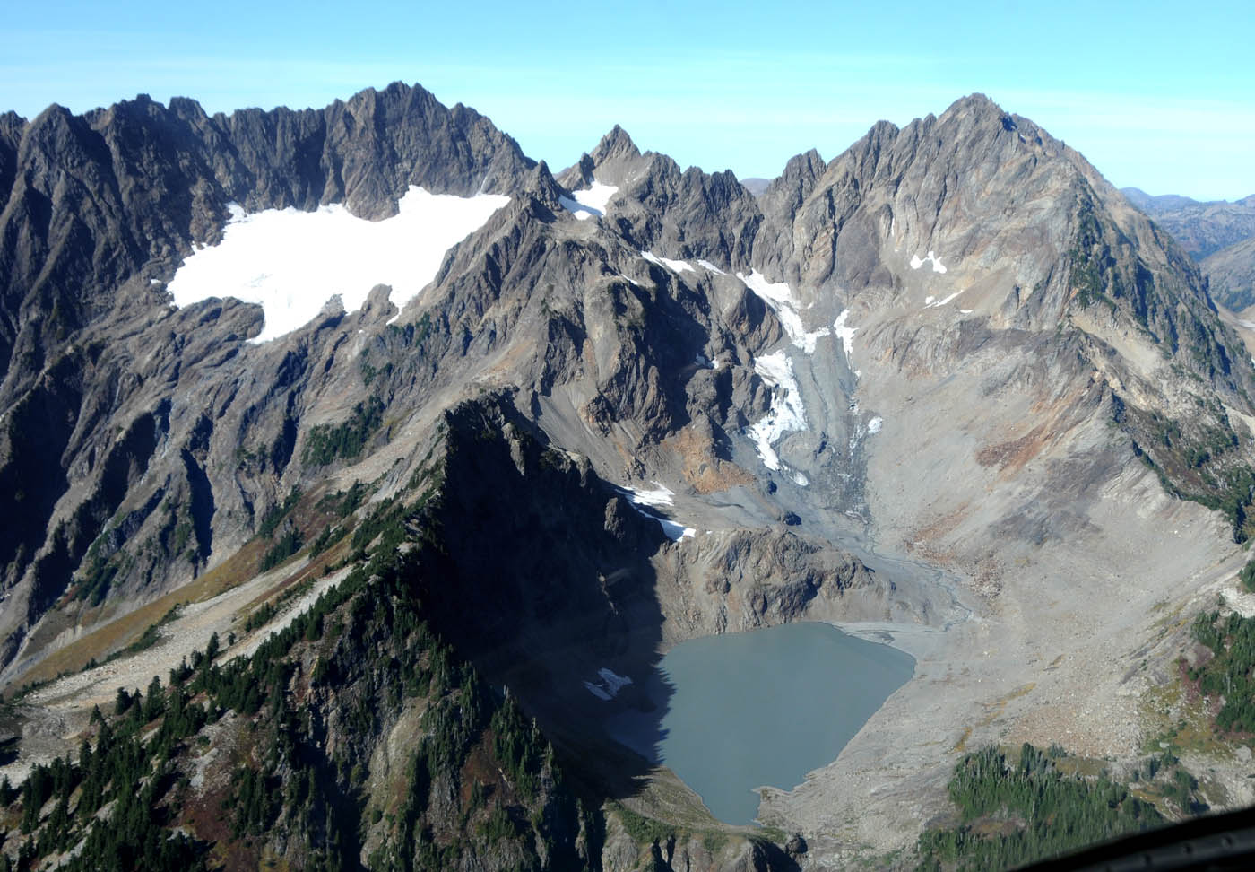
Anderson Glacier Today…
…Illustrates the need to protect & restore degraded ecosystem function, in order to increase resilience to climate change impacts…
Notes:
And if we look at a picture of Anderson Glacier today, it reinforces the need to restore our ecosystems in order to increase our resilience to future climate change impacts.

Slide 11
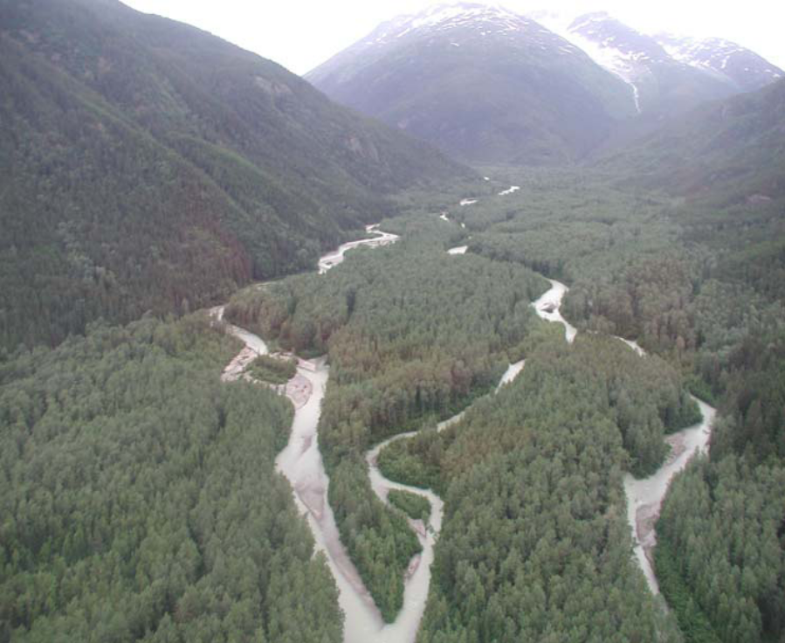
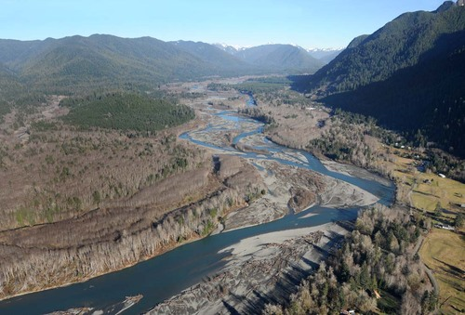
Loss of Ecosystem Function in the Upper Quinault River
1850
Today
Abundant Functional Salmon Habitat
Limited Functional Salmon Habitat
(Taiya River, Alaska)
(Quinault River, Washington)
Notes:
If we take a close look at the loss of ecosystem function in the Upper Quinault River, looking back to 1850 the Quinault Valley would have looked very similar to the picture on the left taken of the Taiya River, Alaska….with a mature conifer dominated floodplain with an abundance of side channel habitat
In the photo on the right we see a picture of the Quinault valley today where extensive timber harvesting and land use has left us with a deciduous, red alder dominated floodplain with very little side channel habitat.

Slide 12

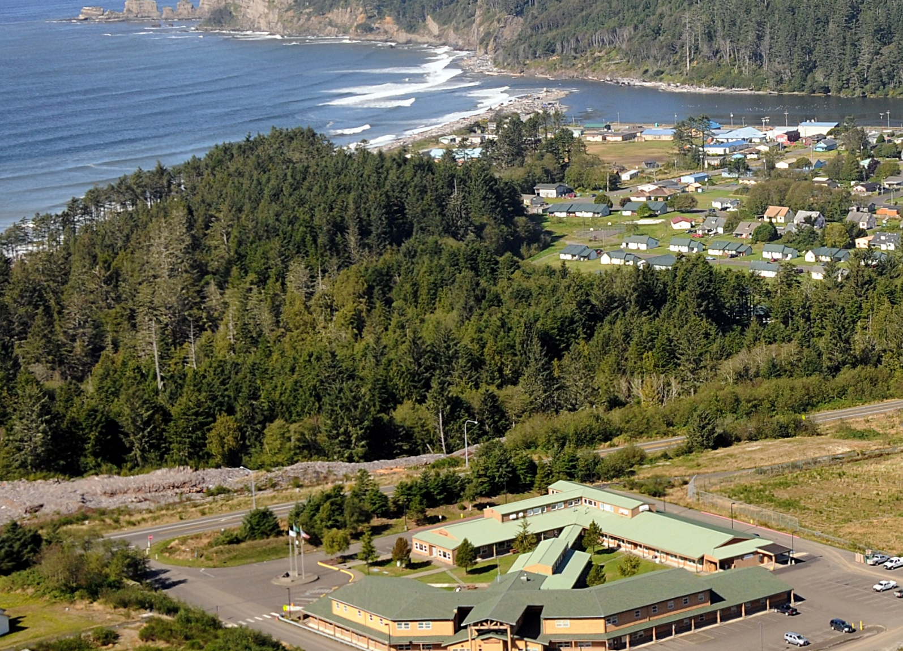
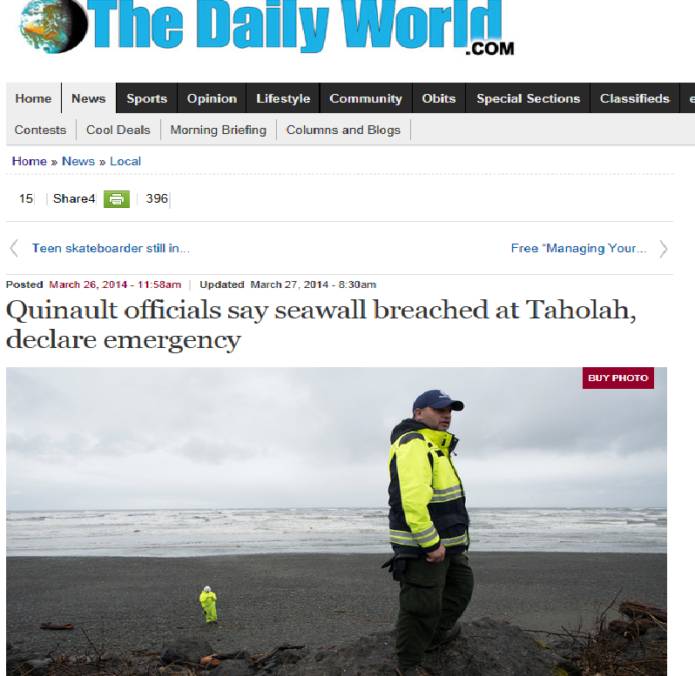
Tsunami Zone/Flood Zone
Seawall Breached

Slide 13
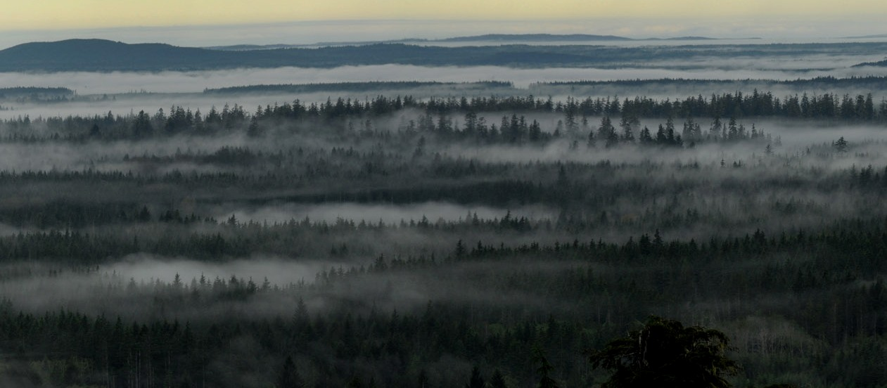
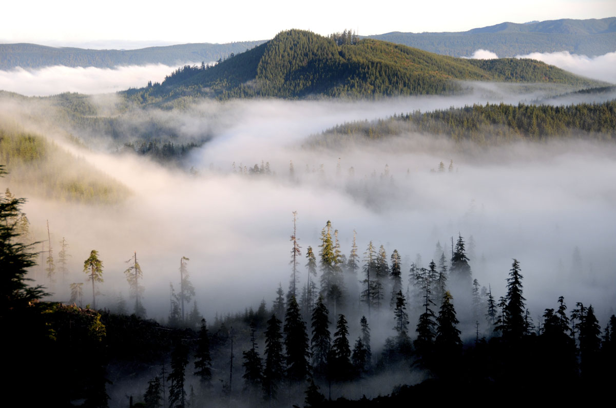
Implications for Terrestrial Ecosystems: Forests
…Forests are both a result of, and a contributing factor to climate…
Notes:
When we talk about climate change implications for forests it’s important to remember that forests are both a result of, and a contributing factor to climate…
Which makes sound forest management decisions even more crucial considering the Pacific NW has a heavy timber based economy.

Slide 14



Northwest Forest Management “Working Forests”
…with climate change implications comes new considerations for Northwest Forest Managers…
Climate Change
Healthy Ecosystems
Healthy Ecosystems
Notes:
Historically forest management in the Pacific Northwest has focused on maintaining a balance between “realizing economic potential by supplying a global demand for wood products” vs. “maintaining healthy ecosystems”
But as we look at some of the climate change implications for forests, we see a potential need to reconsider our current forest management practices.

Slide 15
New Considerations for Northwest Forest Managers
Changes in Seedling regeneration & Tree growth
Potential increases in forest fires
Invasive Species/Disease
The PNW is likely to see increased forest growth region-wide over the next few decades followed by decreased forest growth as temperature increases overwhelm the ability of trees to make use of higher winter precipitation and higher carbon dioxide.
Potential for extinction of local populations and loss of biological diversity if environmental shifts outpace species migration rates and interact negatively with population dynamics.
Notes:
As mentioned in a previous slide most these new considerations revolve around seasonal temperature variations and the availability of water. Both of those factors have the potential to increase the risk of wildfire, and insect & disease outbreaks.
Probably of biggest concern to our area is the severity and distribution of Swiss Needle, cast a pathogen that has caused serious damage to Douglas Fir forests in western Oregon over the last 20 years. Our fear is that increases in winter temperatures and spring precipitation will move this pathogen further north and inland, making it a problem across our entire forest land base.
We’re also likely to see changes in species composition and growth…tree growth being an important metric on commercial forest lands. This will vary from region to region, and could mean better growth in some areas or less growth for others.
Effects will also be seen on prairies, wetlands, bogs, & all other ecosystems.

Slide 16
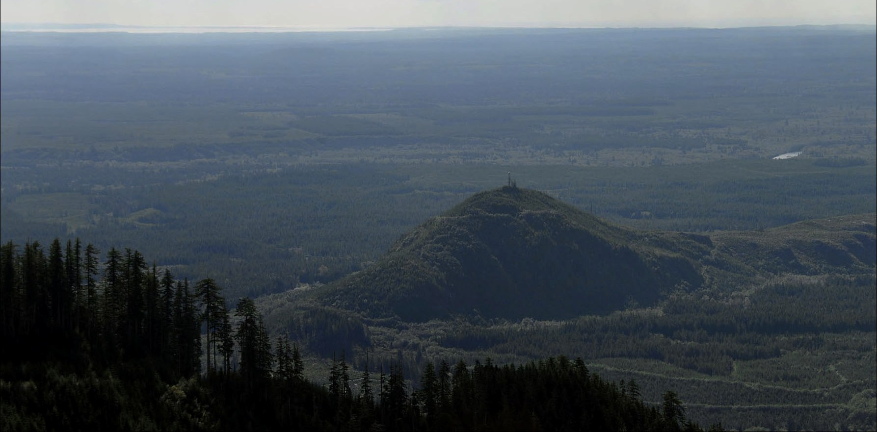
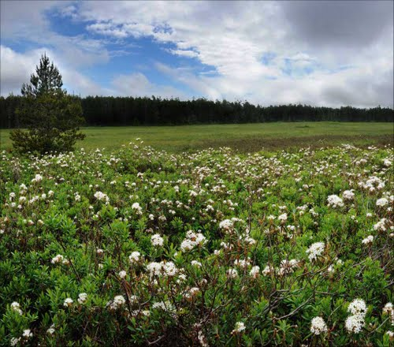
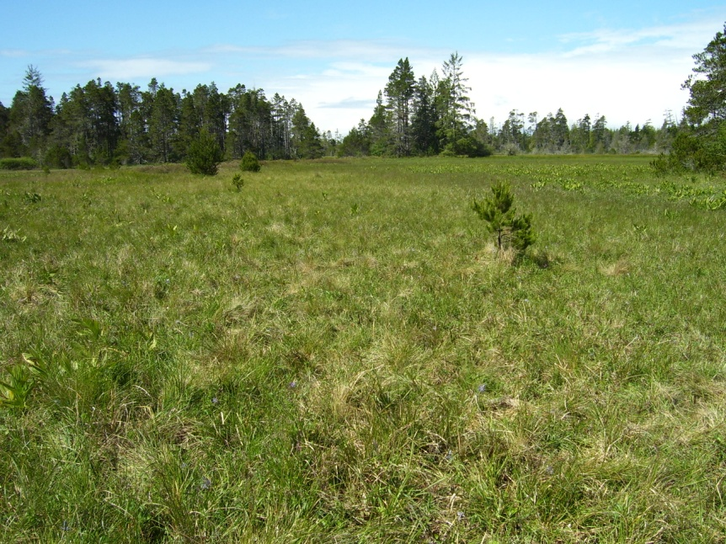
Cultural Significance
Traditional Hunting & Gathering Areas
Abundant in Culturally Significant Flora & Fauna…
  Labrador tea, camas, bear grass, huckleberry, bracken fern, deer, elk, waterfowl, upland game birds, etc…
Wide variety of uses of plant species…i.e. traditional food, medicine, & fibrous materials
Notes:
Historically, and even still today, these prairies serve as an important hunting and gathering area…and they are extremely abundant in Culturally significant Flora & Fauna…with the list of species that would probably take up the rest of my presentation time.
But, it is important to point out that Prairie plant life served a wide variety of purposes
like food, with camas root being an important source of starch,
And Labrador tea or “Indian tea” that is known for its many healing powers
and bear grass, a major source of fibrous material for basket weaving.

Slide 17
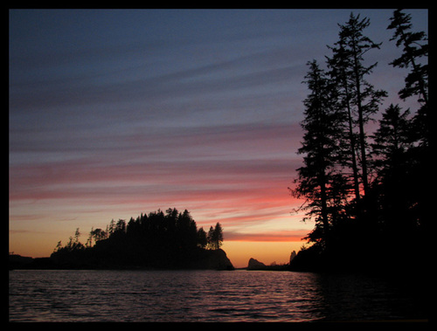
Implications for Ocean Ecosystems
…The waves of change…climate change…
Increased coastal erosion and beach loss due to rising sea levels
Increased landslides due to increased winter rainfall
Increased coastal flooding due to sea level rise and increased winter stream flow from interior and coastal watersheds
Increased acidity has been shown to have serious impacts to calcification in some of our shell and plate forming plank tonic organisms; especially in coastal waters.
Sea Level Rise & Temperature Changes
Notes:
And now we move to our oceans ecosystem where in the Pacific Northwest, and especially in our coastal tribal communities, we see a strong influence of commercial ocean fisheries in our local economies.
It’s very difficult to have a climate change discussion without talking about some of the changes we’re seeing in ocean chemistry that are associated with our increased CO2 emissions…the main one being ocean acidification.

Slide 18
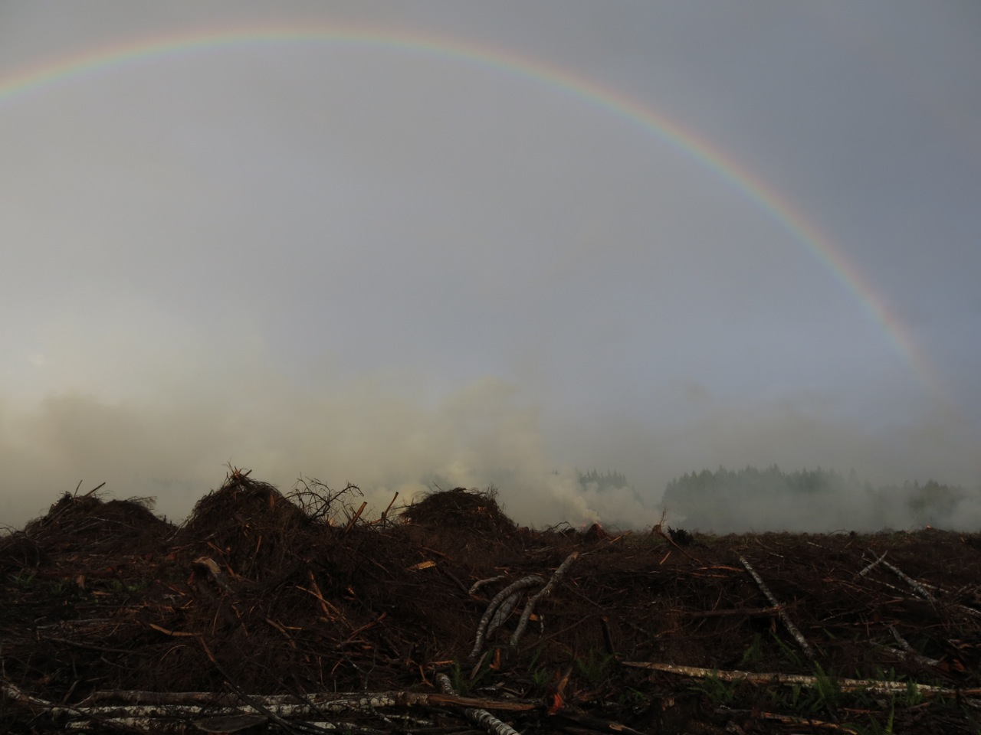
Successes
Increased awareness of climate change and related issues
  Increased efforts by various departments
Greater involvement with other organizations/institutions/tribes/etc.
  Increased collaboration
  Ethnobotany & Ocean Acidification Projects - students
Staff efforts providing a stronger voice for the our needs
Notes:
Not only has the Business Committee acknowledged that climate change has and will continue to affect the environments, lands, resources, and communities of the Quinault, but they’ve gone so far is to include it in our strategic plan which lays out priority issues the tribe wants addressed. Because of this, groups like the Climate Change Committee are able to create resolutions and go out for grants and other opportunities that

Slide 19
Successes Cont’d.
QDNR Climate Change Committee
  Multi-Tribe Vulnerability Assessment
  Grant Proposals for funding
    Travel to training/conferences
    Youth Initiatives; getting students involved in the natural resources and climate change
Other Interests
  Getting youth involved (Tribal Lands Day)
  Move the Lower Village
  Purchase land to create a tsunami evacuation route
  Invasive Species - Genetic work with trees
  Habitat Loss - Engineered Log Jams
  Better Forestry Management (increase RMZ, increase species diversity, education of others)

Slide 20
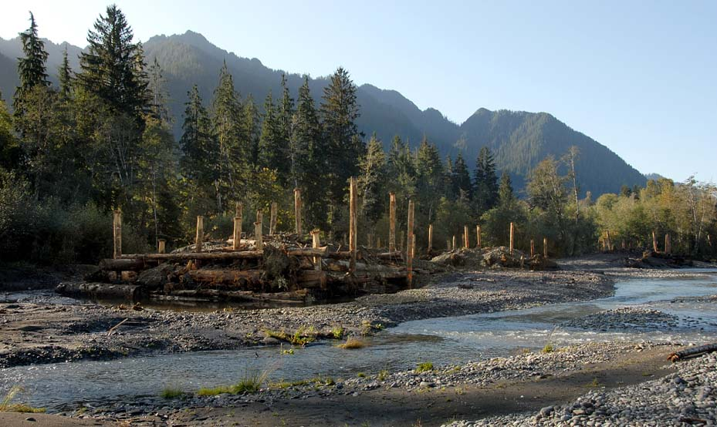
Restoring Ecosystem Function In the Upper Quinault River
Notes:
A few years ago the Quinault Indian Nation started down a long term path to restore the Upper Quinault watershed by reintroducing stability back into the floodplain through the use of engineered log jams…the basic idea being that the log jams will serve as stable collection points for wood and sediment, creating a place for forest succession free from frequent cyclical channel disturbance.
Over time we’ll see mature conifer forests re establish themselves throughout the floodplain leaving us with a more functional ecosystem.
Improvement to water temperature will be one of the many benefits of having an abundance of large shade trees, which should provide some resilience to the affects of the loss of our glacier.

Slide 21

Quinault Division of Natural Resources
The Climate Change Committee is an interdepartmental collaboration of technical and upper level staff whose goal is to organize and coordinate a climate change initiative within the Division. The Committee will act as a source and clearing house for knowledge, news and innovations to address climate change issues and concerns related to natural resources management and protection within the Quinault Territory. The Committee will focus on researching and discussing potential climate effects to natural resources which are economically and culturally important to the Quinault Indian Nation. The QDNRCCC also seeks to find funding and resources for protecting these natural resources and mitigating for future effects.

Slide 22


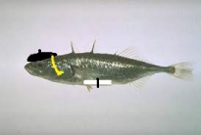


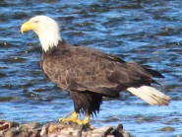
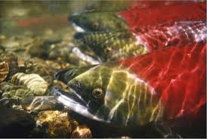
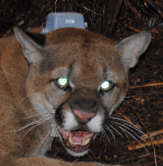
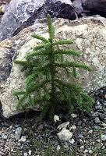
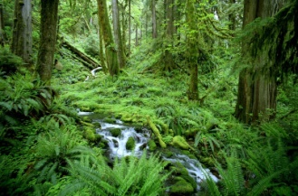

QDNR Climate Change Committee!
Notes:
Visual evidence that although there is a broad range of skills and education, there is no one person to coordinate climate change specific matters as a whole.

Slide 23
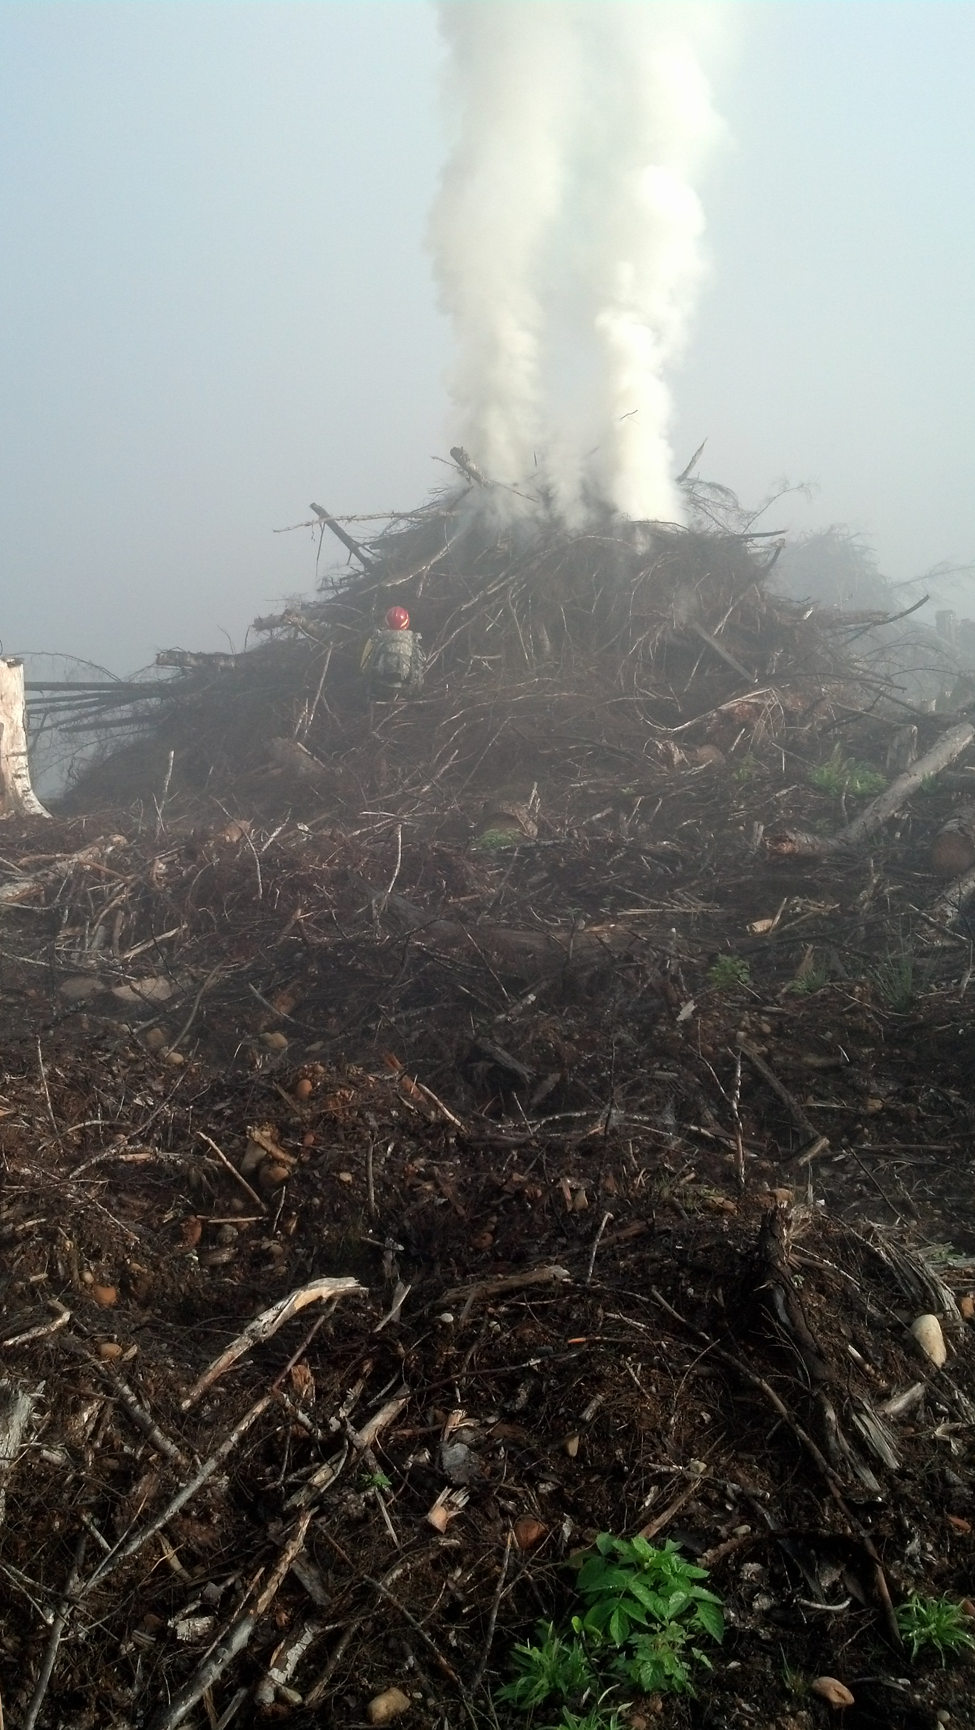
Challenges
Staffing!
  Time, availability, etc.
Funding!
  Vulnerability assessment, adaptation plans, generation of baseline data, implementation of mitigation efforts, etc.
  ‘Doing stuff’
General Coordination!
  Who’s doing what? Who’s applying for grants?

Slide 24
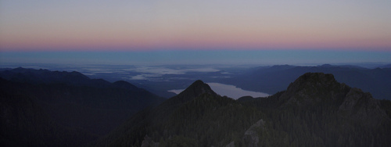
Incorporating Traditional Knowledge
Potential contributions of Traditional Ecological Knowledge (TEK) in contemporary Natural Resource Management
Continued efforts to combine experiential, intergenerational knowledge with experimental sciences
Tribal communities are willing and able!
Notes:
There’s also been a growing effort to research the potential contributions of tribal TEK in contemporary natural resource management. Which has long been a priority for indigenous people.
Because most forecasting calls for noticeable changes for the next generation of resource managers, I think we’ll need continued efforts to combine our experiential, intergenerational knowledge with the new age experimental sciences.
But, in order to make this possible I think indigenous cultures are going to have look at new methods of documenting, archiving, and sharing our extensive knowledge base.
And as you can see through our presence here, I think it’s safe to say that our tribal communities are willing and able to step up and help move us forward.

Slide 25
Adaptation of
Indigenous People
For 1000’s of Years, we have gained traditional knowledge that has enabled us to adapt to changing climates and landscapes
…Today, tribes and others must join together to help our communities prepare for and adapt to climate change…
Notes:
And finally, this traditional knowledge and adaptability has been passed down through generations for thousands of years.
So, with these tools, we stand ready to join with other communities in the effort to prepare for and adapt to future climate change.

Slide 26
Questions ?

