Slide 1

2015-16 S-TEK Implementation Plan
Frank Shipley, Chair, S-TEK Subcommittee
Mary Mahaffy, Science Coordinator
Karen Jenni, Insight Decisions - Facilitator
Steering Committee Discussion – July 9, 2014

Slide 2
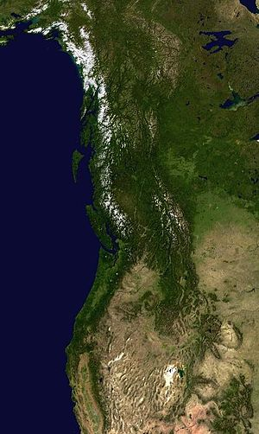
Outline
Review
  Context and purpose of the annual implementation plans
  S-TEK process for updating the plan
  Status of plan
Discussion
  Types of activities proposed/planned
  Relative priorities across areas of focus
  Moving beyond allocation of NPLCC funding to projects – what else can you do for each other?
Next steps

Slide 3
NPLCC Charter
Mission
S-TEK Strategy
5 Priority Topics
Conservation Goals and Objectives
Annual S-TEK Implementation Plans (Determines Areas of focus and NPLCC funding priorities)
7 NPLCC Objectives
Four Guiding Principles
NPLCC funded projects
NPLCC-relevant work by Partners

Slide 4
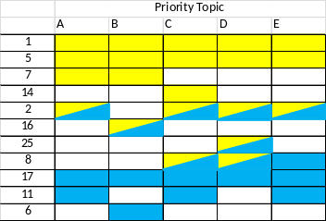
Closing Questions – Sense of the SC
2015-16 Implementation Planning Process
Task 1. Identify potential activities
Task 2. Evaluate and rank activities
Task 3. Select Areas of focus for 2015-2016
Task 4. Develop Activities for NPLCC support in 2015 (& 2016)
Activity
Need
Description
Specific actions
$$
Guiding Principles | Priority Topics
… … … … | A B C D
Activity
Need
Description
Specific actions
$$
Activity
Need
Description
Specific actions
$$
Importance for NPLCC action
…
Tasks 1 – 3 have been completed
List of ~50 candidate activities within the 9 areas of focus has been developed

Slide 5
Elements of the Implementation Plan
Areas of focus specify the types of work associated with each Priority Topic that would be most useful to the partnership in the near-term
Activities are defined for each area of focus as a more specific way of carrying out the work of the NPLCC
  Activities identified in the annual implementation plan form the basis for direct support- or RFP-initiated projects
Notes:
Aiming for more clarity in terminology…
Status – nine area

Slide 6
9 Areas of Focus for 2015-2016
See Table 1 in your “homework”
The first three areas of focus were evaluated as high priority for most Priority Topics
The remaining six were evaluated as high priority for a narrower set of Priority Topics
“High priority” =
  Likely to produce management and decision-relevant information or tools
  Useful for multiple/many NPLCC partners
  Particularly useful if started “now”
Notes:
I will have as back up where the actvities ranked for the other areas of focus – in case people protest or want to modify

Slide 7
Activities for 2015 (and 2016)
S-TEK identified a set of candidate Activities for each of the Area of Focus
  See Table 2 in the “homework” document
S-TEK activity recommendations will be informed by by these Steering Committee discussions
Three types of candidate activities were identified:
  Tool development / Needs identification
  Analysis and sharing of “what works”
  Adding climate considerations to “traditional” projects

Slide 8
Three types of activities
Tool development / Needs identification | Analysis and sharing of “what works” | Adding climate considerations to “traditional” projects
Continue and extend development of existing NPLCC tools and processes for identifying and meeting the decision-relevant climate information needs of the partnership. | Identify, document, disseminate “best practices” and lessons learned from the application of existing tools and approaches. | Work with a partner on a smaller-scale project to add consideration of climate into existing planning or management processes (& extend that work to others)
Examples: Continue to develop / expand the data platform Continue / expand support for existing Partner Forums Support development of one or more of the specific decision-support tools identified by multiple stakeholders in previous work (NWF focus groups; USGS-sponsored workshops) | Examples: Evaluate the uses of past scenario planning exercises; develop guidance on how results can be made more useful Connect existing / ongoing VAs from multiple watersheds to create a “landscape” level perspective Identify commonalities and climate-relevant indicators from a thorough review of past work | Examples: Case studies using different approaches for incorporating climate information into vulnerability assessment or adaptation plans Work with (1+) partners to customize existing priority-setting processes to include climate considerations Explore how to bring climate information into community-based planning processes
Notes:
Under #1 – it is always possible to extend, add on to, existing past work to make it more useful

Slide 9
Discussion Question 1
Of the three types of activities:
  What type would be most valuable to your agency as you integrate climate considerations into your conservation and sustainable resource management decisions?
  Are activities of one type more (or less) suitable for NPLCC direct funding support than activities of another type?
  (hypothetical) If the NPLCC had $800K to fund projects, how much funding would you allocate to each type of activity?
    Assuming good, well-defined activities of each type

Slide 10
Discussion Question 2
Returning to Table 1 and the 9 Areas of Focus:
  What areas of focus would yield information most useful to your agency as you integrate climate considerations into your conservation and sustainable resource management decisions?
    New or different areas of focus you would find more valuable?
    Any that should not be a NPLCC priority (e.g., you or another entity can do just as well without NPLCC funding support)
  (hypothetical) If the NPLCC had $800K to fund projects, how would you allocate that funding across the areas of focus?
    Assuming good, well-defined activities and projects would be available within each

Slide 11
Discussion Question 3
Put consideration of NPLCC funding for activities aside
  What can your agency do to help others in the NPLCC partnership (as it relates to any of the five Priority Topics)?
    Are there “low cost” ways you can extend your work to make it more useful to other entities engaged in similar or related management decisions affected by climate change?
  What can others on the Steering Committee / within the NPLCC partnership do to help your agency as you integrate climate considerations into your conservation and sustainable resource management decisions?
Notes:
Ask not …

Slide 12
Discussion Question 4 (Optional)
Consider the candidate activities in Table 2 of the “Homework” document (and the results of discussion question 2)
For the areas of focus most useful to your agency:
  Which of the listed activities would be most beneficial and most in need of NPLCC funding?
  Are there any obvious gaps or other activities within that area of focus that you think should be of higher priority?

Slide 13
Next Steps
NPLCC Staff and the S-TEK subcommittee will incorporate insights from this discussion into a full draft of the 2015-2016 Implementation Plan
  Additional feedback welcome
That Implementation Plan will be submitted to the Steering Committee for discussion and approval at the next meeting
Once approved, RFPs and/or directed project descriptions will be prepared for 2015 funding cycle

