Slide 1


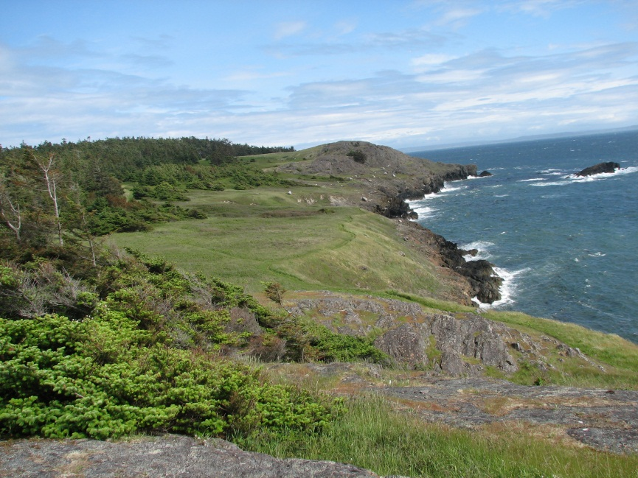
Science-TEK 2014 Projects and Activities
Frank Shipley – Chair S-TEK Subcommittee
Mary Mahaffy – Science Coordinator
Tom Miewald – Data Coordinator
Jill Hardiman – Assistant Science Coordinator
Steering Committee Mtg.
July 9, 2014

Slide 2

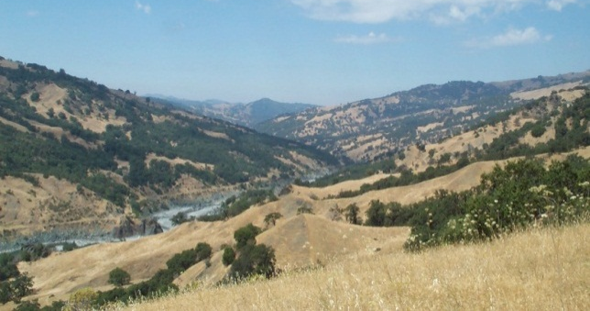
2014 Science-TEK Projects and Activities:
2014 projects (approx. $430K)
Conservation Planning Atlas
USGS financial support of Assistant Science Coordinator ($60K)
Updates to Website – New Resources Page (http:northpacificlcc.org)
Science-TEK Strategy’s 2015-2016 Implementation Plan
Project Management and Accountability Practices
NPLCC’s Conservation Goals and Objectives
Notes:
4.4 – 9 out of 22 proposed by First Nations or Tribe
4.4 – 1 pre-proposal was 3 pages, limit 2 pages so only read first 2 pages – OK not score well based on what you have read

Slide 3

Implementation Plan: 2014 Focused Activities
Augment, integrate and share existing data & information
Align and coordinate the delivery of science and TEK with decision-maker needs
Identify information necessary to support landscape-scale planning and management that involves multiple entities and jurisdictions.
Incorporate climate information into “line management activities”
Joint support for partner-initiated projects
Notes:
Interest and obligation in making sure some of the service’s objectives and goals are met
For example talked last week how SLR work we advocate for or fund can meet info needs of Mig birds
Want same conversations with other Service programs.
Want to see where can do work that meets both of our needs.

Slide 4
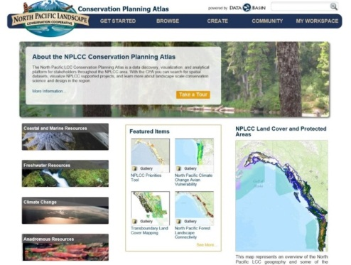
FA 1: Augment, integrate & share existing data & information
Conservation Planning Atlas (CBI, $25K)
  3 Interactive webinars
  Aug 7 – USFWS webinar
  Will conduct special webinars for others- just ask
Cascadia Partner Forum (Conservation NW, $9,500)
  WildLinks: transboundary gathering for practitioners working on building resiliency into species/ecosystems of Cascadia.
  Identify and upload transboundary data layers into the CPA for science planning for salmon, grizzly bear, & ecological connectivity; Transboundary data sharing workshop
Cascadia Interactive Climate Map (UW - CIG, $25K)
  Continue work started by NWF - bring synthesis reports alive
Conference Support: Exchange of Climate Science Information ($1.5K)
  PNW Climate Science Conference; Seattle, WA; Sept 9-10, 2014
  International Congress for Conservation Biology; Missoula, MT; July 14-17, 2014
Notes:
Interest and obligation in making sure some of the service’s objectives and goals are met
For example talked last week how SLR work we advocate for or fund can meet info needs of Mig birds
Want same conversations with other Service programs.
Want to see where can do work that meets both of our needs.

Slide 5
FA 2: Align and coordinate the delivery of science and TEK
with decision-maker needs
Climate Change Vulnerability Assessment of Pacific Lamprey (Year 2): USFWS – Schaller ($26K)
  Evaluate vulnerability of Pacific Lamprey to climate change using model projections for stream conditions (i.e., hydrograph, temperatures, and winter flood events) and lamprey sensitivity to environmental changes due to climate change
  Help guide implementation planning actions
Workshop- Using species traits to predict nearshore species climate vulnerability: EPA/USGS/NPLCC ($30K EPA funding)
  This workshop builds on a 2011 NPLCC project with USGS and EPA
  Convenes experts from throughout U.S. and international in August
Bringing Climate Change into Habitat Conservation Plans: Hoffman & USFWS (likely $2-$3K NPLCC; joint project w/ GBLCC, CA LCC & Desert LCC)
  Develop quick guide for use to help make HCPs climate smart
  USFWS Region 8 pilot – goal nation-wide model; share lessons learned
Notes:
Potential model for national-level guidance

Slide 6
FA 4: Incorporate climate information into “line
management activities”
Incorporating Spatial Heterogeneity in Temperature into Climate Vulnerability Assessments for Coastal Pacific Rivers (UW /NOAA, $73K)
  Map and evaluate locations cold water patches, ID potential hydroclimatic and landscape drivers in ~ 30 large rivers WA, OR, CA
  Work with conservation planners to illustrate how climate-induced changes to thermal heterogeneity could influence vulnerability and resilience of salmon in 2 case study watersheds (CA and OR)
Applied Case Study to integrate climate change science into culvert design for WDFW& Partners (WDFW, $45K)
  Translate available hydrologic projections derived from downscaled climate projections into metrics used in design fish passage structures
  Map decision pathways to indicate where and how to incorporate climate information
Notes:
Interest and obligation in making sure some of the service’s objectives and goals are met
For example talked last week how SLR work we advocate for or fund can meet info needs of Mig birds
Want same conversations with other Service programs.
Want to see where can do work that meets both of our needs.

Slide 7
FA 4: Incorporate climate information into “line
management activities”
Cross Boundary planning for resilience and restoration of Endangered Oak savanna and Coastal Douglas-fir Forest Ecosystems (Nature Trust of BC, $52.5K)
  Synthesize existing regional models of invasive/native species distribution, ecosystem mapping, forest age & climate change to deliver GIS tools to prioritize land acquisition & conservation investment
  Integrate tools with US partners to facilitate cross-boundary planning
Implementing Climate-smart resource management across multiple ownerships in SW OR (USFS, $49.5K)
  Implement recommendations from Rogue Basin Action Plan for resource management and planning
  Link key vulnerabilities with specific adaptation strategies and tactics and link adaptation with restoration, planning, and resource monitoring programs
Notes:
Interest and obligation in making sure some of the service’s objectives and goals are met
For example talked last week how SLR work we advocate for or fund can meet info needs of Mig birds
Want same conversations with other Service programs.
Want to see where can do work that meets both of our needs.

Slide 8
FA 4: Incorporate climate information into “line
management activities”
How to adapt to climate change – a practical workshop for protected are managers (B.C. FLNRO/Parks, $10k)
  Build on 2011 NPLCC project conducted by University of Washington
  Bring together existing tools with a rapid assessment technique that allows for examination of management decisions.
Climate Change Impacts on Nooksack River Hydrology (Nooksack Tribe; co-funded by BIA & ATNI; $50K)
  Conduct a vulnerability assessment and inform salmon habitat restoration actions
  Prepare an adaptation plan that can be directly integrated into management practices
Notes:
Interest and obligation in making sure some of the service’s objectives and goals are met
For example talked last week how SLR work we advocate for or fund can meet info needs of Mig birds
Want same conversations with other Service programs.
Want to see where can do work that meets both of our needs.

Slide 9
FA 4: Incorporate climate information into “line
management activities”
How to adapt to climate change – a practical workshop for protected area managers (B.C. FLNRO/Parks, $10k)
  Build on 2011 NPLCC project conducted by University of Washington
  Bring together existing tools with a rapid assessment technique that allows for examination of management decisions.
Climate Change Impacts on Nooksack River Hydrology (Nooksack Tribe; co-funded by BIA & ATNI; $50K)
  Conduct a vulnerability assessment and inform salmon habitat restoration actions
  Prepare an adaptation plan that can be directly integrated into management practices
Notes:
Interest and obligation in making sure some of the service’s objectives and goals are met
For example talked last week how SLR work we advocate for or fund can meet info needs of Mig birds
Want same conversations with other Service programs.
Want to see where can do work that meets both of our needs.

Slide 10
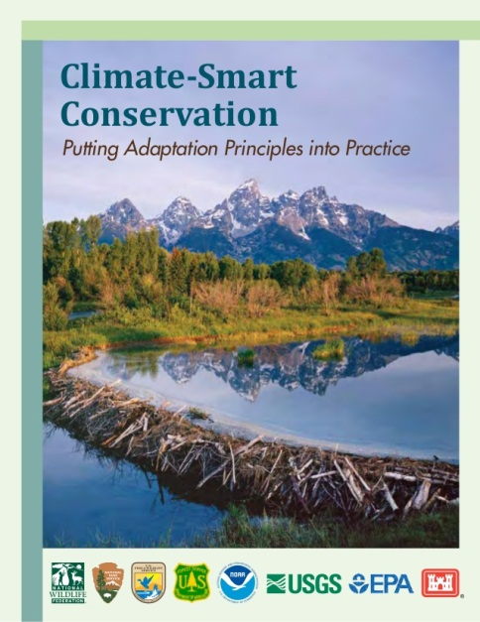
FA 4: Incorporate climate information into “line
management activities”
Climate-Smart Conservation Class for NPLCC Partners ($9.5K)
  40 spaces available at no cost to participants
  Olympia, WA; October 26-28, 2014
  Register on-line: USFWS – National
  Conservation Training Center
  Course ALC3195

