Slide 1


Communication & Outreach Tool Performance Report
Meghan Kearney, Communication Specialist
Steering Committee Meeting, April 24th,2014

Slide 2
Overview
30 day performance measures example & key strategies for:
  www.nplcc.org via Google Analytics
  Mailchimp: Newsletters & Listserve
  Social Media Platforms: Facebook & Twitter

Slide 3

nplcc.org
30-Day Example
March 8th – April 7th, 2014:
Visits = 727
Page views = 4,486
Visit Duration = Approx. 5 mins.
How visitors are arriving:
1. Organic Search (43.33%)
Reoccurring keywords:
nplcc
Northpacificlcc.org
North pacific lcc
Unique keyword examples:
Climate change/wetland ecosystems
geographic features of north west pacific
Job announcement “landscape conservation cooperative”
Landscape conservation
2. Direct Links (34.53%)
/Resources/Projects
/About
/NPLCCBusiness
3. Referral (20.77%)
lccnetwork.org (51.66%)
fws.gov (7.95%)
nplcc.s3.amazonaws.com (5.3%)
biology.sfu.ca (3.97%)
tribalclimate.uoregon.edu (2.65%)
Doi.gov (1.32%)
4. E-mail (0.96%)
5. Social (0.42%)
3 from Twitter (100%)

Slide 4
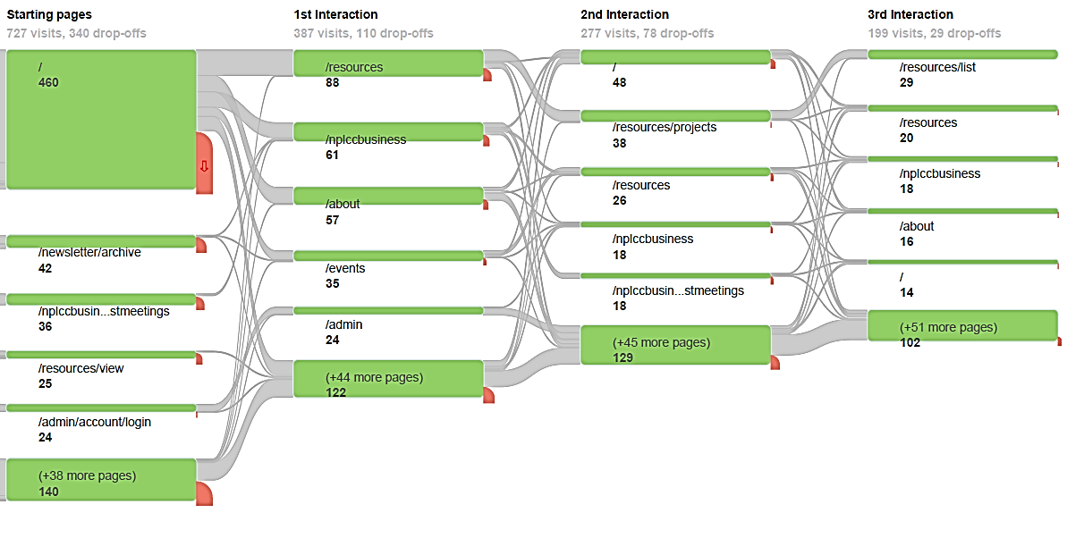
nplcc.org
30-Day Example March 8th – April 7th, 2014:
Page Flow:

Slide 5
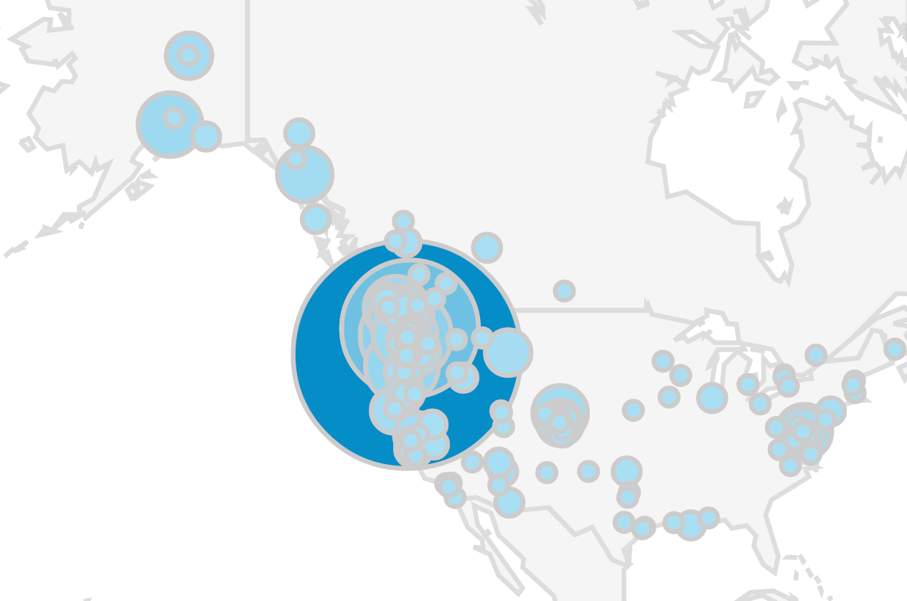
nplcc.org
30-Day Example March 8th – April 7th, 2014:
Visitor Geography Map:

Slide 6
MailChimp
Climate Science Digest (CSD), North Pacific Tidings (NPT), Science-Management Webinar Announcements
3,001 subscribers.
Approx 85% USA, 10% CA
What we’ve learned:
CSD - Highlights & Upcoming Events sections are most-clicked
CSD click rates are higher at the top (most important stories at top)
Even distribution among topic areas, steady engagement with Tribes & First Nations section
NPT has consistent clicks (shorter, more “feature” oriented)
nplcc.org is consistently one of the top clicked links in all mailings
Successful special announcements (i.e. Webinar/RFPs)
Verbal informal feedback has been positive

Slide 7
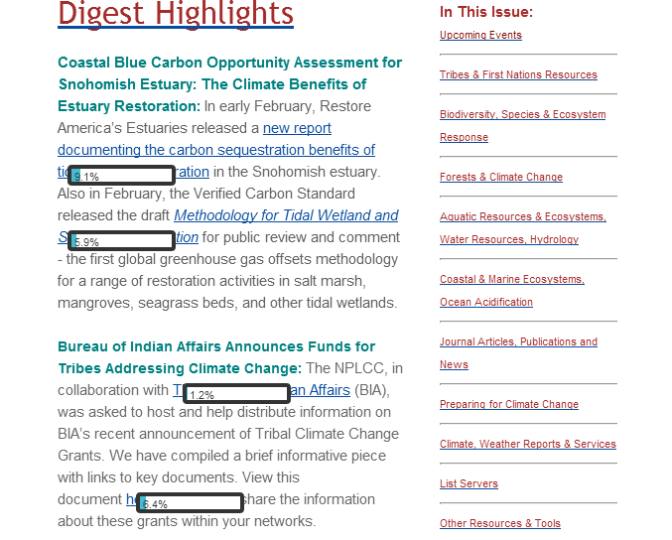
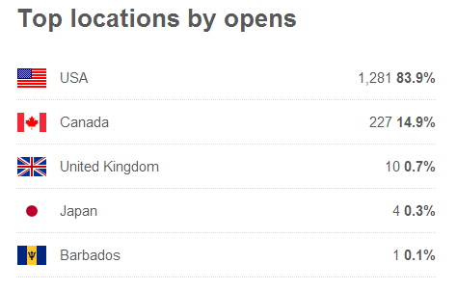
MailChimp
Tracking Readership Examples
Click Mapping: Shows percentage of clicks on links
Location:

Slide 8
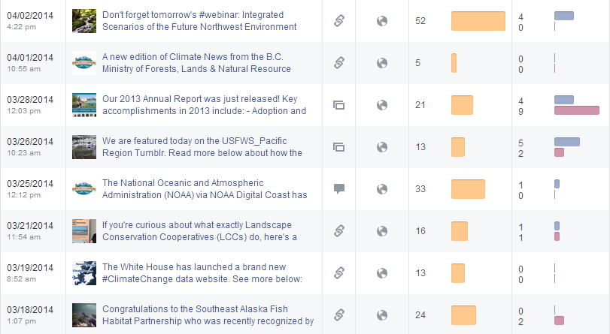
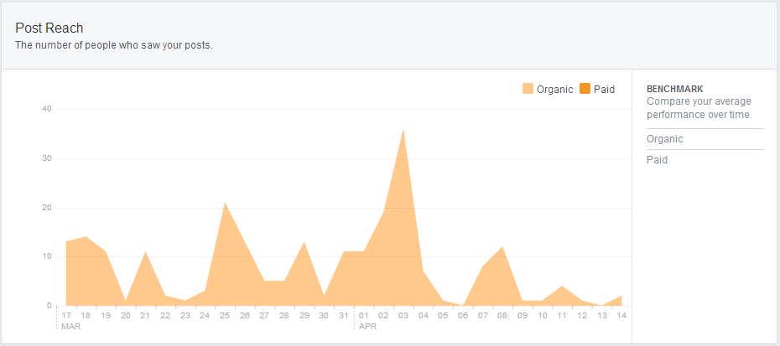
Facebook
We can:
Track what types of posts are the most engaging
What topics receive the most engagement
Who/What engages with our page
Track how many people our posts are reaching
Track what days and times our posts do the best or when followers are most active

Slide 9
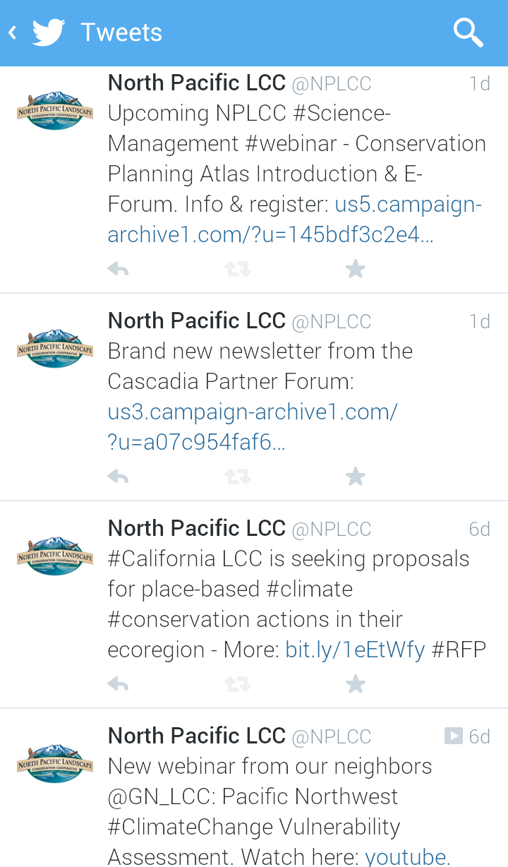
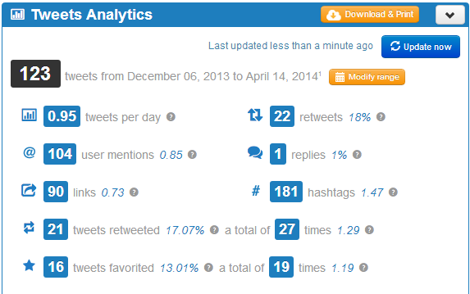
Twitter
Snapshot of NPLCC Activity on Twitter
What we tweet:
NPLCC Content
Partner news & content
Related climate science news & content (regional, national, international)

Slide 10
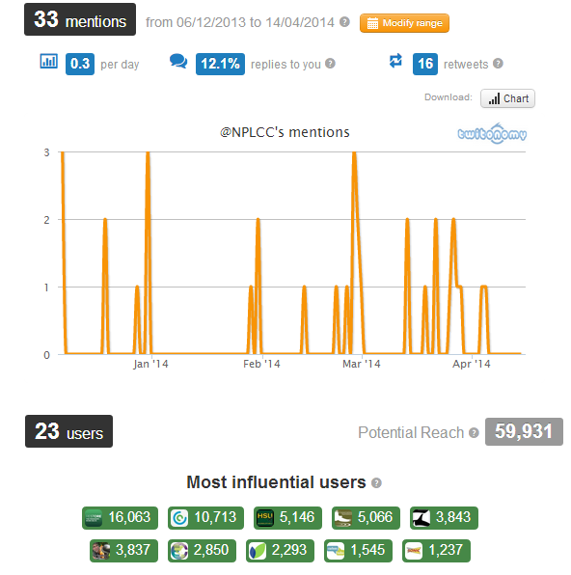
Twitter
Mentions:
When tweeters link to our page in a tweet using the @ symbol:
Potential Reach:
59,931 people (primarily interested parties, not random)
Will continue to grow as we expand followers
Influential Users:
When they interact with @NPLCC it exposes us to their followers. Keeping track if most influential/relative tweeters helps the NPLCC determine who to interact with for best results.
Examples:
@RestoreDelta mentioned us in a tweet = 16,063 potential reach from one tweet
@Fsologists_AK – reach of 4,575 + Partner/NPLCC Range

Slide 11
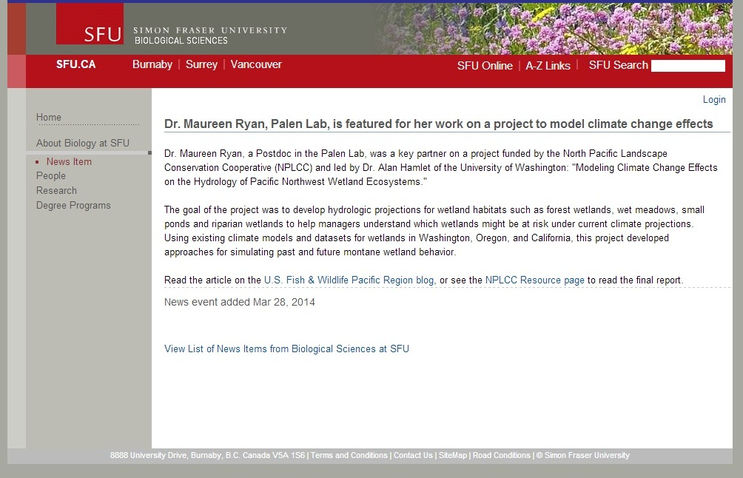
Shared Content

Slide 12
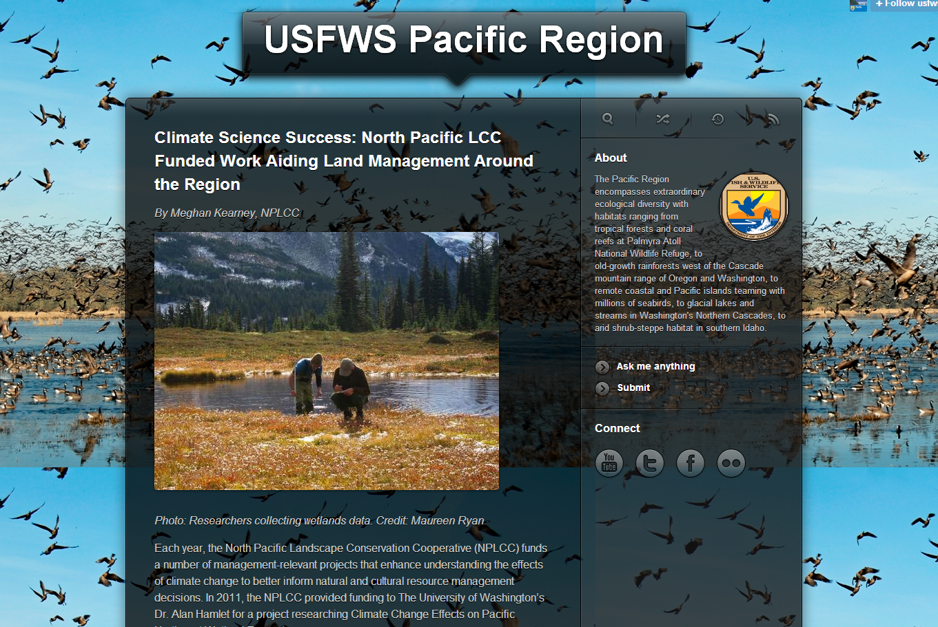
Shared Content

Slide 13
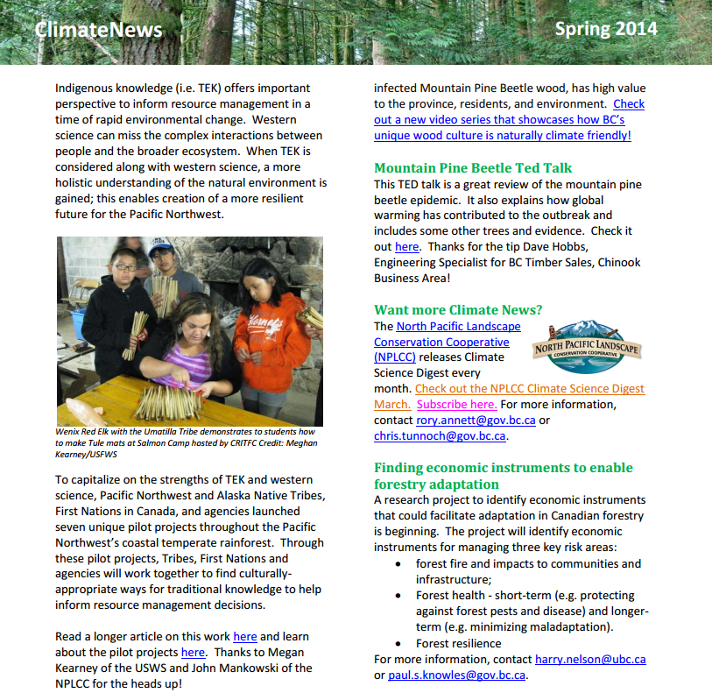
Shared Content
BC’s Forests, Lands and Natural Resource Operations Climate Newsletter

