Slide 1



Conservation Goals & the NPLCC
John Mankowski, Coordinator
Mary Mahaffy, Science Coordinator
Steering Committee Briefing – April 24, 2014

Slide 2

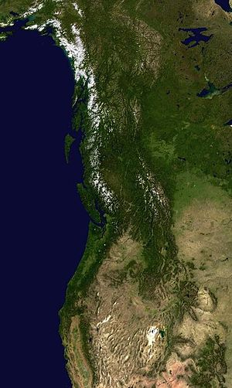
Briefing Outline
What are Conservation Goals in context of LCCs?
Why articulate them?
Overview of proposed goals for the NPLCC

Slide 3
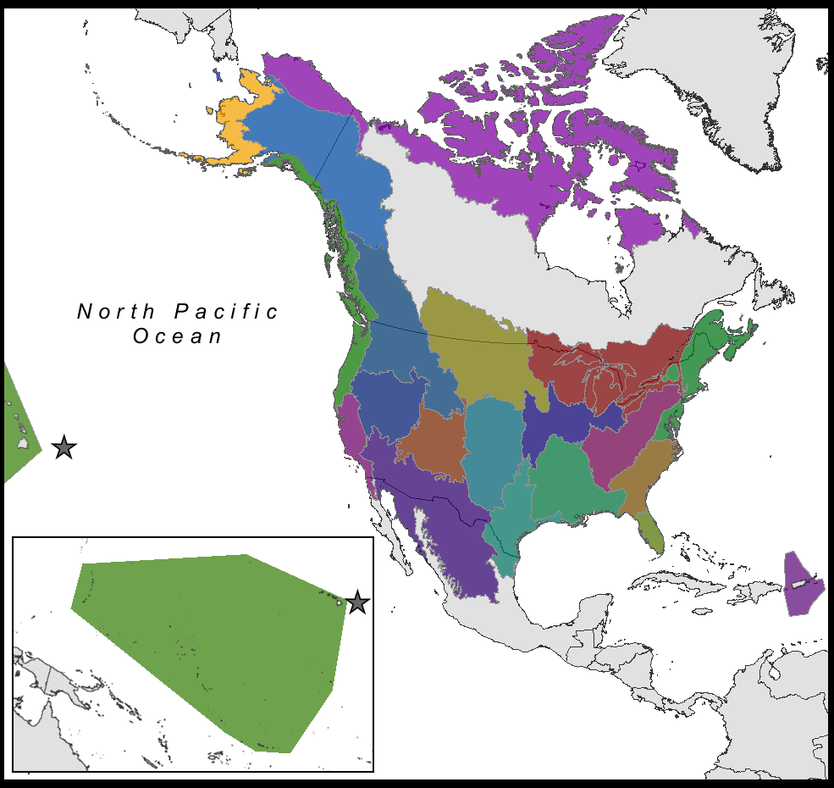
What are LCC Conservation Goals?
22 Partner-lead Collaboratives
Respond to Congressional direction to “establish clear goals, objectives, and measureable outcomes for LCCs”
DOI/FWS funding/performance expectations
SIAS – Science Investment & Accountability Schedule
  Includes 8 performance categories (sample)
  One of which is: Collating and Establishing Conservation Goals and Measurable Objectives for priority resources

Slide 4
Why Articulate LCC-Specific Conservation Goals
Achieve national performance benchmark, linked to funding
Provides method to refine S/TEK Strategy and what we work on within our 5 Priority Topics
Provides metrics and opportunities for performance tracking, demonstrating our success/value to partners
Helps better define “why” NPLCC exists, what it does, how it helps, where it is adding value.

Slide 5
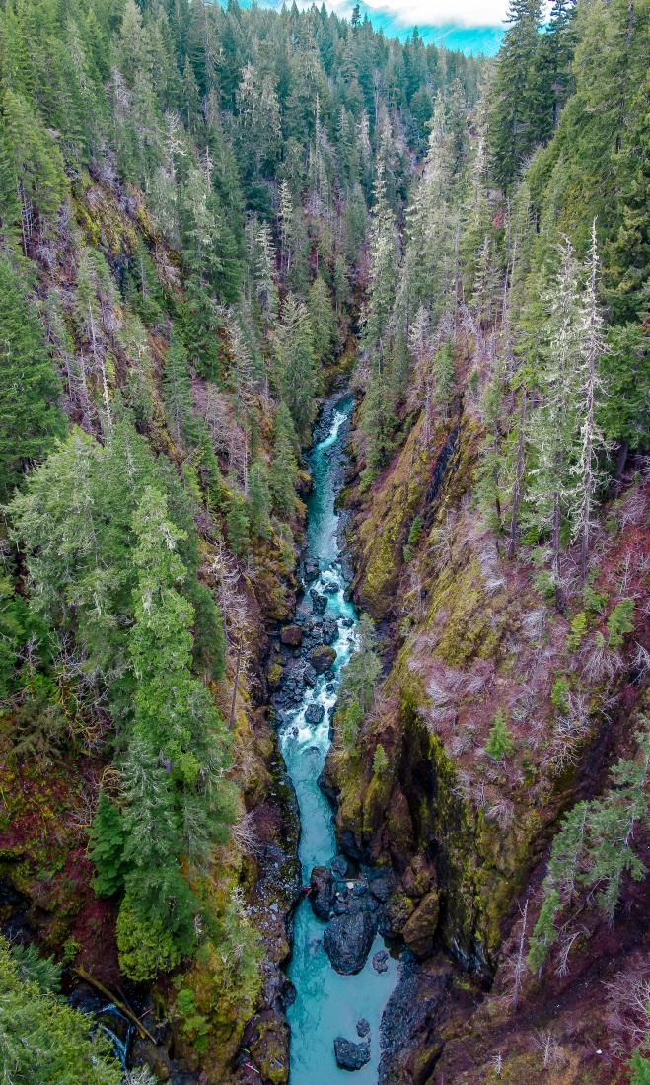
Proposed NPLCC Goals and Objectives
Approach –
  Pulled from S/TEK Strategy - 5 Priority Topics (Priority Resources + Significant Climate Stressors)
  Reviewed goals/objectives of many NPLCC partner climate-related initiatives (BC VA for working forests)
  Reviewed work of other LCCs (Arctic LCC)
  Ensured consistency with NPLCC charter, mission, and 7 overarching goals.

Slide 6
Document Orientation
Document Orientation (review draft)
Next steps:
  Review
  Provide Ideas/Comments w/i 3weeks
  New draft will be distributed
  Prepare to discuss and decide during Summer In-person meeting.

Slide 7
Closing Remarks
Annual Report is available on-line
NPLCC CPA Webinar/E-forum, May 15th
National RFP funding announcement
Next meetings:
  Summer meeting July 8, 9, 10 in WA
  August 13th – tele-meeting
  November 3-6 – In-person, Anchorage, joint mtg with AK CSC and other AK LCCs

Slide 8
Topics for Summer Meeting
Welcome new members (OR, OR Tribe, WA alternate, ?)
Partnership engagement strategy survey results
Tribe/First Nations strategy and implementation plan
Adopt overall Strategic Plan
Project highlight(s)
Field trip option
Partner highlight
Adopt Project Accountability Policy
Panel on successes/barriers to incorporate CC into natural and cultural resource management
Finalize Conservation Goals/Objectives
FY 15-16 S/TEK Priorities – homework assignment

