Slide 1




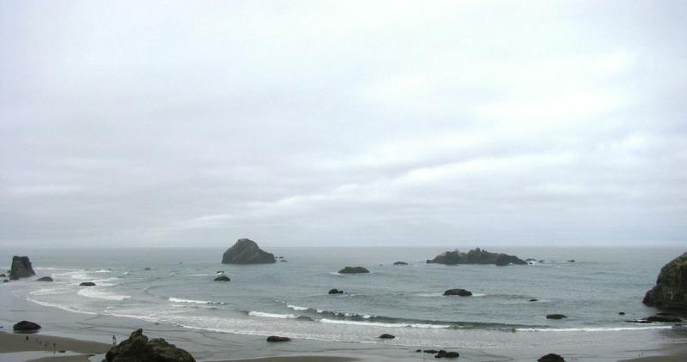


Tribe/First Nations collaboration
  Where we’ve been
  Moving forward
March 2nd, 2016

Slide 2

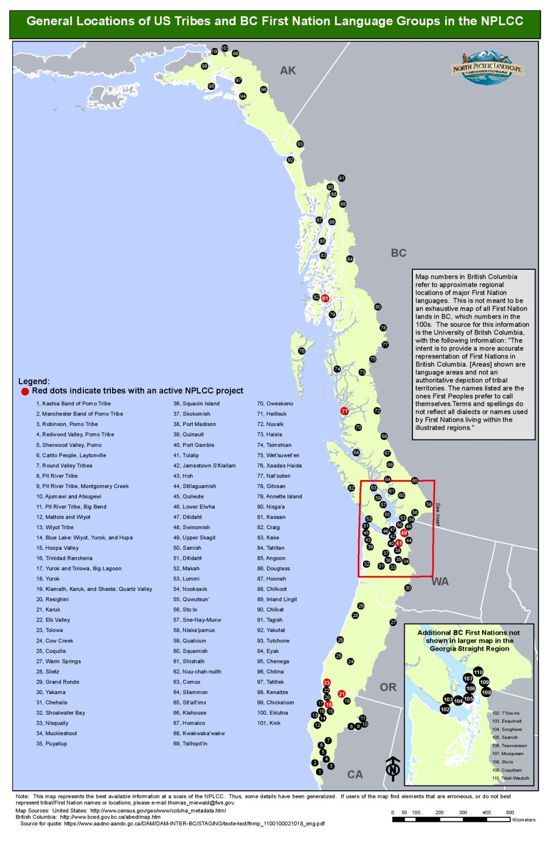
Engaging Tribes and First Nations
The NPLCC has over 200 Tribes and First Nations within our footprint.
Engagement approach - inclusivity, transparency, representative, and sovereign
Include diverse values as we assess the impacts of large-scale stressors, and manage for common future outcomes
Include TK and western science as we address impacts to natural/cultural resources.
Recognize proprietary and sensitive nature of TEK

Slide 3

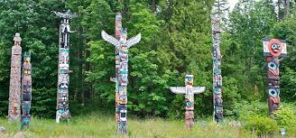
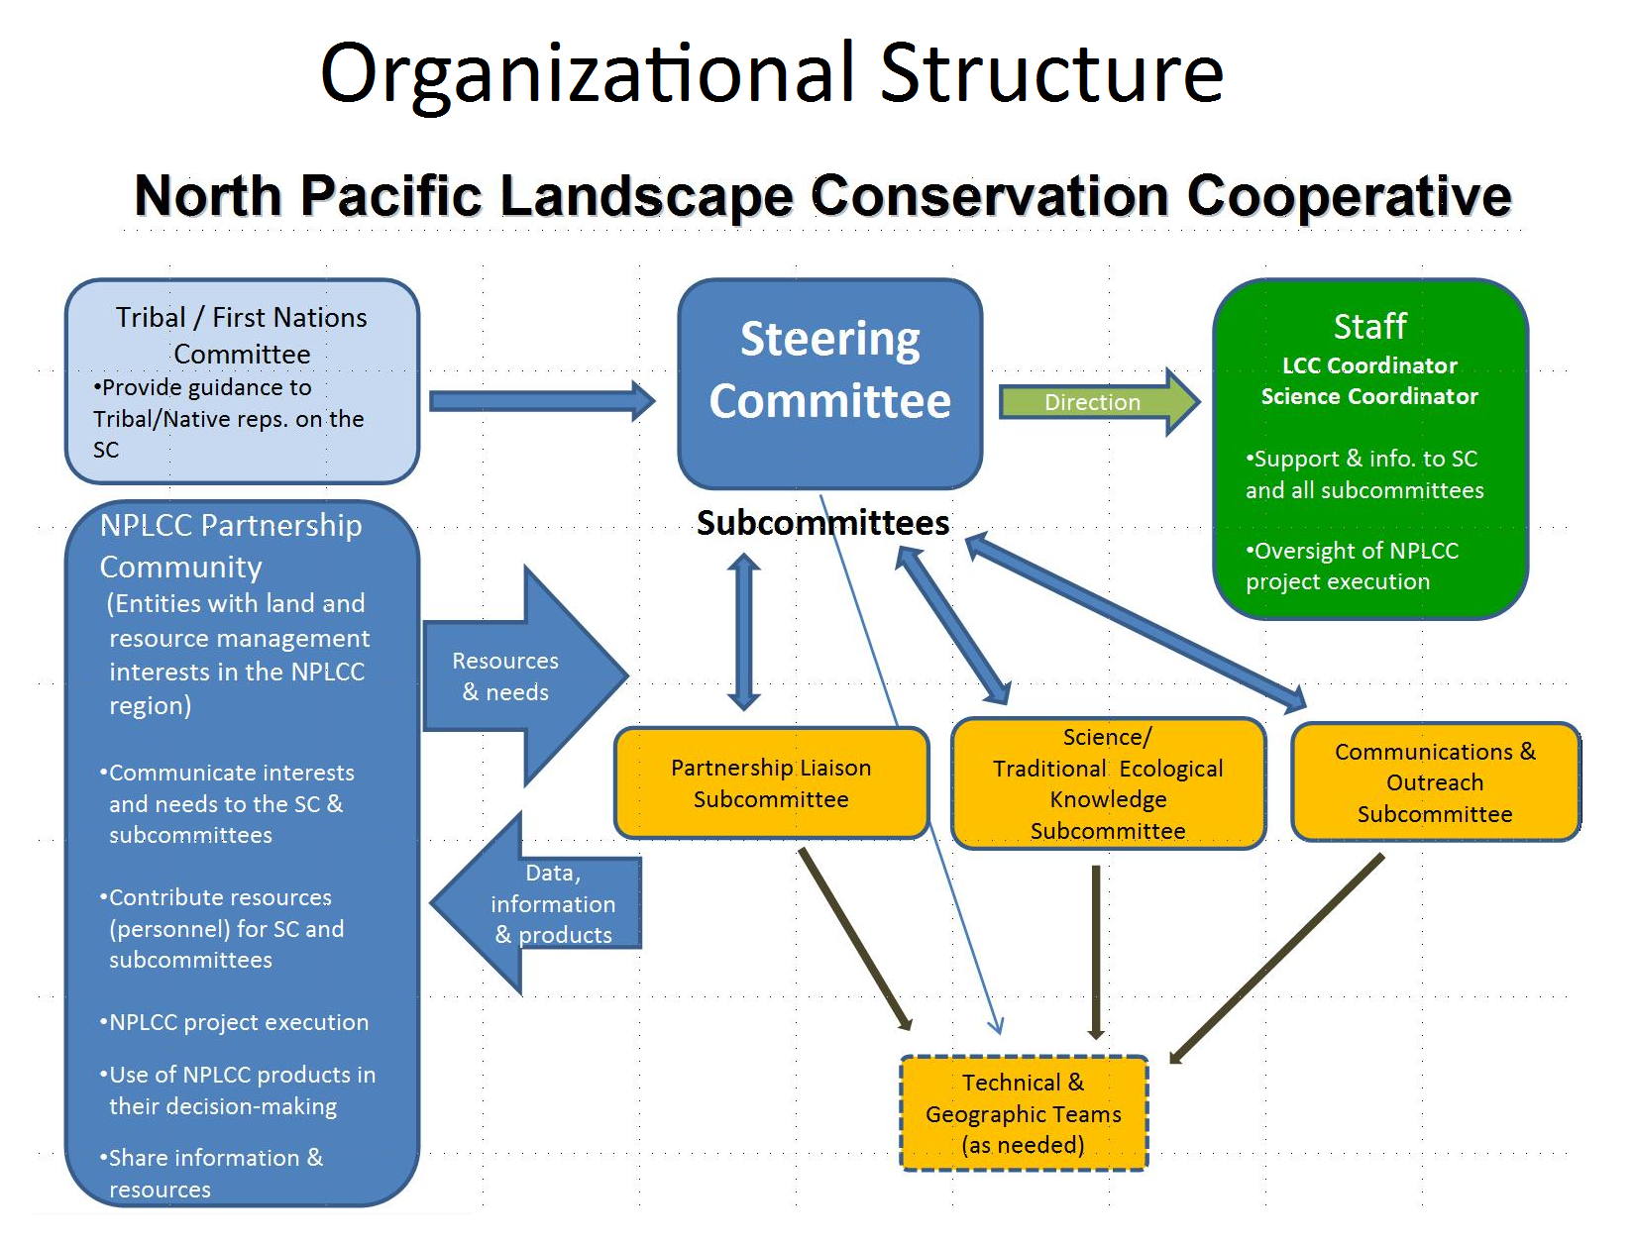
Structure:
Leadership on Steering Committee
T/FN Committee
Subcommittees
Outreach responsive to needs and interests
TE and Tribal priorities reflected in in NPLCC goals, plans, and actions

Slide 4

Action on all 10 recs from 2015
Support T/FN Committee meetings.
Support a tribal climate change work.
Build connectins between tribes and scientists working outside of tribes.
Provide consistent, fair support for tribal climate change work.
Explore ecosystem-based measures for protection and restoration of cultural resources.

Slide 5
Action on all 10 recs from 2015
Support tribally-led on-the-ground projects.
Integrate and refine the policy language in Tribal engagement in NPLCC mission, structure, and procedures.
Share information on benefits/projects resulting from active engagement.
Document approach in strategy with specific objectives and actions
Increase outreach to First Nations.

Slide 6
Tribal Engagement Strategy
Draft completed and reviewed – Darcey Evans with input from T/FN Leadership
Highlight document and focus on Goals and Actions

Slide 7
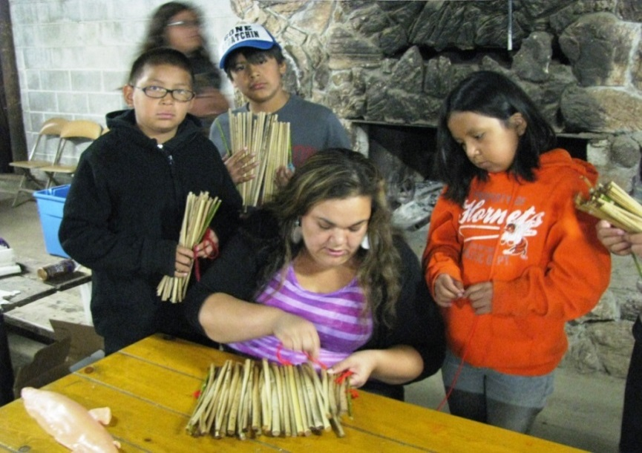
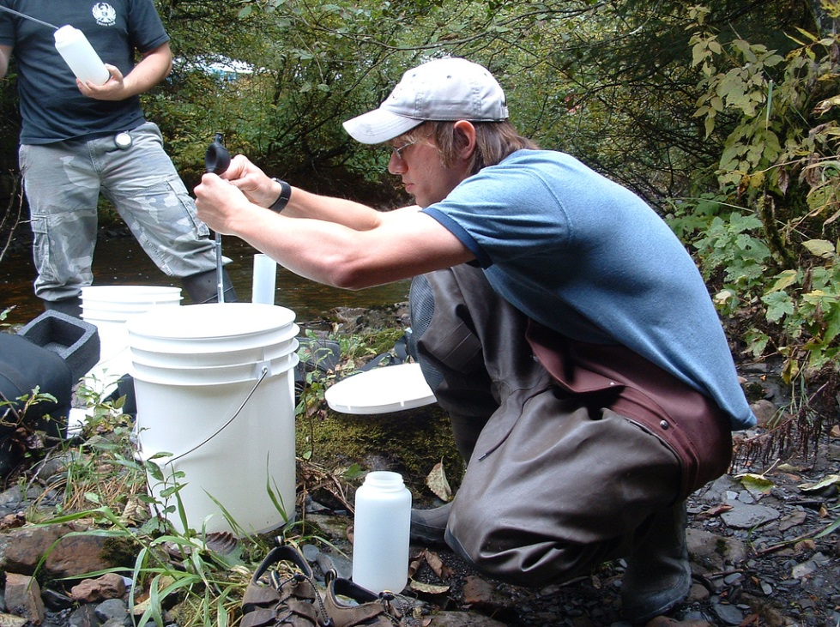
Highlight Outcomes of Efforts
Blog, web site, articles
Overview project handout

Slide 8
Other –
Travel support - BIA, ATNI
Communication Network Support and participation – PNW Tribal Climate Change Network
  Kathy Lynn
Tribal Intern – Darcey Evans
Leverage resources to support projects
  BIA, 3 CSCs, USFS, CIRC/RISA

Slide 9
Tribe/FN Engagement Next Steps
Expand leadership and participation
Act on items in new strategic plan
Share our work with Margaret Herzog (BIA contractor)
Fund projects responsive to Tribal priorities
T/FN event in Summer/Fall 2017
  Share results of TEK and subsistence resources projects
  Assess progress on tribal adaptation plans; identify gaps
  Explore ways to incorporate TEK and subsistence work into landscape management (demo projects, pilots, practices).
  Partner with GNLCC, ATNI, BIA TCRP, Raychelle Daniel, Tribal Climate Change Policy Analyst , DOI, LCC Council

Slide 10
Tribe/FN Engagement Next Steps
T/FN gathering on impacts and adaptation for cultural resources, TK, collaboration to improve resource management
Lead by T/FN; for T/FN
Share experiences and practices, learn from others, advance work going forward
Inclusive
NPLCC geography and neighboring regions
Topics:
  Share results of TEK experiences, tools, policies
  Subsistence resources – threats and management options
  Future changes and tribal adaptation plans; identify gaps
  Explore ways to incorporate TEK and subsistence work into landscape management (demo projects, pilots, practices).
Partner with MAAR, GNLCC, ATNI, BIA, PNW TCC Network, CRITFC, NWIFC, CC, others

