Slide 1
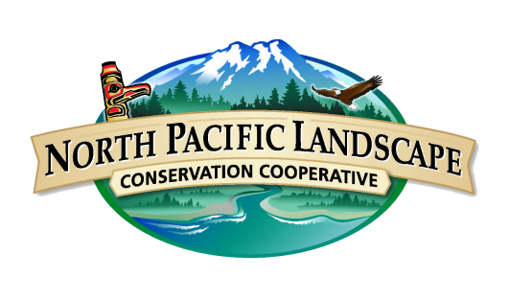
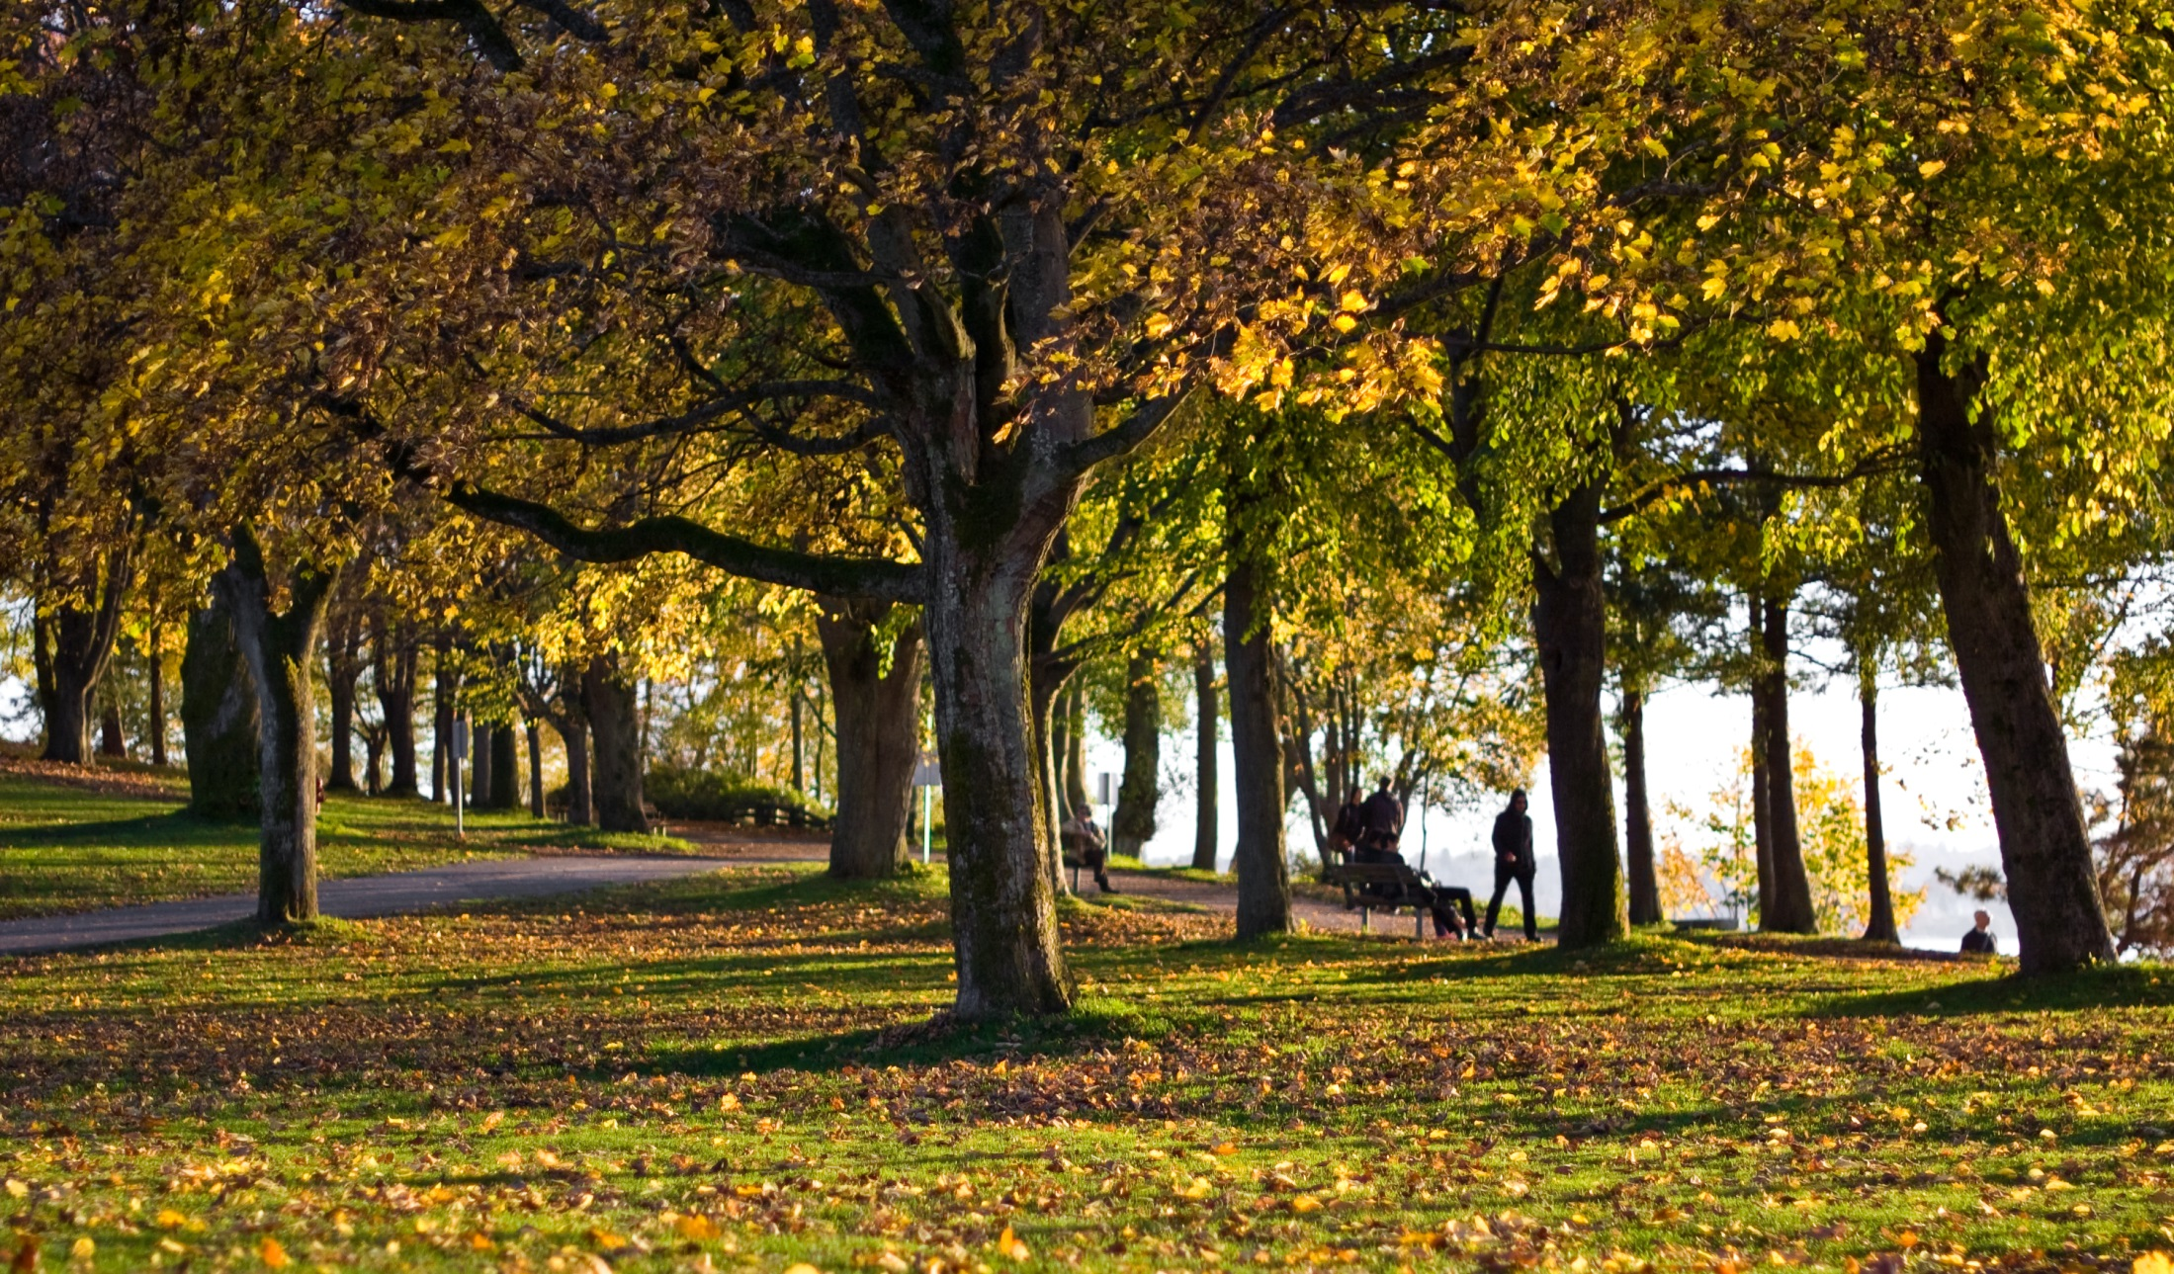
NPLCC Communication and Outreach: Trends, Tools, Actions
Steering Committee, Vancouver, B.C.
2 March 2017
Photo: Difei Li

Slide 2
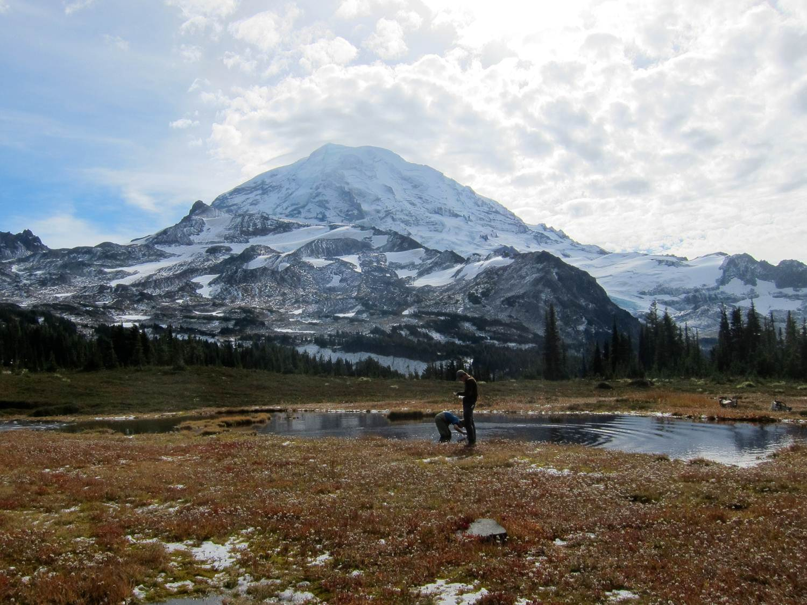
2016 Performance Review
11,000+ website visits
135k Twitter impressions
+2,000 new mailing list subscribers
Over 80,000 opens
NW Climate Magazine
PNW LCD Website

Slide 3
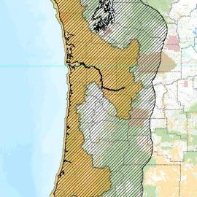
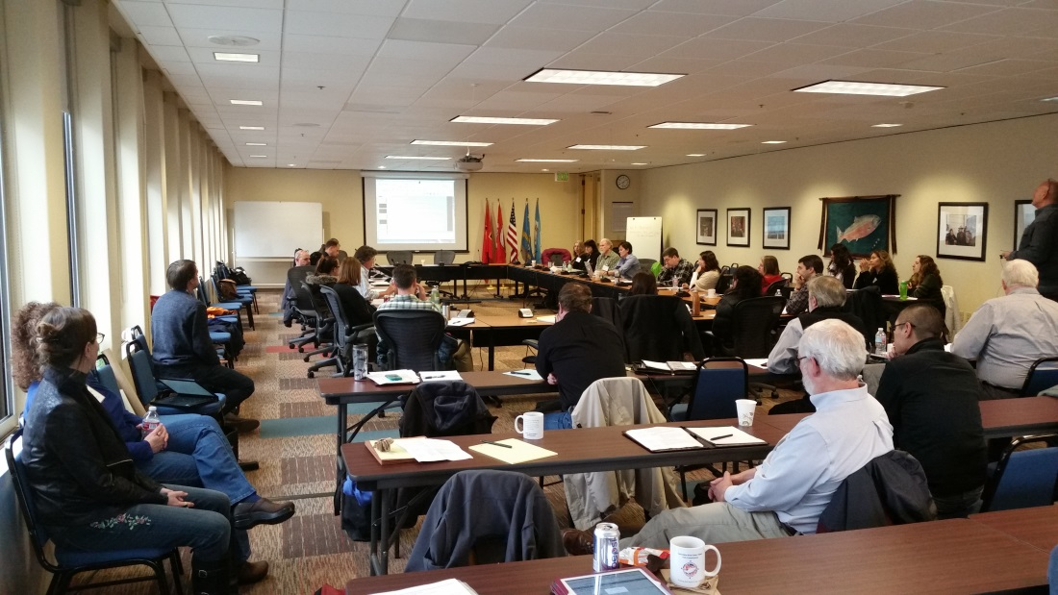
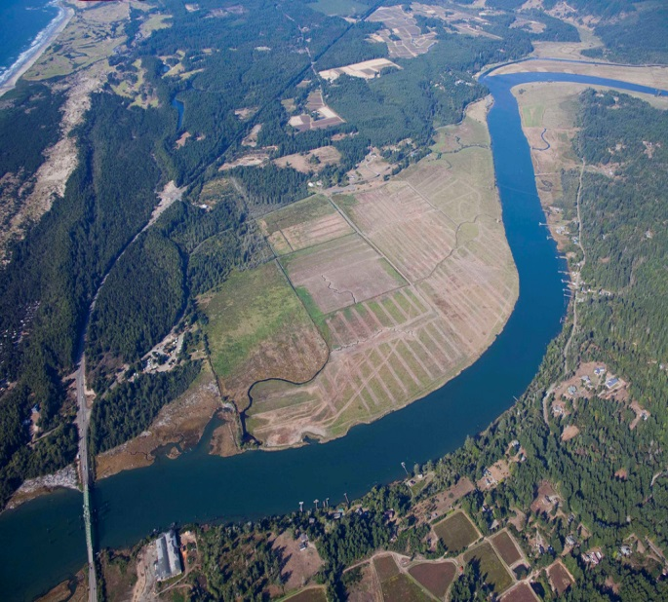
Pacific Northwest Coast Landscape Conservation Design Project
Build and maintain website
Develop Communication Strategy
Organize Communication Subcommittee
Webinars and briefings
Develop messaging for stakeholders
columbiacoastblueprint.org

Slide 4
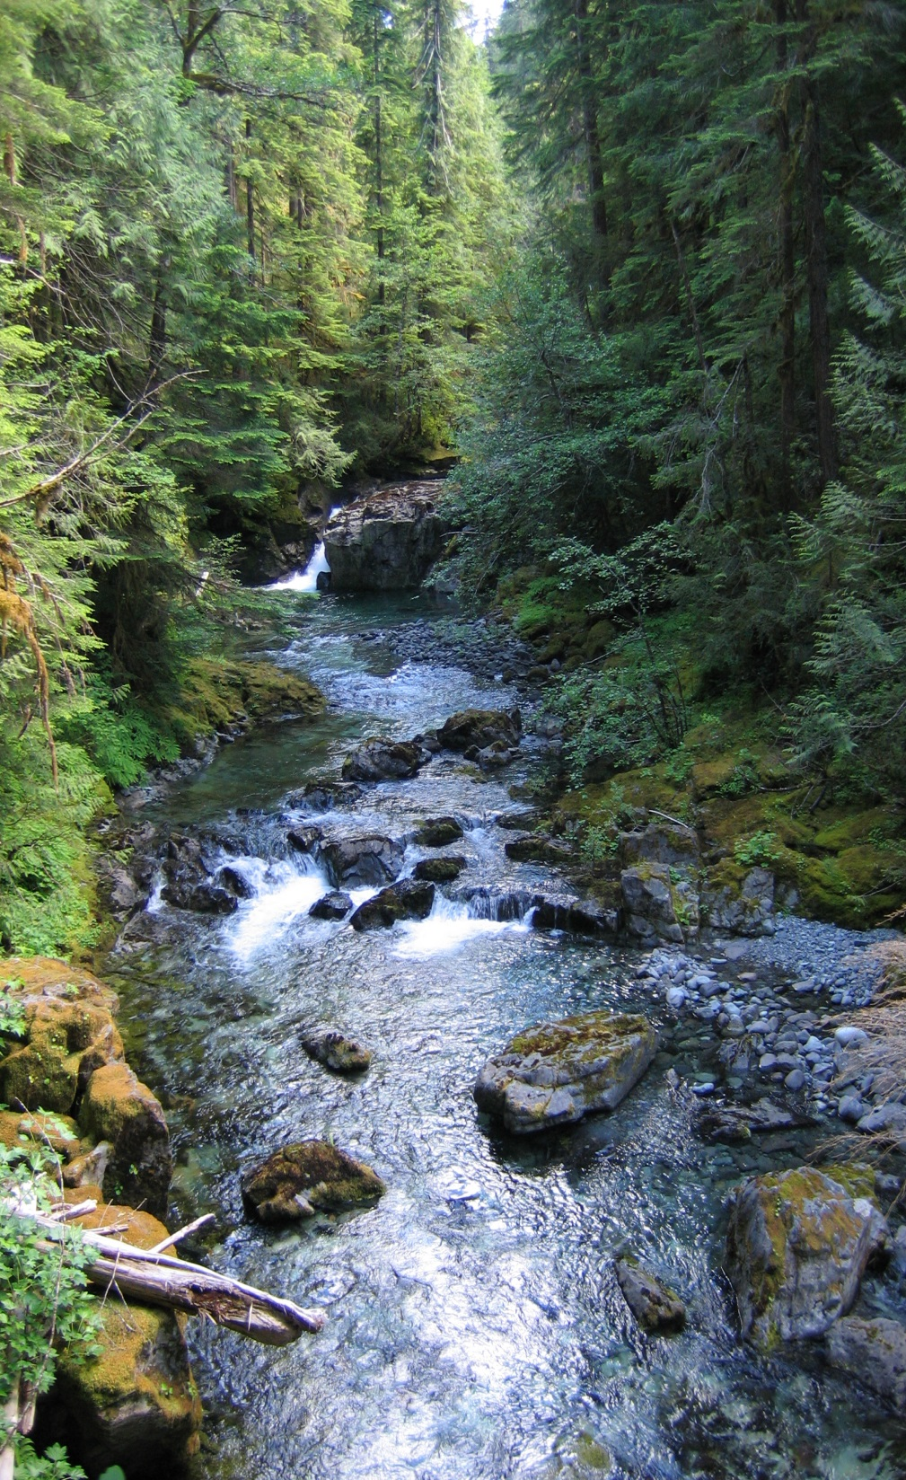
New Conservation Digest
Climate Science from Northwest Climate Science Center
Learning Opportunities
Tribes/First Nations
New focus on landscape conservation information
Highlight strengths of LCCs: Partnerships, collective capacity, shared priorities
New topics: Health, economy, water, energy, transportation, LCD

Slide 5
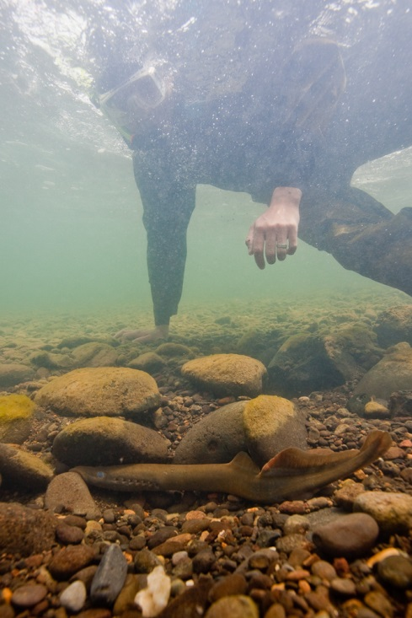

LCC Network Key Messages
LCCs are changing how we think about, plan, and act upon collaborative conservation
LCCs advance innovative partnerships and approaches on an unprecedented scale
LCCs partners work together to articulate shared priorities; identify gaps in scientific knowledge and capacity; and complement and build upon each other’s efforts
Conserving natural and cultural resources at a landscape level is about making better-informed decisions and working collaboratively
We are taking care of our health, quality of life, and economy.
Through locally driven partnerships, LCCs are increasing their collective science and management capacity to focus on critical conservation.

Slide 6
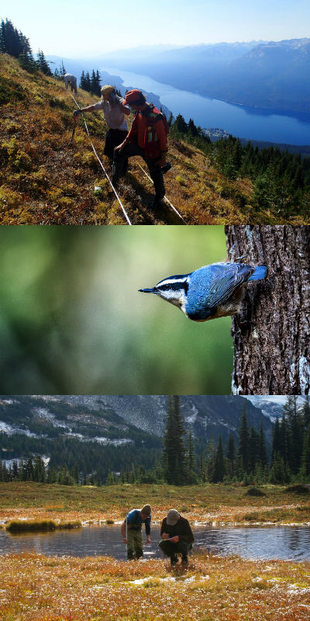
New 5-year COR Strategy
General update
Apply new key messages, tools, audiences
Reconvene COR subcommittee
Collaborations
Sea-level Rise “Open House”
Climate Magazine
California/SW, Comms Team, Strategic Messaging
Committee Newsletter
Quarterly
Exclusively for our 4 committees
High level NPLCC & partner news
Two-way updates
Network Comm Meeting
In-person, May
Strategize at the national level
Network branding
Develop Communication Plan for Network

