Slide 1
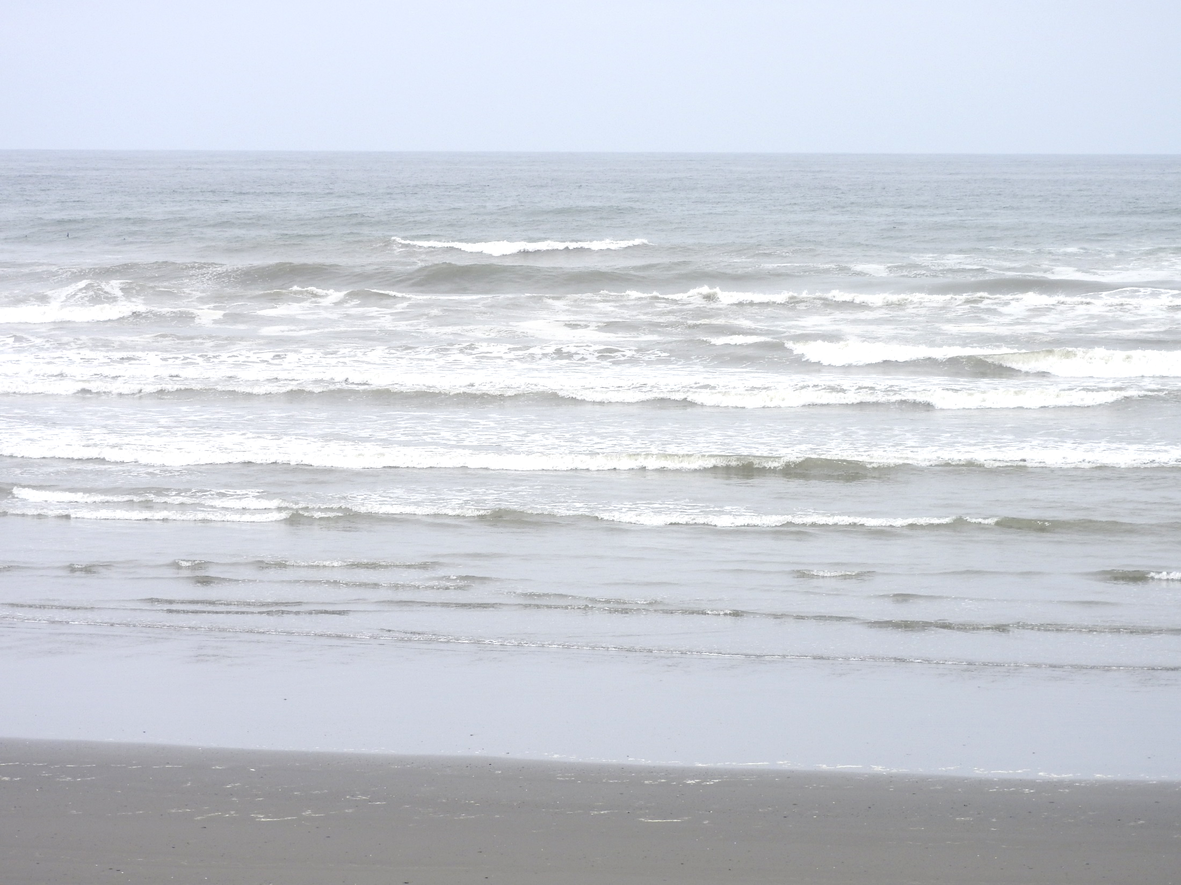
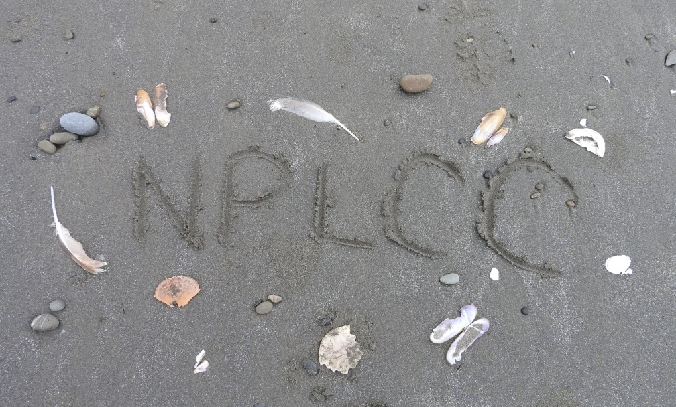

NPLCC Steering Committee Meeting
New S-TEK Strategy Update
March 2, 2017

Slide 2
Morning Agenda (Pacific Time)
8:40 - Introduction
  Background 2012-2016 Science/TEK (S/TEK) Strategy
  Framework 2017-2021 S/TEK Strategy
  Conservation Targets Discussed by S-TEK Subcommittee
  Brief intro Open Standards of Conservation Practice (OS)
  New Strategy Draft Conceptual Models
9:30 - Break-out groups (2 in room and 1 on phone/webex)
10:15 - BREAK
10:30 - Groups report out
11:15 - Introduction
  OS Conservation Target-Threat ratings
  Working Draft Conceptual Model ratings by S-TEK
11:30 - Break-out groups (continue discussions)

Slide 3
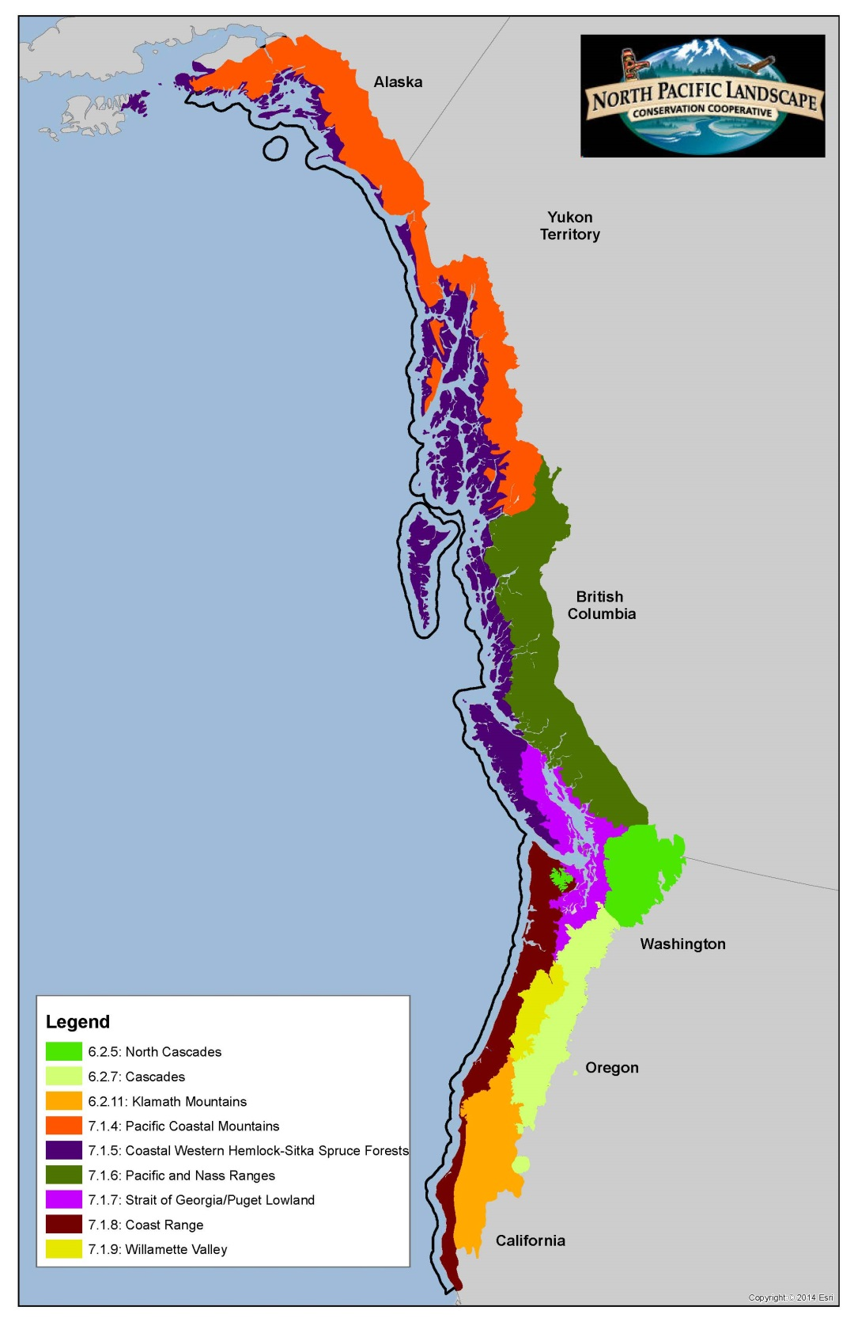

Common Themes Across NPLCC
Valued human, ecological, and cultural resources:
Forest Products
Old growth forests
Freshwater quality, timing, availability
Anadromous fish populations
Migratory birds
Carbon sequestration capacity
Cultural resources
Habitat connectivity
Near-shore/ coastal/ estuarine habitats
Community stability/ human well-being
Recreation/ tourism
Climate-related stressors and potential climate change impacts:
Climate change
Infrastructure development
Energy development
Invasive species
Sea level rise
Ocean acidification
Ocean current changes
Food web dynamics
Phenological mismatches
Disturbed regimes
High sensitivity to land-sea interactions
Global economic dynamics
From: Woodward, A; A. Taylor; A. Weeks. 2012. Ecological Context for the North Pacific Landscape Conservation Cooperative. U.S. Geological Survey Open-File Report 2012-1211

Slide 4

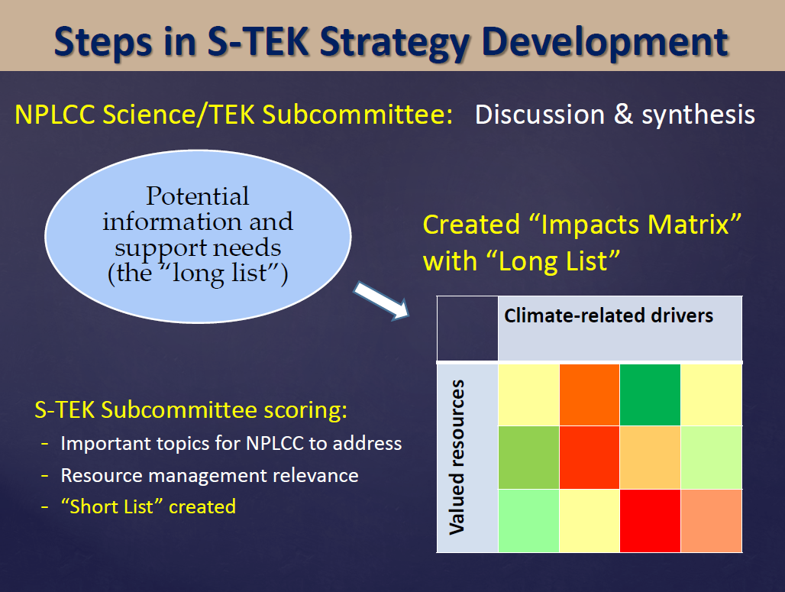
2013-2016 Science/TEK Strategy
Notes:
Looking at how the different foundational NPLCC documents fit together, we see:
The Charter defines the NPLCC mission, goals and defining principles; clarifies the governance of the NPLCC; and outlines its operating procedures
The Strategic Plan lays out the near-term plan to work toward those goals, describing at a high level how and where the NPLCC will focus its activities. Where needed, it provides additional implementation guidance.
Each committee and subcommittee, as well as NPLCC staff, uses the Charter and Strategic Plan to guide their strategies and work plans. It is at this level that we see the most specific and targeted goals and objectives, each focused on the roles and responsibilities of the particular committee, subcommittee or NPLCC staff.
Additionally, the Steering Committee, advised by the T/FN Committee, provides guidance to subcommittees and NPLCC staff.

Slide 5
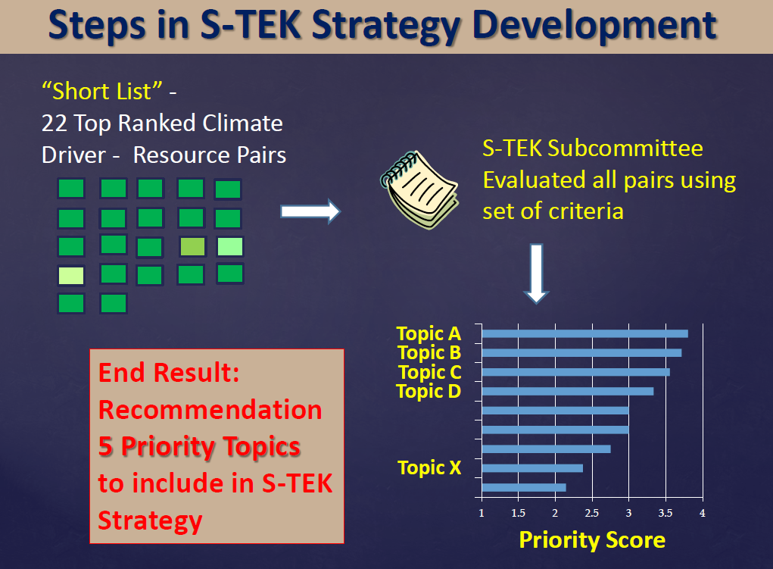
2013-2016 Science/TEK Strategy
Notes:
Looking at how the different foundational NPLCC documents fit together, we see:
The Charter defines the NPLCC mission, goals and defining principles; clarifies the governance of the NPLCC; and outlines its operating procedures
The Strategic Plan lays out the near-term plan to work toward those goals, describing at a high level how and where the NPLCC will focus its activities. Where needed, it provides additional implementation guidance.
Each committee and subcommittee, as well as NPLCC staff, uses the Charter and Strategic Plan to guide their strategies and work plans. It is at this level that we see the most specific and targeted goals and objectives, each focused on the roles and responsibilities of the particular committee, subcommittee or NPLCC staff.
Additionally, the Steering Committee, advised by the T/FN Committee, provides guidance to subcommittees and NPLCC staff.

Slide 6
2013-2016 Science/TEK Strategy
Guiding Principles | Priority Topics
In annual implementation planning, and in the activities it supports, the NPLCC will: Focus on helping managers understand the availability and effectiveness of adaptation and mitigation response actions Focus on facilitating coordination, collaboration, and capacity building, and on developing or assisting with tools to assist decision-makers Identify and promote opportunities to use TEK to inform partner and stakeholder decisions Promote and facilitate consideration of the connections and interactions between ecosystems | Effects of hydrologic regime shifts on rivers, streams, and riparian corridors Effects of change in air temperature and precipitation on Forests Effects of changes in sea levels and storms on marine shorelines, the nearshore and estuaries Effects of the changes in the hydrologic regime on anadromous fish Invasive species, diseases, pests and their effects on biological communities
Notes:
Looking at how the different foundational NPLCC documents fit together, we see:
The Charter defines the NPLCC mission, goals and defining principles; clarifies the governance of the NPLCC; and outlines its operating procedures
The Strategic Plan lays out the near-term plan to work toward those goals, describing at a high level how and where the NPLCC will focus its activities. Where needed, it provides additional implementation guidance.
Each committee and subcommittee, as well as NPLCC staff, uses the Charter and Strategic Plan to guide their strategies and work plans. It is at this level that we see the most specific and targeted goals and objectives, each focused on the roles and responsibilities of the particular committee, subcommittee or NPLCC staff.
Additionally, the Steering Committee, advised by the T/FN Committee, provides guidance to subcommittees and NPLCC staff.

Slide 7
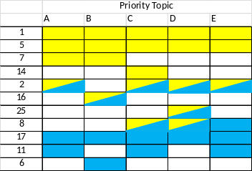
Closing Questions – Sense of the SC
Annual Implementation Planning Process
Task 1. Identify potential activities
Task 2. Evaluate and rank activities
Task 3. Select Areas of focus
Task 4. Develop Activities for NPLCC support
Activity
Need
Description
Specific actions
$$
Guiding Principles | Priority Topics
… … … … | A B C D
Activity
Need
Description
Specific actions
$$
Activity
Need
Description
Specific actions
$$
Importance for NPLCC action
…
Identified tasks that have been completed
Lists of candidate activities within identified areas of focus were developed

Slide 8
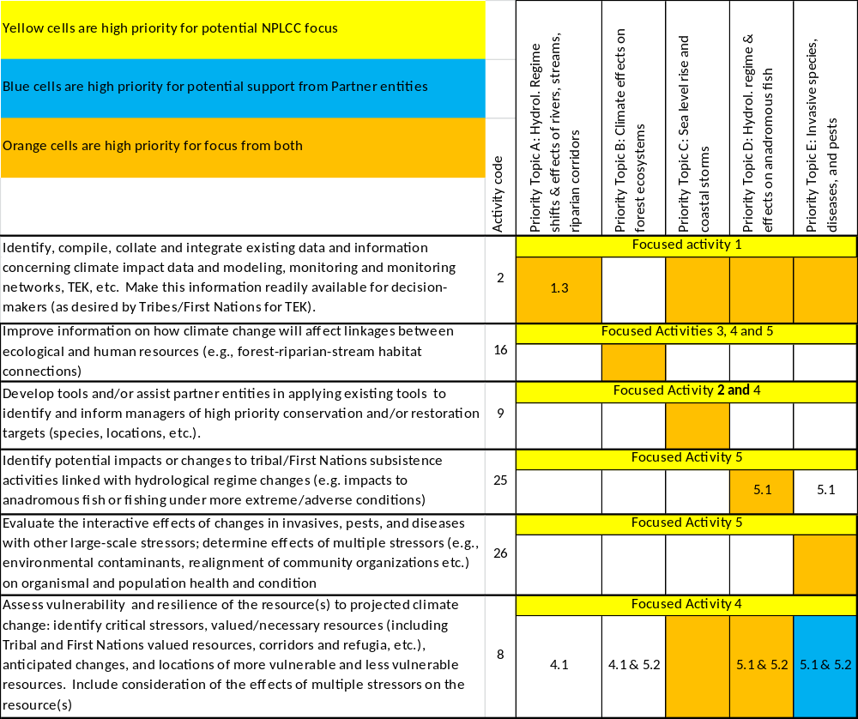

Slide 9
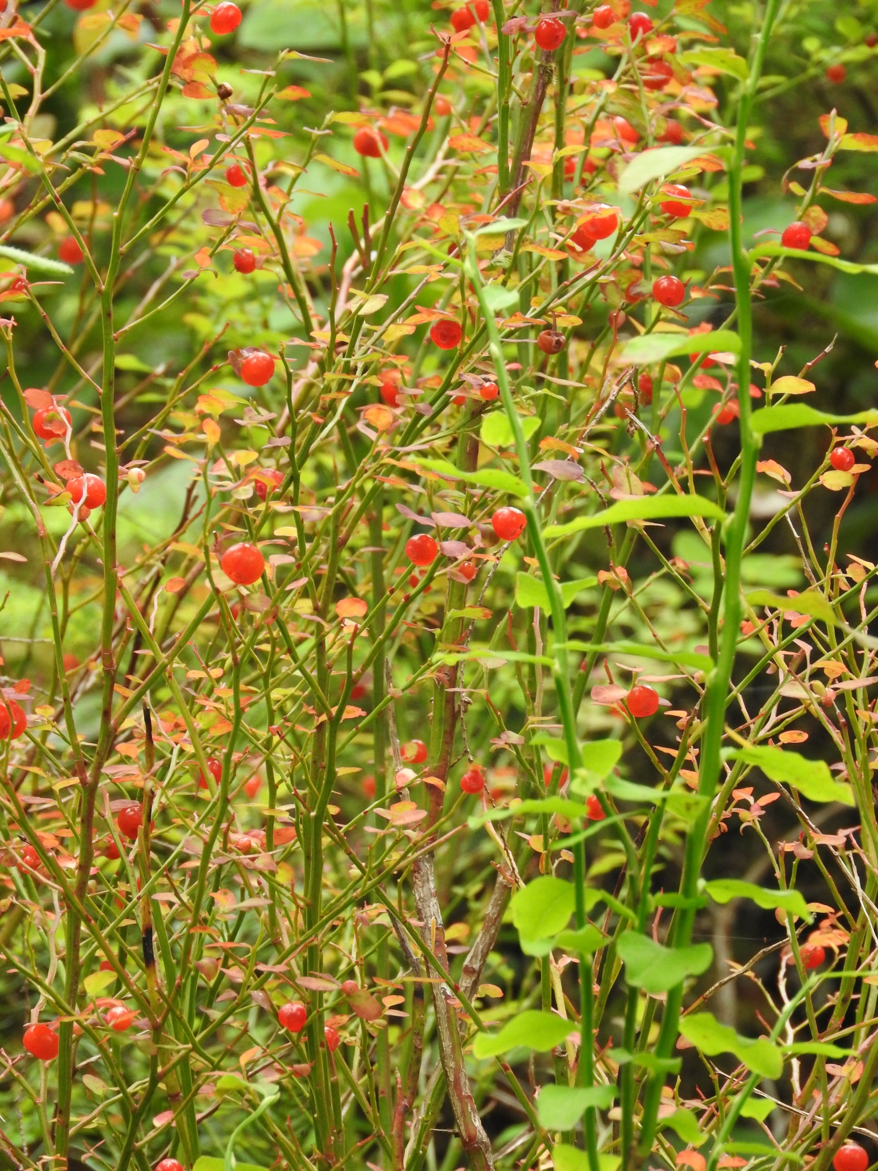
Proposed Framing Questions for the 2017-2021 S-TEK Strategy
What are the most immediate conservation needs across the NPLCC landscape?
How valuable is this information for managers and other decision-makers?
How critical is it for the NPLCC to focus on work of this type?
Is there relevant work of this type already being done by others?
What Role Should the NPLCC Play?
See handout for full descriptions

Slide 10

Conservation Targets Within the NPLCC
Cascadia Partner Forum:
Ecological Connectivity
Grizzly Bear
Salmon
PNW Coast LCD (draft targets):
Connectivity
Diversity
Other Coarse and Fine Filter Targets
Conservation Targets – Adjacent LCCs
Great Northern LCC:
Connectivity
Aquatic Integrity
Other
Northwest Boreal LCC:
Intact and connected landscapes and watersheds
Sustained biodiversity and ecosystem services
Cultural, economic, environmental, recreational, and spiritual values supported
See Handout for More Targets/Priorities

Slide 11
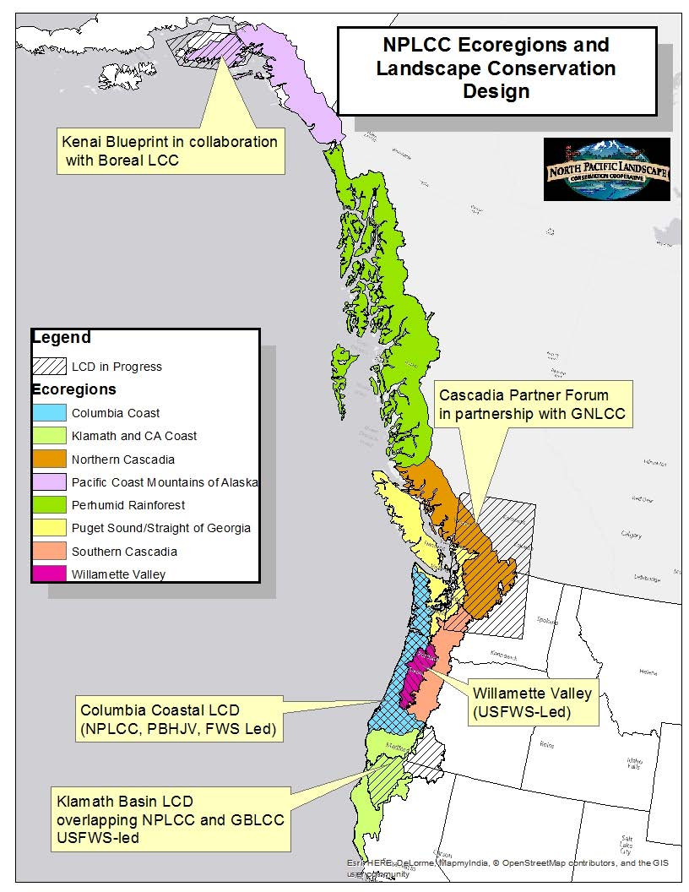
SE Alaska Landscape Planning Partnership

Slide 12

Potential NPLCC-Wide Conservation Targets
Ecological connectivity
Biodiversity
Healthy biological communities
Sustainable anadromous fish populations
Physical and biological integrity of rivers, streams, and riparian cooridors
Sustainable forests
Heathy lakes and wetlands
Functioning coastal resources
Coastal resiliency
Functioning alpine and sub-alpine ecosystems

Slide 13
S-TEK Poll Results – Conservation Targets
32%
21%
16%
16%
11%
0%
0%
0%

Slide 14

Conservation Targets Discussed:
Terrestrial connectivity for the service of fully functioning terrestrial ecosystems
Aquatic Connectivity in the service of fully functional aquatic and riparian ecosystems
Healthy and resilient coastal communities
Notes:
Looking at how the different foundational NPLCC documents fit together, we see:
The Charter defines the NPLCC mission, goals and defining principles; clarifies the governance of the NPLCC; and outlines its operating procedures
The Strategic Plan lays out the near-term plan to work toward those goals, describing at a high level how and where the NPLCC will focus its activities. Where needed, it provides additional implementation guidance.
Each committee and subcommittee, as well as NPLCC staff, uses the Charter and Strategic Plan to guide their strategies and work plans. It is at this level that we see the most specific and targeted goals and objectives, each focused on the roles and responsibilities of the particular committee, subcommittee or NPLCC staff.
Additionally, the Steering Committee, advised by the T/FN Committee, provides guidance to subcommittees and NPLCC staff.

Slide 15
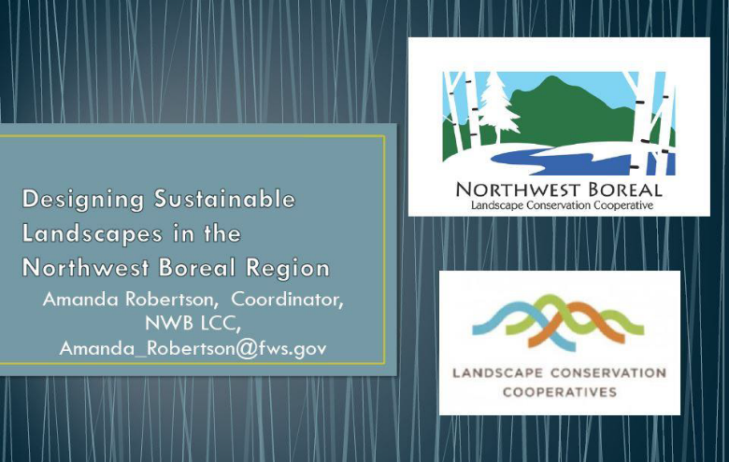
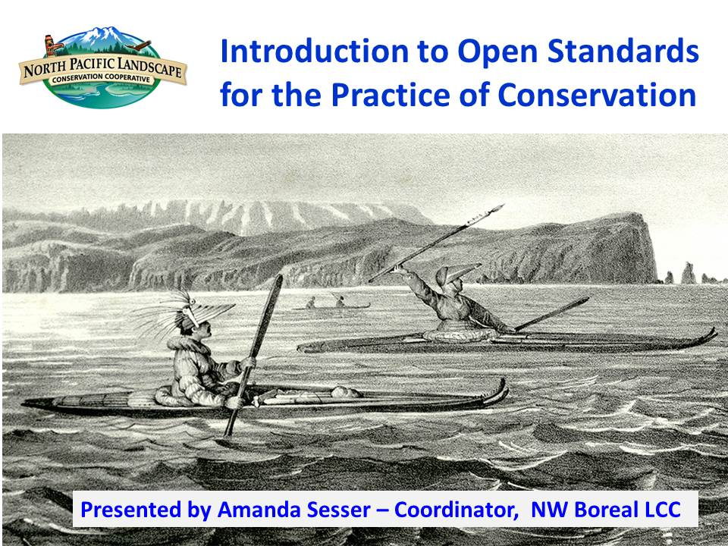
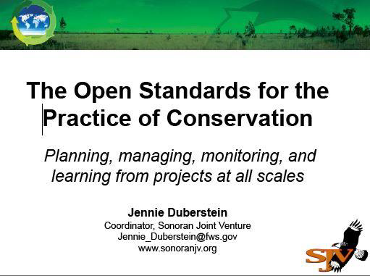
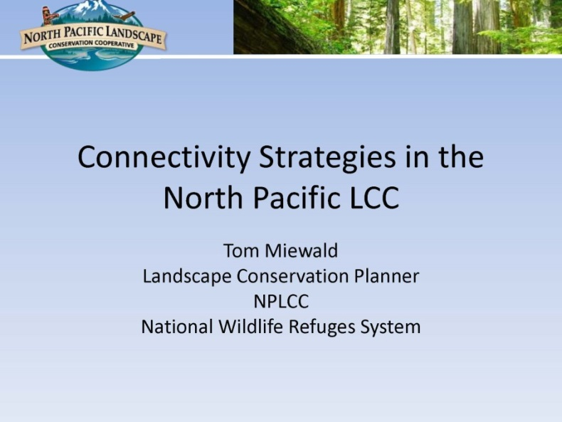
Acknowledgements for following slides - Open Standards process (not mine)

Slide 16
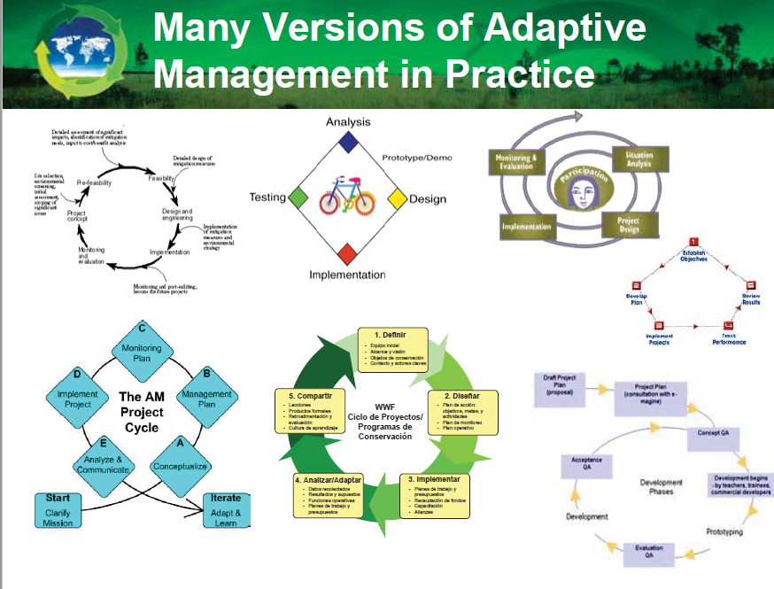

Slide 17
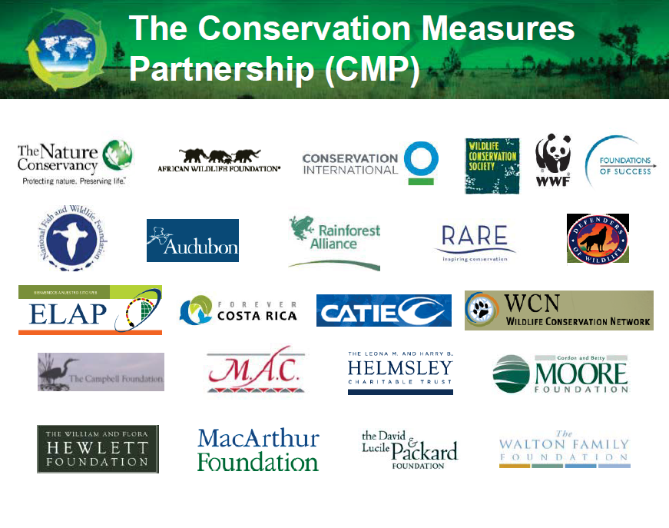
Notes:
The Conservation Measures Partnership (CMP) is a partnership of conservation organizations that seek better ways to design, manage, and measure the impacts of their conservation actions.

Slide 18
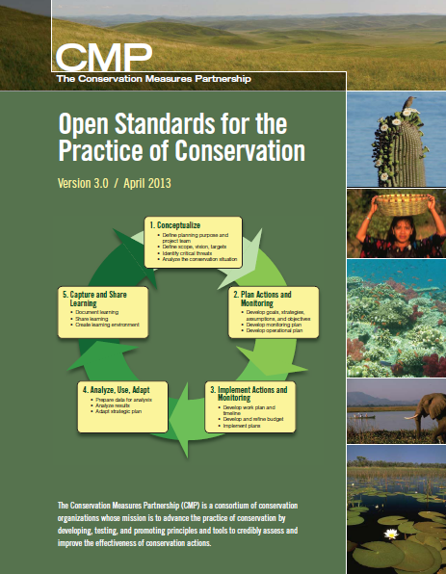

Conservation Measures Partnership Resources
Threats and Actions Taxonomy
http://cmp-openstandards.org/using-os/tools/classification-beta-v-2-0
Miradi (software)
www.miradi.org
www.conservationmeasure.org
Notes:
Version 3.0 was published in April 2013 and was a joint effort between many individuals and organizations.
Open source & common language; Used around the world

Slide 19
OS addresses these questions…
What is the biodiversity (or human/cultural target) of interest and its status?
What threats exist and what’s their importance?
Which stakeholders should be engaged, what underlying causes and opportunities warrant attention?
What specific outcomes are we trying to achieve?
What strategies and actions do we need to take to achieve the desired outcomes?
How do we know if our actions are working?
How can we adapt and learn and share results to achieve impact at broader scales?

Slide 20
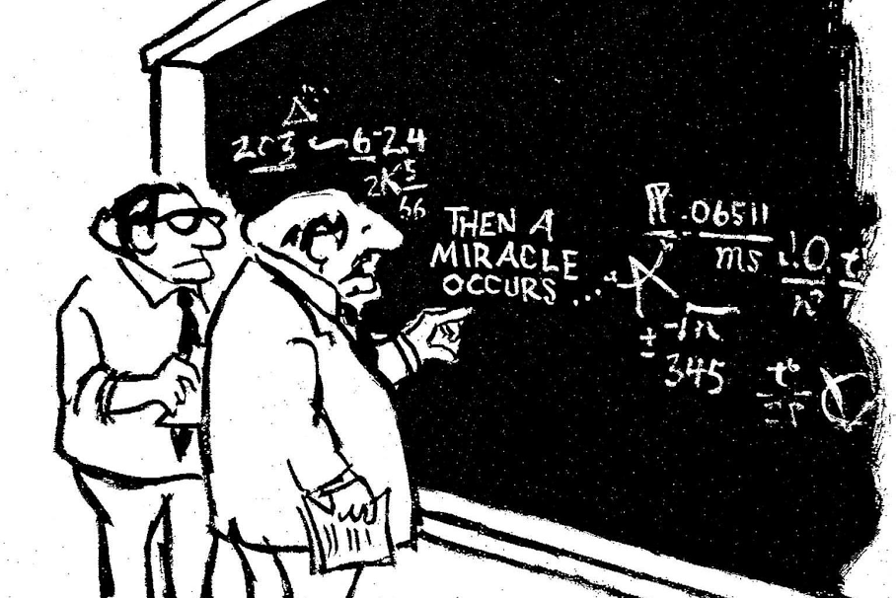

Slide 21
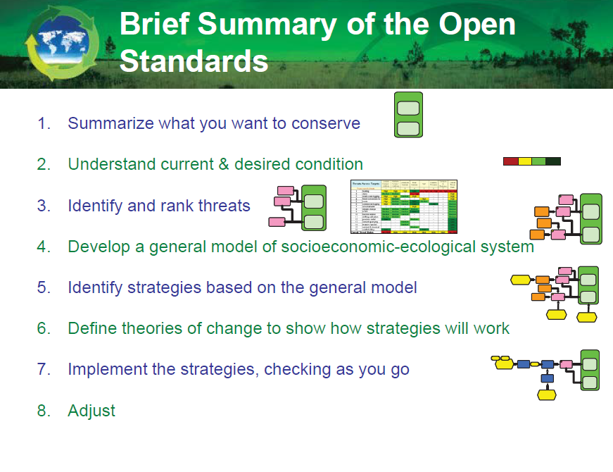
www.conservationmeasures.org

Slide 22
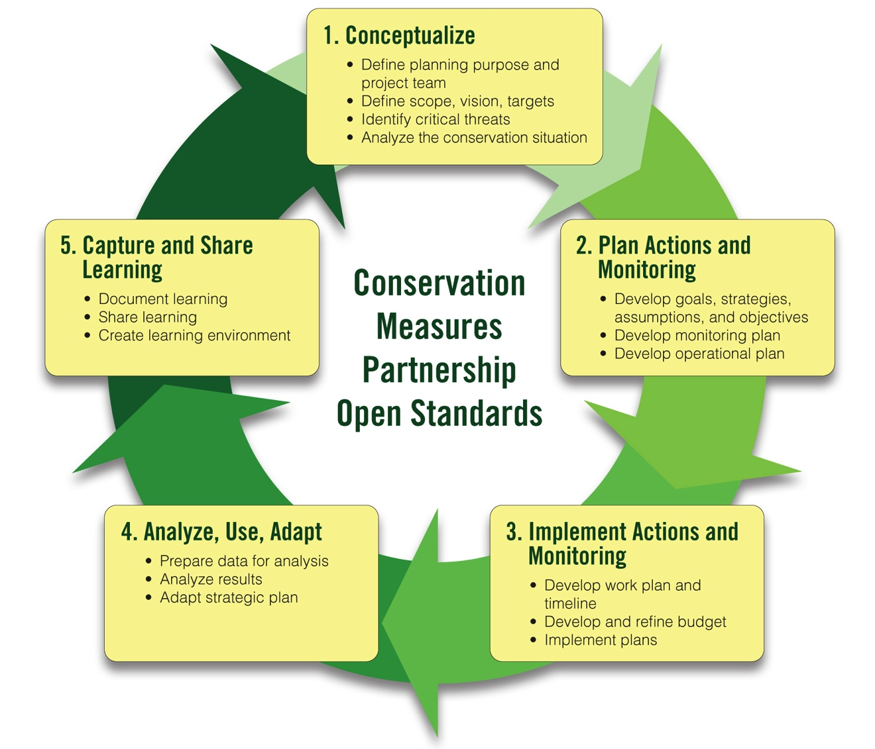
Open Standards for the Practice of Conservation: Key Initial Steps…
www.conservationmeasures.org

Slide 23
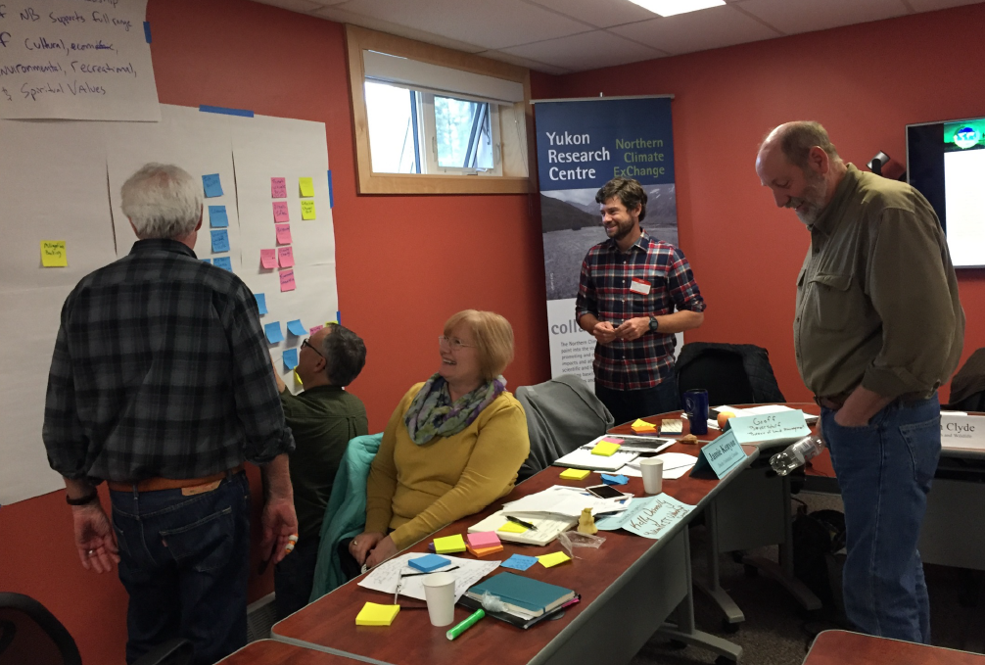
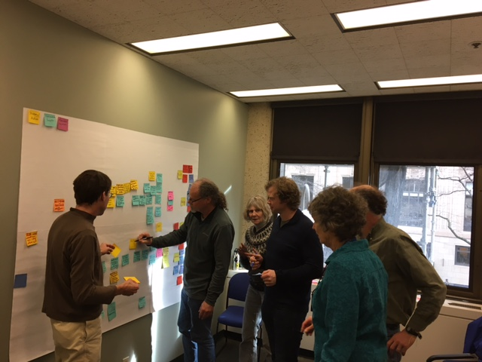
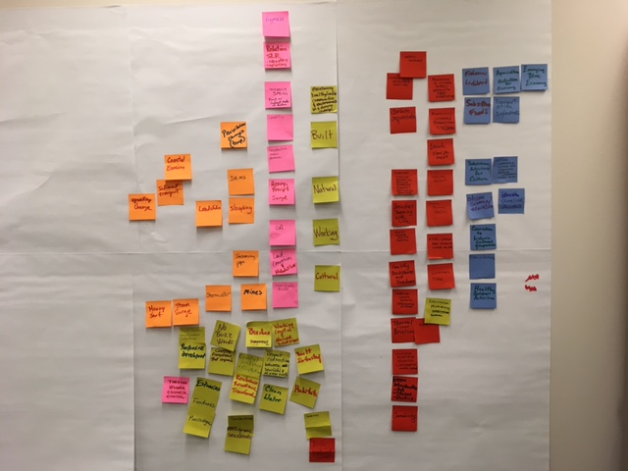
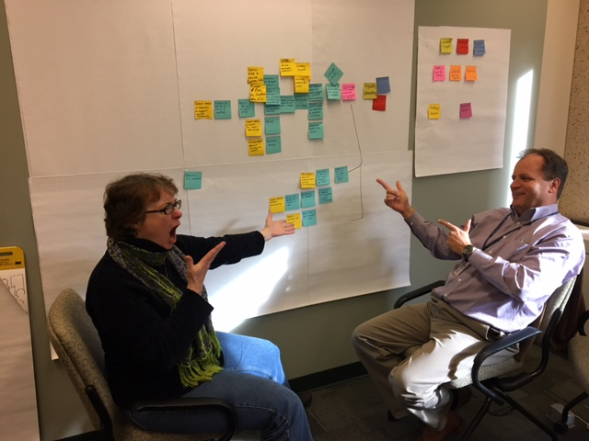

Slide 24
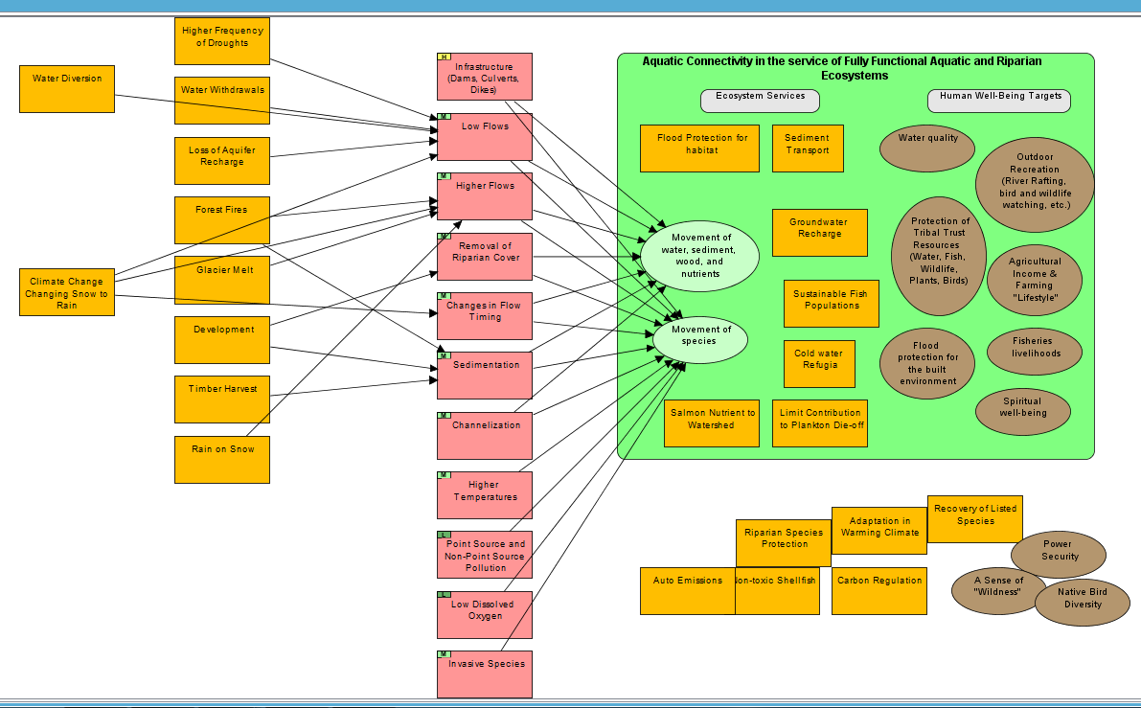
WORKING DRAFT Conceptual Model for Aquatic Connectivity
Contributing
Factors & Opportunities
Direct Threat (Change Agent)
Conservation Target

Slide 25
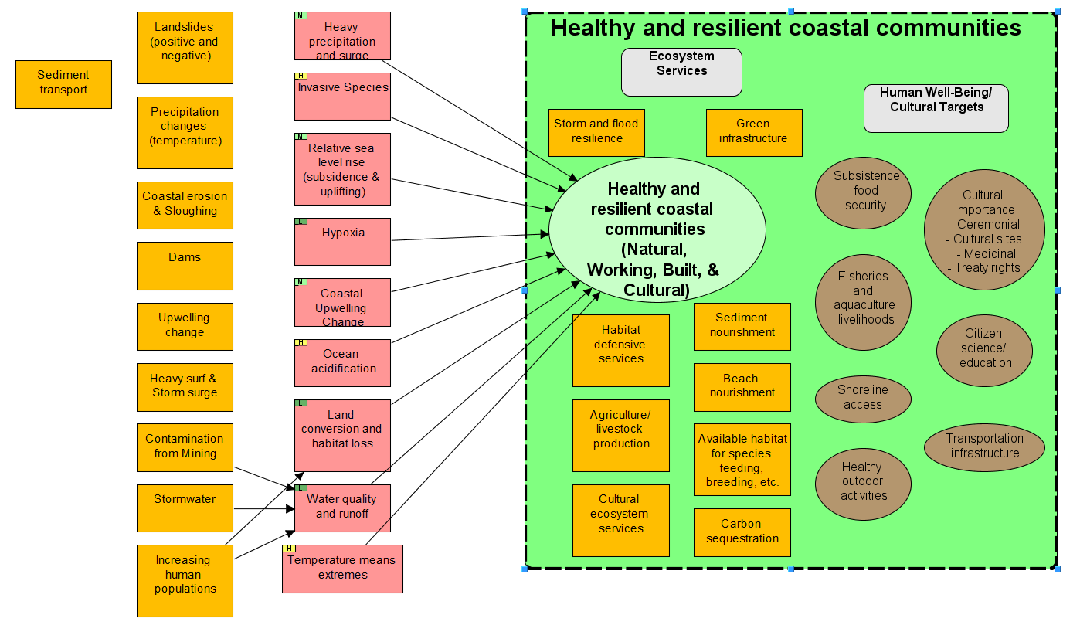
WORKING DRAFT Conceptual Model Coastal Communities
Contributing
Factors & Opportunities
Direct Threat (Change Agent)
Conservation Target
Contributing
Factor

Slide 26
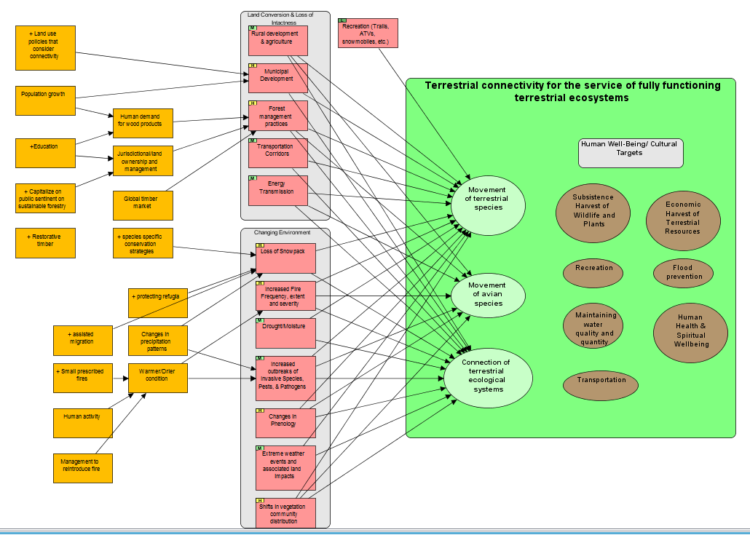
Working Draft – Conceptual Model
For Terrestrial Connectivity

Slide 27
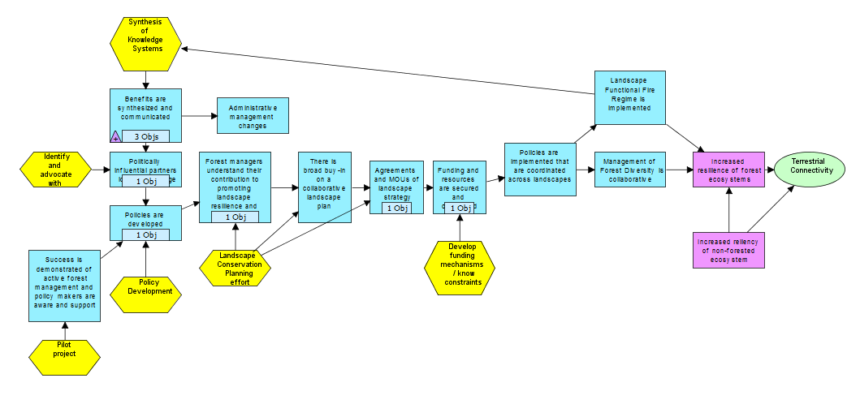
Results Chains - Important for S-TEK Strategy Work Plans
Strategy
Intermediate
Result
Threat
Reduction
Result
Conservation Target
Activity
Draft Theory of Change example created during Seattle S-TEK meeting:
Articulating a Path Towards Connectivity

Slide 28
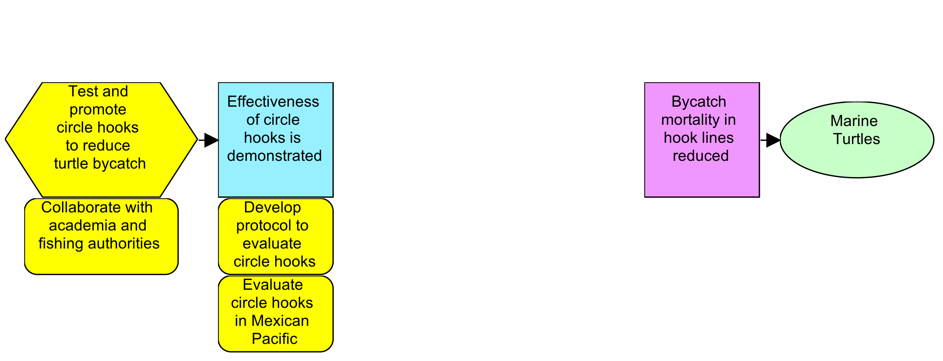
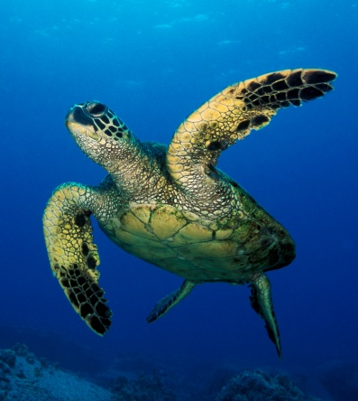
Example of a Real Theory of Change

Slide 29
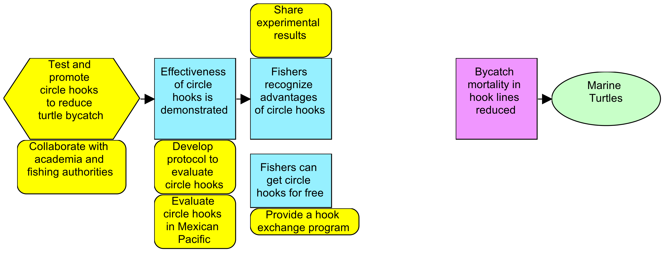
Example of a Real Theory of Change

Slide 30
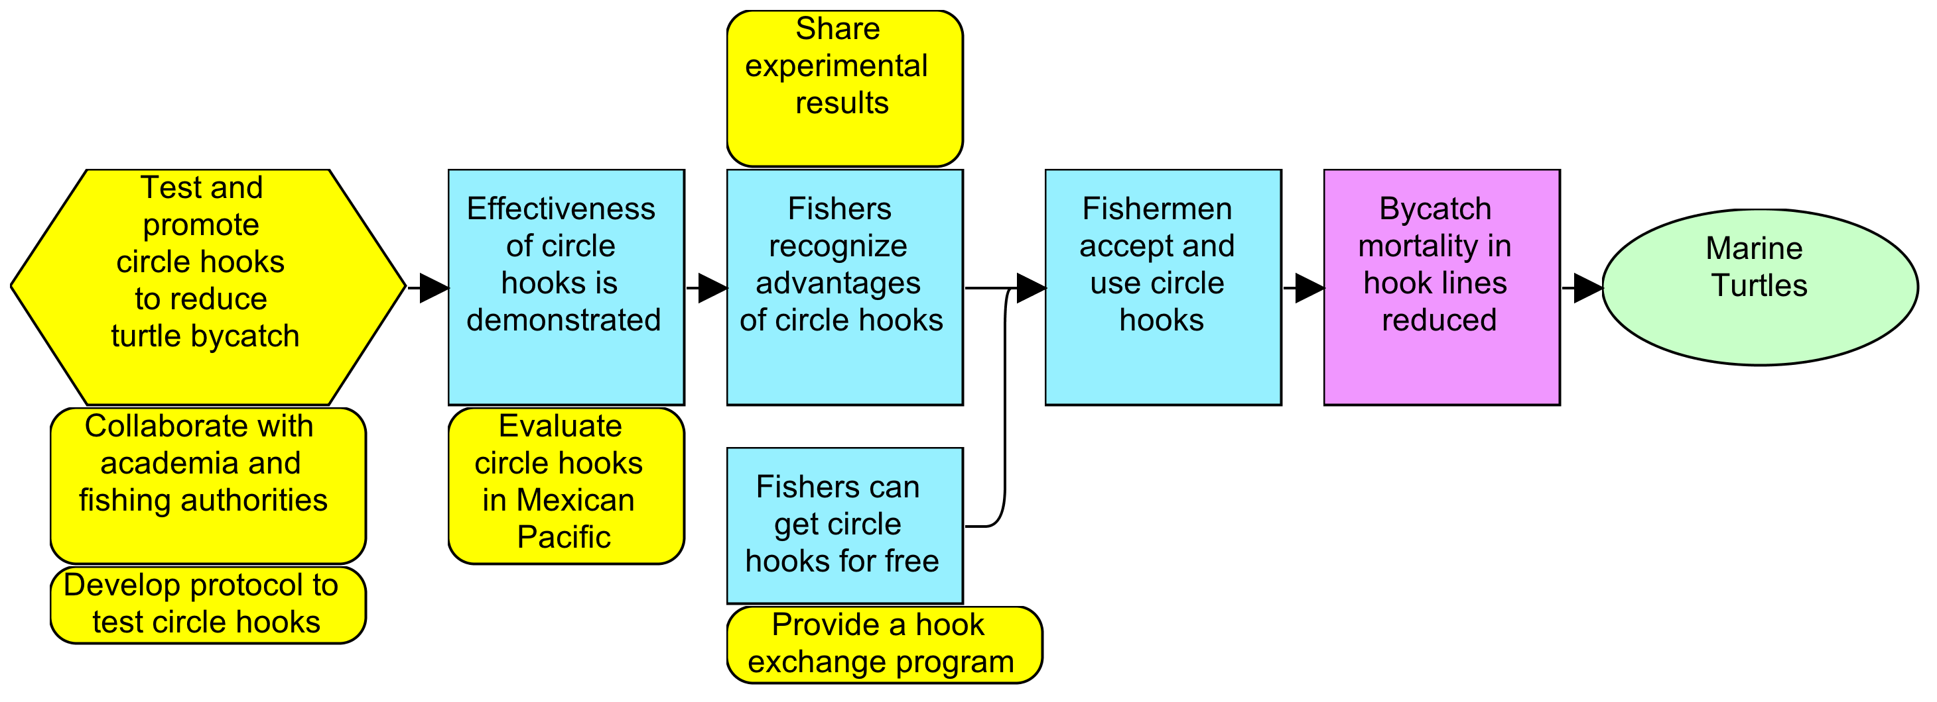
Example of a Real Theory of Change
Measurable Goal:
By 2025, there will be a 10% increase in the survival of leatherback and green turtles into the GoC compared to 2005 levels.
Indicator: Abundance Index
Method: Counting of nesting turtles
Date: Every three years, starting in 2007
Responsible Entity: Turtle camps personnel
Place: Baja California Sur and Michoacán turtle camps

Slide 31
Example of a Real Theory of Change
Measurable Objective:
By 2012, 90% of the Gulf’s artisanal longliner fleet will operate with circle hooks.
Indicator: Percentage of boats using circle hooks
Measurable Objective:
By 2009, we will have a proven method (circular hooks) to significantly reduce marine turtle bycatch from the artisanal longline fleets from 12 locations on the Mexican Pacific.
Indicator: Circular hooks bycatch rate for marine turtle
Measurable Objective:
By 2010, at least 220,000 circular hooks will have been exchanged for the same number of type “J” hooks in the artisanal longliner fleet in the GoC.
Indicator: Number of “J” hooks exchanged for circular hooks

Slide 32
Example of a Real Theory of Change
Activity Planning:
By July 2008, carry out 10 three-day fishing trials in three different locations using circular hooks. Publish full report by November 2008.
Activity Planning:
By January 2009, develop, staff, publicize and initiate major hooks exchange campaign initiative in three regions.

Slide 33
Number of NPLCC Funded Projects (2011 – 2016 ) Shown by Category:
($3.0M NPLCC and $630K National LCCs for projects with adjacent LCCs included)
(3 geographies with
Notes:
Important to look back on what we have done the past 6 years before we set priorities for the next 5 years.
The project numbers do not totally correspond with the $$ spent because the $$ are for the NPLCC projects funded by USFWS, BIA and USGS. The total project numbers include relevant projects funded by National LCC $$ (primarily in the second category – data discovery and management platforms ) that include the NPLCC and adjacent LCCs.
I combined our Priority Topics B and D form our current Science/TEK Strategy because of the overlap of effects of hydrologic regime shifts on rivers, streams, riparian areas and anadromous fish. This is where the greatest number of projects and funding have gone.

Slide 34
Theories of Change
FWS
NPLCC
Strategy
Strategy
Strategy
F.S.
Intermediate Outcome
Intermediate Outcome
Intermediate Outcome
Outcome: Connected Landscapes
Strategy
Strategy
TNC
WDFW
ODFW

Slide 35
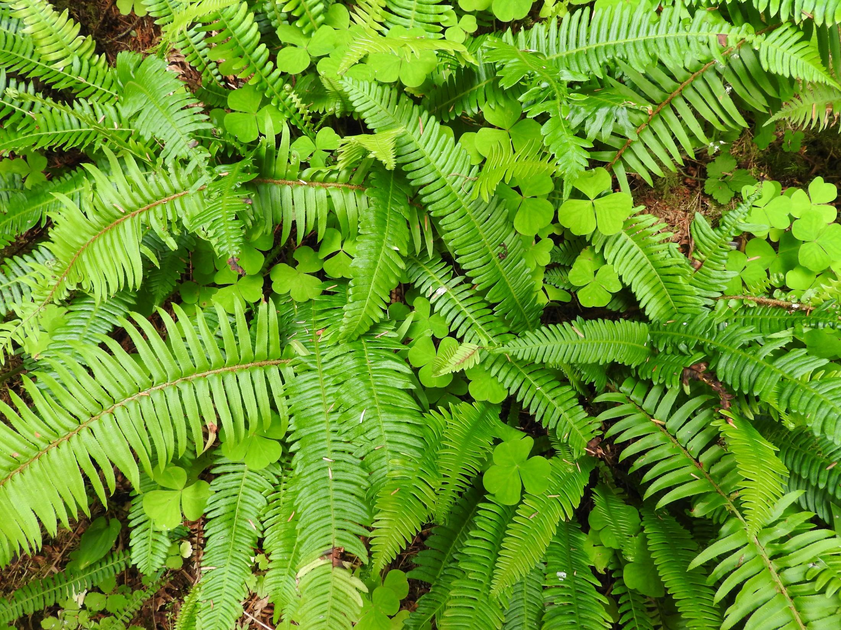
Break-out Groups
(2 in room & 1 on phone)
Review Conservation Targets
  Seem reasonable? Recommend Changes?
Review DRAFT List Direct Change Agents
  Any missing based on your work?
Review Contributing Factors
  Key ones missing affect Change agents?
  Mark Direct Change Agents you address management actions/decisions (dots/poll)
  Group Report Out

Slide 36
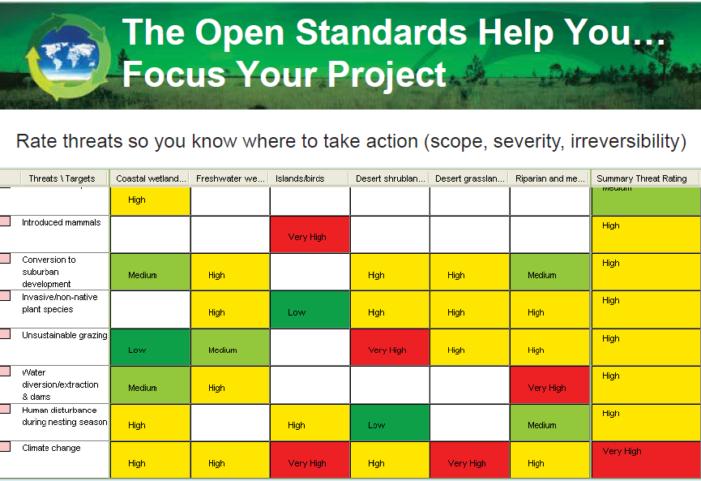

Slide 37
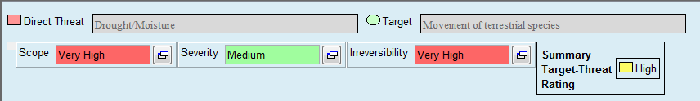
Summary Threat Rating
Evaluate 3 Factors:
Scope
Severity
Irreversibility
4 Scores:
Very High
High
Medium
Low

Slide 38
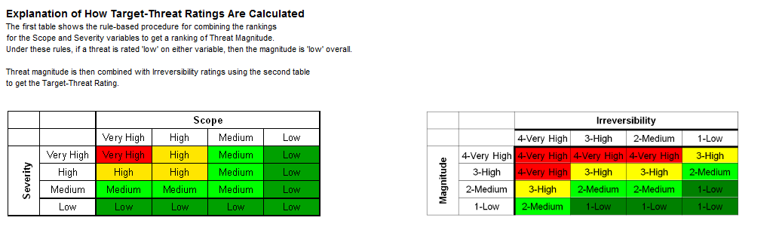
Explanation of How Target-Threat Ratings are Calculated
1. Threat Magnitude ranking
2. Target-Threat Rating

Slide 39
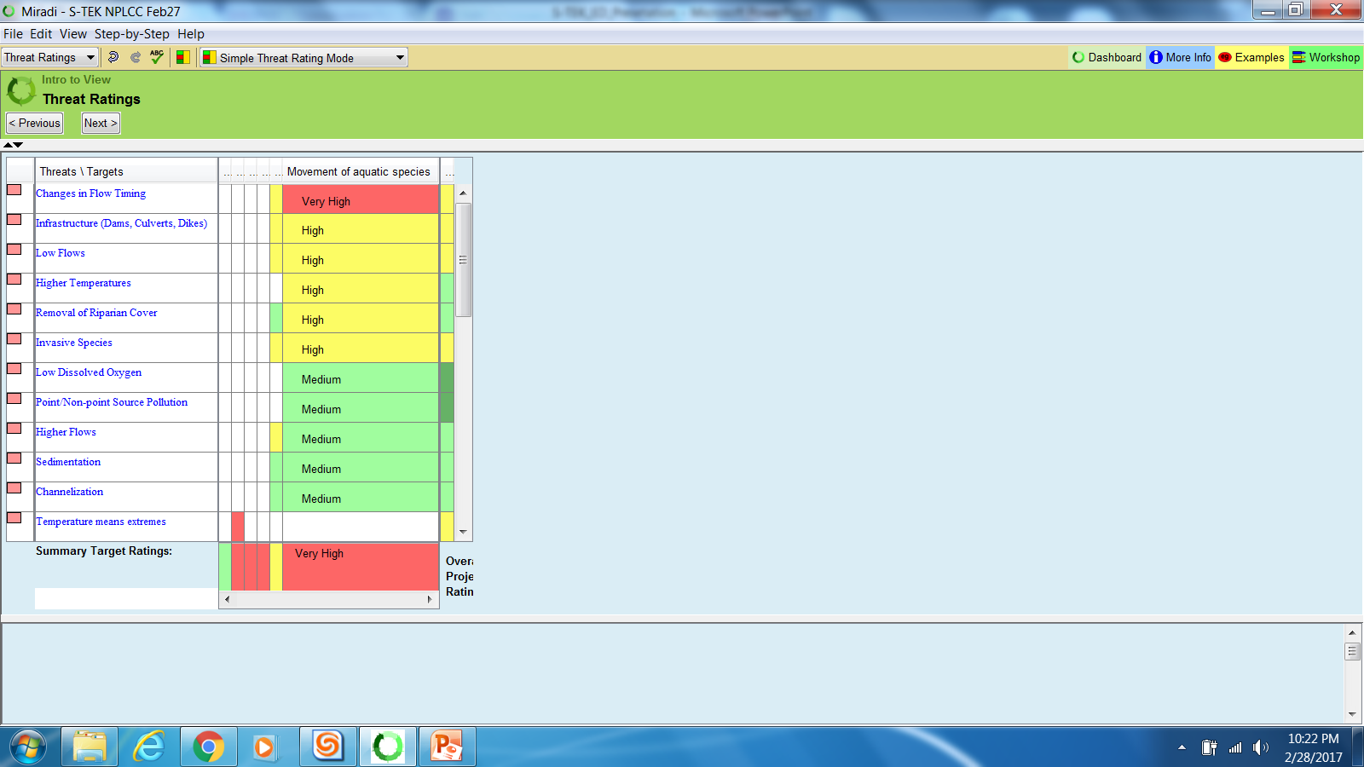
Threat Ratings for Aquatic Connectivity
Movement of Aquatic Species
WORKKING DRAFT

Slide 40
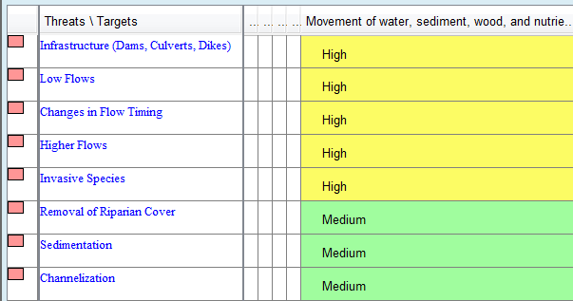
Threat Ratings for Aquatic Connectivity
Movement water, sediment, wood, and nutrients
WORKKING DRAFT

Slide 41
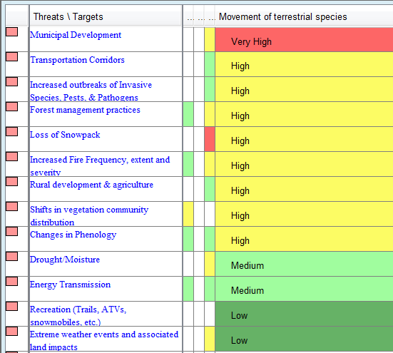
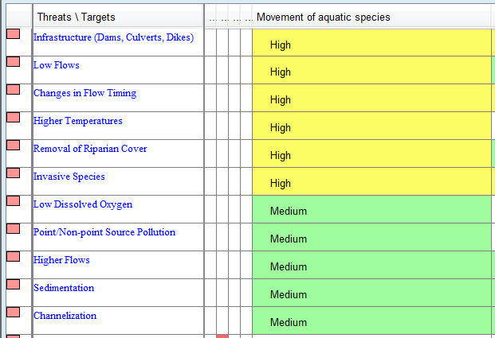
Threat Ratings for Terrestrial Connectivity
Movement of Terrestrial Species
WORKKING DRAFT

Slide 42
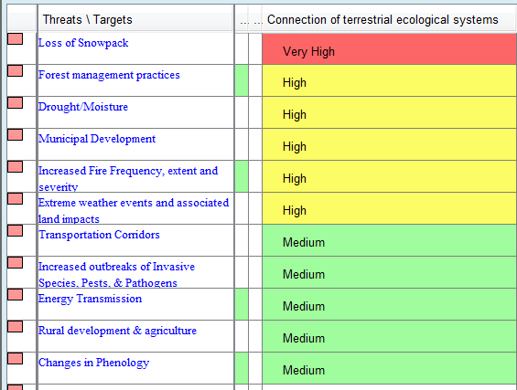
Threat Ratings for Terrestrial Connectivity
Connection of terrestrial ecological systems
WORKKING DRAFT

Slide 43
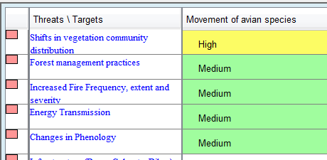
Threat Ratings for Terrestrial Connectivity
Movement of Avian Species
WORKKING DRAFT

Slide 44
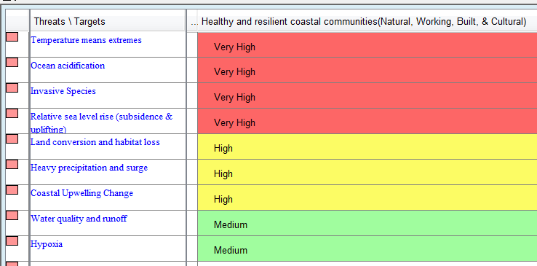
Threat Ratings for Coastal Communities
Natural, Working, Built, and Cultural
WORKKING DRAFT

Slide 45
Break-out Groups
(2 in room & 1 on phone)
Discuss Conservation Targets
  Recommend include 3 presented?
  Recommend different or additional
Review DRAFT Target-Threat Ratings
  Surprises?
Based on gut feeling – mark top 1 or 2 Direct Change Agents to continue to evaluate (not a vote – just feedback)

Slide 46
Proposed Framing Questions for the 2017-2021 S-TEK Strategy
What are the most immediate conservation needs across the NPLCC landscape?
How valuable is this information for managers and other decision-makers?
How critical is it for the NPLCC to focus on work of this type?
Is there relevant work of this type already being done by others?
What Role Should the NPLCC Play?

