Slide 1

Pacific Estuary Conservation Program
NPLCC
Tasha Sargent
Pacific Birds Habitat Joint Venture Coordinator (Canada)
March 1, 2017

Slide 2
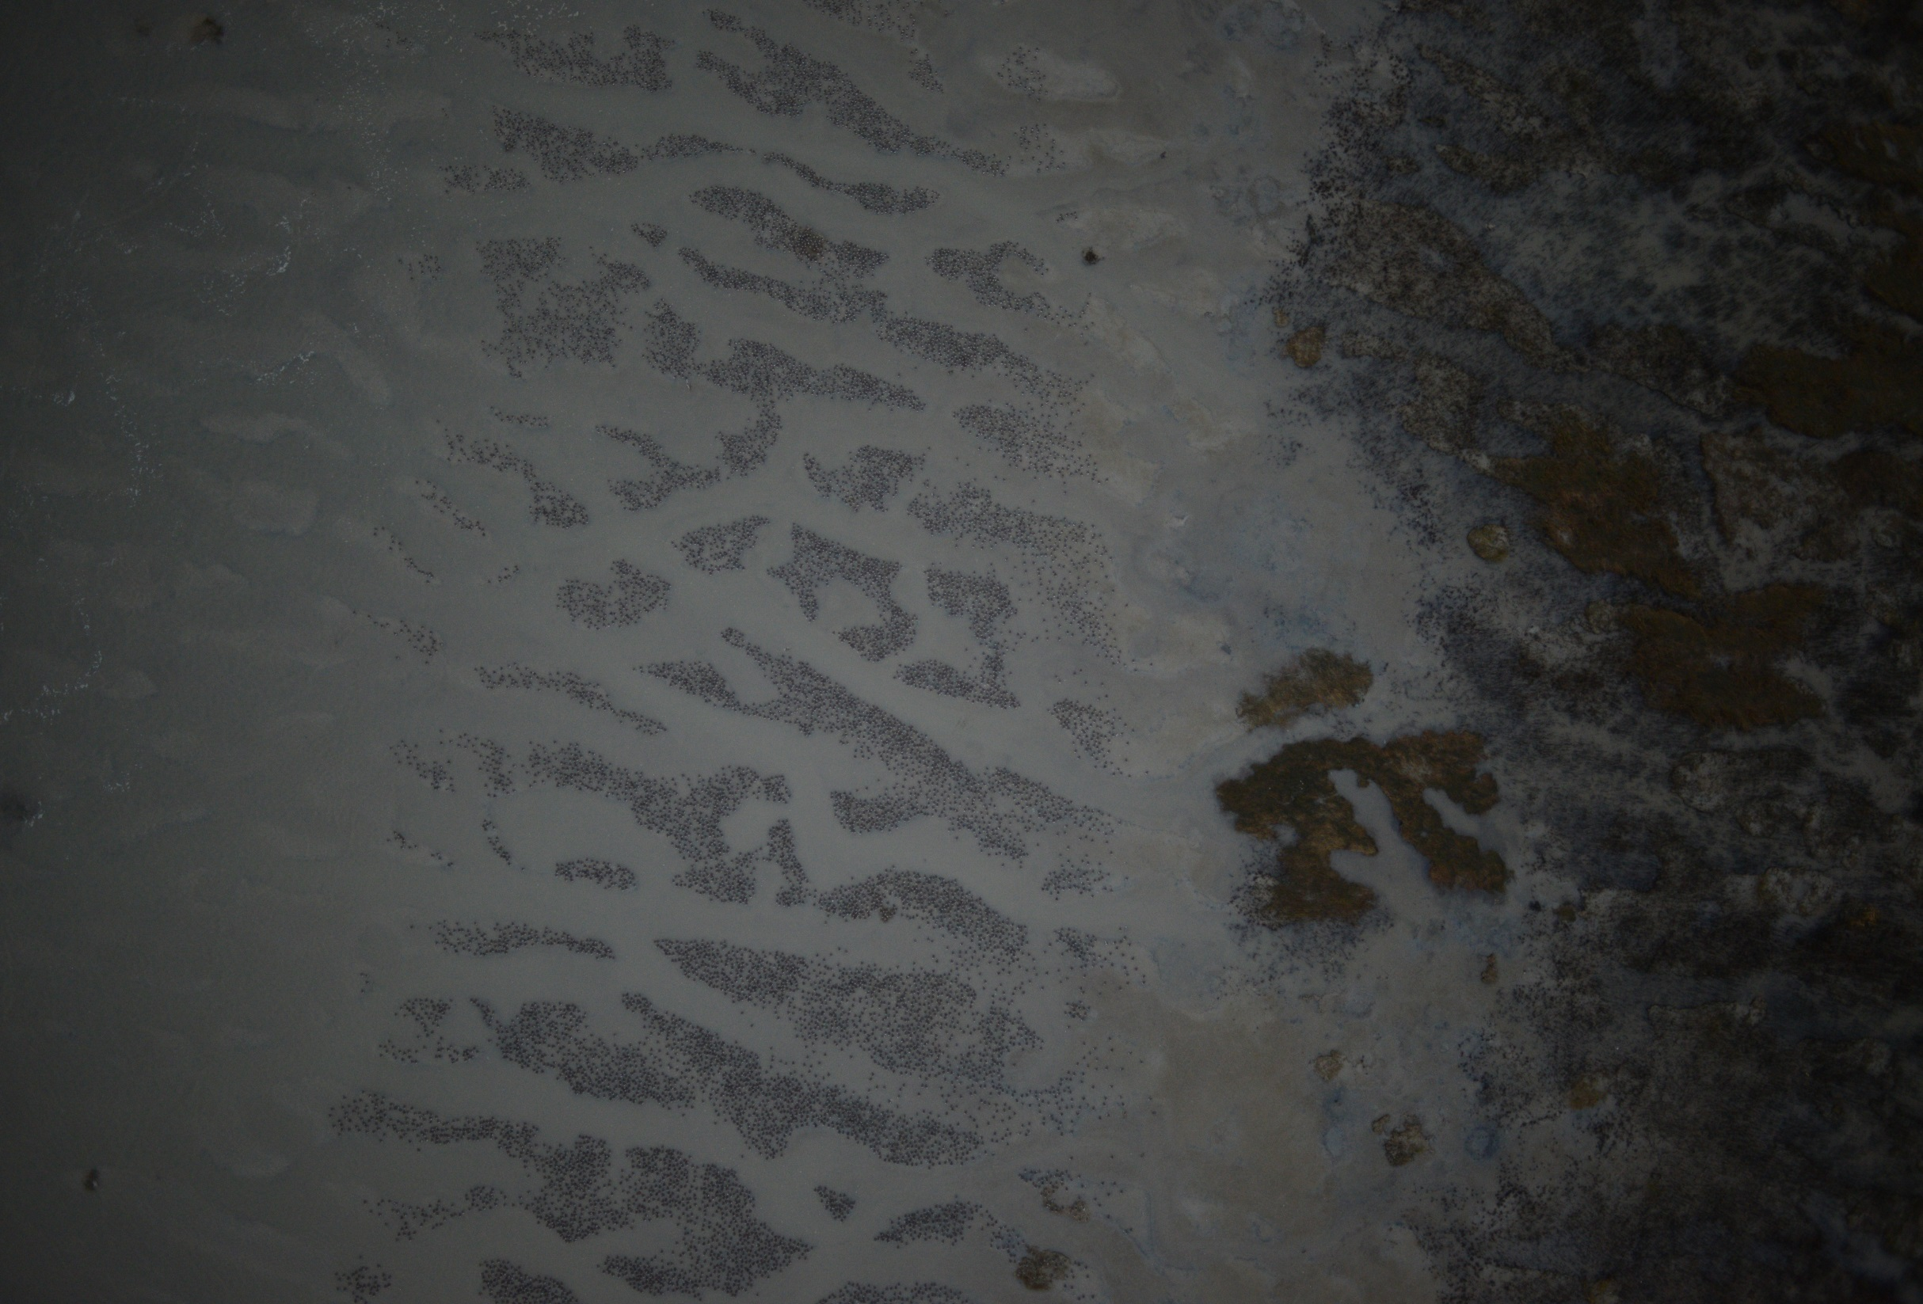

Slide 3
Contents
What is the Pacific Estuary Conservation Program (PECP)
Estuaries in BC
Ranking Methodology
Results
Intended Uses
Actual Uses
Threat Assessment
Update to Ranking
Expanding the Ranking Across the Pacific Coast

Slide 4
What is the PECP?
The Pacific Estuary Conservation Program was created in 1987 under the Pacific Coast Joint Venture (now Pacific Birds Habitat Joint Venture)
  JVs are coordinated through a contribution of ECCC staff time
Coalition of government and non-government agencies
Mechanism to pool both financial and technical resources amongst the partners
Responsible for the securement and enhancement of estuarine habitats of conservation importance in BC
PECP partners have successfully secured thousands of hectares of shoreline and intertidal habitats in many of BC's major estuaries
Winner of the International Ramsar Convention Award in 1999

Slide 5
Estuaries in BC
Estuaries make up <3% of BC’s coastline but are seasonally or annually important to a variety of species
As of 2007, 43% of BC’s estuaries are threatened by coastal development, modification, and pollution
Need for :
  an objective, landscape-level scientific assessment to ID important areas for sustaining waterbird populations, and
  timely/efficient allocation of resources to conserve priority sites

Slide 6
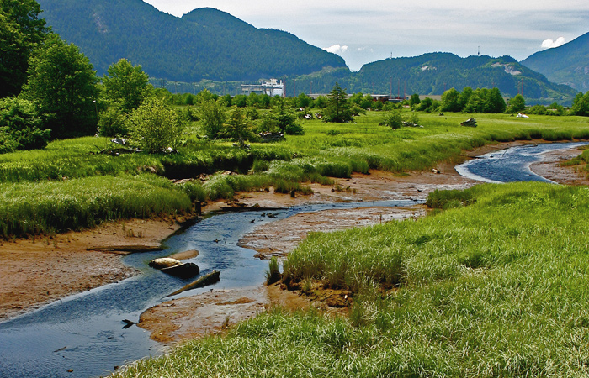

Slide 7
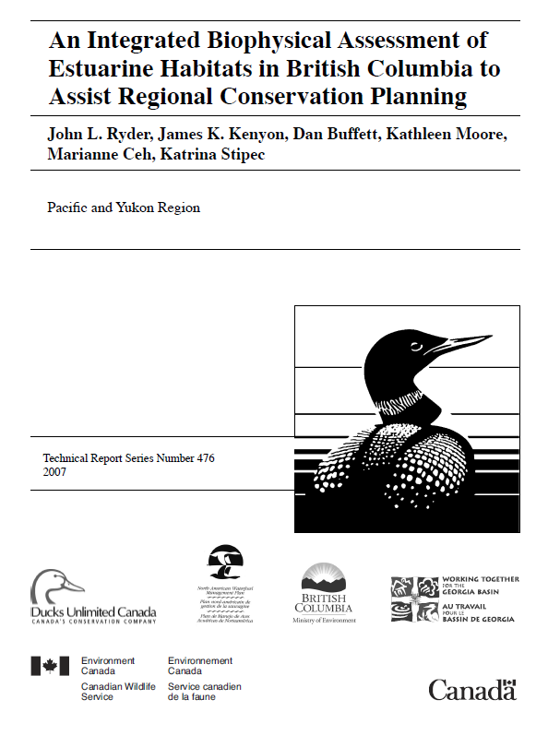
Estuaries in BC - Ranking
In 2007, PECP partners published a ranking of BC’s estuaries for waterbirds
Identified and mapped 442 estuaries
Ranked for biological importance to waterbirds using data and metrics of:
  Estuary size
  Habitat type and rarity
  Herring spawn occurrence
  Waterbird use
  Intertidal biodiversity

Slide 8
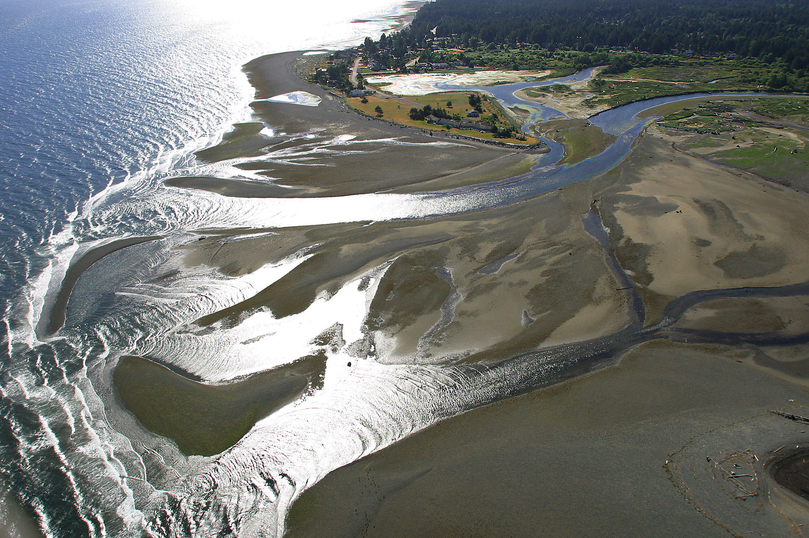
Notes:
Englishman River Estuary (Van Island, TNTBC)

Slide 9
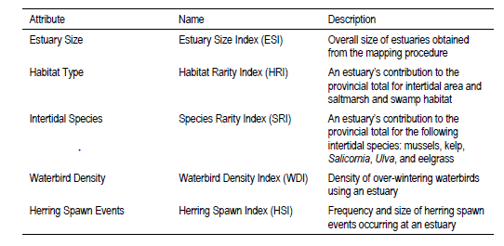
Methodology
Estuary boundaries were defined to include the intertidal (below coastline to lowest normal tide) and supratidal (above coastline) zones as well as habitat features connected to each river or stream above the coastline to an upstream distance of 500m

Slide 10
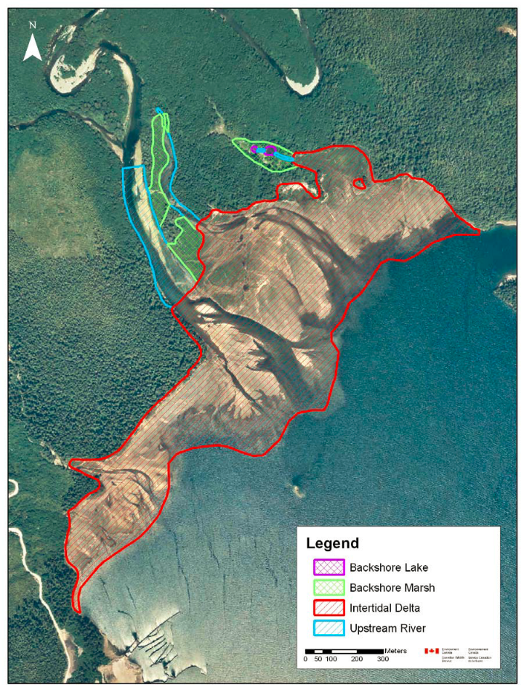
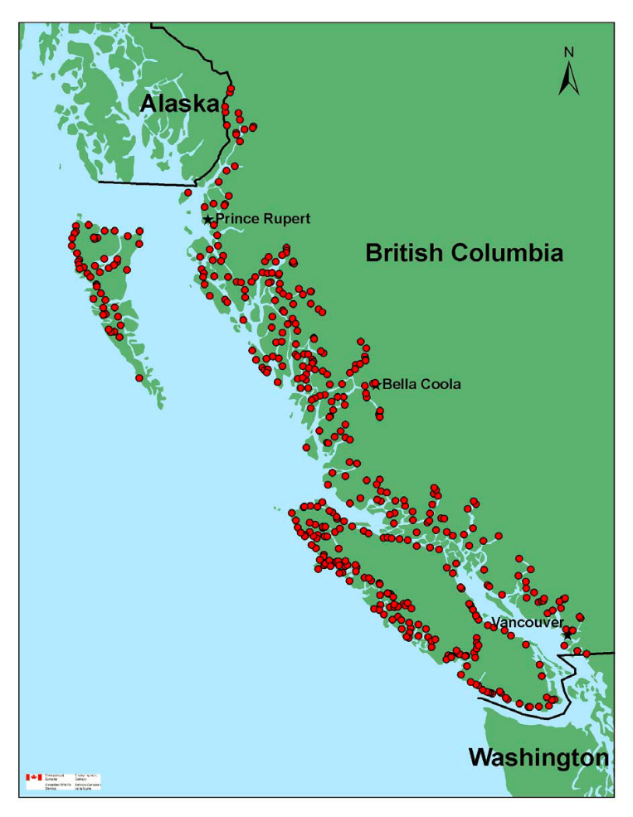
Results
Notes:
Example of different habitat types that make up an estuary – Toquart River estuary Barlkey Sound (west coast VI)
Map of 442 ranked estuaries in BC

Slide 11
Results
PECP Identified Estuaries cover 74,585 ha ranging in size from <1 ha to the 21,694 ha Fraser River estuary
Most estuaries in British Columbia are small (i.e. <10 ha) with four exceptionally large estuaries (i.e. >1,000 ha) located in the Lower Mainland and Coastal Gap ecoregions
The largest estuaries (>1,000 ha) account for >63% of all estuarine area
Although the Lower Mainland ecoregion contains only a small proportion of all estuaries it contains 39 of all estuarine area due to the presence of two of the largest estuaries: the Fraser River and the Nicomekl/Serpentine River complex.
Notes:
Coastal Gap: : Fraser River, Nicomekl/Serpentine River complex, Nass/Ksi’Higinx/Burton/Iknouk/Chambers/ Kincolith River complex, and Skeena/Ecstall/ McNeil River complex.

Slide 12
Results
5 Importance Classes
  IC 1: highest ranked, relative rankings
  of 80-100% of max. scoring estuary
  IC 2: relative rankings of 60-80%
  IC 3: relative rankings 40-60%
  IC 4: relative rankings 20-40%
  IC 5: relative rankings 0-20%
49 estuaries, not distributed equally throughout BC
Important note: Fraser River Estuary was not assigned to any importance class due to a lack of data consistent with the methodologies. Despite this, it is well documented and recognized that the Fraser River Delta remains one of the most important estuaries in BC for waterfowl. (Ramsar, IBA)
Notes:
Importance classes based upon biological attributes of the estuary
Existing datasets for the Fraser River estuary were unavailable or
inconsistent with the standardized requirements used in our analysis. Due to its immense size
and adjoining land uses (e.g. Vancouver International Airport); many waterbird surveys only
examined portions of the estuary, not the entire estuary. The shorezone dataset used for
calculating the Species Rarity Index had no data for the Fraser River estuary. This resulted in
an inability to develop scores for the relevant indices and the Fraser River would have been
ranked in Importance Class 2. However, the high biological value of the Fraser River estuary
has been substantiated. The significance of the Fraser River estuary, relative to other estuaries
in British Columbia and western North America, has been documented (FREMP 2003).

Slide 13
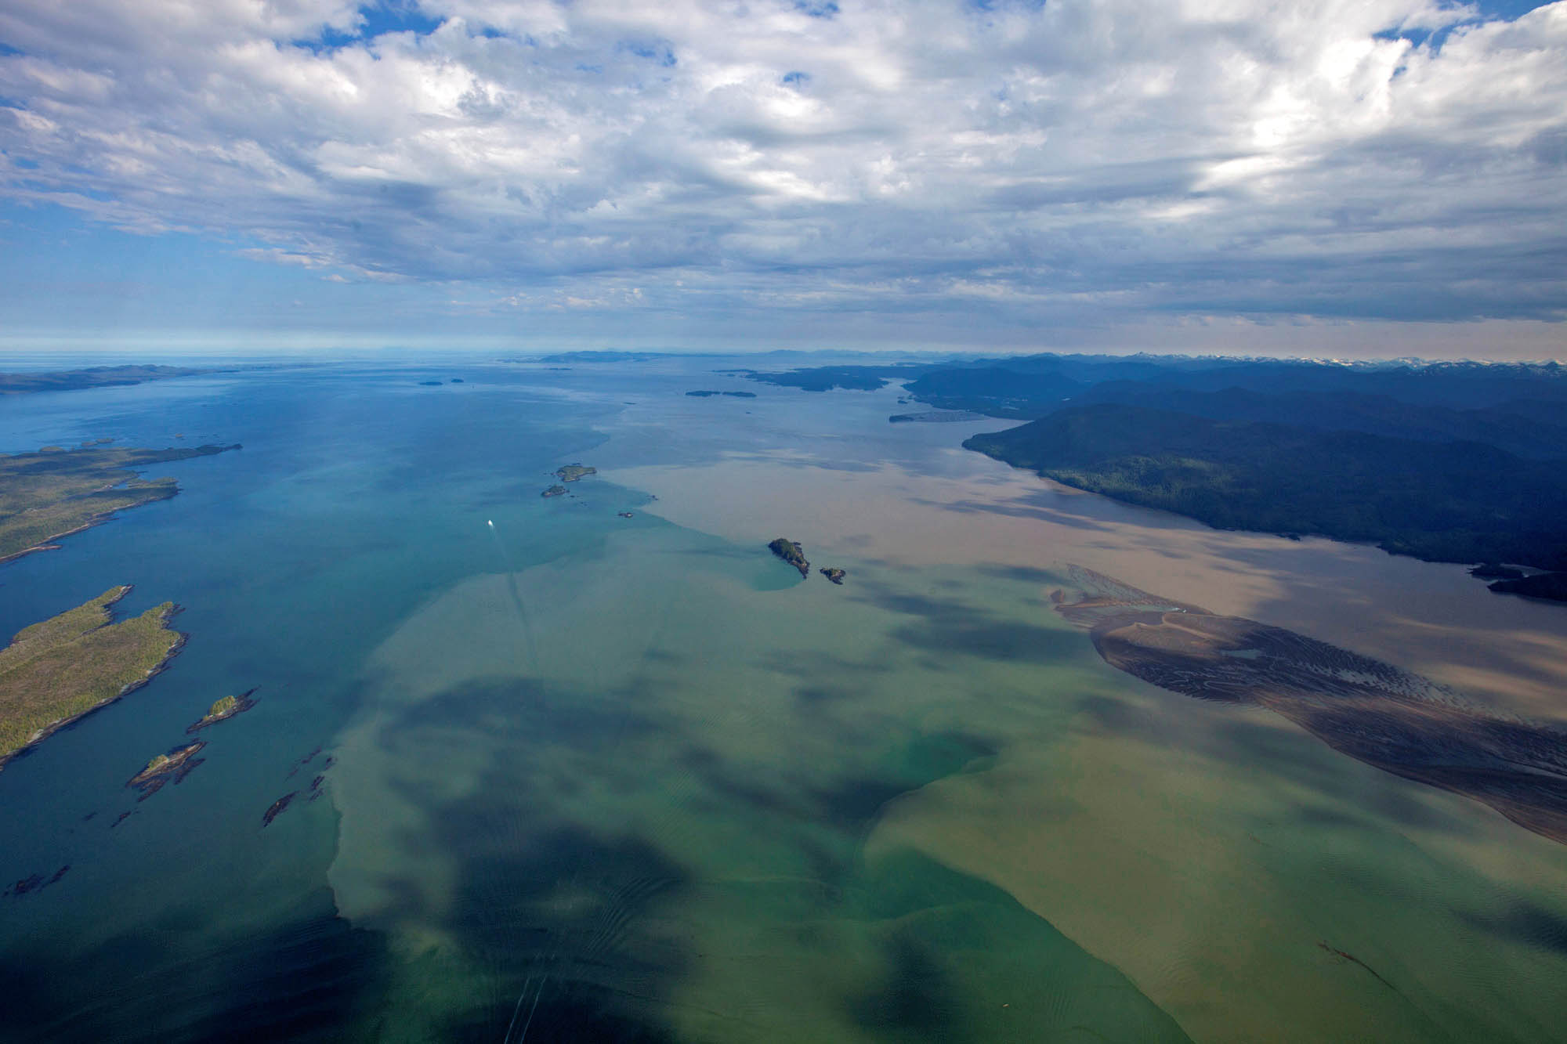
Notes:
Chatham Sound, Skeena Estuary, North Coast (oceanecology.ca)

Slide 14
Intended Uses for Conservation
Provides spatially explicit foundation to accumulate future information
Ranking process highlights data gaps
  E.g. >59% missing waterbird surveys, can be used to direct future survey efforts
Knowledge of current biological attributes/potential – can be combined with current conservation and socio-economic status to create a prioritization list for conservation initiatives.
Notes:
The baseline or benchmark status or condition of biological or
physical resources can be combined with waterbird species population information to develop
habitat-species associations at a landscape level for predictions of the spatial distribution of a
species.

Slide 15
Actual uses for conservation so far
Draft Federal Wetland Policy (for environmental assessments)
Prioritization of conservation actions (when funds were available)
National Wetland Conservation Fund priority areas
NAWMP continentally significant areas
Prioritization of actions in environmental emergencies (i.e. oil spills)
Threat assessment by C. Robb with Living Oceans

Slide 16
Threat Assessment
20 Threat Categories identified
  Terrestrial (8)
  Marine (8)
  Increased Atmospheric CO2 (4)
2 systems in Strait of Georgia had 15 threats, average 11 threats
Overall 7.9 threats per estuary-watershed
Systems with protected areas faced average 7.6 threats
Less area protected = more threats

Slide 17
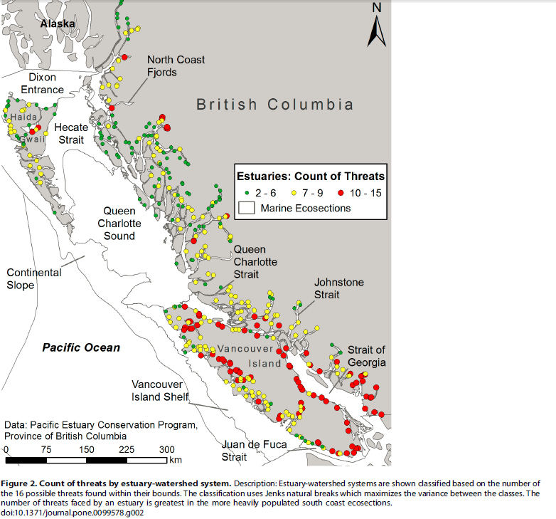
Threat Assessment
From:
Robb, C.K. 2014. Assessing the Impact of Human Activities on British Columbia’s Estuaries. Vol 9, Issue 6.
www.plosone.org

Slide 18
Update to PECP Estuary Ranking
Problem polygons identified in original mapping currently being reviewed
  i.e. missing estuaries, too large, too small, non-estuaries
Preliminary re-ranking conducted using new data such as new bird surveys and fisheries data

Slide 19
Expansion of Estuary Ranking
Methodology could be applied along the entire Pacific Coast
Pacific Birds Habitat Joint Venture is reviewing methodology and results for Coastal Wetland Conservation Priority development
Opportunity to review estuaries on the entire Pacific Coast in terms of threats given Carrie Robb used same method in her thesis as was used in California (adapted to data and issues appropriate to BC)

Slide 20
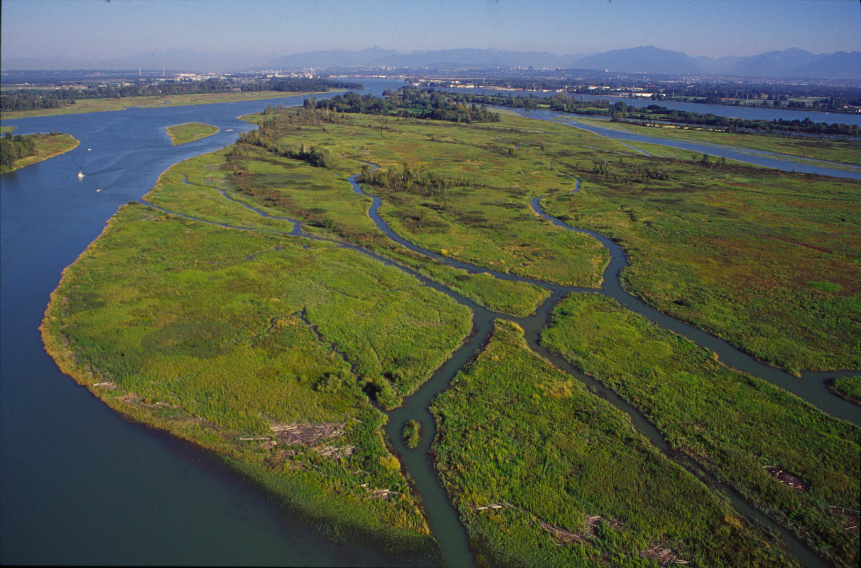
Thanks!
tasha.sargent@canada.ca
Notes:
South Arm Marsh, TNTBC

