Slide 1
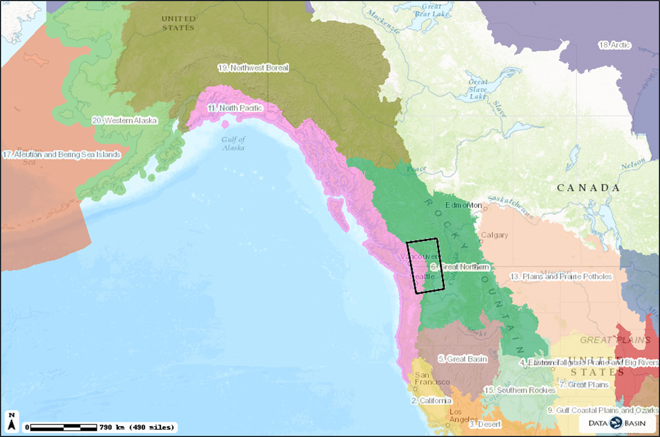
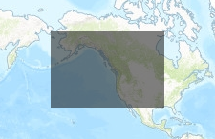

Legend
Cascadia Boundary
Document generated by Jen Watkins on Oct. 12, 2016
Notes:
This slide simply orients us to the general area of the Cascadia Partner Forum, which we received some feedback on slight editions to the boundary at our last WildLinks to consider expanding.

Slide 2

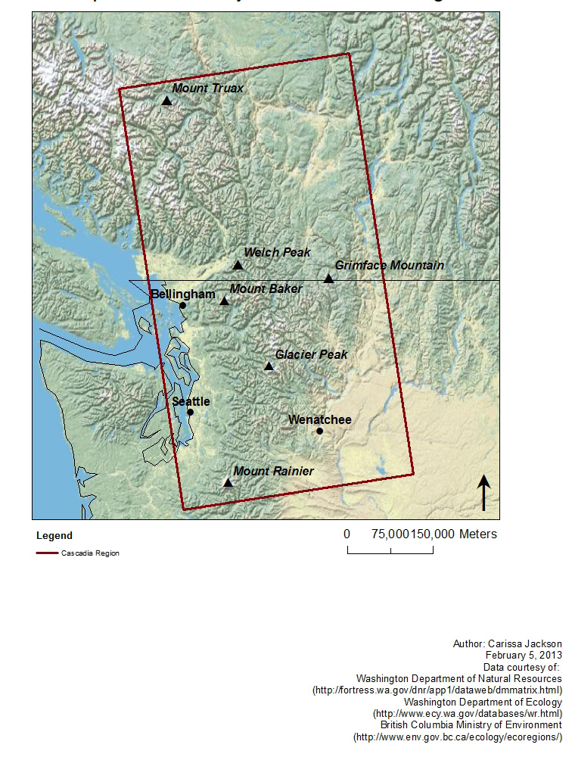
Formed in 2012
Fosters a network of natural resource practitioners
Straddles and works with NPLCC and GNLCC

Slide 3
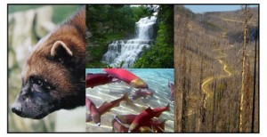
Cascadia Partner Forum Priority Issues
Ecological connectivity – terrestrial and aquatic
Water
Access Management
Specific Conservation Targets prioritized for coordination and planning: Bull trout, Canada lynx, Grizzly bear, Salmon (including early focus on Sockeye Salmon), and Wolverine.
Highlighted issues are those we asked NPLCC to prioritize in revised strategic plan
Notes:
At our inception we knew that we needed to focus on a finite set of priorities to initiate our collaboration on something as large as “climate adaptation”, so we began establishing a suite of “priority topics” that have grown over the years. These meet a criteria of being timely, transboundary, and climate sensitive.

Slide 4
Cascadia Partner Forum Priority Issues: 2017
Launch of 2017 webinar series on our priority issues to better share information with our full network.
  Grizzly bears
  Transboundary connectivity in Okanagan-Kettle subregion
Continue conservation planning and discussions on all conservation targets, updating existing reports, sharing timely information with our network, and filling science gaps where possible.
  Transboundary connectivity in North Cascades-Coast subregion
  Complete eDNA project on bull trout and other species
  Information sharing on wolverine monitoring
Notes:
A few examples of the work that we’ll be taking on during the coming year on our priority issues include.
March 3rd, 10:30am-Noon: Grizzly Bears featuring Bill Gaines (WSCI), Jack Oelfke (NPS), and Tony Hamilton (MOE)
** Specially timed to occur during the open comment period for the USFWS and NPS grizzly recovery EIS process underway.
April 5th, 10:30-Noon: Okanangan-Kettle Subregion Connectivity Analyses & Practitioner Workshops featuring the Transboundary Connectivity Working Group
The Transboundary Connectivity Working Group is initiating discussions for a North-Cascades Coast Ecological Connectivity Analysis and Conservation Planning effort to fill an existing science gap;
Completing our pilot e-DNA effort on bull trout and other identified priority riparian species in the Skagit and Bridge-Seton systems to inform current partner monitoring, and discussions Cascadia-wide on how this technology can help in climate adaptation;
Facilitating information sharing on range-wide wolverine monitoring and surveys between professional, student, and citizen science efforts throughout Cascadia.

Slide 5
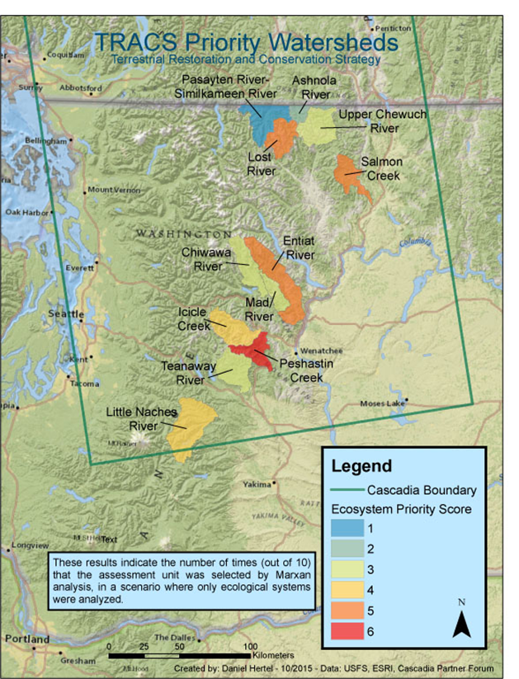
Cascadia Spatial Priorities
Coordinate with our network on spatial priorities.
Scientific analyses inform our understanding of priority landscapes
Watersheds prioritized by US Forest Service through their TRACS analysis
Notes:
In addition to priority issues, we did take on spatial priorities last year.
TRACS = Terrestrial Restoration and Conservation Strategy

Slide 6
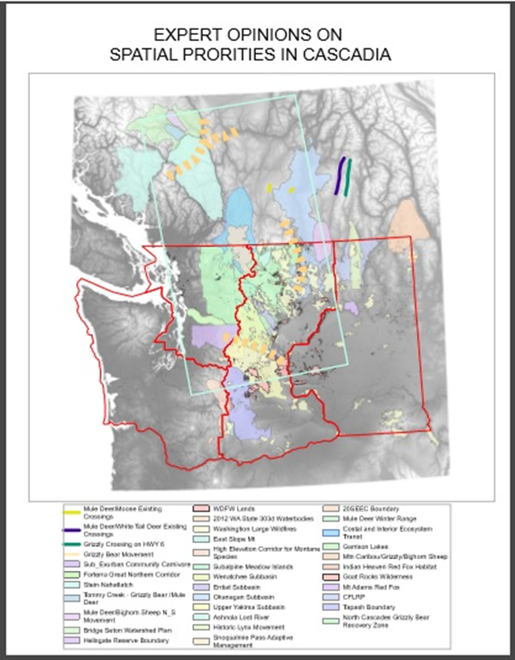
Cascadia Spatial Priorities: 2016 Work Focus
Identify and inventory existing spatial priority landscapes
Review and synthesize existing relevant climate science analyses within or overlapping Cascadia to inform a process for identifying spatial priorities for climate adaptation.
Notes:
The work that we undertook included these specific tasks

Slide 7
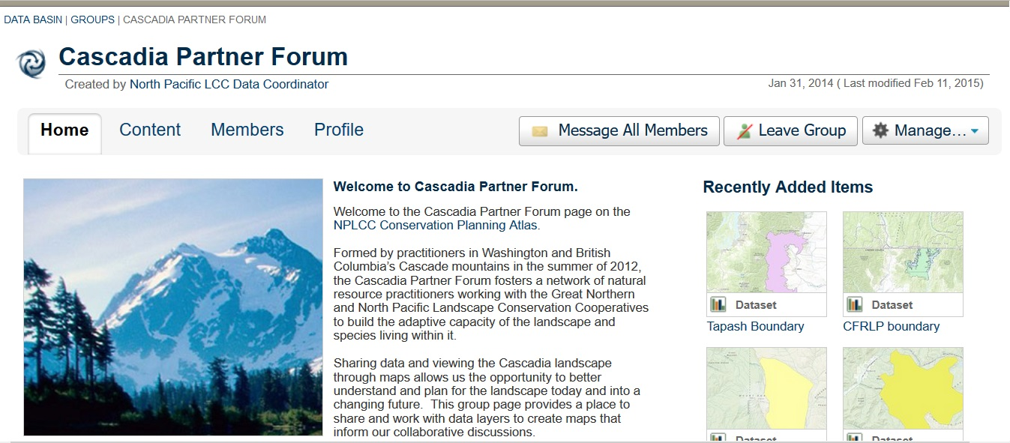
Notes:
We catalogued all of the data that we found on Databasin to create a living inventory

Slide 8
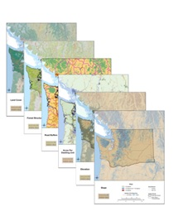
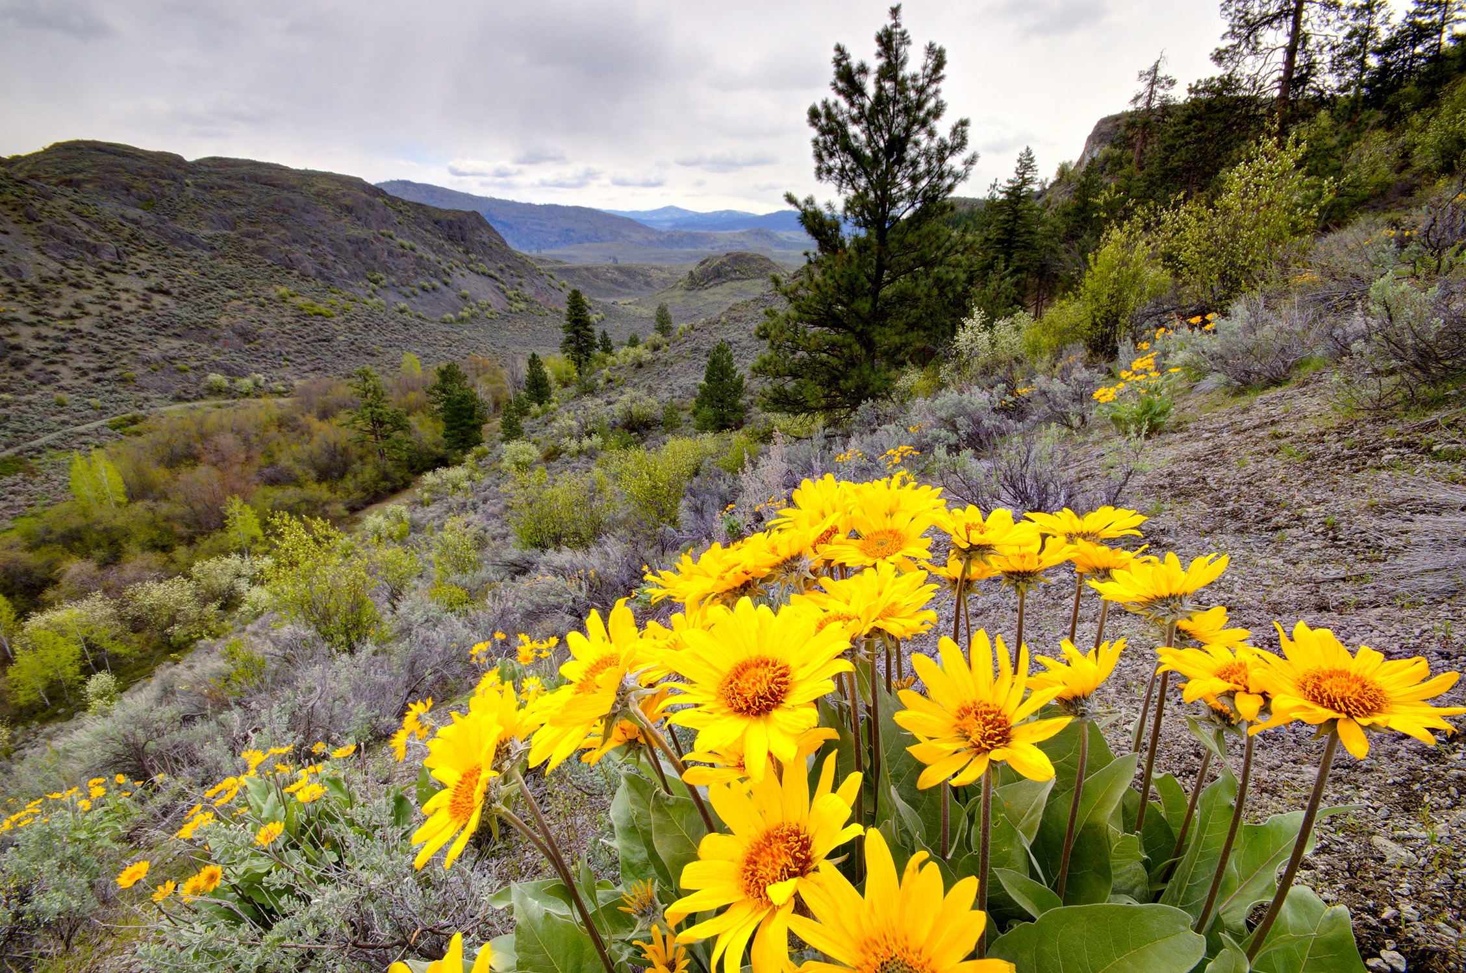
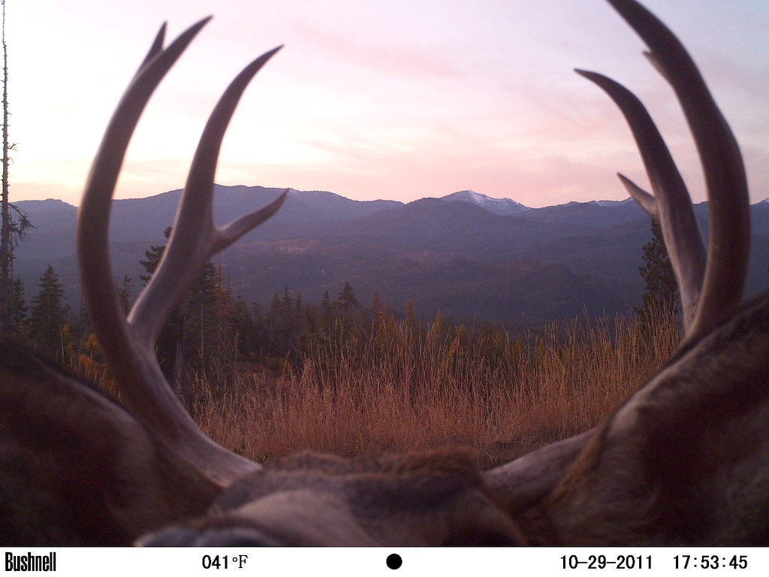
Cascadia Spatial Priorities: 2017 Work Focus
Creating a team and methodology to begin development of a living Cascadia Climate Adaptation Blueprint
Notes:
The work that we undertook included these specific tasks
The scale and pace of climate change will require a historic effort by public and private partners to identify and implement actions that will help human and natural communities adapt. Given limited conservation resources, the identification of shared spatial priority areas for directing adaptation efforts will be critical to ensuring a sustainable and biodiverse Cascadia into the future.
We are not starting from scratch, we have a wealth of existing data and planning efforts completed or underway throughout Cascadia. We need to bring them together at a landscape scale.

Slide 9

Leadership Team
Operations including communications (WildLinks, website, enewsletter)
Priority Landscapes
Priority Issues
Subgroups and networks for each priority topic already exist or are created to address coordination need.
Ecological connectivity:
Washington Wildlife Habitat Connectivity Working Group
Transboundary Connectivity Working Group
Grizzly bear:
North Cascades IGBC
Facilitated meetings to integrate First Nations, tribes, and NGO’s into discussion and forum planning.
Salmon:
Ongoing large identified network of recovery boards, watershed groups, and transboundary bodies.
Facilitate coordination and highlight existing priorities.
Canada Lynx:
Transboundary Lynx Working Group
** Established at 2016 WildLinks
Notes:
Here’s a view of how we are structured to accomplish work

Slide 10

www.cascadiapartnerforum.org
Notes:
We utilize a public website and listserv to communicate with our full network and track our workload as it is underway

