Slide 1
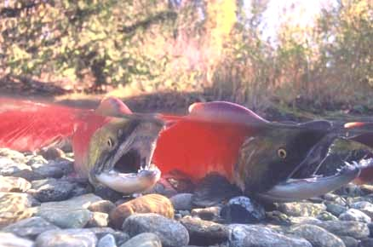
Managing Wild Salmon Biodiversity (DFO 2005) Given the Challenge of Climate Change in Canada’s Pacific Region
Dr. Kim Hyatt, NPLCC Meeting, Vancouver, March, 2017

Slide 2
Sustainable Management of Wild Salmon CUs (i.e. ESU’s) in Canada’s Pacific Region (and the NPLCC)
Intent: provide a thumbnail sketch of wild salmon diversity in Canada’s Pacific region .
Identify challenge of managing them as a high value but complex entity.
Use examples from freshwater and marine ecosystems to highlight the challenges climate change poses for sustainable management of this species complex in our region.
K. Hyatt, Salmon & Environment, Fraser Forum, Jan 2017.

Slide 3
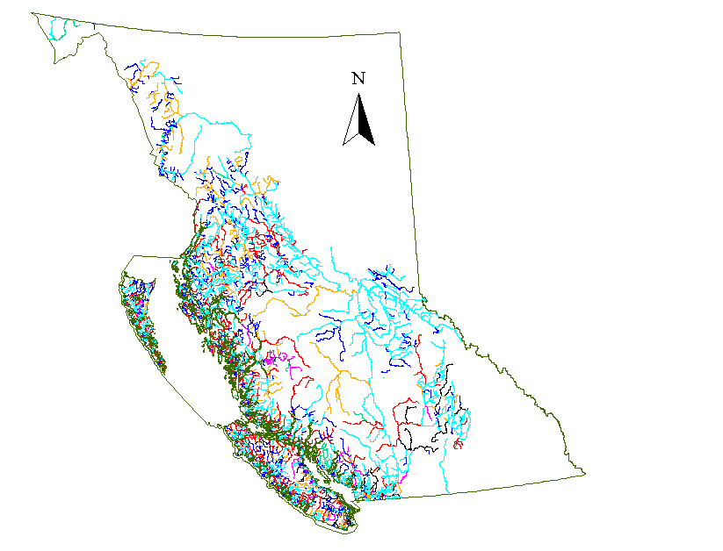
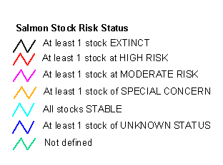

Status of Salmon “Stocks” on Canada’s West Coast (Slaney, Hyatt, Northcote and Fielden,1996).
Total Stocks | Species | % for Region | % “Healthy” | % Med Risk | % High Risk | % Extinct
866 | Chinook | 9 | 82.5 | 1.5 | 11.8 | 4.3
1625 | Chum | 17 | 84.7 | 1.1 | 12.4 | 1.9
2594 | Coho | 27 | 79.4 | 1.7 | 16.6 | 2.2
2169 | Pink | 23 | 88.1 | 1.4 | 9.3 | 1.2
917 | Sockeye | 9.5 | 84.8 | 0.4 | 11.2 | 3.7
867 | Steelhead | 9 | 91.3 | 3.2 | 2.6 | 2.9
612 | Cutthroat | 6.3 | 60.0 | 5.6 | 17.8 | 16.7
9650 | % of all | 100 | 84.2 | 1.5 | 11.9 | 2.5
Queen Charlotte’s
Vancouver Island
More than 9650 “stocks” of 7 species of salmon account for annual returns of between 5 to 30 million spawners that occupy more than 2500 B.C. lakes, streams and rivers

Slide 4
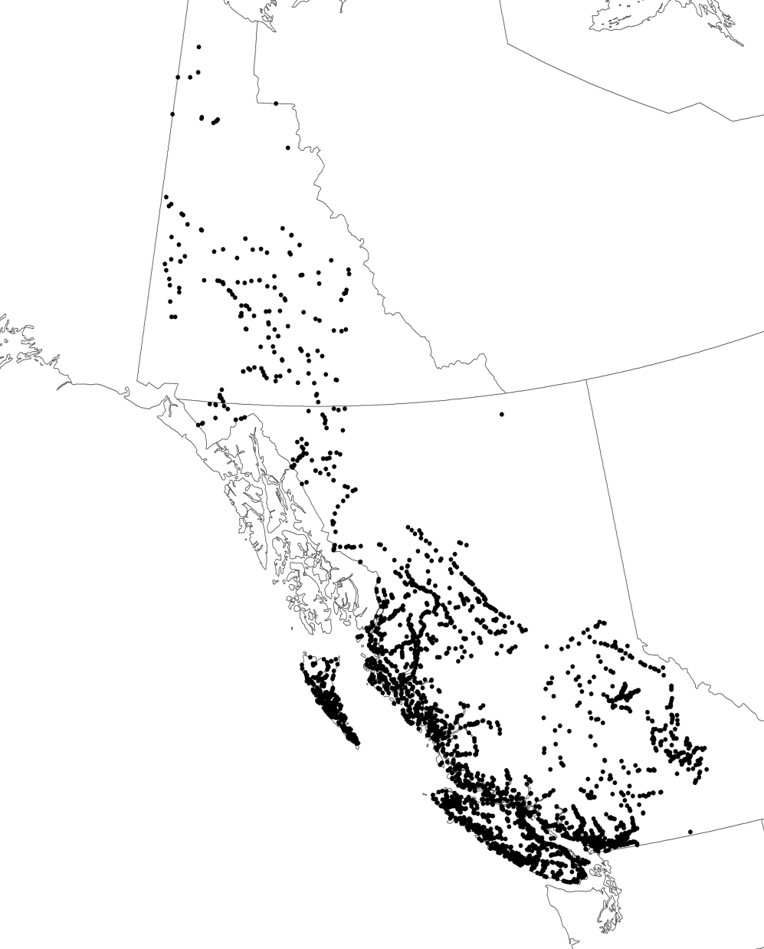
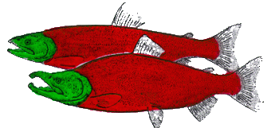
Escapement Monitoring Sites
Under Fisheries and Oceans Canada’s 2005 Wild Salmon Policy DFO is charged with sustainable management of 464+ CUs (equivalent of ESUs, Holtby & Cirunna 2008) made up of more than 9,000 local spawning populations (Slaney et al 1996) of wild salmon distributed in more than 3000 stream and river systems in BC and the Yukon (overlaps largely with the NPLCC !)
Yukon.
B. C.
    Approx. 3460 river systems with documented salmon presence in Pacific/Yukon Region
    There are many more- these are only those in DFOs nuSEDS database.
Notes:
4

Slide 5
Given their life history variations and spatial distribution, developing effective EBM of wild salmon poses a major challenge?
Headwaters
Adult
Migration
Juvenile
Migration
Salmon CUs and the ecosystems
they occupy are complex.
WSP-EBM involves moving from status classifications (e.g. threatened, degraded, healthy & productive) to diagnosis (cause and effect explanations, prediction) & then “treatments” (maintain, restore, enhance) that deal with multi-scalar “pieces & processes” that may drive outcomes in each salmon life-stage & habitat (i.e. the operational “ecosystem units” or EUs of WSP-S3).
Given their cultural, economic and social value salmon have a long history of study as an indicator-rich, complex “system” that is the focus of the WSP.
Spawning
and
Rearing
Geographic Range
Ocean
Rearing
Ocean
Yr-0 Yr-2 Yrs 2-6 Yrs 3-6
Time
(events lasting hours to several years)

Slide 6
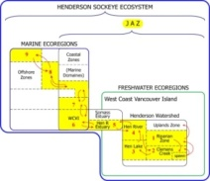
CU-EU status & trends are driven by combinations of natural and human induced disturbance events & regimes (NIDER & HIDER) acting on one or more life history stages anywhere in the JAZ.
NIDER
floods
drought
predators, pathogens
El Nino – La Nina
PDO phase
HIDER
harvest
enhancement
aquaculture
habitat
JAZ
Joint Adaptive Zone (JAZ)
Headwaters
Juvenile
Migration
Adult
Migration
Range
Spawn & Rear
Ocean
Rearing
EBM requires analysis of how interactions among CU-EUs, NIDER & HIDER control CU-EU status & trends.
Ocean
Time (events lasting hours to several years)
Notes:
The initial qualitative review of key subjects and issues revolves around the principal that CU-EU status and trends are driven by combinations of natural and human induced disturbance events and regimes (NIDER & HIDER) acting on one or more life history stages of a salmon CU anywhere in the JAZ.
Examples of NIDER are floods, droughts, predators, pathogens, El Nino, La Nina, warm or cold PDO phase etc…
Examples of HIDER are salmon harvest, salmon enhancement, salmon aquaculture, habitat alterations that are disruptive or deleterious.
The WSP version of EBM requires analysis or models (conceptual, numeric) of how interactions among CU-EUs, NIDER and HIDER control CU-EU status & trends. The sheer numbers of potential interactions among NIDER-HIDER-CUs-EUs recommends the use of qualitative to quantitative ecosystem-unit, risk-assessment (EURA) information (extensive, intensive ).This simplifies the task of identifying limiting factor(s) interactions that are likely to affect CU-EU status where DFO has the authority and means to implement management interventions to favor maintenance or return of a desirable reference state (acceptable range of conditions for a CU-EU).
In what follows, I’ve chosen a few examples to illustrate a multi-scalar assessment approach for EBM of Barkley Sd sockeye CUs. These examples follow a sequence from coarse-scale CU-JAZ level assessments through finer-scale regional CU-MAZ or CU-FAZ assessments and finally to local-scale CU-habitat assessments as a basis for generating insights to CU-EU issues and applied EBM advice.

Slide 7
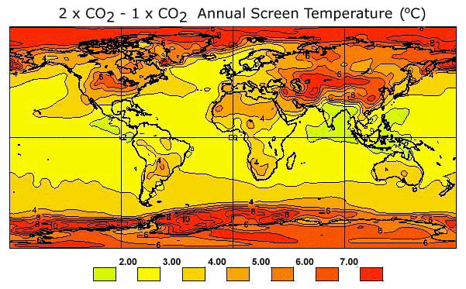
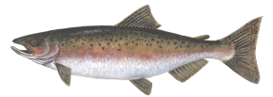
Predicted changes of surface AIR temperature in a double CO₂ scenario suggest climate change poses a major threat to sustainable management of wild salmon biodiversity for Fisheries and Oceans Canada and the NPLCC (now and increasingly in the future).
CC Impacts on Landscapes, Aquatic Ecosystems and Salmon
Physical properties of freshwater ecosystems will be impacted by climate change.
Projected temperature changes are more intense at high latitudes

Slide 8
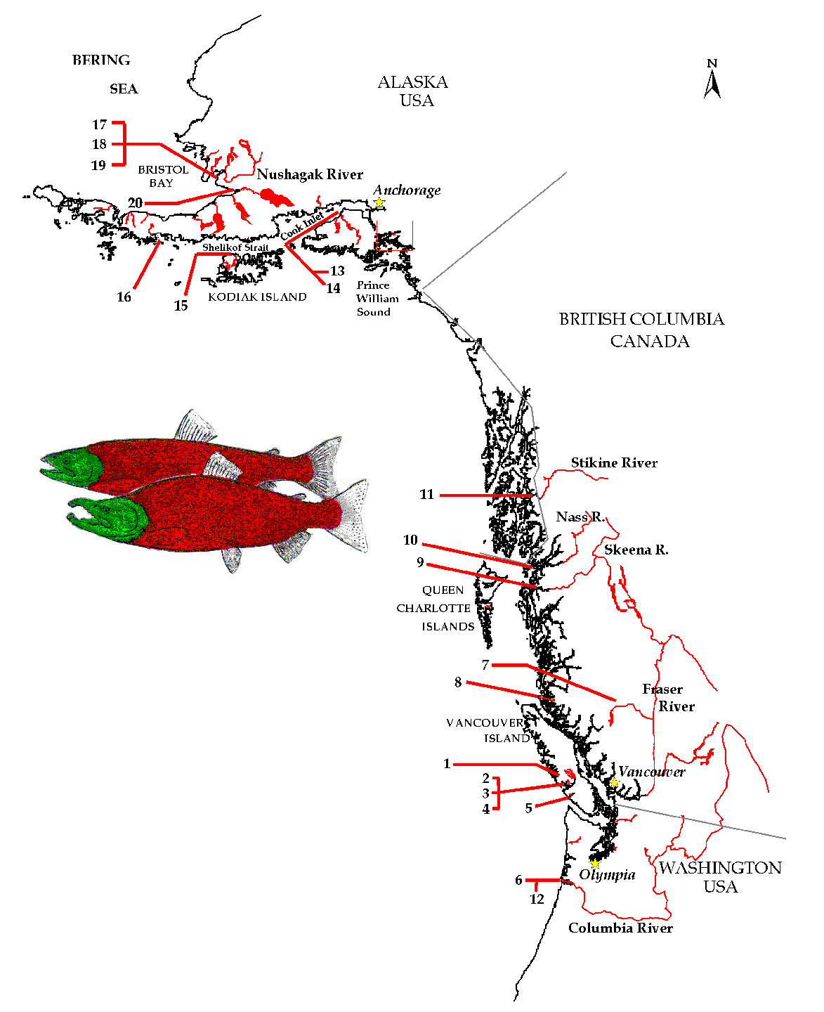
Pacific Rim Anadromous Salmon Stocks are Likely to be Especially Sensitive to Climate Change Effects due to Their Life History
Thousands of populations of salmon
spend portions of their life cycle in freshwater &
marine ecosystems associated with the eastern
rim of the N. Pacific.
CVC effects on salmon exhibit so much variability
that general guidelines to improve fisheries management
have largely failed to emerge to date.

Slide 9
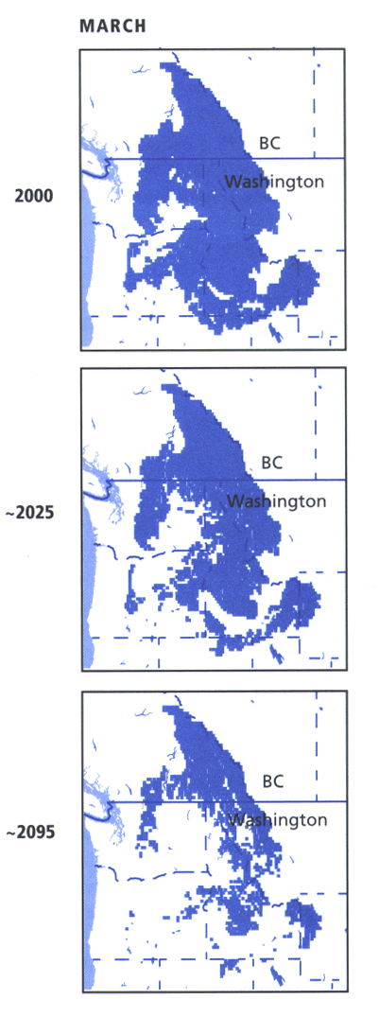
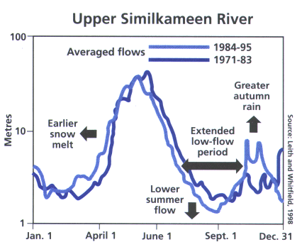
GCM and Regional Climate Models Project Many Changes for Watersheds & Freshwater Ecosystems:
Flow Timing and Variability in Snow Fed Rivers (P. Whitfield - DOE)
Regional Snow pack (P. Mote- UW)
Changes to Seasonal Thermal Regimes in Freshwater Lakes, Rivers and Streams

Slide 10
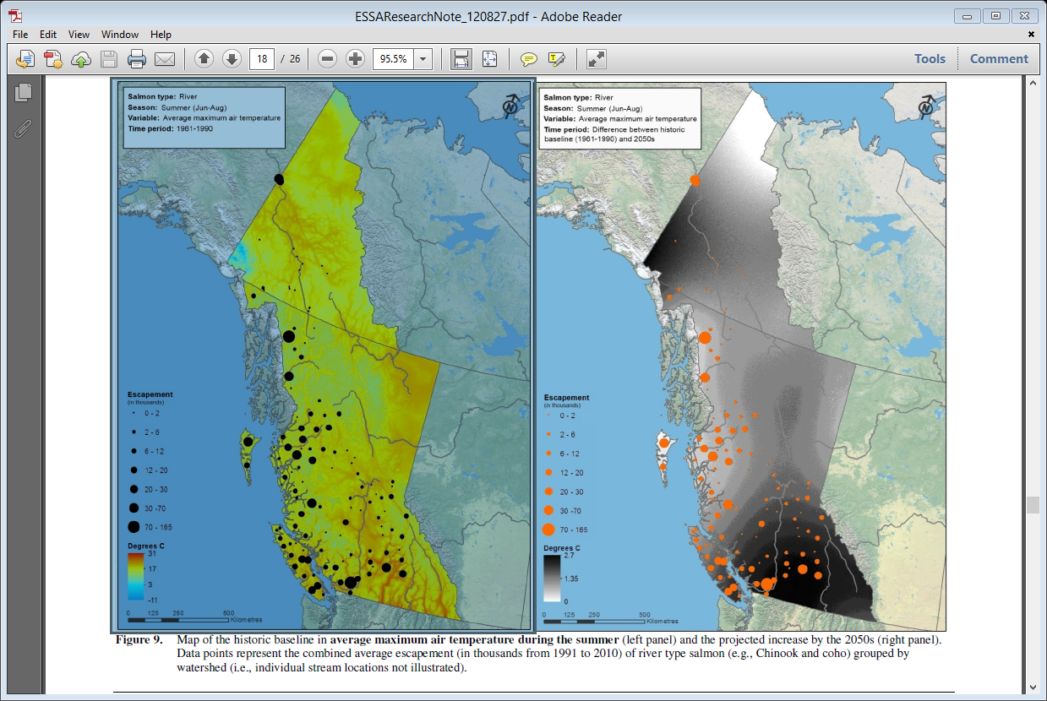
Average max-temp in summer for historic (1961-1990) baseline (left panel) & future (2050s, right panel) intervals (Nelitz-ESSA & Hyatt-DFO).
Current average of 20-31ºC for BC southern interior (BCSI) at low elevation will increase 2.7ºC i.e. average max-temp for BCSI in summer of 23-34ºC by the 2050s thus increasing stress on salmon CUs that are already temperature sensitive.

Slide 11
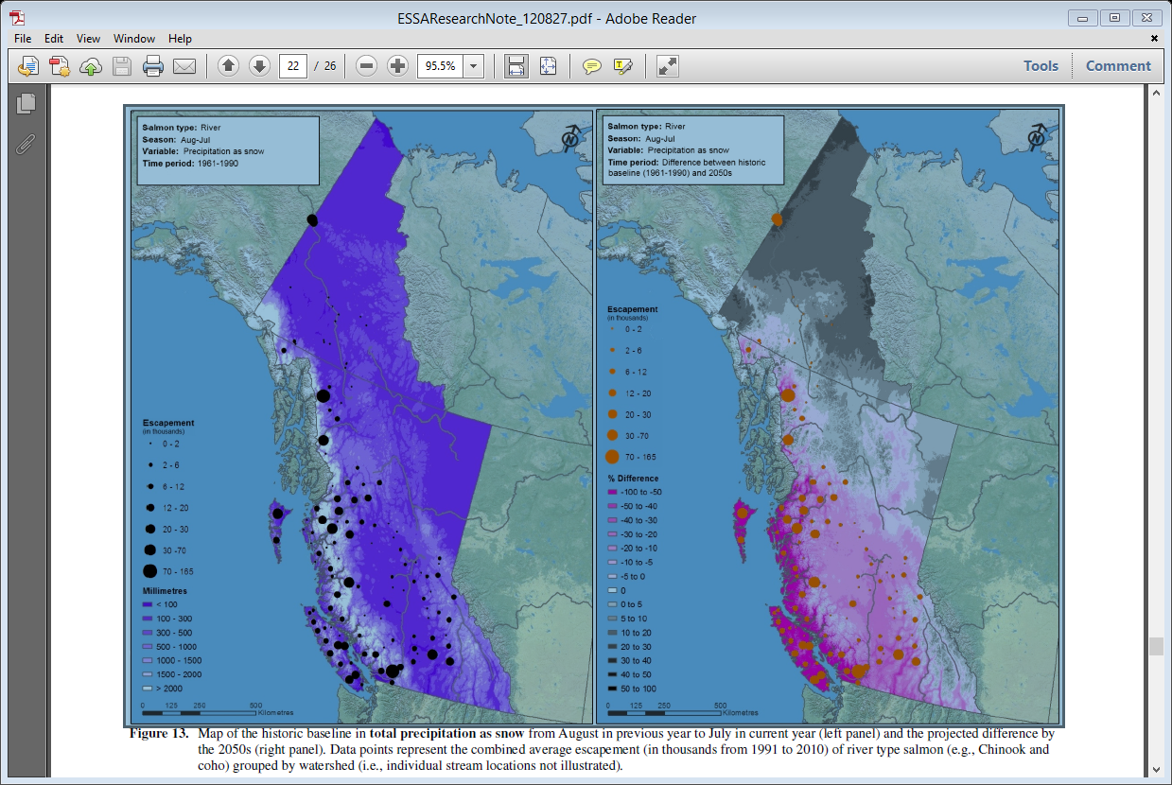
Total snow-pack (mm) during historic (1961-1990) baseline (left panel) & future (2050s, right panel) intervals (Nelitz-ESSA & Hyatt-DFO).
Currently snow-packs of 500-1500mm in winter along the spine of Vancouver Is. & west facing slopes of the coastal mountains from southern to northern BC. Reductions of 50-100% throughout this area by 2050s i.e. conversion of hydrographs from pluvial-nival to solely pluvial will add to risk of winter flood-scour and chronic, late-summer to fall drought conditions already faced by salmon.

Slide 12
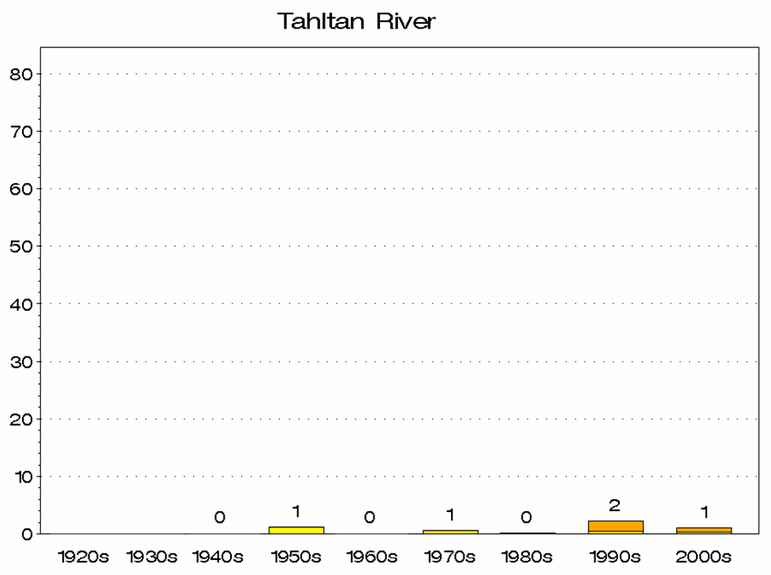
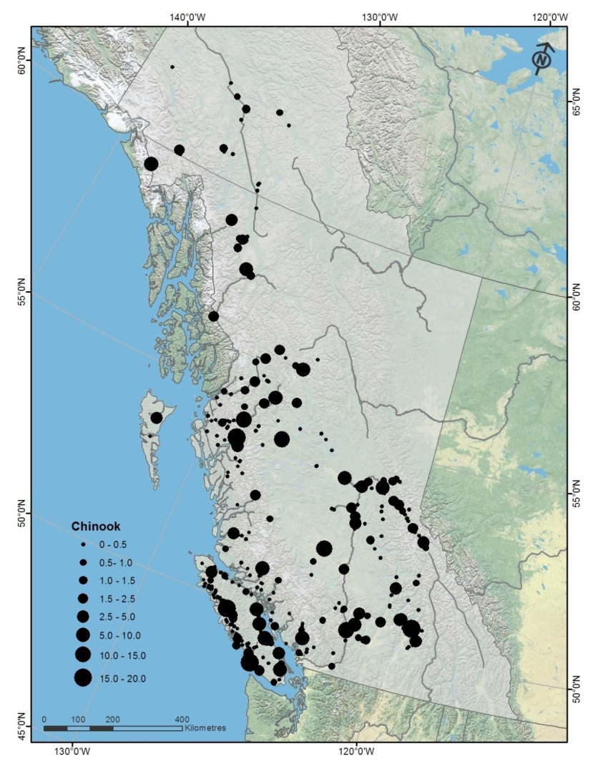
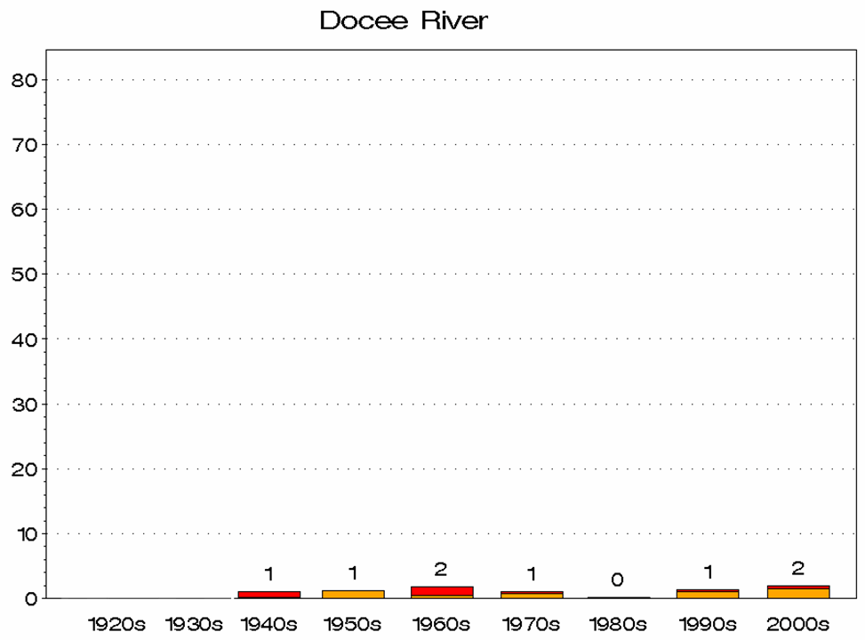
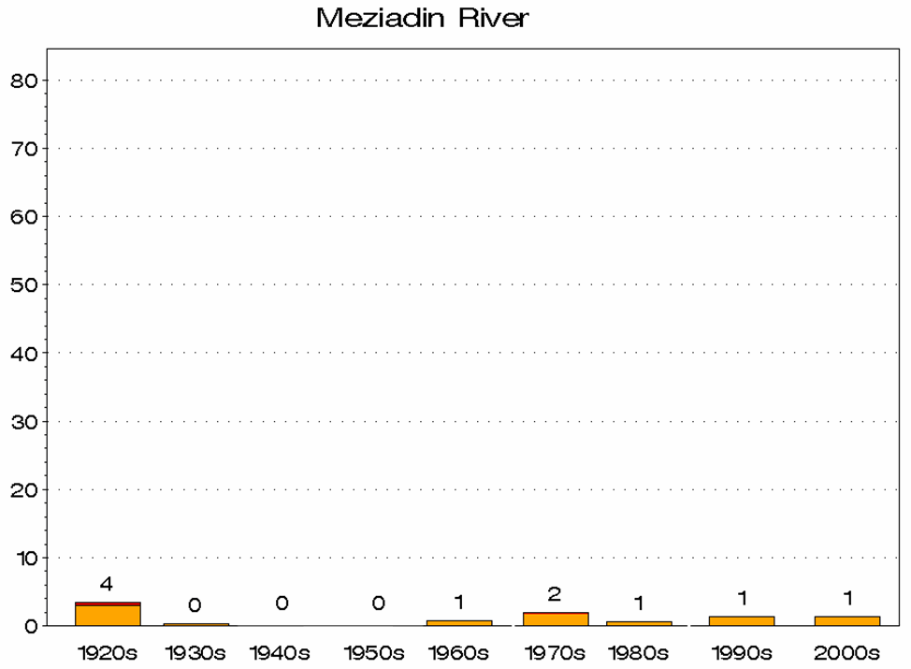
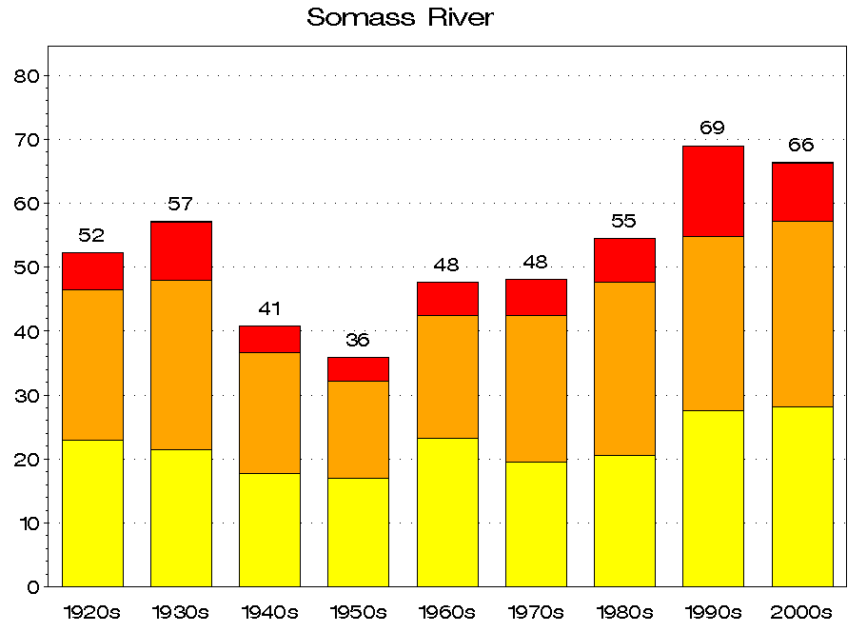
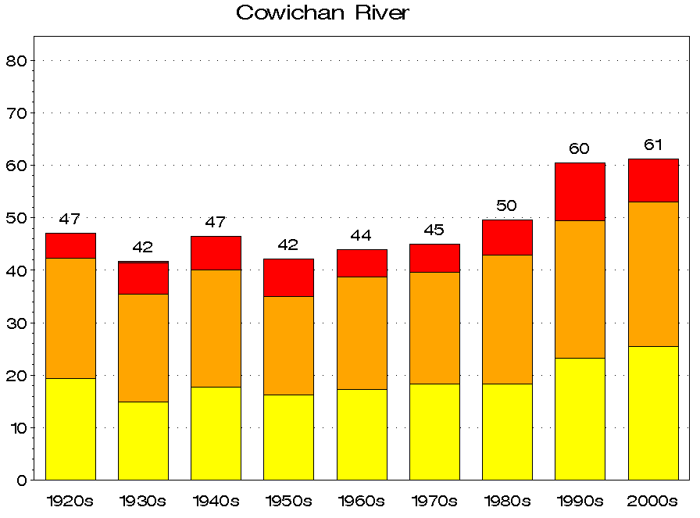
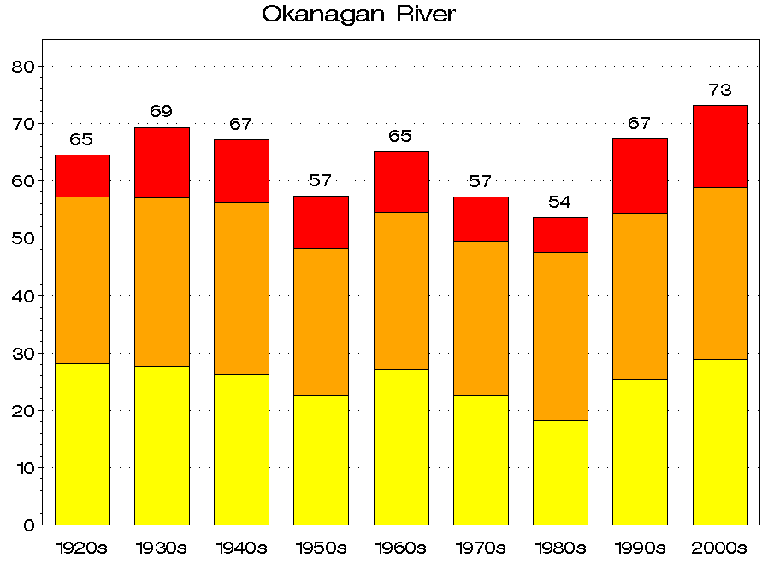
POE perspective at landscape-scale
(Hyatt & Stiff, DFO-2013).
Tahltan River (northern)
POT _{>18}ºc event analysis: Assumes Chinook migration interval of July-Oct in BC rivers by decade from 1920s-2010
Docee River (central)
Meziadin River (northern)
Cowichan River (southern)
Okanagan River (southern)
Somass River (southern)

Slide 13
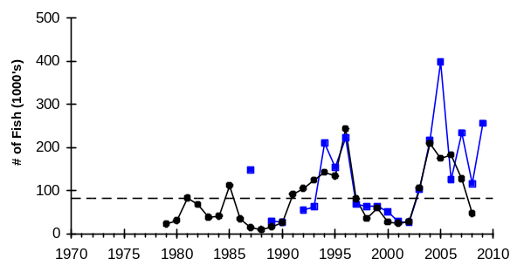
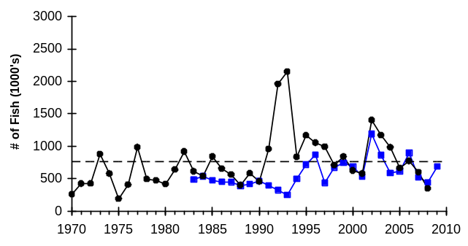
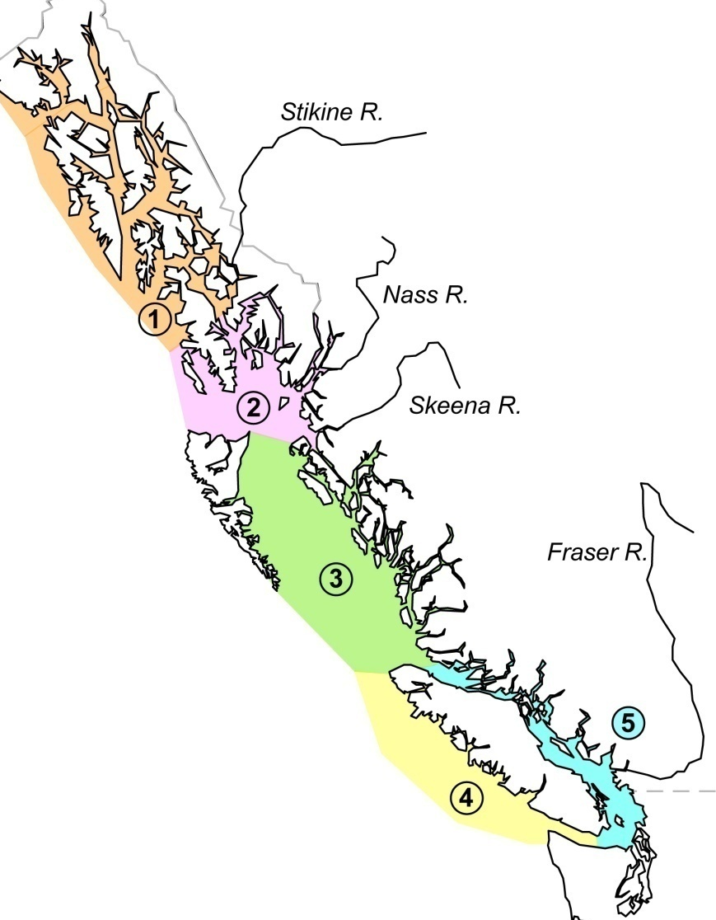
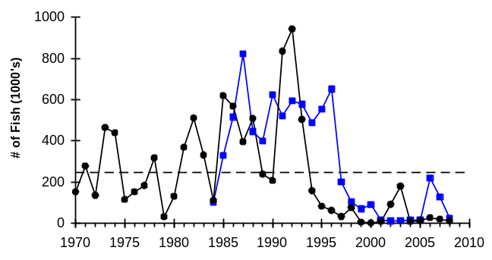
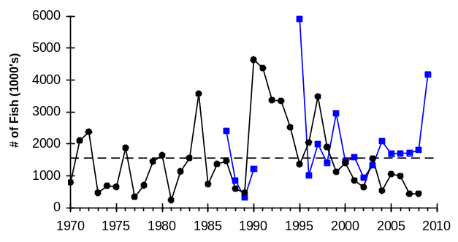
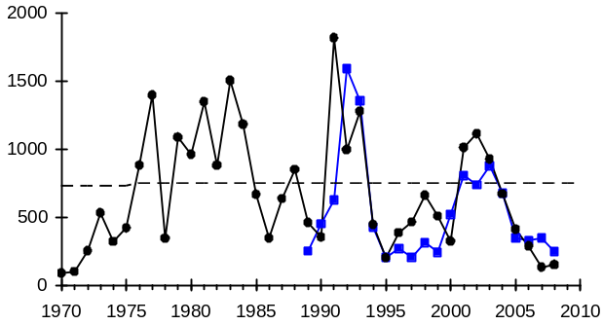
Time series salmon abundance and biological traits help diagnose if changes in the status of salmon CUs are responsive to coast-wide or local “ecosystem” effects associated with climate change or other drivers.
1. Tbdry-Tahltan
2. N. Coast - Nass
3. C. Coast - Long
5. G. Basin-Chilko
K.H.
4. WCVI - Barkley
Observed Returns
Forecast Returns
All Year Average
Hyatt et al.,

Slide 14
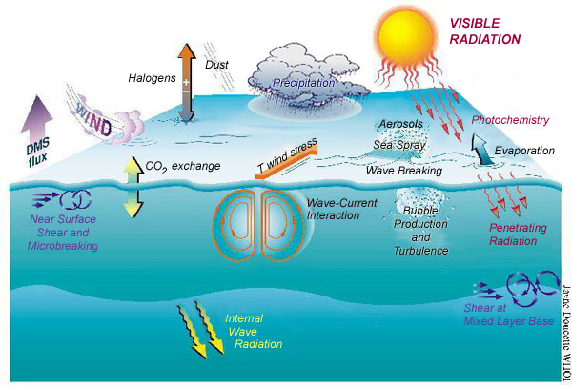
Climate Change Impacts on Sea-scapes, Marine Ecosystems and Salmon
Oceans regulate climate
70% of the earth is ocean
Top 3m of ocean has equivalent heat capacity of the atmosphere
Therefore very high thermal inertia

Slide 15
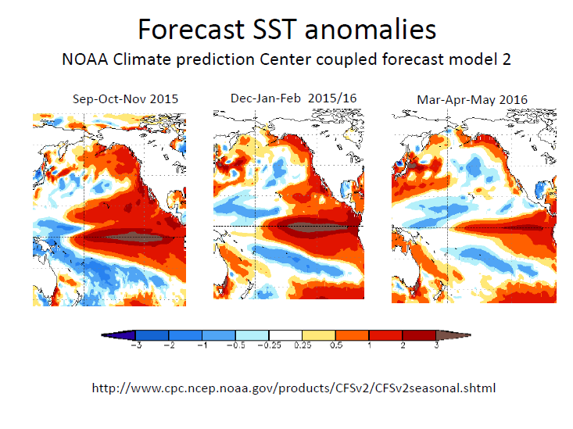
“Godzilla” El Nino developing for fall-spring 2015-2016
Hyatt Presentation to DFO Salmon-WG Meeting, VI-Conference Centre, Nanaimo, B.C.,18 November 2015.

Slide 16
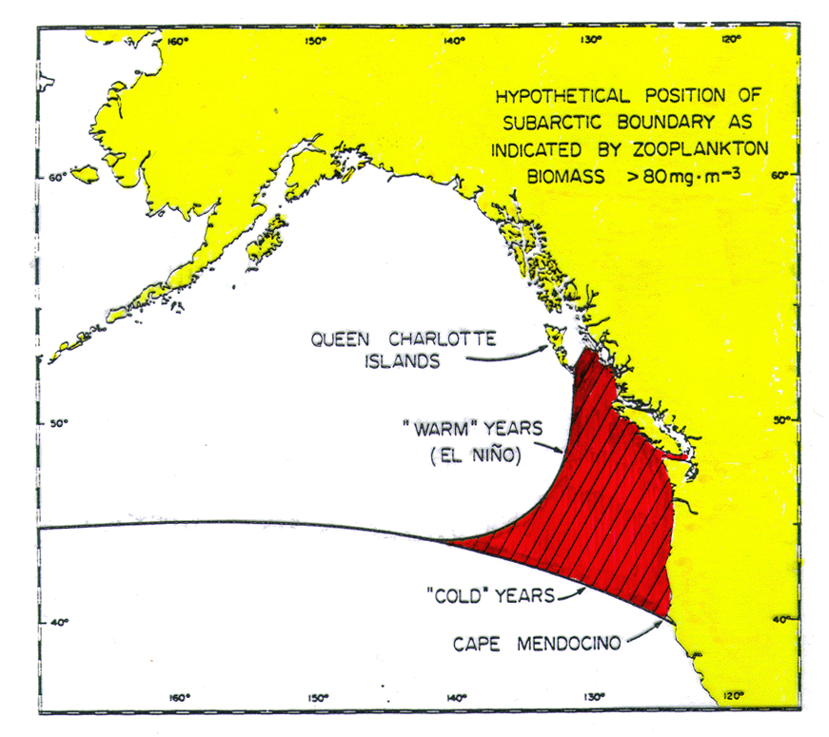
Hypothesis: Barkley Sound sockeye are especially sensitive to CVC effects because of their transitional zone location over which the subarctic domain has a varying influence (Fulton and LeBrasseur 1985)
Strong El Niño-
La Nina events
induce major
changes in
continental shelf
ecosystems.
Some of these
changes alter
ecosystem capacity
to support “robust”
salmon populations.

Slide 17
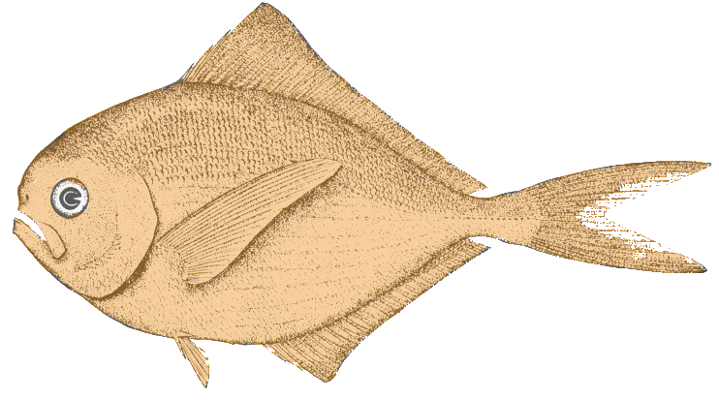
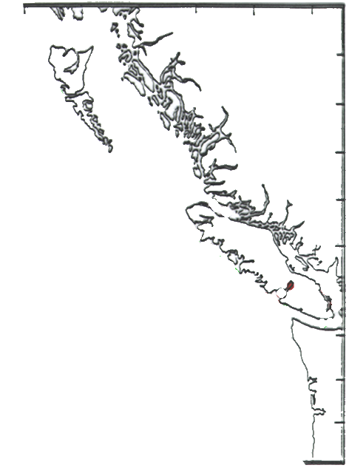
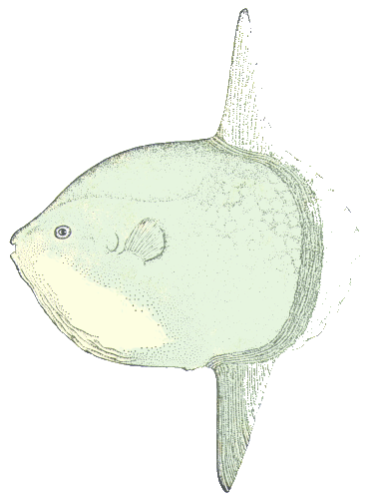
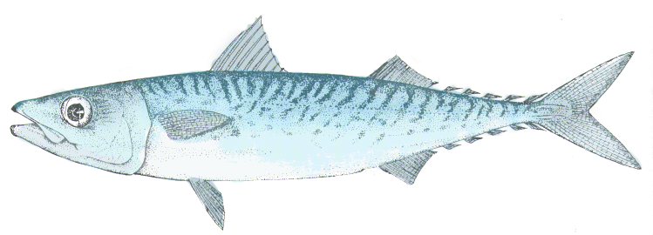
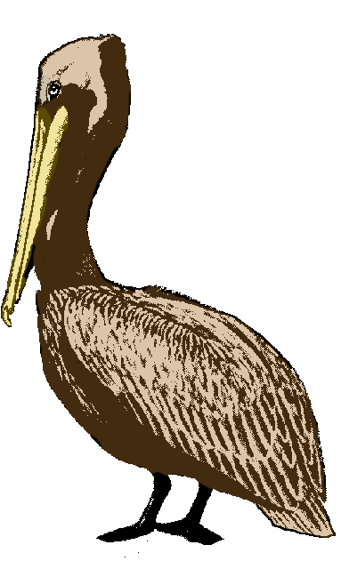
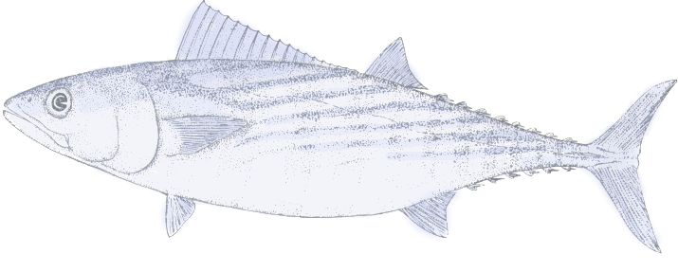
Hypothesis: Exotic Species on the BC Coast in 1983 & 2005 Suggest Ecosystem Reorganization (J. Fulton-83 & M. Trudel-05 P.B.S.)
(Brama japonica)
(Mola mola)
(Scomber japonicus)
(Sarda chiliensis)
(Pelicanus occidentalis)

Slide 18
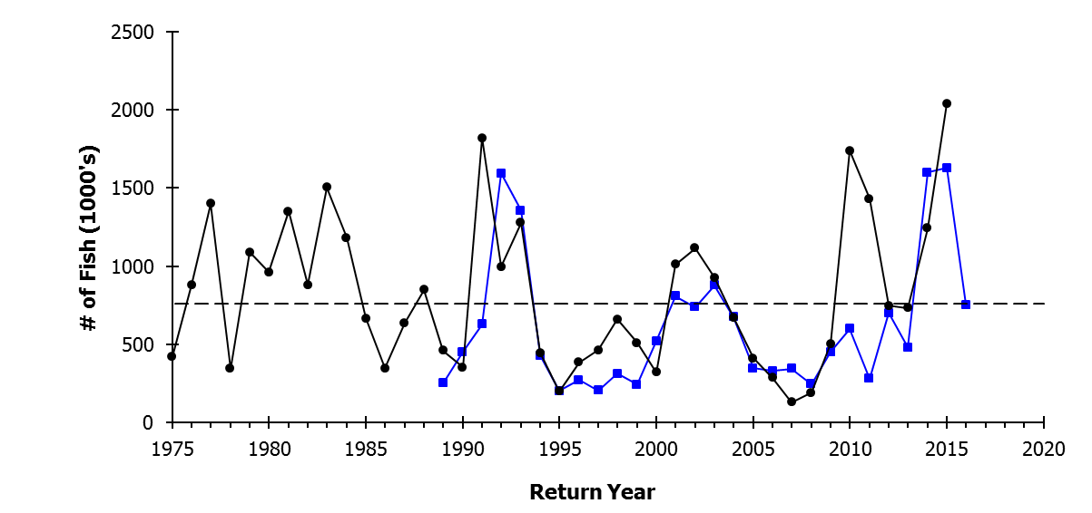
Survival Stanza Method (Hyatt et al. 1989) Predictions vs Observed Returns of Bk. Sd. Sockeye
Observed
Forecast
All Year Average
In our 2014 SOPO report we noted that ENSO neutral conditions in 2012 & 2013 suggest average marine survivals (4-5% ) but far above average returns in 2014-2015 due to exceptional production of smolts in freshwater.
The 2.1 million record return of Barkley Sd sockeye in 2015 was not entirely unexpected given that it was based on record breaking smolt production during sea entry year 2013. The SStM forecast of 1.6 million for 2015 was exceeded because marine survival was about 25% higher than anticipated by the all-year average during a “La Nada” year like 2013.
SST & ENSO shifts to highly positive (Blob and El Nino) in 2015-2016 so WCVI and Columbia-Okanagan salmon returns will decline quite dramatically in 2017-2019 (e.g. 760,000 or less to Barkley in 2016).

Slide 19
Complex POE Model for a Marine Ecosystem: Barkley Sd. Sockeye, two-state, production-model, reflecting PDO-ENSO induced reorganization of biophysical properties of the Northern California Current System (Hyatt et al. PSARC 1989)
Cold Ocean: low northward transport (5.0% SAR)
Warm Ocean: high northward transport (2.5% SAR)
Dominant piscivores coevolved with sockeye
Zooplankton: high biomass and large size
Dominant piscivores “foreign” to sockeye
Zooplankton: low biomass and small size
Average to low mortality for juvenile sockeye
Rapid growth by juvenile sockeye
Above average mortality for juvenile sockeye
Slow growth by juvenile sockeye
Average to above average adult returns
Below average adult returns
Sockeye Fry Recruitment:
increases
decreases

Slide 20
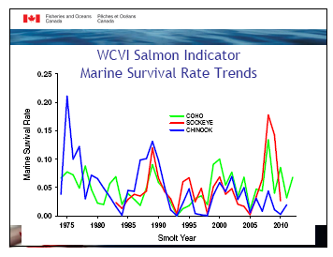
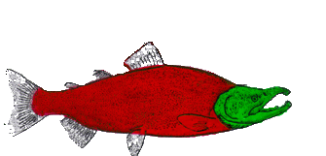

Marine survivals of WCVI salmon CUs co-vary suggesting POE-model applies to at least three salmon species & fisheries in the NCCS !

Slide 21
NOAA Earth Simulator 2 Climate model WCVI-SST projections to 2060 relative to 2006-2011 mean (adapted from Preikshot and Perry 2013)
Optimistic* scenario: Moderate increase in “warm ocean” frequency i.e. WCVI salmon production declines likely similar to mid 80s & mid 90s so local fisheries persist
Pessimistic** scenario: Larger increase of “warm ocean” frequency i.e. WCVI salmon production declines likely more severe than mid-80s & 90s so local fisheries collapse.
*GHG emission rate decreases, ** GHG emission rate remains at current levels

Slide 22
Conclusions
Overview of CVC status & future climate trends in freshwater & ocean ecosystems suggest freshwater trends are already apparent & significant, climate-induced changes to both are likely between now and 2050.
Pathways of effects models (POE) within freshwater and marine ecosystems at both local and broader spatial scales may be used to develop insights into future CVC impacts on Chinook & other salmon CUs.
Local to regional-scale POE model applications should be examined for match or mismatch of outcomes to observed production variations (e.g. Dorner & Peterman R/S analysis) at similar scale(s) to help explain trends.
“Coupled,” freshwater & marine POE models can provide insights into potential causes of salmon production variations as one approach to assessing climate change in a cumulative-impacts context to account for freshwater and marine effects (e.g. CVC projections clearly suggest some salmon CUs in south coast BC will experience negative POE impacts accumulated first in freshwater and then in marine ecosystems driving acute production declines and future sustainability issues for DFO fisheries managers).

