Slide 1
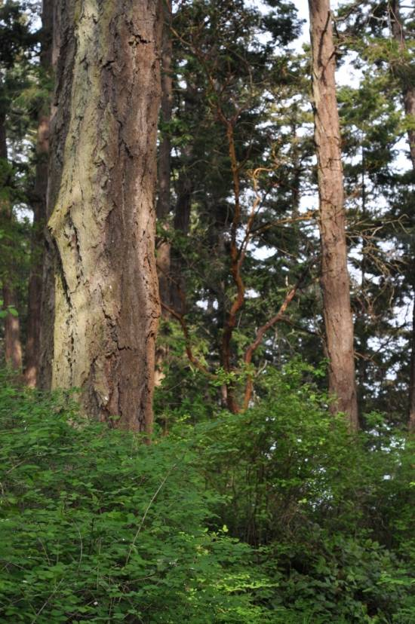
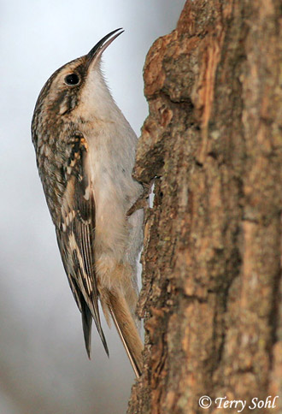
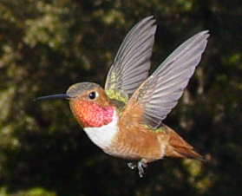


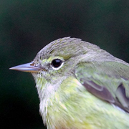
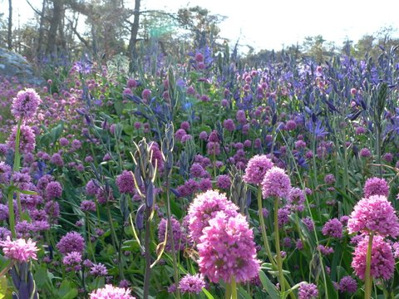

Cross-boundary Planning for Resilience and Restoration of Oak Savannah and Coastal Douglas-fir Forest Ecosystems
P Arcese, R Schuster, E Kleynhans, A Rodewald, T Wang, P Dunwiddie, J. Alexander, T Martin, K Emming, J Lawlor, B Klinkenberg, D McConkey
Univ. of British Columbia, Cornell University, Univ. of Washington, The Nature Trust of BC, Islands Trust, BC Ministry of FLNRO, Klamath Bird Observatory, Coastal Douglas Fir Conservation Partnership
Notes:
In the Douglas Fir/Garry Oak Woodlands of coastal BC, we are using SCAD to prioritize investments in land conservation, but doing so in a landscape were no ‘intact’ old-growth habitat remains. This raises the interesting question of where to start. In this talk, we’d like to attract your feedback on an evolving approach we are using to prioritize areas for the restoration of ‘old growth’ ecosystems, under the assumption that the best restoration candidates are those areas that currently support the richest communities of species thought to rely on historic habitat attributes.

Slide 2
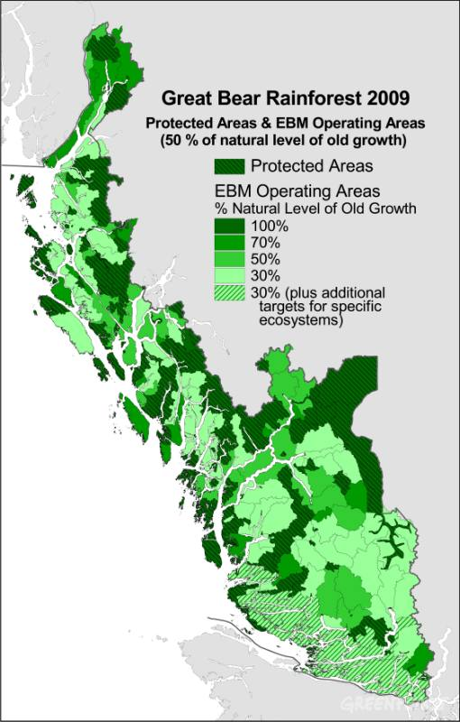
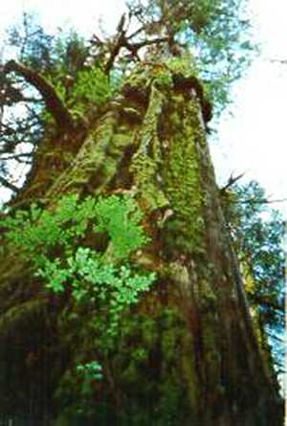
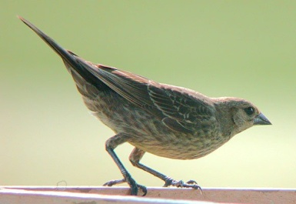
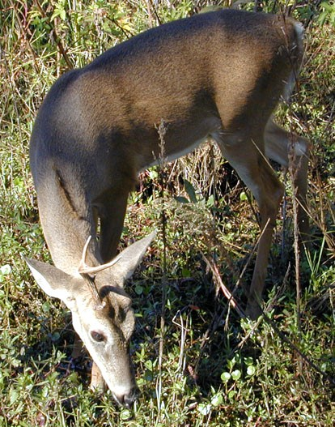
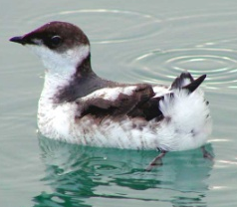
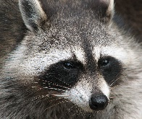
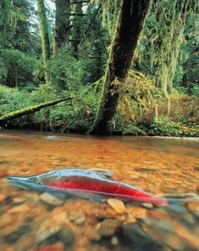
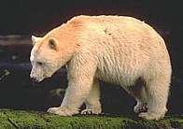
Traditional Goal of Conservation Area Design
Prioritize and Conserve ‘Intact’ or ‘Relic Ecosystems’
Multiple criteria
Decision support tools (Marxan)
Impractical in Human-dominated Landscapes
No Benchmark Ecosystems
Biological Survey Data Often Biased
Many Threats Hard to Map

Slide 3
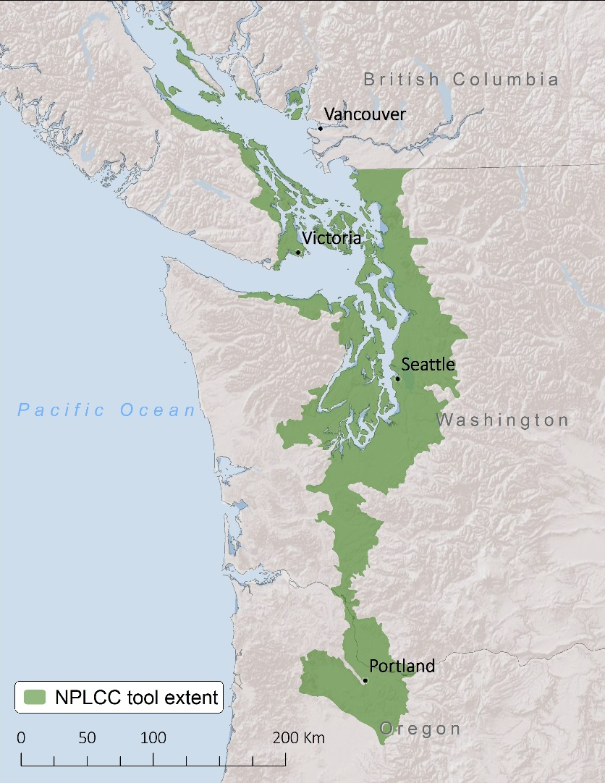
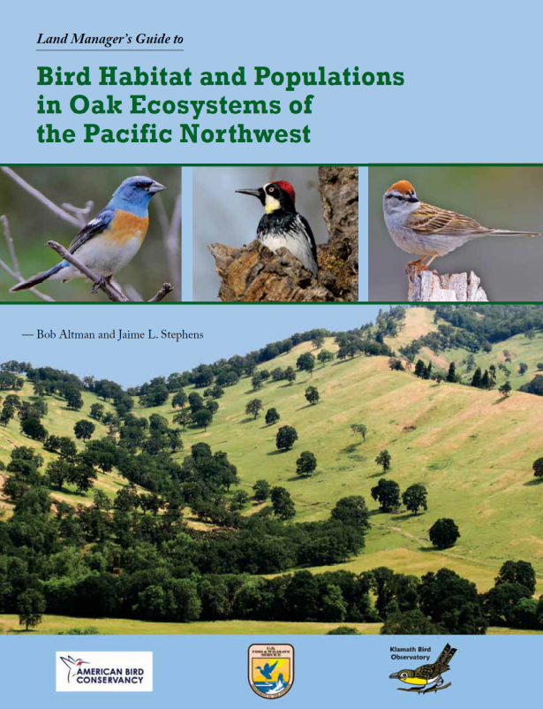
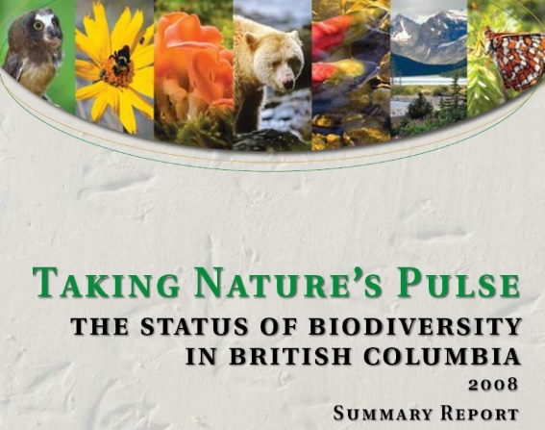
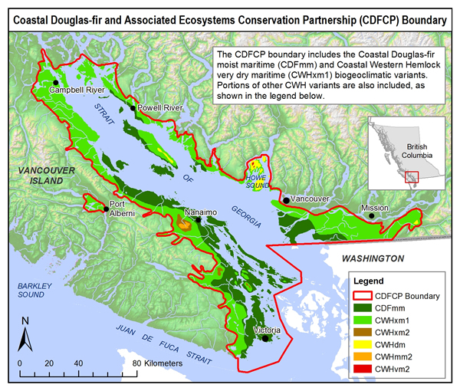
Dry Forest / Savanna Habitats of the Georgia Basin
49% Converted to Human Use
< 3% Pre-settlement Forest Intact
> 80% Privately-owned
>153 Species At Risk
Most Imperiled Ecosystem in BC
Vancouver
And Throughout the Pacific Northwest

Slide 4
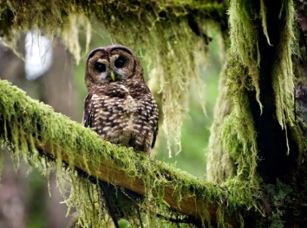
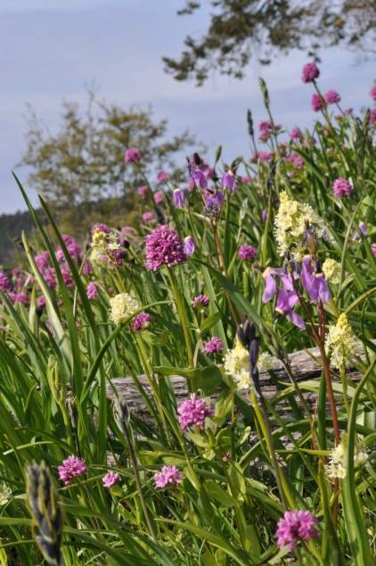

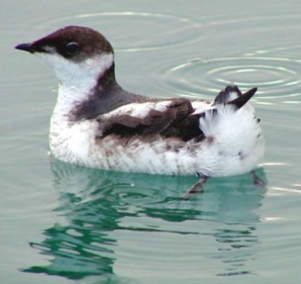
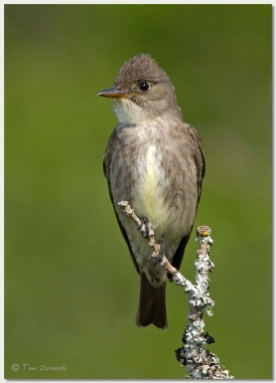

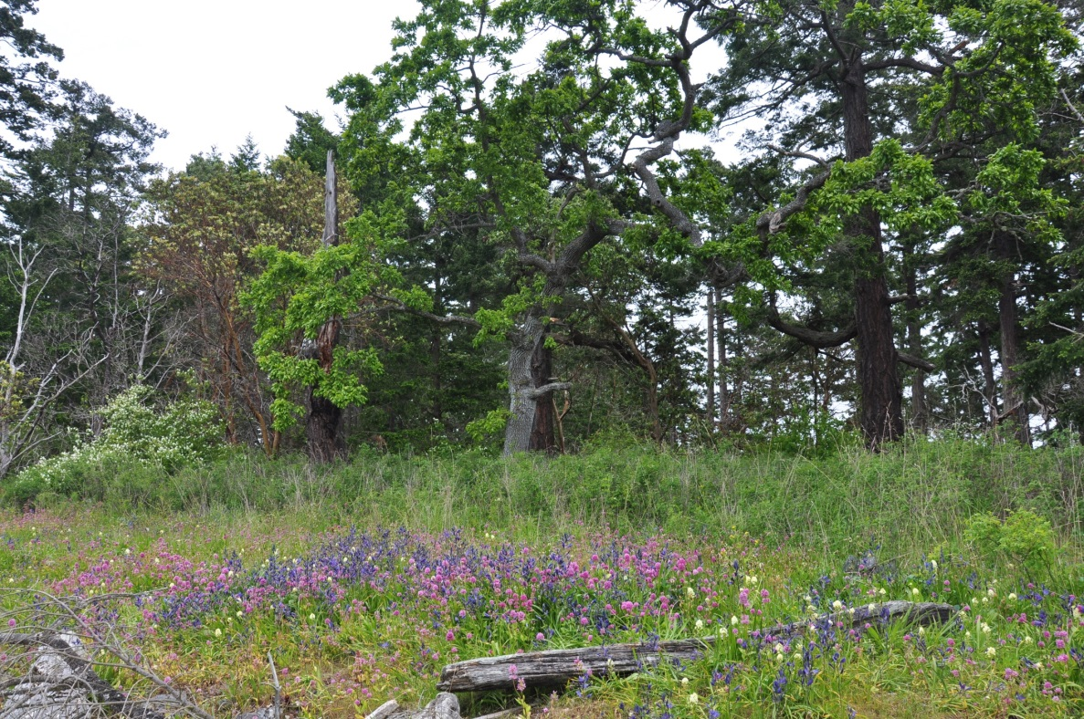
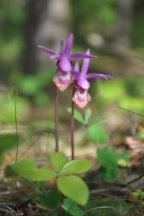
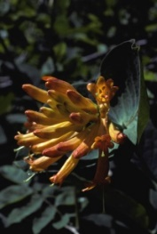
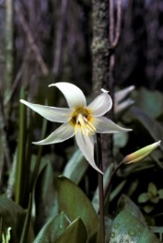
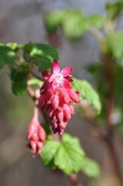
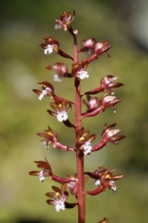
Deep and Shallow Soil Forest / Savanna Sites

Slide 5
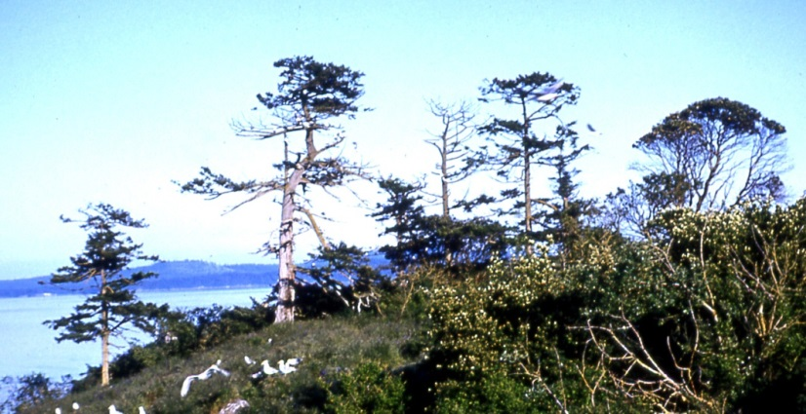
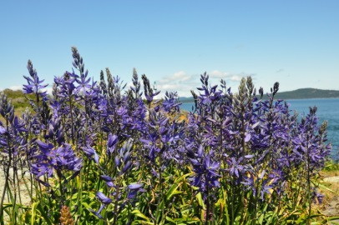
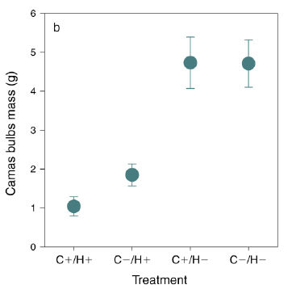
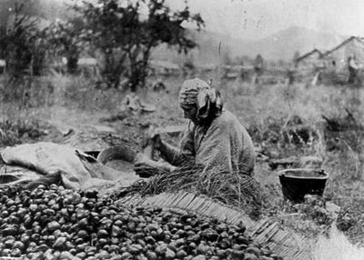

First Nations History
Camas gardens of the Coast Salish
400 bulbs/hr
1.0 – 2.3 million bulbs/1000 people/yr
65 – 600 million bulbs annually
Turner 2014
Arcese et al. 2014

Slide 6

Conserving Functional Landscapes
  Identify Reliable Predictors of Biodiversity Targets at Landscape Scales
  Prioritize ‘Intact’ Parcels for Conservation / Restoration
  Provide Open-source Tools to Facilitate Collaborative Decision-making
  Maximize the Efficiency of Conservation Actions

Slide 7

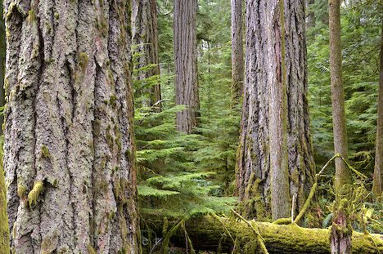

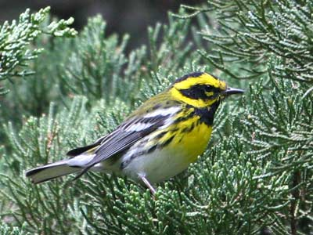
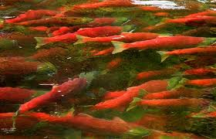
Example: Can We Identify Stands Already Hosting ~Intact Old-Growth Communities?

Slide 8
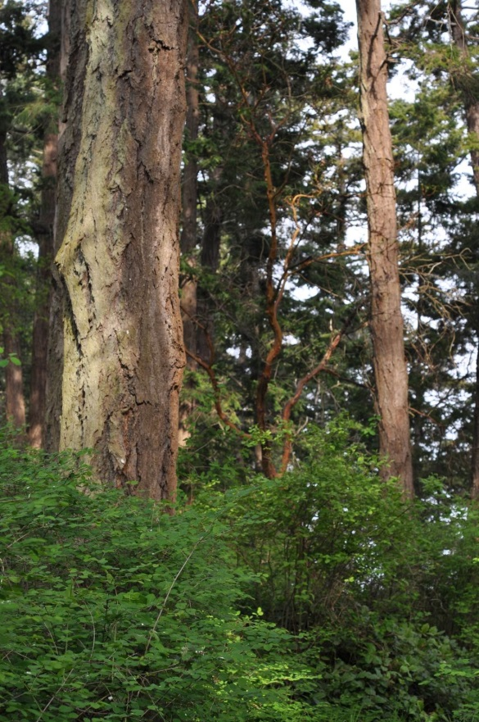
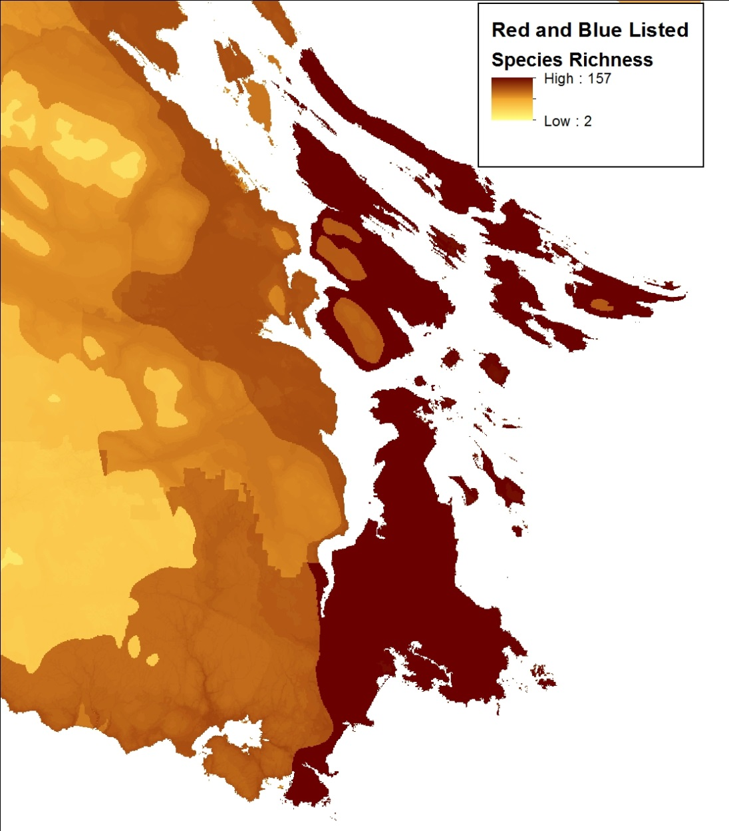
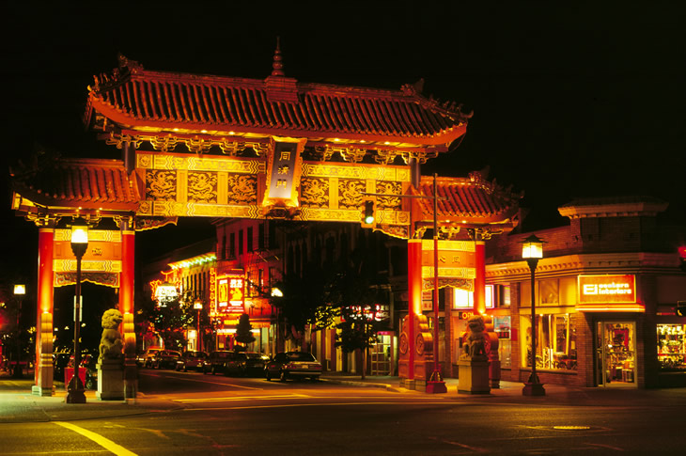
Expert Maps of Threatened Species Distribution 2014
Vancouver I.

Slide 9
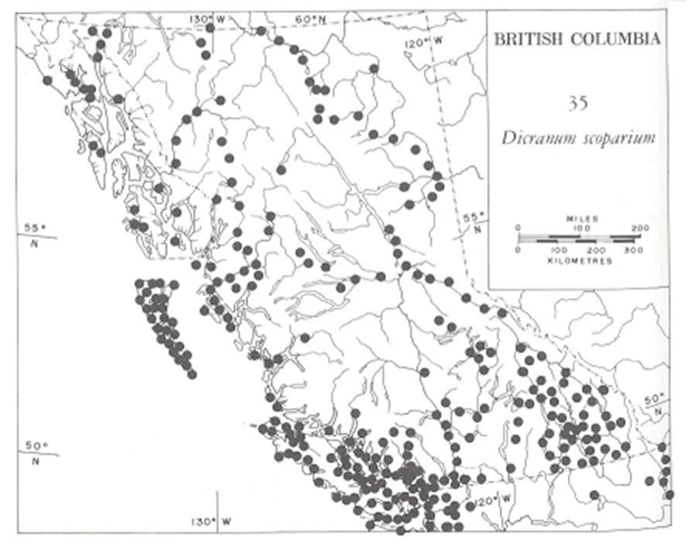
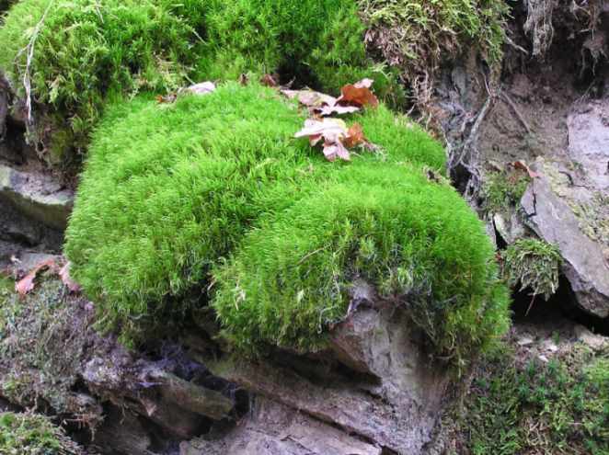
Occurrence Data can be Misleading
Dicranum scoparium
Access / Survey Effort Drive Indicator and Rare Species Richness

Slide 10
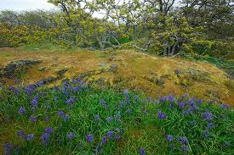
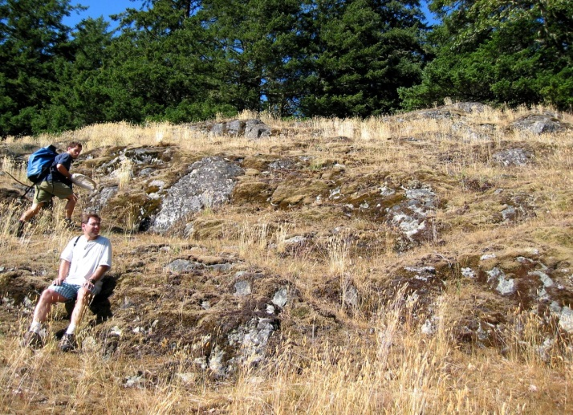
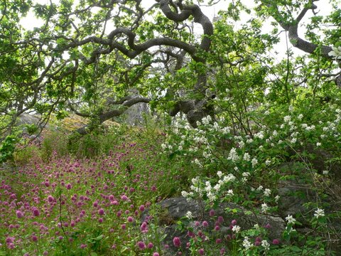
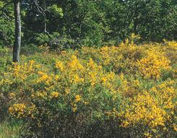
How Do We Identify Intact Sites Without Visiting All Sites?
High Native Cover/Richness
vs High Exotic Cover/Richness

Slide 11
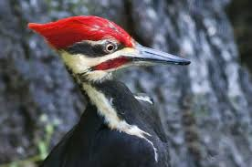
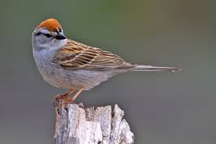
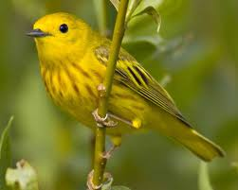
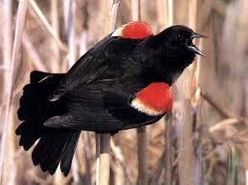
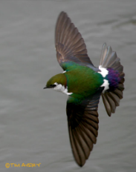

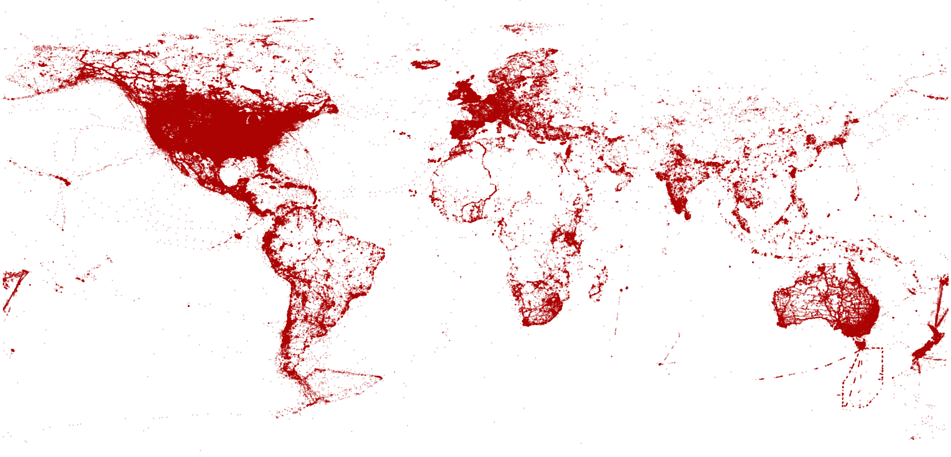
Conservation Values Predicted by Focal Indicators
93,000 eBird Detections of Presence/Absence
27 Landscape and 5 Current and Future Climate variables and AIC to map ‘Occupancy’
74 Species with ≥ 50 Detections, representing 34 Families
Assembled into Communities by Experts given ‘Habitat Reliance’
Notes:
1. Can an old forest reliant bird species community be used to identify high priority areas of mature forest for old growth restoration?

Slide 12
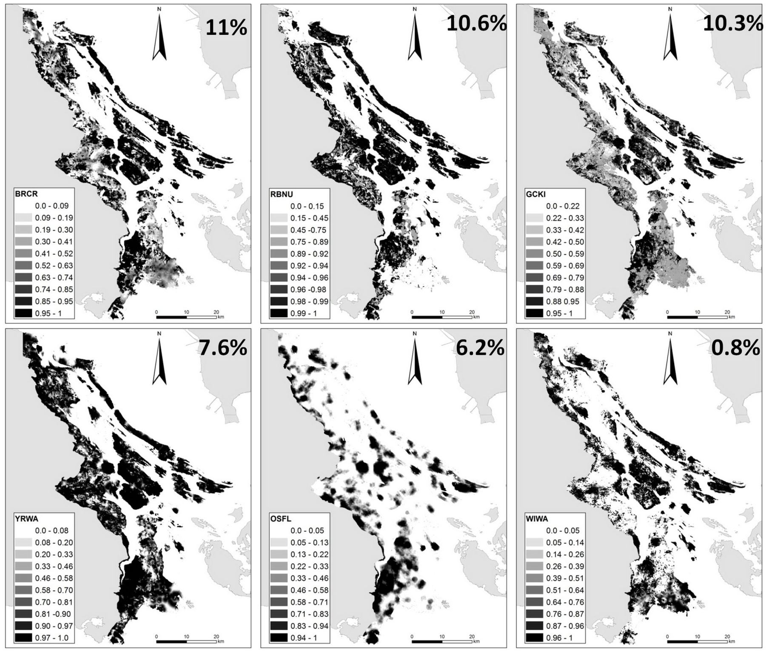




Southern Gulf Islands/ SE Vancouver I.
Schuster & Arcese 2013, Ecography

Slide 13





Climate Prediction
Tong Li Wang
ClimateWNA

Slide 14


Current Distribution of ‘Old Forest’ Community (17 spp)
Predicted Distribution in 2045

Slide 15




Savanna, Shrub, Wetland and Human Commensal Communities

Slide 16







Savanna, Shrub, Wetland and Human Commensal Communities

Slide 17






Native and Exotic Plants

Slide 18

Native and Exotic Plants

Slide 19


On-line Marxan ILP Tool: High Priority Parcels at Low ‘Cost’
Engage Stakeholders to Identify Targets and Costs
Prioritize 3 million Land Parcels to Facilitate Conservation Decisions
A Prioritization Tool for the Conservation of Coastal Douglas-fir Forest and Savannah Habitats of the Georgia Basin and Puget Sound Lowlands
Schuster, R., CROMBIE, M., Morrell, N., & Arcese P.
The Nature Trust of British Columbia, Coastal Douglas Fir Conservation Partnership and Department of Forest and Conservation Sciences, University of British Columbia
http://arcese.forestry.ubc.ca/marxan-tool/

Slide 20


Maximizing Benefits Given ‘Cost’
Tax Assessed Value
Human-commensal Cost (plants & birds)
Management/Restoration Cost (predicted condition, location)

Slide 21




Exploring Scenarios

Slide 22


Goal
Protect 50% of the Best 33% OF, SAV, WET and NAT Ecosystems
50
50
50
50

Slide 23



Slide 24


57% Overlap with TNC Ecoregional Priorities
96% Overlap for Current and 2045 Scenarios

Slide 25

Applications?
Acquire Biodiverse Parcels
Minimize Management Costs, Maximize Return on Conservation Investments
Burgoyne Bay $900K
Develop Contact Lists to Engage Private Landowners in Landscape-level Conservation

Slide 26


CDFCP: Prioritize Parcels to Facilitate Collaborative Decision-making
Complying with the CBD Means Increasing PA’s from 9 to 17%
Acquisition?
~$500,000,000 Assessed Value

Slide 27

‘Tax Shifting’
Identify Priority Parcels
Shift Taxes from High to Low Biodiversity-value Parcels
CDFCP Goals
Reduce Cost Requisite Increase
100% $4.2m $0.03 / $100K (0.18%)
Tax Shifting Can Facilitate Targeted Incentives at No Net Cost

Slide 28



Strategic Investment for ‘Co-benefits’
Standing / Sequestered Carbon
Water Quality / Supply
Organic Farm Practices
Notes:
Think of a reverse auction as similar to when a homeowner solicits multiple bids for work from contractors. The homeowner puts together a scope of work, solicit bids, and chooses a contractor based on some combination of factors including price and quality.
Finally, based on estimates of the amount of habitat needed and the pricing of bids, BirdReturns accepted up to 80 percent of the bids. Each farmer received the price they bid. Just as with the contracting example, the lowest price didn’t always win, but it was a key criteria.
Farmer’s bids varied based on factors such as water cost, soil conditions, labor costs associated with creating the temporary habitat, and economic risks the program might create like not being able to plant on time in the spring.
BirdReturns has many advantages over conservation programs that set a single, uniform price for all farmers.
If the price is too low, there will be insufficient demand and too few farmers will sign up for the program. If the price is too high, there will be an excess of demand and the government will over-pay. In a time of huge societal needs and competing demands for scarce public dollars, such over-payment means that other valuable programs are not being funded.
In a reverse auction, the farmer sets the price, a price based on producing habitat. Farmers understand this intuitively. It is how they work, how they get paid for producing crops.
As one farmer put it at one of the Conservancy’s initial meetings: “You want us to grow birds, like we grow rice. We know how to do that.”
Farmer’s bids varied based on factors such as water cost, soil conditions, labor costs associated with creating the temporary habitat, and economic risks the program might create like not being able to plant on time in the spring.

Slide 29



Slide 30
Conclusions
Humans have pervasive ‘indirect’ impacts on species and ecosystems via the ‘bad actors’ they facilitate
Ecosystem Maps Offer a Direct Route to Prioritize ‘Intact’ Target Communities
Planning Tools Facilitate Stakeholder Engagement in Target Identification, Goal-setting and Policy Development
A Prioritization Tool for the Conservation of Coastal Douglas-fir Forest and Savannah Habitats of the Georgia Basin and Puget Sound Lowlands
Schuster, R., CROMBIE, M., Morrell, N., & Arcese P.
The Nature Trust of British Columbia, Coastal Douglas Fir Conservation Partnership and Department of Forest and Conservation Sciences, University of British Columbia
http://arcese.forestry.ubc.ca/marxan-tool/

Slide 31



Next Steps?

