Slide 1
starring… the Pacific Salmon Explorer!
Population and habitat assessments for wild Pacific salmon
Eileen Jones
Pacific Salmon Foundation
March 1, 2017
Notes:
- Introduce myself, give thanks to NPLCC
- In terms of an outline for today, I’m going to try to keep it succinct. I’ll start with a short discussion of PSF and the process that we use to undertake habitat and population assessments and then move into a demonstration of the Pacific Salmon Explorer, a data-visualization and decision-support tool that we launched last summer. I’ll wrap-up with a discussion of our plans to scale out our work other regions.
We have the interest and the capacity, but not the money. It won’t just be the PSE – population information is not in NCC database. Scoping exercise (LGL?) to figure out what data does exist and the work/effort to pull the data together. Also, combining spatial datasets from across the border will be a new and exciting challenge (technical/methods) and also social/political.
Starting point is CUs defined under Canada’s Wild Salmon Policy. Do we also look at populations that spawn on the USA side? Are there any? Chinook is a main interest (Unuk).
Salmon focussed. Instead, PSE focussed…..landscape-level conservation, aquatic connectivity
Habitat & population assessments, decision-support tools
WSP is still a good way to frame this.
Populations & habitat assessments for salmon watersheds in PNW & developing scalable decision-support tool
Model, template, approach (NOT a case study)
ALSO add a slide about how our work is being used by the Gitanyow to support decision making and implementation of their Land-Use Plan??
In terms of an outline for today, I’m going to try to keep it succinct. I’ll start with a short discussion of PSF and work that we’ve done on habitat and population assessments and then move into a demonstration of the Pacific Salmon Explorer. I’ll wrap-up with a discussion of our plans to scale out our work other regions.
I’m going to be speaking about our work in the Skeena River watershed and specifically how we’ve been working to advance the implementation of the WSP in northern BC.
--------
– solutions to assess risk factors, implementation – work is directly relevant, it provides a blueprint for how one can systematically assess the status of wild salmon populations and it can understand where there are gaps in knowledge and it uses information on habitat to further inform and help prioritize CUs that are of high relevant need for science, mgmt actions, and monitoring
If take a watershed perspective, know what CUs need information, can compare at provincial scale, those that are in poor condition, high risks to habitat and/or have no information
-tell story through the Skeena, modeled on policy document, can be and is being applied at broader spatial scale
-its collaborative, open access, driven by needs and activities of Fns and local communities, and it’s evidence base
-not intended to provide policy prescriptions but it is intended to provide a common understanding that elevates the ability of decision-makers to take steps mitigate threats or risk factors

Slide 2
Pacific Salmon Foundation
Support the conservation, restoration, and enhancement of Pacific salmon and their habitats
Notes:
The Pacific Salmon Foundation has been around since 1987. We are a non-governmental organization that focusses on the conservation, restoration, and enhancement of wild Pacific salmon populations in BC and the Yukon.
At the heart of our organization is the Community Salmon Program, which focusses on giving grants to volunteer and community-driven organizations that undertake salmon conservation and restoration projects.
In recent years, PSF has been supporting salmon science and research initiatives, including almost a decade of work in the Skeena watershed.

Slide 3
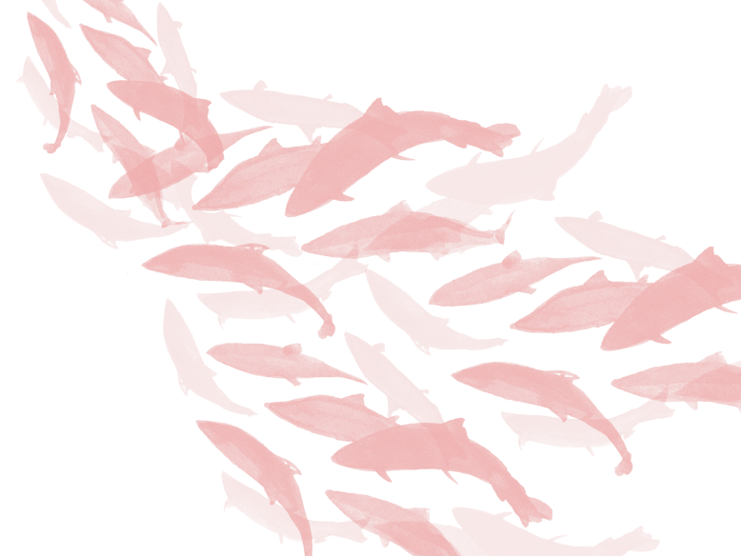
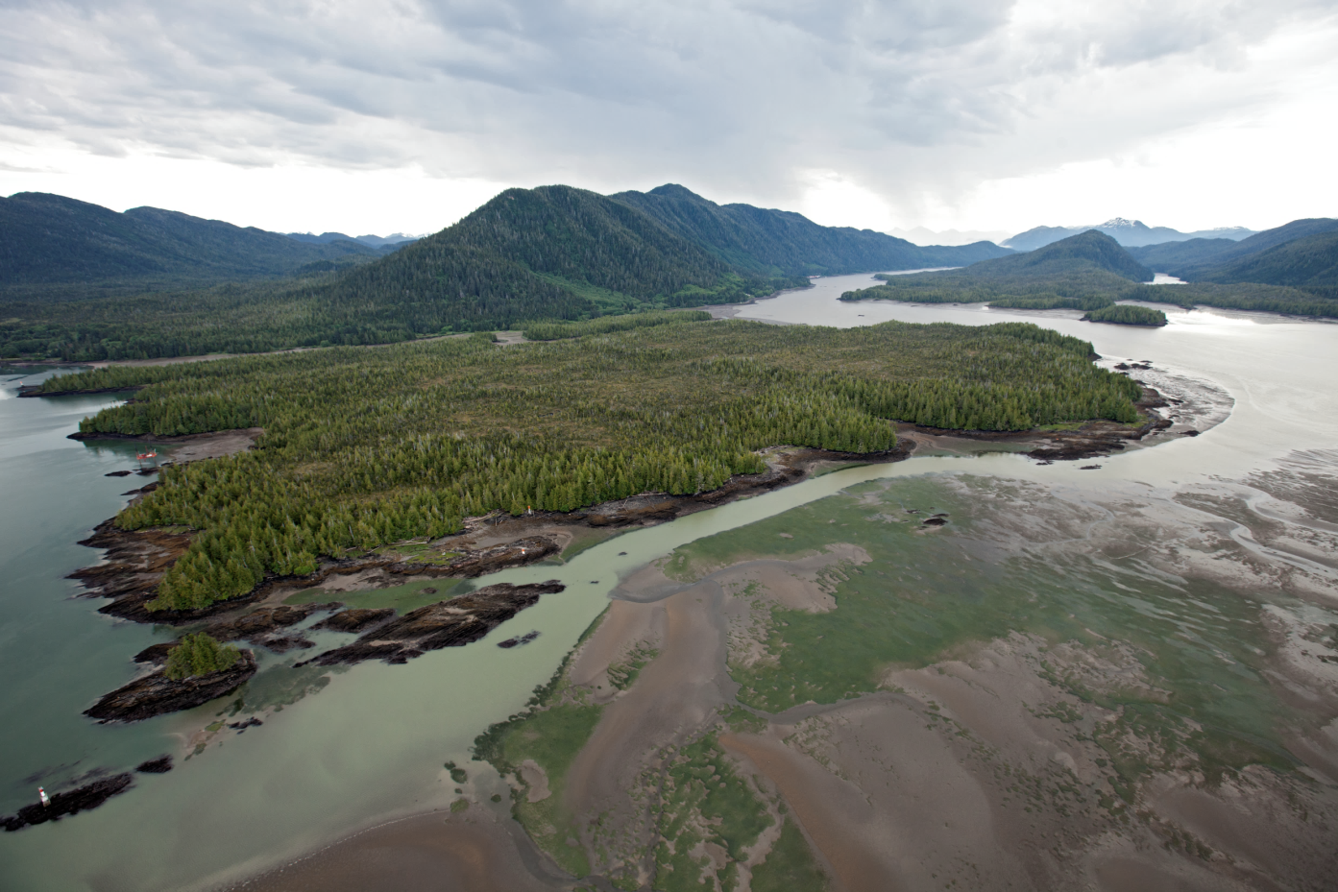
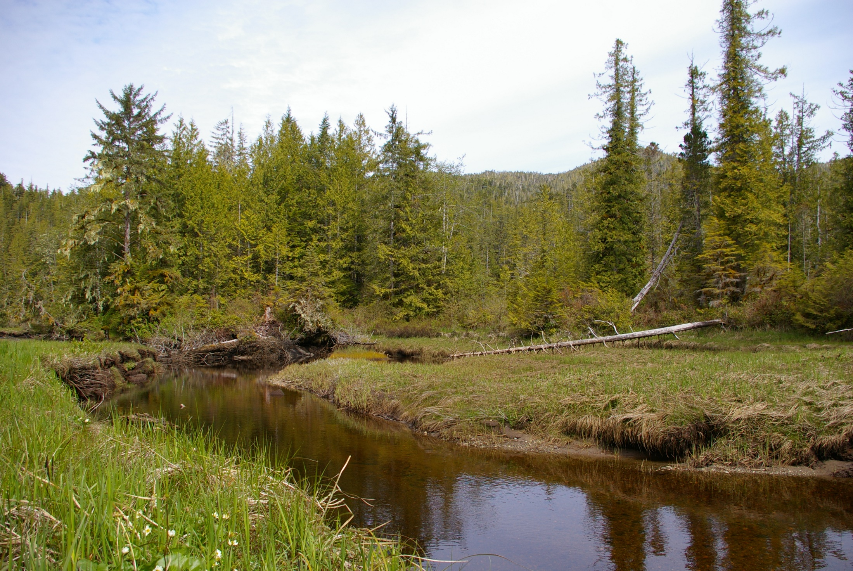
Skeena Salmon Program
Skeena Salmon Program
Expand baseline scientific information
Assess status of salmon populations & their habitats
Make data accessible to broad audience
Notes:
We’ve been working in the Skeena since 2008. Used Canada’s Wild Salmon Policy as a framework for our work around conservation science. 3 high level goals or steps which are outlined here.
expanding the baseline of scientific information for wild salmon and their habitats
using this information to assess the status of salmon populations and their habitats
making this information widely accessible to inform decisions around the management salmon and relevant land-use decisions.
Taken the same approach in other watersheds, which I’ll touch on at the end of my presentation. Through a decade of working in the Skeena watershed, we’ve developed a collaborative methodology for assessing status of salmon populations & their habitats and have begun to scale out to other regions.
And there’s an extensive collaborative, partnership-driven scientific process that is the foundation of all this work, but I’m going to jump straight to the punchline, to the outputs of each step

Slide 4
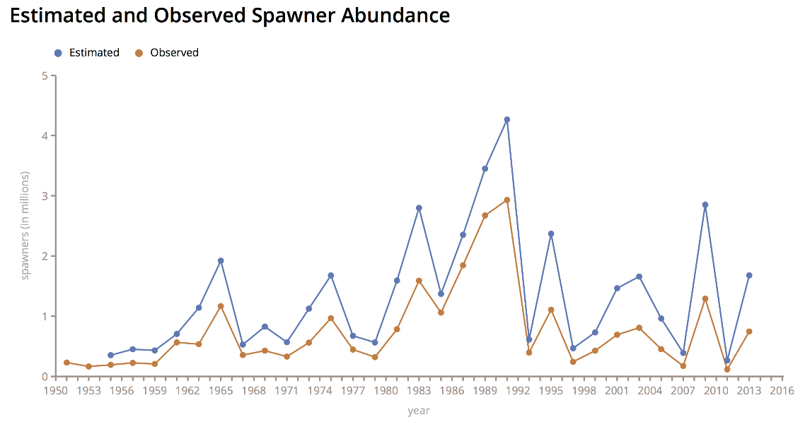
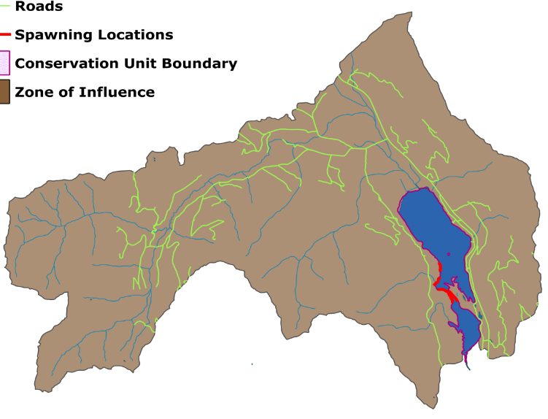
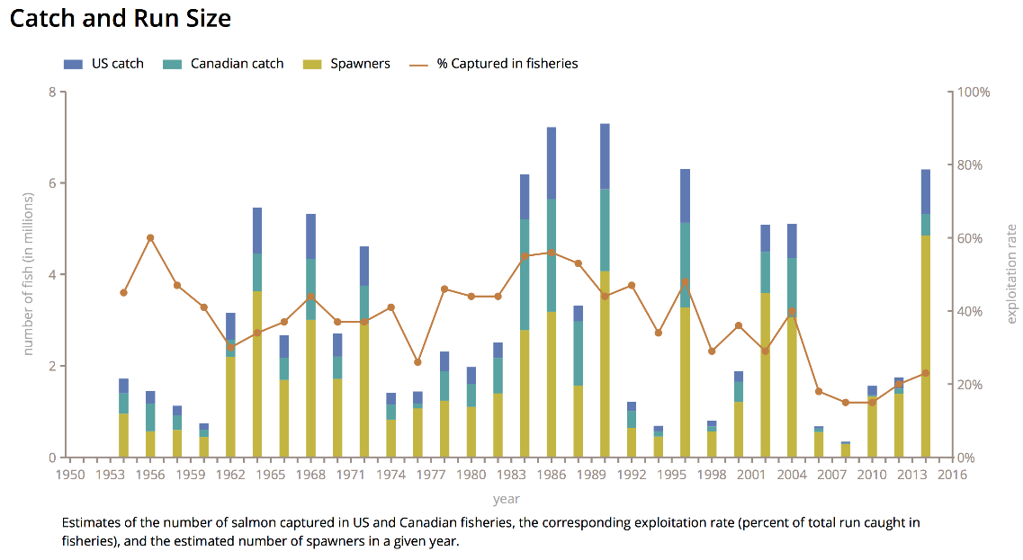
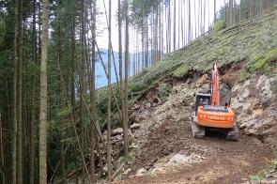
Baseline Data
Skeena Salmon Program
Expand baseline scientific information
Road Density
Notes:
Expand the baseline of available information for Skeena salmon populations. Over the past several years, we’ve invested substantial effort in assembling key data sets for most North and Central Coast salmon populations. These data include information on spawning locations, escapement, catch and run size, run timing, age-structure, and other metrics. This was a collaborative exercise that involved working with regional Fisheries and Oceans Canada staff as well as local First Nations.
Emphasize that this step involves significant effort and the time, input, and expertise of many partners. And without this work, none of the subsequent analysis would have been possible.
Also assembled existing data on habitat pressures, sourced largely from provincial databases. e.g. road density.

Slide 5
Skeena Salmon Program
Skeena Salmon Program
Assemble baseline scientific information
Assess status of salmon populations & their habitats
Notes:
Once we complete the step of assembling baseline data, we then use this information to assess the status of salmon populations and their habitats.

Slide 6
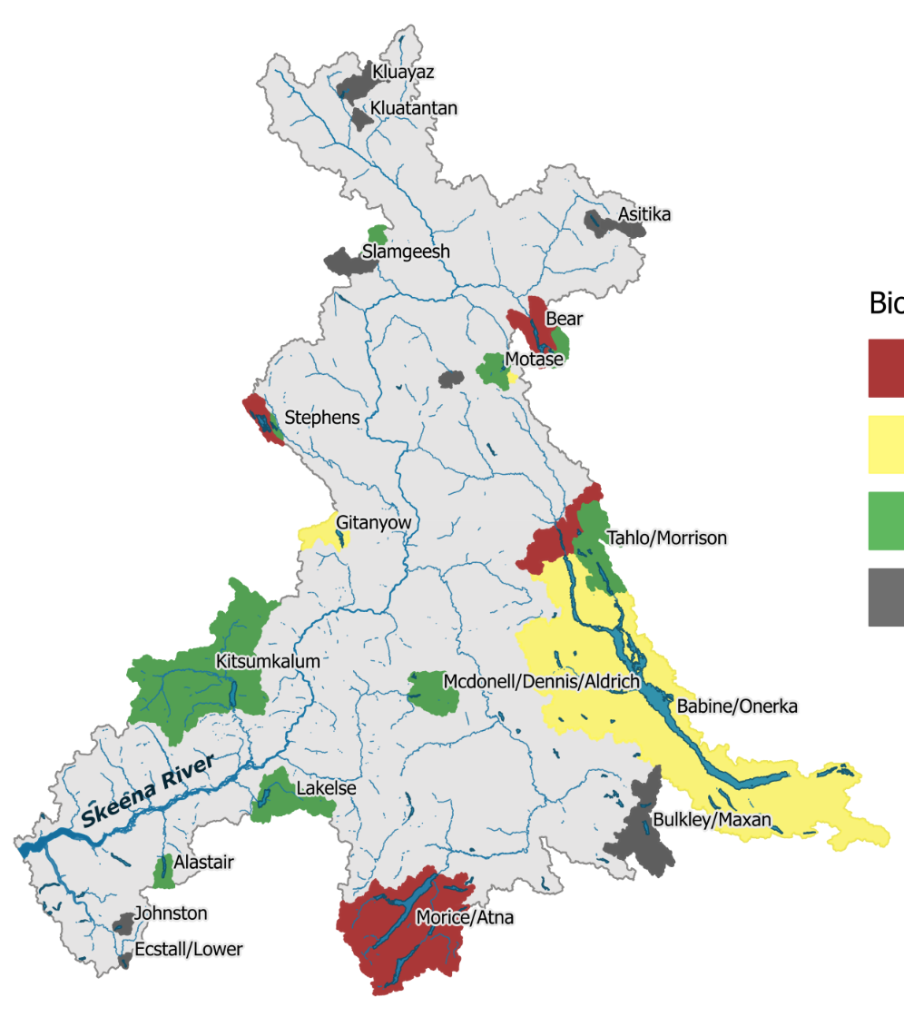
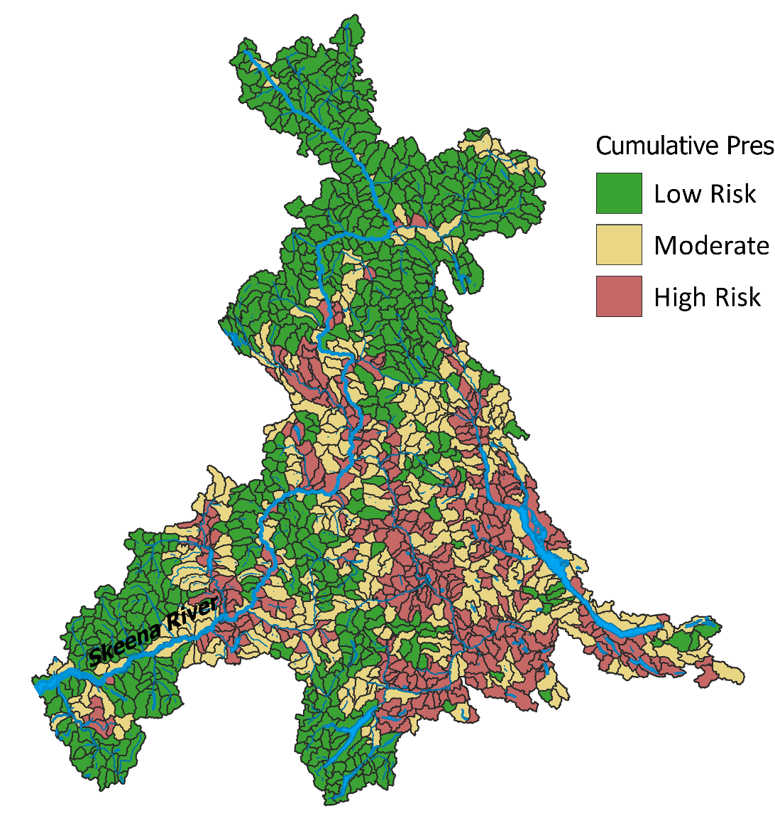
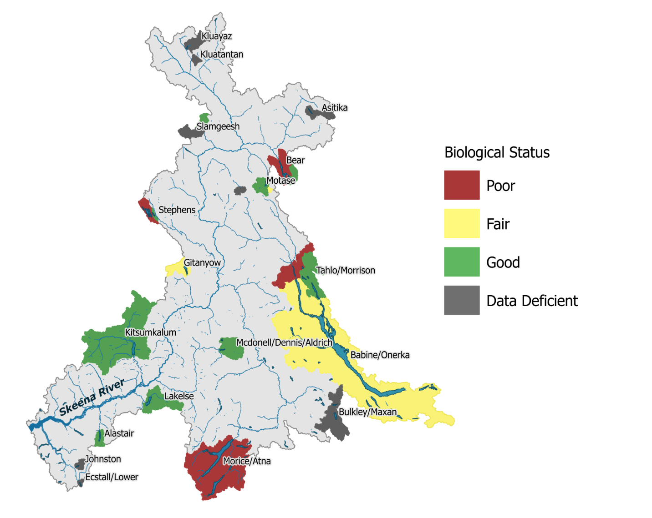
Population & Habitat Assessments
Population Assessments
Habitat Assessments
Biological Status
Cumulative Pressures
Notes:
I’m skipping over many, many steps in the methods, but, at a high-level, we’ve used all the information we assembled to undertake population and habitat assessments, which I understand to be a project area for the NPLCC and just happens to mirror strategies 1 and 2 of the Wild Salmon Policy.
We assessed populations at the scale of conservation units, which are groups of genetically, geographically, and ecologically distinct wild salmon. As an example, this map shows the status of 32 lake sockeye conservation units, using stock-recruitment-based benchmarks.
We also assessed pressures on freshwater habitats. We used a suite of 14 indicators, which we assessed individually and also rolled-up into a cumulative pressure assessment to produce this heat map. Red is areas with high risk of habitat degradation due to anthropogenic and environmental pressures and green is lower risk of habitat degradation. Yellow is somewhere in the middle. We also looked at freshwater habitats on a CU-by-CU basis, which you’ll see in the PSE.
All this work was done with a Technical Advisory Committee and various working groups which included representatives from Skeena First Nations, DFO, Provincial MOE, NGOs, and other regional experts.

Slide 7
Skeena Salmon Program
Skeena Salmon Program
Assemble baseline scientific information
Assess status of salmon populations & their habitats
Make data accessible to broad audience
Notes:
Our final goal is making the data and analyses broadly available to the public to help inform decision-making processes for management of wild salmon and relevant land-use decisions. This has occurred primarily through two online tools, though there are also some hard copy materials that we produce as well.

Slide 8
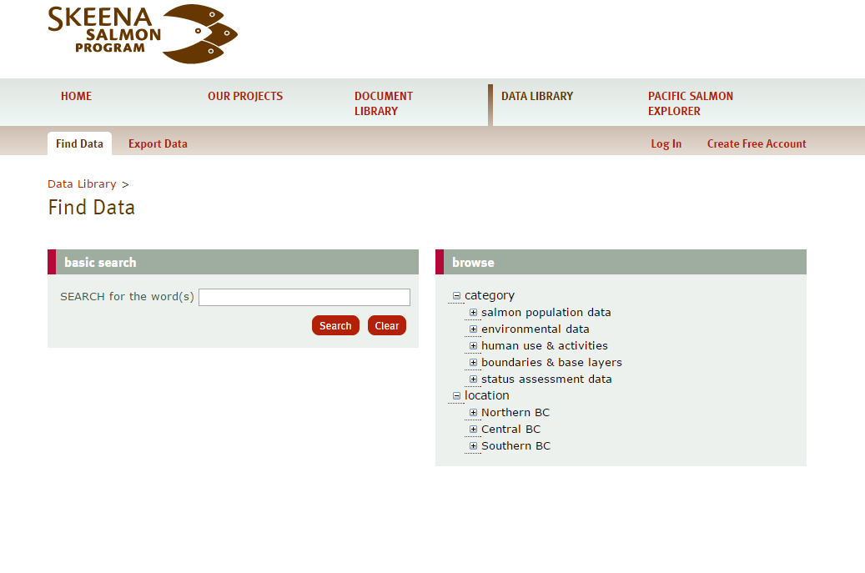
Salmon Database
data.skeenasalmonprogram.ca
Notes:
The first online tool is a centralized database to house the datasets that we’ve developed and assembled.
It is accessible via our website. (URL). This is a screenshot of the database (but we’ll look at it later). Ability to search for datasets by keywords or browse different categories of information or browse by location.
Investing in this infrastructure has been a key priority for us as it allows for transparency and accessibility of our data holdings.
In addition, it allows us to easily update datasets as new information becomes available and keep our analyses up to date.
Furthermore, this database powers the Pacific Salmon Explorer.

Slide 9
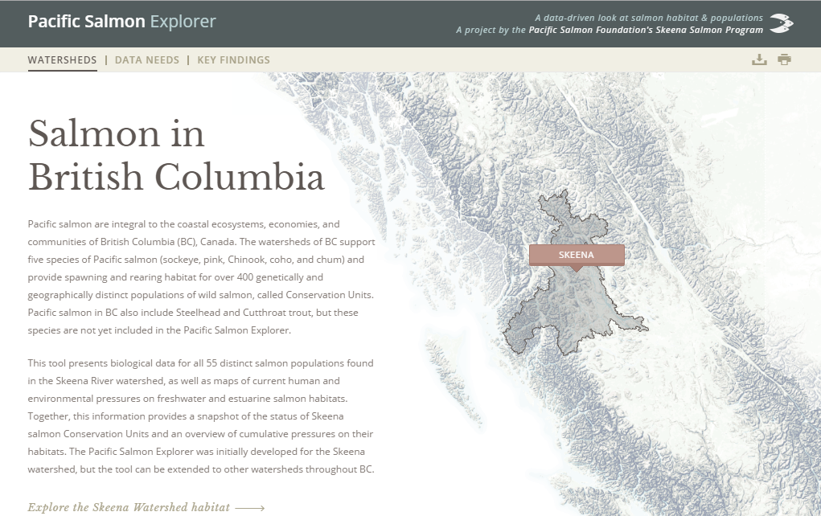
Pacific Salmon Explorer
salmonexplorer.ca
Notes:
The second online tool is the Pacific Salmon Explorer,
a data visualization and decision support tool that we launched last summer. I’m going to give a very brief overview of the tool, but I encourage you to check it out when you have time by visiting salmonexplorer.ca.

Slide 10
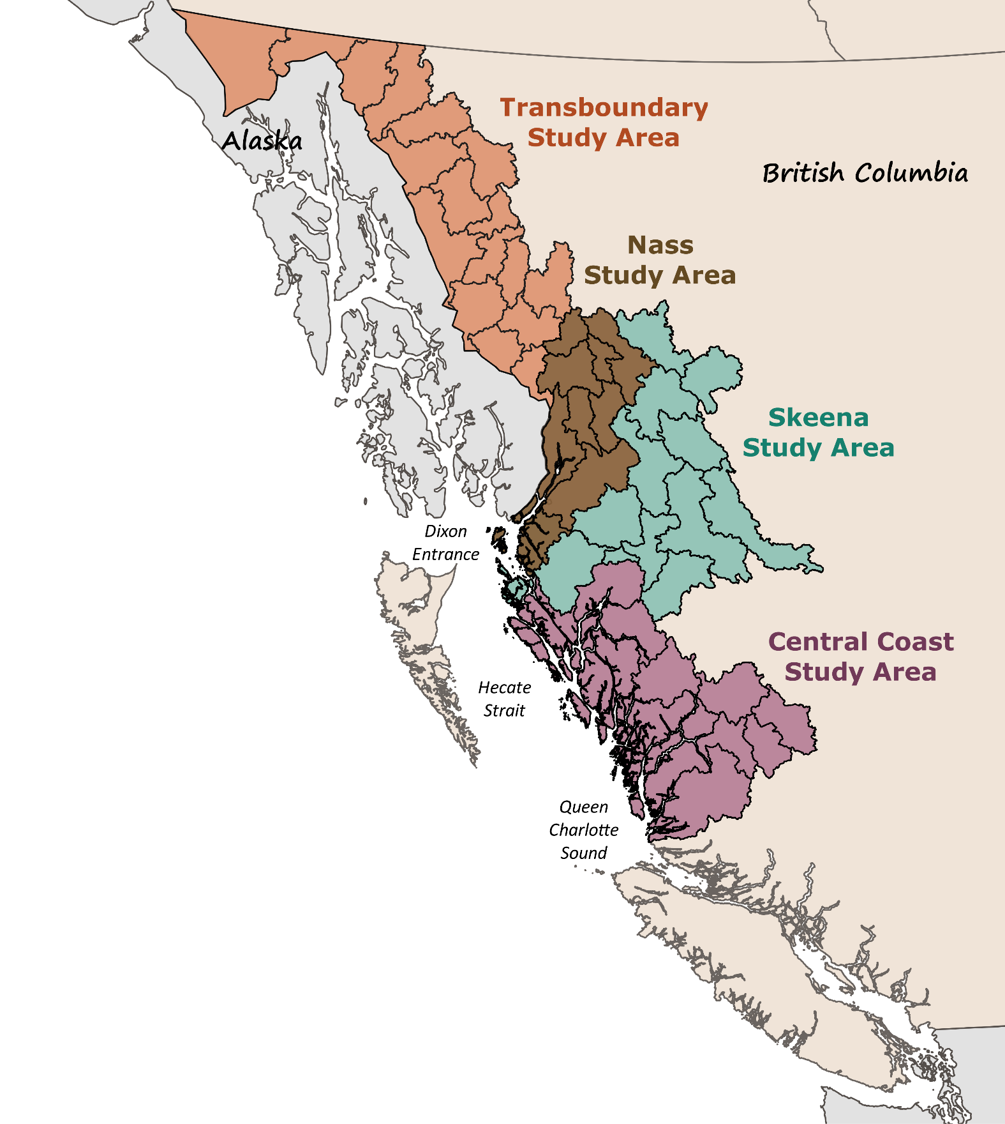
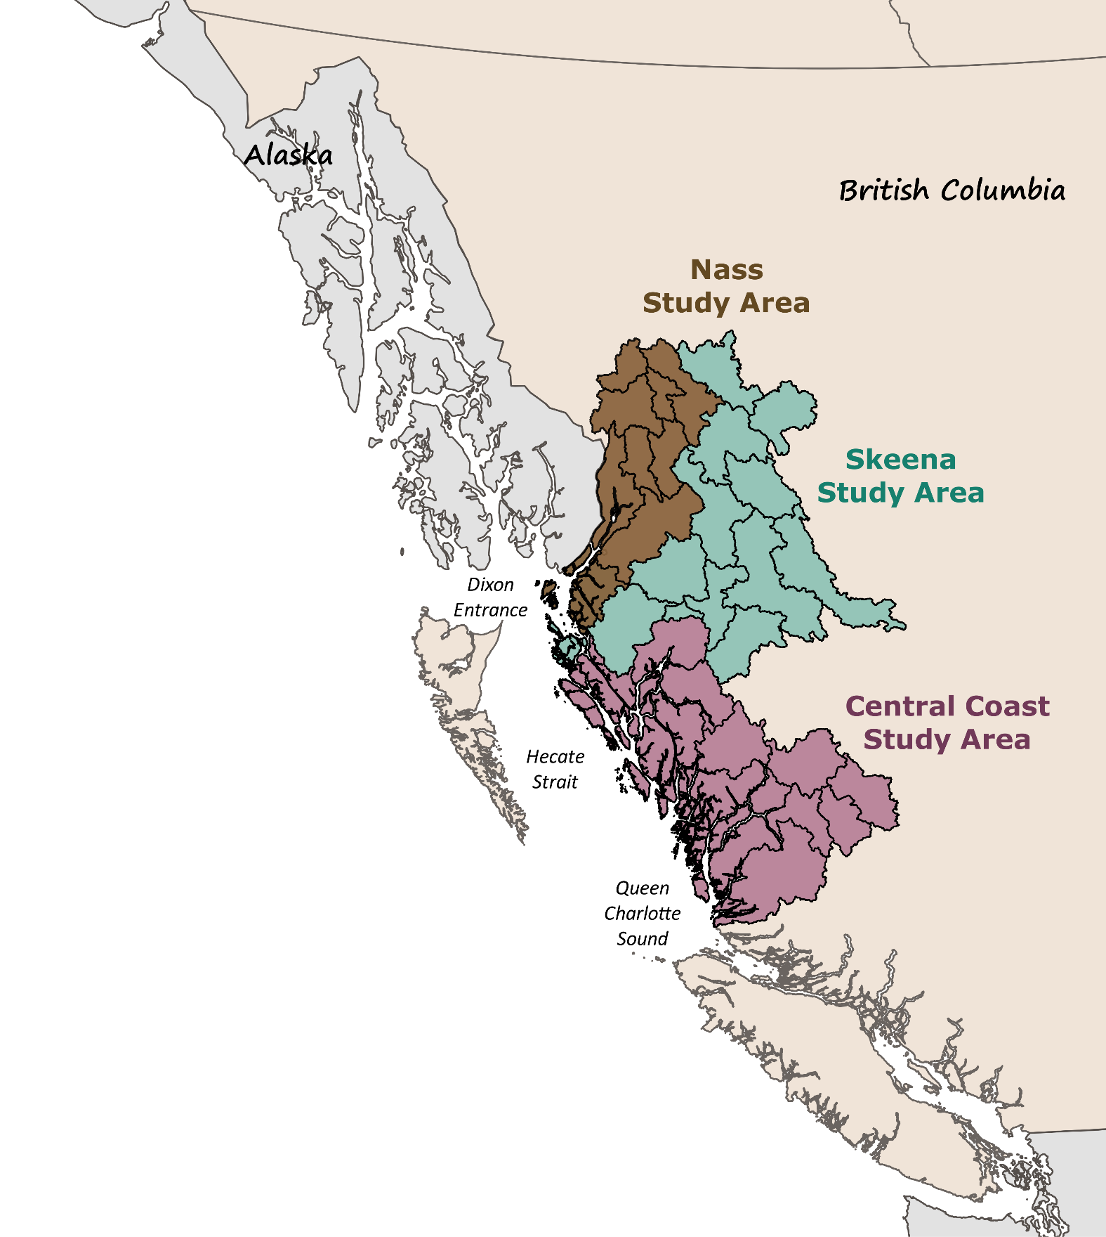
Scaling Out
Notes:
Using the approach that we’ve developed for the Skeena, PSF is actively working to scale out to other watersheds to inform conservation and land-use decisions across the North and Central Coast of BC. Skeena and Nass are done. Central Coast is underway.
We’re also very interested in working on watersheds that are transboundary with Alaska, and we’re in the very, very early stages of percolating some ideas with folks at Trout Unlimited and The Nature Conservancy. Apologize that this map only shows the Canadian side of the study area – so early in the process that we don’t have shapefiles for the US watersheds! Look at aquatic connectivity across multiple jurisdictional areas….
We’re looking to build partnerships and our network of data stewards. Collaboration is the foundation of our approach. We really rely on the knowledge of those that live and work in these regions. To the table, PSF is able to bring scientific capacity, methods that have been well-developed, robust data systems, and a platform for disseminating the results. (And we need funding.)
One thing to highlight that the population data assembly has not, to my knowledge, been completed for any CUs in this area. So that first step of bringing together existing population and stock assessment data will be significant and crucial for doing any subsequent work.
PSF’s overall aspiration for this work is that we can continue to scale out throughout BC and the Yukon and establish long-term partnerships with local communities, First Nations, Crown governments, industry, and others to keep the data and assessments up-to-date as new information becomes available.

Slide 11

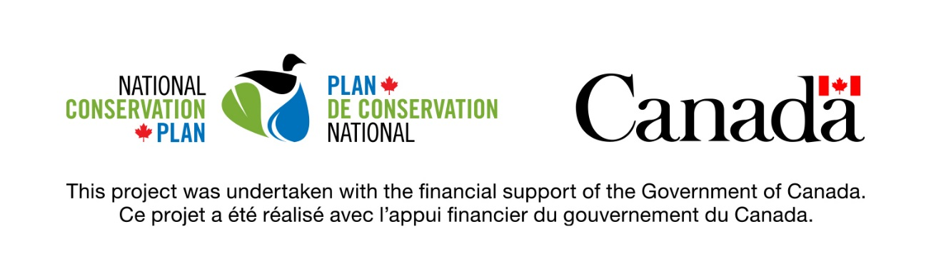
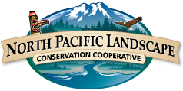


Acknowledgements
This project was funded by the Gordon and Betty Moore Foundation.
Notes:
Acknowledge funders. Although NPLCC and GNLCC haven’t contributed directly to this work, both groups have supported a project that my team is leading to develop a predictive stream temperature model for pilot watersheds in BC. Kim Hyatt is contributing to this work.

Slide 12


Photos
Paul Colangelo
Brian Huntington
Illustrations
Aimée van Drimmelen
ejones@psf.ca
data.skeenasalmonprogram.ca
salmonexplorer.ca

