Slide 1




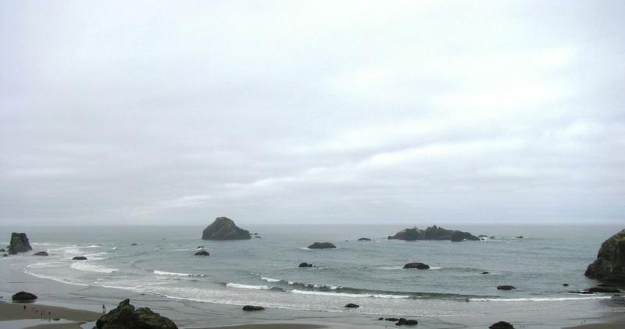
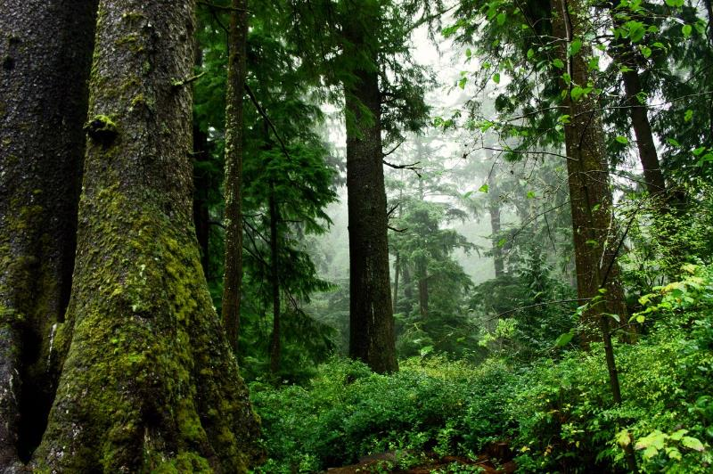

Who we are
Where we work
What we do
Local and network news
March 1, 2017

Slide 2

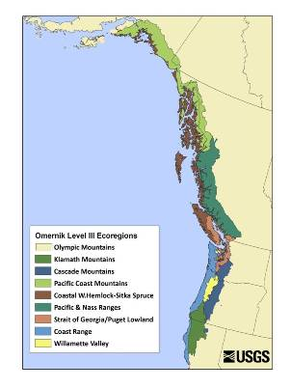
Coastal temperate rainforest region
Spans multiple agency, state, and international boundaries
Wide range of type and intensity of human land-use activities
Rich and diverse array of natural and cultural resources
Alpine areas at the crests of coastal mountains across subalpine, montane, and lowland forests and nearshore marine environment

Slide 3
Major System Stressors
Marine Areas
  Oceans increasing in acidity
  Sea surface temperatures are rising
  Increased storm intensity, extreme wave heights, coastal erosion
  Rising sea levels, varies by location
  Increase in hypoxic events in the California Current
  Species range shifts, altered phenology, invasives, disease
  Food chain impacts, plankton die offs

Slide 4
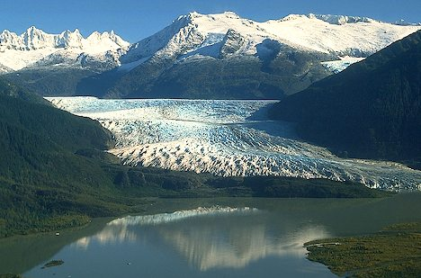
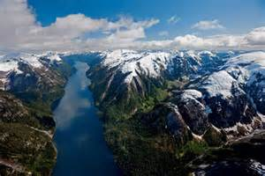
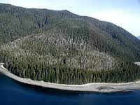
On Land
Annual average temperatures increasing
Reduced snowpack, earlier snowmelt, more intense rain
Increased frequency and size of landslides
Wetter winters; increased summer drought
Increased growing seasons and frost-free periods
Fire frequency and severity is increasing
Invasives, pests, and disease:
  Spruce bark beetle, Swiss needle cast, sudden oak death
  Yellow-cedar decline is expanding
  Mountain pine beetle risk increasing
Habitat loss and transition
Species phenology, range shifts, and community composition.

Slide 5

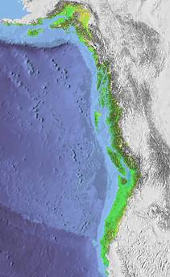
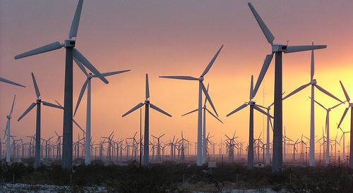
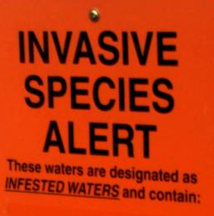
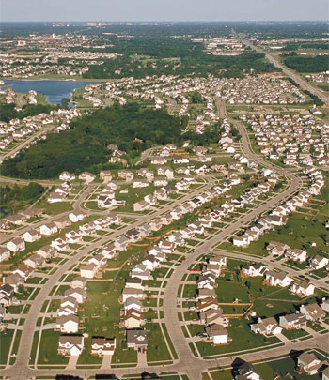
Other Challenges
Other Change Agents:
  Population growth, land use changes, energy development, resource uses
Many sovereign entities with distinct priorities and authorities
Data and partnership rich in southern portions; lack of baseline information in northern regions
Fire hose challenges on climate and adaptation; need translation
Many uncoordinated plans, processes, data sets – lack of large-scale landscape vision for future

Slide 6
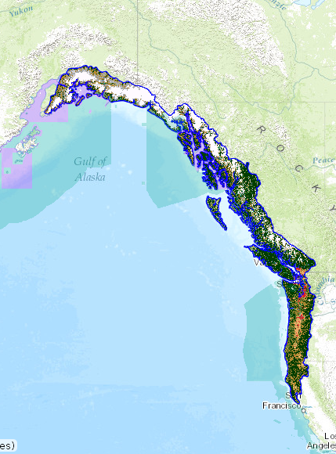
A True Self-directed Partnership
Promote development, coordination & dissemination of science
to inform landscape-level conservation & sustainable resource management
in the face of a changing climate and other landscape-scale change agents.
Notes:
If you need to leave out a slide – I recommend this one (or just briefly mention points here)
In FY 2012 – a focus was placed on funding TEK projects throughout the NPLCC. We hope to learn more about how and where TEK can be incorporated into NPLCC actions and management decisions. We may also need to update the Science/ TEK Strategy and the Implementation Plan based on lessons learned with these projects.
Currently on our website are draft reports that National Wildlife Federation prepared that compile literature and synthesize information about climate change effects and adaptation approaches for freshwater and for marine and coastal ecosystems in the entire range of the NPLCC. They are in the process of preparing a similar report for terrestrial habitats.
A cross –boundary data sharing workshop that will be held in Vancouver. B.C. was also supported. The Alaska Coastal Rainforest Center hosted the first two workshops and this third workshop will build on the past efforts.

Slide 7

Seven Goals:
Maximize ability resource managers make informed decisions given climate change and related stressors
Identify and address transboundary, landscape-level natural and cultural resource needs
Identify priorities for applied science and other information for conservation/sustainable resource management; coordinate efforts with science centers
Maximize availability and accessibility of data & information about large-scale stressors, impacts to natural & cultural resources, management options
Promote identification, use and sharing of science, traditional ecological knowledge, other relevant information
Promote coordination and efficiency of efforts
Promote awareness of effects climate change on environment, cultures, economies
Notes:
If you need to leave out a slide – I recommend this one (or just briefly mention points here)
In FY 2012 – a focus was placed on funding TEK projects throughout the NPLCC. We hope to learn more about how and where TEK can be incorporated into NPLCC actions and management decisions. We may also need to update the Science/ TEK Strategy and the Implementation Plan based on lessons learned with these projects.
Currently on our website are draft reports that National Wildlife Federation prepared that compile literature and synthesize information about climate change effects and adaptation approaches for freshwater and for marine and coastal ecosystems in the entire range of the NPLCC. They are in the process of preparing a similar report for terrestrial habitats.
A cross –boundary data sharing workshop that will be held in Vancouver. B.C. was also supported. The Alaska Coastal Rainforest Center hosted the first two workshops and this third workshop will build on the past efforts.

Slide 8

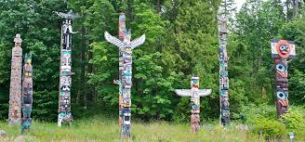
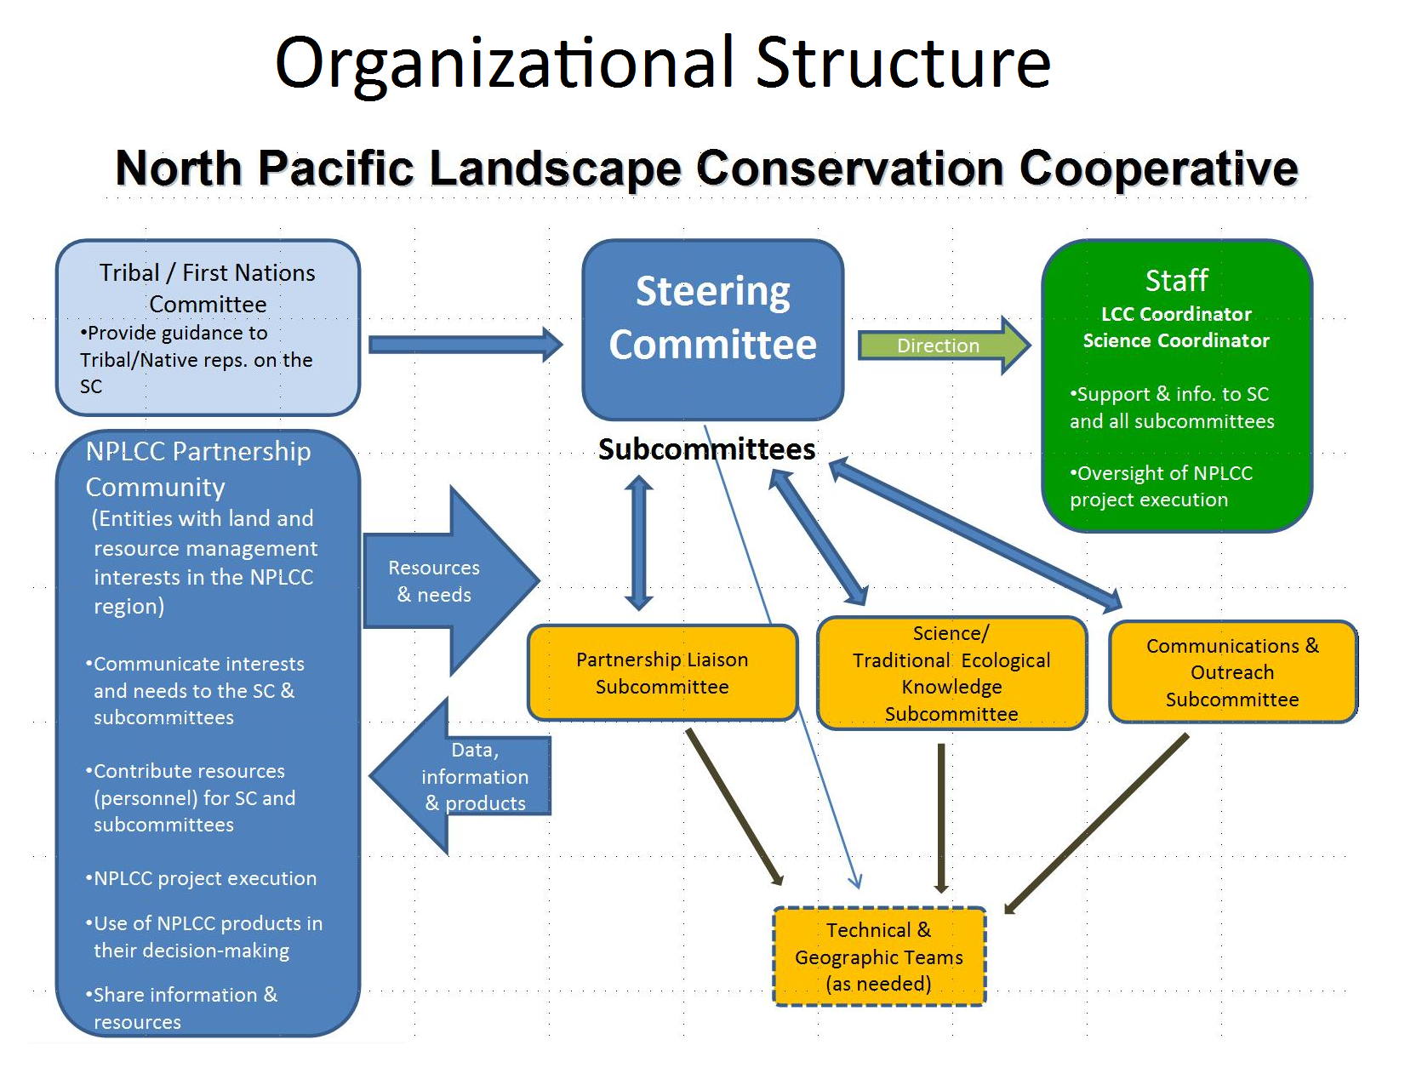

Slide 9
Steering Committee Entities
5 Tribes & First Nations
AK, BC, WA, OR, CA
Provincial/State
British Columbia
4 States (AK, WA, OR, CA)
Partnerships:
Pacific Birds Habitat J.V.
Fish Habitat Partnerships
Science Orgs:
CSC (AK, NW, SW)
NOAA RISAs
Pac. Climate Impacts Con.
Federal
CWS, DFO, USFWS, USFS, BLM, NOAA, NRCS, EPA, NPS, USGS, BIA
NGOs
Notes:
If you need to leave out a slide – I recommend this one (or just briefly mention points here)
In FY 2012 – a focus was placed on funding TEK projects throughout the NPLCC. We hope to learn more about how and where TEK can be incorporated into NPLCC actions and management decisions. We may also need to update the Science/ TEK Strategy and the Implementation Plan based on lessons learned with these projects.
Currently on our website are draft reports that National Wildlife Federation prepared that compile literature and synthesize information about climate change effects and adaptation approaches for freshwater and for marine and coastal ecosystems in the entire range of the NPLCC. They are in the process of preparing a similar report for terrestrial habitats.
A cross –boundary data sharing workshop that will be held in Vancouver. B.C. was also supported. The Alaska Coastal Rainforest Center hosted the first two workshops and this third workshop will build on the past efforts.

Slide 10
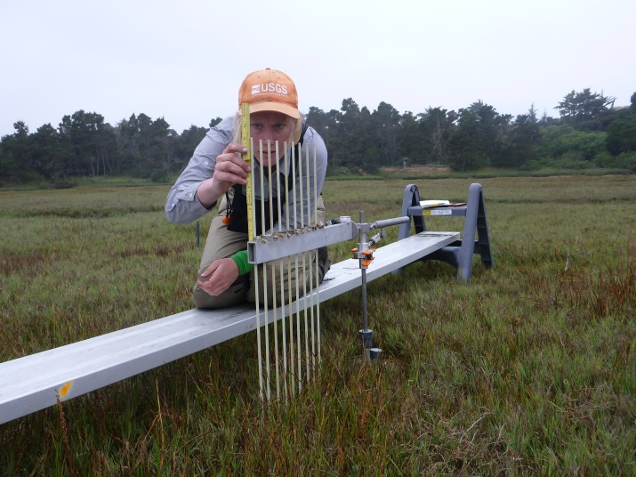
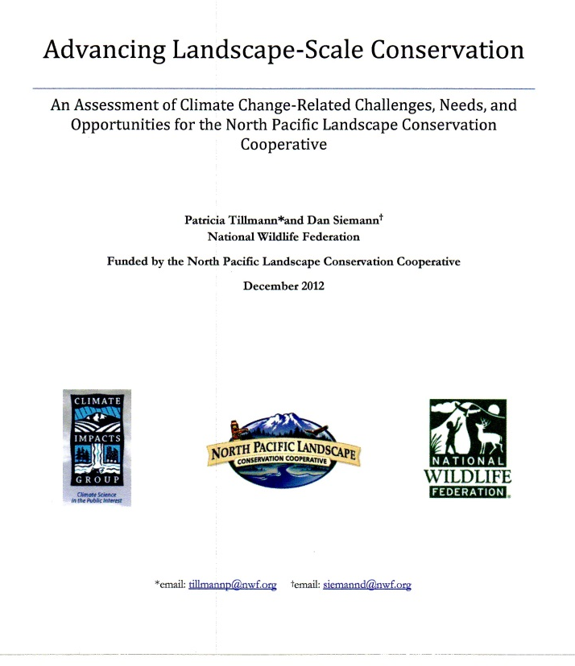
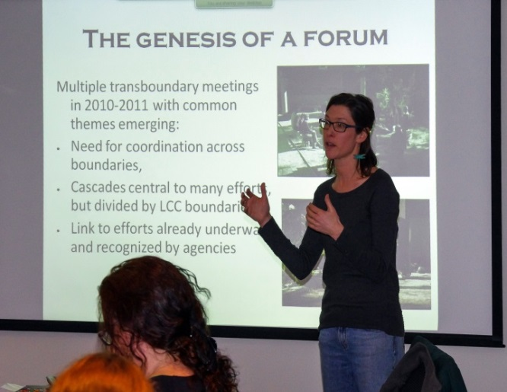
NPLCC Strategic Roles:
Convene partners and assess conservation management needs
Build capacity to address needs
Fund/Leverage management-relevant projects
Communicate & share Information

Slide 11
 | Climate-related drivers
Valued resources
Assess Partner Needs
Priority Topics:
Hydrologic regime shifts - rivers, streams, and riparian corridors
Air temp and precip in forests
Effects of changes in sea levels and storms on shorelines
Changes affecting anadromous fish
Invasive species, diseases, pests s
Additional needs:
Communication tools
Climate models
Training
Traditional Knowledge
Subsistence Resources
Demonstration projects
Localized needs
Notes:
The Science/TEK Strategy includes Key parts - Guiding Principles and Priority Topics
Guiding Principles:
They are not ties to specific Priority Topics but encompass a variety of approaches that can be used to address an identified information or support gap.
They will be important in the annual planning work
The first guiding principle recognizes the importance of the NPLCC assisting with the development of adaptation and mitigation response actions and having a direct management link.
The second strategy recognizes the large amount of data and information that already exists and the need for the NPLCC to facilitate coordination, collaboration, capacity building, and developing tools for decision-makers, versus focusing on new data collections.
TEK is recognized as equally important as western science. The NPLCC will help identify and promote opportunities to use TEK where desired by Tribes and First Nations.
The NPLCC has a large number of different ecosystems and addressing the connections and interactions is important.
Priority Topics:
The first 3 Priority Topics focus in the NPLCCs three general ecosystems – freshwater/riparian, marine/coastal, and forests
Anadromous fish were selected as a priority topic because of their cultural and economic importance
The last priority topic focuses on invasive species, diseases, pests and their effects on biological communities in all the ecosystems.

Slide 12
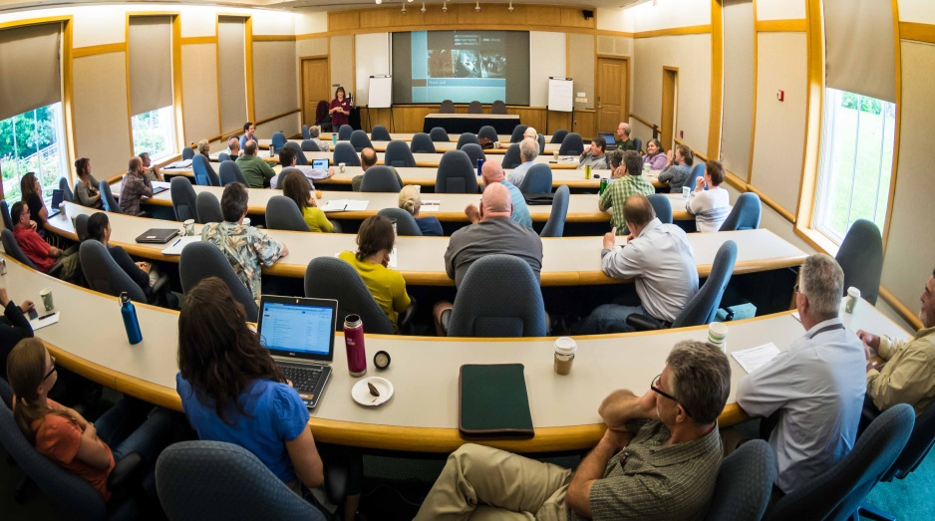
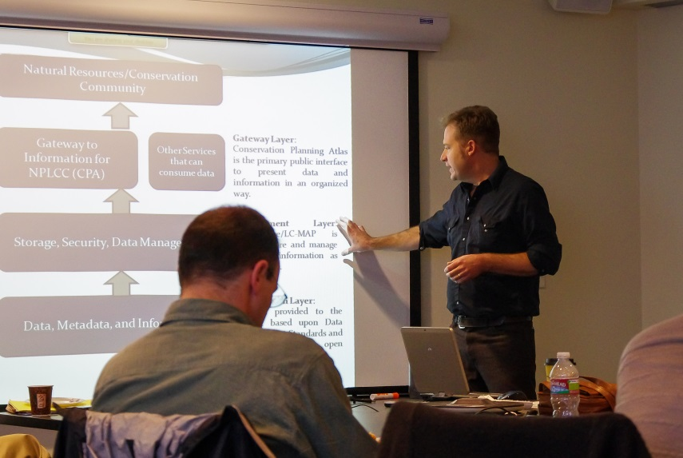
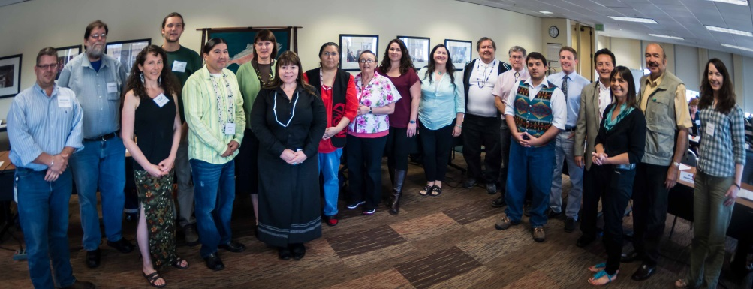
Build Capacity
  VA Training
  Climate Smart Conservation Planning
  Pilot/demonstration projects
  Travel/participation support
  Information sharing platform and workshops
  Convene partners on common topics, geographies
  Landscape Conservation Design
Notes:
The Science/TEK Strategy includes Key parts - Guiding Principles and Priority Topics
Guiding Principles:
They are not ties to specific Priority Topics but encompass a variety of approaches that can be used to address an identified information or support gap.
They will be important in the annual planning work
The first guiding principle recognizes the importance of the NPLCC assisting with the development of adaptation and mitigation response actions and having a direct management link.
The second strategy recognizes the large amount of data and information that already exists and the need for the NPLCC to facilitate coordination, collaboration, capacity building, and developing tools for decision-makers, versus focusing on new data collections.
TEK is recognized as equally important as western science. The NPLCC will help identify and promote opportunities to use TEK where desired by Tribes and First Nations.
The NPLCC has a large number of different ecosystems and addressing the connections and interactions is important.
Priority Topics:
The first 3 Priority Topics focus in the NPLCCs three general ecosystems – freshwater/riparian, marine/coastal, and forests
Anadromous fish were selected as a priority topic because of their cultural and economic importance
The last priority topic focuses on invasive species, diseases, pests and their effects on biological communities in all the ecosystems.

Slide 13
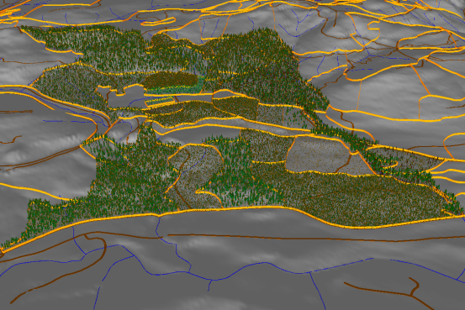
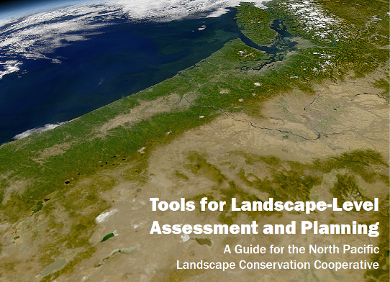
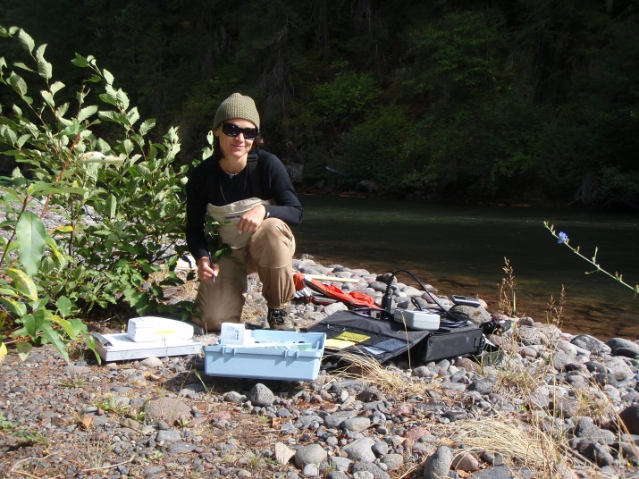
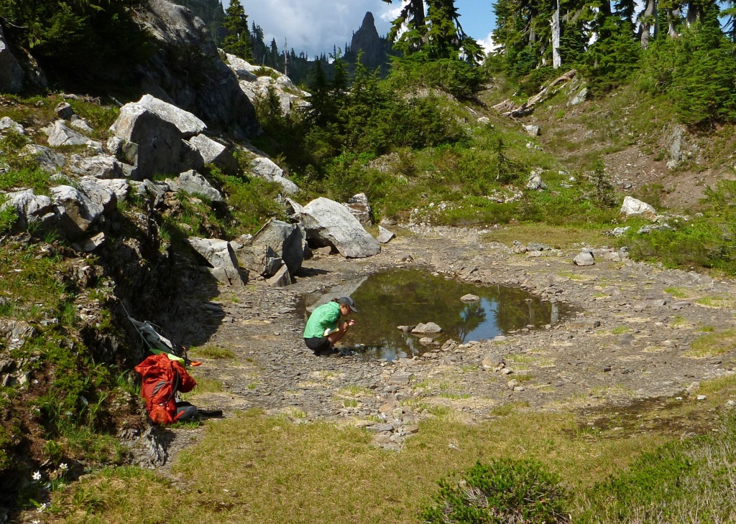
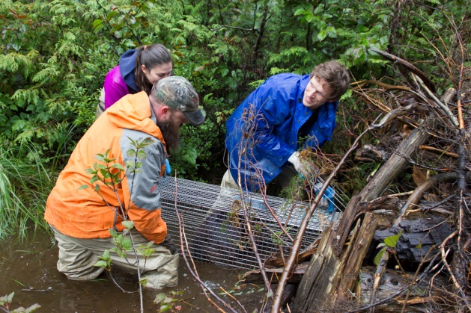
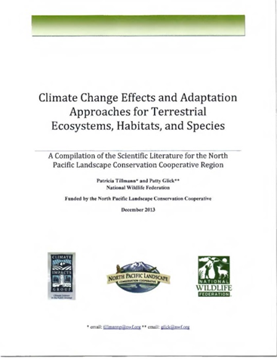
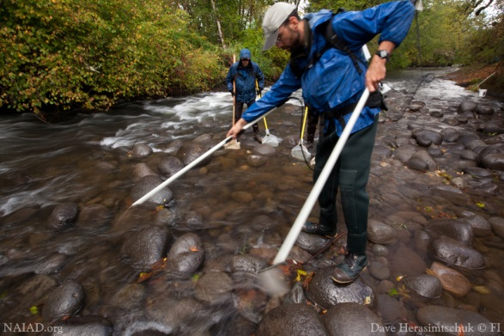
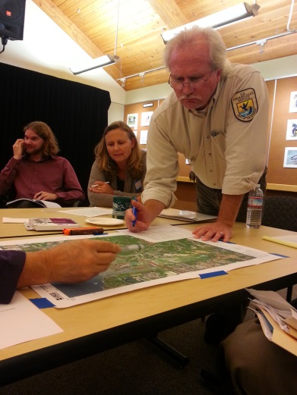
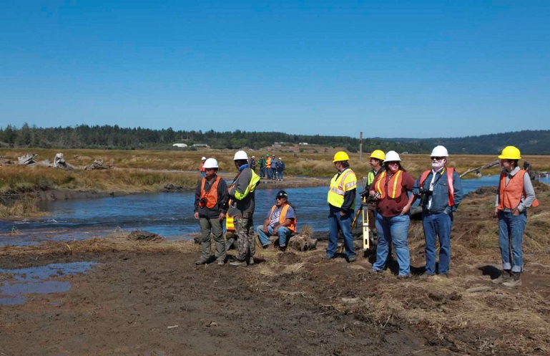
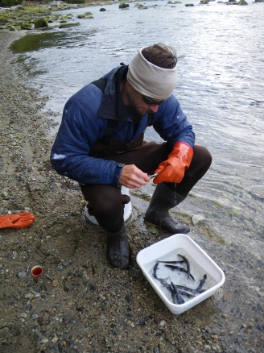
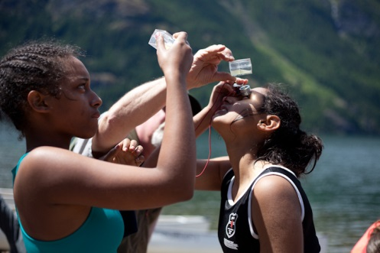
Fund/Leverage Strategic Projects
Notes:
The Science/TEK Strategy includes Key parts - Guiding Principles and Priority Topics
Guiding Principles:
They are not ties to specific Priority Topics but encompass a variety of approaches that can be used to address an identified information or support gap.
They will be important in the annual planning work
The first guiding principle recognizes the importance of the NPLCC assisting with the development of adaptation and mitigation response actions and having a direct management link.
The second strategy recognizes the large amount of data and information that already exists and the need for the NPLCC to facilitate coordination, collaboration, capacity building, and developing tools for decision-makers, versus focusing on new data collections.
TEK is recognized as equally important as western science. The NPLCC will help identify and promote opportunities to use TEK where desired by Tribes and First Nations.
The NPLCC has a large number of different ecosystems and addressing the connections and interactions is important.
Priority Topics:
The first 3 Priority Topics focus in the NPLCCs three general ecosystems – freshwater/riparian, marine/coastal, and forests
Anadromous fish were selected as a priority topic because of their cultural and economic importance
The last priority topic focuses on invasive species, diseases, pests and their effects on biological communities in all the ecosystems.

Slide 14
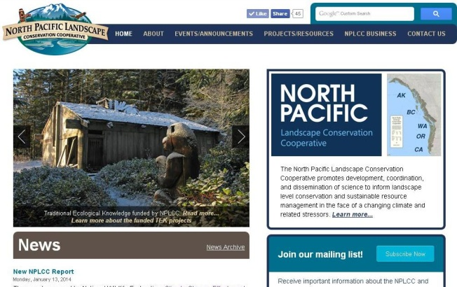

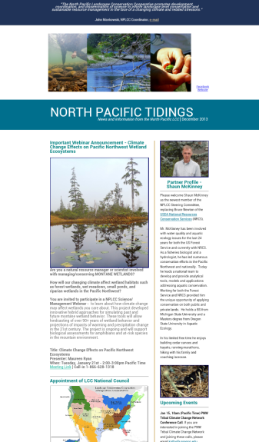



Communicate & Share Information
Website
Conservation Planning Atlas
Science/Management Webinars
Newsletters
  Climate Science Digest
  North Pacific Tidings
Social Media
  Facebook, Twitter, YouTube, Tumblr
Conferences/workshops/trainings
  NorthPacificLcc.org

Slide 15
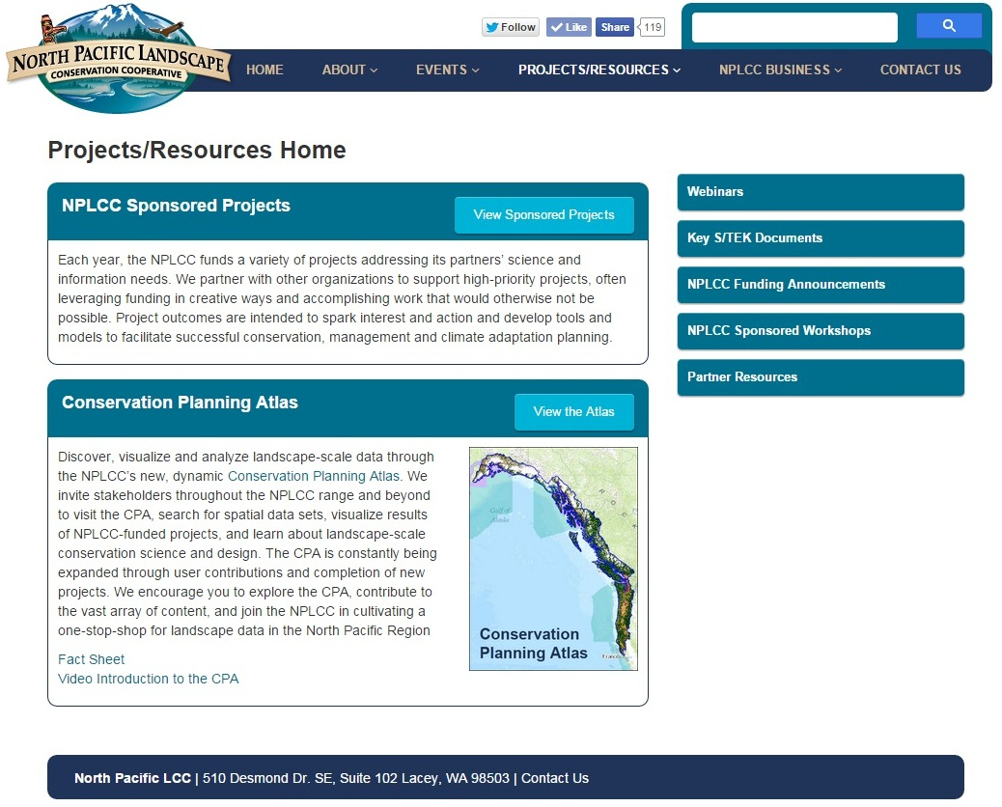
Over 50 Projects Funded
~$2 M invested

Slide 16
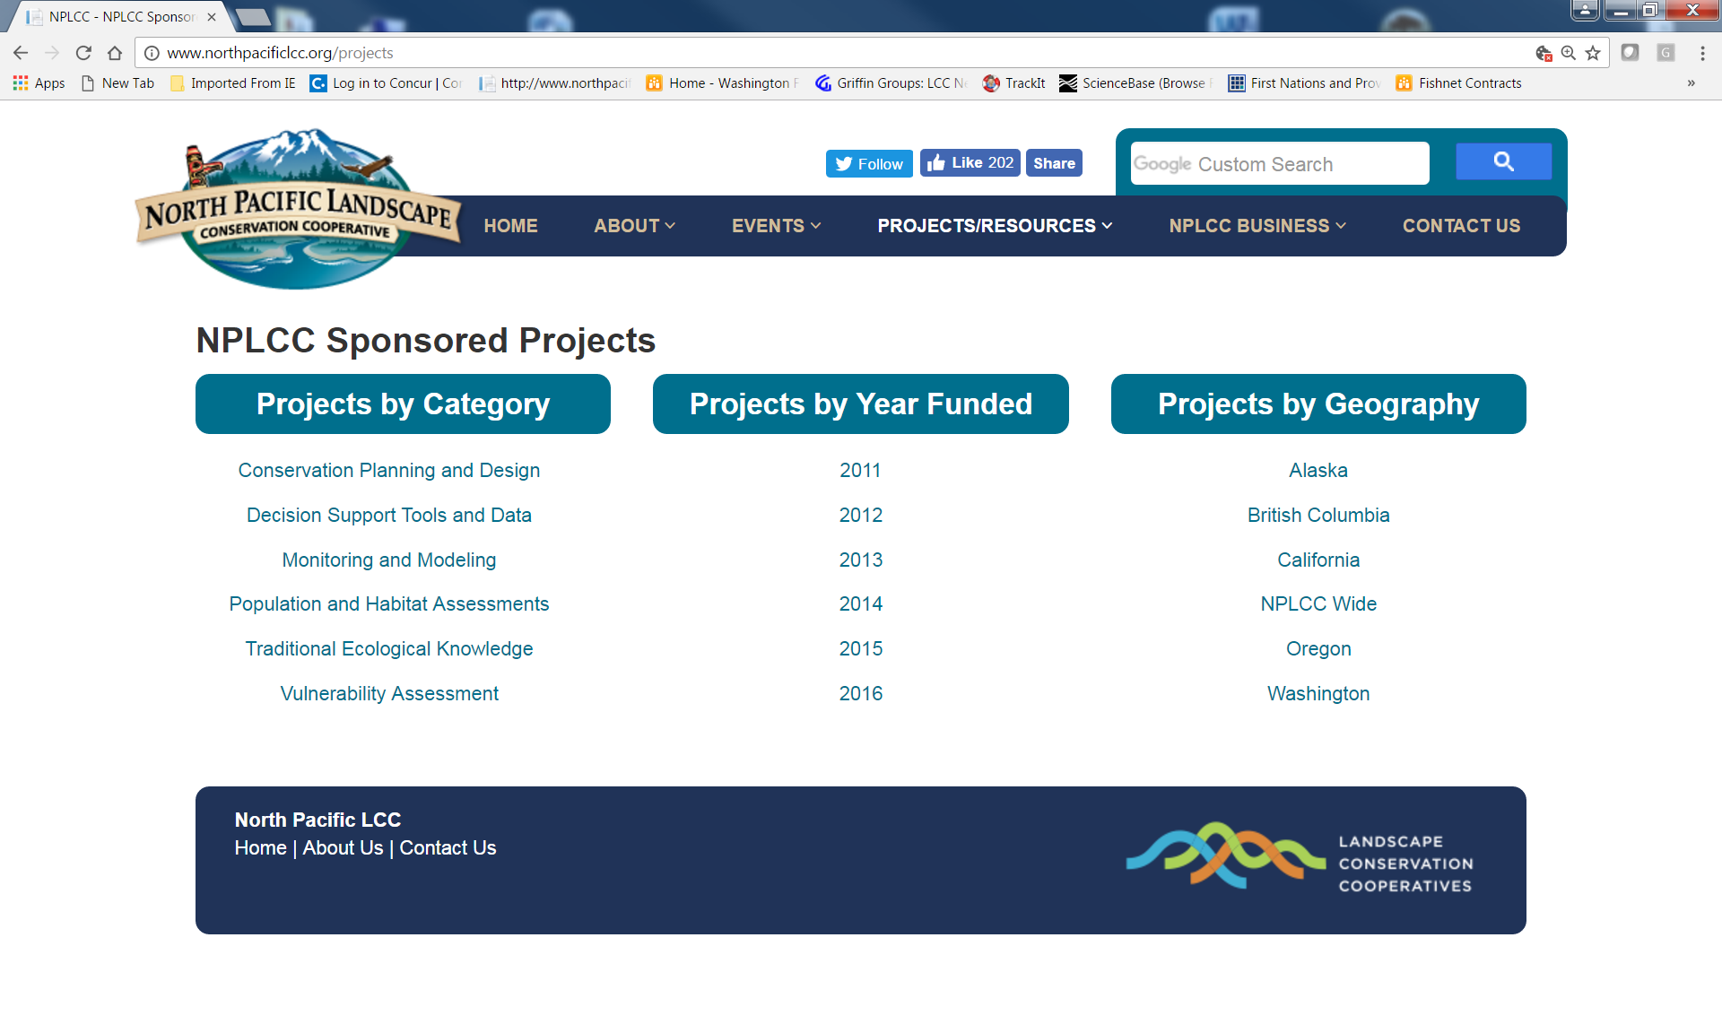

Slide 17
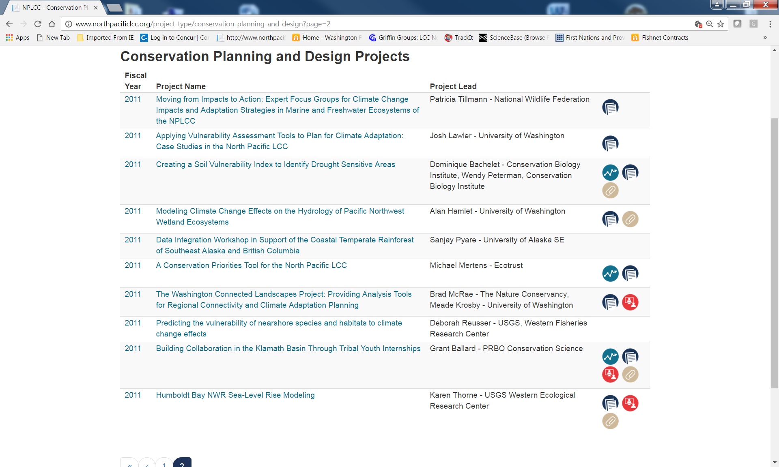

Slide 18
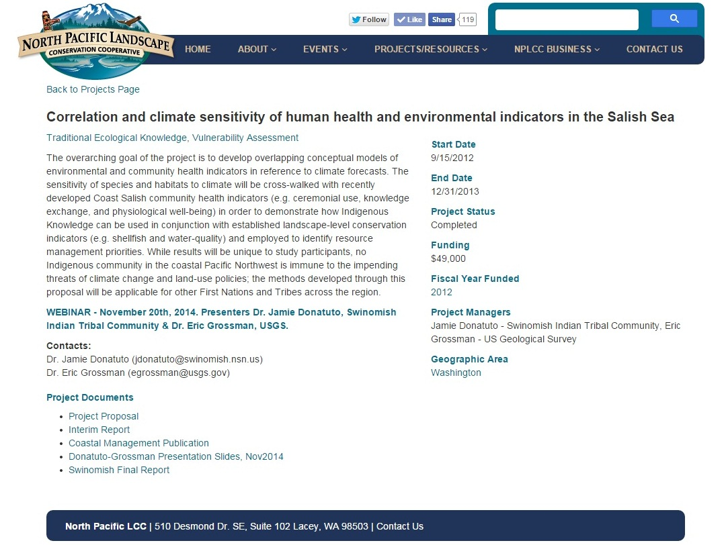

Slide 19
Looking Forward
5- Year Strategic Plan 2017 - 2021
Combined overall SP (T/FN, S/TEK, Coms)
Focus work on partner priorities, where we can make a difference
Create/use performance metrics/measures
Expand partnership and resource pool
FWS partnership support outlook
FY 17- Continuing resolution for the rest of FY17; will know in April. Working on project priorities
FY 18 – President’s budget in a couple of weeks
  NorthPacificLcc.org

Slide 20

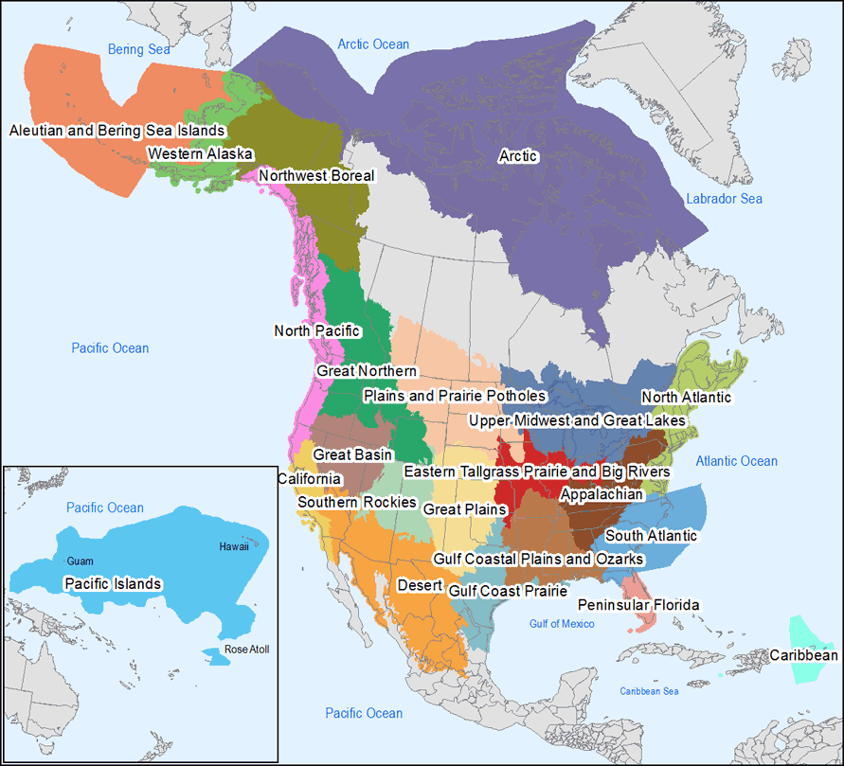

Slide 21
National Network News
LCC Council News
  Membership expanded
  Actions adopted on Collaborative Conservation
  Funding Committee established
Building Blocks communications document
NAS Report and Report Card (see handouts)
Performance Measures
  NorthPacificLcc.org

Slide 22
Closing Points
Our Thanks
  Barry Smith, Chris Tunnoch, Tasha Sargent
  Guests and presenters
Your Team
  Barry Smith, Karen Taylor-Goodrich
  Penny and Sophie from EI
  Mary Mahaffy
  Meghan Kearney
  Tom Miewald
Keeping connected – Updated Tidings Newsletter
Information in the room
Four important announcements:

