Slide 1
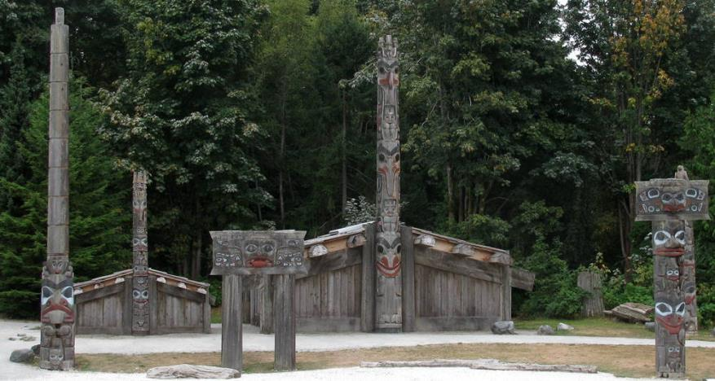
Conversations on Climate with First Nations Communities in BC

Slide 2
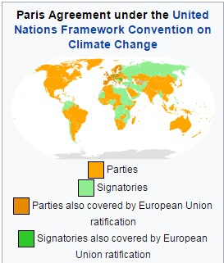
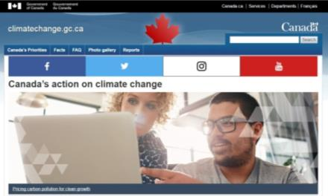
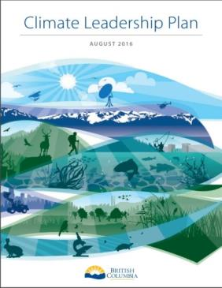

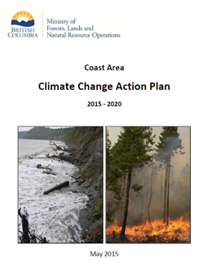
Government and climate change
Pan Canadian Framework 2016
Paris Climate Accord 2015
BC Climate Leadership Plan
(updated in 2016)
Ministry Action Plans

Slide 3
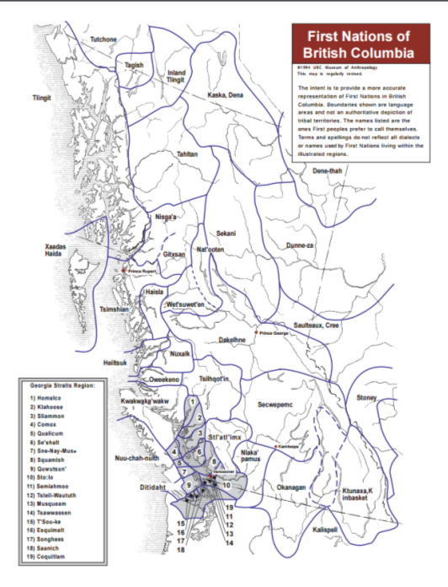
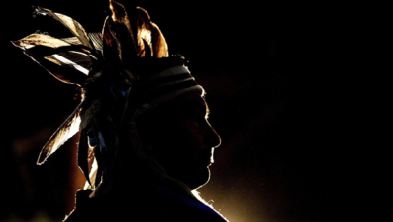
BC First Nations and climate change
198 distinct First Nations, each with their own unique traditions, culture and history
30+ different languages and close to 60 dialects spoken in the province

Slide 4
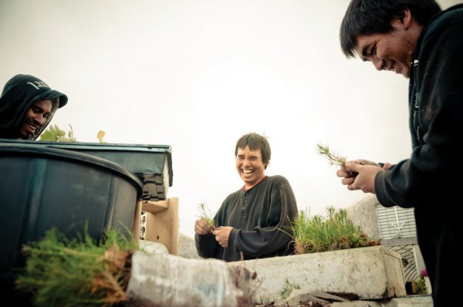
LCC/Ministry of Forests, Lands & Natural Resource Operations project….
Goal:
Create a better understanding of the climate change risks and impacts faced by First Nation communities, specifically those related to natural resource values in order for FLNRO to collaborate in a meaningful way in adaptation and mitigation planning.

Slide 5
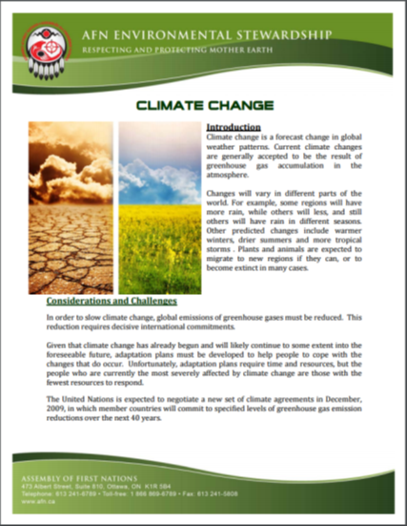
Objectives:
Identify and inventory climate change research, plans and vulnerability assessments currently being developed by FN’s across BC.
Produce an up to date inventory detailing climate impacts, risks and vulnerability assessments as developed by FN. (similar to and tying in, where appropriate, with University of Oregon Tribal data base)
Create a better understanding with staff the risks that climate change poses for FN Communities and where collaboration opportunities may exist.
Contribute to a comprehensive representation of climate change adaptation initiatives by the indigenous peoples of the Pacific Northwest.

Slide 6
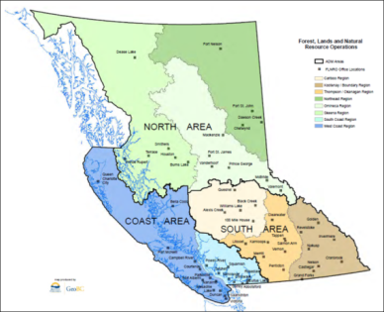
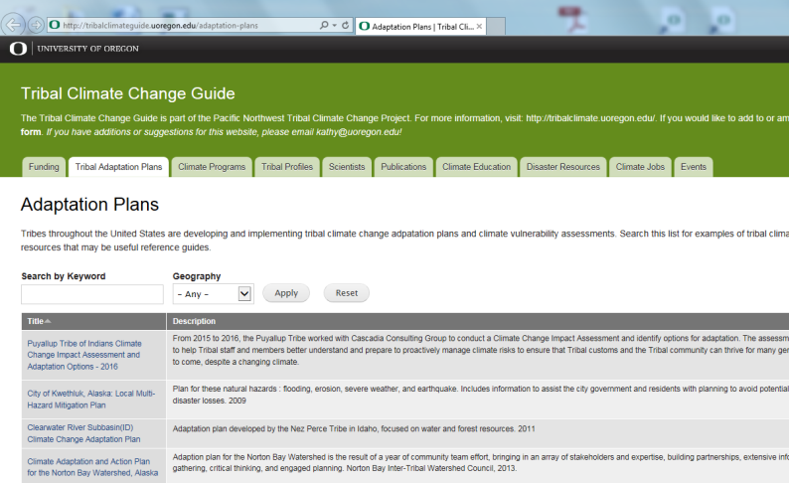
Project status & deliverables
Currently in information collection stage
Setting up collaborative approaches with other ministries and regions
Networking through workshops
Ultimate goal….
Production of a provincial accessible data base that ties into and supports University of Oregon's online Tribal Climate Change Guide

Slide 7
Ministry of Aboriginal Relations and Reconciliation project
Goals:
Establish a network of key First Nation communities who are mitigating and/or adapting to effects of climate change within their territories
Increase understanding within the provincial government of climate change impacts and responses from a First Nations perspective
An integrated First Nation approach on engagement across government on climate change
A coordinated strategy with outside partners to support First Nations communities in the context of climate change adaptation and mitigation

Slide 8
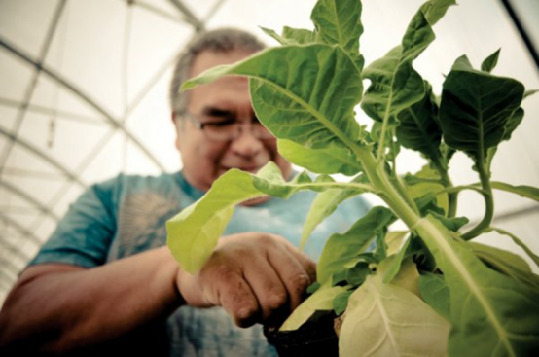
Objective/Deliverable:
Develop a report on First Nations and climate change
How are First Nations impacted by climate change?
What actions are First Nations communities taking to address climate change?
Recommendations on engagement
Understanding information sharing
networks
Where is there available funding?
Identification of key partners
Recommended next steps

Slide 9
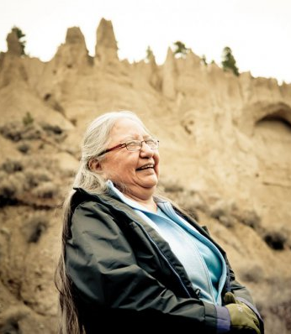
Project Status
Engagement:
First Nations Leadership Gathering;
Generate: Clean Energy Conference
Regional Forestry Workshops
Interviews
Preliminary Findings:
Climate impacts
Climate initiatives
Climate engagement and support
Next steps…
Collaboration and engagement with First Nations based on respect and understanding

Slide 10
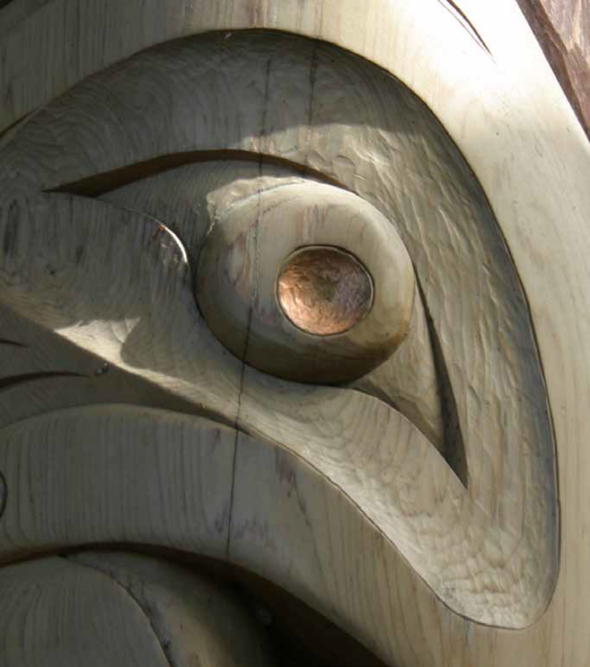
Bringing the two projects together
Similarities:
Collection of information; baseline of understanding for government staff
Establishment of a repository of information
Collaboration is key
Differences/Strengths:
Specific ministry perspectives and purpose e.g. natural resource lens vs. holistic community lens

Slide 11

Collaboration:
Sharing all info between MARR and FLNR
Combining effort on information gathering and engagement processes
Outcome:
A proactive and inclusive government approach to conversing with First Nations communities across BC on the challenges of climate change and opportunities for working together to mitigate and adapt.

Slide 12
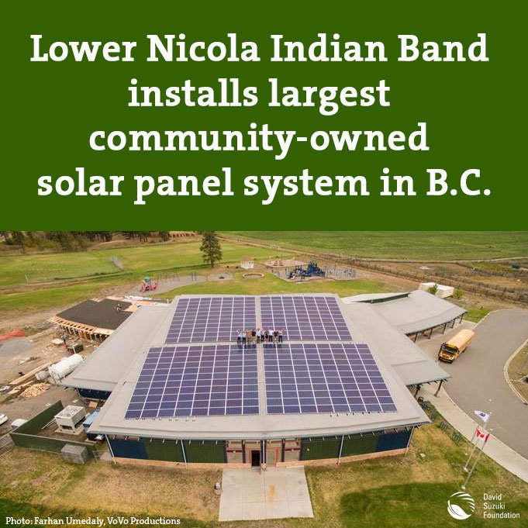
Where are we going from here….

