Slide 1
Trans-boundary Species at Risk Recovery and the Landscape Conservation Cooperatives
1 March,2017
NPLCC, Vancouver
Blair Hammond
Canadian Wildlife Service
Piping Plover melodus Subspecies

Slide 2
Outline
Who we are and what we do.
Canada’s approach to Species at Risk recovery
Overview of the Species at Risk Act
Transboundary ecosystems and species
Barriers and opportunities to greater cooperation
Opportunities for more effective trans-boundary conservation

Slide 3
Who we are and what we do
The federal (terrestrial) wildlife agency
  Aquatic species are managed by Fisheries and Oceans Canada
Primary responsibilities include:
  The conservation and management of migratory birds
  The conservation of species at risk
  Management of National Wildlife Areas and Migratory Bird Sanctuaries
  National leadership on conservation issues and wildlife management
  Largest environmental grant-maker in Canada
Wildlife research is handled largely by ECCC’s Science and Technology Branch.
Partnering is in our DNA – it’s how we accomplish most of our work

Slide 4
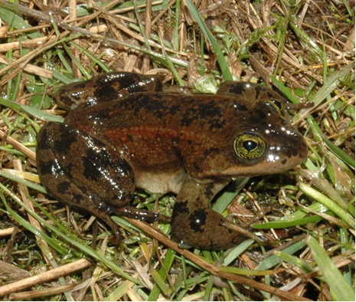
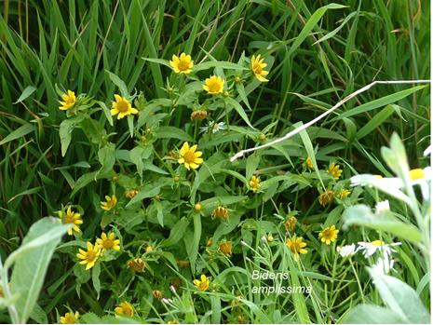
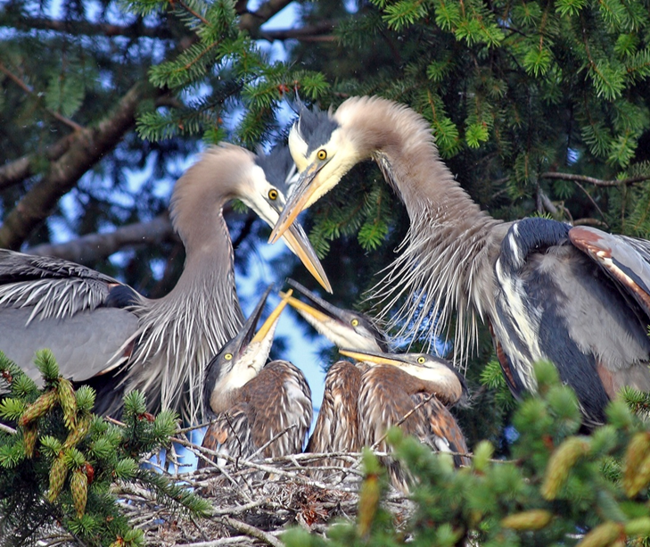

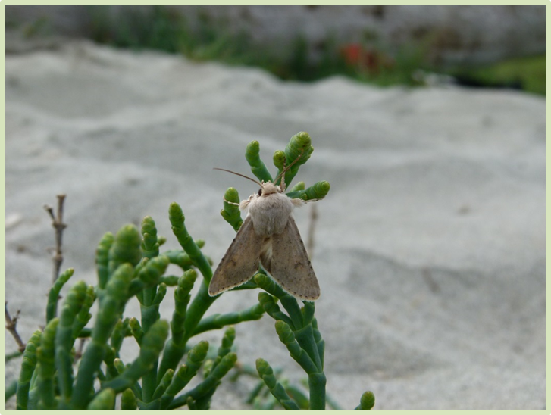
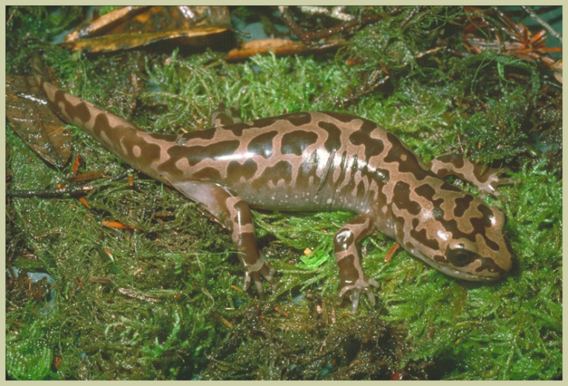
Canada’s Approach to Species at Risk Conservation

Slide 5
Canada’s Approach
  The Accord for the Protection of Species at Risk (1996)
  The Species at Risk Act (2002) (‘SARA’)
  Complementary provincial legislation & policy
  Agreements and Stewardship
  Funding Programs
  https://www.registrelep-sararegistry.gc.ca/default.asp?lang=en&n=24F7211B-1

Slide 6
ECCC’s Species at Risk Mandate
Derives primarily from the Species at Risk Act (2002)
A jurisdictionally complex landscape
  2 other federal agencies involved (Fisheries & Oceans and Parks Canada)
  Most lands and resources are constitutionally provincial
  Most wildlife management is traditionally provincial
SARA can be seen as ‘meet or beat’ legislation.
  Contains tools to encourage provincial leadership, but also ‘back-stop’ mechanisms (e.g. regulatory powers)

Slide 7
Overview of SARA
  The Act provides for:
    national species status assessment
    national species listing (at the discretion of GiC)
    planning for survival/recovery of listed species
    ensuring protection of species at risk and the habitat necessary for their survival/recovery
    public reporting including on progress toward survival/recovery for these listed species
  The Act is prescriptive about what obligations are to be met and when, and in cooperation and consultation requirements, including Aboriginal engagement, but provides for flexibility on the ‘how’ of implementation.

Slide 8
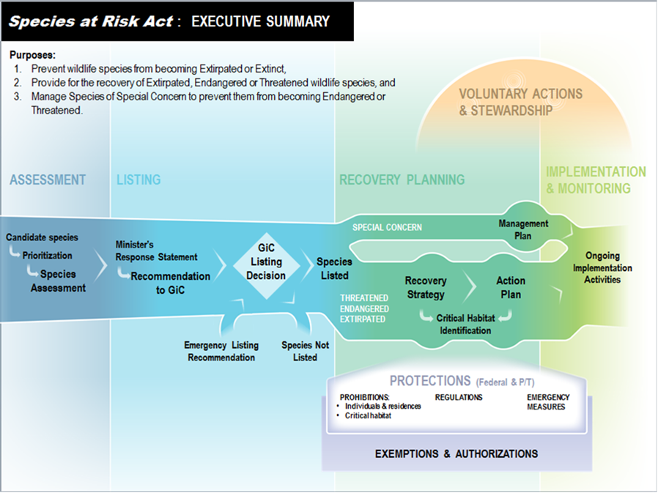
SARA Program Process

Slide 9

Assessment
Assessment is conducted by the Committee on the Status of Endangered Wildlife in Canada
  independent committee of experts appointed by the Minister of Environment
  membership includes: government, academia, Aboriginal organizations, non-government organizations and the private sector
Committee assessments based on:
  status of wildlife in Canada, not globally
  quantitative criteria adapted from the World Conservation Union
  scientific knowledge, Aboriginal Traditional Knowledge and community knowledge
    Socio-economic considerations are NOT factored into COSEWIC’s assessment (except wrt threats)
Notes:
9

Slide 10
Consultation and Cooperation
Canada has legal obligations to consult with Indigenous communities on matters that may affect aboriginal rights, title or treaties
Consultation on SARA listing occurs by policy directive
Recovery planning requires consultation or cooperation with:
  Provinces and territories
  Aboriginal organizations
  Other ‘persons’ the Minister considers directly affected by the recovery strategy, action plan or management plan process.
Notes:
10

Slide 11
Listing
Minister receives the assessment of risk status reports from the Committee on the Status of Endangered Wildlife in Canada
Typically Governor in Council has nine months from receipt of the reports to consider whether or not to list a species
  However, an “extended process” may be followed for species requiring more extensive consultation/analysis.
>500 species are currently listed under the Act.
  11 species added 22 February, 2017, including 9 in BC.
Notes:
Minister has 90 days to acknowledge receipt of the reports
Recovery planning - EC accountable for 331; PCA 76: DFO 111)

Slide 12
Protection of individuals and ‘residences’
Listing triggers “general prohibitions” that apply to species listed as extirpated, endangered, or threatened (not special concern). No person shall:
  kill, harm, harass, capture or take an individual
  possess, collect, buy, sell or trade an individual, or any part or derivative
  damage or destroy the “residence” of one or more individuals
General Prohibitions apply:
  On all federal lands
  To aquatic species anywhere they occur
  To migratory birds protected under the MBCA 1994 anywhere they occur
The Act’s prohibitions do not apply on private or P/T lands for terrestrial species without a GiC order.
Notes:
12
Protection is triggered when Governor in Council decides to list a species
Note that - Prohibitions also do not apply for species of special concern, a category that includes polar bear

Slide 13
Recovery Planning
Listing triggers recovery planning requirements:
  Recovery Strategies and Action Plans for extirpated, endangered and threatened species
    For extirpated species, only required if reintroduction is deemed feasible
  Management Plans for species of special concern
Legislated timelines for posting recovery strategies and management plans
  Timelines for Action Plans are stated in Recovery Strategies
Notes:
13

Slide 14
Recovery Strategies
Science-based strategic documents that must include:
  Description of species’ needs
  Identification of threats to survival
  Identification of critical habitat (to extent possible)
  Schedule of studies to identify critical habitat
  Statement of population and distribution objectives
  Statement of matters prescribed by regulation
  Statement about additional information requirements
  Statement of when one or more action plans will be completed
Notes:
14
ATK must also be included where and when made available.

Slide 15
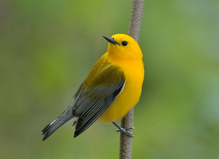
Action Plans
More ‘tactical’ documents intend to guide on-the-ground recovery activities. Must include:
  Identification of critical habitat
  Statement of proposed measures to be taken
  Identification of any unprotected critical habitat
  Methods that will be used to monitor the species’ recovery
  Evaluation of the socio-economic costs of the action plan and the benefits to be derived from implementation
  Other measures prescribed by regulation
Prothonotary Warbler
Notes:
15

Slide 16
Critical Habitat Protection Requirements
Once critical habitat is identified in a final recovery strategy or action plan, it must be protected from destruction:
  On federal protected areas
    Automatic prohibitions once gazetted
  On federal lands and for aquatic species:
    Legal protection using federal legislation, regulations or orders
  On non-federal (provincial, territorial, private) lands:
    ‘Effective’ protection relying first on provincial or territorial measures
    Stewardship agreements may also contribute
    Federal orders or regulations can be applied
Notes:
For critical habitat located in federal protected areas, a description of the critical habitat must be published in the Canada Gazette within 90 days after posting of a final recovery strategy or action plan
S. 58 critical habitat prohibition automatically applies 90 days after publication in Canada Gazette.
For critical habitat located on federal lands or for aquatic species, the Minister has 180 days to put “legal protection” in place.
For critical habitat located on non-federal lands, the Minister must form an opinion as to whether other Acts of Parliament or laws of the province/territory provide “effective protection”.
If it does not exist, but steps are being taken to put protection in place, the Minister must include progress reports on the Species at Risk Public Registry every 180 days.
If it does not exist, and is not going to be put in place, the Minister must make a recommendation to GIC that an order be made bringing the s. 61 critical habitat prohibition into force.
GIC decides whether or not to make the order, based upon broader considerations (including socio-economics).

Slide 17
Management Plans
Must include:
  Measures for the conservation of the species that the Minister considers appropriate
  May apply in respect of more than one wildlife species
  No prohibitions or protection of residences
  No critical habitat identification or protection
Notes:
17

Slide 18
Summary of Recovery planning and Critical habitat protection requirements
Listing and Critical habitat identification are the triggers for various legislative timelines
Species Status on Schedule 1 | Recovery Planning Document | Timeline for Document | Timeline for Action Plan | Timeline for Critical habitat Protection (starts with critical habitat identification)
Endangered | Recovery strategy | 1 year to post | Defined in each strategy | 90 days if in federal protected area, or 180 days if it’s critical habitat on federal lands, or No timeline if it’s on private or P/T lands; must report every 180 days on unprotected CH and steps taken to protect
Threatened or Extirpated | Recovery Strategy | 2 years to post | Defined in each strategy
Special Concern | Management Plan | 3 years to post | Not applicable | Not applicable

Slide 19
Emergency Measures
Emergency Listing:
  Governor in Council may make an emergency order to list a species under the Act if the Minister forms the opinion that its survival is imminently threatened
  COSEWIC has proposed to the Minister that three bat species be recommended for emergency listing
Emergency Protection Order
  Minister must recommend an order to the Governor in Council if he or she is of the opinion that the species faces imminent threats to its survival or recovery.

Slide 20
Governance
Environment Canada:
  General administration of the Act and program
  Minister makes recommendations to the Governor in Council (GIC) for listing, emergency orders, and “safety net” orders
  Carries out recovery planning and protection assessments for most terrestrial species and all migratory birds under the Migratory Birds Convention Act, 1994
Parks Canada (PCA):
  Responsible for all species that occur primarily on lands they administer
Fisheries and Oceans Canada (DFO):
  Responsible for aquatic species
  Provinces and Territories: all (except for Alberta and BC) have species at risk legislation. Provinces have ‘first line’ responsibilities for terrestrial species and protection on their lands and private lands.
Notes:
20
Federal responsibilities center on migratory birds, aquatic species, and federal lands, but the Act provides the federal government with the authority for federal intervention in provincial or territorial management if necessary.
“Competent Minister”: The Act establishes a concept of “competency” for a minister with respect to a listed species
once competent for a species, that Minister represents the recovery interests/needs of that species in the SARA process, and in related federal processes
Other Federal Departments:
have obligations under SARA when species at risk occur on land that they own, manage, or administer.

Slide 21
Trans-boundary Ecosystems & Species
Priority Ecosystems:
  Fraser-Puget Lowlands
  Garry Oak and related ecosystems
Priority species within NPLCC area:
  Marbled Murrelet
  Northern Goshawk
  Oregon spotted Frog
  Oregon Forest Snail
  Pacific Water Shrew

Slide 22
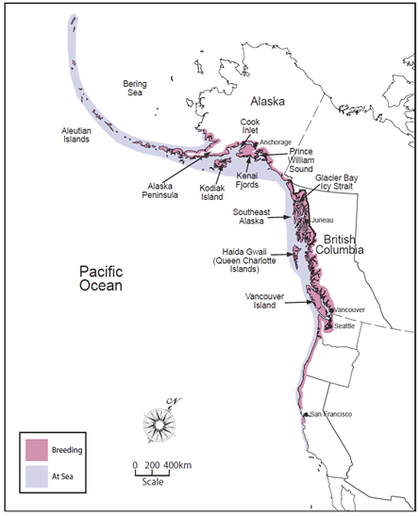
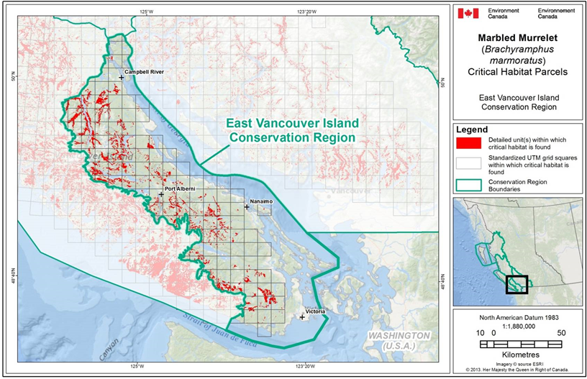
Marbled Murrelet – G3 Threatened

Slide 23
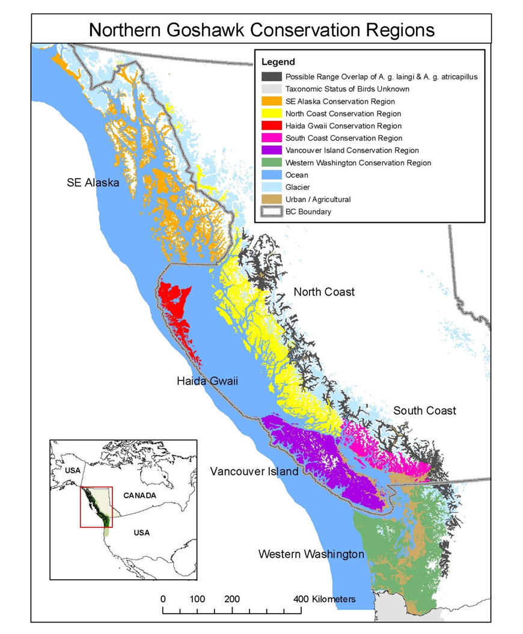
Northern Goshawk – G2 Threatened
Recovery strategy led by Parks Canada
Posting anticipated this year.
CWS will lead on implementation and further planning

Slide 24
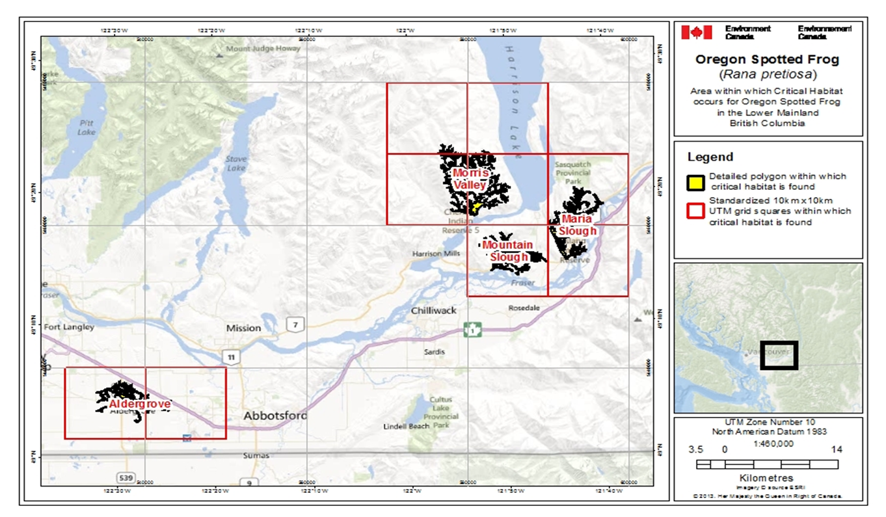
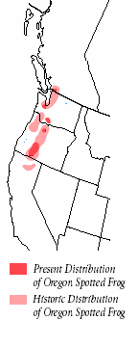
Oregon Spotted Frog – G2 Endangered

Slide 25
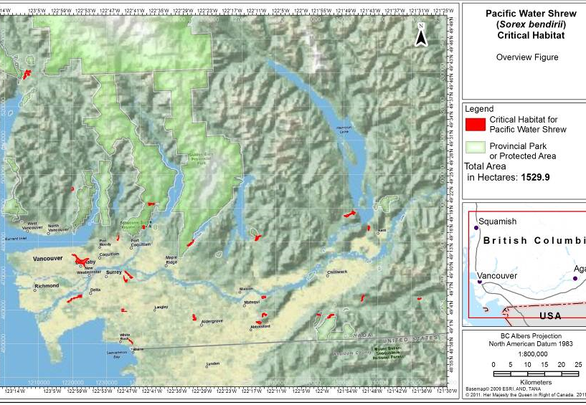
Pacific Water Shrew – G4 Endangered

Slide 26
Engagement with LCC’s
Long-standing engagement with US partners through NAWCC Canada Council and the Joint Venture system
  Pacific Birds Habitat Joint Venture is the only formally ‘international’ joint venture
  Flyway technical committees and NAWMP Science Support Team
CWS represented on North Pacific and Great Northern LCC steering committees
  CWS has participated on science and funding review committees
  JV partners have apply to LCC’s for funding
  Staff and partners participate in WebEx learning events
LCC’s have helped to facilitate agency level contacts for science and monitoring collaborations
  E.g. Marbled Murrelet monitoring and critical habitat mapping approaches.

Slide 27

Barriers to greater engagement
Jurisdictional responsibilities and Mandate
  DFO leads on most oceans issues
  BC leads on most land use and resource management issues
Different priorities
  e.g. Limited overlap in focal wildlife species
  e.g. of 5 NPLCC S-Tek ‘Topics’ only 2 have direct linkages to our regular work
Divergent scales of investment and capacity
International travel challenges
  LCC’s low profile in the RoC
    Other EC regions not engaged
    Only 5/22 LCC’s transboundary

Slide 28
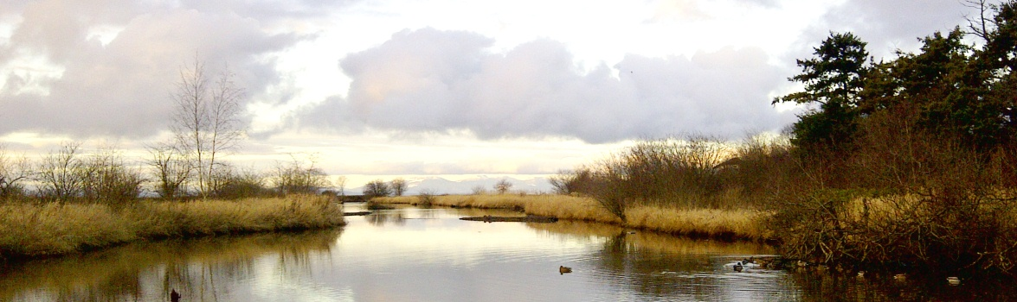
Enhancing Canadian Federal Engagement
Demonstrate direct linkages to federal priorities and deliverables
  Need national level buy-in
  Articulate the value-added over existing relationships
For EC-CWS:
  Recovery of species at risk
    Landscape connectivity and the ‘rescue effect’
    Source populations
    Science collaborations on landscape drivers to extinction risks
    Collaboration on recovery measures and evaluation
Notes:
Third attempt in six years to pass a law for species protectio

Slide 29
Climate Adaptation & the Federal Wildlife Mandate
Science:
  Understanding how climate may change in regions and sub-regions
  Understanding ‘knock-on’ effects of climate change
    E.g. to inform recovery planning (is recovery feasible?)
    E.g. impact on local sea levels, changes to hydrograph and impacts on lotic wetlands
Management:
  Most land management will remain provincial
  Not apparent how climate change will result in significantly different approaches to wildlife conservation
    E.g. water will still run down hill and basic management practices are unlikely to change and we will still want to secure estuarine uplands.
  Understanding climate-induced ecological changes at a local scale could inform environmental assessment processes.

Slide 30
Opportunities for greater engagement
Better sharing of information on priority species, ecosystems and habitats
Estuary conservation to maintain ecological linkages
Improved compatibility and availability of habitat and land-cover data sets
Development of compatible, cost-effective metrics for monitoring landscape and habitat changes
Trans-boundary species at risk coordination
Invasive species science and management
Notes:
Low tide Lidar data for estuaries
SLAM model
ff

Slide 31
Landscape and Habitat Data
Canada’s Open Data Portal: http://open.canada.ca/en
Tools to ‘translate’ different jurisdictional map products an identified need to support trans-boundary mapping
  Different jurisdictions use different ecosystem mapping protocols.
Notes:
Third attempt in six years to pass a law for species protectio

Slide 32
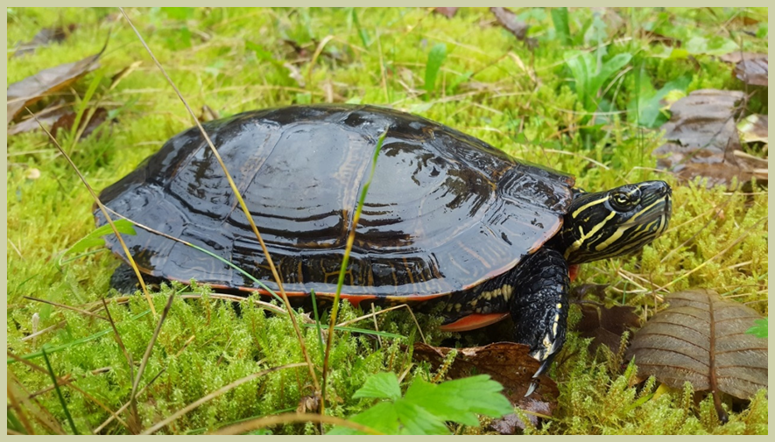
Questions?

