Slide 1
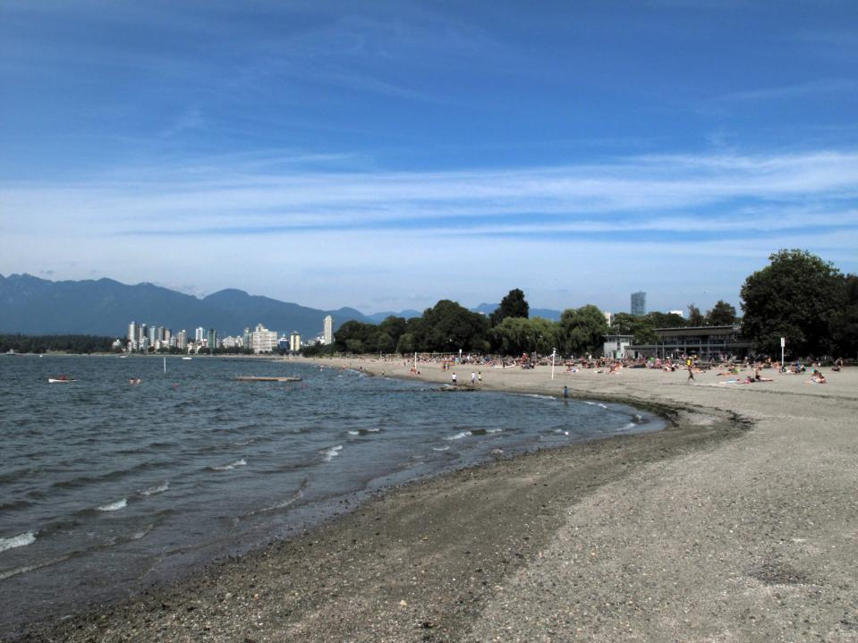

City of Vancouver
Sea Level Rise Background
NPLCC 2017

Slide 2
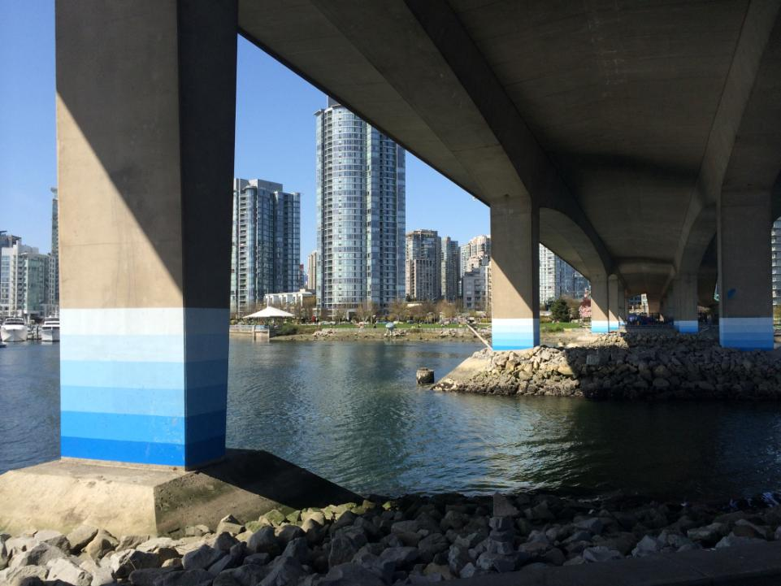
Preparing for Climate Change

Slide 3
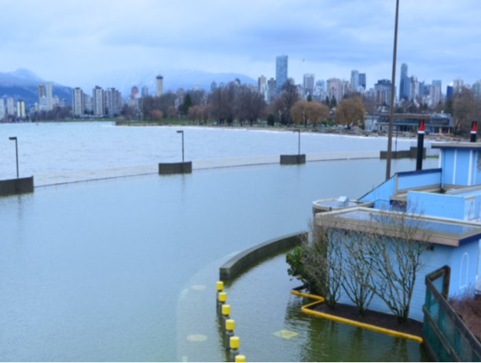
As sea level rises ocean and river flooding will occur
Kits Pool: King Tide 2012
Preparing for Climate Change
Notes:
As outlined in the Climate Change Adaptation Strategy for the City of Vancouver, anticipated local impacts from climate change include:
Ocean and river flooding during extreme conditions as the mean sea level rises
Picture is from the king tide event in December 2012. This is one of the highest tides of the year and can be used as a proxy for where water levels could be on a calm day in 2100 with sea level rise.

Slide 4
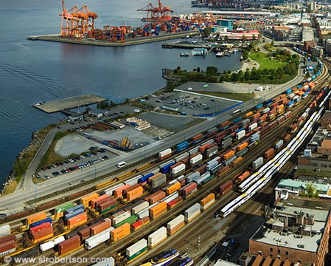
We rely heavily on our coastline
For Working
~135 Million Tonnes of cargo a year
98,800 jobs
$9.7 billion in Gross Domestic Product (GDP)
$20.3 billion in economic output
$1.3 billion per year in tax revenues
Impacts to our coastline

Slide 5
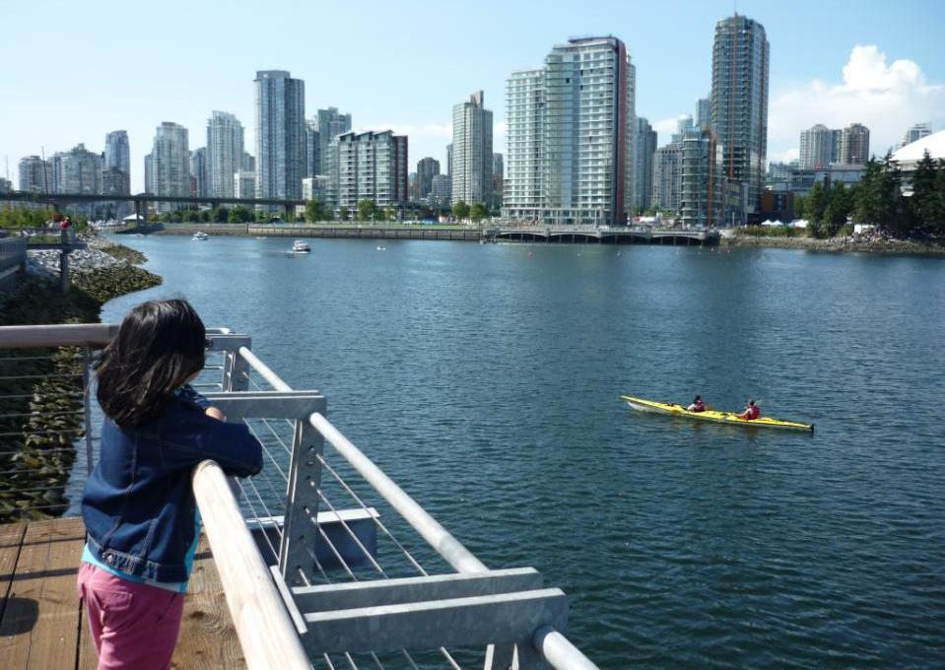
For Playing
17 ha of natural shoreline habitat
Almost 18 km of beaches surround Vancouver, including ten ocean-side locations and one fresh water lake.
Impacts to our coastline

Slide 6
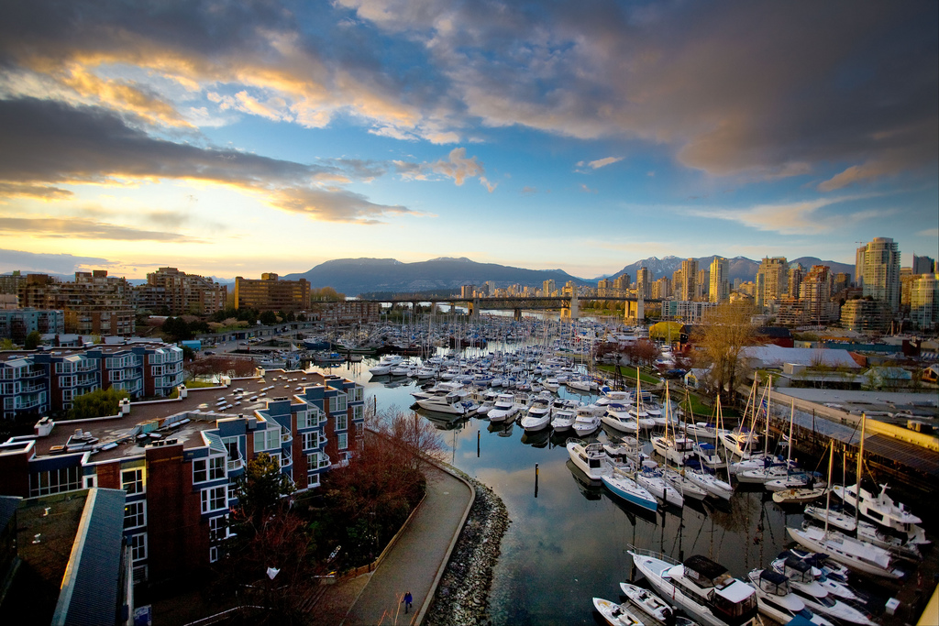
For Living
25,000 people living within 300m of shoreline
16 million sq ft of residential space
Photo by Kenny Louie: Flickr
Impacts to our coastline

Slide 7
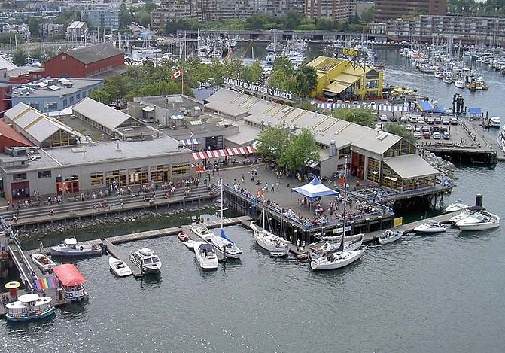
For Tourism
In 2012, the tourism industry generated $3.6 billion in revenue
Over 666,000 cruise ship passengers visited contributing $167M to the economy
Impacts to our coastline
Notes:
http://www.tourismvancouver.com/includes/content/images/media/docs/ei_cruise.pdf

Slide 8
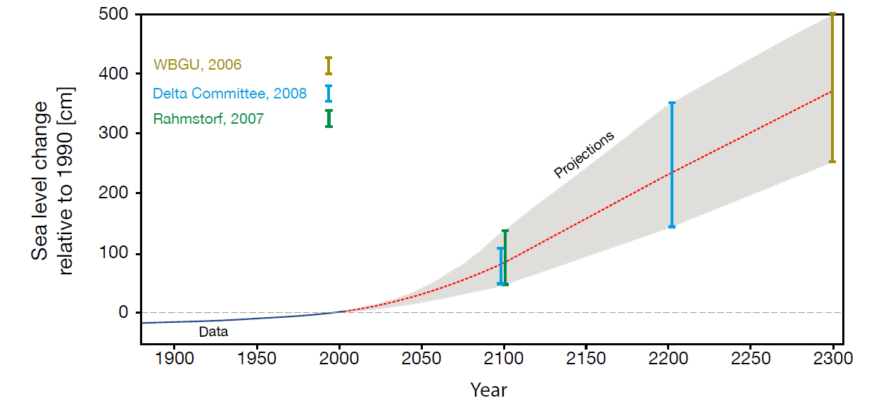
Our coastal areas will be impacted by ongoing sea level rise,
And in some areas by more intense storms also
Impacts to our coastline
Notes:
Source is the 2013 BC Sea Level Rise Primer
http://www2.gov.bc.ca/assets/gov/environment/climate-change/policy-legislation-and-responses/adaptation/sea-level-rise/slr-primer.pdf

Slide 9
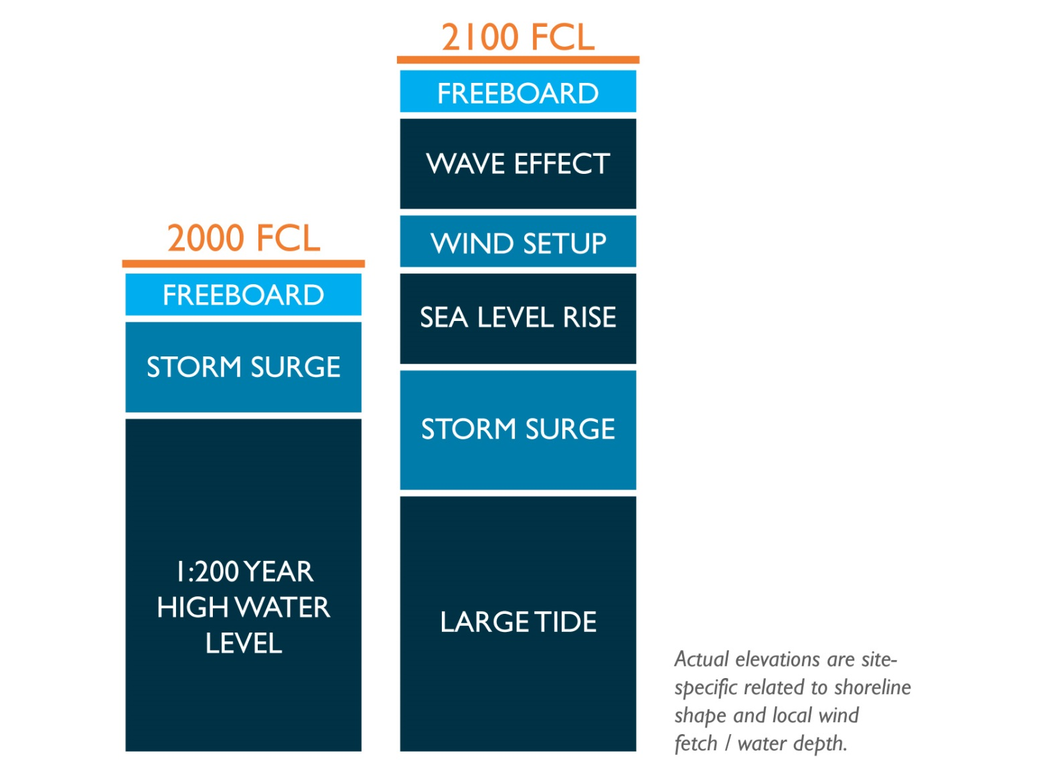
Focus on Coastal and Riverine flooding with sea level rise and storm surge
Tidal water and storm surge data based on Canadian Hydrographic Service tide gauges
Lidar data
Notes:
Hired NHC to do a variety of modeling.
No appropriate wave measurements were available in Burrard inlet, so wave conditions were calculated using a sophisticated computational wave model. Shoreline-specific variations in water level due to wind setup and wave setup were found to be the smallest contributors to the total water level; these effects were calculated using one-dimensional (1D) parametric models.
A schematic of the modelling approach is provided in Figure 1. Tide and storm surge data are provided as a still water level to the wave model. Measured wind data are used to drive the wave model and the wind setup model. Using the wave model results at the 10 m bathymetric contour, the static wave setup was calculated using a 1D parametric model. The tidal water level, external surge wave setup and wind setup are summed to arrive at a total water level. All components are calculated at 1 hour intervals throughout the hind-cast period.

Slide 10
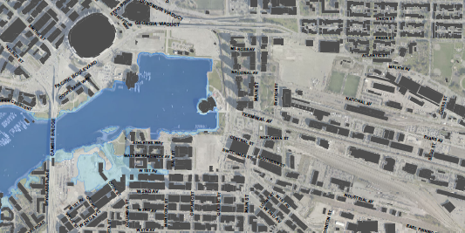
And with increasing sea level, our risk grows
Huge storm, high tide 2020
Impacts to our coastline

Slide 11
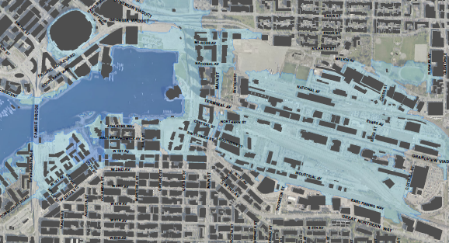
And with increasing sea level, our risk grows
~ year 2100
Impacts to our coastline

Slide 12
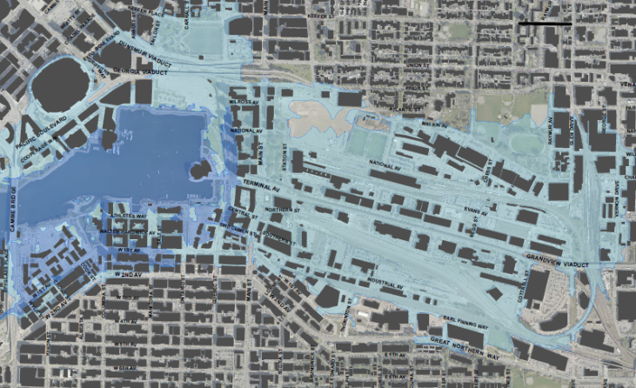
And with increasing sea level, our risk grows
~ year 2200
Impacts to our coastline

Slide 13
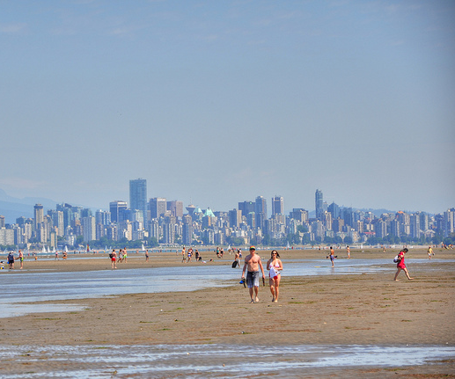
City of Vancouver Sea Level Rise Strategy
Notes:
First, let’s define what the term “urban forest” means …

Slide 14
Sea Level Rise Strategy Principles
Use best science and learn from others
Pragmatic balance of cost and risk
Be opportunistic and proactive
Take a phased approach, distribute cost of adaptation across time

Slide 15
Sea Level Rise Strategy
City-wide coastal flood response actions
Location-based responses
Leverage large-site redevelopments
Immediate actions in impacted areas
City-wide / Location-based / Large Site Redevelopment/ Immediate actions
Notes:
First, let’s define what the term “urban forest” means …

Slide 16
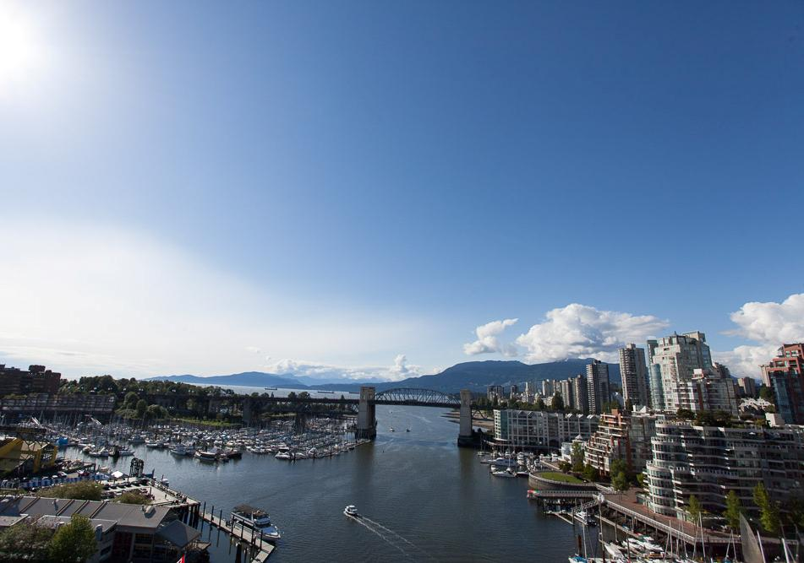
City-wide Coastal Response
    FCL was set as 3.5 in 1972
    In 2014 the FCL was set to 4.6 m in all floodplain areas
City-wide / Location-based / Large Site Redevelopment / Immediate actions
Notes:
FCL was set as 3.5 in 1972
In 2014 the FCL was set to 4.5 m in all floodplain areas

Slide 17
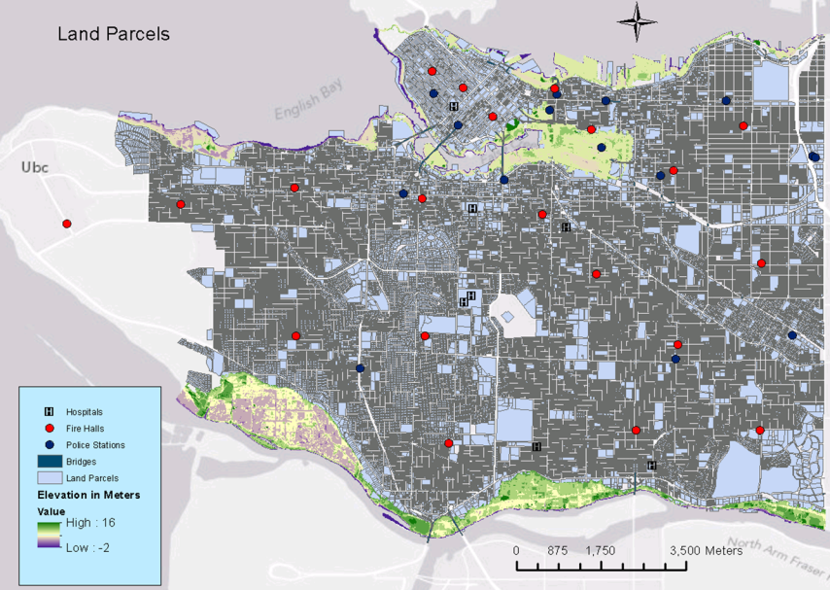
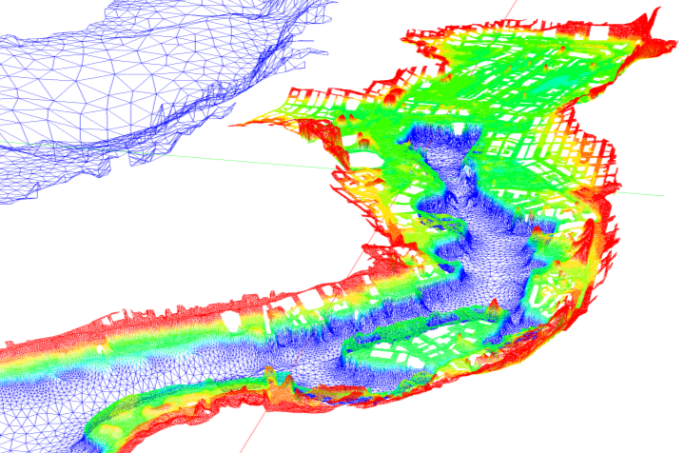
The models were used to map coastal flood plains and depth of flooding to the year 2100 and establish the FCL recommendation.
City-wide / Location-based / Large Site Redevelopment / Immediate actions
Notes:
In setting FCLs, used sophisticated modelling etc.

Slide 18
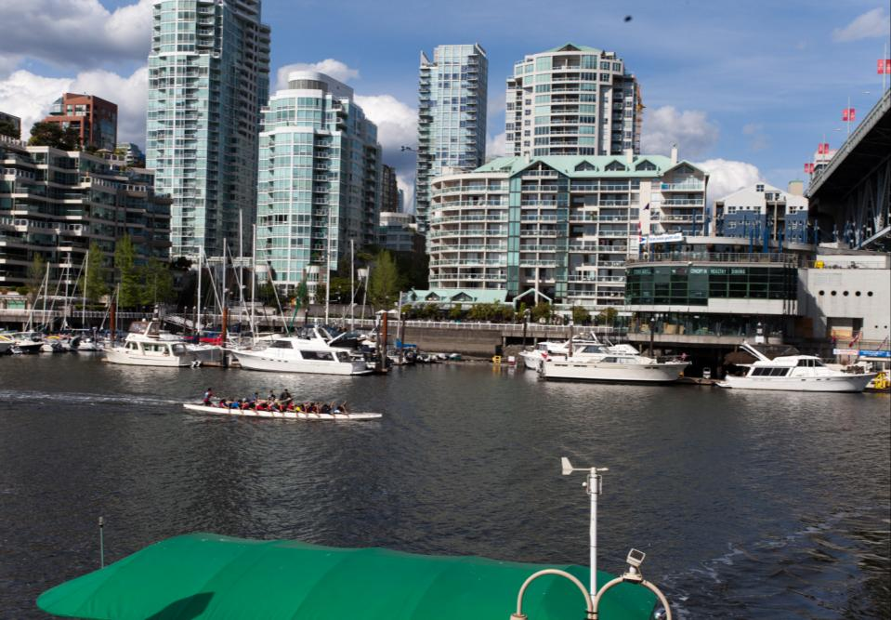
Location-based Responses
City-wide / Location-based / Large Site Redevelopment / Immediate actions

Slide 19
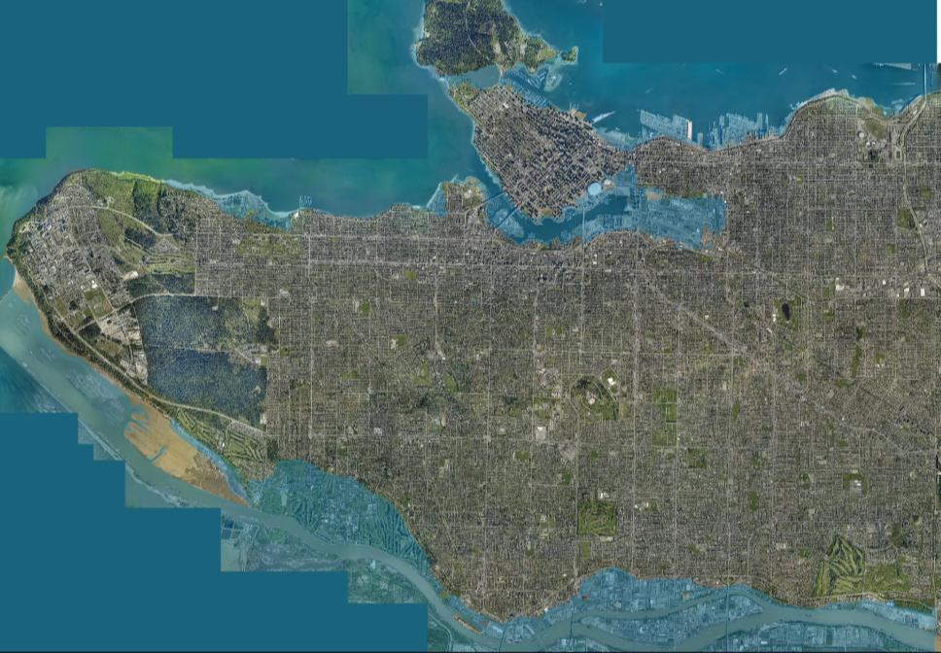
Modelling indicated future flood prone locations include:
Coal Harbour
Port
Kits Point
False Creek
Southlands
River District
City-wide / Location-based / Large Site Redevelopment / Immediate actions
Notes:
Greater room here for site specific habitat use and species presence as well as ecological processes like longshore sediment transport, water quality, blue carbon, snot presences absence?, prey-predator relations.
Coastal squeeze. Ocean acidification

Slide 20
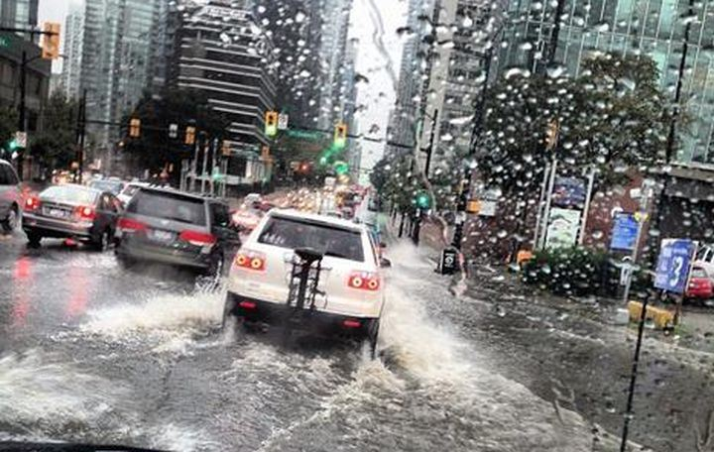
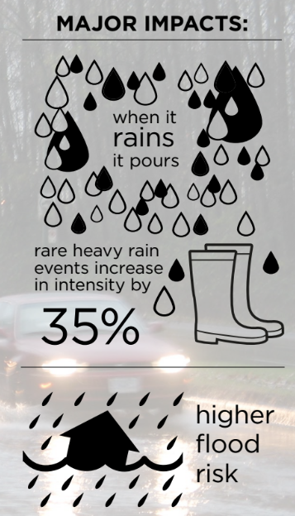
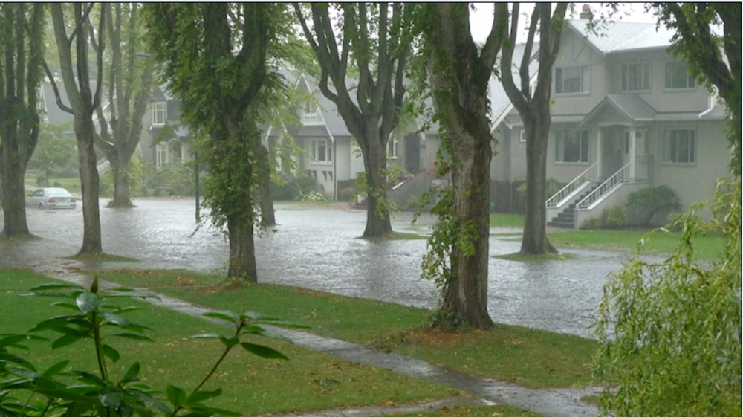

Wetter Vancouver
Vancouver Rainstorm 2010
Notes:
Source: PCIC
Rainiest day in October and April increase about 20% in amount of rain – we are going to need to plan our streetscapes accordingly.
Others have gone over this in detail.
Approved Integrated Rainwater Management Plan & Green Infrastructure plan
More intense rain storms could mean more flooding, more sewer back-ups and more combined sewer overflows
City has partially separated its stormwater and sanitary sewers
$30M a year
To be complete by 2050

Slide 21
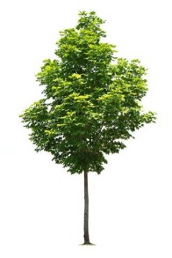
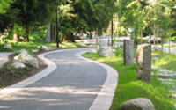
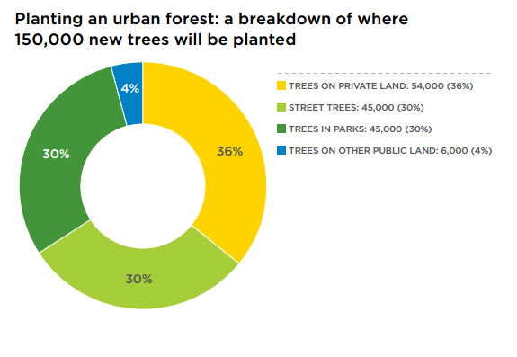


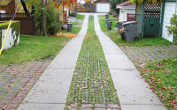
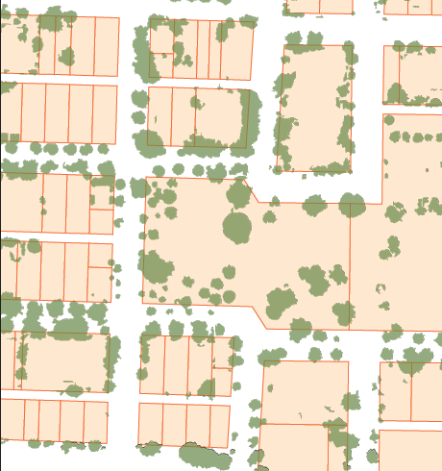
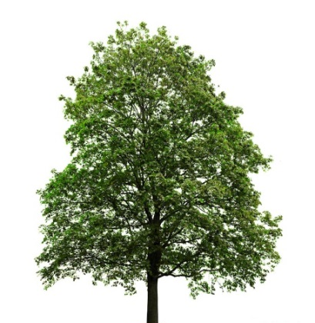
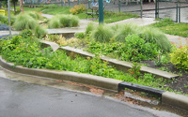
Absorbent landscapes
Crown Street
Country Lane
Canopy Cover
Rain Garden
Notes:
Basically how can you design your project to:
Absorb water?
Store rain that has been shed off the roof and/or other places for later use and/or reuse in the building system (I know the Coastal Health Authority has guidelines on that)
Adaptive design that complements the other issues and futures associated with climate change, e.g. coastal flooding, heat and changing ecosystems.
Trees: April 16, 2014 – Council voted to approve the Urban Forest Strategy, which includes an update to the Protection of Trees Bylaw. Review the strategy to learn how we plan to protect, plant, and manage Vancouver's urban forest. Plant 150,000 trees by 2020. We are at 48K trees
Different species, different ages will have a range of temperature, soil moisture, wind and pest tolerances. They will also need a range of soil requirements.

Slide 22
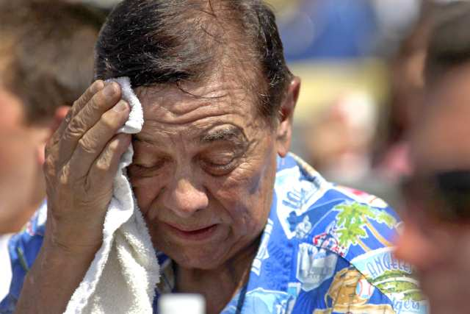
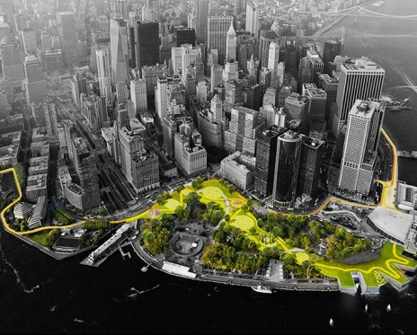
Big U project – Manhattan
$383 M project
Protection that provides public space
Increase flood construction levels
Extreme Heat

Slide 23
Planning for Extreme Heat
Increased heat has significant health implications, particularly on vulnerable populations
  Heat wave in 2009 led to an estimated 122 heat-related deaths in Lower Mainland
What influences vulnerability to heat?
  Age
  Pre-existing health issues
  Social isolation
  Socio-economic factors
  Environmental factors
Notes:
Design for your users;
Ensure new buildings are designed to stay cool – PASSIVE HOUSE
Design to allow for retrofit cooling utilities and managing inhabitants expectations to pay for it
Explore ways to retrofit existing buildings (especially multi-family) –
Cool landscaping

Slide 24
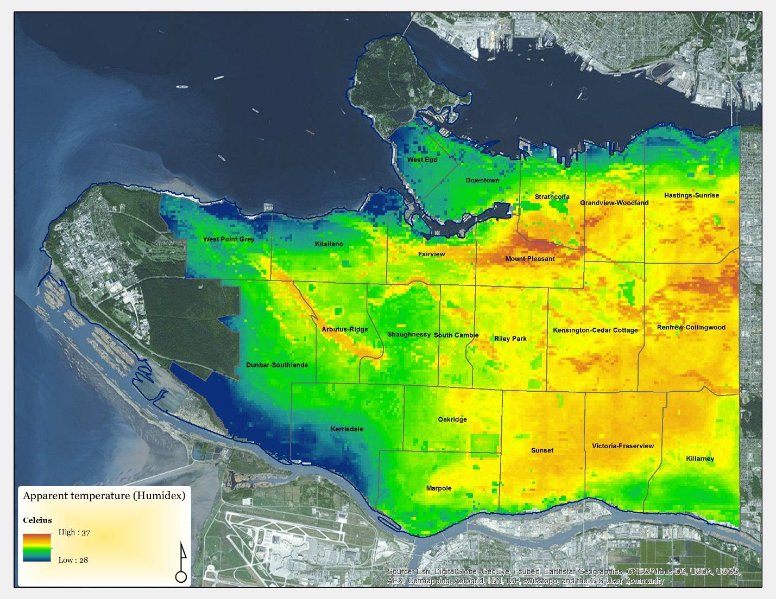
Humidex map of the City
Aminipouri and Knudby, SFU (in progress)
Notes:
How can you plan buildings and cooling public spaces when we know it’s going to get hotter? Parks and streetscapes
Cooling rooms in non-market housing: e.g. temporary cooling parklet that is going to be outside the DTES market on Hastings. Will have shade, sitting area, access to public water. It has been a challenge to create and establish a more semi-permanent one b/c the concept clashes with current road and street design, e.g. parking, congregating on a sidewalk or outside commercial space, cost of maintaining site.
Public access to drinking water

Slide 25
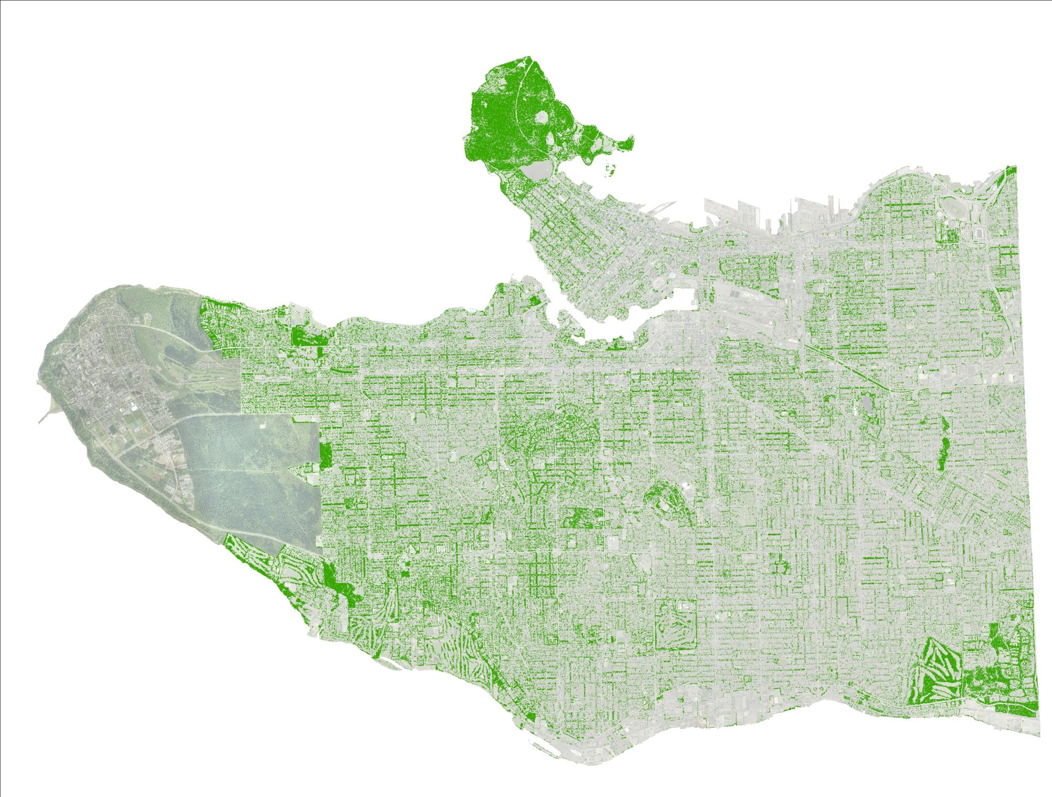
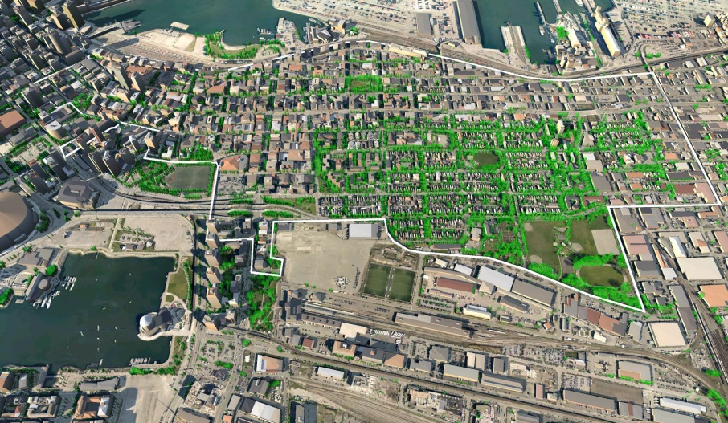
Create Street Tree Cooling Networks
Downtown East Side
False Creek Flats
Marpole
Canopy cover, canopy cover gaps, high urban heat areas and vulnerable population
Notes:
Reduce heat islands – plant more trees!

Slide 26
Questions and possible research topics
Rocky intertidal algae needs – depth, geometry, exposure
More information on the impacts of coastal squeeze
Vancouver’s place in terms of waterfowl
The storm surge value of marine wetlands and nearshore habitats
Water quality needs for eelgrass in urban settings as part of restoration plans
How do we bring herring back and other forage fish?
How do we include wildlife and ecology in coastal adaptation?
Ocean acidification

