Slide 1




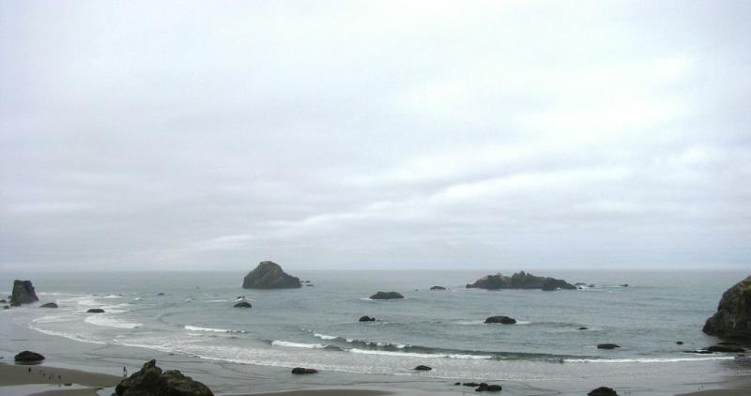


North Pacific Landscape Conservation Cooperative
Strategic Plan Overview
Charter Amendments
Meeting Planning
John Mankowski – Coordinator
October 6, 2016
Notes:
The NPLCC Strategic Plan provides near-term, high-level guidance for the NPLCC’s work. It is the leadership template for the next five years.
It fills the gap between the Charter and the strategies and work plans committees and subcommittees prepare.
It helps the NPLCC meet the SIAS benchmarks, which are used to evaluate all LCCs and influence funding levels – the better we do on the benchmarks, the more funding becomes available to us to advance the good work we aim to do throughout the region.

Slide 2

5-Year Strategic Plan Purpose -- Your plan; your priorities
Present the Vision, Mission, Goals of NPLCC -- 2017-2022
Articulate SMART objectives to work toward the NPLCC vision and goals
Identify actions to accomplish objectives and metrics to measure progress
Includes implementation approach (who does what)
Document the management and operations work needed to develop and sustain the NPLCC partnership
Participate in National LCC Network; demonstrate contributions to Network vision, mission and goals
Notes:
While the Charter articulates NPLCC goals, the strategic plan connects those goals to objectives that are specific, measurable, achievable, realistic and time-bound, or SMART. It is focused on the near-term, the next five years.
Another feature of the strategic plan is that it demonstrates alignment between the LCC Network vision, mission and goals, and NPLCC work to-date.
The role and function of NPLCC staff is not currently articulated in any foundational NPLCC documents. This strategic plan captures that work and further, links NPLCC staff roles and responsibilities to SMART objectives that can be tracked, evaluated and reported on.
Finally, the strategic plan will position the NPLCC to accurately report on its progress toward the SIAS benchmarks to the Government Accountability Office, Office of Management and Budget, and others who determine NPLCC funding and viability.

Slide 3
Charter
SC & T/FN work
5-YEAR STRATEGIC PLAN
S/TEK Strategy
COR Strategy
NPLCC Staff Work
Annual Work Plans
T/FN Strategy
Measure Performance and Adapt
Notes:
Looking at how the different foundational NPLCC documents fit together, we see:
The Charter defines the NPLCC mission, goals and defining principles; clarifies the governance of the NPLCC; and outlines its operating procedures
The Strategic Plan lays out the near-term plan to work toward those goals, describing at a high level how and where the NPLCC will focus its activities. Where needed, it provides additional implementation guidance.
Each committee and subcommittee, as well as NPLCC staff, uses the Charter and Strategic Plan to guide their strategies and work plans. It is at this level that we see the most specific and targeted goals and objectives, each focused on the roles and responsibilities of the particular committee, subcommittee or NPLCC staff.
Additionally, the Steering Committee, advised by the T/FN Committee, provides guidance to subcommittees and NPLCC staff.

Slide 4
Approach
Uses existing key documents and cumulative recent SC input to lay out a path for achieving NPLCC goals:
  Revised Vision, Mission, Goals
  Clearly defined SMART objectives (ends, means, metrics)
  Link objectives to NPLCC goals
  Assigns lead entity responsible for progress/tracking each objective
Objectives organized by goal; by implementer, for planning and a tool for implementation
Includes crosswalk of NPLCC strategy with LCC Network strategy
Notes:
To develop the Strategic Plan, we used existing key documents to reflect the ongoing work and wisdom of NPLCC partners and the LCC Network.
The key documents used to develop the strategic plan are:
NPLCC Charter
T/FN White Paper
S/TEK strategy
COR strategy
SC guidance from previous meetings
LCC Network Strategic Plan
SIAS benchmarks
Summary of NPLCC staff roles and responsibilities to-date

Slide 5
Outline
Introduction and Background
LCC Network and Strategic Plan
NPLCC Vision, Mission and Goals
  Goals prefaced with concise Issue Statements
Implementation Approach
Objectives
Appendix: Objectives, by Lead
Notes:
Introduction and Background includes basic information on the ecology, geography and structure of the NPLCC; the LCC Network vision, mission and goals; and a crosswalk between the LCC Network goals and NPLCC goals
NPLCC Vision, Mission and Goals lists the refined vision, mission and goals approved in 2015.
The Implementation Approach explains the NPLCC implements activities through four subcommittees and subcommittees, as well as a management and operations group. The management and operations group captures much of the work NPLCC staff do to develop and sustain the NPLCC partnership, both internally and externally. The proposed title for this group is Partnership Sustainability & Management Services, or PSMS.
The Objectives form the bulk of the document. For each goal, there are five to 11 objectives identified to work toward achieving that goal between 2017 and 2022. The entity responsible for each objective is also listed.
The Strategic Plan acknowledges that the committees, subcommittees and PSMS work together on NPLCC activities. There are natural “lead” and “support” roles for the different goals and objectives, and these are articulated in the plan.
To make it easier for committees, subcommittees and PSMS to track objectives, the appendix lists objectives according to who is leading implementation.

Slide 6
Vision
Natural and cultural resources successfully respond to rapidly changing landscapes and seascapes.
Notes:
Introduction and Background includes basic information on the ecology, geography and structure of the NPLCC; the LCC Network vision, mission and goals; and a crosswalk between the LCC Network goals and NPLCC goals
NPLCC Vision, Mission and Goals lists the refined vision, mission and goals approved in 2015.
The Implementation Approach explains the NPLCC implements activities through four subcommittees and subcommittees, as well as a management and operations group. The management and operations group captures much of the work NPLCC staff do to develop and sustain the NPLCC partnership, both internally and externally. The proposed title for this group is Partnership Sustainability & Management Services, or PSMS.
The Objectives form the bulk of the document. For each goal, there are five to 11 objectives identified to work toward achieving that goal between 2017 and 2022. The entity responsible for each objective is also listed.
The Strategic Plan acknowledges that the committees, subcommittees and PSMS work together on NPLCC activities. There are natural “lead” and “support” roles for the different goals and objectives, and these are articulated in the plan.
To make it easier for committees, subcommittees and PSMS to track objectives, the appendix lists objectives according to who is leading implementation.

Slide 7
In our Vision we see . . .
• Natural and cultural resources are managed landscape/seascape scale context.
• Managers incorporate multiple social, economic, environmental and cultural factors
• Landscape-scale conservation crosses jurisdictional boundaries.
• Responding to rapidly changing landscapes is normal and commonplace.
• It is easy to find, acquire and use quality climate and landscape-scale science and information.
Notes:
Introduction and Background includes basic information on the ecology, geography and structure of the NPLCC; the LCC Network vision, mission and goals; and a crosswalk between the LCC Network goals and NPLCC goals
NPLCC Vision, Mission and Goals lists the refined vision, mission and goals approved in 2015.
The Implementation Approach explains the NPLCC implements activities through four subcommittees and subcommittees, as well as a management and operations group. The management and operations group captures much of the work NPLCC staff do to develop and sustain the NPLCC partnership, both internally and externally. The proposed title for this group is Partnership Sustainability & Management Services, or PSMS.
The Objectives form the bulk of the document. For each goal, there are five to 11 objectives identified to work toward achieving that goal between 2017 and 2022. The entity responsible for each objective is also listed.
The Strategic Plan acknowledges that the committees, subcommittees and PSMS work together on NPLCC activities. There are natural “lead” and “support” roles for the different goals and objectives, and these are articulated in the plan.
To make it easier for committees, subcommittees and PSMS to track objectives, the appendix lists objectives according to who is leading implementation.

Slide 8
In our vision, we believe:
• We are all struggling to keep up with the rapid changes
• Bringing more perspectives to the table is essential
• Together, we can better provide information to and give voice to those who are working to sustain ecological integrity and health.
• We are here to support the decision makers and managers that make and implement decisions about landscape-level conservation.
• With a relentless commitment to collaboration, we can make sustainable connections across landscapes.
Notes:
Introduction and Background includes basic information on the ecology, geography and structure of the NPLCC; the LCC Network vision, mission and goals; and a crosswalk between the LCC Network goals and NPLCC goals
NPLCC Vision, Mission and Goals lists the refined vision, mission and goals approved in 2015.
The Implementation Approach explains the NPLCC implements activities through four subcommittees and subcommittees, as well as a management and operations group. The management and operations group captures much of the work NPLCC staff do to develop and sustain the NPLCC partnership, both internally and externally. The proposed title for this group is Partnership Sustainability & Management Services, or PSMS.
The Objectives form the bulk of the document. For each goal, there are five to 11 objectives identified to work toward achieving that goal between 2017 and 2022. The entity responsible for each objective is also listed.
The Strategic Plan acknowledges that the committees, subcommittees and PSMS work together on NPLCC activities. There are natural “lead” and “support” roles for the different goals and objectives, and these are articulated in the plan.
To make it easier for committees, subcommittees and PSMS to track objectives, the appendix lists objectives according to who is leading implementation.

Slide 9
Mission Statement
In the face of a changing climate and other landscape-scale stressors, the North Pacific Landscape Conservation Cooperative
supports development and application of useful science;
we coordinate and disseminate that science; and
we serve as a convener to further collaborative efforts to inform and advance landscape-scale conservation.
Notes:
Introduction and Background includes basic information on the ecology, geography and structure of the NPLCC; the LCC Network vision, mission and goals; and a crosswalk between the LCC Network goals and NPLCC goals
NPLCC Vision, Mission and Goals lists the refined vision, mission and goals approved in 2015.
The Implementation Approach explains the NPLCC implements activities through four subcommittees and subcommittees, as well as a management and operations group. The management and operations group captures much of the work NPLCC staff do to develop and sustain the NPLCC partnership, both internally and externally. The proposed title for this group is Partnership Sustainability & Management Services, or PSMS.
The Objectives form the bulk of the document. For each goal, there are five to 11 objectives identified to work toward achieving that goal between 2017 and 2022. The entity responsible for each objective is also listed.
The Strategic Plan acknowledges that the committees, subcommittees and PSMS work together on NPLCC activities. There are natural “lead” and “support” roles for the different goals and objectives, and these are articulated in the plan.
To make it easier for committees, subcommittees and PSMS to track objectives, the appendix lists objectives according to who is leading implementation.

Slide 10
5 Goals
Informing management decisions - Maximize the ability to make informed landscape-level conservation decisions by understanding conservation challenges and providing practical and useable information and solutions
Unique role of LCC -- Facilitate progress on trans-boundary opportunities for (and barriers to) landscape-level conservation
Use of/access to information -- Determine priorities for applied science and promote identification, open-access, use, and sharing of science, traditional knowledge (only as appropriate)
Outreach -- Promote awareness of the NPLCC (partnerships and products); effects of climate change on ecosystems, resources, cultures, and economies
Coordination of science & conservation actions -- Promote coordination and alignment of efforts among resource managers and science entities to improve how we provide management-relevant information and advance landscape-scale conservation
Notes:
Introduction and Background includes basic information on the ecology, geography and structure of the NPLCC; the LCC Network vision, mission and goals; and a crosswalk between the LCC Network goals and NPLCC goals
NPLCC Vision, Mission and Goals lists the refined vision, mission and goals approved in 2015.
The Implementation Approach explains the NPLCC implements activities through four subcommittees and subcommittees, as well as a management and operations group. The management and operations group captures much of the work NPLCC staff do to develop and sustain the NPLCC partnership, both internally and externally. The proposed title for this group is Partnership Sustainability & Management Services, or PSMS.
The Objectives form the bulk of the document. For each goal, there are five to 11 objectives identified to work toward achieving that goal between 2017 and 2022. The entity responsible for each objective is also listed.
The Strategic Plan acknowledges that the committees, subcommittees and PSMS work together on NPLCC activities. There are natural “lead” and “support” roles for the different goals and objectives, and these are articulated in the plan.
To make it easier for committees, subcommittees and PSMS to track objectives, the appendix lists objectives according to who is leading implementation.

Slide 11
Next Steps . . .
Receive draft within 2 weeks
Send comments any parts (large and small)
  General agreement in past discussions on Vision, Mission, Revised Goals
  Most input needed on Objectives (ends, means, metrics)
    Pertinent to your organization's interests and actions?
    Clear and Concise?
    Lead to success of Goals?
Staff incorporate comments, send revised draft 2 weeks before Nov 30/ Dec 1 SC Meeting
At SC Meeting - Discuss, improve, and finalize
Questions?
Notes:
In preparing the strategic plan, natural “leads” for different goals emerged and are summarized here.
While all of the committees work together and support each other, this differentiation of roles acknowledges that there do tend to be leads on certain work – such as S/TEK on use of and access to information or COR on outreach.
There are also natural alliances between goals. For example, there is a support role for COR in informing management decisions through distribution of information.
Of course, the SC and T/FN provide strategic direction for all NPLCC activities.

Slide 12
Charter Amendments
  Charter adopted on 12/14/2011, not amended since
  Includes Mission, Goals, Guiding Principles, Composition, Operations, Staffing
Recommended changes
  Add National Fish Habitat Partnerships (1 seat)
  Add NGOs (3-4 seats)
  Review language
Notes:
In preparing the strategic plan, natural “leads” for different goals emerged and are summarized here.
While all of the committees work together and support each other, this differentiation of roles acknowledges that there do tend to be leads on certain work – such as S/TEK on use of and access to information or COR on outreach.
There are also natural alliances between goals. For example, there is a support role for COR in informing management decisions through distribution of information.
Of course, the SC and T/FN provide strategic direction for all NPLCC activities.

Slide 13
Charter Amendments -- Next Steps
  Distribute language to SC for comments
  If no substantive comments received after 2 weeks, consider approved
  If substantive comments are received, address them during next (or special) SC meeting
  When approved, NPLCC staff will work with FHPs and NGOs to bring names to SC for consideration
  Questions?
Notes:
In preparing the strategic plan, natural “leads” for different goals emerged and are summarized here.
While all of the committees work together and support each other, this differentiation of roles acknowledges that there do tend to be leads on certain work – such as S/TEK on use of and access to information or COR on outreach.
There are also natural alliances between goals. For example, there is a support role for COR in informing management decisions through distribution of information.
Of course, the SC and T/FN provide strategic direction for all NPLCC activities.

Slide 14
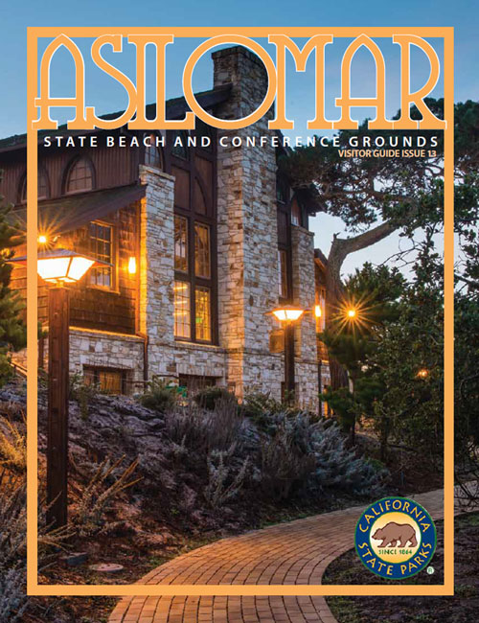
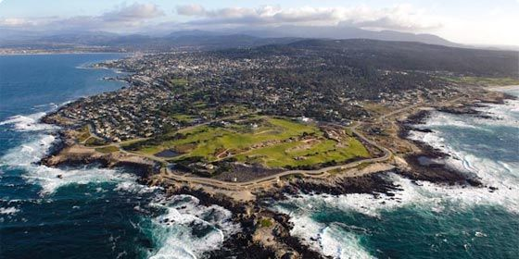
All CA LCCs and CSC Meeting
http://www.californialcc.org/joint-lcc-csc-meeting
  Location
  Agenda
  Logistics
  Participants

Slide 15

NPLCC In-Person meeting, Vancouver
Need full attendance
November 30 – December 2 (travel on Nov 29th and Dec 2)
Expect 2 full-day sessions (Nov 30, Dec 1) with field trip (morning of Dec 2nd)
Planning committee priorities to be sent next week
  Save the date; Meeting Location; Lodging Options; Draft agenda
Agenda Topics
  Local issues, partners, needs
  NPLCC funded work in the region
  Strategic Planning
  S/TEK strategy – priorities
  Field trip
  Your Ideas?

Slide 16
WRAP UP ~
Strategic Plan
Charter Amendments
CA ALL-LCC Meeting
NPLCC SC Meeting, Vancouver November 30-Dec 2

